Slide 1
Presenting your Research
Caitlin Kuhlman, Tom Hartvigsen, Allison Roset

Slide 2
Bottom line up front
Communication is key to success in research.

Slide 3
Bottom line up front
Communication is key to success in research.
Ways to disseminate your research:
Presentations
Posters
Research Papers
Online

Slide 4
Tips for Research Talks
Notes:
Motivation: The hook
Will try to find some image/joke/example to put here to demonstrate that intro/motivation is key.
Tom – any ideas?

Slide 5
Tips for Research Talks: Motivation
Notes:
Style:
not too much text
consistent use of color
make your own figures when you can, cite when you can’t
Avoid math

Slide 6
Tips for Research Talks: Style
not too much text
consistent use of color
make your own figures when you can, cite when you can’t
Avoid math
Notes:
Style:
not too much text
consistent use of color
make your own figures when you can, cite when you can’t
Avoid math

Slide 7
Tips for Research Talks: Style
not too much text
consistent use of color
make your own figures when you can, cite when you can’t
Avoid math
Bulleted lists are super boring!
Notes:
Style:
not too much text
consistent use of color
make your own figures when you can, cite when you can’t
Avoid math

Slide 8
PACING
Notes:
outline helps people follow along
use blank slides or full slide images to punctuate
2 min per slide rule of thumb

Slide 9
Tips for Research Talks: Results
Notes:
will put an example chart here, and talk about how to present experimental results
Don’t show all your results – just the most important
One figure per slide
Explain axes
Highlight key idea

Slide 10
Tips for Research Talks: Conclusion
Finish strong
Recap the ideas you covered
Show how your work can lead to more interesting future work.
Leave an image/figure on the last slide to prompt discussion
Notes:
How to make this slide better?

Slide 11
Tips for Research Talks
Motivation: The hook
IMPORTANT
Use running example
Style:
not too much text
consistent use of color
make your own figures when you can, cite when you can’t
avoid math
Avoid bullets
Pacing
Outline slide, footer
Blank slides to punctuate
Finish strong
Recap the ideas you covered
Show how your work can lead to more interesting future work.
Leave an image/figure on the last slide to prompt discussion
Notes:
Motivation: The hook

Slide 12
PRESENTATION SKILLS
Notes:
outline helps people follow along
use blank slides or full slide images to punctuate
2 min per slide rule of thumb

Slide 13
Presentation skills
Know your stuff
Know yourself
Know your audience
Practice, practice, practice, practice, practice…

Slide 14
TOM + ALLISON
– want to talk / add stuff here?

Slide 15
POSTERS
Notes:
outline helps people follow along
use blank slides or full slide images to punctuate
2 min per slide rule of thumb

Slide 16
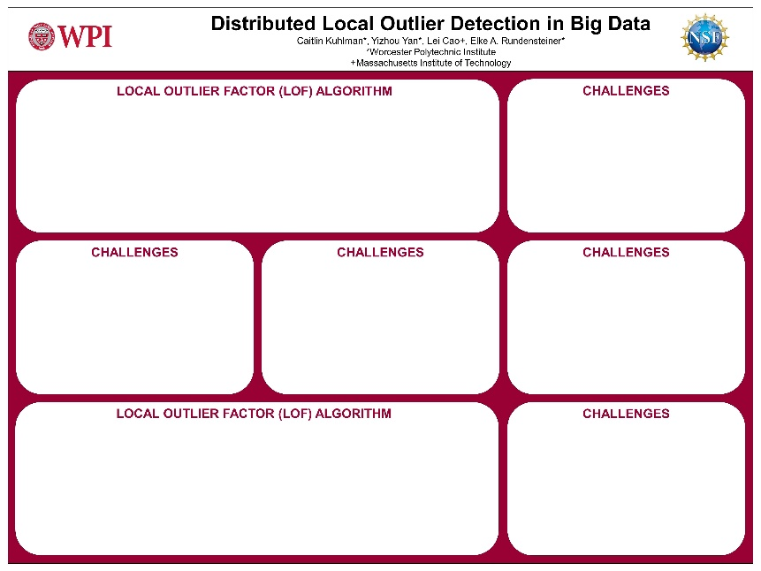
Poster Tips – same rules apply
Create with powerpoint
Avoid too much text: show don’t tell
Make text and figures LARGE
Minimum 40 pt for headings, 24pt subheadings, 18pt for text
Make a nice template and reuse it

Slide 17
PAPERS

Slide 18

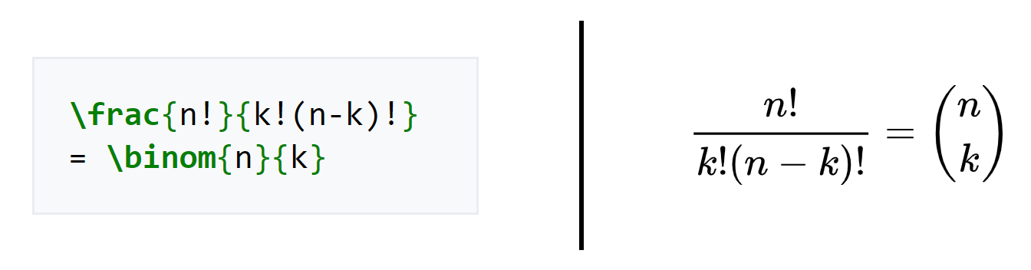
Formatting papers
Research papers in Math and sciences formatted using LaTex markup language.
Macros used to typeset section headings, figures, and math equations.

Slide 19

Overleaf
https://www.overleaf.com/gallery/tagged/academic-journal
https://www.overleaf.com/latex/templates/association-for-computing-machinery-acm-sigchi-proceedings-template/nhjwrrczcyys

Slide 20



References
Bibtex format used to manage citations.
https://scholar.google.com/
https://dl.acm.org/
https://ieeexplore.ieee.org

Slide 21
Sharing your work
Personal Website
Github
Jupyter notebooks

Slide 22

Last Slide
Thanks!
cakuhlman@wpi.edu
https://github.com/caitlinkuhlman/presenting_research

