Slide 1
Visualizing Simulation-level metrics of parallel discrete-event simulations
Caitlin Ross and Noah Wolfe

Slide 2
Background - ROSS
parallel discrete-event simulation (PDES) framework
Simulation entities are called logical processes (or LPs) which are mapped to the processing elements (or PEs) being used in the simulation
LPs communicate with each other through timestamped events/messages
Optimistic parallel execution: each PE processes the events for its LPs without global synchronization
If receiving an event out of time stamp order, must rollback and re-execute
Rolling back consists of calling reverse event handlers which undoes the computation performed in the respective forward handler to revert the state of the simulation
Global Virtual Time (GVT) computation performed at regular intervals
Useful for helping to throttle overly optimistic execution
The interval is controlled by two parameters: gvt-interval and batch

Slide 3
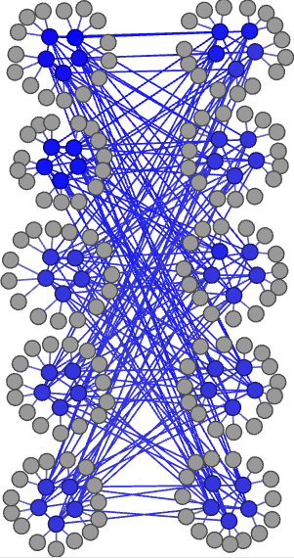
Background – Slim Fly network model
What is it?
Cost-effective structured layout for connecting compute nodes in large scale supercomputing systems
Max network diameter: 2
Logical Processes (LPs)
Terminals/compute nodes
Routers/Switches
Processing Elements (PEs)
MPI processes

Slide 4
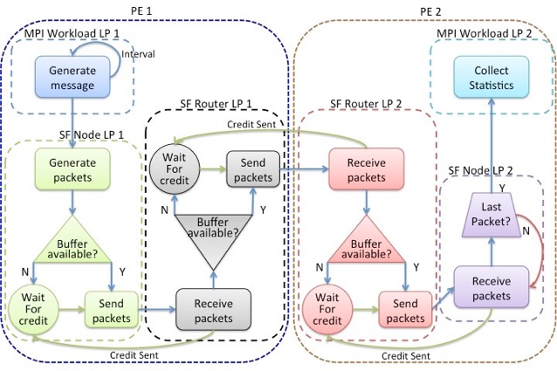
Background – Slim Fly simulation

Slide 5
Motivation and Audience
Learning how to effectively visualize simulation performance data on a smaller scale model
PDES developers, particularly those using ROSS and other optimistic simulators
Questions we aimed to answer with this visualization:
How can we boost the performance of the visualization?
Optimizing batch and gvt-interval parameters
How does the performance of the slim fly and dragonfly models differ?
Only had time to focus on the slim fly model

Slide 6
Demo

Slide 7
Future Work
Fix LP radial view
Make GVT selection work
Selection for metric to view
Demo for our research group and get their feedback
Pull in data from larger-scale simulations
Visualize dragonfly simulation data
Combine visualization of simulation-level data with model-level data to better understand performance of different models
In situ visualization

