Slide 1
2020 Title

Slide 2
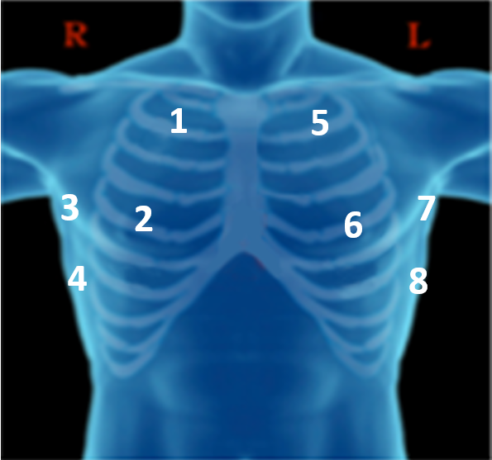
1
5
2
6
3
7
4
8

Slide 3
Thank you!

