Slide 1
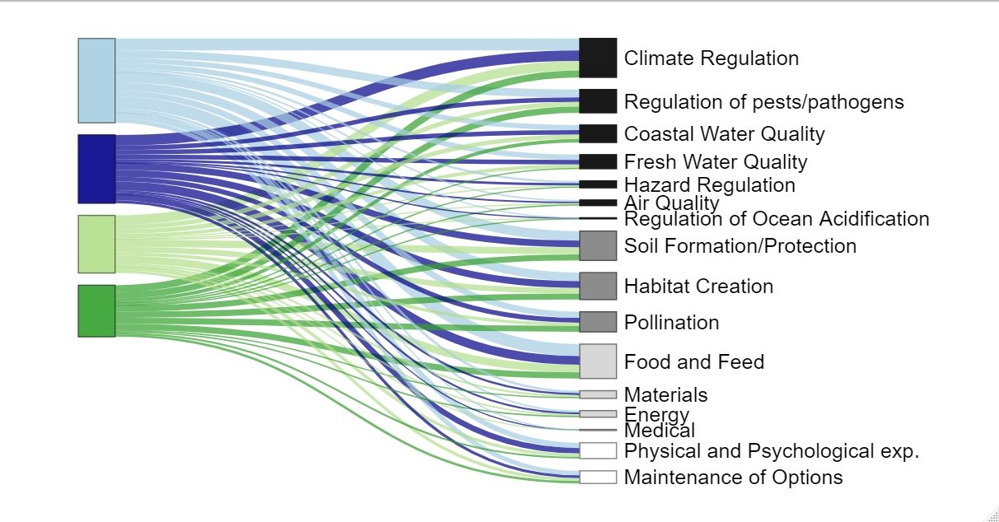
Ecosystem Service
Driver Type
Human
Land Use/
Land Change
Environmental
Biotic
Legend
Regulating Services
Supporting Services
Provisioning Services
Cultural Services

