Slide 1
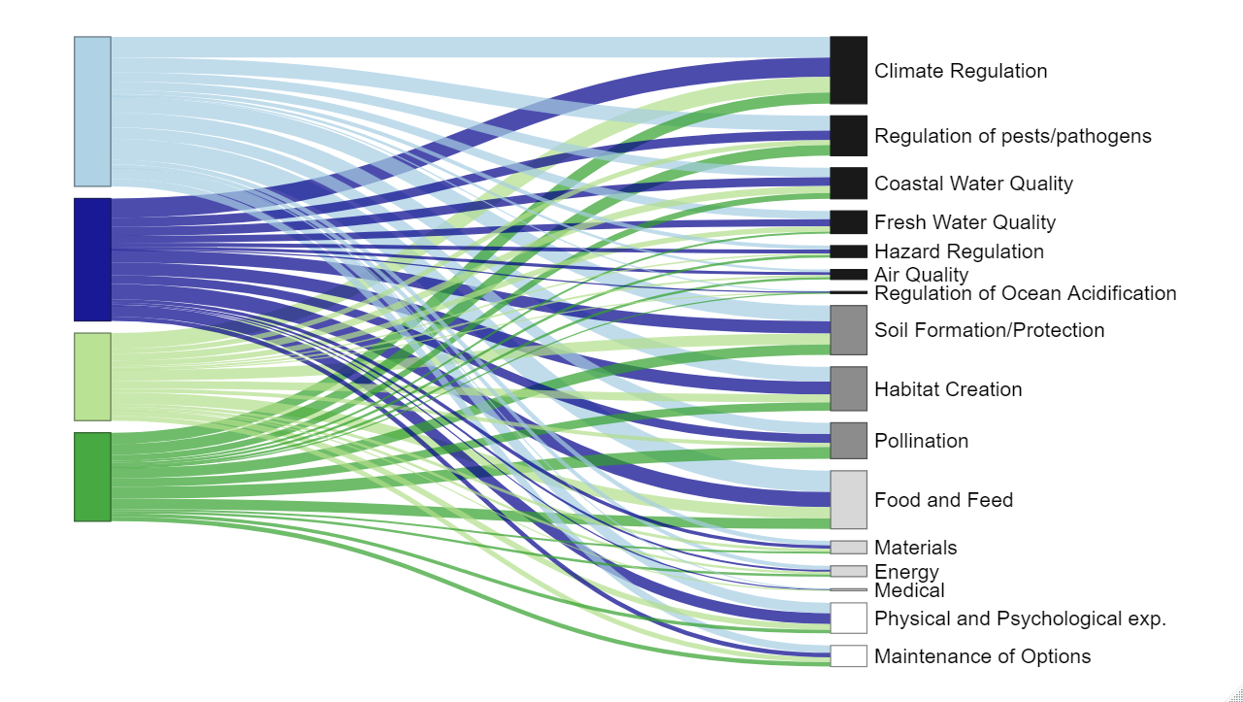
Driver Type
Ecosystem Service
Climate Regulation
Human
Regulation of Pests/Pathogens
Coastal Water Quality
Land Use/
Land Change
Fresh Water Quality
Hazard Regulation
Air Quality
Regulation of Ocean Acidification
Soil Formation/Protection
Environmental
Habitat Creation
Pollination
Biotic
Food and Feed
Legend
Materials
Energy
Regulating Services
Medical
Physical and Psychological exp.
Supporting Services
Maintenance of Options
Provisioning Services
Cultural Services

