Slide 1
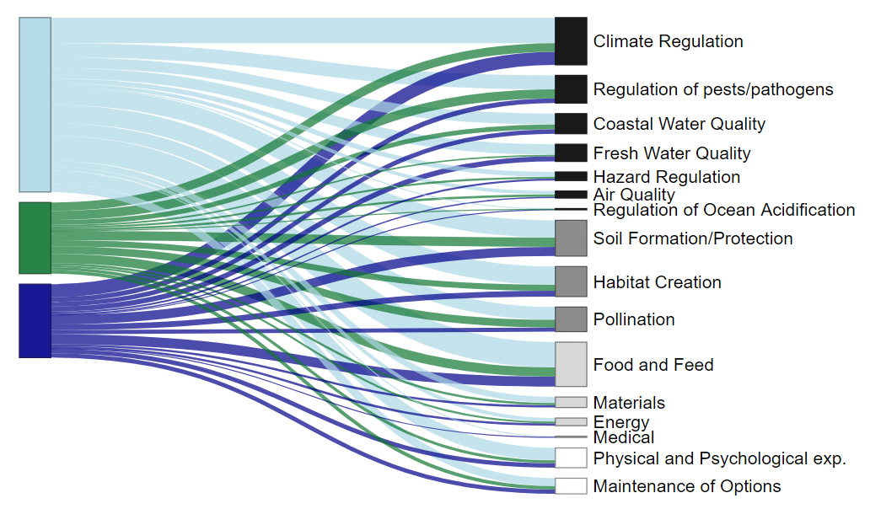
Driver Type
Ecosystem Service
Human
Biotic
Environmental
Legend
Regulating Services
Supporting Services
Provisioning Services
Cultural Services

