Slide 1

Predicting Water Point Functionality in Tanzania
Caitlin Snyder
Flat Iron - Data Science
Module 3

Slide 2
Research Question
Given a set of waterpoint characteristics, can we accurately predict whether that waterpoint is functional, non-functional, or functional but in need of repair?

Slide 3
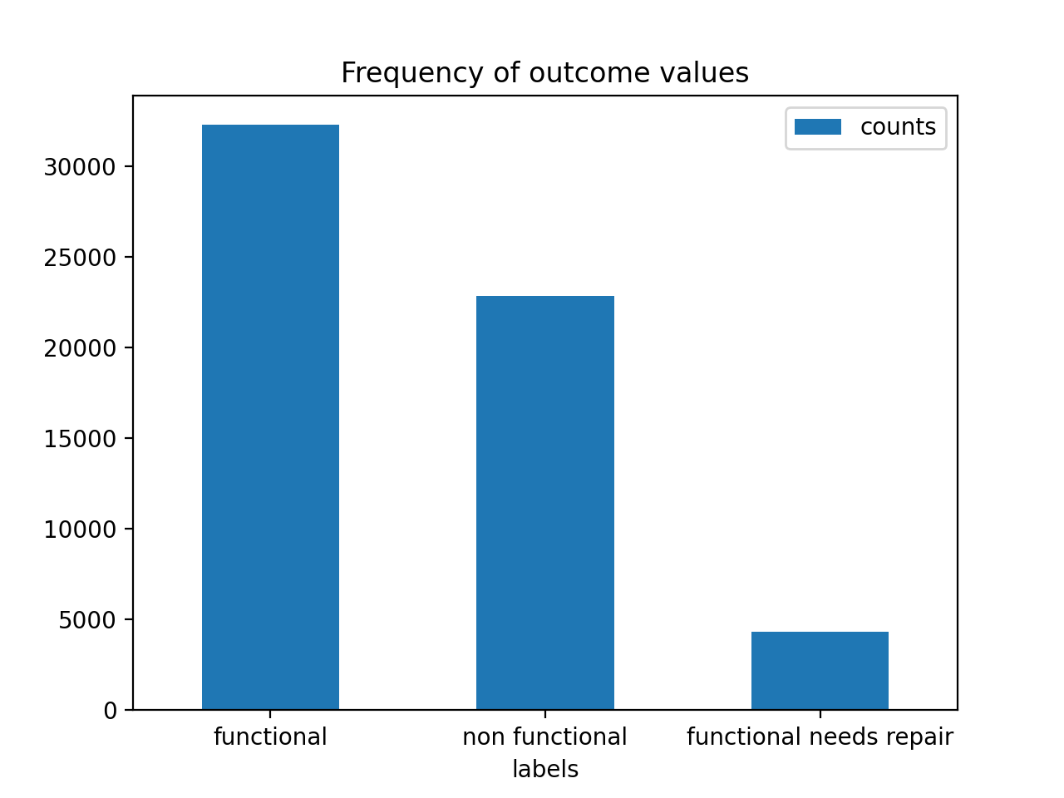

Slide 4
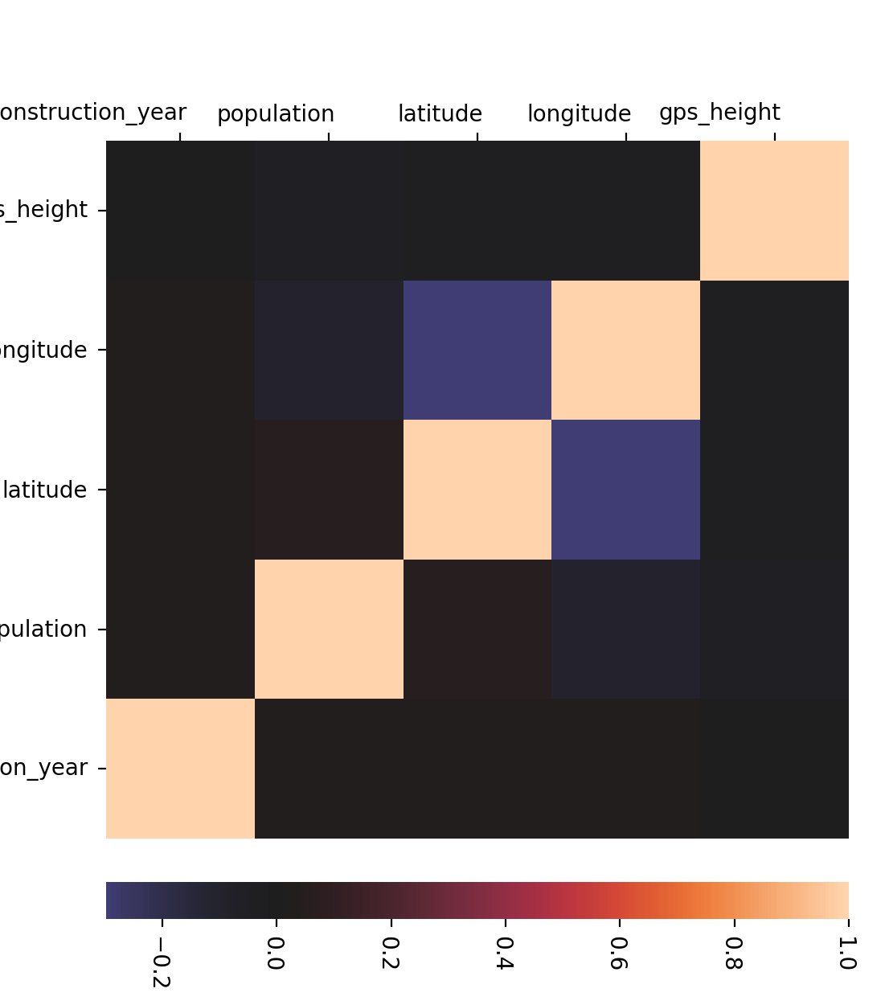

Slide 5
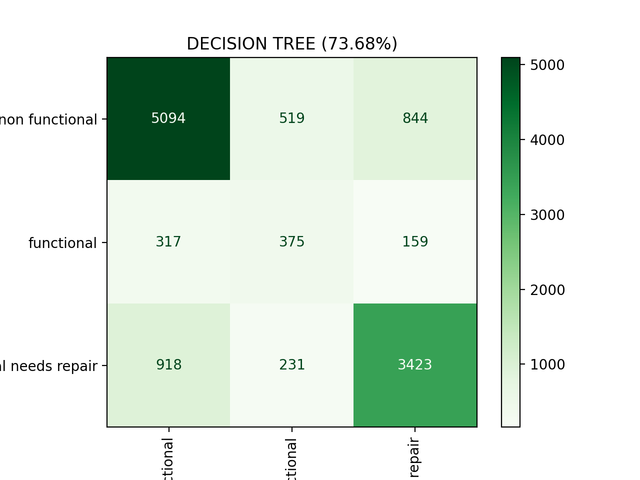
Evaluating the model: Decision Tree

Slide 6
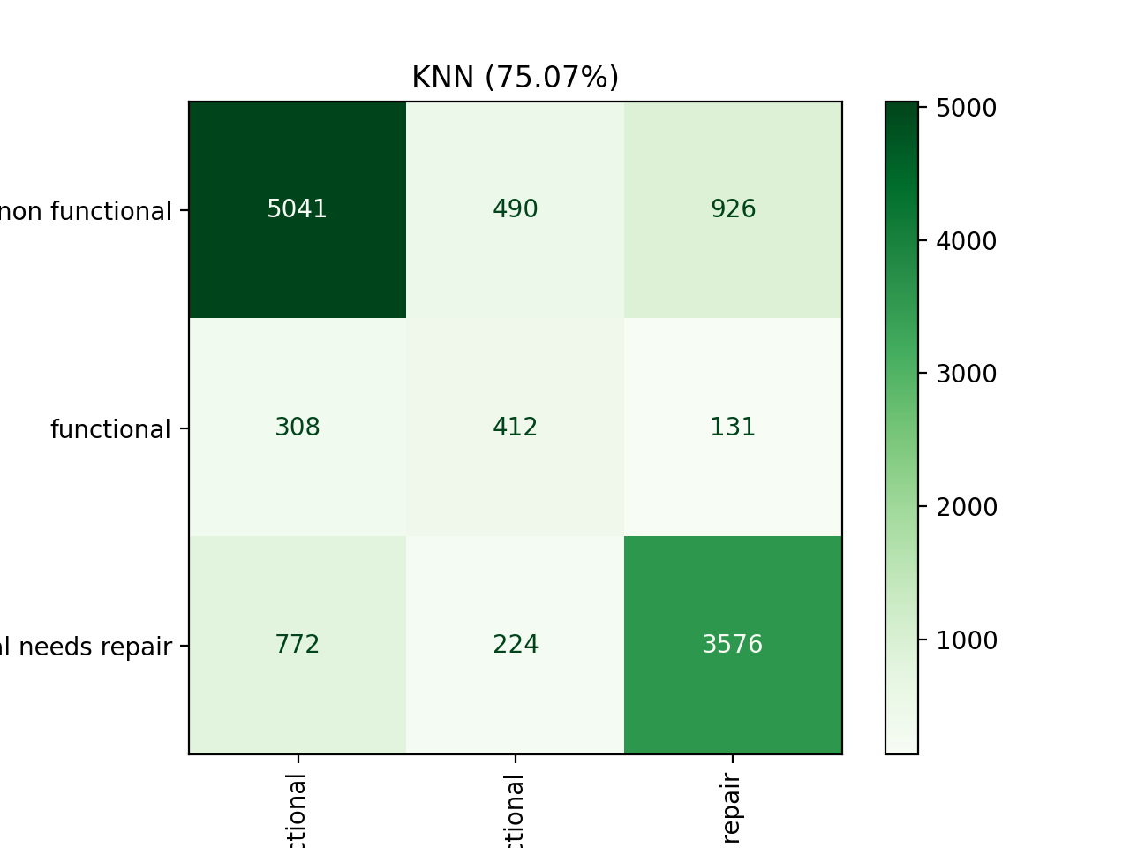
Evaluating the model: KNN

Slide 7
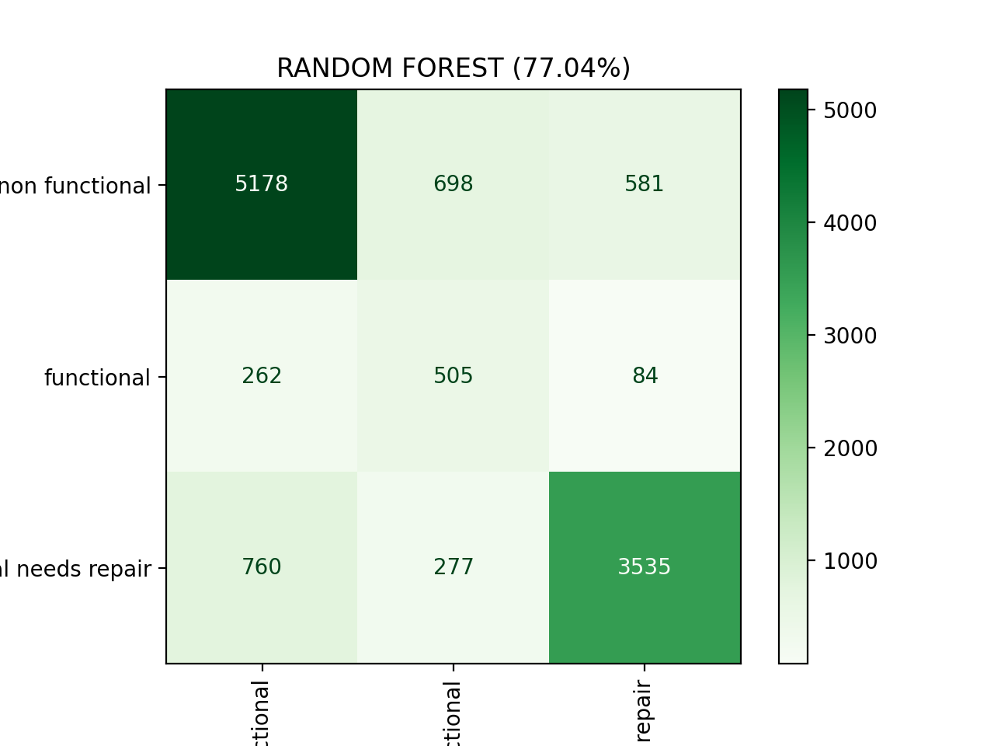
Evaluating the model: Random Forest

Slide 8

Evaluating the model: XGBoost

Slide 9
Take-aways
Although XGBoost and Random Forest produced very similar accuracy scores, XGBoost slightly (0.2%) outperformed Random Forest.
The intensive memory requirements of these classifiers would be best served using cloud computing resources.

Slide 10
Future avenues for exploration
Does inclusion of elevation enhance the model’s predictive accuracy?
What is the effect of including frequency of conflict incidences related to water-resource usage?

Slide 11
Sources
https://towardsdatascience.com/fuzzywuzzy-find-similar-strings-within-one-column-in-a-pandas-data-frame-99f6c2a0c212
https://towardsdatascience.com/fuzzywuzzy-fuzzy-string-matching-in-python-beginners-guide-9adc0edf4b35
https://stackabuse.com/overview-of-classification-methods-in-python-with-scikit-learn/
https://stackabuse.com/the-naive-bayes-algorithm-in-python-with-scikit-learn/
https://medium.com/@erikgreenj/k-neighbors-classifier-with-gridsearchcv-basics-3c445ddeb657
https://medium.com/vickdata/a-simple-guide-to-scikit-learn-pipelines-4ac0d974bdcf
https://datascience.stackexchange.com/questions/60862/if-i-have-negative-and-positive-numbers-for-a-feature-should-minmaxscaler-be-1

Slide 12
Sources cont’d
https://stackoverflow.com/questions/41899132/invalid-parameter-for-sklearn-estimator-pipeline
https://lifewithdata.com/2021/04/02/how-to-build-machine-learning-pipeline-with-scikit-learn-and-why-is-it-essential/
https://stackoverflow.com/questions/63467815/how-to-access-columntransformer-elements-in-gridsearchcv
https://openscoring.io/blog/2020/10/24/converting_sklearn_imblearn_pipeline_pmml/
https://imbalanced-learn.org/stable/over_sampling.html
https://towardsdatascience.com/imbalanced-class-sizes-and-classification-models-a-cautionary-tale-part-2-cf371500d1b3

Slide 13
Thank you!

