Slide 1
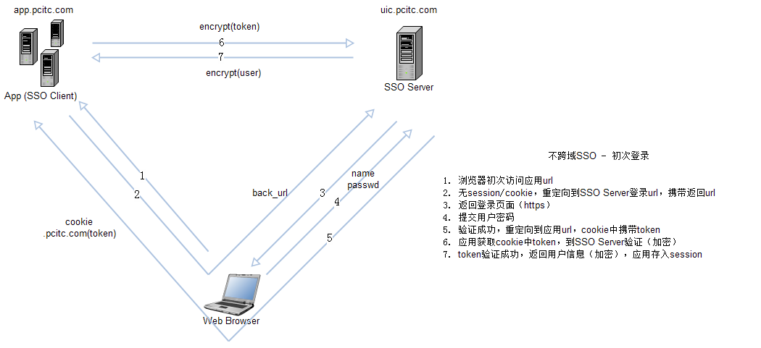
单点登录 - 不跨域初次
Notes:
1.
2. com.pcitc.sso.client.SSOFilter.doFilter()
3. com.pcitc.sso.web.sso.login()
4. com.pcitc.sso.system.service.SSOService.validateLogin()
5. com.pcitc.sso.system.service.SSOService.loginReturn()
6. com.pcitc.sso.client.SSOClient.getLoginUser()
7. com.pcitc.sso.api.SSORestApiController.getLoginUser

Slide 2
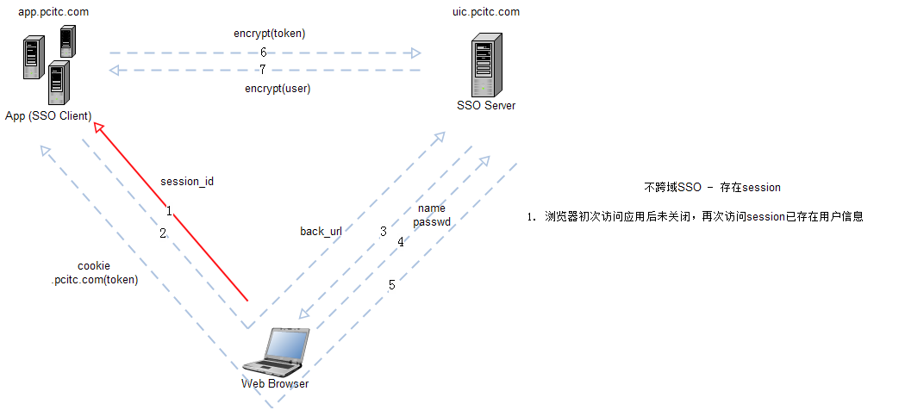
单点登录 - 有session

Slide 3
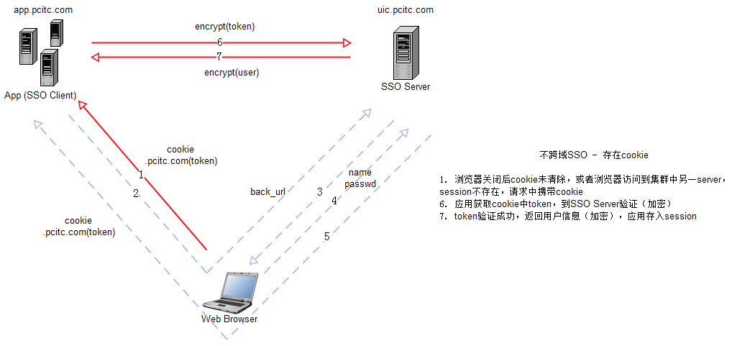
单点登录 - 不跨域有cookie

Slide 4
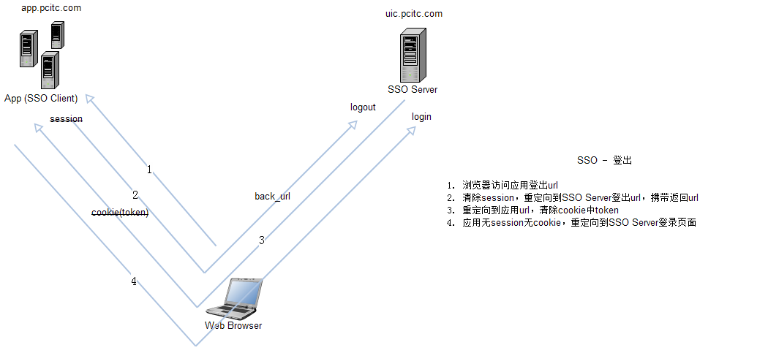
单点登录 – 登出

