Slide 1


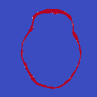



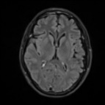
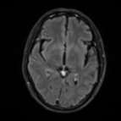
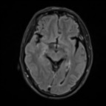
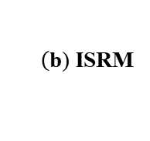



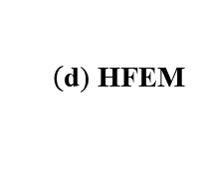




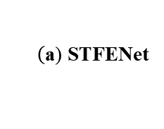

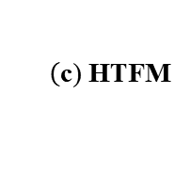

F₁
F₂
Stage 1
F₃
Shared
Decoder
$$ℒ_{Seg}$$
Patch
Embedding
Segmentation Head
Saliency Map
Saliency Map
$$ℒ_{Seg}$$
F₃
ISRM
HFEM
HTFM
$\tilde{\text{F}}$₃
Stage 2
F₂
$\hat{\text{F}}$₂
Prediction
Center Result
Stage 1: Generate
Saliency Map
F₁
Saliency Map
$$ℒ_{Edge}$$
$\hat{\text{F}}$₁
Stage 2: Final Segmentation
with Enhanced Features
$$\left(\text{a}\text{)} \text{STFENet}\right.$$
Saliency Map
F₃
Weight
Channel
Attention
Spatial
Attention
Key
Encoder
H W C/2
H W C
Cosine
Similarity
Bi-ConvLSTM
$\tilde{\text{F}}$₃
Sigmoid
CBR
BN
$\hat{\text{F}}$₃
Down
C
Conv
LN
C
Project
Key
Encoder
Temporal
Mamba
1-Weight
$$\left(\text{b}\text{)} \text{ISRM}\right.$$
$$\left(\text{c}\text{)} \text{HTFM}\right.$$
$$ℒ_{Edge}$$
F₂
DWT
Discrete Wavelet
Transformation
Stage 1 flow
DWT
HFFM
Down
$\hat{\text{F}}$₂
LL
Saliency Map
Sigmoid
F₁
CBR
Conv-BN-ReLU
Block
Stage 2 flow
DWT
HFFM
Down
$\hat{\text{F}}$₁
C
Channel-wise
Concatenate
Loss flow
$$ℒ_{Edge}$$
$$\left(\text{d}\text{)} \text{HFEM}\right.$$

