Slide 1
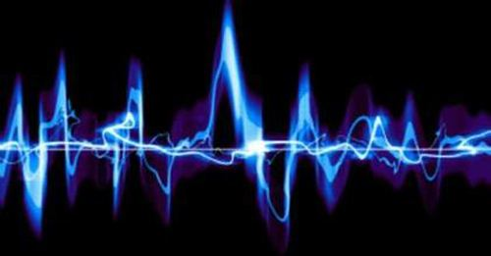
Mixed Audio
single track
Split Audio
single track
Is he
or not?
ASR result - text
(with time stamp)
Service/Customer Identification
ASR Module
SRE Module
Mixed audio

Slide 2
Mixed Audio
single track
Split Audio
single track
Is he
or not?
ASR Module
ASR result - text
(with time stamp)
Service/Customer Identification
SRE Module
Mixed audio

Slide 3
Highway LSTM - 3L
FilterBank Feature
senone posterior
MFCC Feature
Baum-Welch Statistics
I-vector Model

Slide 4
SV feature
UBM posterior
GMM-UBM framework
GMM-UBM
Feature extraction
SV feature (i.e. MFCC, PLP)
i-Vector
Extractor
i-vector
Scoring
Backend
DNN-UBM
(DNN can be FDNN, LSTM, TDNN, etc.)
DNN feature
(i.e. FBANK)
DNN posterior
DNN-UBM framework

Slide 5
Feature extraction
SV feature
GMM-UBM
UBM posterior
i-Vector
Extractor
i-vector
Scoring
Backend
SV feature (i.e. MFCC, PLP)
Feature extraction
DNN feature
(i.e. FBANK)
DNN-UBM
(DNN can be FDNN, LSTM, TDNN)
DNN posterior
i-Vector
Extractor
i-vector
Scoring
Backend
SV feature (i.e. MFCC, PLP)

Slide 6
Mixed Audio
single track
ASR Module
ASR result - text
(with time stamp)
Service/Customer Identification
Original mixed audio
Highway LSTM - 3L
FilterBank Feature
Split Audio
single track
senone posterior
I-vector
Model
MFCC Feature
Baum-Welch Statistics

Slide 7
Mixed Audio
single track
ASR Module
ASR result - text
(with time stamp)
Service/Customer Identification
Original mixed audio
Highway LSTM - 3L
FilterBank Feature
Split Audio
single track
senone posterior
I-vector
Model
MFCC Feature
Baum-Welch Statistics

Slide 8
Feature extraction
SV feature
GMM-UBM
UBM posterior
i-Vector
Extractor
i-vector
Scoring
Backend
SV feature (i.e. MFCC, PLP)
Feature extraction
DNN feature
(i.e. FBANK)
DNN-UBM
(DNN can be FDNN, LSTM, TDNN)
DNN posterior
i-Vector
Extractor
i-vector
Scoring
Backend
SV feature (i.e. MFCC, PLP)

Slide 9
Feature extraction
SV feature
GMM-UBM
UBM posterior
i-Vector
Extractor
i-vector
Scoring
Backend
SV feature (i.e. MFCC, PLP)
Feature extraction
DNN feature
(i.e. FBANK)
DNN-UBM
(DNN can be FDNN, LSTM, TDNN)
DNN posterior
i-Vector
Extractor
i-vector
Scoring
Backend
SV feature (i.e. MFCC, PLP)

Slide 10
Feature extraction
SV feature
GMM-UBM
UBM posterior
i-Vector
Extractor
i-vector
Scoring
Backend
SV feature (i.e. MFCC, PLP)

Slide 11
Feature extraction
DNN feature
(i.e. FBANK)
DNN-UBM
(DNN can be FDNN, LSTM, TDNN)
DNN posterior
i-Vector
Extractor
i-vector
Scoring
Backend
SV feature (i.e. MFCC, PLP)

