Slide 1
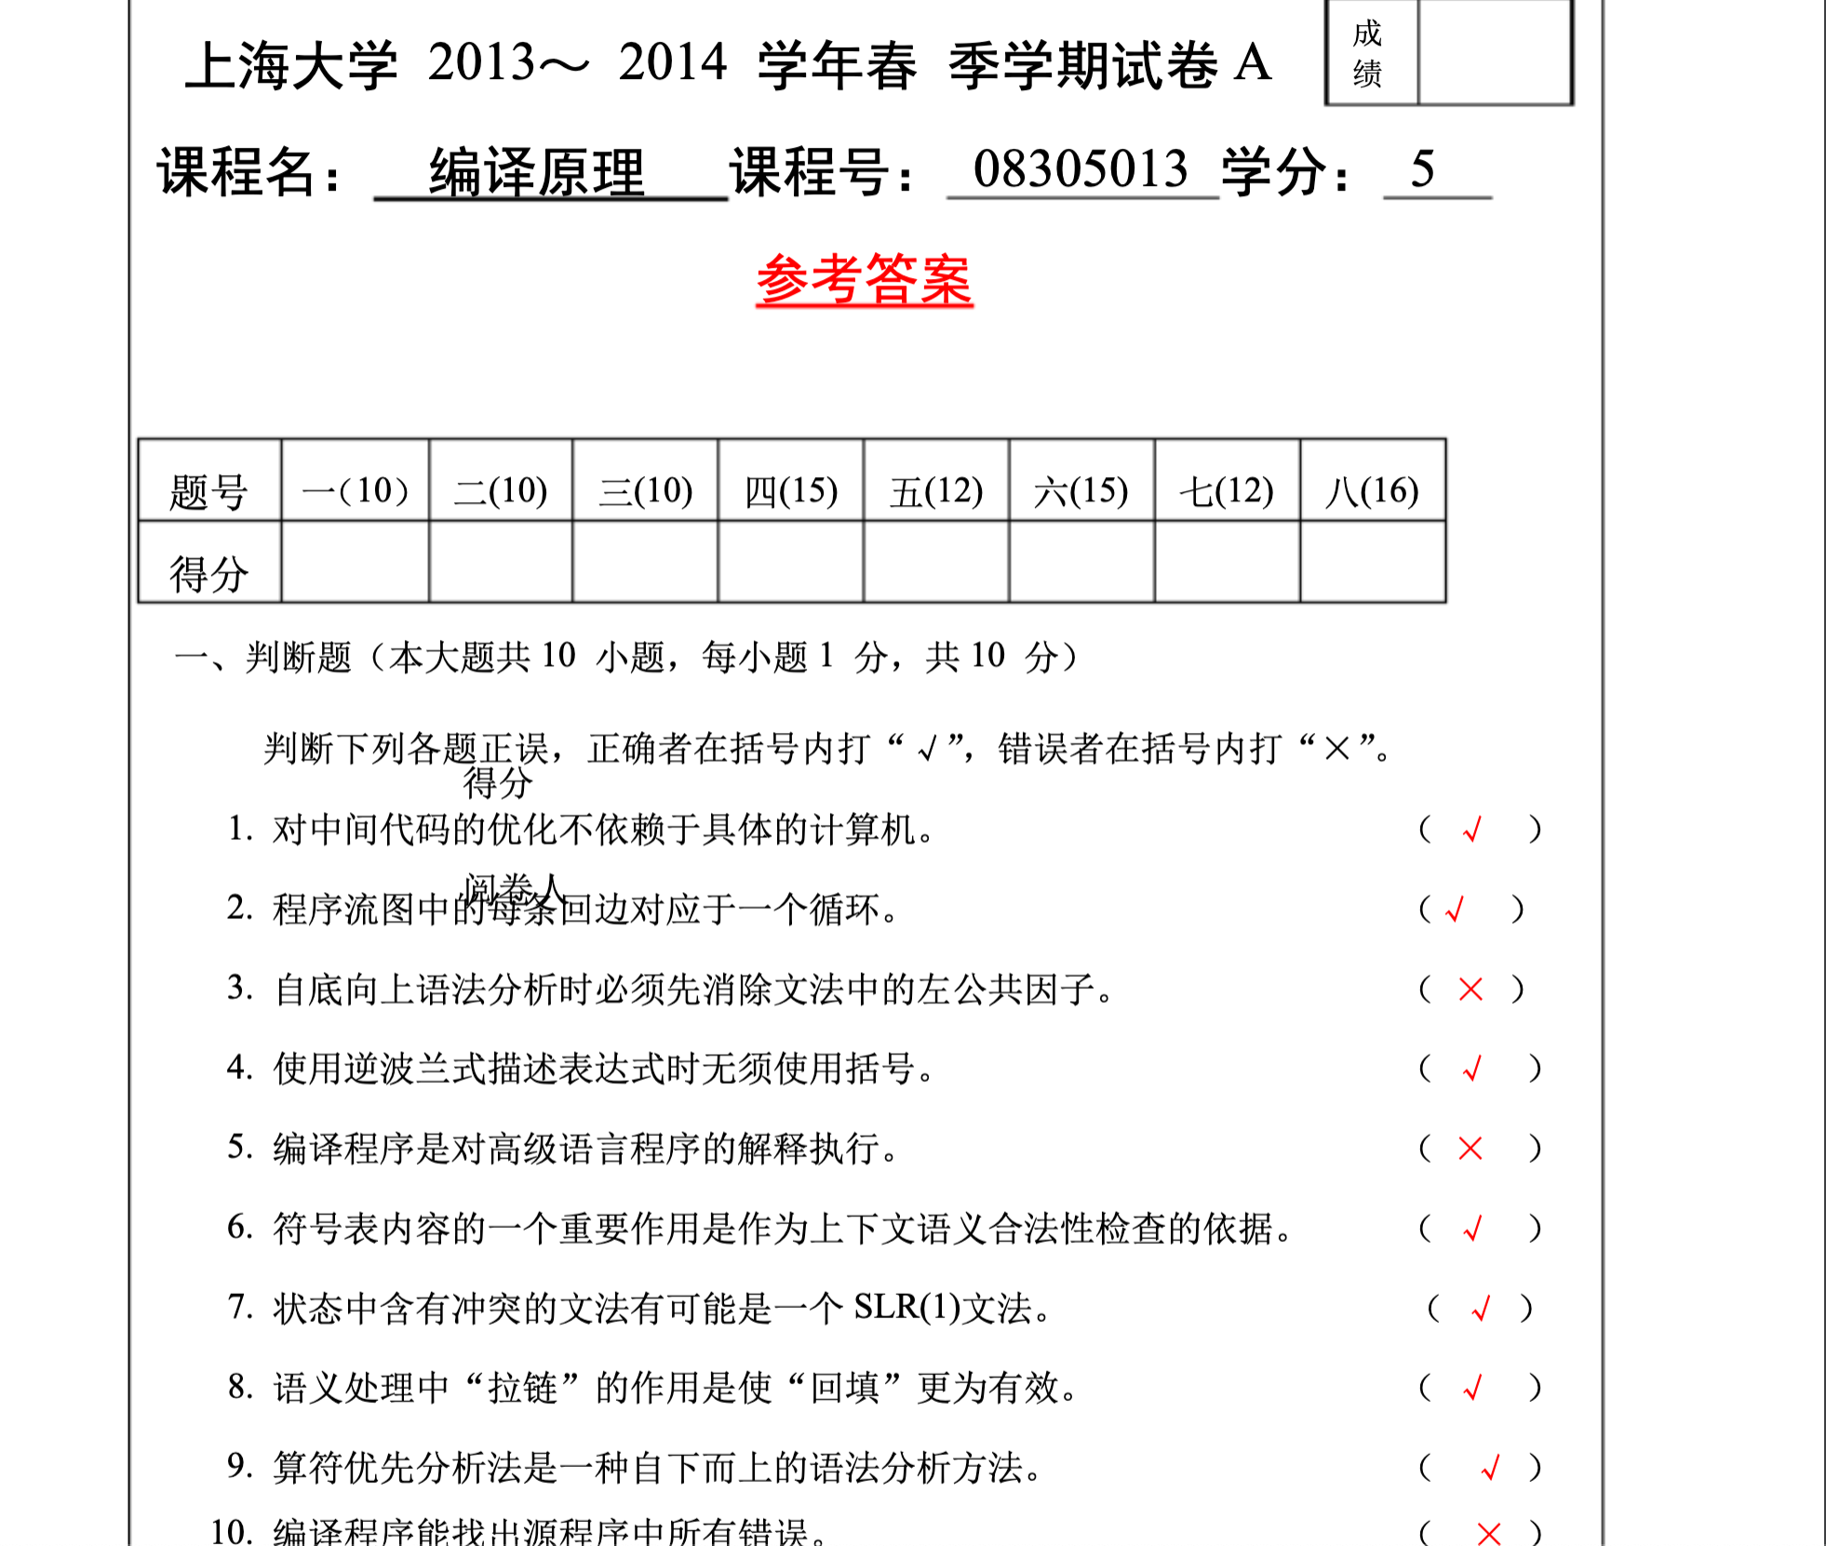
https://wenku.baidu.com/view/e0145b29f38583d049649b6648d7c1c708a10b0d.html?fr=income5-doc-search&_wkts_=1684463179544&wkQuery=%E4%B8%8A%E6%B5%B7%E5%A4%A7%E5%AD%A6%E7%BC%96%E8%AF%91%E5%8E%9F%E7%90%86

Slide 2
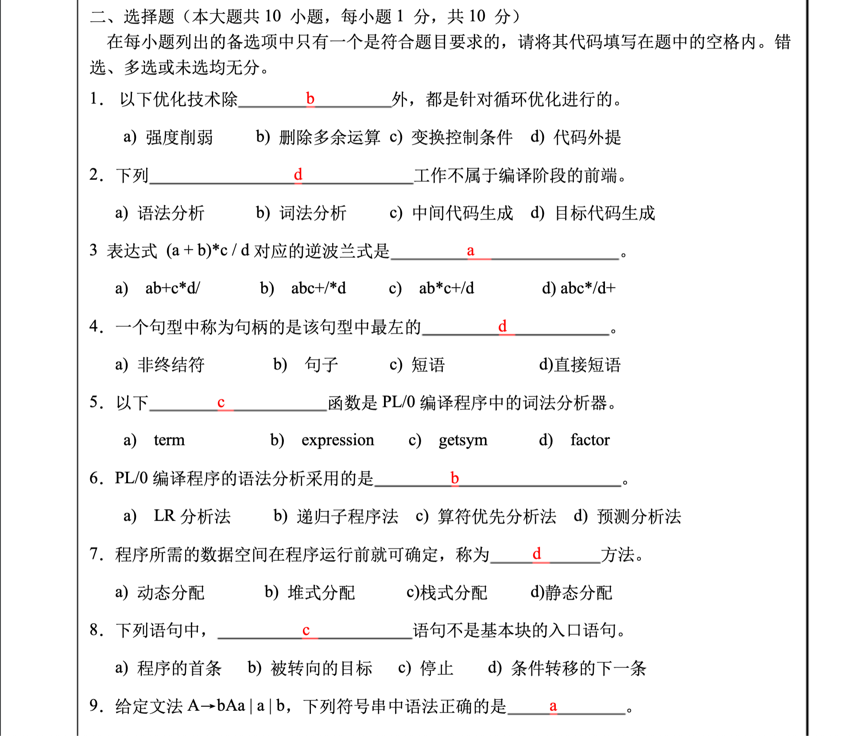


Slide 3
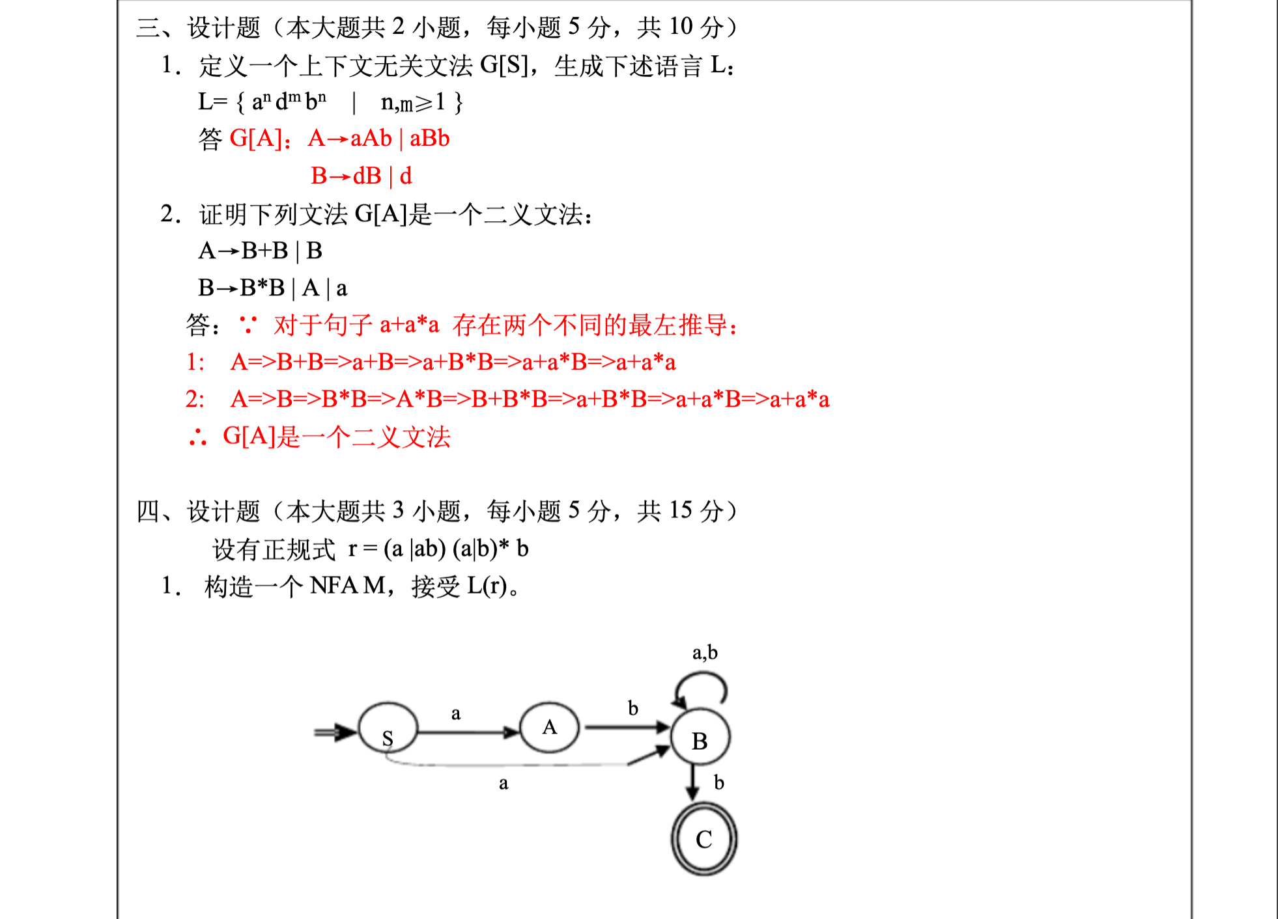

Slide 4
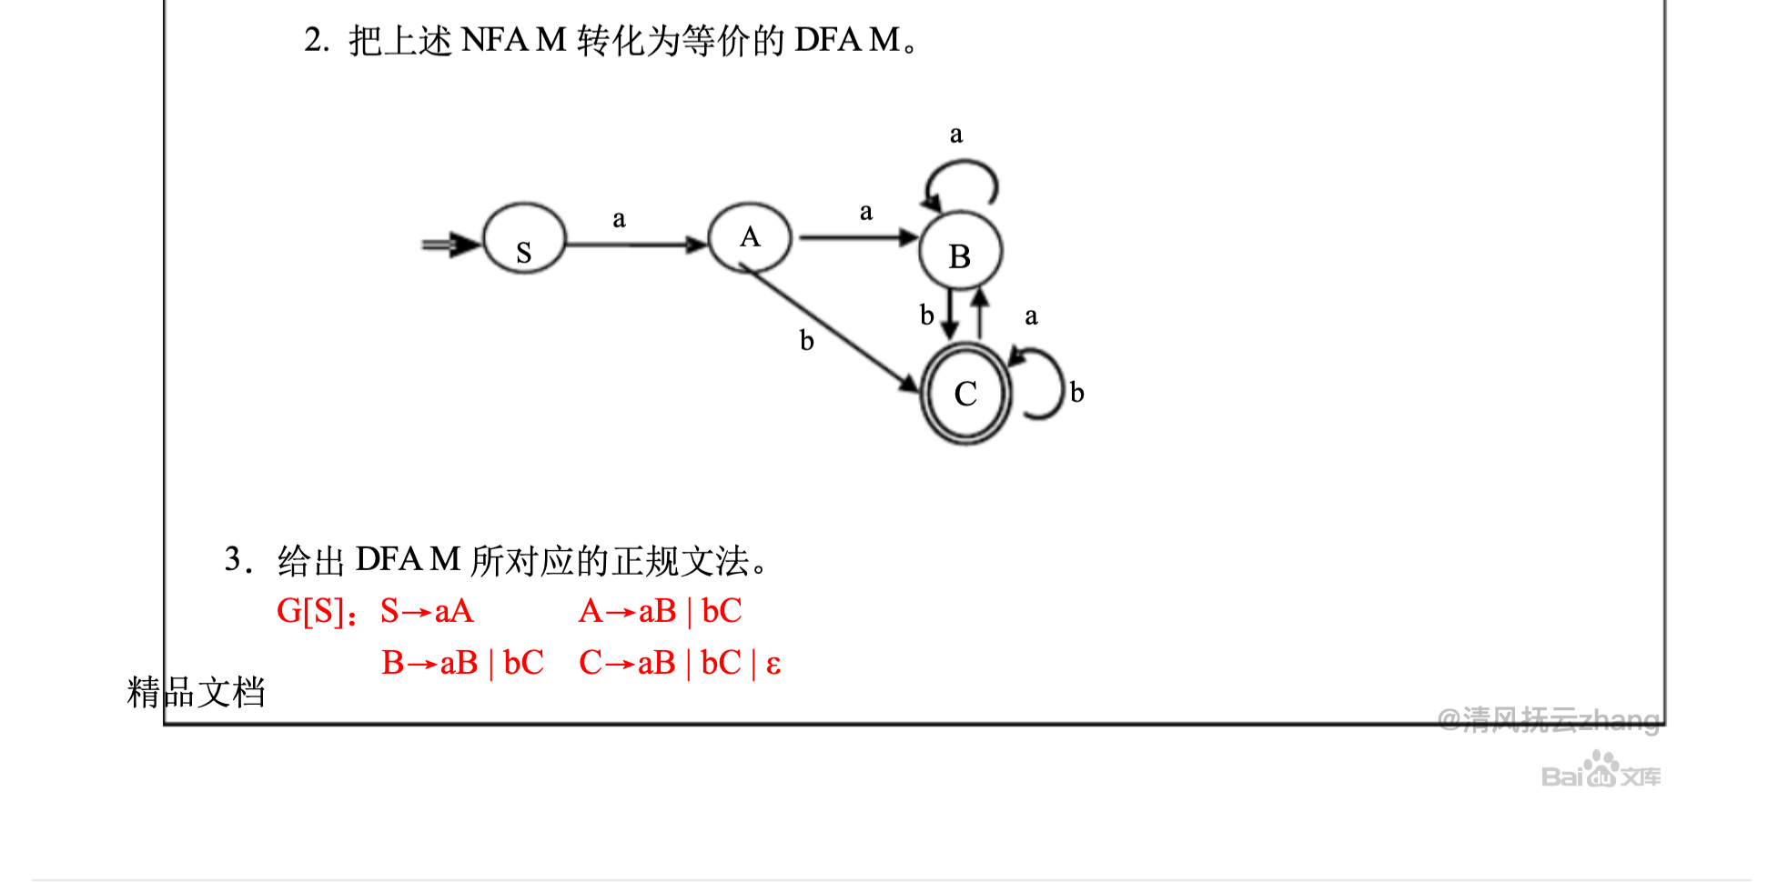

Slide 5
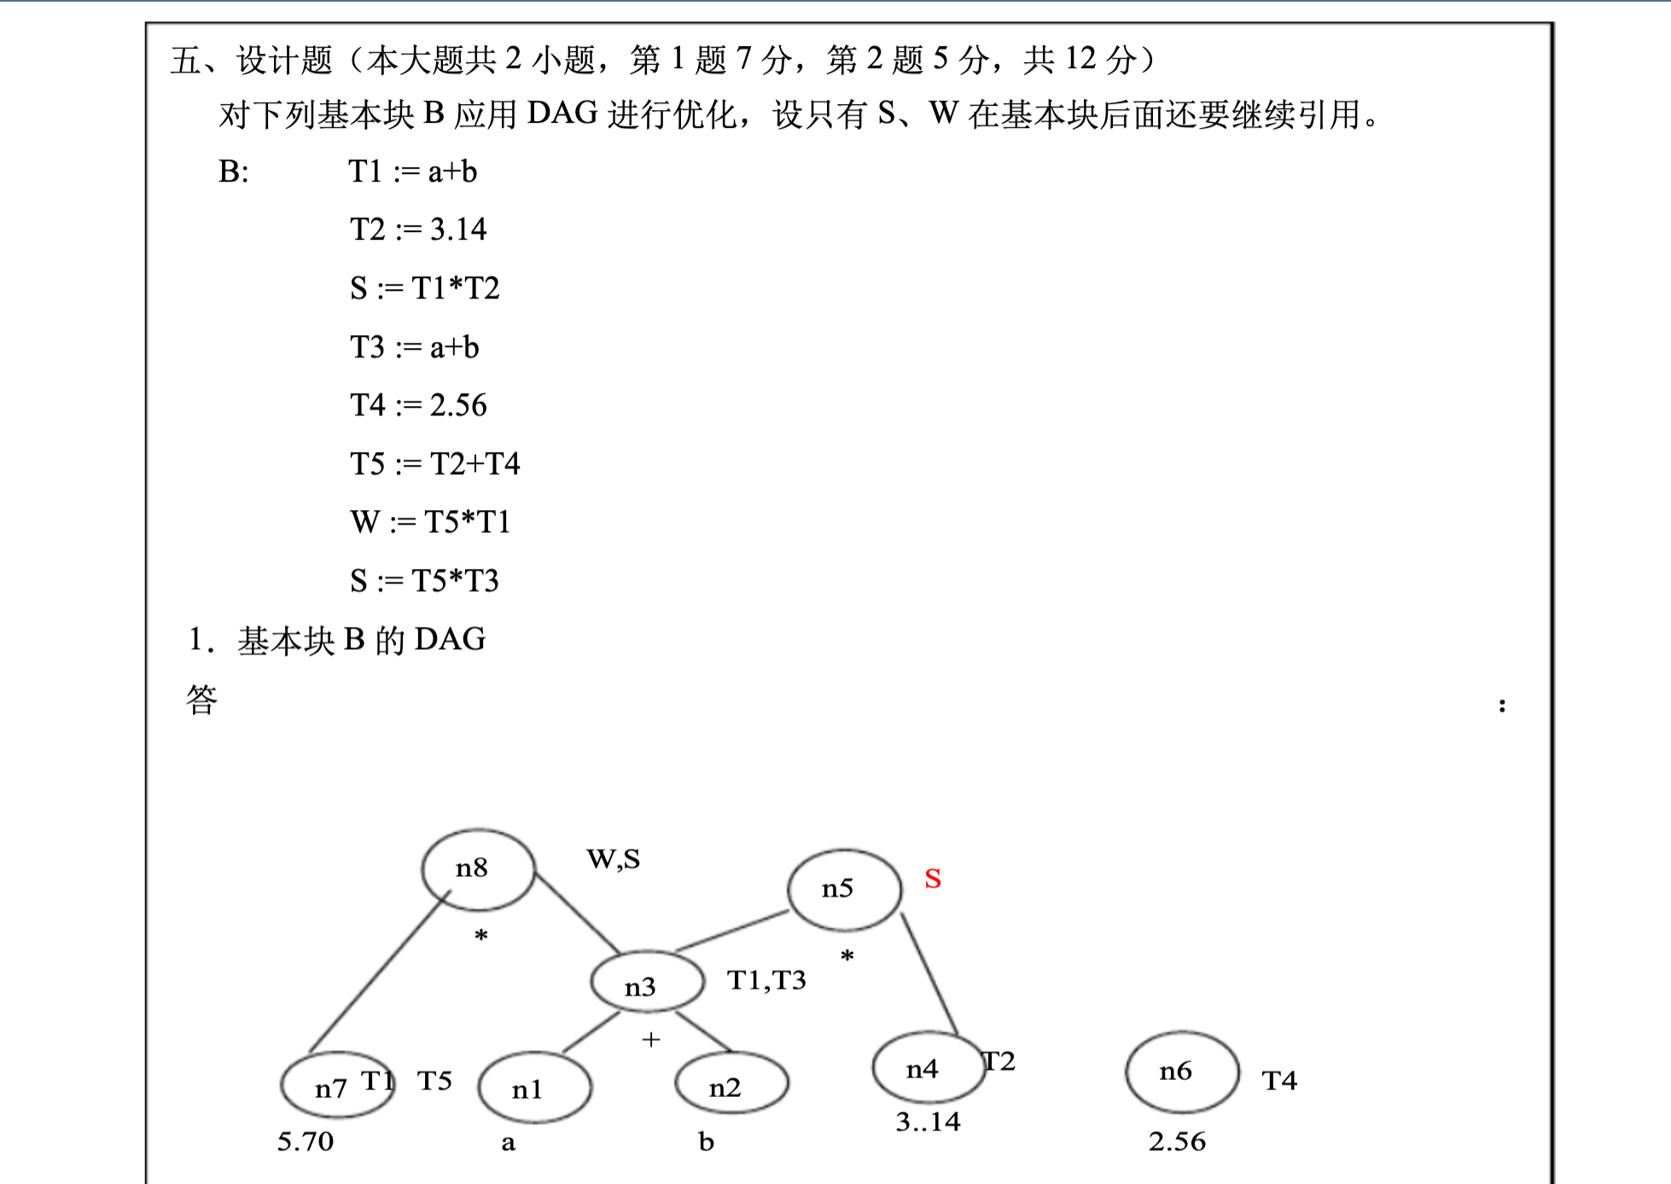
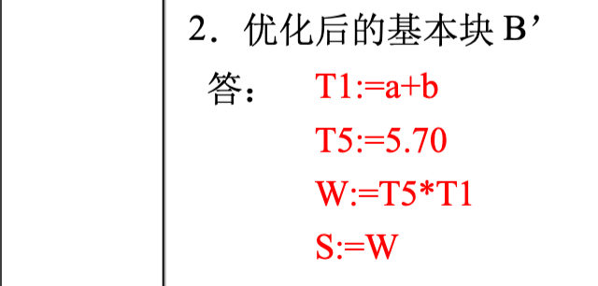

Slide 6
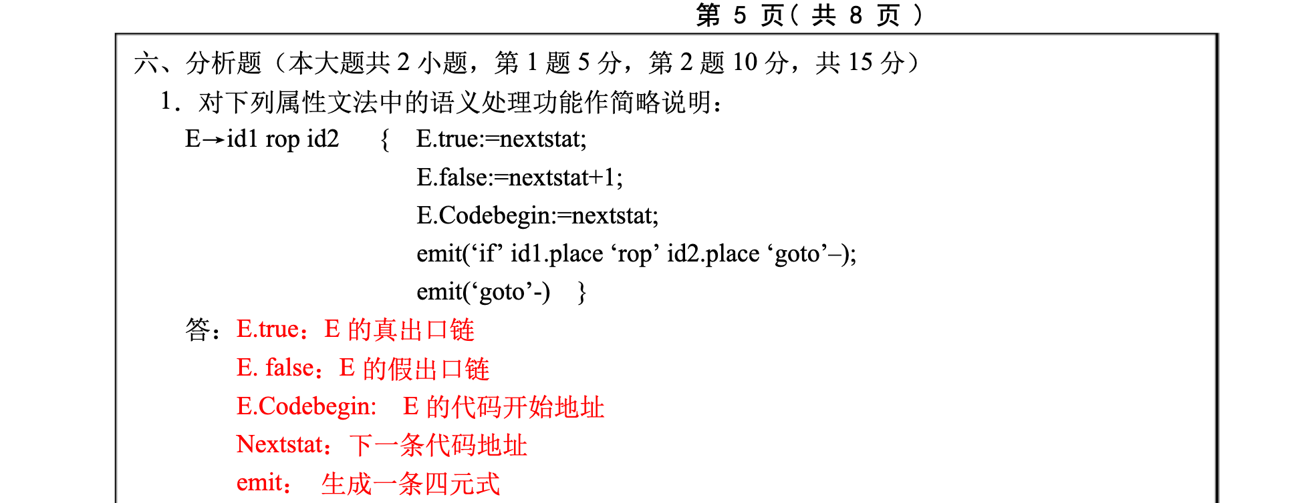

Slide 7
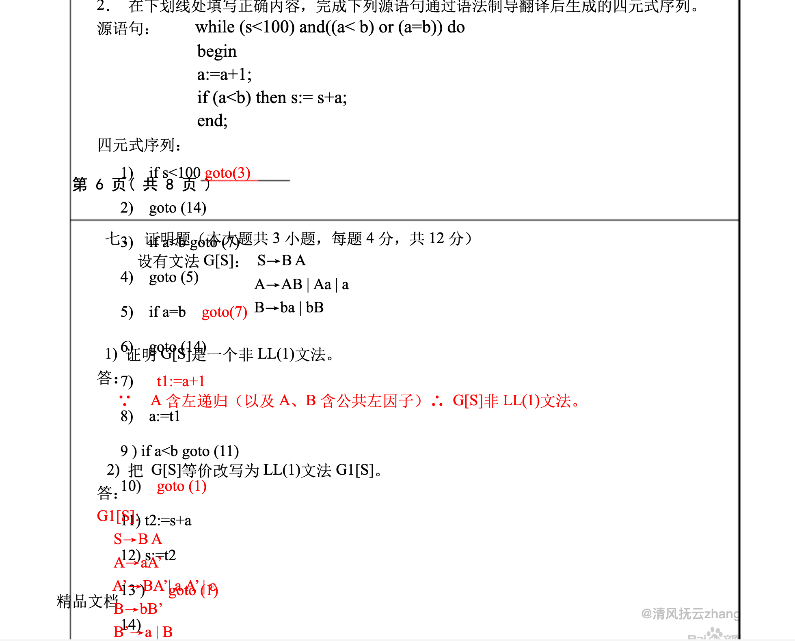

Slide 8
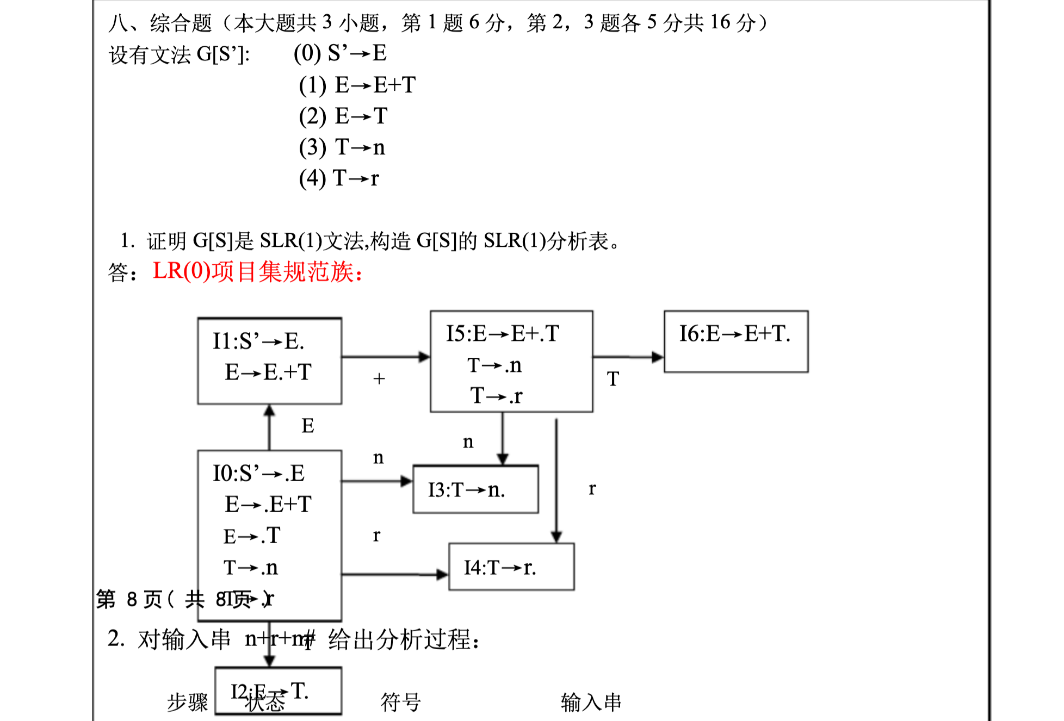

Slide 9
