Slide 1
Chapter 10: File-System Interface

Slide 2
Chapter 10: File-System Interface
File Concept
Access Methods
Directory Structure
File-System Mounting
File Sharing
Protection

Slide 3
Mind Map for Ch10 & 11
Operations (functions) on file/filesystem
File attributes
Data structures
(Open file tables)
File system interface
File system structure
In-memory structures
Disk structures

Slide 4
Objectives
To explain the function of file systems
To describe the interfaces to file systems
To discuss file-system design tradeoffs, including access methods, file sharing, file locking, and directory structures
To explore file-system protection
Why tradeoffs?
Too few structures: programming inconvenient;
Too many structures: OS bloat & programmer confused.

Slide 5
What Is a File System？
The way that controls how data is stored and retrieved in a storage medium.
File naming
Where files are placed
Metadata
Access rules

Slide 6
File Concept
Contiguous logical address space
A sequence of bits, bytes, lines, or records. The meaning is defined by the creator and user.
Types:
Data
numeric
character
binary
Program
Source
Object
Executable

Slide 7
File Structure
None - sequence of words, bytes
Simple record structure
Lines
Fixed length
Variable length
Complex Structures
Formatted document
Relocatable load file
Can simulate last two with first method by inserting appropriate control characters
Who decides:
Operating system
Program

Slide 8
File Attributes
Name – only information kept in human-readable form
Identifier – unique tag (number) identifies file within file system
Type – needed for systems that support different types
Location – pointer to file location on device
Size – current file size
Protection – controls who can do reading, writing, executing
Time, date, and user identification – data for protection, security, and usage monitoring
Information about files are kept in the directory structure, which is maintained on the disk

Slide 9
File Operations
Class File{
Public:
Create();
Write();
Read();
Seek();
……
}
File is an abstract data type
Create
Write – define a pointer
Read – use the same pointer
Per-process current file-position pointer
Reposition within file (file seek)
Delete
Truncate
Open(F_{i}) – search the directory structure on disk for entry F_{i}, and move the content of entry to memory
Close (F_{i}) – move the content of entry F_{i} in memory to directory structure on disk

Slide 10
Open-file table
Open() system call returns a pointer to an entry in the open-file table
Per-process table
Current file pointer
Access rights
…
System-wide table
Open count
…

Slide 11
Open Files
Several pieces of data are needed to manage open files:
File pointer: pointer to last read/write location, per process that has the file open
File-open count: counter of number of times a file is open – to allow removal of data from open-file table when last processes closes it
Disk location of the file: cache of data access information – system doesn’t need to read it from disk for every operation.
Access rights: per-process access mode information

Slide 12
Open File Locking
Provided by some operating systems and file systems
Mediates access to a file (by multiple processes)
File locks are similar to reader-writer locks
Shared lock (reader)
Exclusive lock (writer)
Mandatory or advisory:
Mandatory – access is denied depending on locks held and requested
Advisory – processes can find status of locks and decide what to do

Slide 13
File Locking Example – Java API
import java.io.*;
import java.nio.channels.*;
public class LockingExample {
public static final boolean EXCLUSIVE = false;
public static final boolean SHARED = true;
public static void main(String arsg[]) throws IOException {
FileLock sharedLock = null;
FileLock exclusiveLock = null;
try {
RandomAccessFile raf = new RandomAccessFile("file.txt", "rw");
// get the channel for the file
FileChannel ch = raf.getChannel();
// this locks the first half of the file - exclusive
exclusiveLock = ch.lock(0, raf.length()/2, EXCLUSIVE);
/** Now modify the data . . . */
// release the lock
exclusiveLock.release();

Slide 14
File Locking Example – Java API (cont)
// this locks the second half of the file - shared
sharedLock = ch.lock(raf.length()/2+1, raf.length(), SHARED);
/** Now read the data . . . */
// release the lock
sharedLock.release();
} catch (java.io.IOException ioe) {
System.err.println(ioe);
}finally {
if (exclusiveLock != null)
exclusiveLock.release();
if (sharedLock != null)
sharedLock.release();
}
}
}

Slide 15
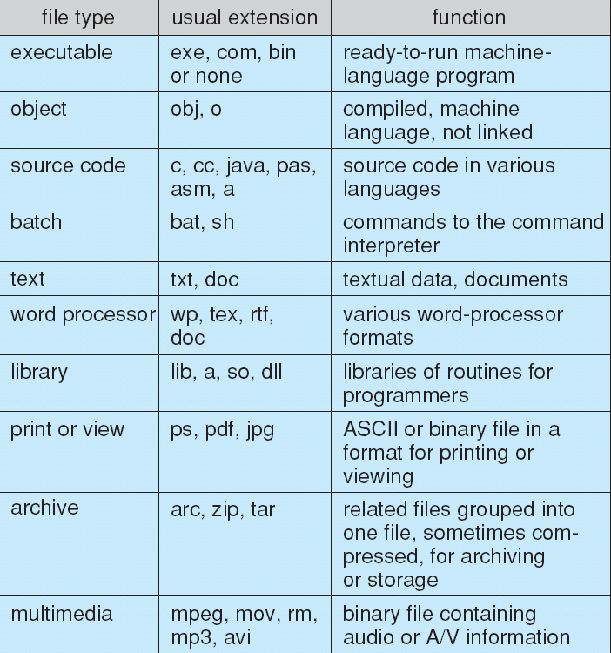
File Types – Name, Extension

Slide 16
File Types
MS-DOS
MAC OS X
Each file has a creator attribute containing the name of the program that created it.
UNIX
Magic number (executable, shell script, postscript, …)

Slide 17
Access Methods
Sequential Access
read next
write next
reset
no read after last write
(rewrite)
Direct (Random) Access
read n
write n
position to n
read next
write next
rewrite n
n = relative block number

Slide 18
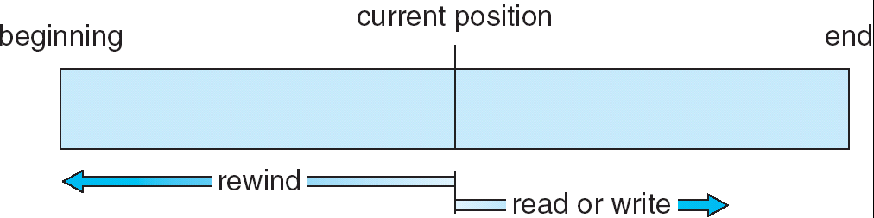
Sequential-access File

Slide 19
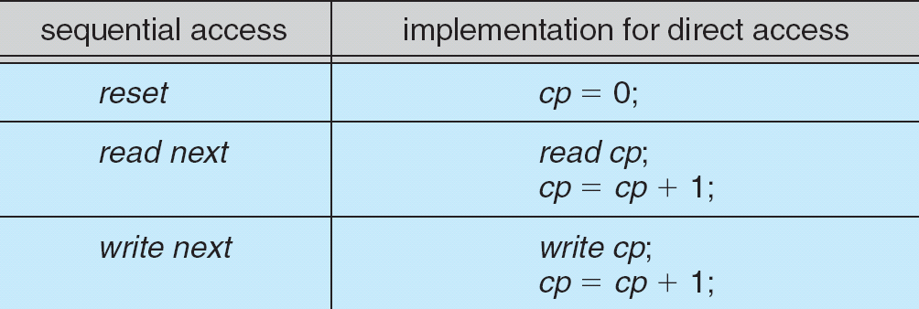
Simulation of Sequential Access on a Direct-access File

Slide 20
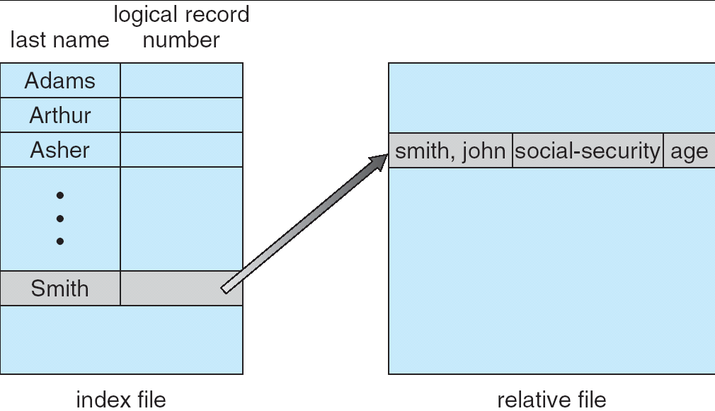
Example of Index and Relative Files

Slide 21
Directory Structure
A collection of nodes containing (management) information about all files
Directory
Files
F 1
F 2
F 3
F 4
F n
Both the directory structure and the files reside on disk
Backups of these two structures are kept on tapes

Slide 22
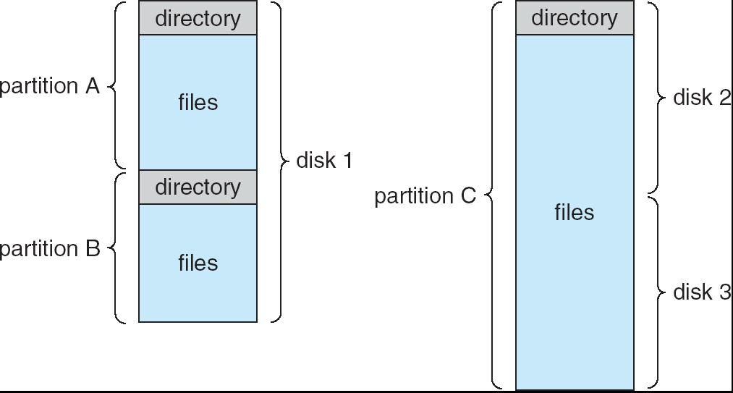
A Typical File-system Organization
The directory records information about the files in the system – such as name, location, size and type.
Notes:
Partitions are for different purposes.

Slide 23
Operations Performed on Directory
Search for a file
Create a file
Delete a file
List a directory
Rename a file
Traverse the file system – access every dir and file for backing up.

Slide 24
Organize the Directory (Logically) to Obtain
Efficiency – locating a file quickly
Naming – convenient to users
Two users can have same name for different files
The same file can have several different names
Grouping – logical grouping of files by properties, (e.g., all Java programs, all games, …)
Notes:
When you are designing a directory structure, you have to take these into consideration.

Slide 25
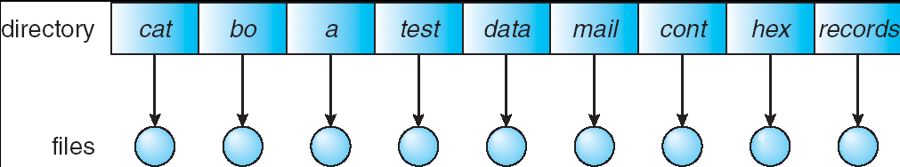
Single-Level Directory
A single directory for all users
Naming problem
Grouping problem

Slide 26
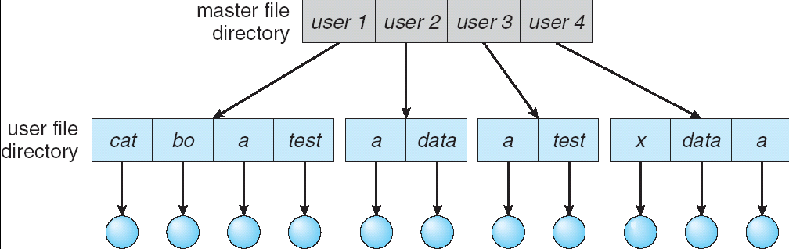
Two-Level Directory
Separate directory for each user
Path name
Can have the same file name for different user
Efficient searching
No grouping capability

Slide 27
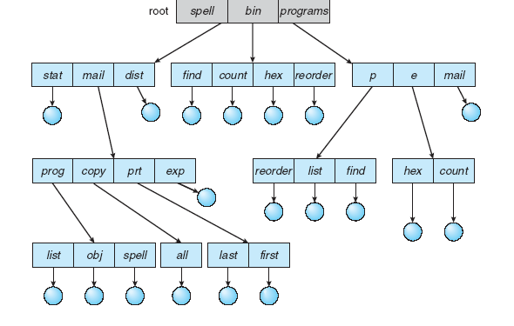
Tree-Structured Directories

Slide 28
Tree-Structured Directories (Cont)
Each directory entry contains a bit defining the entry as file(0) or directory(1).
Efficient searching
Grouping Capability
Current directory (working directory)
cd /spell/mail/prog
type list

Slide 29
Tree-Structured Directories (Cont)
Absolute or relative path name
Creating a new file is done in current directory
Delete a file
rm <file-name>
Creating a new subdirectory is done in current directory
mkdir <dir-name>
Example: if in current directory /mail
mkdir count
mail
prog
copy
prt
exp
count
Deleting “mail” ⇒ deleting the entire subtree rooted by “mail”

Slide 30
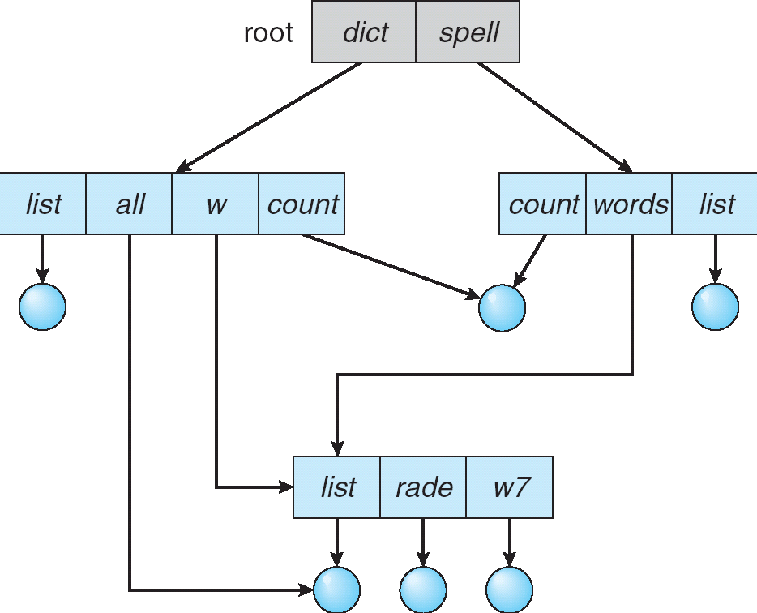
Acyclic-Graph Directories
Requirement for file sharing
Have shared subdirectories and files

Slide 31
Acyclic-Graph Directories (Cont.)
Two different names (aliasing)
If dict deletes count ⇒ dangling pointer
Solutions:
Backpointers (keep a list of references to a file), so we can delete all pointers But: Large, variable size reference list is a problem
Entry-hold-count solution
New directory entry type
Link – another name (pointer) to an existing file
Resolve the link – follow pointer to locate the file
Notes:
1）同一文件会有多个路径，引起某些情况下的复杂性，比如backup的时候，不想复制多份，traverse的时候不想错误统计；
2）删除也会成为问题。导致文件指针悬空（指向某个错误的磁盘地址）。Link下删除会比较容易些，因为link和正式的文件是不同的。
在unix系统里面，symbolic links are left when a file is deleted.责任在于用户。

Slide 32
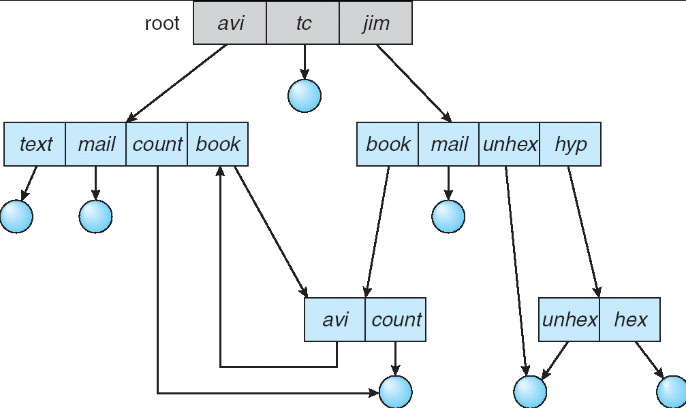
General Graph Directory
A serious problem with acyclic-graph is to ensure no cycles.

Slide 33
General Graph Directory (Cont.)
If cycles allowed
Repeated search the same object
File deletion problem (count <>0 even if unused)
How do we guarantee no cycles?
Allow only links to file not subdirectories
Garbage collection
Every time a new link is added, use a cycle detection algorithm to determine whether it is OK
Notes:
Garbage collection involves traversing the entire file system, marking everything that can be accessed. Then, a second pass collects everything that is not marked onto a list of free space.
缺点：太花时间

Slide 34
File System Mounting
A file system must be mounted before it can be accessed
An un-mounted file system (i.e. Fig. 10-12(b)) is mounted at a mount point

Slide 35
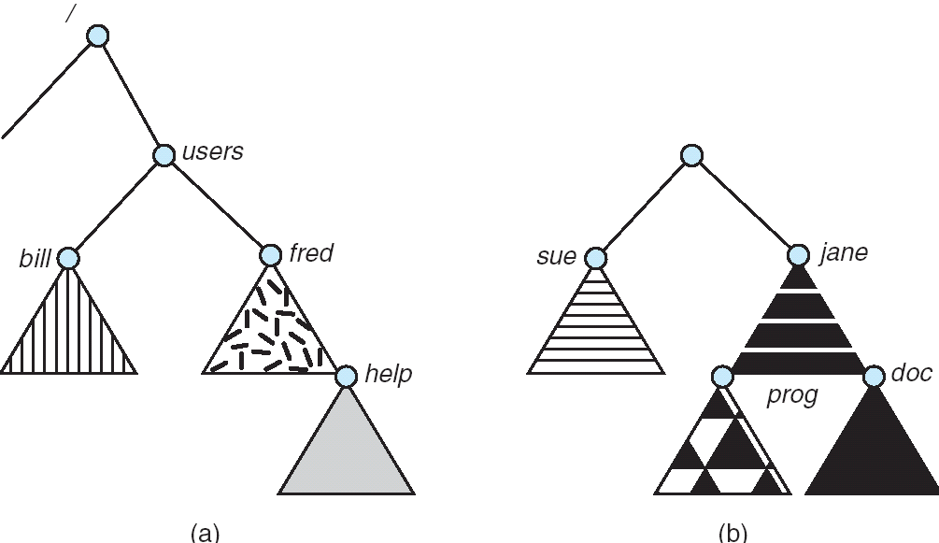
(a) Existing. (b) Unmounted Partition
Unmounted volume residing on /dev/dsk

Slide 36
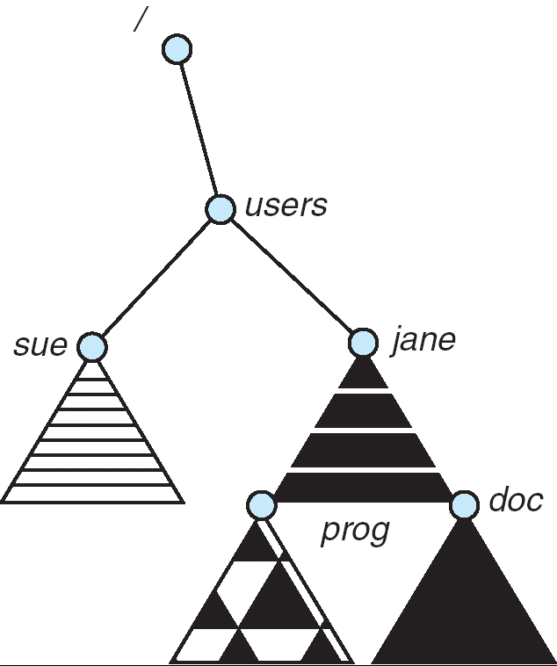
Mount Point
$ mount /dev/dsk /users

Slide 37
File Sharing
Sharing of files on multi-user systems is desirable
Sharing may be done through a protection scheme
On distributed systems, files may be shared across a network
Network File System (NFS) is a common distributed file-sharing method

Slide 38
File Sharing – Multiple Users
User IDs identify users, allowing permissions and protections to be per-user
Group IDs allow users to be in groups, permitting group access rights

Slide 39
File Sharing – Remote File Systems
Uses networking to allow file system access between systems
Manually via programs like FTP
Automatically, seamlessly using distributed file systems
Semi automatically via the world wide web
Client-server model allows clients to mount remote file systems from servers
Server can serve multiple clients
Client and user-on-client identification is insecure or complicated
NFS is standard UNIX client-server file sharing protocol
CIFS is standard Windows protocol
Standard operating system file calls are translated into remote calls
Distributed Information Systems (distributed naming services) such as LDAP, DNS, NIS, Active Directory implement unified access to information needed for remote computing

Slide 40
File Sharing – Failure Modes
Remote file systems add new failure modes, due to network failure, server failure
Recovery from failure can involve state information about status of each remote request
Stateless protocols such as NFS include all information in each request, allowing easy recovery but less security

Slide 41
File Sharing – Consistency Semantics
Consistency semantics specify how multiple users are to access a shared file simultaneously
Similar to Ch 6 process synchronization algorithms
Tend to be less complex due to disk I/O and network latency (for remote file systems) – slow speed
Andrew File System (AFS) implemented complex remote file sharing semantics
Unix file system (UFS) implements:
Writes to an open file visible immediately to other users of the same open file
Sharing file pointer to allow multiple users to read and write concurrently
AFS has session semantics
Writes only visible to sessions starting after the file is closed

Slide 42
Protection
File owner/creator should be able to control:
what can be done
by whom
Types of access
Read
Write
Execute
Append
Delete
List

Slide 43
Access Lists and Groups
Mode of access: read, write, execute
Three classes of users
RWX
a) owner access 7 ⇒ 1 1 1 RWX
b) group access 6 ⇒ 1 1 0
RWX
c) public access 1 ⇒ 0 0 1
Ask manager to create a group (unique name), say G, and add some users to the group.
For a particular file (say game) or subdirectory, define an appropriate access.
owner
group
public
chmod
761
game
Attach a group to a file chgrp G game

Slide 44
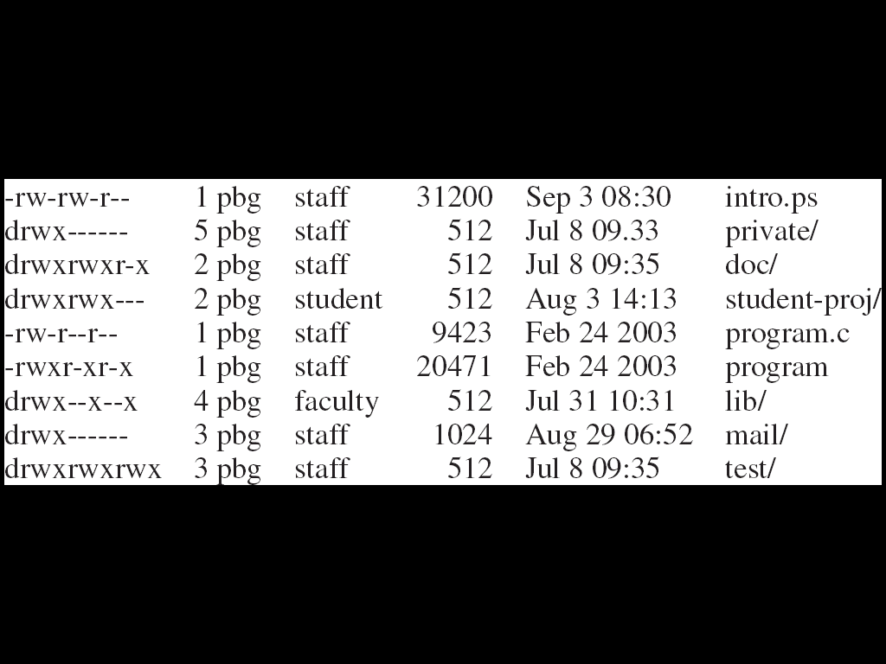
A Sample UNIX Directory Listing

Slide 45
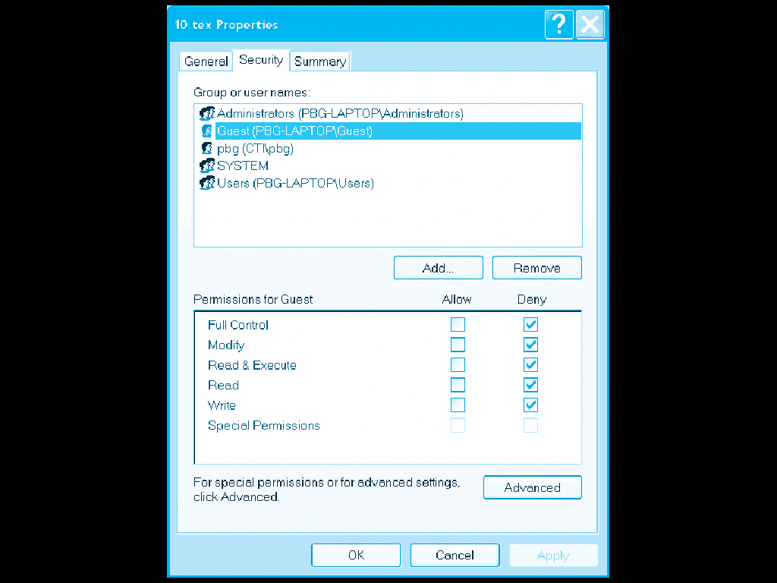
Windows XP Access-control List Management

Slide 46
End of Chapter 10

