Slide 1
Chapter 11: File System Implementation

Slide 2
Chapter 11: File System Implementation
File-System Structure
File-System Implementation
Directory Implementation
Allocation Methods
Free-Space Management
Efficiency and Performance

Slide 3
Objectives
To describe the details of implementing local file systems and directory structures
To discuss block allocation and free-block algorithms and trade-offs

Slide 4
File-System Structure
File structure
Logical storage unit
Collection of related information
File system resides on secondary storage (disks)
File system organized into layers

Slide 5
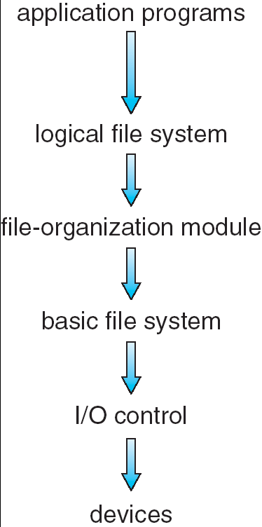
Layered File System
Manages metadata of files,
Protection and security
Translates logical block addr
To physical addr. Free space
mgmt
Block I/O subsystem
Commands to r/w physical
blocks，IO schedule, buffer
Translates ‘r/w block x’ to low-
level hw instructions,FTL
Device drivers
Notes:
metadata 存在FCB，filename（in Dir_Entry）

Slide 6
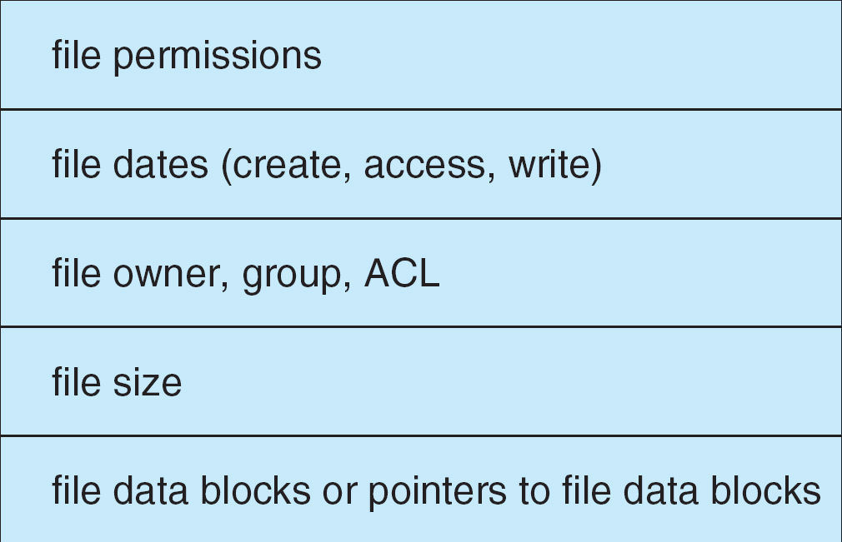
A Typical File Control Block
File control block – storage structure consisting of information about a file. Not a block.

Slide 7
Data Structures Used to Implement FS
Disk structures
Boot control block
Volume control block (superblock in Unix)
Directory structure per file system
Per-file FCB(file control block) (inode in Unix)
In-memory structures
In-memory mount table about each mounted volume
Directory cache for recently accessed directories
System-wide open-file table
Per-process open-file table
Notes:
磁盘结构 vs 内存结构
Persistent vs volatile

Slide 8
In-Memory File System Structures
The following figure illustrates the necessary file system structures provided by the operating systems.
Figure 12-3(a) refers to opening a file.
Figure 12-3(b) refers to reading a file.

Slide 9
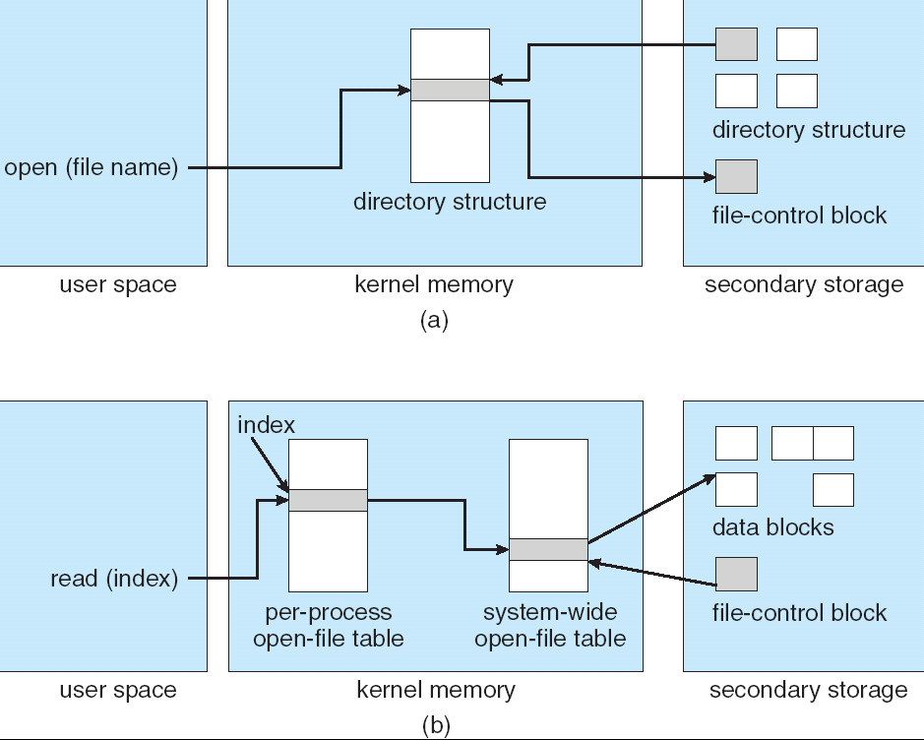
In-Memory File System Structures
Notes:
The file name may not be part of the open-file table, as the system has no use for it once the appropriate FCB is located on disk.
File descriptor (Linux); file handle (windows)

Slide 10
Virtual File Systems
Virtual File Systems (VFS) provide an object-oriented way of implementing file systems. VFS is NOT a disk file system.
VFS allows the same system call interface (the API) to be used for different types of file systems.
The API is to the VFS interface, rather than any specific type of file system.
Defines a network-wide unique structure called vnode.
Notes:
Q: VFS在哪一层？

Slide 11
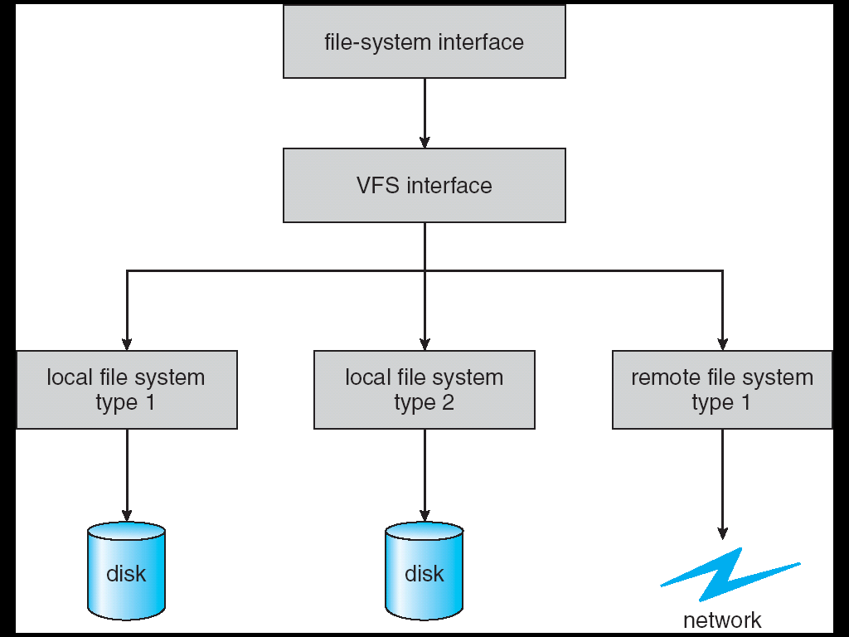
Schematic View of Virtual File System
Write()
Sys_write()
Vfs_write()
Call the write() methods of specific filesystem

Slide 12
Directory Implementation
Linear list of file names with pointer to the data blocks.
simple to program
time-consuming to execute
Hash Table – linear list with hash data structure.
decreases directory search time
collisions – situations where two file names hash to the same location
fixed size – can use chained-overflow hash table
Or rehashing to a larger hash table
tradeoff

Slide 13
Allocation Methods
An allocation method refers to how disk blocks are allocated for files:
Contiguous allocation
Linked allocation
Indexed allocation

Slide 14
Contiguous Allocation
Each file occupies a set of contiguous（连续） blocks on the disk
Simple – only starting location (block #) and length (number of blocks) are required
Random access supported
Wasteful of space (dynamic storage-allocation problem)
Files cannot grow

Slide 15
Contiguous Allocation
Mapping from logical to physical
Q
LA/512
R
Block to be accessed = Q + start_address
Displacement into block = R
Notes:
Q for Quotient
R for Remainder

Slide 16
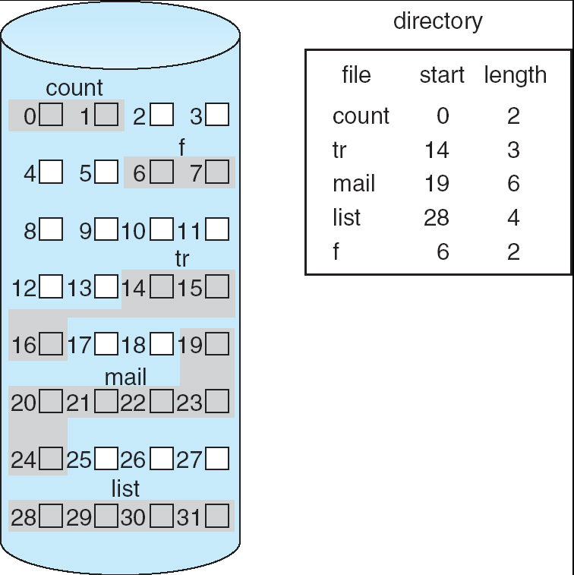
Contiguous Allocation of Disk Space

Slide 17
Extent-Based Systems
Many newer file systems (I.e. Veritas File System) use a modified contiguous allocation scheme
Extent-based file systems allocate disk blocks in extents
An extent is a contiguous block of disks
Extents are allocated for file allocation
A file consists of one or more extents.

Slide 18
Linked Allocation
Each file is a linked list of disk blocks: blocks may be scattered anywhere on the disk.
block =
pointer

Slide 19
Linked Allocation (Cont.)
Simple – need only starting address
Free-space management system – no waste of space
No random access, poor reliability
Mapping
Q
LA/511
R
Block to be accessed is the Qth block in the linked chain of blocks representing the file.
Displacement into block = R + 1
File-allocation table (FAT) – disk-space allocation used by MS-DOS and OS/2.
Notes:
Q for Quotient
R for Remainder

Slide 20
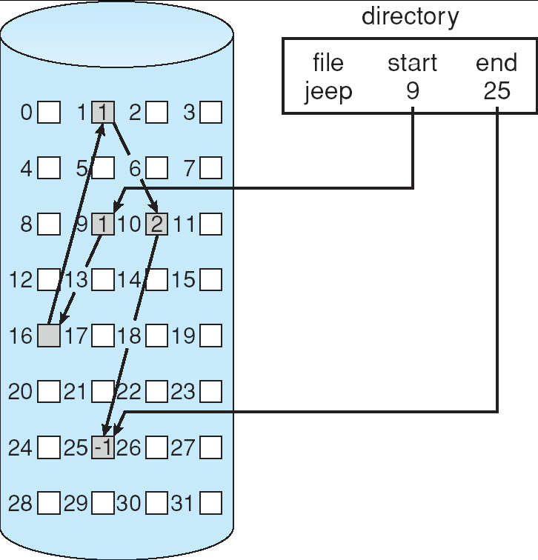
Linked Allocation

Slide 21
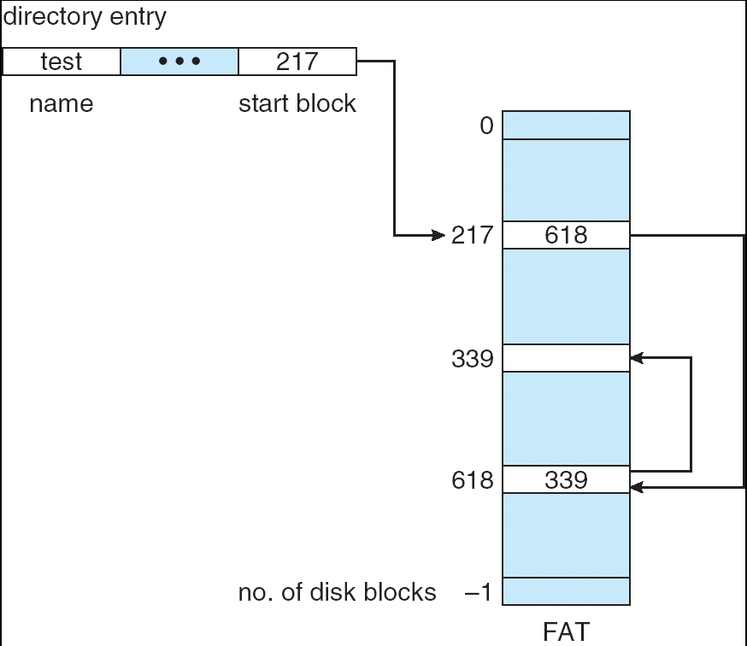
File-Allocation Table

Slide 22
Indexed Allocation
Brings all pointers together into the index block.
Logical view.
index table

Slide 23
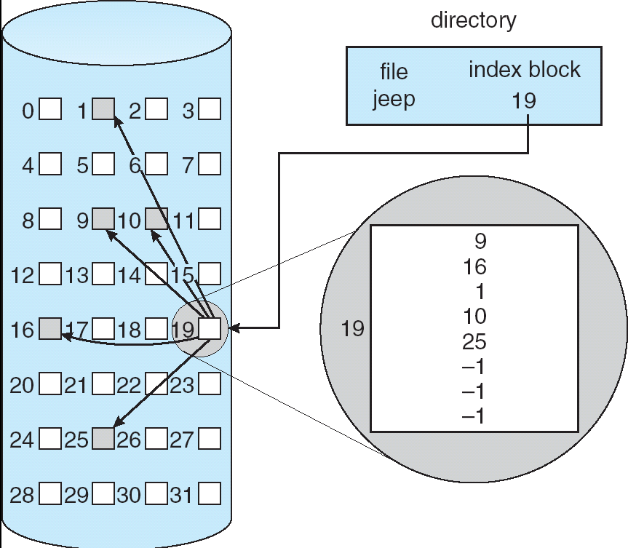
Example of Indexed Allocation

Slide 24
Indexed Allocation (Cont.)
Need index table (analogous to page table)
Random access
Dynamic access without external fragmentation, but have overhead of index block.
When mapping from logical to physical in a file of maximum size of 256K words and block size of 512 words. We need only 1 block for index table.
Q
LA/512
R
Q = displacement into index table
R = displacement into block

Slide 25
Indexed Allocation – Mapping (Cont.)
When mapping from logical to physical in a file of unbounded length (block size of 512 words). – more pointers are needed
Linked scheme – Link blocks of index table (no limit on size).
Q₁
LA / (512 x 511)
R₁
Q₁ = block of index table
R₁ is used as follows:
Q₂
R₁ / 512
R₂
Q₂ = displacement into block of index table
R₂ displacement into block of file:

Slide 26
Indexed Allocation – Mapping (Cont.)
Two-level index (maximum file size is 512³)
Q₁
LA / (512 x 512)
R₁
Q₁ = displacement into outer-index
R₁ is used as follows:
Q₂
R₁ / 512
R₂
Q₂ = displacement into block of index table
R₂ displacement into block of file:

Slide 27
Indexed Allocation – Mapping (Cont.)

outer-index
index table
file

Slide 28
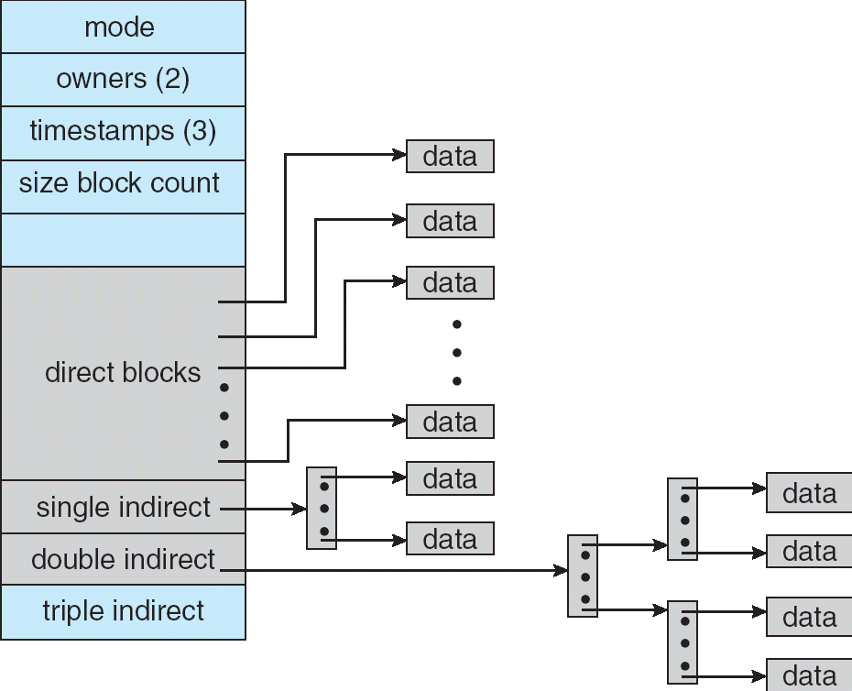
Combined Scheme: UNIX (4K bytes per block)

Slide 29
Free-Space Management
Bit vector (n blocks)
0
1
2
n-1
…
1 ⇒ block[i] free
0 ⇒ block[i] occupied
bit[i] =

Block number calculation (finding the first free block)
(number of bits per word) *
(number of 0-value words) +
offset of first 1 bit

Slide 30
Free-Space Management (Cont.)
Bit map requires extra space
Example:
block size = 2¹² bytes
disk size = 2³⁰ bytes (1 gigabyte)
n = 2³⁰/2¹² = 2¹⁸ bits (or 32K bytes)
Easy to get contiguous files
Linked list (free list) – see figure
Cannot get contiguous space easily
But basically can work (FAT)
No waste of space
Grouping – a modification of the Linked List
Addresses of the n free blocks are stored in the first block.
The first n-1 blocks are actually free. The last block contains addresses of another n free blocks
Counting
Address of the first free block and number n contiguous blocks

Slide 31
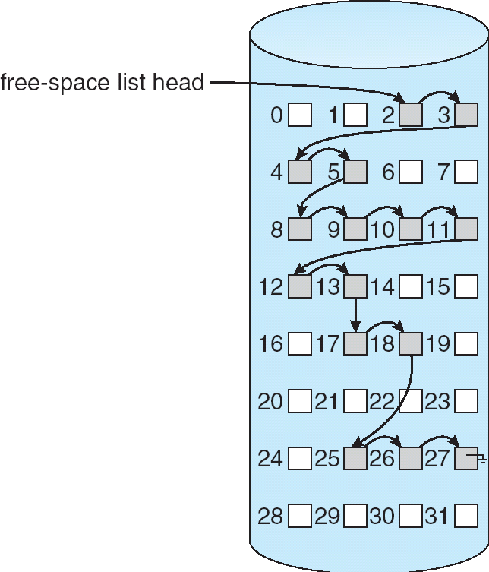
Linked Free Space List on Disk

Slide 32
Free-Space Management (Cont.)
Need to protect:
Pointer to free list
Bit map
Must be kept on disk
The copy in memory and disk may differ
Cannot allow for block[i] to have a situation where bit[i] = 1 in memory and bit[i] = 0 on disk
Solution:
Set bit[i] = 1 in disk
deallocate block[i]
Set bit[i] = 1 in memory

Slide 33
Efficiency and Performance
Efficiency dependent on:
disk allocation and directory algorithms
types of data kept in file’s directory entry (for example “last write date” is recorded in directory)
Performance
disk cache – separate section of main memory for frequently used blocks
free-behind and read-ahead – techniques to optimize sequential access
improve PC performance by dedicating section of memory as virtual disk, or RAM disk
Generally, every data item has to be considered for its effect.

Slide 34
Page Cache
A page cache caches pages rather than disk blocks using virtual memory techniques
Memory-mapped I/O uses a page cache
Routine I/O through the file system uses the buffer (disk) cache
This leads to the following figure

Slide 35
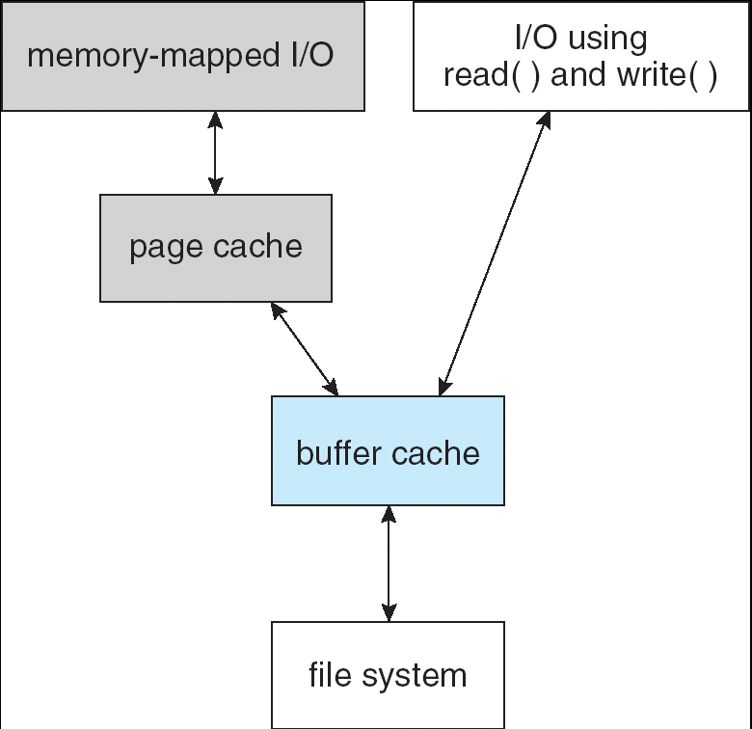
I/O Without a Unified Buffer Cache

Slide 36
Unified Buffer Cache
A unified buffer cache uses the same page cache to cache both memory-mapped pages and ordinary file system I/O
Avoids double caching

Slide 37
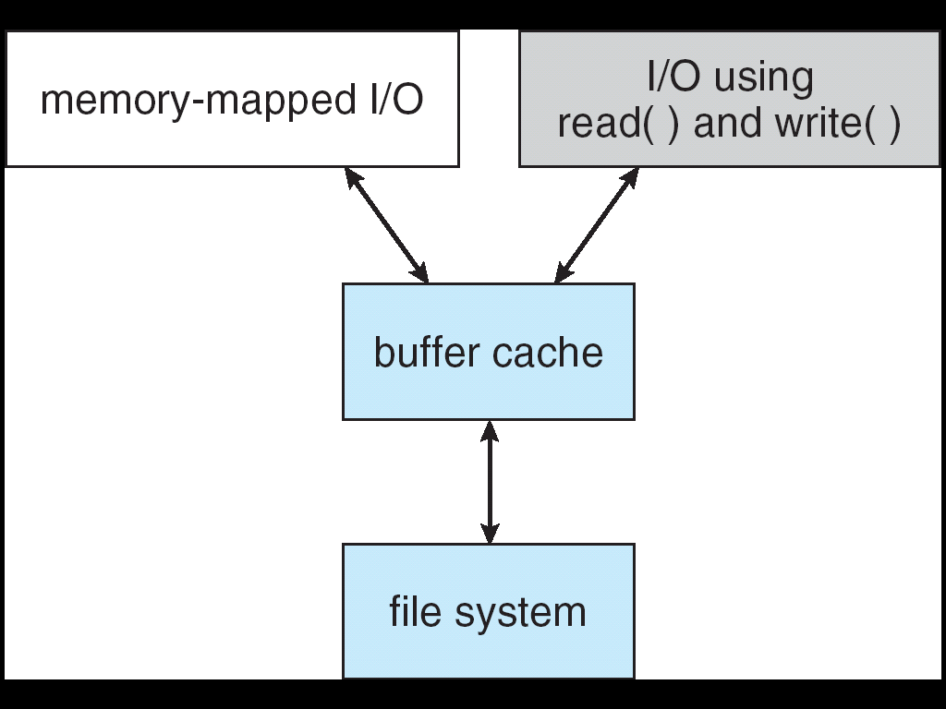
I/O Using a Unified Buffer Cache

Slide 38
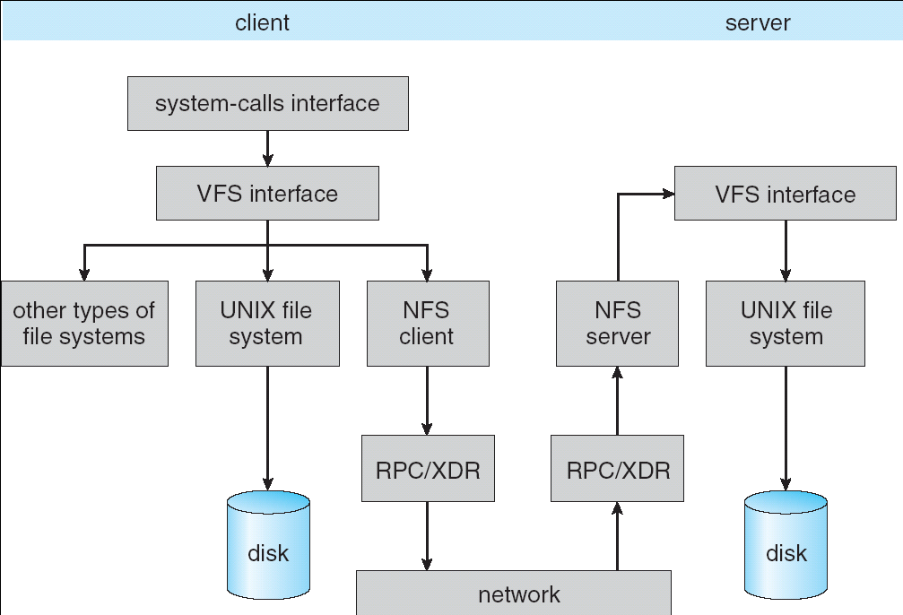
Schematic View of NFS Architecture

Slide 39
Example: WAFL File System
Used on Network Appliance “Filers” – distributed file system appliances
“Write-anywhere file layout”
Serves up NFS, CIFS, http, ftp
Random I/O optimized, write optimized
NVRAM (flash memory) for write caching
Similar to Berkeley Fast File System, with extensive modifications

Slide 40
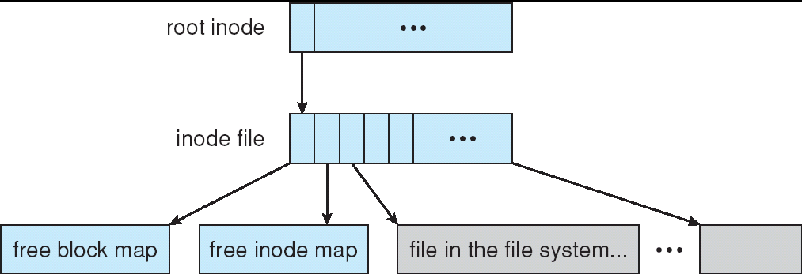
The WAFL File Layout

Slide 41
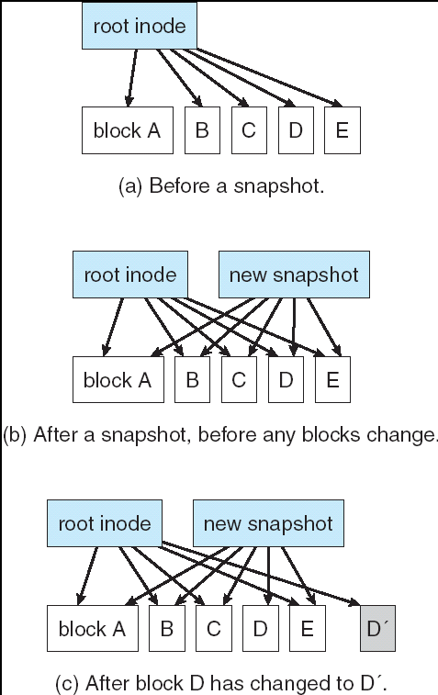
Snapshots in WAFL

Slide 42

11.02

Slide 43
End of Chapter 11

Slide 44
Write/Read Amplification
Write amplification is the ratio of the amount of data written to the storage device versus the amount of data written to the database.
If you are writing 10 MB to the file, and you observe 30 MB disk write, your write amplification is 3.
Write amplification is bad for flash-based storage lifetime.

