Slide 1
Chapter 13: I/O Systems

Slide 2
Chapter 13: I/O Systems
I/O Hardware
Application I/O Interface
Kernel I/O Subsystem
Transforming I/O Requests to Hardware Operations
Performance

Slide 3
Objectives
Explore the structure of an operating system’s I/O subsystem
Discuss the principles of I/O hardware and its complexity
Provide details of the performance aspects of I/O hardware and software

Slide 4
I/O Hardware
Incredible variety of I/O devices
More than 200 harddisk manufacturers
Common concepts
Port
Bus (daisy chain or shared direct access)
Controller (host adapter)
I/O instructions control devices
Devices have (port) addresses, used by
Special I/O instructions
Memory-mapped I/O
Some systems use both.
Device control registers mapped into processor address space.

Slide 5
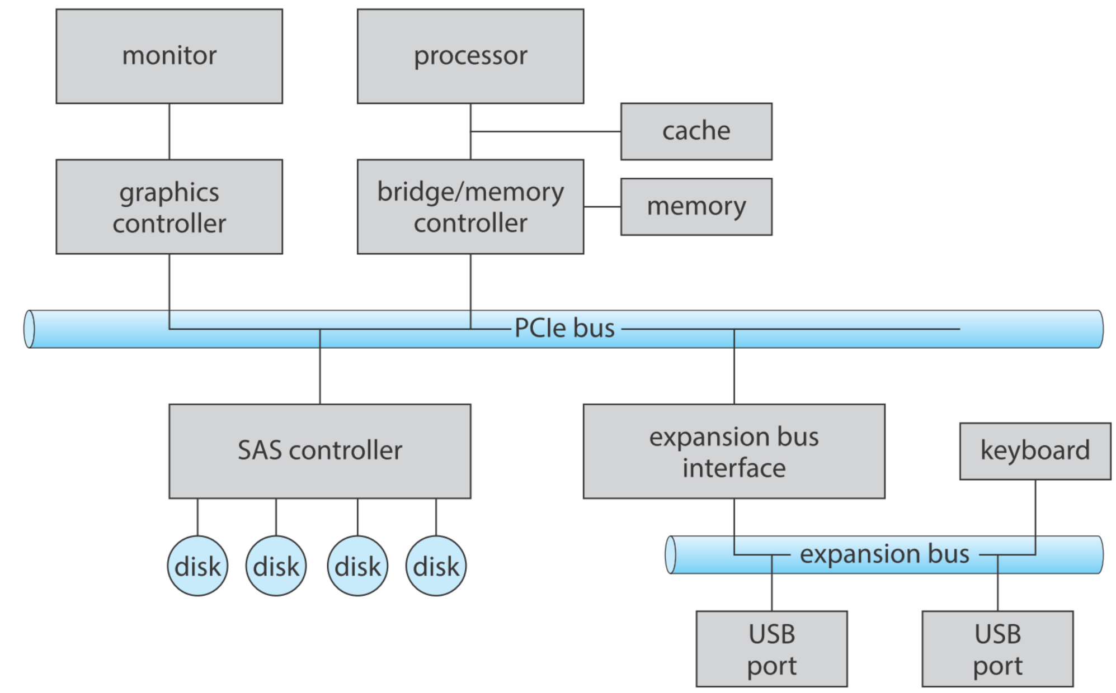
A Typical PC Bus Structure

Slide 6
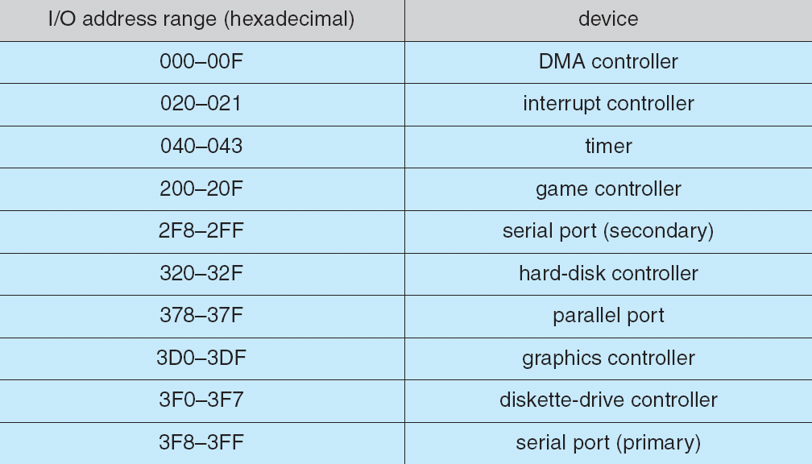
Device I/O Port Addresses on PCs (partial)
Notes:
Used by special IO instructions.
Alternatively device can use Memory-mapped IO. Device-control regs are mapped into physical memory locations.

Slide 7
I/O Port Registers
Data-in: read by the host to get input
Data-out: written by the host to send output
Status: device status read by the host
Control: written by the host to start a command or change the mode of a device

Slide 8
Polling
Repeated for each byte:

Slide 9
Polling
Determines state of device
command-ready
busy
Error
Busy-wait cycle in Step 1 to wait for I/O from device
Repeatedly reading the status register until the busy bit becomes clear.
Can be inefficient!!

Slide 10
Interrupts
CPU Interrupt-request line triggered by I/O device
Interrupt handler receives interrupts
Maskable to ignore or delay some interrupts
Interrupt vector to dispatch interrupt to correct handler
Based on priority
Some nonmaskable
Interrupt chaining: To handle more devices than interrupt vector elements. Handlers on each list are called one by one.
Interrupt mechanism also used for exceptions

Slide 11
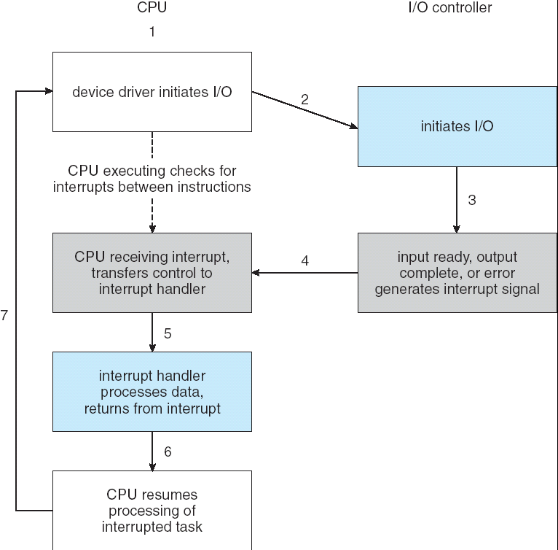
Interrupt-Driven I/O Cycle

Slide 12
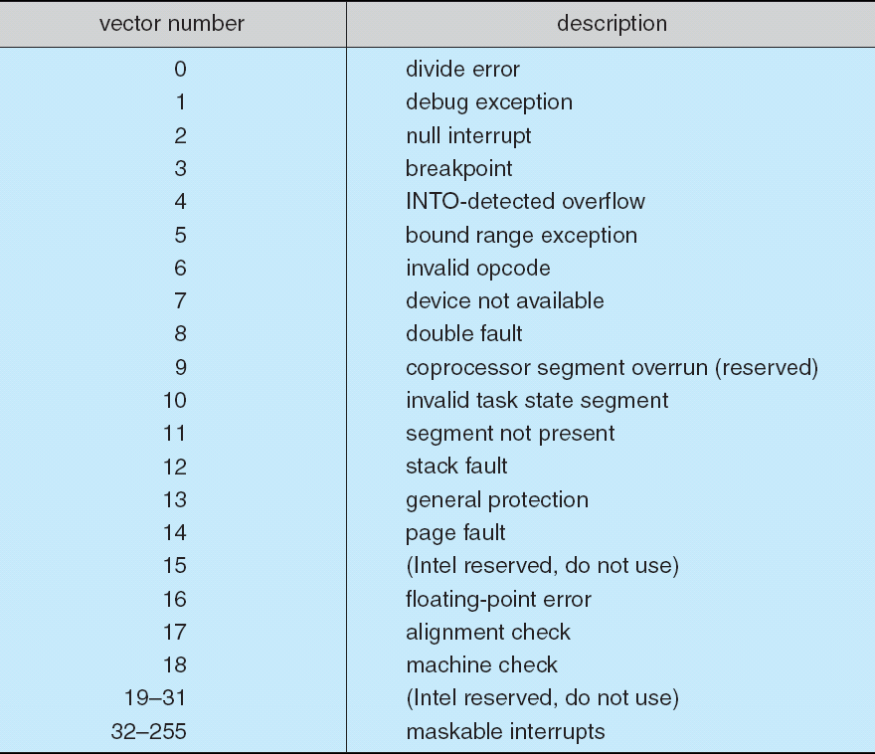
Intel Pentium Processor Event-Vector Table

Slide 13
Various Interrupt Processing
Page fault: saves the state of the process, moves it to the waiting queue, schedules another process to resume execution, then returns.
Trap (s/w interrupt): saves the state of user code, switches to supervisor mode. Low priority
Low priority interrupt can be preempted by high priority ones.
Example usage: high-priority handler
records the I/O status,
clears the device interrupt,
starts the next pending I/O, and
raises a low-priority interrupt to complete the work
Later, the low-priority handler
completes the user-level I/O by copying data from kernel buffers to the application space and
calling the scheduler to place the application on the ready queue
Notes:
RISC-V硬件为了简化设计，并未定义硬件的中断嵌套机制，如果要软件实现中断嵌套需要在trap处理中打开MIE全局中断使能位，并嵌套保存中断上下文，会使软件变得复杂。

Slide 14
Direct Memory Access
Used to avoid programmed I/O (可编程I/O) for large data movement
Requires DMA controller
Bypasses CPU to transfer data directly between I/O device and memory

Slide 15
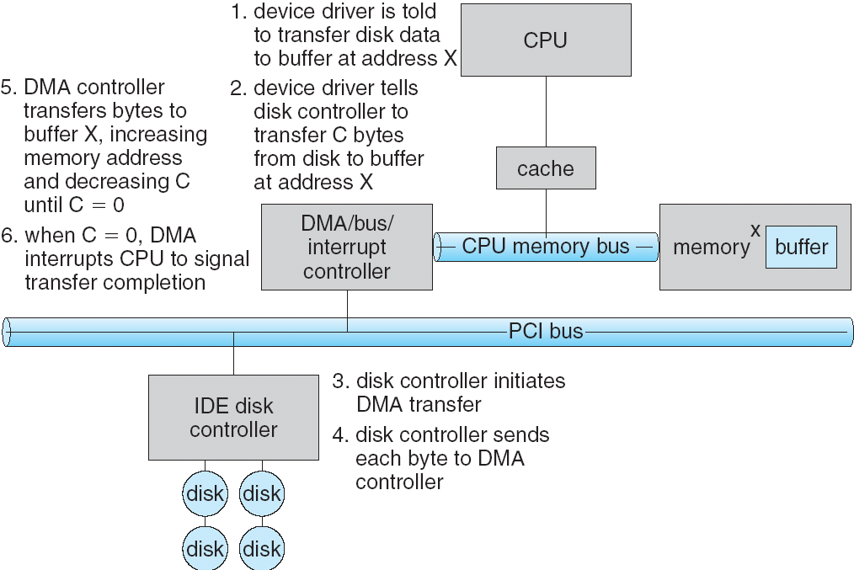
Six Step Process to Perform DMA Transfer
When DMA controller seizes mem bus, CPU is prevented from accessing memory.

Slide 16
Application I/O Interface
I/O system calls encapsulate device behaviors in generic classes
Device-driver layer hides differences among I/O controllers from kernel
Devices vary in many dimensions
Character-stream or block
Sequential or random-access
Sharable or dedicated
Speed of operation
read-write, read only, or write only
Notes:
和API刚好相反

Slide 17
Device Types in Linux
$ ls -l /dev brw-rw---- 1 root disk 8, 0 Dec 20 20:13 sda crw-rw-rw- 1 root root 1, 3 Dec 20 20:13 null srw-rw-rw- 1 root root 0 Dec 20 20:13 log prw-r--r-- 1 root root 0 Dec 20 20:13 fdata
The columns are as follows from left to right:
Permissions
Owner
Group
Major Device Number
Minor Device Number
Timestamp
Device Name
c - character
b - block
p - pipe
s - socket

Slide 18
SCSI devices
/dev/sda - First hard disk
/dev/sdb - Second hard disk
/dev/sda3 - Third partition on the first hard disk
Older ATA HDD
/dev/hda - First hard disk
/dev/hdd2 - Second partition on 4th hard disk
Pseudo devices
/dev/zero - accepts and discards all input, produces a continuous stream of NULL (zero value) bytes
/dev/null - accepts and discards all input, produces no output
/dev/random - produces random numbers

Slide 19
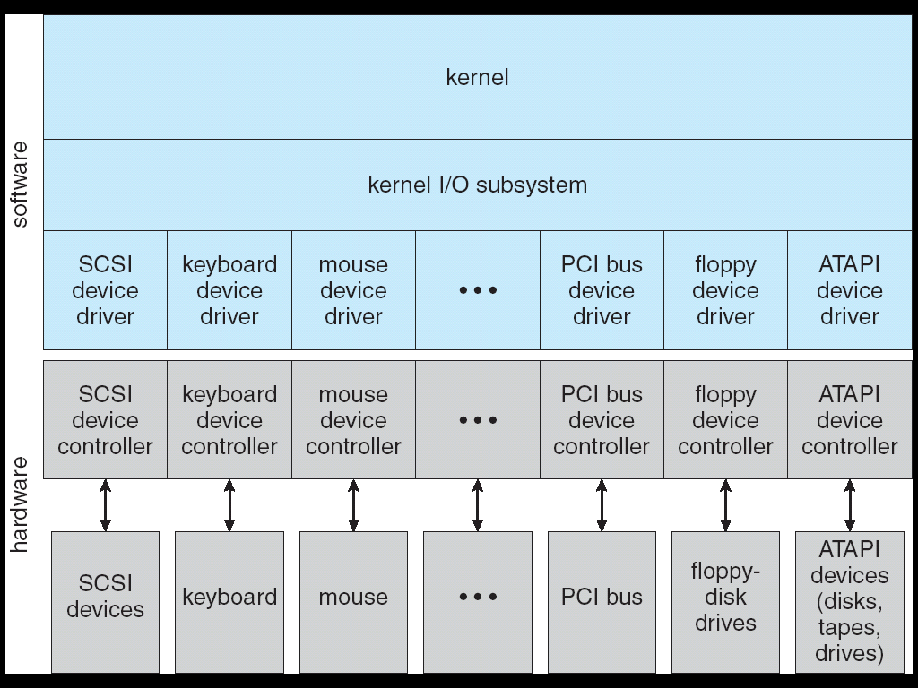
A Kernel I/O Structure
Device driver layer:
Hides differences among device controllers

Slide 20
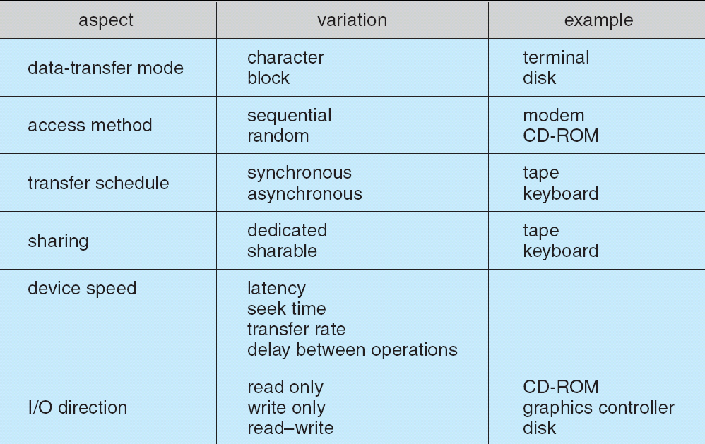
Characteristics of I/O Devices

Slide 21
Block and Character Devices
Block devices include disk drives
Commands include read, write, seek
Raw I/O or file-system access
Memory-mapped file access possible
Character devices include keyboards, mice, serial ports
Commands include get, put
Libraries layered on top allow line editing

Slide 22
Network Devices
Varying enough from block and character to have own interface
Unix and Windows NT/9x/2000 include socket interface
Separates network protocol from network operation
Includes select functionality for servers
Approaches vary widely (pipes, FIFOs, streams, queues, mailboxes)

Slide 23
Clocks and Timers
Provide current time, elapsed time, timer
Programmable interval timer used for timings, to generate periodic interrupts
ioctl (on UNIX) covers odd aspects of I/O such as clocks and timers

Slide 24
Blocking and Nonblocking I/O
Blocking - process suspended until I/O completed
Easy to use and understand
Insufficient for some needs
Nonblocking - I/O call returns as much as available
User interface, data copy (buffered I/O)
Implemented via multi-threading
Returns quickly with count of bytes read or written
Asynchronous - process runs while I/O executes
Difficult to use
I/O subsystem signals process when I/O completed
Notes:
Asynchronous IO returns to a code outside the linear control flow of the app.

Slide 25
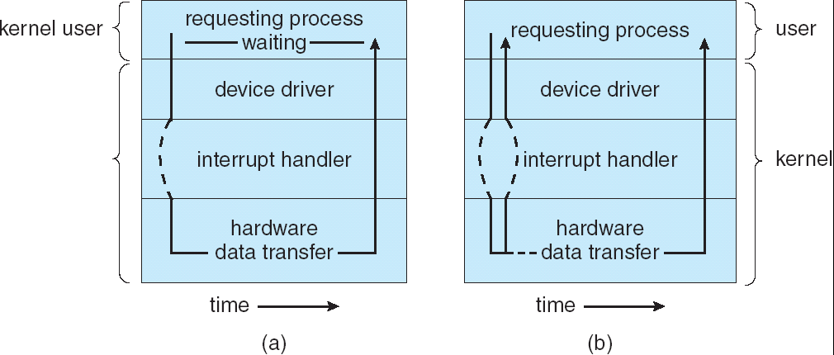
Two I/O Methods
Synchronous
Asynchronous

Slide 26
Kernel I/O Subsystem
Scheduling
Some I/O request ordering via per-device queue
E.g. disk scheduling
Some OSs try fairness
Buffering - store data in memory while transferring between devices
To cope with device speed mismatch, e.g. receiving data from modem to disk.
Double buffering
To cope with device transfer size mismatch, e.g. network packet
To maintain “copy semantics” (when a write() system call specifies a buffer for storing the data, and modifies its contents after the system call)

Slide 27
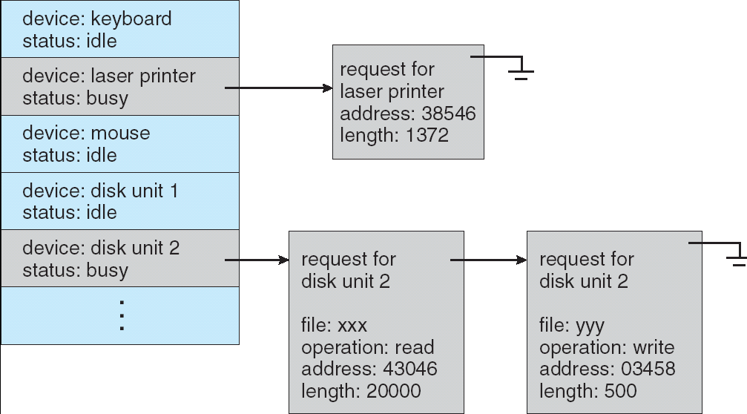
Device-status Table
Aka “device-control table”
I/O scheduling on each device queue

Slide 28
Kernel I/O Subsystem
Caching - fast memory holding copy of data
Always just a copy
Key to performance
Spooling - hold output for a device
If device can serve only one request at a time
i.e., Printing
Device reservation - provides exclusive access to a device
System calls for allocation and deallocation
Watch out for deadlock
Notes:
App I/O interface 之上为kernel io subsystem，主要是为IO提供多种服务。

Slide 29
Error Handling
OS can recover from disk read, device unavailable, transient write failures
Most return an error number or code when I/O request fails
System error logs hold problem reports

Slide 30
I/O Protection
User process may accidentally or purposefully attempt to disrupt normal operation via illegal I/O instructions
All I/O instructions defined to be privileged– cannot be issued directly
I/O must be performed via system calls
Memory-mapped and I/O port memory locations must be protected too
Notes:
isolation

Slide 31
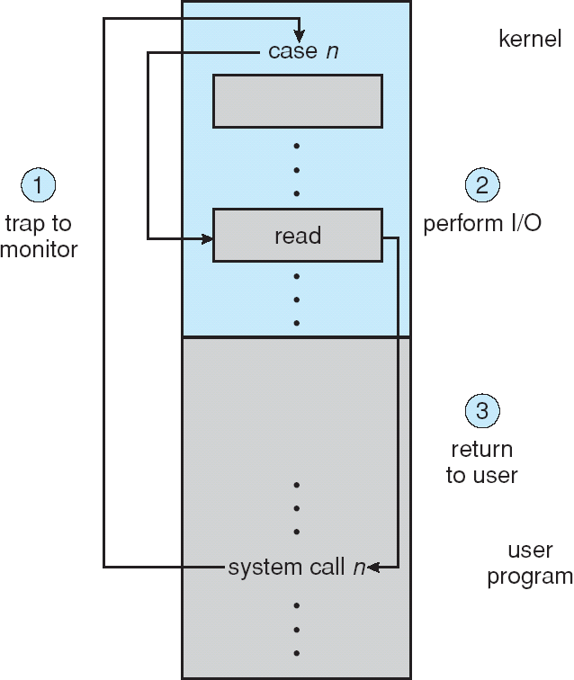
Use of a System Call to Perform I/O

Slide 32
Kernel Data Structures
Kernel keeps state info for I/O components, including open file tables, network connections, character device state
Many, many complex data structures to track buffers, memory allocation, “dirty” blocks
Some use object-oriented methods and message passing to implement I/O. e.g. Unix provides file-system access to a variety of entities such as user files, raw disk, network socket etc.
Notes:
The kernel needs to keep state information about the use of I/O components.
It does so through a variety of in-kernel data structures, such as the open-file table

Slide 33
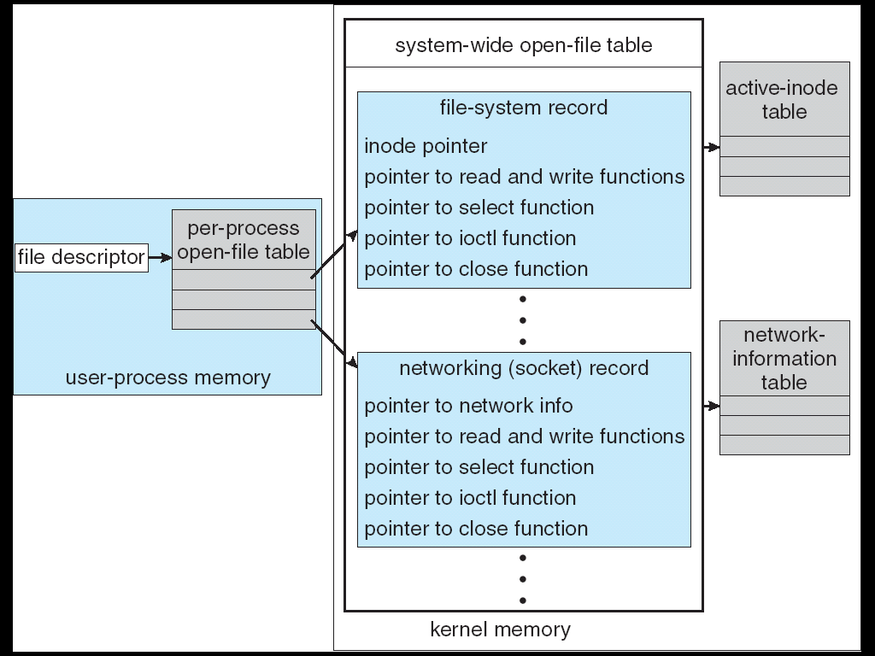
UNIX I/O Kernel Structure
Notes:
比如unix就提供各种实体上的read操作，read user file, need to probe buffer cache,
2)Read raw disk, need request size = num of blocks * blk_sz
3) Read from process addr space, just copy from memory.

Slide 34
Transforming I/O Requests to Hardware Operations
Consider reading a file from disk for a process:
Determine device holding file
MS-DOS uses the ‘c:’ disk id; Unix uses the mount table
Translate name to device representation
Physically read data from disk into buffer
Make data available to requesting process
Return control to process
Notes:
How does OS connects device name to the I/O port address? When UNIX looks up this name in
the file-system directory structures, it finds not an inode number but a <major,
minor> device number. The major device number identifies a device driver
that should be called to handle I/O to this device. The minor device number
is passed to the device driver to index into a device table. The corresponding
device-table entry gives the port address or the memory-mapped address of
the device controller.

Slide 35
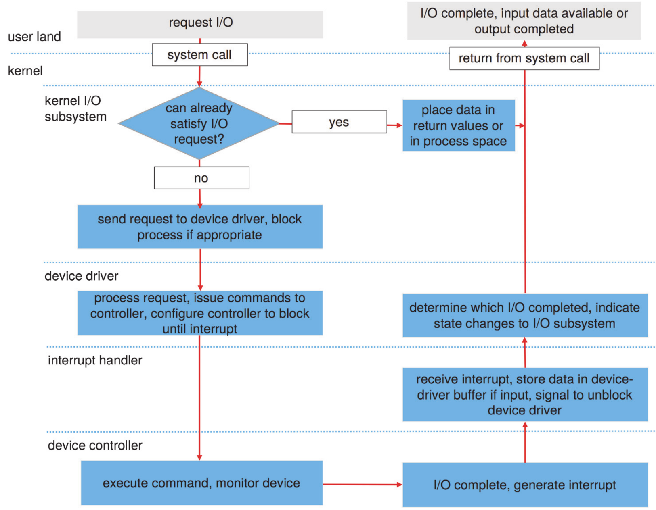
Life Cycle of An I/O Request

Slide 36
Performance
I/O is a major factor in system performance:
Demands CPU to execute device driver, kernel I/O code
Context switches due to interrupts are heavy burden on CPU
Data copying
Network traffic especially stressful

Slide 37
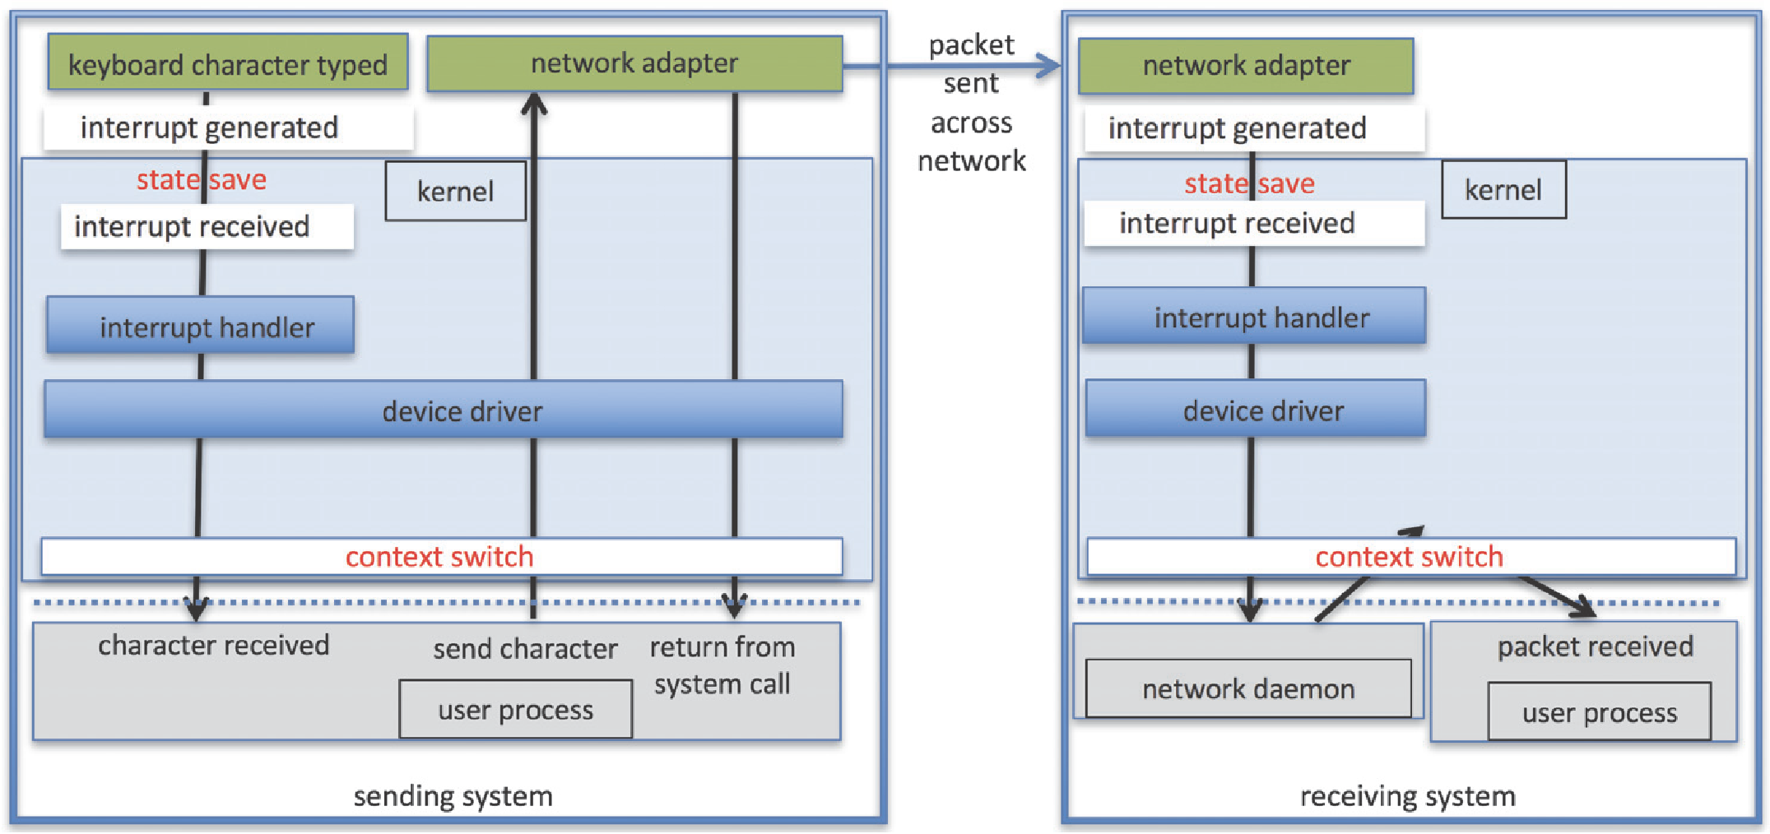
Intercomputer Communications

Slide 38
Improving Performance
Reduce number of context switches
Reduce data copying
Reduce interrupts by using large transfers, smart controllers, polling
Use DMA
Balance CPU, memory, bus, and I/O performance for highest throughput

Slide 39
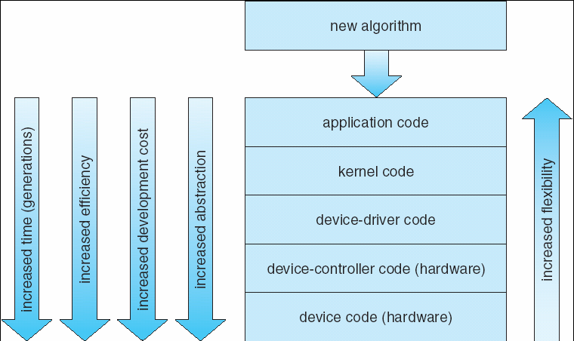
Device-Functionality Progression

Slide 40
End of Chapter 13

Slide 41
STREAMS
STREAM – a full-duplex communication channel between a user-level process and a device in Unix System V and beyond
A STREAM consists of:
- STREAM head interfaces with the user process
- driver end interfaces with the device - zero or more STREAM modules between them.
Each module contains a read queue and a write queue
Message passing is used to communicate between queues
STREAM provides a framework for a modular and incremental approach to writing device drivers and network protocols.

Slide 42
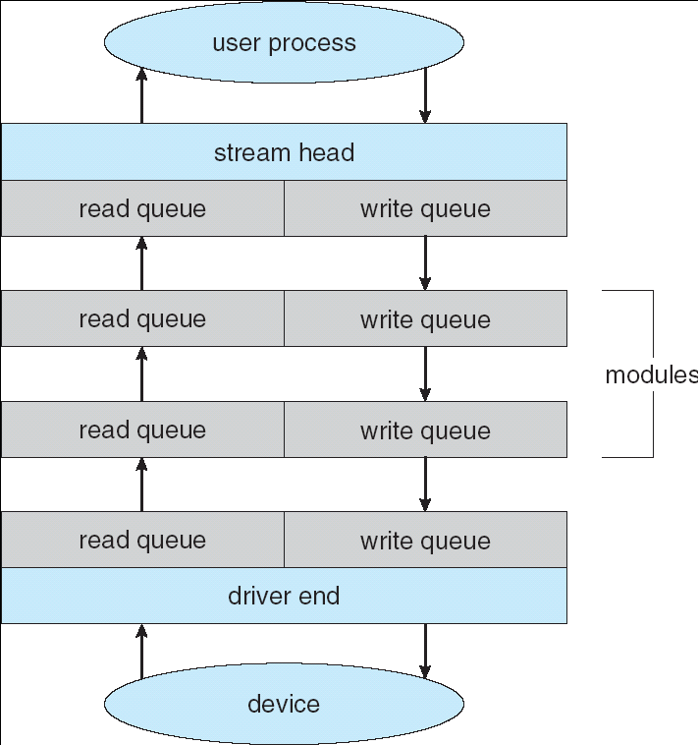
The STREAMS Structure

