Slide 1
Chapter 4: Threads

Slide 2
Chapter 4: Threads
Overview
Multithreading Models
Threading Issues
Pthreads
Windows XP Threads
Linux Threads
Java Threads

Slide 3
Suppose you are developing a Web browser
Main(){
While(1){
RetrieveData(); // Block for 1 second
DisplayData(); // Block for 1 second
GetInputEvents(); // Block for 1 second
}
}
Now what if you want the program to be more responsive?
Main(){
While(1){
RetrieveALittleData(); // Block for 0.1 second
DisplayALittleData(); // Block for 0.1 second
GetAFewInputEvents(); // Block for 0.1 second
}
}

Slide 4
What if you want it to be even more responsive?
Main(){
While(1){
if(CheckData()==True){
RetrieveALittleData(); // 0.1 second
DisplayALittleData(); // 0.1 second
}
if(CheckInputEvents()==True){
GetAFewInputEvents(); // 0.1 second
}
}
}
Problem: A lot Checks, not efficient. And still not responsive!

Slide 5
To make it responsive enough, we need to
Break the operations into very very small pieces;
However, to be efficient enough, we want to execute code in large pieces.
More precisely, we want to SCHEDULE these operations in our own program code.
Leave the tedious work to the OS which schedules them in Threads!
These two requirements conflict with each other!

Slide 6
Multi-thread version of the program
Main(){
CreateThread (RetrieveData());
CreateThread (DisplayData());
CreateThread (GetInputEvents());
WaitForThreads();
}
// Each thread routine enters a loop.
Void RetrieveData(){
while(1){
retrieveData();
…
}
}
….
……
Void DisplayData(){
while(1){
displayData();
…
}
}

Slide 7
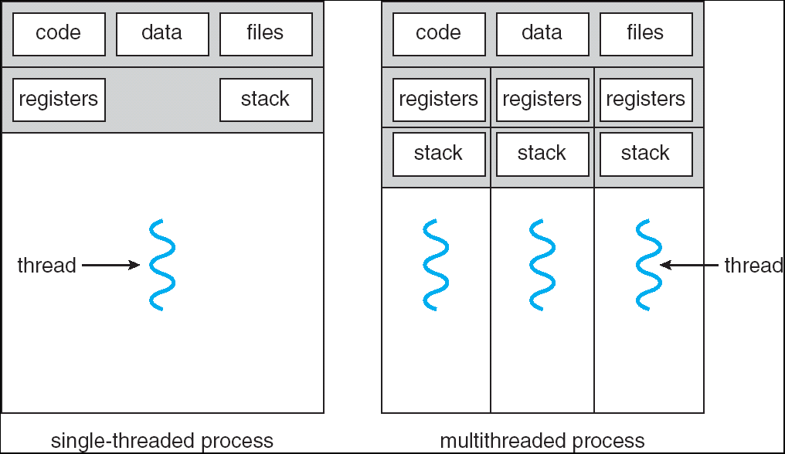
Single and Multithreaded Processes

Slide 8
Benefits
Responsiveness interactive applications
Resource Sharing memory for code and data can be shared.
Economy creating processes are more expensive.
Utilization of MP Architectures
multi-threading increases concurrency.

Slide 9
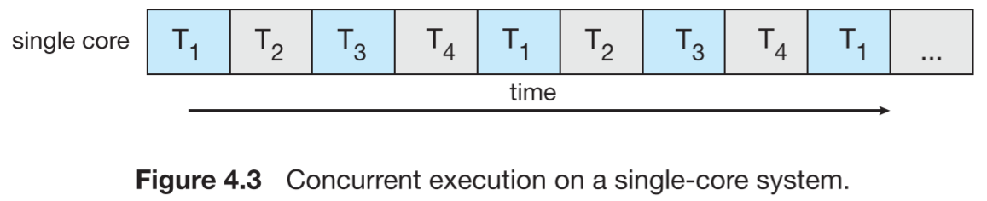
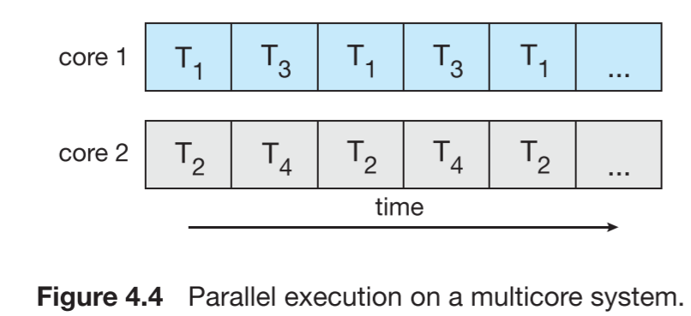
Concurrency vs. Parallelism

Slide 10
User Threads
Thread management done by user-level threads library
Three primary thread libraries:
POSIX Pthreads (can also be provided as system library)
Win32 threads
Java threads

Slide 11
Kernel Threads
Supported by the Kernel
Almost all contemporary OS implements kernel threads. Examples
Windows XP/2000
Solaris
Linux
Tru64 UNIX
Mac OS X

Slide 12
Multithreading Models
Many-to-One thread mgmt is efficient, but will block if making system call, kernel can schedule only one thread at a time
One-to-One more concurrency, but creating thread is expensive
Many-to-Many
flexible

Slide 13
Many-to-One
Many user-level threads mapped to single kernel thread
Examples:
Solaris Green Threads
GNU Portable Threads

Slide 14
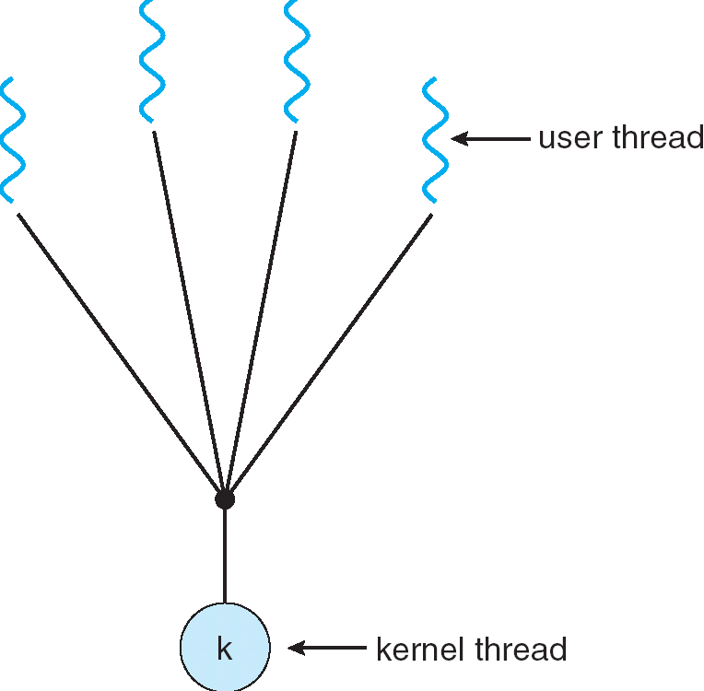
Many-to-One Model

Slide 15
One-to-One
Each user-level thread maps to kernel thread
Examples
Windows NT/XP/2000
Linux
Solaris 9 and later

Slide 16
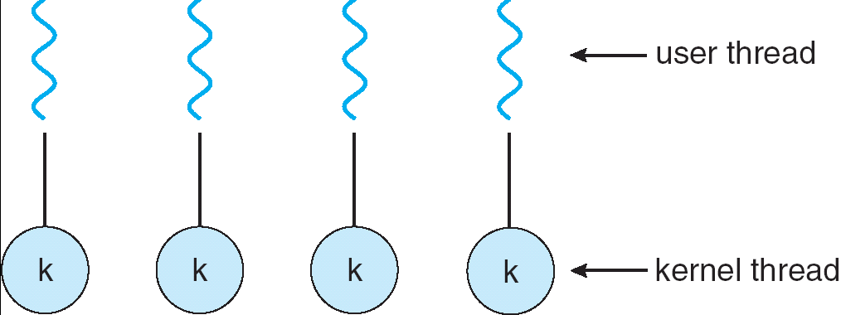
One-to-one Model

Slide 17
Many-to-Many Model
Allows many user level threads to be mapped to many kernel threads
Allows the operating system to create a sufficient number of kernel threads
Solaris prior to version 9
Windows NT/2000 with the ThreadFiber package

Slide 18
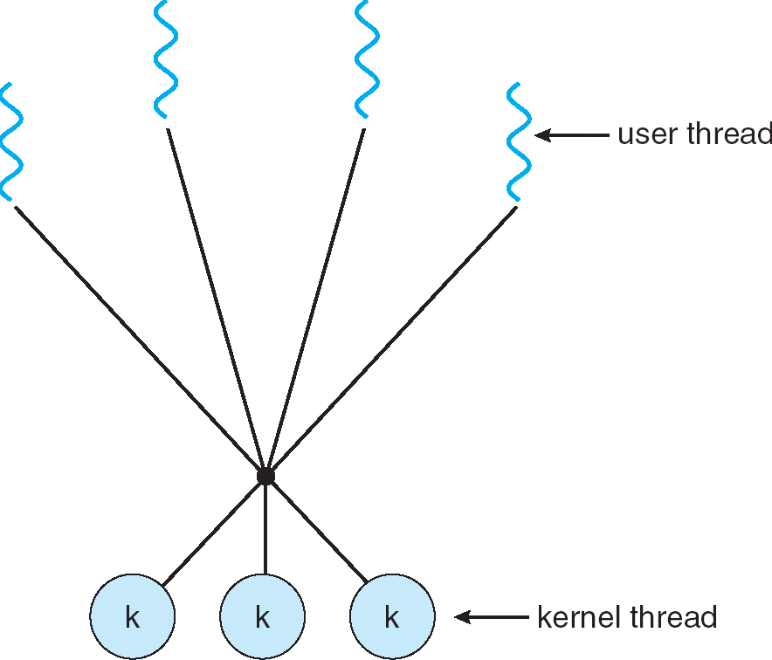
Many-to-Many Model

Slide 19
Two-level Model
Similar to M:M, except that it allows a user thread to be bound to kernel thread
Examples
IRIX
HP-UX
Tru64 UNIX
Solaris 8 and earlier

Slide 20
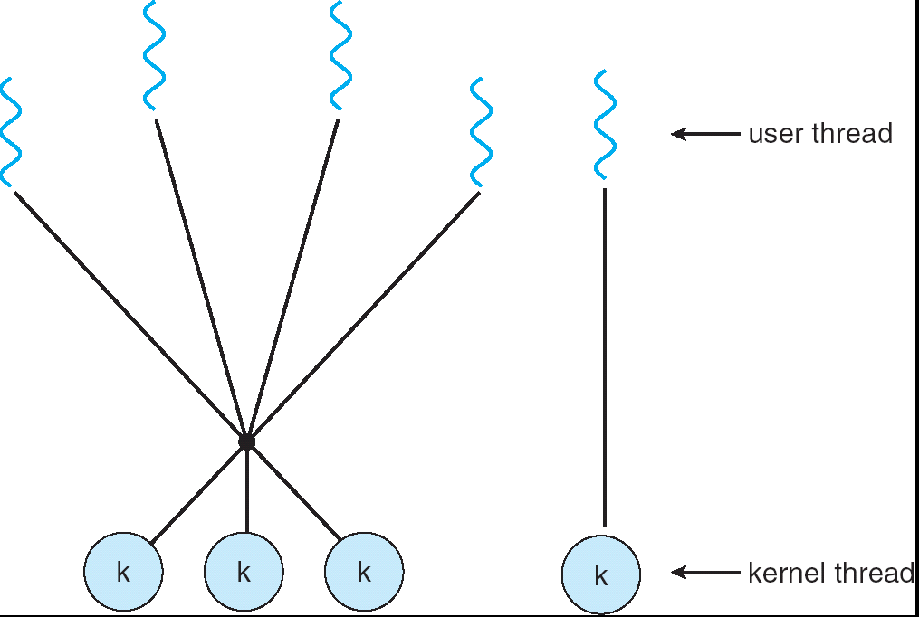
Two-level Model

Slide 21
Threading Issues
Semantics of fork() and exec() system calls
Thread cancellation
Signal handling
Thread pools
Thread-specific data
Scheduler activations

Slide 22
Semantics of fork() and exec()
Does fork() duplicate only the calling thread or all threads?
Some unix systems have two versions of fork(), one that duplicates all threads and another that duplicates the thread that invokes fork().
Exec() will replace the entire process.

Slide 23
Signal Handling
Signals are used in UNIX systems to notify a process that a particular event has occurred
A signal handler is used to process signals, either synchronous or asynchronous:
Signal is generated by particular event
Signal is delivered to a process
Signal is handled
Options: (method of delivery depends on the type of signal)
Deliver the signal to the thread to which the signal applies
Deliver the signal to every thread in the process
Deliver the signal to certain threads in the process
Assign a specific thread to receive all signals for the process

Slide 24
Thread Cancellation
Terminating a thread before it has finished
Two general approaches:
Asynchronous cancellation terminates the target thread immediately
Deferred cancellation allows the target thread to periodically check via a flag if it should be cancelled

Slide 25
Thread Pools
Create a number of threads in a pool where they await work
Advantages:
Usually slightly faster to service a request with an existing thread than create a new thread
Allows the number of threads in the application(s) to be bound to the size of the pool

Slide 26
Thread Specific Data
Thread-Local Storage (in 10th edition)
Allows each thread to have its own copy of data
In some ways similar to static data, but are unique to each thread
Useful when you do not have control over the thread creation process (i.e., when using a thread pool)

Slide 27
Scheduler Activations
Both M:M and Two-level models require communication to maintain the appropriate number of kernel threads allocated to the application
LWP(light weight process) is a virtual processor attached to kernel thread
Scheduler activations provide upcalls - a communication mechanism from the kernel to the thread library
Upcalls are handled by the thread library with an upcall handler
This communication allows an application to maintain the correct number of kernel threads
when an application thread is about to block, an upcall is triggered.

Slide 28
Pthreads
Q: Is it a user- or kernel-level library?
A POSIX standard (IEEE 1003.1c) API for thread creation and synchronization
API specifies behavior of the thread library, implementation is up to development of the library
Common in UNIX operating systems (Solaris, Linux, Mac OS X)
Can be either user- or kernel-level.

Slide 29
Windows XP Threads
Implements the one-to-one mapping
Each thread contains
A thread id
Register set
Separate user and kernel stacks
Private data storage area
The register set, stacks, and private storage area are known as the context of the threads
The primary data structures of a thread include:
ETHREAD (executive thread block)
KTHREAD (kernel thread block)
TEB (thread environment block)

Slide 30
Linux Threads
Linux refers to them as tasks rather than threads
Thread creation is done through clone() system call
clone() allows a child task to share the address space of the parent task (process)

Slide 31
Java Threads
Java threads are managed by the JVM
Java threads may be created by:
Extending Thread class
Implementing the Runnable interface

Slide 32
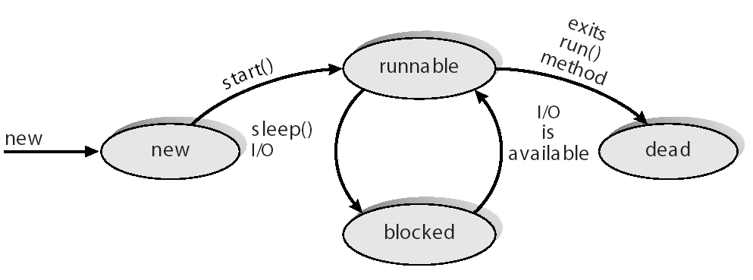
Java Thread States

Slide 33
End of Chapter 4

