Slide 1
Chapter 5: CPU Scheduling

Slide 2
Chapter 5: CPU Scheduling
Basic Concepts
Scheduling Criteria
Scheduling Algorithms
Multiple-Processor Scheduling
Real-Time Scheduling
Thread Scheduling
Operating Systems Examples
Java Thread Scheduling
Algorithm Evaluation

Slide 3
Basic Concepts
Maximum CPU utilization obtained with multiprogramming
CPU–I/O Burst Cycle – Process execution consists of a cycle of CPU execution and I/O wait
CPU burst distribution

Slide 4
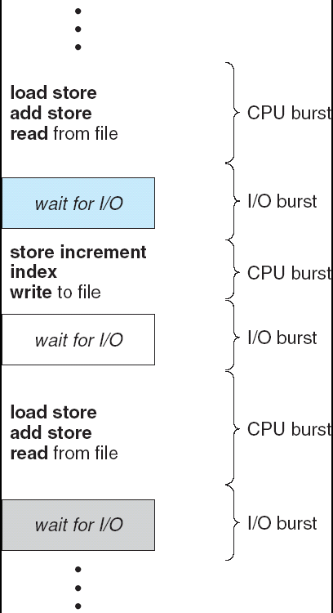
Alternating Sequence of CPU And I/O Bursts
A burst is an instance of breaking

Slide 5
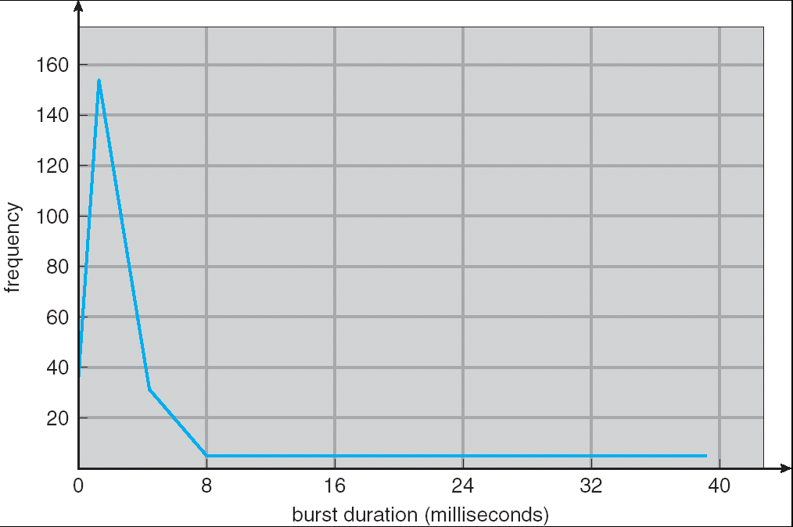
Histogram of CPU-burst Times

Slide 6
CPU Scheduler
Remember the long-term and short-term schedulers
Selects from among the processes in memory that are ready to execute, and allocates the CPU to one of them
CPU scheduling decisions may take place when a process:
When a process switches from the running state to the waiting state (e.g. I/O request or an invocation of wait())
When a process switches from the running state to the ready state (e.g., when an interrupt occurs)
When a process switches from the waiting state to the ready state (e.g., at completion of I/O)
When a process terminates
Scheduling under 1 and 4 is nonpreemptive 非抢占式（主动）
All other scheduling is preemptive抢占式（被动）

Slide 7
Dispatcher
Dispatcher module gives control of the CPU to the process selected by the short-term scheduler; this involves:
switching context
switching to user mode
jumping to the proper location in the user program to restart that program
Dispatch latency – time it takes for the dispatcher to stop one process and start another running

Slide 8
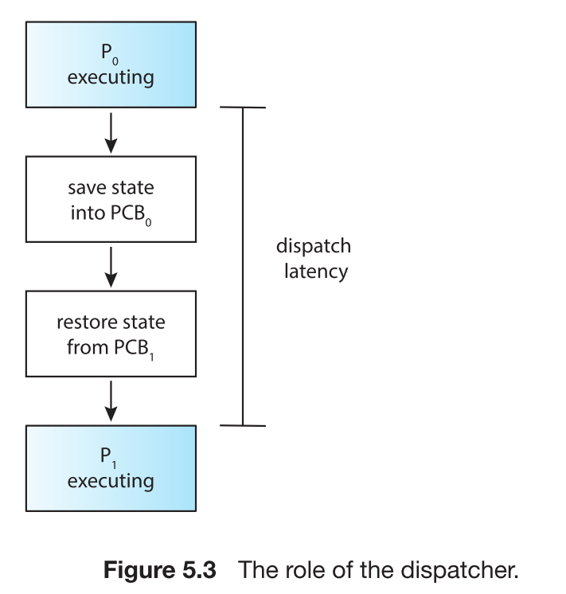
Dispatch Latency
Notes:
PCB:process control block

Slide 9
Scheduling Criteria
CPU utilization (CPU利用率) – keep the CPU as busy as possible
Throughput (吞吐率)– # of processes that complete their execution per time unit
Turnaround time (周转时间)– amount of time to execute a particular process
Waiting time (等待时间)– amount of time a process has been waiting in the ready queue
Response time (响应时间)– amount of time it takes from when a request was submitted until the first response is produced, not output (for time-sharing environment)
Not to confuse with ‘waiting’ state

Slide 10
Optimization Criteria
Max CPU utilization
Max throughput
Min turnaround time
Min waiting time
Min response time

Slide 11
First-Come, First-Served (FCFS) Scheduling
Process Burst Time
P₁ 24
P₂ 3
P₃ 3
Suppose that the processes arrive in the order: P₁ , P₂ , P₃ The Gantt Chart for the schedule is:
Waiting time for P₁ = 0; P₂ = 24; P₃ = 27
Average waiting time: (0 + 24 + 27)/3 = 17
P₁
P₂
P₃
0
24
27
30

Slide 12
FCFS Scheduling (Cont.)
Suppose that the processes arrive in the order
P₂ , P₃ , P₁
The Gantt chart for the schedule is:
Waiting time for P₁ = 6; P₂ = 0; P₃ = 3
Average waiting time: (6 + 0 + 3)/3 = 3
Much better than previous case
Convoy effect short process behind long process (I/O-bound processes wait for the CPU-bound one)
P₂
P₃
P₁
0
3
6
30

Slide 13
Shortest-Job-First (SJF) Scheduling
Associate with each process the length of its next CPU burst. Use these lengths to schedule the process with the shortest time
Two schemes:
nonpreemptive – once CPU given to the process it cannot be preempted until completes its CPU burst
preemptive – if a new process arrives with CPU burst length less than remaining time of current executing process, preempt. This scheme is known as the Shortest-Remaining-Time-First (SRTF)
SJF is optimal – gives minimum average waiting time for a given set of processes
Why is it optimal?

Slide 14
Example of Non-Preemptive SJF
Process Arrival Time Burst Time
P₁ 0.0 7
P₂ 2.0 4
P₃ 4.0 1
P₄ 5.0 4
SJF (non-preemptive)
Average waiting time = (0 + 6 + 3 + 7)/4 = 4
P₁
P₃
P₂
P₄
0
3
7
8
12
16

Slide 15
Example of Preemptive SJF
Process Arrival Time Burst Time
P₁ 0.0 7
P₂ 2.0 4
P₃ 4.0 1
P₄ 5.0 4
SJF (preemptive)
Average waiting time = (9 + 1 + 0 +2)/4 = 3
P₁
P₂
P₃
P₂
P₄
P₁
0
2
4
5
7
11
16

Slide 16
Determining Length of Next CPU Burst
Unfortunately, no way to know the length of the next burst
Can only estimate the length
Can be done by using the length of previous CPU bursts, using exponential averaging

Slide 17
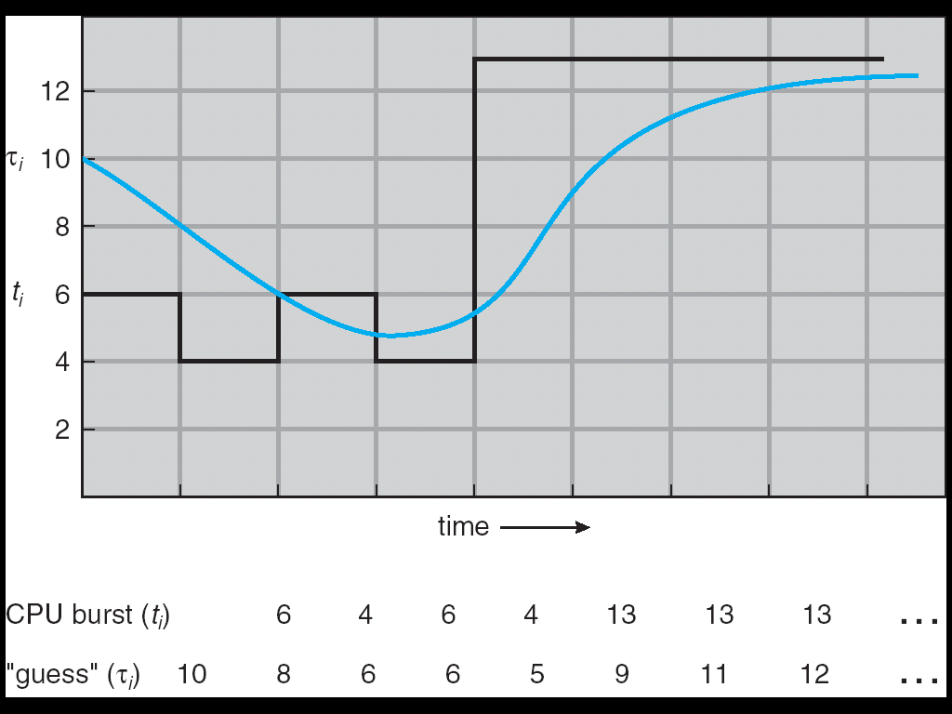
Prediction of the Length of the Next CPU Burst

Slide 18
Examples of Exponential Averaging
α =0
τ_{n+1} = τ_{n}
Recent history does not count
α =1
τ_{n+1} = t_{n}
Only the actual last CPU burst counts
If we expand the formula, we get:
τ_{n+1} = α t_{n}+(1 - α)α t_{n} ₋₁ + …
+(1 - α )^{j} α t_{n} _{-j} + …
+(1 - α )^{n +1} τ₀
Since both α and (1 - α) are less than or equal to 1, each successive term has less weight than its predecessor

Slide 19
Question
Prove that SJF is Optimal in average waiting time. (Non-preemptive case)

Slide 20
Priority Scheduling
A priority number (integer) is associated with each process
The CPU is allocated to the process with the highest priority (smallest integer ≡ highest priority)
Preemptive
nonpreemptive
SJF is a priority scheduling where priority is the predicted next CPU burst time
Problem ≡ Starvation – low priority processes may never execute
Solution ≡ Aging – as time progresses increase the priority of the process

Slide 21
Round Robin (RR)
Each process gets a small unit of CPU time (time quantum), usually 10-100 milliseconds. After this time has elapsed, the process is preempted and added to the end of the ready queue.
If there are n processes in the ready queue and the time quantum is q, then each process gets 1/n of the CPU time in chunks of at most q time units at once. No process waits more than (n-1)q time units.
Performance
q large ⇒ FIFO
q small ⇒ q must be large with respect to context switch, otherwise overhead is too high
Question: What are the waiting times of RR?

Slide 22
Example of RR with Time Quantum = 20
Process Burst Time
P₁ 53
P₂ 17
P₃ 68
P₄ 24
The Gantt chart is:
Typically, higher average turnaround than SJF, but better response
P₁
P₂
P₃
P₄
P₁
P₃
P₄
P₁
P₃
P₃
0
20
37
57
77
97
117
121
134
154
162

Slide 23
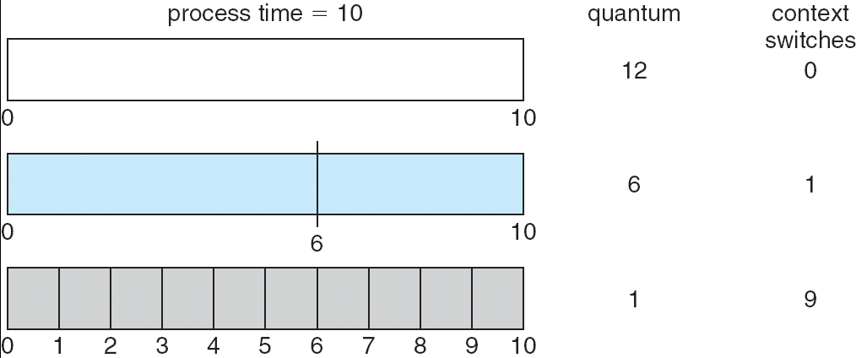
Time Quantum and Context Switch Time

Slide 24
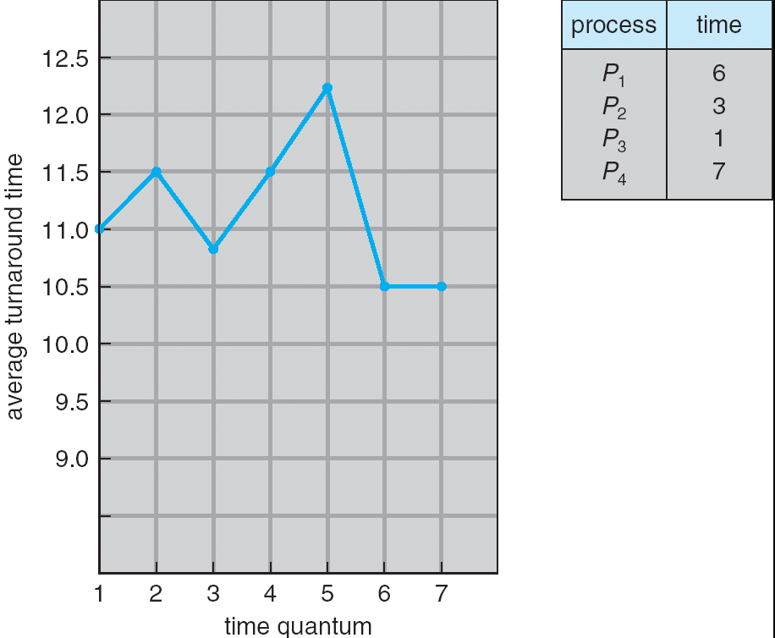
Turnaround Time Varies With The Time Quantum
Question: what’s the turnaround time for SJF?

Slide 25
Multilevel Queue
Ready queue is partitioned into separate queues: foreground (interactive) background (batch)
Each queue has its own scheduling algorithm, for example
foreground – RR
background – FCFS
Scheduling must be done between the queues
Fixed priority scheduling; (i.e., serve all from foreground then from background). Possibility of starvation.
Time slice – each queue gets a certain amount of CPU time which it can schedule amongst its processes; i.e., 80% to foreground in RR
20% to background in FCFS

Slide 26
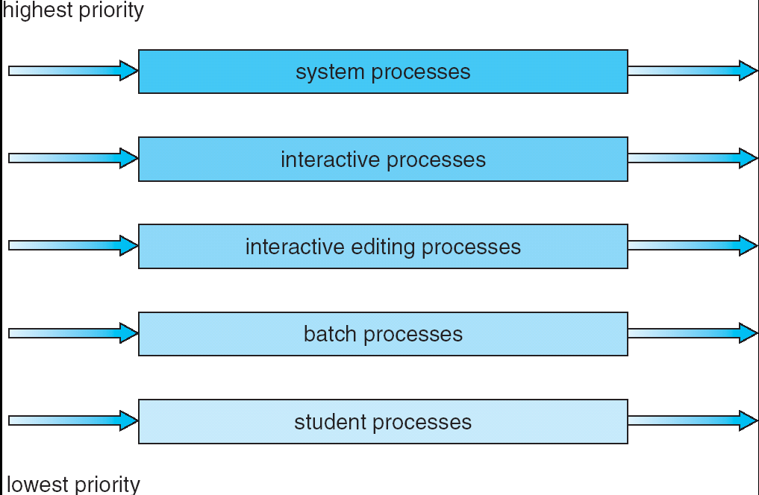
Multilevel Queue Scheduling

Slide 27
Multilevel Feedback Queue
A process can move between the various queues; aging can be implemented this way
Multilevel-feedback-queue scheduler defined by the following parameters:
number of queues
scheduling algorithms for each queue
method used to determine when to upgrade a process
method used to determine when to demote a process
method used to determine which queue a process will enter when that process needs service

Slide 28
Example of Multilevel Feedback Queue
Three queues:
Q₀ – RR with time quantum 8 milliseconds
Q₁ – RR time quantum 16 milliseconds
Q₂ – FCFS
Scheduling
A new job enters queue Q₀ which is served FCFS. When it gains CPU, job receives 8 milliseconds. If it does not finish in 8 milliseconds, job is moved to queue Q₁.
At Q₁ job is again served FCFS and receives 16 additional milliseconds. If it still does not complete, it is preempted and moved to queue Q₂.

Slide 29
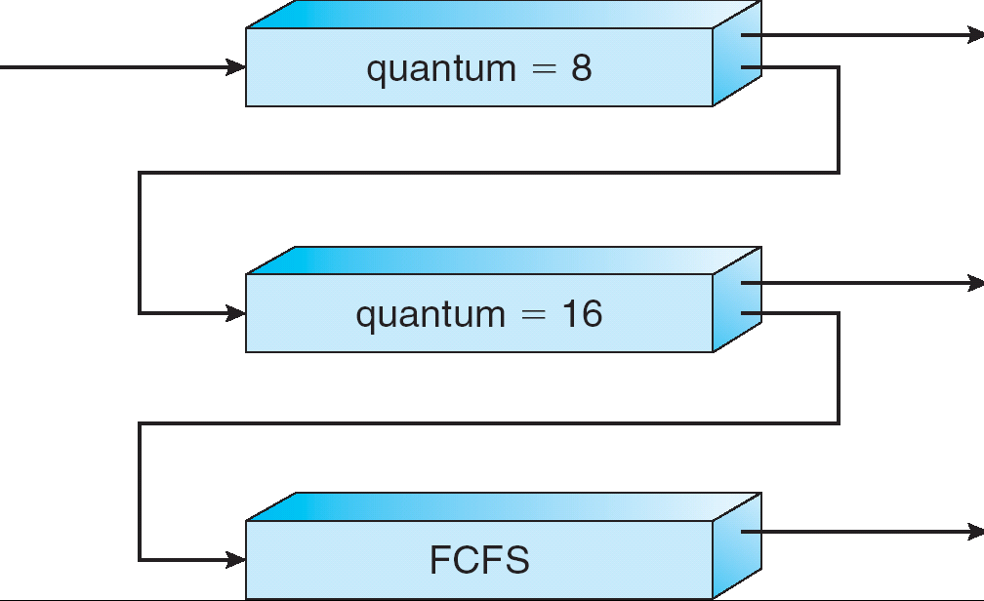
Multilevel Feedback Queues

Slide 30
Multiple-Processor Scheduling
CPU scheduling more complex when multiple CPUs are available
Homogeneous processors within a multiprocessor
Load balancing
Asymmetric multiprocessing – only one processor accesses the system data structures, alleviating the need for data sharing; others execute only user code.
Symmetric multiprocessing (SMP) – each processor is self-scheduling. Multiple processors might access and update a common data structure.

Slide 31
Real-Time Scheduling
Hard real-time systems – required to complete a critical task within a guaranteed amount of time
Soft real-time computing – requires that critical processes receive priority over less fortunate ones

Slide 32
Thread Scheduling
Also known as the Contention Scope
Local Scheduling (Process-Contention Scope) – How the threads library decides which thread to put onto an available LWP
Global Scheduling (System-Contention Scope) – How the kernel decides which kernel thread to run next

Slide 33
Pthread Scheduling API
#include <pthread.h>
#include <stdio.h>
#define NUM_THREADS 5
int main(int argc, char *argv[])
{
int i;
pthread_t tid[NUM THREADS];
pthread_attr t attr;
/* get the default attributes */
pthread_attr_init(&attr);
/* set the scheduling algorithm to PROCESS or SYSTEM */
pthread_attr_setscope(&attr, PTHREAD SCOPE SYSTEM);
/* set the scheduling policy - FIFO, RR, or OTHER */
pthread_attr_setschedpolicy(&attr, SCHED OTHER);
/* create the threads */
for (i = 0; i < NUM_THREADS; i++)
pthread_create(&tid[i],&attr,runner,NULL);

Slide 34
Pthread Scheduling API
/* now join on each thread */
for (i = 0; i < NUM_THREADS; i++)
pthread_join(tid[i], NULL);
}
/* Each thread will begin control in this function */
void *runner(void *param)
{
printf("I am a thread\n");
pthread_exit(0);
}

Slide 35
Operating System Examples
Solaris scheduling
Windows XP scheduling
Linux scheduling

Slide 36
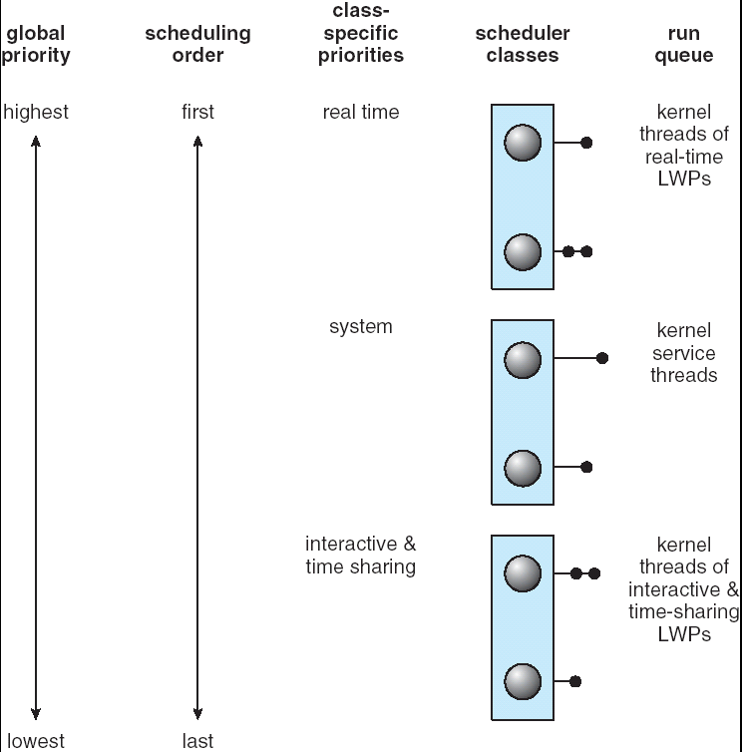
Solaris 2 Scheduling

Slide 37
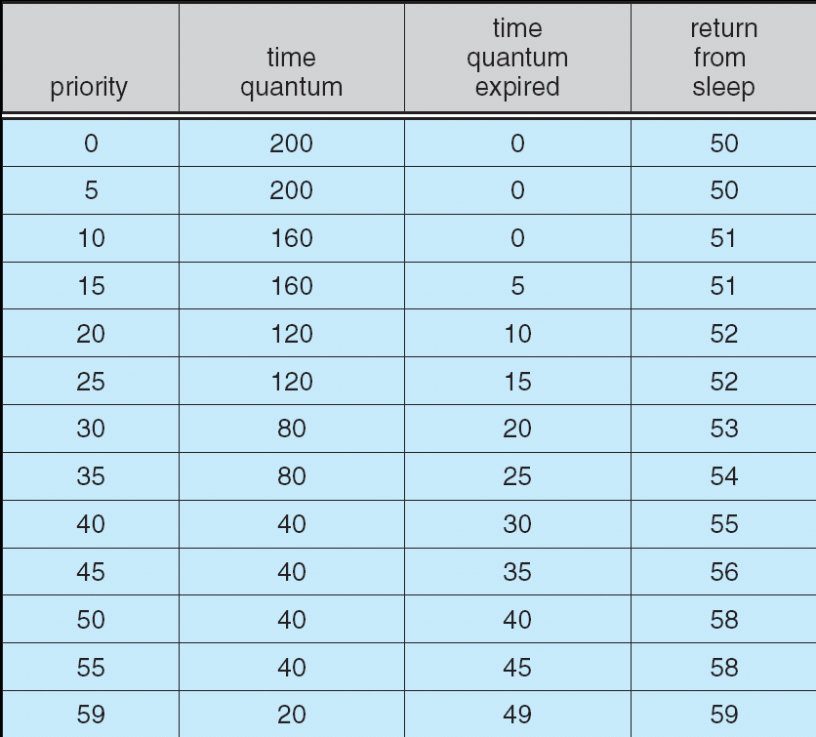
Solaris Dispatch Table
low
Higher priority for better interactivity
Priority lowered when quantum expired.
high

Slide 38
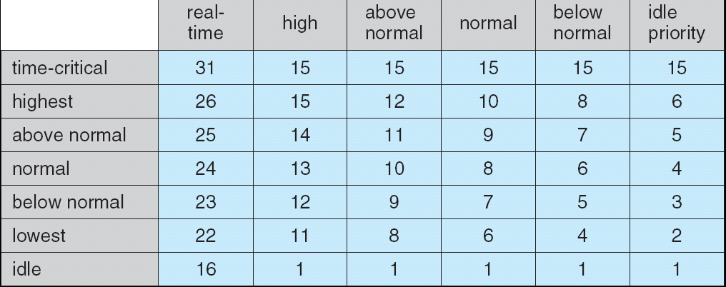
Windows XP Priorities
Priority classes
Relative
Priorities

Slide 39
Linux Scheduling
Two algorithms: time-sharing and real-time
Time-sharing
Prioritized credit-based – process with most credits is scheduled next
Credit subtracted when timer interrupt occurs
When credit = 0, another process chosen
When all processes have credit = 0, recrediting occurs
Based on factors including priority and history
Real-time
Soft real-time
Posix.1b compliant – two classes
FCFS and RR
Highest priority process always runs first

Slide 40
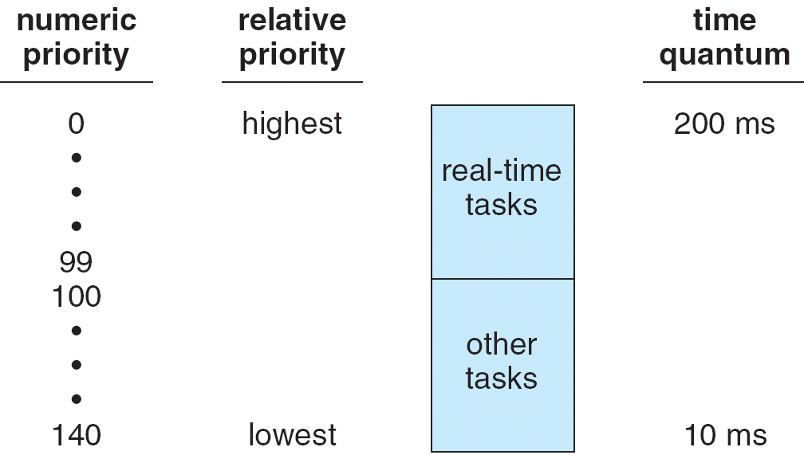
The Relationship Between Priorities and Time-slice length

Slide 41
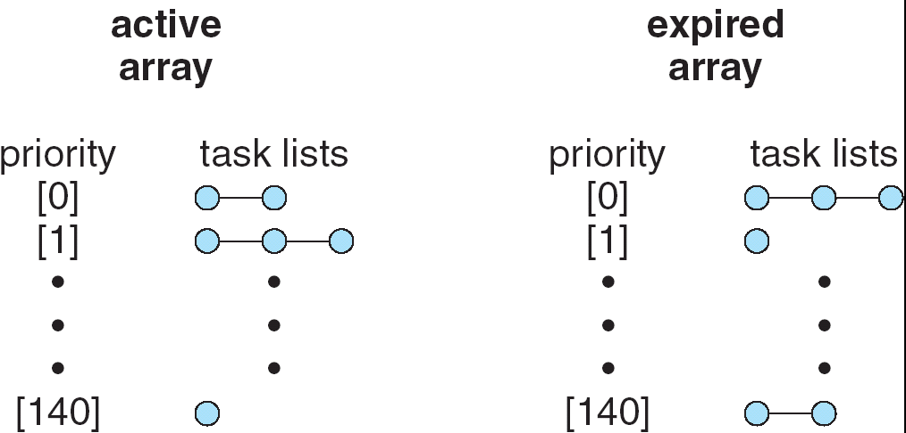
List of Tasks Indexed According to Prorities
The runqueue data structure

Slide 42
Algorithm Evaluation
Deterministic modeling(确定性模型) – takes a particular predetermined workload and defines the performance of each algorithm for that workload
Queueing models
Little’s Law:
Simulations
Implementation
which states that the long-term average number L of customers in a stationary system is equal to the long-term average effective arrival rate λ multiplied by the average time W that a customer spends in the system.

Slide 43
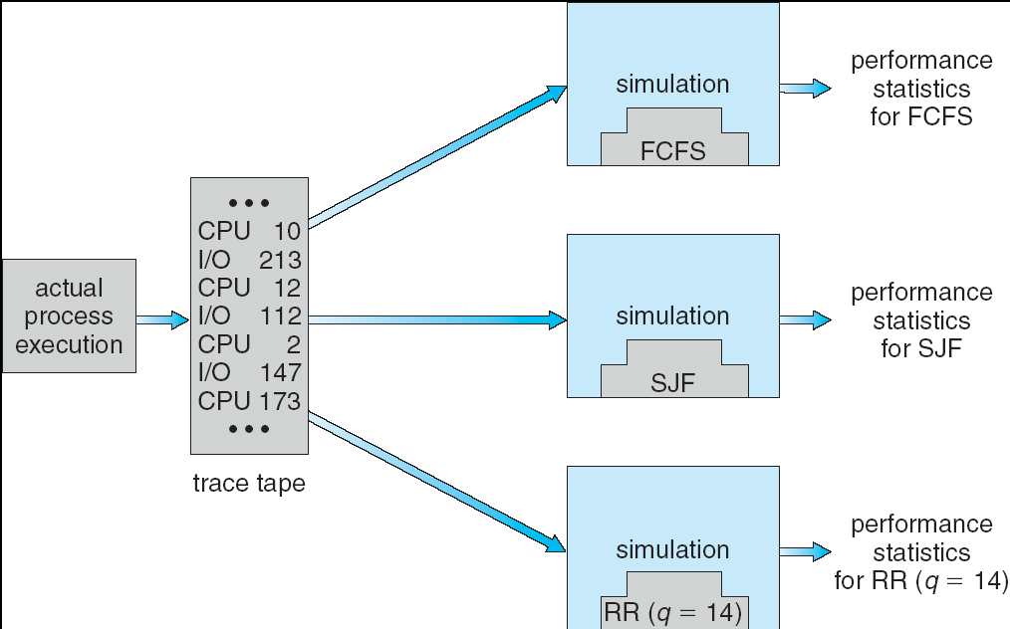
Fig 5.15 simulations

Slide 44
End of Chapter 5

Slide 45
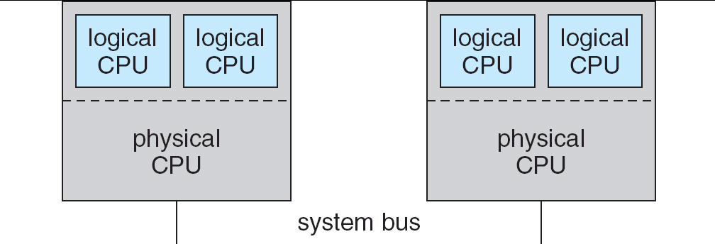
5.08

Slide 46
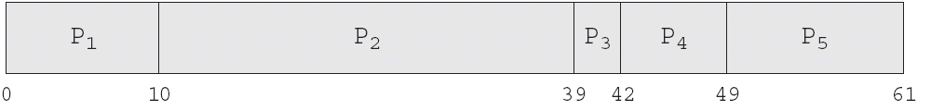
In-5.7

Slide 47
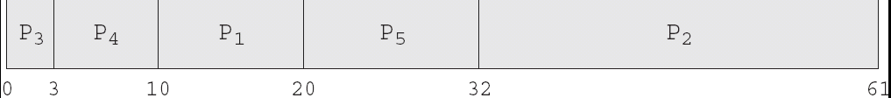
In-5.8

Slide 48

In-5.9

Slide 49
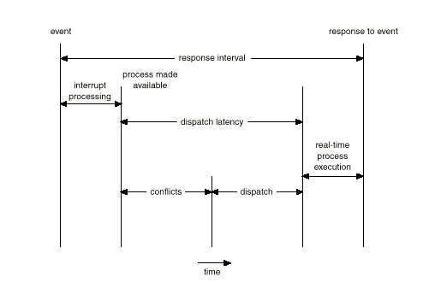
Dispatch Latency
The conflict phase of dispatch latency has two components:
Preemption of any process running in the kernel
Release resources from low-priority process for the high-priority process

Slide 50
Java Thread Scheduling
JVM Uses a Preemptive, Priority-Based Scheduling Algorithm
FIFO Queue is Used if There Are Multiple Threads With the Same Priority

Slide 51
Java Thread Scheduling (cont)
JVM Schedules a Thread to Run When:
The Currently Running Thread Exits the Runnable State
A Higher Priority Thread Enters the Runnable State
* Note – the JVM Does Not Specify Whether Threads are Time-Sliced or Not

Slide 52
Time-Slicing
Since the JVM Doesn’t Ensure Time-Slicing, the yield() Method
May Be Used:
while (true) {
// perform CPU-intensive task
. . .
Thread.yield();
}
This Yields Control to Another Thread of Equal Priority

Slide 53
Thread Priorities
Priority Comment
Thread.MIN_PRIORITY Minimum Thread Priority
Thread.MAX_PRIORITY Maximum Thread Priority
Thread.NORM_PRIORITY Default Thread Priority
Priorities May Be Set Using setPriority() method:
setPriority(Thread.NORM_PRIORITY + 2);

