Slide 1
Chapter 6: Process Synchronization

Slide 2
Chapter 6: Process Synchronization
Background
The Critical-Section Problem
Peterson’s Solution
Synchronization Hardware
Semaphores
Classic Problems of Synchronization
Monitors
Synchronization Examples
Atomic Transactions

Slide 3
Background
Concurrent access to shared data may result in data inconsistency
Maintaining data consistency requires mechanisms to ensure the orderly execution of cooperating processes
Suppose that we wanted to provide a solution to the consumer-producer problem that fills all the buffers. We can do so by having an integer count that keeps track of the number of full buffers. Initially, count is set to 0. It is incremented by the producer after it produces a new buffer and is decremented by the consumer after it consumes a buffer.

Slide 4
Producer
while (true) {
/* produce an item and put in nextProduced */
while (count == BUFFER_SIZE)
; // do nothing
buffer [in] = nextProduced;
in = (in + 1) % BUFFER_SIZE;
count++;
}

Slide 5
Consumer
while (true) {
while (count == 0)
; // do nothing
nextConsumed = buffer[out];
out = (out + 1) % BUFFER_SIZE;
count--;
/* consume the item in nextConsumed
}

Slide 6
Race Condition （竞态条件）
count++ could be implemented as register1 = count register1 = register1 + 1 count = register1
count-- could be implemented as register2 = count register2 = register2 - 1 count = register2
Consider this execution interleaving with “count = 5” initially:
S0: producer execute register1 = count {register1 = 5} S1: producer execute register1 = register1 + 1 {register1 = 6} S2: consumer execute register2 = count {register2 = 5} S3: consumer execute register2 = register2 - 1 {register2 = 4} S4: producer execute count = register1 {count = 6 } S5: consumer execute count = register2 {count = 4}

Slide 7
A practical definition of Race Condition
“A race condition is a situation in which a memory location is accessed concurrently, and at least one access is a write.”
Additional Readings: Section 6.1 of “xv6: a simple, Unix-like teaching operating system”

Slide 8
Critical-section problem
To design a protocol that the processes can use to cooperate
Do {
Entry section
Critical section
Exit section
Remainder section
}while(TRUE);
General structure of a typical process Pj
Q: critical section problems in OS kernel

Slide 9
Solution to Critical-Section Problem
1. Mutual Exclusion - If process P_{i} is executing in its critical section, then no other processes can be executing in their critical sections
2. Progress - If no process is executing in its critical section and there exist some processes that wish to enter their critical section, then the selection of the processes that will enter the critical section next cannot be postponed indefinitely
3. Bounded Waiting - A bound must exist on the number of times that other processes are allowed to enter their critical sections after a process has made a request to enter its critical section and before that request is granted
Assume that each process executes at a nonzero speed
No assumption concerning relative speed of the N processes
Notes:
A solution must satisfy the following Requirements.
Progress 有译作“空闲让进”

Slide 10
Algorithm 1
int turn; turn = 0; // Pi can enter the critical section
Process Pi:
do{
while(turn != i);
critical section
turn=j;
remainder section
} while (1);
Mutual Exclusion is satisfied. How about Progress?
Process Pj:
do{
while(turn != j);
critical section
turn=i;
remainder section
} while (1);
Notes:
When Pj is in the remainder section and blocked, Pi tries to enter the Critical Section, it will not Progress!!
两进程必须交替进入CS

Slide 11
Algorithm 2
boolean flag[2]; flag[0] = flag[1] = 0;
flag[i] = true if Pi tries to enter CS
Process Pi:
do{
flag[i]=true;
while( flag[j] );
critical section
flag[i]=false;
remainder section
} while (1);
Mutual Exclusion is satisfied. How about Progress?
Process Pj:
do{
flag[j]=true;
while( flag[i] );
critical section
flag[j]=false;
remainder section
} while (1);
Notes:
When two flag[] assignments are executed simultaneously, both while(flag[]) will block forever.

Slide 12
Algorithm 3
boolean flag[2]; flag[0] = flag[1] = 0;
Process Pi:
do{
while(flag[j]); // ①
flag[i]=TRUE; // ③
critical section;
flag[i] = FALSE;
remainder section;
}while(1);
Mutual Exclusion is NOT satisfied.
Process Pj:
do{
while(flag[i]); // ②
flag[j] =TRUE; // ④
critical section;
flag[j] = FALSE;
remainder section;
} while (1);
Notes:
互斥无法保证，1-2-3-4执行

Slide 13
Peterson’s Solution
Two process solution
Assume that the LOAD and STORE instructions are atomic; that is, cannot be interrupted.
The two processes share two variables:
int turn;
Boolean flag[2]
The variable turn indicates whose turn it is to enter the critical section.
The flag array is used to indicate if a process is ready to enter the critical section. flag[i] = true implies that process P_{i} is ready!

Slide 14
The Algorithm for Process P_{i}
while (true) {
flag[i] = TRUE;
turn = j;
while ( flag[j] && turn == j);
CRITICAL SECTION
flag[i] = FALSE;
REMAINDER SECTION
}
★

Slide 15
The Respective Algorithm for Process P_{j}
while (true) {
flag[j] = TRUE;
turn = i;
while ( flag[i] && turn == i);
CRITICAL SECTION
flag[j] = FALSE;
REMAINDER SECTION
}
If two processes are running the statement simultaneously, only one will last.
★

Slide 16
Synchronization Hardware
Many systems provide hardware support for critical section code
Uniprocessors – could disable interrupts
Currently running code would execute without preemption
Generally too inefficient on multiprocessor systems
Operating systems using this not broadly scalable
Modern machines provide special atomic hardware instructions
Atomic = non-interruptable
Either test memory word and set value
Or swap contents of two memory words

Slide 17
TestAndSet Instruction
Definition:
boolean TestAndSet (boolean *target)
{
boolean rv = *target;
*target = TRUE;
return rv:
}

Slide 18
Solution using TestAndSet
Shared boolean variable lock., initialized to false.
Solution:
while (true) {
while ( TestAndSet (&lock ))
; /* do nothing
// critical section
lock = FALSE;
// remainder section
}

Slide 19
Swap Instruction
Definition:
void Swap (boolean *a, boolean *b)
{
boolean temp = *a;
*a = *b;
*b = temp:
}
Notes:
Amoswap.w rd,rs2,(rs1) : atomically load a 32-bit signed data value from the address in rs1, place the value into register rd, swap the loaded value and the original 32-bit signed value in rs2, then store the result back to the address in rs1.

Slide 20
Solution using Swap
Shared Boolean variable lock initialized to FALSE; Each process has a local Boolean variable key.
Solution:
while (true) {
key = TRUE;
while ( key == TRUE)
Swap (&lock, &key );
// critical section
lock = FALSE;
// remainder section
}

Slide 21
Semaphore
Synchronization tool that is less complicated
Semaphore S – integer variable
Two atomic standard operations modify S: wait() and signal()
Originally called P() and V()
Can only be accessed via two indivisible (atomic) operations
wait (S) {
while S <= 0
; // no-op
S--;
}
signal (S) {
S++;
}
Can be implemented without busy waiting

Slide 22
Usage as General Synchronization Tool
Counting semaphore – integer value can range over an unrestricted domain
Binary semaphore – integer value can range only between 0 and 1; can be simpler to implement
Also known as mutex locks
Can implement a counting semaphore S as a binary semaphore
Provides mutual exclusion
Semaphore S; // initialized to 1
wait (S);
Critical Section
signal (S);

Slide 23
Usage as General Synchronization Tool(2)
P1 has a statement S1, P2 has S2
Statement S1 to be executed before S2
S1;
Signal(S);
P1
Question: What’s the initial value of S?
P2
Wait(S);
S2;

Slide 24
Semaphore Implementation
Must guarantee that no two processes can execute wait () and signal () on the same semaphore at the same time
Thus, implementation becomes the critical section problem where the wait and signal code are placed in the critical section.
Could now have busy waiting in critical section implementation
But implementation code is short
Little busy waiting if critical section rarely occupied
Note that applications may spend lots of time in critical sections and therefore this is not a good solution.

Slide 25
Semaphore Implementation with no Busy waiting
With each semaphore there is an associated waiting queue. Each semaphore has two data items:
value (of type integer)
pointer to a linked-list of PCBs.
Two operations (provided as basic system calls):
block – place the process invoking the operation on the appropriate waiting queue.
wakeup – remove one of processes in the waiting queue and place it in the ready queue.

Slide 26
Semaphore Implementation with no Busy waiting (Cont.)
Implementation of wait:
wait (S){
value--;
if (value < 0) {
// add this process to waiting queue
block(); }
}
Implementation of signal:
Signal (S){
value++;
if (value <= 0) {
// remove a process P from the waiting queue
wakeup(P); }
}
Notes:
如何保证wait和signal本身成为Critical Section？单处理器可以关闭中断（但效率不高）。多核可以在访问共享变量时使用spinlock，虽然并未避免使用spin，但spin的量大大减少了（真正等待期间不必spin）。

Slide 27
Deadlock and Starvation
Deadlock – two or more processes are waiting indefinitely for an event that can be caused by only one of the waiting processes
Let S and Q be two semaphores initialized to 1
P₀ P₁
wait (S); wait (Q);
wait (Q); wait (S);
. .
. .
. .
signal (S); signal (Q);
signal (Q); signal (S);
Starvation – indefinite blocking. A process may never be removed from the semaphore queue in which it is suspended.

Slide 28
Classical Problems of Synchronization
Bounded-Buffer Problem
Readers and Writers Problem
Dining-Philosophers Problem

Slide 29
Bounded-Buffer Problem
N buffers, each can hold one item
Semaphore mutex initialized to the value 1
Semaphore full initialized to the value 0, counting full items
Semaphore empty initialized to the value N, counting empty items.

Slide 30
Bounded Buffer Problem (Cont.)
The structure of the producer process
while (true) {
// produce an item
wait (empty);
wait (mutex);
// add the item to the buffer
signal (mutex);
signal (full);
}

Slide 31
Bounded Buffer Problem (Cont.)
The structure of the consumer process
while (true) {
wait (full);
wait (mutex);
// remove an item from buffer
signal (mutex);
signal (empty);
// consume the removed item
}

Slide 32
Readers-Writers Problem
A data set is shared among a number of concurrent processes
Readers – only read the data set; they do not perform any updates
Writers – can both read and write.
Problem – allow multiple readers to read at the same time. Only one single writer can access the shared data at the same time.
Shared Data
Data set
Semaphore mutex initialized to 1, to ensure mutual exclusion when readcount is updated.
Semaphore wrt initialized to 1.
Integer readcount initialized to 0.

Slide 33
Readers-Writers Problem (Cont.)
The structure of a writer process
while (true) {
wait (wrt) ;
// writing is performed
signal (wrt) ;
}

Slide 34
Readers-Writers Problem (Cont.)
Reason is that wrt is initialized to “1”
“Locking” the wrt semaphore, rather than “waiting”
The structure of a reader process
while (true) {
wait (mutex) ;
readcount ++ ;
if (readcount == 1) wait (wrt) ;
signal (mutex)
// reading is performed
wait (mutex) ;
readcount - - ;
if (readcount == 0) signal (wrt) ;
signal (mutex) ;
}
“Unlocking” the wrt semaphore, rather than “signaling”

Slide 35
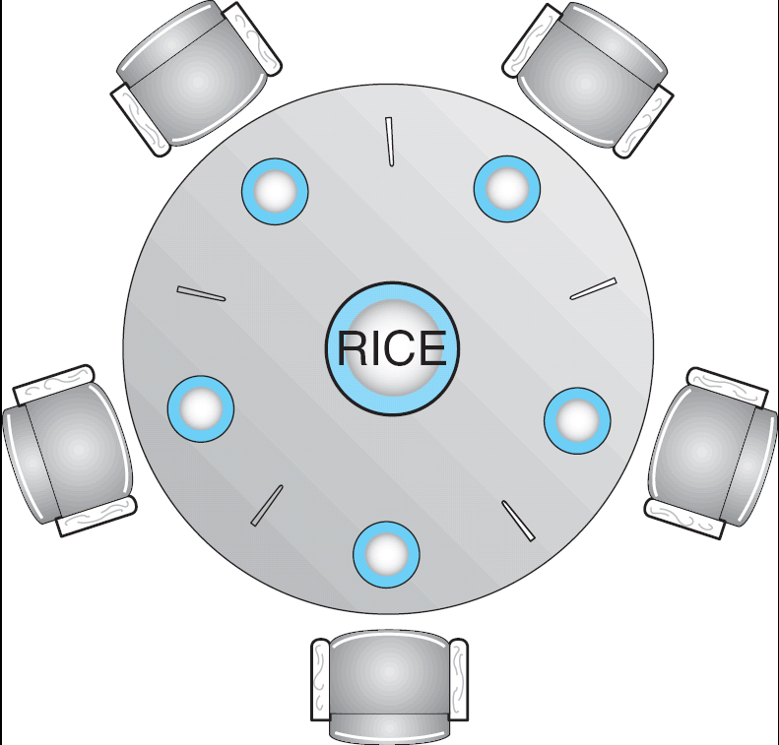
Dining-Philosophers Problem
Shared data
Bowl of rice (data set)
Semaphore chopstick [5] initialized to 1

Slide 36
Dining-Philosophers Problem (Cont.)
The structure of Philosopher i:
While (true) {
wait ( chopstick[i] );
wait ( chopStick[ (i + 1) % 5] );
// eat
signal ( chopstick[i] );
signal (chopstick[ (i + 1) % 5] );
// think
}

Slide 37
Problems with Semaphores
Correct use of semaphore operations:
signal (mutex) …. wait (mutex)
wait (mutex) … wait (mutex)
Omitting of wait (mutex) or signal (mutex) (or both)

Slide 38
Monitors
A high-level abstraction that provides a convenient and effective mechanism for process synchronization
Only one process may be active within the monitor at a time
(hint: the other processes may be sleeping within the monitor)
monitor monitor-name
{
// shared variable declarations
procedure P1 (…) { …. }
…
procedure Pn (…) {……}
Initialization code ( ….) { … }
…
}

Slide 39
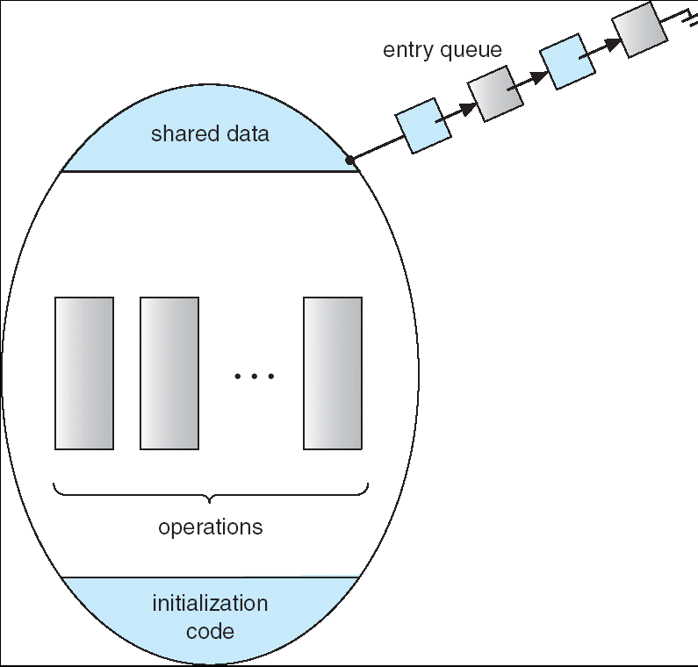
Schematic view of a Monitor

Slide 40
Condition Variables
condition x, y;
Two operations on a condition variable:
x.wait () – a process that invokes the operation is
suspended.
x.signal () – resumes one of processes (if any) that
invoked x.wait ()

Slide 41
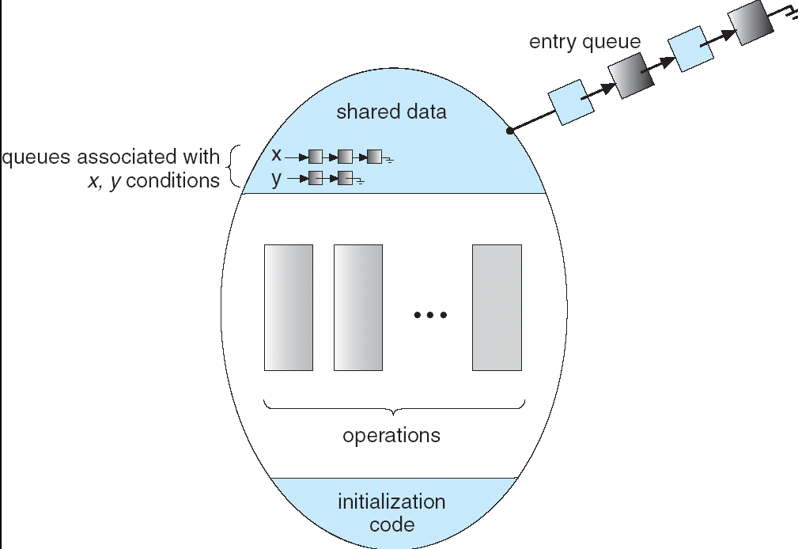
Monitor with Condition Variables

Slide 42
Solution to Dining Philosophers
monitor DP
{
enum { THINKING; HUNGRY, EATING) state [5] ;
condition self [5]; //philosopher i can delay herself when unable to get chopsticks
void pickup (int i) {
state[i] = HUNGRY;
test(i);
if (state[i] != EATING) self [i].wait;
}
void putdown (int i) {
state[i] = THINKING;
// test left and right neighbors
test((i + 4) % 5);
test((i + 1) % 5);
}

Slide 43
Solution to Dining Philosophers (cont)
void test (int i) {
if ( (state[(i + 4) % 5] != EATING) &&
(state[i] == HUNGRY) &&
(state[(i + 1) % 5] != EATING) ) {
state[i] = EATING ;
self[i].signal () ;
}
}
initialization_code() {
for (int i = 0; i < 5; i++)
state[i] = THINKING;
}
}

Slide 44
Solution to Dining Philosophers (cont)
Each philosopher I invokes the operations pickup()
and putdown() in the following sequence:
dp.pickup (i)
EAT
dp.putdown (i)
When the left and right philosophers, self[(i+4)%5] and self[(i+1)%5] continue to eat, self[i] may starve.
Notes:
Note: when running in the EAT code above, the process is not active in the monitor. Thus the other processes(e.g. its neighbors) are allowed to pickup, but they would have to wait on their self[i] condition variables.
不会死锁，因为死锁发生前的最后一个test（）应该可以EAT成功。
No deadlock would occur. Proof by contradiction: the last one to enter wait would have both neighbors waiting and thus it should be eating rather than waiting!

Slide 45
Monitor Implementation Using Semaphores
Variables
semaphore mutex; // (initially = 1), entry protection
semaphore next; // (initially = 0), signaling process may suspend themselves.
int next-count = 0;
Each procedure F will be replaced by
wait(mutex);
…
body of F;
…
if (next-count > 0)
signal(next)
else
signal(mutex);
Mutual exclusion within a monitor is ensured.
Since a signaling process must wait until the resumed process either leaves or waits, an additional semaphore “next” is introduced, on which the signaling process may suspend themselves.

Slide 46
Monitor Implementation
For each condition variable x, we have:
semaphore x-sem; // (initially = 0)
int x-count = 0;
The operation x.wait can be implemented as:
x-count++;
if (next-count > 0)
signal(next);
else
signal(mutex);
wait(x-sem);
x-count--;
If someone has been waiting, wake her up because I’ll be entering the waiting state.
No one else waiting in the monitor. I’m going to block. Allow someone else to enter the monitor now.

Slide 47
Monitor Implementation
The operation x.signal can be implemented as:
if (x-count > 0) {
next-count++;
signal(x-sem);
wait(next);
next-count--;
}
This is the signaling process. It will wait on the “next” semaphore.

Slide 48
Synchronization Examples
Solaris
Windows XP
Linux
Pthreads

Slide 49
Solaris Synchronization
Implements a variety of locks to support multitasking, multithreading (including real-time threads), and multiprocessing
Uses adaptive mutexes for efficiency when protecting data from short code segments (page 218)
Uses condition variables and readers-writers locks when longer sections of code need access to data
Uses turnstiles to order the list of threads waiting to acquire either an adaptive mutex or reader-writer lock

Slide 50
Windows XP Synchronization
Uses interrupt masks to protect access to global resources on uniprocessor systems
Uses spinlocks (busy-waiting semaphore) on multiprocessor systems
Also provides dispatcher objects which may act as either mutexes and semaphores
Dispatcher objects may also provide events
An event acts much like a condition variable

Slide 51
Linux Synchronization
Linux:
disables interrupts to implement short critical sections
Linux provides:
semaphores
spin locks

Slide 52
Pthreads Synchronization
Pthreads API is OS-independent
It provides:
mutex locks
condition variables
Non-portable extensions include:
read-write locks
spin locks

Slide 53
Pthread mutex example
void reader_function ( void ); void writer_function ( void ); char buffer; int buffer_has_item=0; pthread_mutex_t mutex; struct timespec delay; void main ( void ){ pthread_t reader; delay.tv_sec = 2; delay.tv_nec = 0; pthread_mutex_init (&mutex,NULL); pthread_create(&reader, pthread_attr_default, (void *)&reader_function), NULL); writer_function( ); }

Slide 54
The writer thread
void writer_function (void){ while(1){ pthread_mutex_lock (&mutex); if (buffer_has_item==0){ buffer=make_new_item( ); buffer_has_item=1; } pthread_mutex_unlock(&mutex); pthread_delay_np(&delay); } }

Slide 55
The reader thread
void reader_function(void){ while(1){ pthread_mutex_lock(&mutex); if(buffer_has_item==1){ consume_item(buffer); buffer_has_item=0; } pthread_mutex_unlock(&mutex); pthread_delay_np(&delay); } }

Slide 56
Using pthread_cond_wait() & pthread_cond_signal()
pthread_mutex_t count_lock;
pthread_cond_t count_nonzero;
unsigned count;
decrement_count()
{
pthread_mutex_lock(&count_lock);
while (count == 0)
pthread_cond_wait(&count_nonzero, &count_lock);
count = count - 1;
pthread_mutex_unlock(&count_lock);
}
increment_count()
{
pthread_mutex_lock(&count_lock);
if (count == 0)
pthread_cond_signal(&count_nonzero);
count = count + 1;
pthread_mutex_unlock(&count_lock);
}

Slide 57
Atomic Transactions
System Model
Log-based Recovery
Checkpoints
Concurrent Atomic Transactions

Slide 58
System Model
Assures that operations happen as a single logical unit of work, in its entirety, or not at all
Related to field of database systems
Challenge is assuring atomicity despite computer system failures
Transaction - collection of instructions or operations that performs single logical function
Here we are concerned with changes to stable storage – disk
Transaction is series of read and write operations
Terminated by commit (transaction successful) or abort (transaction failed) operation
Aborted transaction must be rolled back to undo any changes it performed

Slide 59
Types of Storage Media
Volatile storage – information stored here does not survive system crashes
Example: main memory, cache
Nonvolatile storage – Information usually survives crashes
Example: disk and tape
Stable storage – Information never lost
Not actually possible, so approximated via replication or RAID to devices with independent failure modes
Goal is to assure transaction atomicity where failures cause loss of information on volatile storage

Slide 60
Log-Based Recovery
Record to stable storage information about all modifications by a transaction
Most common is write-ahead logging
Log on stable storage, each log record describes single transaction write operation, including
Transaction name
Data item name
Old value
New value
<T_{i} starts> written to log when transaction T_{i} starts
<T_{i} commits> written when T_{i} commits
Log entry must reach stable storage before operation on data occurs

Slide 61
Log-Based Recovery Algorithm
Using the log, system can handle any volatile memory errors
Undo(T_{i}) restores value of all data updated by T_{i}
Redo(T_{i}) sets values of all data in transaction T_{i} to new values
Undo(T_{i}) and redo(T_{i}) must be idempotent
Multiple executions must have the same result as one execution
If system fails, restore state of all updated data via log
If log contains <T_{i} starts> without <T_{i} commits>, undo(T_{i})
If log contains <T_{i} starts> and <T_{i} commits>, redo(T_{i})

Slide 62
Checkpoints
Log could become long, and recovery could take long
Checkpoints shorten log and recovery time.
Checkpoint scheme:
Output all log records currently in volatile storage to stable storage
Output all modified data from volatile to stable storage
Output a log record <checkpoint> to the log on stable storage
Now recovery only includes Ti, such that Ti started executing before the most recent checkpoint, and all transactions after Ti. All other transactions already on stable storage

Slide 63
Concurrent Transactions
Must be equivalent to serial execution – serializability
Could perform all transactions in critical section
Inefficient, too restrictive
Concurrency-control algorithms provide serializability

Slide 64
Serializability
Consider two data items A and B
Consider Transactions T₀ and T₁
Execute T₀, T₁ atomically
Execution sequence called schedule
Atomically executed transaction order called serial schedule
For N transactions, there are N! valid serial schedules

Slide 65
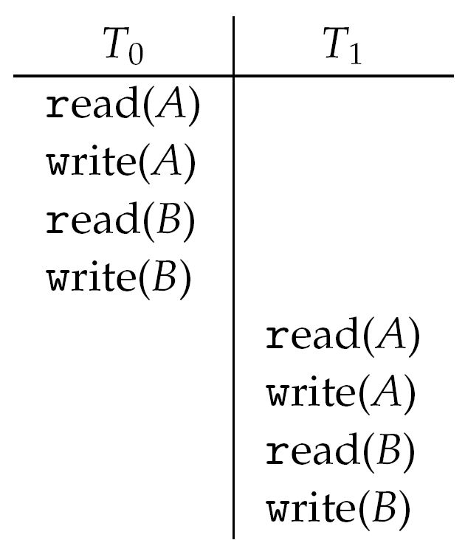
Schedule 1: T₀ then T₁

Slide 66
Nonserial Schedule
Nonserial schedule allows overlapped execute
Resulting execution not necessarily incorrect
Consider schedule S, operations O_{i}, O_{j}
Conflict if access same data item, with at least one write
If O_{i}, O_{j} consecutive and operations of different transactions & O_{i} and O_{j} don’t conflict
Then S’ with swapped order O_{j} O_{i} equivalent to S
If S can become S’ (a serial schedule) via swapping nonconflicting operations
S is conflict serializable

Slide 67
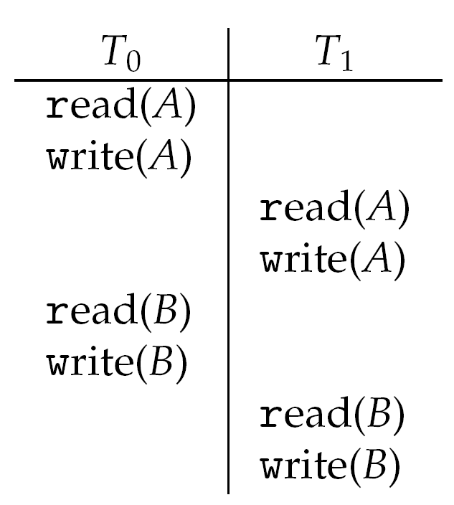
Schedule 2: Concurrent Serializable Schedule

Slide 68
Locking Protocol
Ensure serializability by associating lock with each data item
Follow locking protocol for access control
Locks
Shared – T_{i} has shared-mode lock (S) on item Q, T_{i} can read Q but not write Q
Exclusive – Ti has exclusive-mode lock (X) on Q, T_{i} can read and write Q
Require every transaction on item Q acquire appropriate lock
If lock already held, new request may have to wait
Similar to readers-writers algorithm

Slide 69
Two-phase Locking Protocol
Generally ensures conflict serializability
Each transaction issues lock and unlock requests in two phases
Growing – obtaining locks
Shrinking – releasing locks
Does not prevent deadlock

Slide 70
Timestamp-based Protocols
Select order among transactions in advance – timestamp-ordering
Transaction T_{i} associated with timestamp TS(T_{i}) before T_{i} starts
TS(T_{i}) < TS(T_{j}) if Ti entered system before T_{j}
TS can be generated from system clock or as logical counter incremented at each entry of transaction
Timestamps determine serializability order
If TS(T_{i}) < TS(T_{j}), system must ensure produced schedule equivalent to serial schedule where T_{i} appears before T_{j}

Slide 71
Timestamp-based Protocol Implementation
Data item Q gets two timestamps
W-timestamp(Q) – largest timestamp of any transaction that executed write(Q) successfully
R-timestamp(Q) – largest timestamp of successful read(Q)
Updated whenever read(Q) or write(Q) executed
Timestamp-ordering protocol assures any conflicting read and write executed in timestamp order
Suppose Ti executes read(Q)
If TS(T_{i}) < W-timestamp(Q), Ti needs to read value of Q that was already overwritten
read operation rejected and T_{i} rolled back
If TS(T_{i}) ≥ W-timestamp(Q)
read executed, R-timestamp(Q) set to max(R-timestamp(Q), TS(T_{i}))

Slide 72
Timestamp-ordering Protocol
Suppose Ti executes write(Q)
If TS(T_{i}) < R-timestamp(Q), value Q produced by T_{i} was needed previously and T_{i} assumed it would never be produced
Write operation rejected, T_{i} rolled back
If TS(T_{i}) < W-tiimestamp(Q), T_{i} attempting to write obsolete value of Q
Write operation rejected and T_{i} rolled back
Otherwise, write executed
Any rolled back transaction T_{i} is assigned new timestamp and restarted
Algorithm ensures conflict serializability and freedom from deadlock

Slide 73
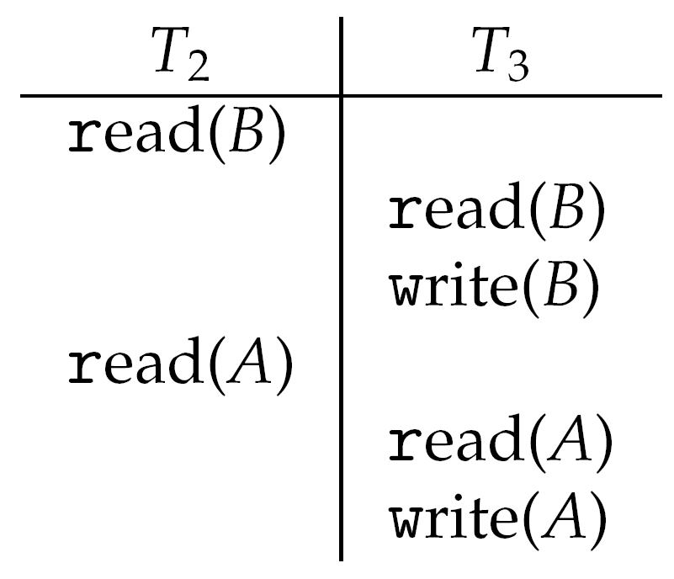
Schedule Possible Under Timestamp Protocol

Slide 74
End of Chapter 6

