Slide 1
Chapter 7: Deadlocks

Slide 2
Chapter 7: Deadlocks
The Deadlock Problem
System Model
Deadlock Characterization
Methods for Handling Deadlocks
Deadlock Prevention (预防)
Deadlock Avoidance (避免)
Deadlock Detection
Recovery from Deadlock

Slide 3
Chapter Objectives
To develop a description of deadlocks, which prevent sets of concurrent processes from completing their tasks
To present a number of different methods for preventing or avoiding deadlocks in a computer system.

Slide 4
The Deadlock Problem
A set of blocked processes each holding a resource and waiting to acquire a resource held by another process in the set.
Example
System has 2 disk drives.
P₁ and P₂ each hold one disk drive and each needs another one.
Example
semaphores A and B, initialized to 1
P₀ P₁
wait (A); wait(B)
wait (B); wait(A)

Slide 5
Bridge Crossing Example
Traffic only in one direction.
Each section of a bridge can be viewed as a resource.
If a deadlock occurs, it can be resolved if one car backs up (preempt resources and rollback).
Several cars may have to be backed up if a deadlock occurs.
Starvation is possible.

Slide 6
What happens at a four-way intersection
Excerpt from “California Driving: Road Rules & Driving Laws”
“Four-way stop signs — many four-way intersections have stop signs on all sides of the intersection. This sounds like a recipe for deadlock, but the rules for who gives way to whom are pretty easy. In general, you take turns to go through the intersection in the order at which you got to the edge of the intersection. If two or more of you got there at the same time, the ordering is clock-wise (i.e. the driver to your right goes first). This scheme isn't fool-proof (I still don't know what you're supposed to do when four cars get there at exactly the same time...) so keep a tight watch. “

Slide 7
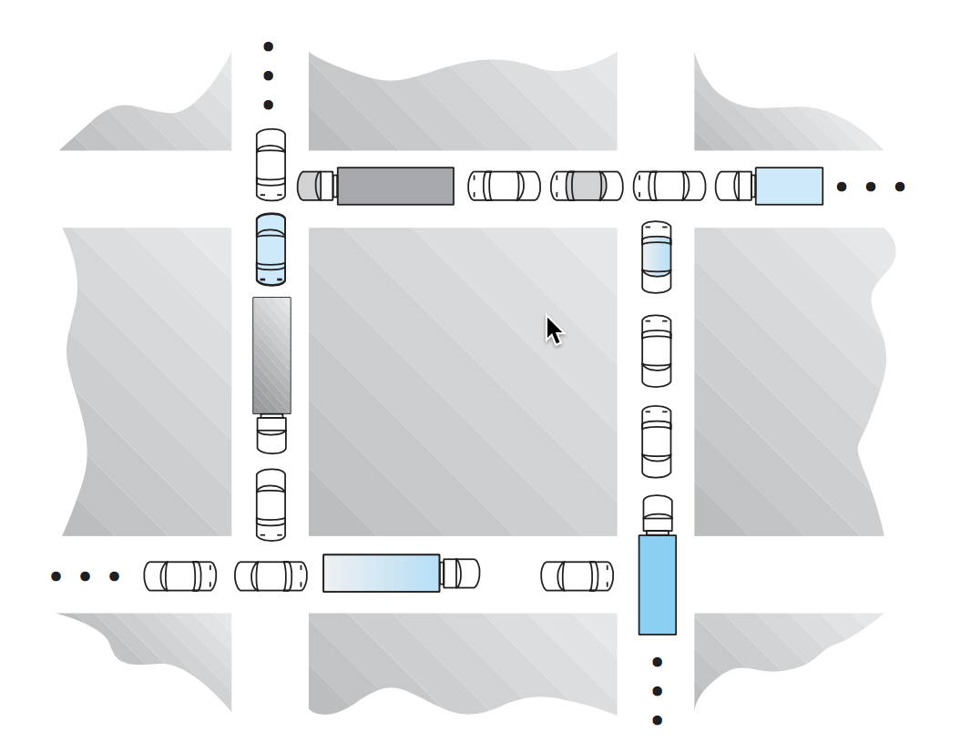

Slide 8
System Model
Resource types R₁, R₂, . . ., R_{m}
CPU cycles, memory space, I/O devices
Each resource type R_{i} has W_{i} instances.
Each process utilizes a resource as follows:
request
use
release

Slide 9
Deadlock Characterization
Deadlock can arise if four conditions hold simultaneously.
Mutual exclusion: only one process at a time can use a resource.
Hold and wait: a process holding at least one resource is waiting to acquire additional resources held by other processes.
No preemption: a resource can be released only voluntarily by the process holding it, after that process has completed its task.
Circular wait: there exists a set {P₀, P₁, …, P_{n}} of waiting processes such that P₀ is waiting for a resource that is held by P₁, P₁ is waiting for a resource that is held by
P₂, …, P_{n–1} is waiting for a resource that is held by P_{n}, and P_{n} is waiting for a resource that is held by P₀.

Slide 10
Resource-Allocation Graph
A set of vertices V and a set of edges E.
V is partitioned into two types:
P = {P₁, P₂, …, P_{n}}, the set consisting of all the processes in the system.
R = {R₁, R₂, …, R_{m}}, the set consisting of all resource types in the system.
request edge – directed edge P₁ → R_{j}
assignment edge – directed edge R_{j} → P_{i}

Slide 11
Resource-Allocation Graph (Cont.)
Process
Resource Type with 4 instances
P_{i} requests instance of R_{j}
P_{i} is holding an instance of R_{j}
P_{i}
R_{j}
P_{i}
R_{j}

Slide 12
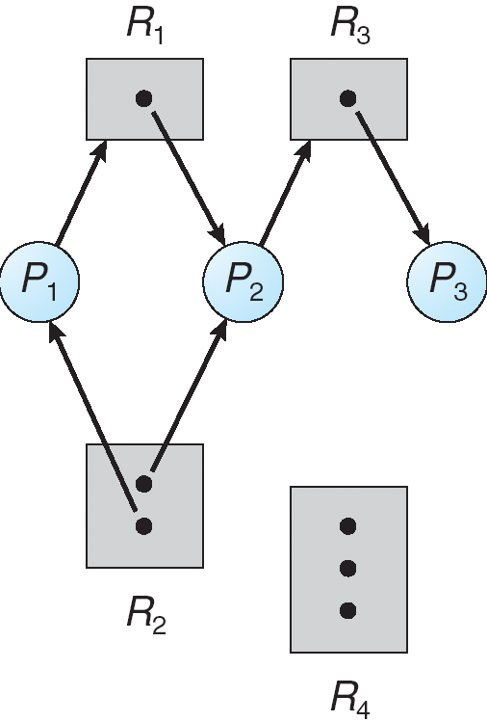
Example of a Resource Allocation Graph

Slide 13
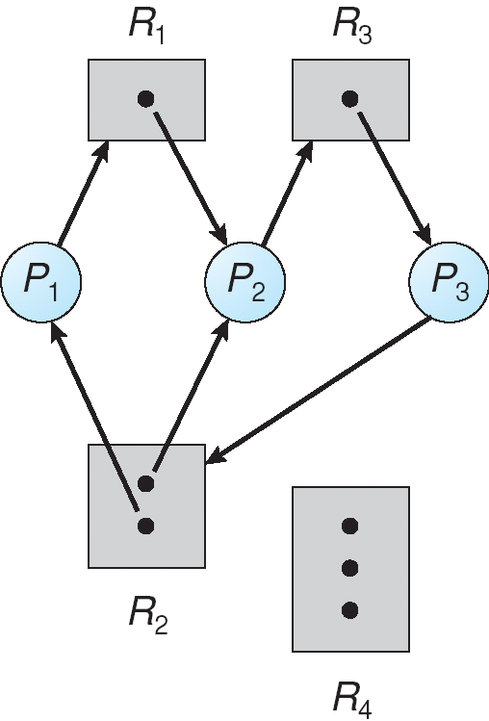
Resource Allocation Graph With A Deadlock

Slide 14
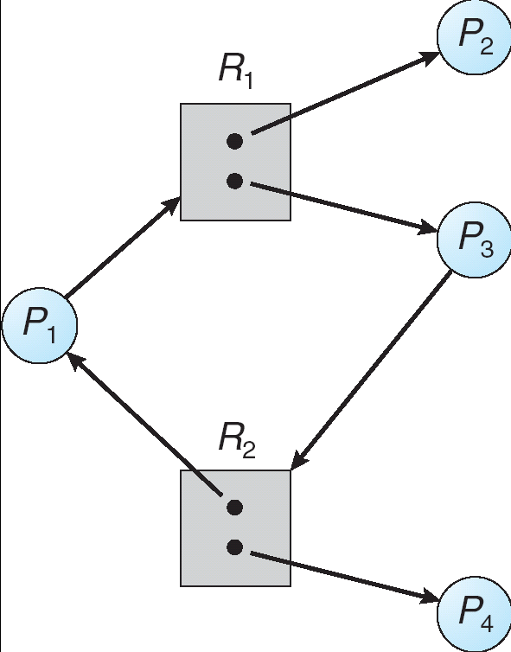
Graph With A Cycle But No Deadlock

Slide 15
Basic Facts
If graph contains no cycles ⇒ no deadlock.
If graph contains a cycle ⇒
if only one instance per resource type, then deadlock.
if several instances per resource type, possibility of deadlock.

Slide 16
Methods for Handling Deadlocks
Ensure that the system will never enter a deadlock state.
Allow the system to enter a deadlock state and then recover.
Ignore the problem and pretend that deadlocks never occur in the system; used by most operating systems, including UNIX.

Slide 17
Deadlock Prevention
Restrain the ways request can be made.
Mutual Exclusion – not required for sharable resources; must hold for nonsharable resources.
Hold and Wait – must guarantee that whenever a process requests a resource, it does not hold any other resources.
Require process to request and be allocated all its resources before it begins execution, or allow process to request resources only when the process has none (release all current resources before requesting any additional ones).
Low resource utilization; starvation possible. (example: copy data from DVD drive to a disk file, sorts the file, then prints the results to a printer.)

Slide 18
Deadlock Prevention (Cont.)
No Preemption –
If a process that is holding some resources requests another resource that cannot be immediately allocated to it, then all resources currently being held are released.
Preempted resources are added to the list of resources for which the process is waiting.
Process will be restarted only when it can regain its old resources, as well as the new ones that it is requesting.
Circular Wait – impose a total ordering of all resource types, and require that each process requests resources in an increasing order of enumeration. (page 255)
F(tape drive)=1
F(disk drive)=5
F(printer)=12

Slide 19
Deadlock Avoidance
Requires that the system has some additional a priori information available.
Simplest and most useful model requires that each process declares the maximum number of resources of each type that it may need.
The deadlock-avoidance algorithm dynamically examines the resource-allocation state to ensure that there can never be a circular-wait condition.
Resource-allocation state is defined by the number of available and allocated resources, and the maximum demands of the processes.

Slide 20
Safe State
When a process requests an available resource, system must decide if immediate allocation leaves the system in a safe state.
System is in safe state if there exists a sequence <P₁, P₂, …, P_{n}> of ALL the processes such that for each P_{i}, the resources that P_{i} can still request can be satisfied by currently available resources + resources held by all the P_{j}, with j < i.
That is:
If P_{i} resource needs are not immediately available, then P_{i} can wait until all P_{j} have finished.
When P_{j} is finished, P_{i} can obtain needed resources, execute, return allocated resources, and terminate.
When P_{i} terminates, P_{i +1} can obtain its needed resources, and so on.

Slide 21
Basic Facts
If a system is in safe state ⇒ no deadlocks.
If a system is in unsafe state ⇒ possibility of deadlock.
Avoidance ⇒ ensure that a system will never enter an unsafe state.

Slide 22
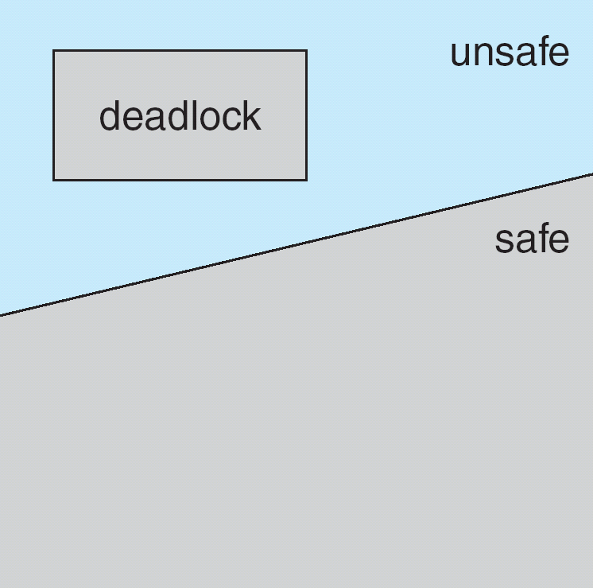
Safe, Unsafe , Deadlock State

Slide 23
Avoidance algorithms
Single instance of a resource type. Use a resource-allocation graph
Multiple instances of a resource type. Use the banker’s algorithm

Slide 24
Resource-Allocation Graph Scheme
Claim edge P_{i} → R_{j} indicated that process P_{j} may request resource R_{j}; represented by a dashed line.
Claim edge converts to request edge when a process requests a resource.
Request edge converted to an assignment edge when the resource is allocated to the process.
When a resource is released by a process, assignment edge reconverts to a claim edge.
Resources must be claimed a priori in the system.

Slide 25
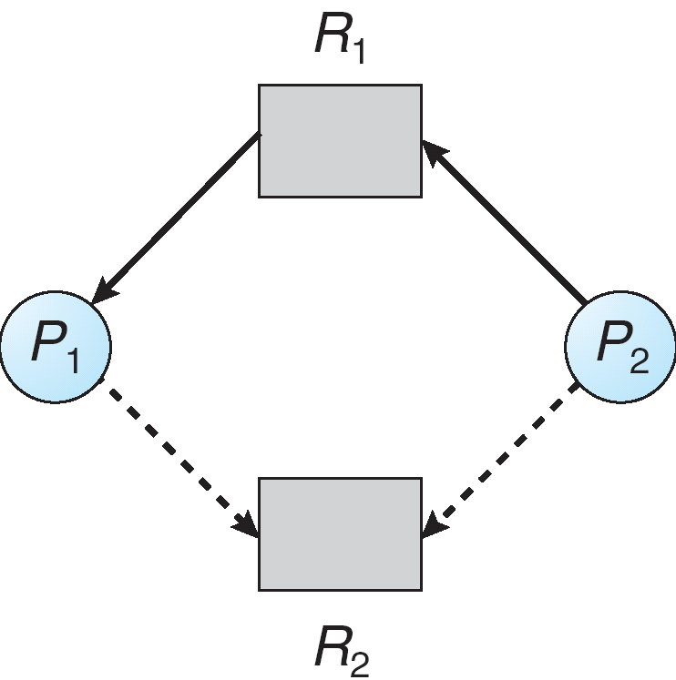
Resource-Allocation Graph

Slide 26
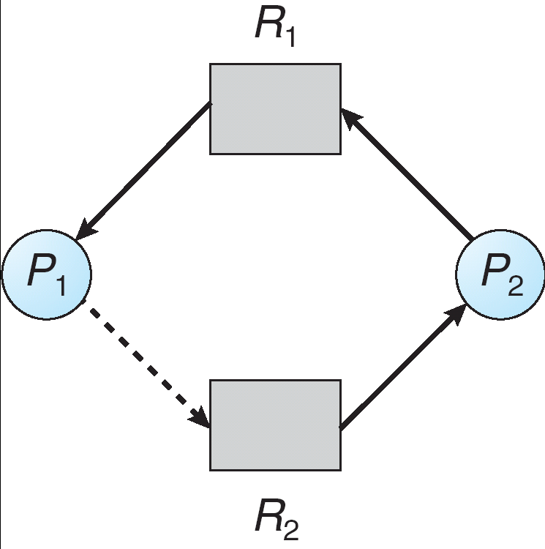
Unsafe State In Resource-Allocation Graph
If P1 requests R2, then a deadlock will occur.

Slide 27
Resource-Allocation Graph Algorithm
Suppose that process P_{i} requests a resource R_{j}
The request can be granted only if converting the request edge to an assignment edge does not result in the formation of a cycle in the resource allocation graph

Slide 28
Banker’s Algorithm
Assumptions
Multiple instances.
Each process must a priori claim maximum use.
When a process requests a resource it may have to wait.
When a process gets all its resources it must return them in a finite amount of time.

Slide 29
Data Structures for the Banker’s Algorithm
Let n = number of processes, and m = number of resources types.
Available: Vector of length m. If available [j] = k, there are k instances of resource type R_{j} available.
Max: n x m matrix. If Max [i,j] = k, then process P_{i} may request at most k instances of resource type R_{j}.
Allocation: n x m matrix. If Allocation[i,j] = k then P_{i} is currently allocated k instances of R_{j.}
Need: n x m matrix. If Need[i,j] = k, then P_{i} may need k more instances of R_{j} to complete its task.
Need [i,j] = Max[i,j] – Allocation [i,j].

Slide 30
Safety Algorithm
1. Let Work and Finish be vectors of length m and n, respectively. Initialize:
Work = Available
Finish [i] = false for i = 0, 1, …, n- 1.
2. Find an i such that both:
(a) Finish [i] = false
(b) Need_{i} ≤ Work
If no such i exists, go to step 4.
3. Work = Work + Allocation_{i} Finish[i] = true go to step 2.
4. If Finish [i] == true for all i, then the system is in a safe state.

Slide 31
Resource-Request Algorithm for Process P_{i}
Request = request vector for process P_{i}. If Request_{i} [j] = k then process P_{i} wants k instances of resource type R_{j.}
1. If Request_{i} ≤ Need_{i} go to step 2. Otherwise, raise error condition, since process has exceeded its maximum claim.
2. If Request_{i} ≤ Available, go to step 3. Otherwise P_{i} must wait, since resources are not available.
3. Pretend to allocate requested resources to P_{i} by modifying the state as follows:
Available = Available – Request;
Allocation_{i} = Allocation_{i} + Request_{i};
Need_{i} = Need_{i} – Request_{i};
If safe ⇒ the resources are allocated to Pi.
If unsafe ⇒ Pi must wait, and the old resource-allocation state is restored

Slide 32
Example of Banker’s Algorithm
5 processes P₀ through P₄;
3 resource types:
A (10 instances), B (5 instances), and C (7 instances).
Snapshot at time T₀:
Allocation Max Available
A B C A B C A B C
P₀ 0 1 0 7 5 3 3 3 2
P₁ 2 0 0 3 2 2
P₂ 3 0 2 9 0 2
P₃ 2 1 1 2 2 2
P₄ 0 0 2 4 3 3

Slide 33
Example (Cont.)
The content of the matrix Need is defined to be Max – Allocation.
Need
A B C
P₀ 7 4 3
P₁ 1 2 2
P₂ 6 0 0
P₃ 0 1 1
P₄ 4 3 1
The system is in a safe state since the sequence < P₁, P₃, P₄, P₂, P₀> satisfies safety criteria.

Slide 34
Example: P₁ Requests (1,0,2)
Check that Request ≤ Available (that is, (1,0,2) ≤ (3,3,2) ⇒ true.
Allocation Need Available
A B C A B C A B C
P₀ 0 1 0 7 4 3 2 3 0
P₁ 3 0 2 0 2 0
P₂ 3 0 1 6 0 0
P₃ 2 1 1 0 1 1
P₄ 0 0 2 4 3 1
Executing safety algorithm shows that sequence < P₁, P₃, P₄, P₀, P₂> satisfies safety requirement.
At this new state:
Can request for (3,3,0) by P₄ be granted?
Can request for (0,2,0) by P₀ be granted?

Slide 35
Deadlock Detection
Allow system to enter deadlock state
Detection algorithm
Recovery scheme

Slide 36
Single Instance of Each Resource Type
Maintain wait-for graph
Nodes are processes.
P_{i} → P_{j} if P_{i} is waiting for P_{j}.
Periodically invoke an algorithm that searches for a cycle in the graph. If there is a cycle, there exists a deadlock.
An algorithm to detect a cycle in a graph requires an order of n² operations, where n is the number of vertices in the graph.

Slide 37
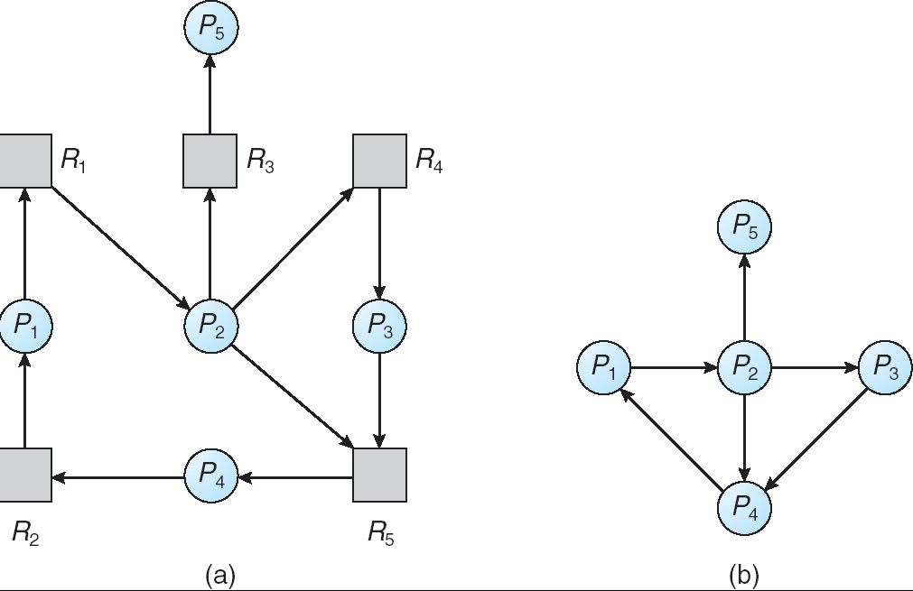
Resource-Allocation Graph and Wait-for Graph
Resource-Allocation Graph
Corresponding wait-for graph

Slide 38
Several Instances of a Resource Type
Available: A vector of length m indicates the number of available resources of each type.
Allocation: An n x m matrix defines the number of resources of each type currently allocated to each process.
Request: An n x m matrix indicates the current request of each process. If Request [i_{j}] = k, then process P_{i} is requesting k more instances of resource type. R_{j}.

Slide 39
Detection Algorithm
1. Let Work and Finish be vectors of length m and n, respectively Initialize:
(a) Work = Available
(b) For i = 1,2, …, n, if Allocation_{i} ≠ 0, then Finish[i] = false;otherwise, Finish[i] = true.
2. Find an index i such that both:
(a) Finish[i] == false
(b) Request_{i} ≤ Work
If no such i exists, go to step 4.

Slide 40
Detection Algorithm (Cont.)
3. Work = Work + Allocation_{i} Finish[i] = true go to step 2.
4. If Finish[i] == false, for some i, 1 ≤ i ≤ n, then the system is in deadlock state. Moreover, if Finish[i] == false, then P_{i} is deadlocked.
Algorithm requires an order of O(m x n²) operations to detect whether the system is in deadlocked state.

Slide 41
Example of Detection Algorithm
Five processes P₀ through P₄; three resource types A (7 instances), B (2 instances), and C (6 instances).
Snapshot at time T₀:
Allocation Request Available
A B C A B C A B C
P₀ 0 1 0 0 0 0 0 0 0
P₁ 2 0 0 2 0 2
P₂ 3 0 3 0 0 0
P₃ 2 1 1 1 0 0
P₄ 0 0 2 0 0 2
Sequence <P₀, P₂, P₃, P₁, P₄> will result in Finish[i] = true for all i.

Slide 42
Example (Cont.)
P₂ requests an additional instance of type C.
Request
A B C
P₀ 0 0 0
P₁ 2 0 2
P₂ 0 0 1
P₃ 1 0 0
P₄ 0 0 2
State of system?
Can reclaim resources held by process P₀, but insufficient resources to fulfill other processes; requests.
Deadlock exists, consisting of processes P₁, P₂, P₃, and P₄.

Slide 43
Detection-Algorithm Usage
When, and how often, to invoke depends on:
How often a deadlock is likely to occur?
How many processes will need to be rolled back?
one for each disjoint cycle
If detection algorithm is invoked arbitrarily, there may be many cycles in the resource graph and so we would not be able to tell which of the many deadlocked processes “caused” the deadlock.

Slide 44
Recovery from Deadlock: Process Termination
Abort all deadlocked processes.
Abort one process at a time until the deadlock cycle is eliminated.
In which order should we choose to abort?
Priority of the process.
How long process has computed, and how much longer to completion.
Resources the process has used.
Resources process needs to complete.
How many processes will need to be terminated.
Is process interactive or batch?

Slide 45
Recovery from Deadlock: Resource Preemption
Selecting a victim – minimize cost.
Rollback – return to some safe state, restart process for that state.
Starvation – same process may always be picked as victim, include number of rollback in cost factor.

Slide 46
End of Chapter 7

Slide 47
Can the requests be granted?
Allocation Need Available
A B C A B C A B C
P₀ 0 1 0 7 4 3 2 4 1
P₁ 3 0 2 0 2 0
P₂ 3 0 1 6 0 0
P₃ 2 1 1 0 1 1
P₄ 2 0 2 4 3 0
Q1: Can request for (0,2,0) by P₀ be granted?
Q2: Can request for (2,3,0) by P₄ be granted?

