Slide 1
Chapter 9: Virtual Memory

Slide 2
Chapter 9: Virtual Memory
Background
Demand Paging
Copy-on-Write
Page Replacement
Allocation of Frames
Thrashing
Memory-Mapped Files
Allocating Kernel Memory
Other Considerations
Operating-System Examples

Slide 3
Objectives
To describe the benefits of a virtual memory system
To explain the concepts of demand paging (请求式分页), page-replacement algorithms, and allocation of page frames
To discuss the principle of the working-set model

Slide 4
Background
Virtual memory – separation of user logical memory from physical memory.
Only part of the program needs to be in memory for execution
Logical address space can therefore be much larger than physical address space
Allows address spaces to be shared by several processes
Allows for more efficient process creation
Xv6 book: virtual memory isn’t a physical object, but refers to the collection of abstractions and mechanisms the kernel provides to manage physical memory and virtual addresses.
Virtual memory can be implemented via:
Demand paging
Demand segmentation

Slide 5
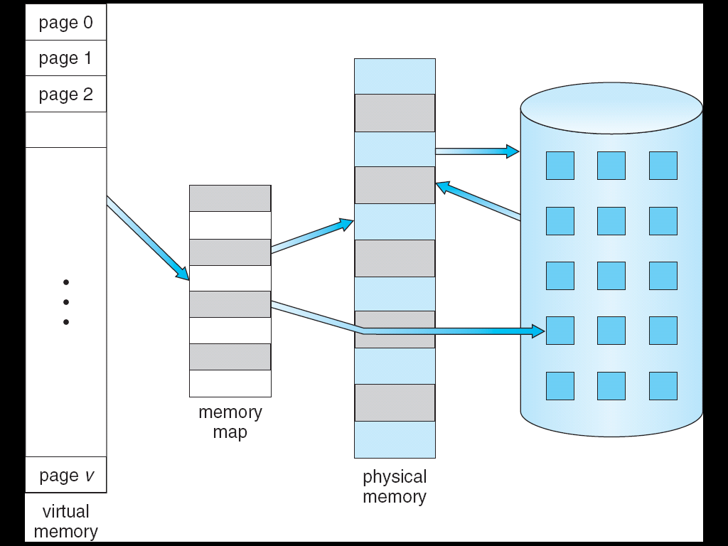
Virtual Memory That is Larger Than Physical Memory
⇒
Via MMU

Slide 6
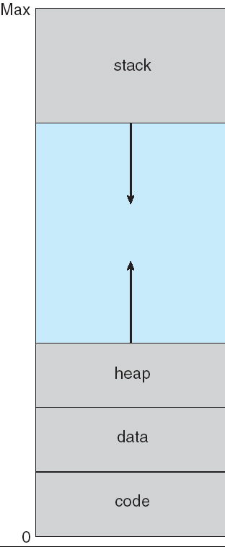
Virtual-address Space
hole
Sparse address space

Slide 7
Other benefits
System libraries can be shared by several processes through mapping of the shared object into a virtual address space
Shared memory is enabled
Pages can be shared during process creation (speeds up creation)

Slide 8
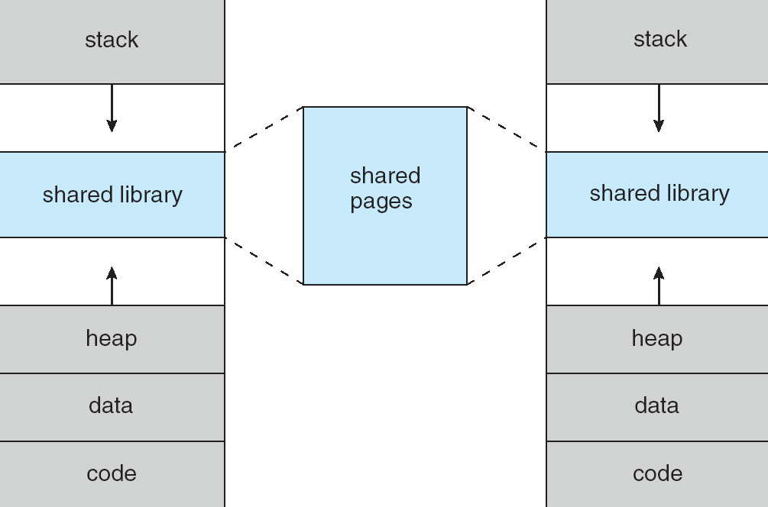
Shared Library Using Virtual Memory

Slide 9
Demand Paging
Bring a page into memory only when it is needed
Less I/O needed
Less memory needed
Faster response
More users
Page is needed ⇒ reference to it
invalid reference ⇒ abort
not-in-memory ⇒ bring to memory
Lazy swapper – never swaps a page into memory unless page will be needed
Swapper that deals with pages is a pager

Slide 10
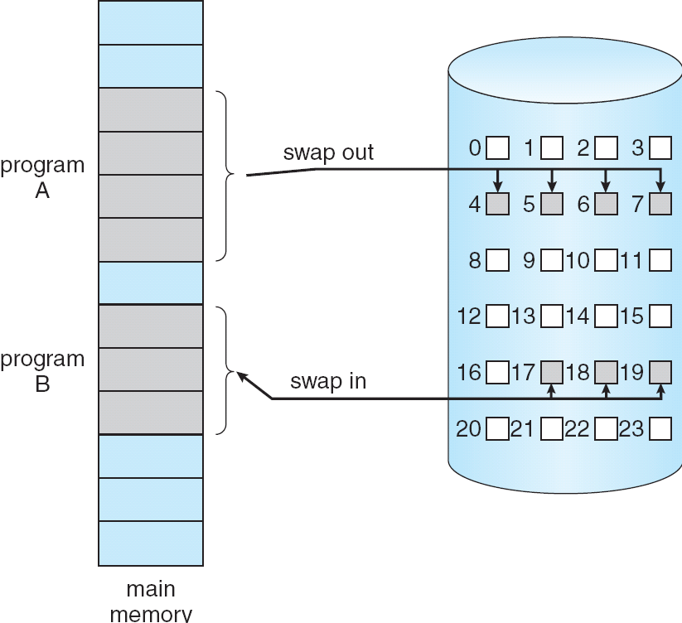
Transfer of a Paged Memory to Contiguous Disk Space

Slide 11
Valid-Invalid Bit
With each page table entry a valid–invalid bit is associated (v ⇒ in-memory, i ⇒ not-in-memory)
Initially valid–invalid bit is set to i on all entries
Example of a page table snapshot:
During address translation, if valid–invalid bit in page table entry
is i ⇒ page fault (a trap to the OS)
Frame #
valid-invalid bit
v
v
v
v
i
….
i
i
page table

Slide 12
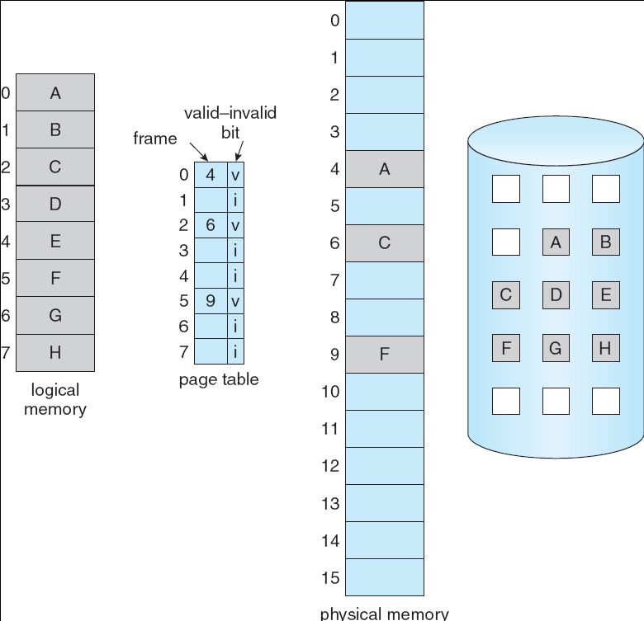
Page Table When Some Pages Are Not in Main Memory

Slide 13
Page Fault
If there is a reference to a page, first reference to that page will trap to operating system:
page fault
Operating system looks at another table (kept with PCB) to decide:
Invalid reference ⇒ abort
Just not in memory
Get empty frame
Swap page into frame
Reset tables
Set validation bit = v
Restart the instruction that caused the page fault

Slide 14
Page Fault (Cont.)
Restart instruction
block move
auto increment/decrement location

Slide 15
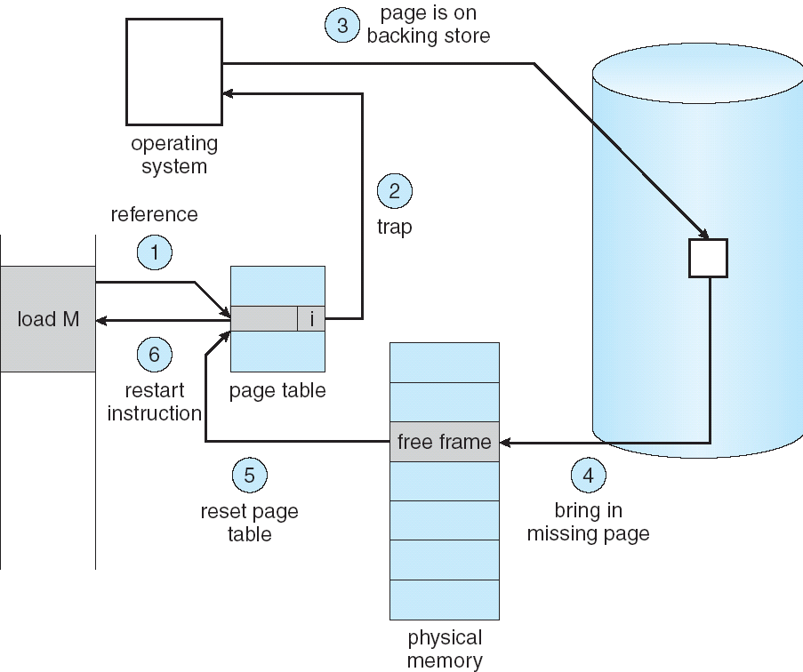
Steps in Handling a Page Fault
Notes:
(2)Trap to the operating system.
Save the registers and process state.
Determine that the interrupt was a page fault.
(3) Check that the page reference was legal, and determine the location of the page in secondary storage.
(4) Issue a read from the storage to a free frame:
Wait in a queue until the read request is serviced.
Wait for the device seek and/or latency time.
Begin the transfer of the page to a free frame.
While waiting, allocate the CPU core to some other process.
Receive an interrupt from the storage I/O subsystem (I/O completed).
Save the registers and process state for the other process (if step 6 is executed).
Determine that the interrupt was from the secondary storage device.
(5) Correct the page table and other tables to show that the desired page is
now in memory.
Wait for the CPU core to be allocated to this process again.
(6) Restore the registers, process state, and new page table, and then resume the interrupted instruction.

Slide 16
A Page Fault Causes The Following
Trap to the operating system.
Save the registers and process state.
Determine that the interrupt was a page fault.
Check that the page reference was legal, and determine the location of the page in secondary storage.
Issue a read from the storage to a free frame:
Wait in a queue until the read request is serviced.
Wait for the device seek and/or latency time.
Begin the transfer of the page to a free frame.
While waiting, allocate the CPU core to some other process.
Receive an interrupt from the storage I/O subsystem (I/O completed).
Save the registers and process state for the other process.
Determine that the interrupt was from the secondary storage device.
Correct the page table and other tables to show that the desired page is now in memory.
Wait for the CPU core to be allocated to this process again.
Restore the registers, process state, and new page table, and then resume the interrupted instruction.

Slide 17
Performance of Demand Paging
Page Fault Rate 0 ≤ p ≤ 1.0
if p = 0 no page faults
if p = 1, every reference is a fault
Effective Access Time (EAT)
EAT = (1 – p) x memory access
+ p (page fault overhead
+ swap page out
+ swap page in
+ restart overhead
)
Notes:
对比和第8章的EAT的不同：这里在Pfault结束后，将会重启memory access指令，故下一次重启的访存就不算在本次的EAT里面了。

Slide 18
Demand Paging Example
Memory access time = 200 nanoseconds
Average page-fault service time = 8 milliseconds
EAT = (1 – p) x 200 + p (8 milliseconds)
= (1 – p) x 200 + p x 8,000,000
= 200 + p x 7,999,800
If one access out of 1,000 causes a page fault, then
EAT = 8.2 microseconds.
This is a slowdown by a factor of 40!!

Slide 19
Process Creation
Virtual memory allows other benefits during process creation:
- Copy-on-Write
- Memory-Mapped Files (later)

Slide 20
Copy-on-Write
Copy-on-Write (COW) allows both parent and child processes to initially share the same pages in memory If either process modifies a shared page, only then is the page copied
COW allows more efficient process creation as only modified pages are copied
Free pages are allocated from a pool of zeroed-out pages

Slide 21
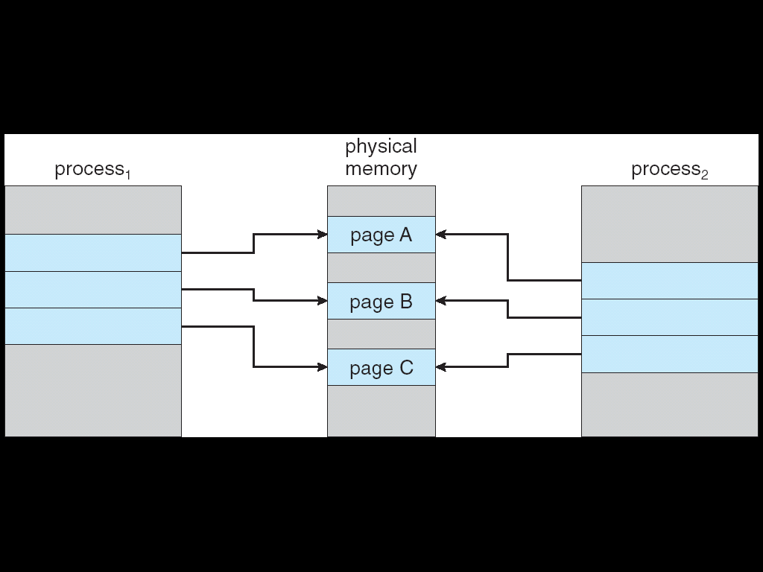
Before Process 1 Modifies Page C

Slide 22

After Process 1 Modifies Page C
Copy of page C

Slide 23
What happens if there is no free frame?
Page replacement – find some page in memory, but not really in use, swap it out
algorithm
performance – want an algorithm which will result in minimum number of page faults
Same page may be brought into memory several times

Slide 24
Page Replacement
Prevent over-allocation of memory by modifying page-fault service routine to include page replacement
Use modify (dirty) bit to reduce overhead of page transfers – only modified pages are written to disk
Page replacement completes separation between logical memory and physical memory – large virtual memory can be provided on a smaller physical memory

Slide 25
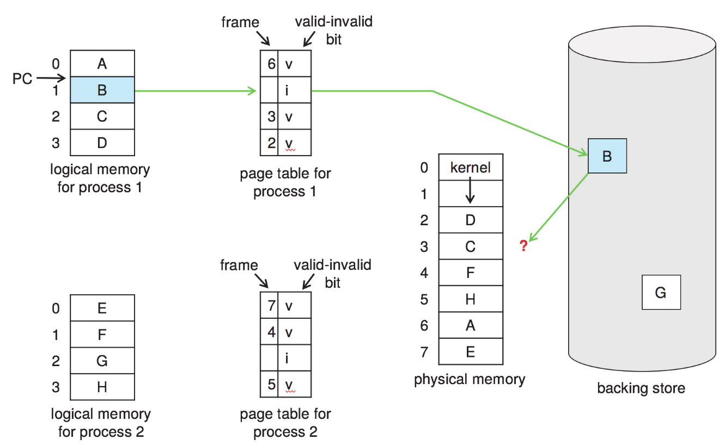
Need For Page Replacement
Notes:
The ? Indicates the need for page replacement

Slide 26
Basic Page Replacement
Find the location of the desired page on secondary storage.
Find a free frame:
If there is a free frame, use it.
If there is no free frame, use a page-replacement algorithm to select a victim frame.
Write the victim frame to secondary storage (if necessary); change the page and frame tables accordingly.
Read the desired page into the newly freed frame; change the page and frame tables.
Continue the process from where the page fault occurred.
Use dirty bit

Slide 27
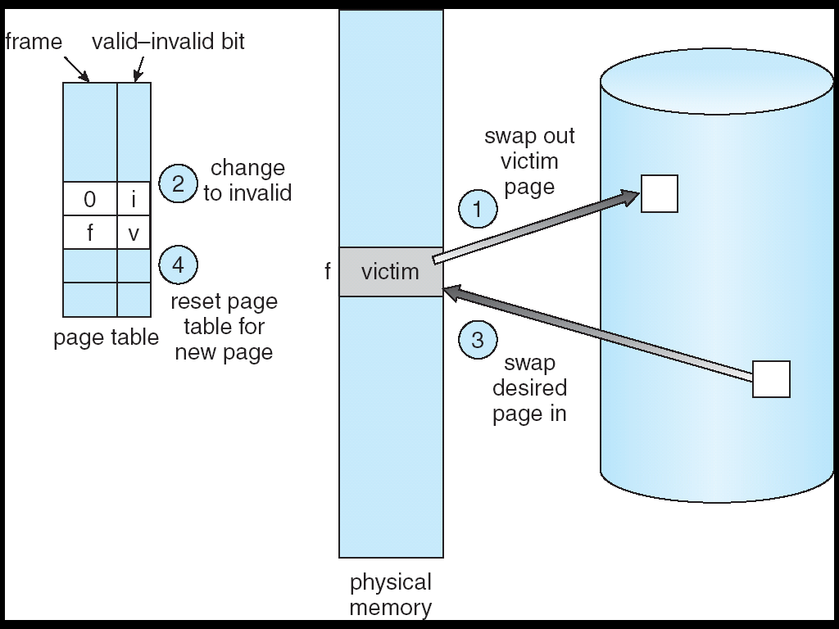
Page Replacement
Notes:
Figure shows page being replaced by another page in the same process.

Slide 28
Page Replacement Algorithms
Want lowest page-fault rate
Evaluate algorithm by running it on a particular string of memory references (reference string) and computing the number of page faults on that string
Address sequence:
0100, 0432, 0101, 0612, 0102, 0103, 0104, 0101, 0611, 0102, 0103, 0104, 0101, 0610, 0102, 0103, 0104, 0101, 0609, 0102, 0105
is reduced to reference string:
1, 4, 1, 6, 1, 6, 1, 6, 1, 6, 1
Notes:
100 bytes per page

Slide 29
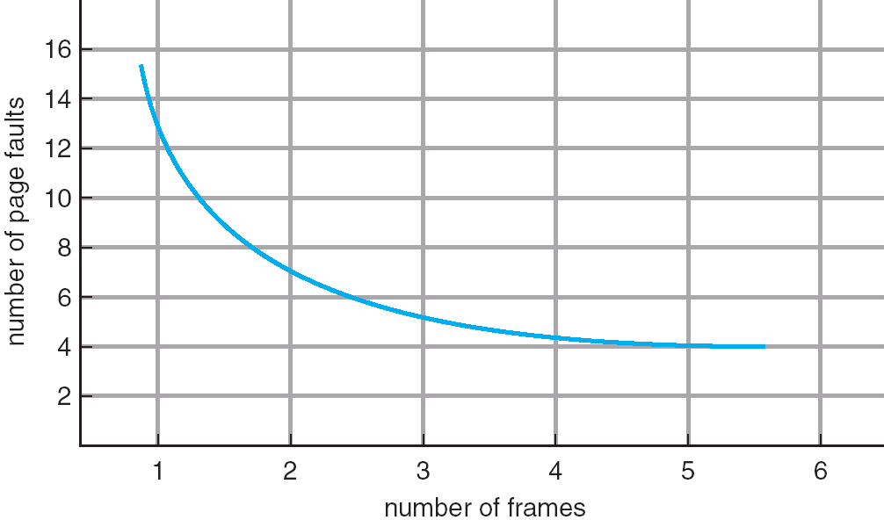
Graph of Page Faults Versus The Number of Frames

Slide 30
First-In-First-Out (FIFO) Algorithm
Reference string: 1, 2, 3, 4, 1, 2, 5, 1, 2, 3, 4, 5
3 frames (3 pages can be in memory at a time per process)
4 frames
Belady’s Anomaly: more frames ⇒ more page faults
1
1
4
5
2
2
1
3
9 page faults
3
3
2
4
1
1
5
4
2
2
1
5
10 page faults
3
3
2
4
4
3

Slide 31
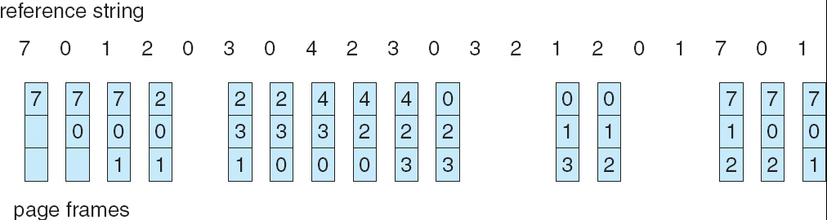
FIFO Page Replacement

Slide 32
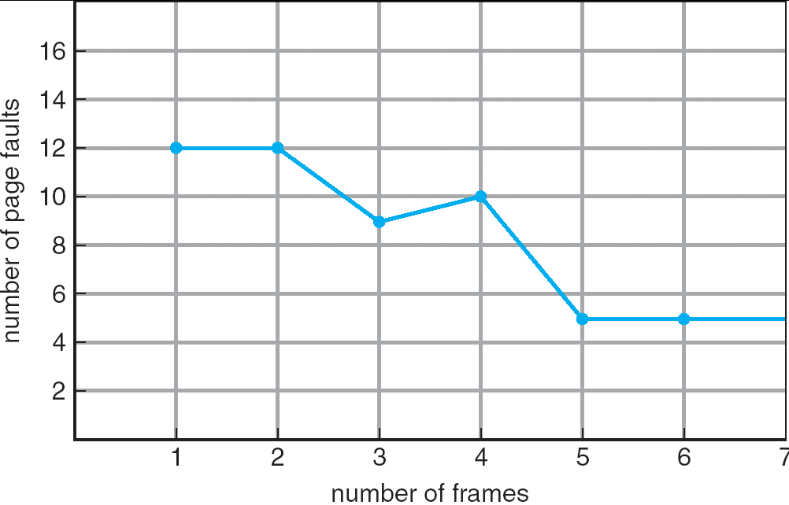
FIFO Illustrating Belady’s Anomaly

Slide 33
Optimal Algorithm
Replace page that will not be used for longest period of time
4 frames example
1, 2, 3, 4, 1, 2, 5, 1, 2, 3, 4, 5
How do you know this?
Used for measuring how well your algorithm performs
1
4
2
6 page faults
3
4
5

Slide 34
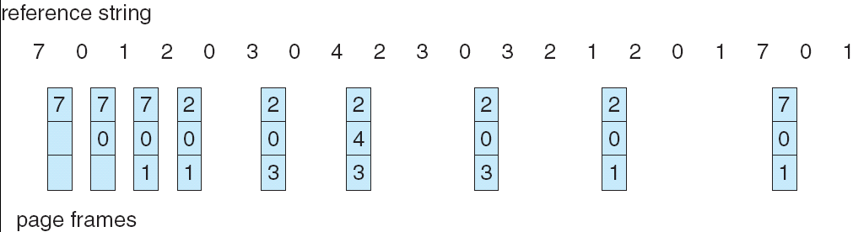
Optimal Page Replacement

Slide 35
Least Recently Used (LRU) Algorithm
Reference string: 1, 2, 3, 4, 1, 2, 5, 1, 2, 3, 4, 5
Counter implementation
Every page entry has a counter; every time page is referenced through this entry, copy the clock into the counter
When a page needs to be changed, look at the counters to determine which are to change
1
1
1
1
5
2
2
2
2
2
3
5
5
4
4
4
4
3
3
3

Slide 36
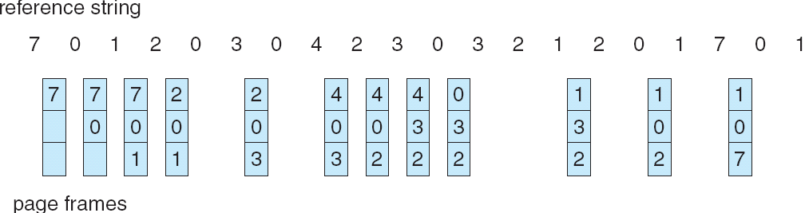
LRU Page Replacement

Slide 37
LRU Algorithm (Cont.)
Stack implementation – keep a stack of page numbers in a double link form:
Page referenced:
move it to the top
requires 6 pointers to be changed
No search for replacement

Slide 38
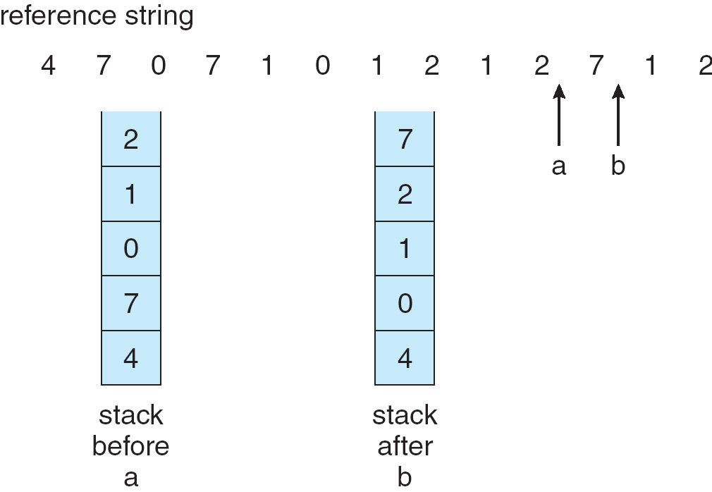
Use Of A Stack to Record The Most Recent Page References

Slide 39
LRU Approximation Algorithms
Reference bit
With each page associate a bit, initially = 0
When page is referenced bit set to 1
Replace the one which is 0 (if one exists)
We do not know the order, however
Second chance
Need reference bit
Clock replacement
If page to be replaced (in clock order) has reference bit = 1 then:
set reference bit 0
leave page in memory
replace next page (in clock order), subject to same rules

Slide 40
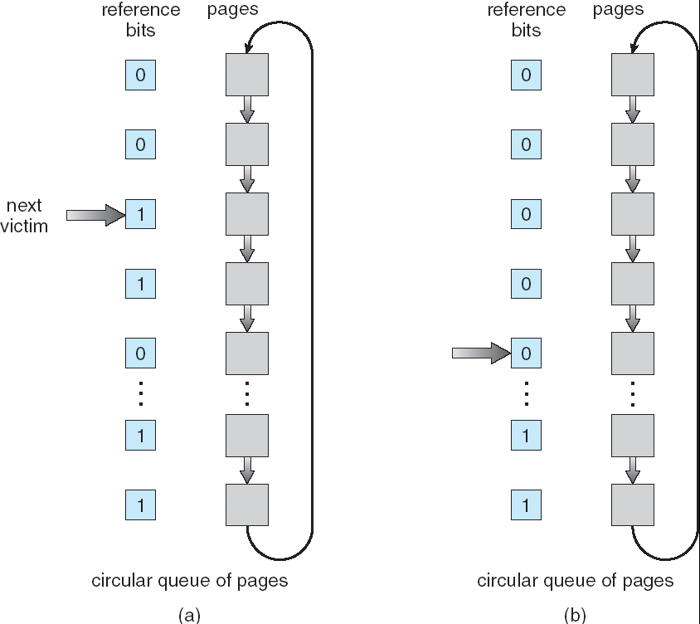
Second-Chance (clock) Page-Replacement Algorithm

Slide 41
Counting-based Algorithms
Keep a counter of the number of references that have been made to each page
LFU Algorithm: replaces page with smallest count
MFU Algorithm: based on the argument that the page with the smallest count was probably just brought in and has yet to be used
Notes:
LFU: Heat-based replacement. If a page is hot initially and then cold, we should periodically reduce the counter.

Slide 42
Allocation of Frames
Each process needs minimum number of pages － usually determined by computer architecture.
Example: IBM 370 – 6 pages to handle Storage-to-Storage MOVE instruction:
instruction is 6 bytes, might span 2 pages
2 pages to handle from
2 pages to handle to
Two major allocation schemes
fixed allocation
priority allocation
Notes:
2 pages to handle from: indirect references.

Slide 43
Fixed Allocation
Equal allocation – For example, if there are 100 frames and 5 processes, give each process 20 frames.
Proportional allocation – Allocate according to the size of process
Notes:
Size of process: size of the virtual memory for each process s_i

Slide 44
Priority Allocation
Use a proportional allocation scheme using priorities rather than size
If process P_{i} generates a page fault,
select for replacement one of its frames
select for replacement a frame from a process with lower priority number

Slide 45
Global vs. Local Allocation
Global replacement – process selects a replacement frame from the set of all frames; one process can take a frame from another
Local replacement – each process selects from only its own set of allocated frames
Problem with global replacement: unpredictable page-fault rate. Cannot control its own page-fault rate. More common
Problem with local replacement: free frames are not available for others. – Low throughput

Slide 46
Thrashing （颠簸）
If a process does not have “enough” pages, the page-fault rate is very high. This leads to:
low CPU utilization
Queuing at paging device, the ready queue becomes empty
operating system thinks that it needs to increase the degree of multiprogramming
another process added to the system
Thrashing ≡ a process is busy swapping pages in and out

Slide 47
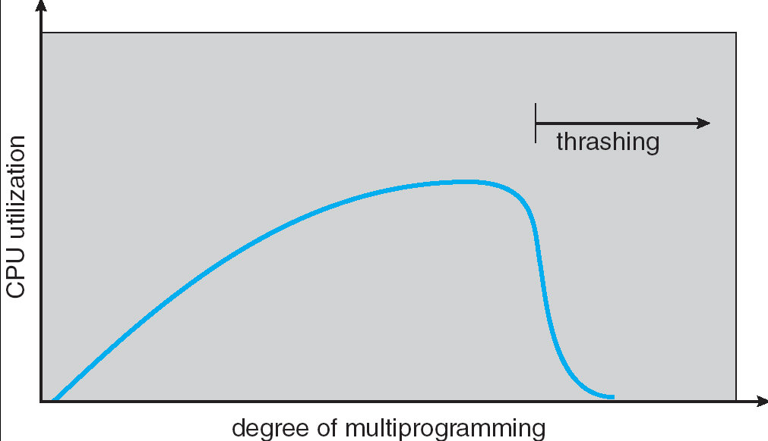
Thrashing (Cont.)

Slide 48
Demand Paging and Thrashing
Why does demand paging work? Locality model
Process migrates from one locality to another
Localities may overlap
Why does thrashing occur? Σ size of locality > total memory size
To limit the effect of thrashing: local replacement algo cannot steal frames from other processes. But queue in page device increases effective access time.
To prevent thrashing: allocate memory to accommodate its locality

Slide 49
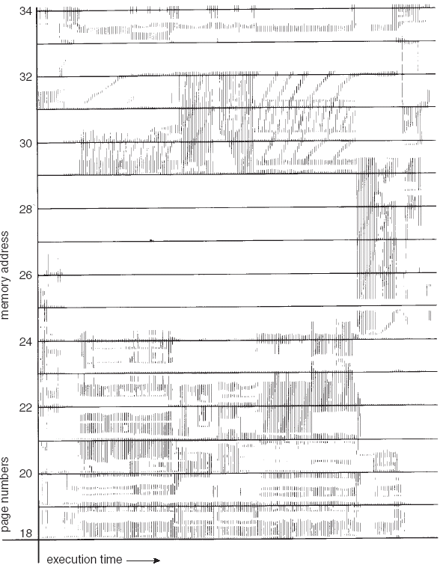
Locality In A Memory-Reference Pattern

Slide 50
Data Locality Example
Function A()
{ int i=0; float result;
float array[100];
for (i=0; i< 100; i++){
array[i]=i*PI;
}
result= B();
}
Function B()
{
int j=0;
float value, sum;
for(j=0; j< 100; j++){
value = rand()*10;
sum+= value;
}
return sum
}
result
i
array
sum
j
value

Slide 51
Working-Set Model
Δ ≡ working-set window ≡ a fixed number of page references Example: 10,000 instruction
WSS_{i} (working set size of Process P_{i}) = total number of pages referenced in the most recent Δ (varies in time)
if Δ too small will not encompass entire locality
if Δ too large will encompass several localities
if Δ = ∞ ⇒ will encompass entire program
D = Σ WSS_{i} ≡ total demand frames for all processes in the system
if D > m ⇒ Thrashing
Policy if D > m, then suspend one of the processes

Slide 52
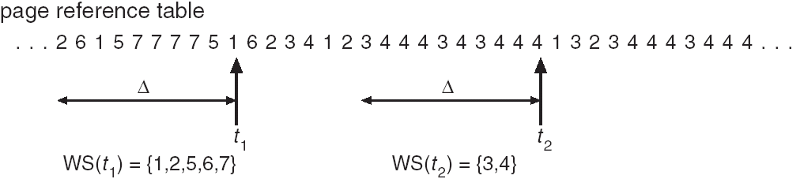
Working-set model

Slide 53
Keeping Track of the Working Set
Approximate with interval timer + a reference bit
Example: Δ = 10,000
Timer interrupts after every 5000 time units
Keep in memory 2 bits for each page
Whenever a timer interrupts copy and sets the values of all reference bits to 0
If one of the bits in memory = 1 ⇒ page in working set
Why is this not completely accurate? Cannot tell where a reference occurred in 5000 units.
Improvement = 10 bits and interrupt every 1000 time units

Slide 54
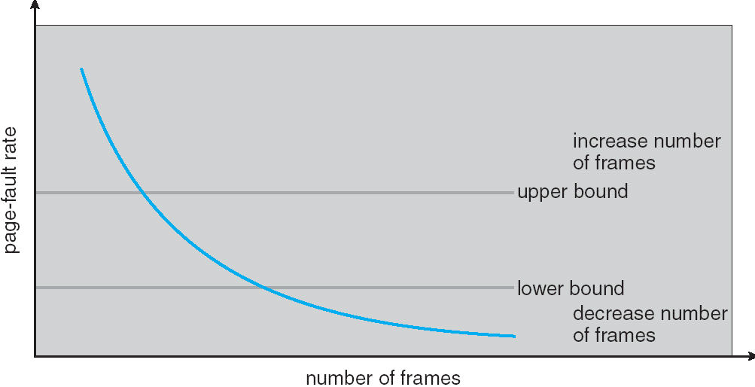
Page-Fault Frequency Scheme
Establish “acceptable” page-fault rate for each process
If actual rate too low, process loses frame
If actual rate too high, process gains frame

Slide 55
Memory-Mapped Files
Memory-mapped file I/O allows file I/O to be treated as routine memory access by mapping a disk block to a page in memory
A file is initially read using demand paging. A page-sized portion of the file is read from the file system into a physical page. Subsequent reads/writes to/from the file are treated as ordinary memory accesses.
Simplifies file access by treating file I/O through memory rather than read() write() system calls
Also allows several processes to map the same file allowing the pages in memory to be shared

Slide 56
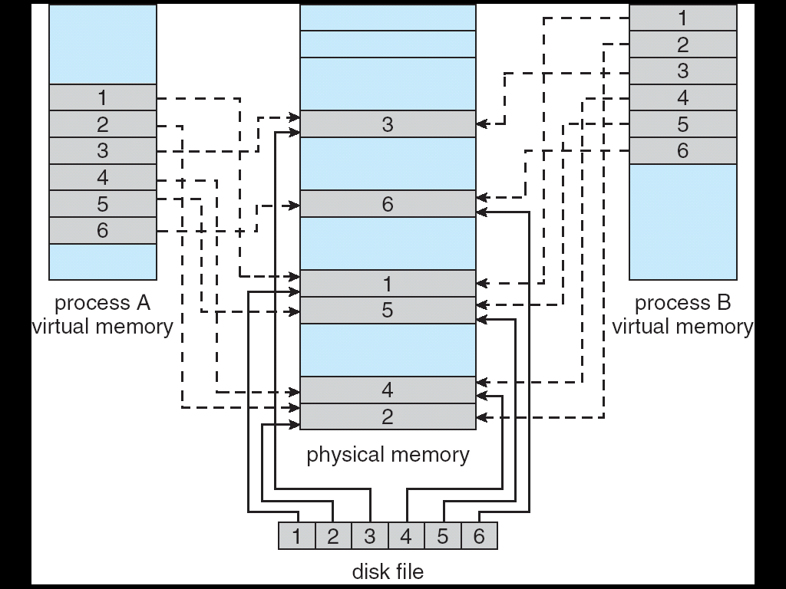
Memory Mapped Files

Slide 57
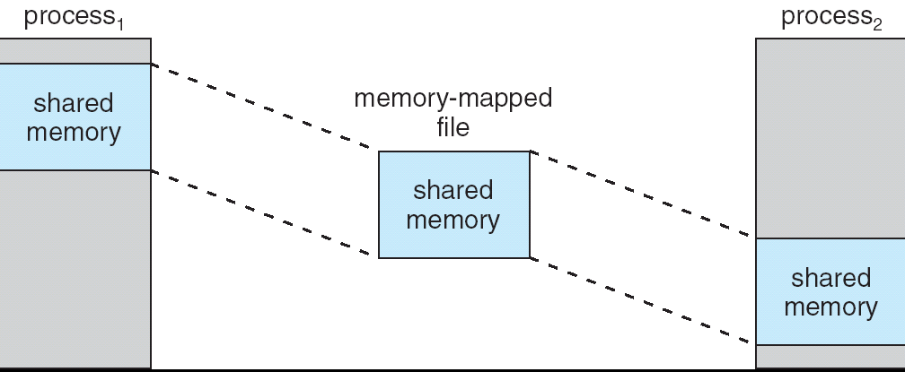
Memory-Mapped Shared Memory in Windows
Refer to text book pg 351

Slide 58
Allocating Kernel Memory
Treated differently from user memory
Often allocated from a free-memory pool
Kernel requests memory for structures of varying sizes – needs to reduce fragmentation
Some kernel memory needs to be contiguous (certain h/w device interacts with contiguous physical memory)
Therefore, many systems do NOT utilize paging for kernel code and data.
Notes:
For example, embedded OS may not use paging for the kernel code.
Stackoverflow: NT kernels and device drivers use virtual memory for data structures and objects that can be safely paged out to storage. For example, a driver can request virtual memory as a usermode program does.
However, the kernel has data and code that: 1) must be kept always in memory for efficiency reasons 2) must be kept in memory because a page fault cannot be serviced. A typical example is entering ISRs (interrupt service routine) (such as the page fault handling code itself). Code and data of this type is kept on physical memory always, and it's called nonpaged pool on NT kernels.
The latter does not means that nonpaged memory addresses are referenced directly. They are always translated to physical addresses (and viceversa) by the kernel memory manager.
I think (i listen for corrections) the only physical addresses used without virtual mapping is the first 1MB when the system boots up (in WinNT, the NTLDR / NTDETECT.COM phase until protected mode is activated).

Slide 59
Buddy System
Allocates memory from fixed-size segment consisting of physically-contiguous pages
Memory allocated using power-of-2 allocator
Satisfies requests in units sized as power of 2
Request rounded up to next highest power of 2
When smaller allocation needed than is available, current chunk split into two buddies of next-lower power of 2
Continue until appropriate sized chunk available

Slide 60
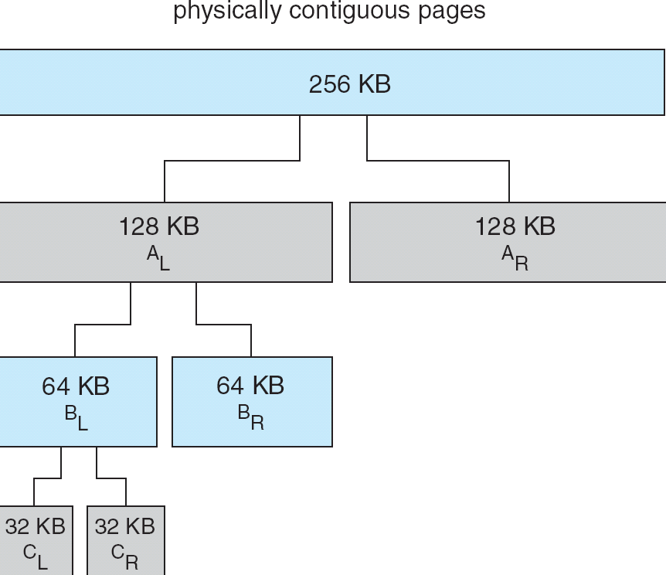
Buddy System Allocator

Slide 61
Slab Allocator
Alternate strategy
Slab is one or more physically contiguous pages
Cache consists of one or more slabs
Single cache for each unique kernel data structure
Each cache filled with objects – instantiations of the data structure
When cache created, filled with objects marked as free
When structures stored, objects marked as used
If slab is full of used objects, next object allocated from empty slab
If no empty slabs, new slab allocated
Benefits include no fragmentation, fast memory request satisfaction
Notes:
Good for small data structures.

Slide 62
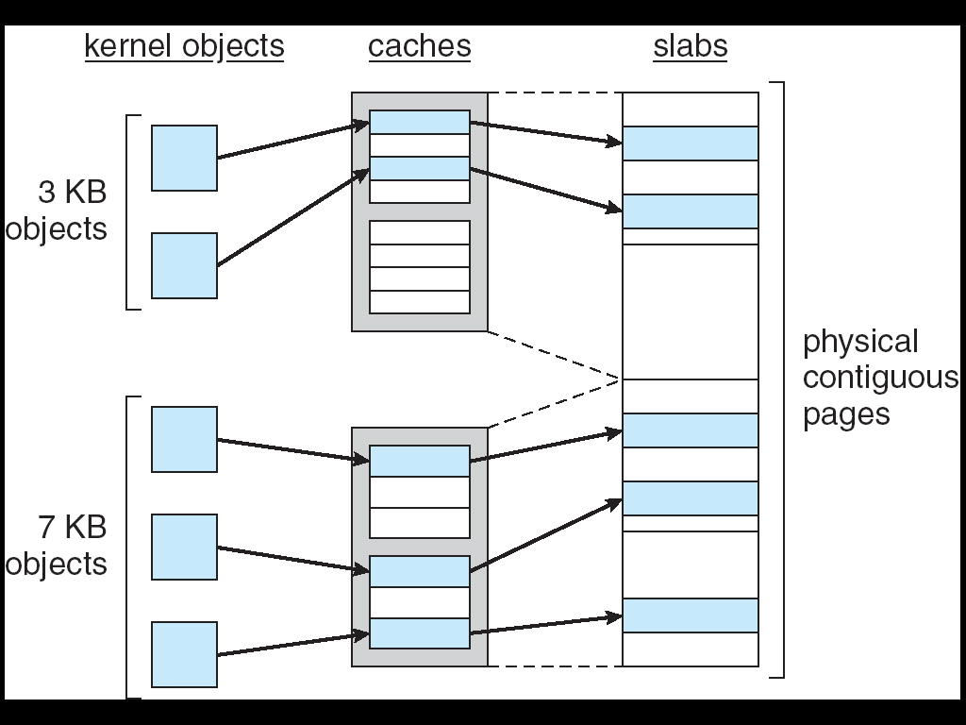
Slab Allocation

Slide 63
Other Issues -- Prepaging
Prepaging
To reduce the large number of page faults that occurs at process startup
Prepage all or some of the pages a process will need, before they are referenced
But if prepaged pages are unused, I/O and memory was wasted
Assume s pages are prepaged and α of the pages is used
Is benefit of s * α saved pages faults > or < than the cost of prepaging s * (1- α) unnecessary pages?
α near zero ⇒ prepaging loses

Slide 64
Other Issues – Page Size
Page size selection must take into consideration:
Fragmentation – small page size
table size -> large page size
I/O overhead -> large page size
Locality -> small page size , accurate locality

Slide 65
Other Issues – TLB Reach
TLB Reach - The amount of memory accessible from the TLB
TLB Reach = (TLB Size) X (Page Size)
Ideally, the working set of each process is stored in the TLB
Otherwise there is a high degree of page faults
Increase the Page Size
This may lead to an increase in fragmentation as not all applications require a large page size
Provide Multiple Page Sizes
This allows applications that require larger page sizes the opportunity to use them without an increase in fragmentation

Slide 66
Other Issues – Program Structure
Program structure
Int[128,128] data;
Each row is stored in one page
Program 1
for (j = 0; j <128; j++) for (i = 0; i < 128; i++) data[i,j] = 0;
128 x 128 = 16,384 page faults
Program 2
for (i = 0; i < 128; i++) for (j = 0; j < 128; j++) data[i,j] = 0;
128 page faults

Slide 67
Other Issues – I/O interlock
I/O Interlock – Pages must sometimes be locked into memory
Consider I/O - Pages that are used for copying a file from a device must be locked from being selected for eviction by a page replacement algorithm

Slide 68
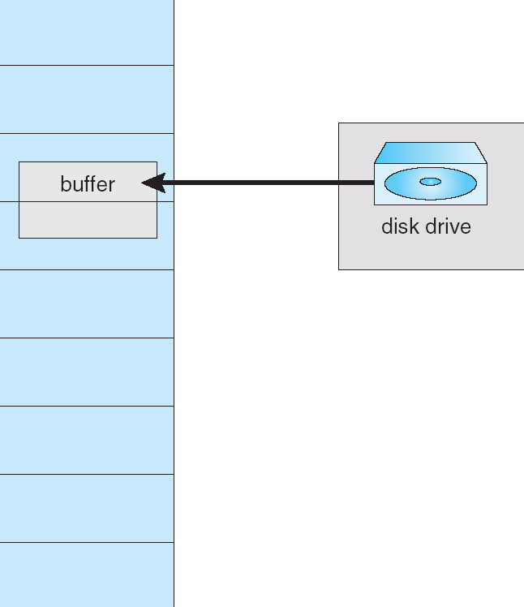
Reason Why Frames Used For I/O Must Be In Memory

Slide 69
Operating System Examples
Windows XP
Solaris

Slide 70
Windows XP
Uses demand paging with clustering. Clustering brings in pages surrounding the faulting page.
Processes are assigned working set minimum and working set maximum (50-345 pages)
Working set minimum is the minimum number of pages the process is guaranteed to have in memory
A process may be assigned as many pages up to its working set maximum. If page fault at maximum, replace local pages.
When the amount of free memory in the system falls below a threshold, automatic working set trimming is performed to restore the amount of free memory
Working set trimming removes pages from processes that have pages in excess of their working set minimum

Slide 71
Solaris
Maintains a list of free pages to assign faulting processes
Lotsfree – threshold parameter (amount of free memory) to begin paging out
Desfree – threshold parameter to increasing paging frequency
Minfree – threshold parameter to begin swapping
Paging is performed by pageout process
Pageout scans pages using modified clock algorithm
Scanrate is the rate at which pages are scanned. This ranges from slowscan to fastscan
Pageout is called more frequently depending upon the amount of free memory available

Slide 72
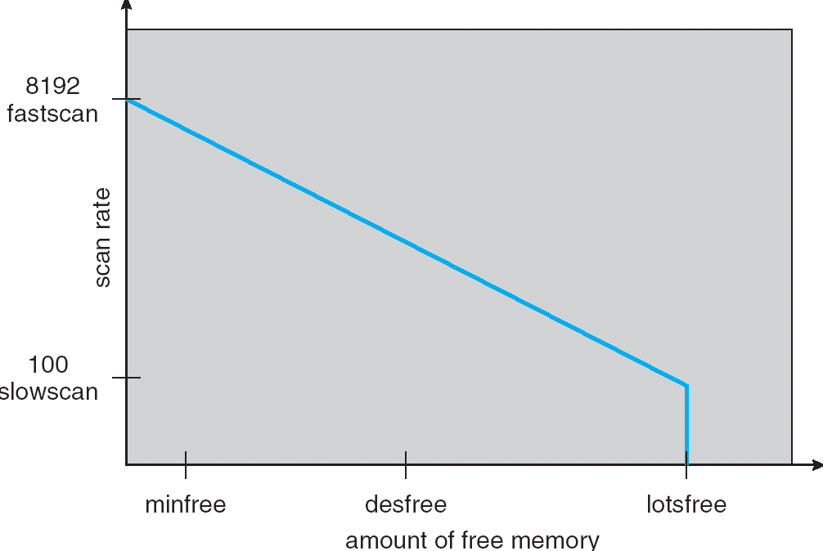
Solaris 2 Page Scanner

Slide 73
End of Chapter 9

