Slide 1
Multiple-Importance Sampling
蔡易逸 Cyy
GAMES101 final

Slide 2
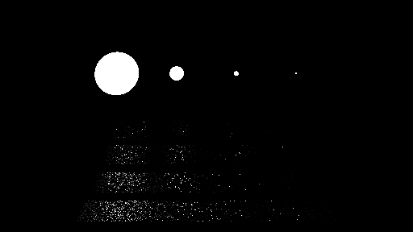
Background
Regular random sampling can lead to very noisy result like below.

Slide 3
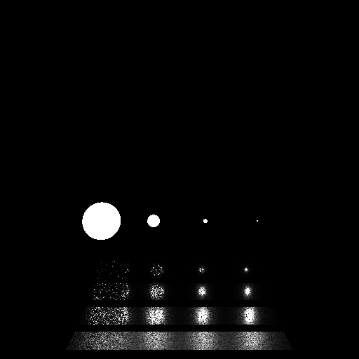
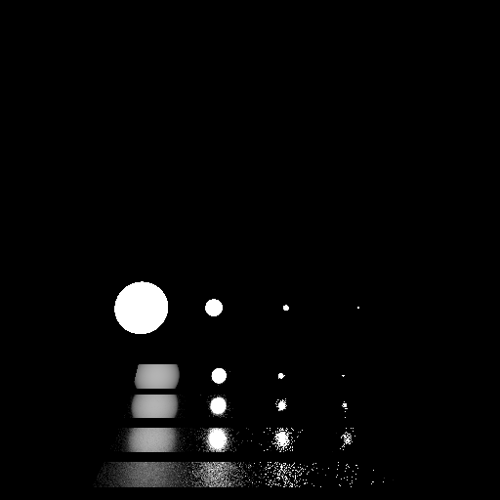
Background
People find ways to reduce the variance by importance sampling.
Pics below are “sampling light” and “sampling BRDF” respectively.
Roughness
0.001
0.005
0.02
0.1
Roughness
0.001
0.005
0.02
0.1

Slide 4


Background
However, both methods are only good at partial of the region.
Sampling BRDF is not good at sampling small light sources.
Sampling Light is not good at sampling material with low roughness (specular).
Roughness
0.001
0.005
0.02
0.1
Roughness
0.001
0.005
0.02
0.1

Slide 5

MIS
MIS is an unbiased method trying to balance all the methods (sampling light and BRDF in this case)
$Li_{light}=\frac{1}{n_{1}}(Σ\frac{Li\left(X_{i,j}\right)}{p_{light}\left(X_{i,j}\right)})$
$Li_{BRDF}=\frac{1}{n_{2}}(Σ\frac{Li\left(X_{i,j}\right)}{p_{BRDF}\left(X_{i,j}\right)})$
$Li_{MIS}=\frac{1}{n_{1}}\left(Σ\frac{w_{1}\left(X_{i,j}\right)Li\left(X_{i,j}\right)}{p_{light}\left(X_{i,j}\right)}\right)+\frac{1}{n_{2}}(Σ\frac{w_{2}\left(X_{i,j}\right)Li\left(X_{i,j}\right)}{p_{BRDF}\left(X_{i,j}\right)})$

Slide 6

MIS (balance heuristic)
After transfer the equation into 1spp form, we can implement it into regular path tracer. (sample using a certain [method] with probability c_{[method]})
$Li_{MIS}=\frac{1}{n_{1}}\left(Σ\frac{w_{1}\left(X_{i,j}\right)Li\left(X_{i,j}\right)}{p_{light}\left(X_{i,j}\right)}\right)+\frac{1}{n_{2}}(Σ\frac{w_{2}\left(X_{i,j}\right)Li\left(X_{i,j}\right)}{p_{BRDF}\left(X_{i,j}\right)})$
$Li_{MIS}=\frac{Li_{\left[method\right]}}{c_{\left[method\right]}}$
$Li_{\left[method\right]}=\frac{w_{\left[method\right]}\left(X\right)Li\left(X\right)}{p_{\left[method\right]}\left(X\right)}$, $while w_{\left[method\right]}=\frac{p_{\left[method\right]}\left(X\right)}{p_{\left[Σ(all method)\right]}\left(X\right)}$

Slide 7
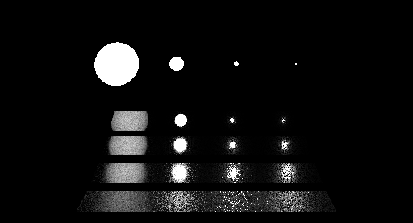
Result
SampleLight SampleBRDF MIS

