Slide 1
Android device
USB
Environment
Actors
U
Panda
U
User setting:
speed limit
Sensors
Steering torque
U
Front/back camera
GPS
U
CAN Bus
U
Physical env:
lanes,cars,etc
Gas - ACC
U
Radar
U
U
Take control
Brake-Decel

Slide 2
Input
Head
Backbone
U
Previous frame
Meta
U
Concat
Flatten
Pose
Current frame
U
Plan
Concat
U
U
U
U
Elu+Gemm+Relu
GRU
Gemm+Relu
Lead
U
U
Lane lines
Desire
Traffic convention
U
Desire state

Slide 3
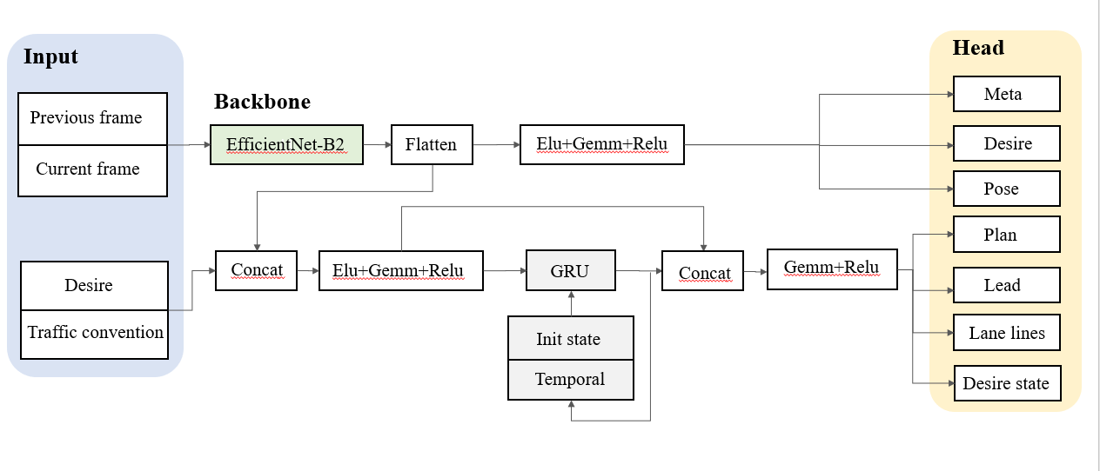

Slide 4
Previous frame
(3,128,256)
Concat
Flatten
Current frame
(3,128,256)
GRU
(6,128,256)
Conv
Hidden State
EfficientNet-B2
（1024,1）
（512,1）
Output

Slide 5
Traditional AD
Sensor
Perception
Prediction
Planning
Control
Actuators
collision
Safety
safety margin
Mission planner
curvature
Metric
Comfort
jerk
Behaviour
planner
Costs
Rules
speed limit
stop signs
Local planner
Dynamics
traffic lights
To control
minimum turning radius
End-to-End AD
Sensor
End-to-End Network
Trajectory
Control
Actuators

Slide 6
Traditional AD
Sensor
Perception
Prediction
Planning
Control
Actuators
End-to-End AD
Sensor
End-to-End Network
Trajectory
Control
Actuators

