Slide 1

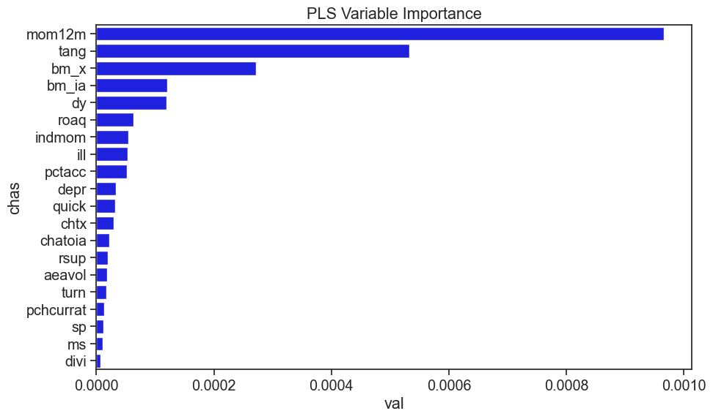
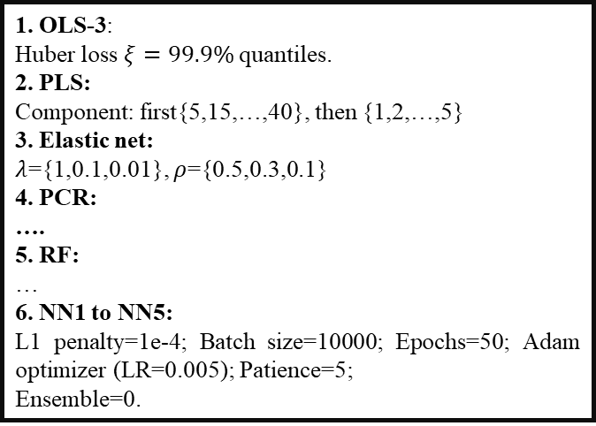
MATH5470 Final Project
Paper Replication: Empirical Asset Pricing via Machine Learning
CUI Daorong, XXX, XXX; {dcuiab, XXX, XXX }@connect.ust.hk
¹ Department of Mathematics, The Hong Kong University of Science and Technology (HKUST)
Problem Overview
Hyperparameters for All Methods
….
2. Monthly out-of-sample R² (%)
3. Conclusions
…..
1. Traditional asset pricing methods have potentially severe limitations that more advanced statistical tools in machine learning can help overcome. In this project, we reproduce some of the works in (Gu et al., 2020), in which they provide a comprehensive analysis of expected returns using machine learning techniques.
2. The six methods we choose are: OLS, OLS3, PCR, PLS, RF, elastic net, NN1 to NN5.
3. We use the out-of-sample R² as the performance metric and use a ‘recursive strategy’ (seen in the following plot) when evaluating our models.
4. We discover influential covariates by ranking them according to a notion of variable importance VI_{j}, which is the decrease of in-sample R² when inforcing one variable equal to 0.
1. OLS-3:
Huber loss $ξ=99.9\%$quantiles.
2. PLS:
Component: first{5,15,…,40}, then {1,2,…,5}
3. Elastic net:
$λ$={1,0.1,0.01}, $ρ$={0.5,0.3,0.1}
4. PCR:
….
5. RF:
…
6. NN1 to NN5:
L1 penalty=1e-4; Batch size=10000; Epochs=50; Adam optimizer (LR=0.005); Patience=5;
Ensemble=0.
OLS-3 (top 1,000) | -0.5876 | NN1 (all) | 0.2081
Elastic net | 0.0081 | NN2 (all) | 0.0984
PLS | -0.1689 | NN3 (all) | 0.1684
PCR |  | NN4 (all) | 0.1554
RF |  | NN5 (all) | 0.1548
Main Results
Dateset
1. Important variables:
References:
Gu, S., Kelly, B., & Xiu, D. (2020). Empirical asset pricing via machine learning. The Review of Financial Studies, 33(5), 2223-2273.
Contributions: CUI Daorong (OLS, OLS-3, NN); ….
After data preprocessing, our dataset contains 3,502,067 valid samples, each with a numerical response variable and 920 numerical baseline covariates.

