Slide 1
100G ATS Platform
Feng.Hu
2014.10.28
www.innolight.com

Slide 2
Old Design
Separated ATS program for each version (ATS1,2,3; QA etc)
  More than 300 codes existing
  More than 1,000 individual programs existing
High maintenance cost
  A simple fix of software bug (e.g. EEPROM writing error) need to
  modify and rebuild 1000+ programs
  Changing of test equipment brand requires rebuild of all programs
High engineering cost for 11-digit BOM release and CAS update
  Intensive engineers time is needed
High reconfiguration cost
  Modules have to be re-tested with full ATS for re-customerization

Slide 3
New Design
Single ATS core program to cover all versions of all 11-digit codes
  Separated program codes and configurable data
  Configurable data differentiates products and test requirements
Flexible and Scalable
  Algorithm library for various DCP, curve fitting methods
  Algorithm parameters are configurable
  New algorithms can be added without change of other core program codes
Independent of test equipment
  Standard equipment driver interface is defined
  Core program is not affected by use of new test equipment
Transparent configuration data
  Straightforward datasheet or CAS spec transfer to configuration data
  Less engineer time is requirement; Most work can be handled by technician

Slide 4
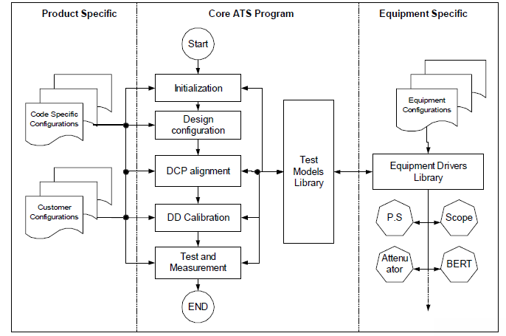
Overview

Slide 5
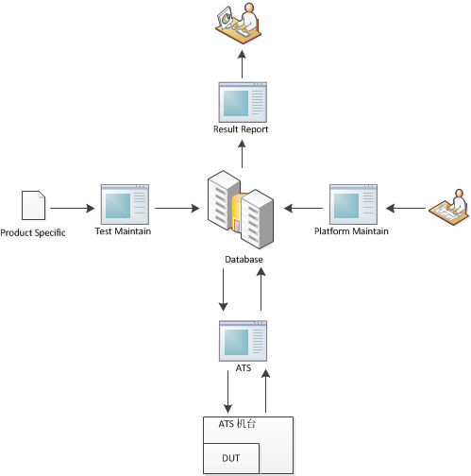
Architecture

Slide 6
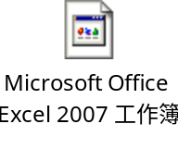
Database
Backbone Designed and Verify Done.
  Database Tables design and implement.
  The relative of tables design and implement.
The data of ATS running depend has filling-in and pass internal verification.
  Production Info(PN, Internal Mapping…)
  Production Specific and Testing Control.
  Equipment Configuration and Parameters.
The data of ATS running generated has filling-in and pass internal verification.
  Production Testing Data.
  ATS Running Record and Log.

Slide 7
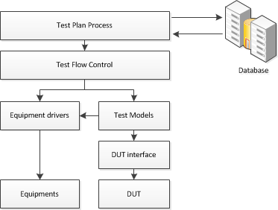
ATS

Slide 8
ATS
Main Program UI/Function Designed and Internal Verification Done. The documents of program design and implement were ready. The document of User-Guide was ready. The list of key features:
Function | Status
测试环境控制 | Done
测试流程控制 | Done
测试项目控制 | Done
测试结果检查 | Done
测试结果保存 | Done
测试控制界面 | Done
调试日志生成 | Done

Slide 9
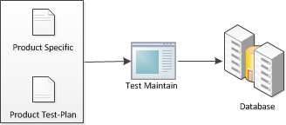
Test Maintain

Slide 10
Test Maintain
Main Program UI/Function Designed and Verification Done. The documents of program design and implement were ready. The document of User-Guide was ready. The list of key features:
Function | Status
测试计划信息维护 | Done
测试规格信息维护 | Done
测试流程信息维护 | Done
测试设备信息维护 | Done
测试项目信息维护 | Done
维护程序控制界面 | Done

Slide 11
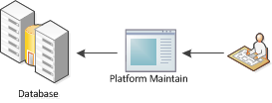
Platform Maintain

Slide 12
Platform Maintain
Maintain Program UI/Function Designed and Internal Verification was done. The documents of program design and implement were ready. The documents of User-Guide is building. The list of key features:
Function | Status
平台运行信息维护 | Done
产品通用信息维护 | Done
用户权限信息维护 | Done
测试设备信息维护 | Done
EEPROM信息维护 | Done
维护程序控制界面 | Done

Slide 13

Result Report

Slide 14
Result Report
Report Program UI/Function Designed and Internal Verification was done. The documents of program design and implement were ready. The documents of User-Guide is building. The list of key features:
Function | Status
产品测试结果查询 | Done
产品测试结果导出 | Done
报表程序控制界面 | Done

Slide 15
Thanks for Watching
www.innolight.com

