Slide 1
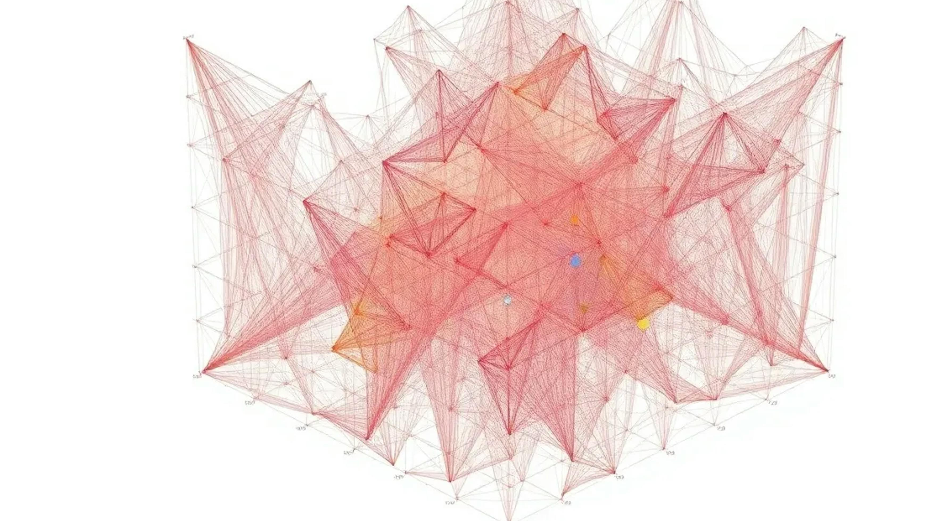
A posture subspace in the primary motor cortex
Patrick J Marino, …, Byron M Yu, Aaron P Batista
Carnegie Mellon and University of Pittsburgh, Neurosurgery

Slide 2
Ethical Statement
3 NHPs (E, N, R) with Utah arrays in M1 (and PMd for E)
Experiments at the University of Pittsburgh (E) and Carnegie Mellon (N, R)
All handling approved by the respective Institutional Animal Care and Use Committees
Ipsilateral arm was braced and trials were ended if force on the arm was too high
Several authors are inventors on a provisional patent for a "posture-invariant brain-computer interface"

Slide 3
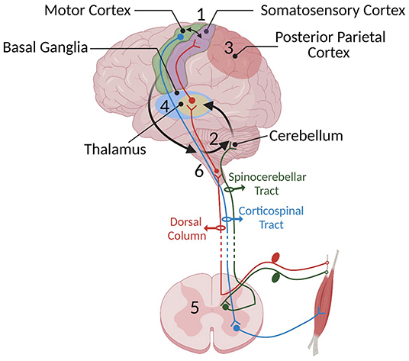
Purpose
Its early in the morning and your alarm goes off on your nightstand. Regardless of how you are sleeping, or the relative position of the alarm to you, you can accurately reach out and hit the snooze for 5 more minutes button
The muscle activity, however, that is needed for the same reach differs across postures, so the brain must combine goal and posture information to generate muscle commands
M1 receives goal information from premotor and parietal cortex, receives posture information from somatosensory and parietal cortex and the cerebellum
Prior work has shown changes in M1 activity as posture is varied at a single neuron level
Other research has shown simple separable latent dynamics at population levels
Notes:
Prior work shows that changing initial posture causes complicated changes in individual M1 neurons (tuning changes, rate offsets), so one might expect complex interactions between posture and goal at the population level However, in many other brain areas, the dominant population-level structure is simple and interpretable even when single-neuron responses are complex This study systematically varies arm posture across BCI, isometric force and reaching tasks to test whether posture and goal signals sit in separable subspaces, whether the posture subspace is shared across tasks, and whether goal-related neural trajectories keep their shape across postures

Slide 4
How are posture and goal signals organized within M1 Neuronal activity to allow us to have goal-oriented behavior from different positions?

Slide 5
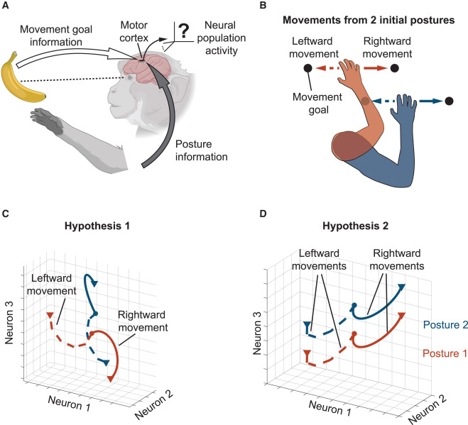
2 hypotheses exist for postural control
Hypothesis 1 (complex): posture and goal interact non-separably. Neural trajectories for a given movement direction would change shape substantially across postures
Hypothesis 2 (simple): posture and goal components are separable
  A change in posture shifts neural activity consistently across movement directions
  Trajectories for each movement direction have similar shapes across postures

Slide 6
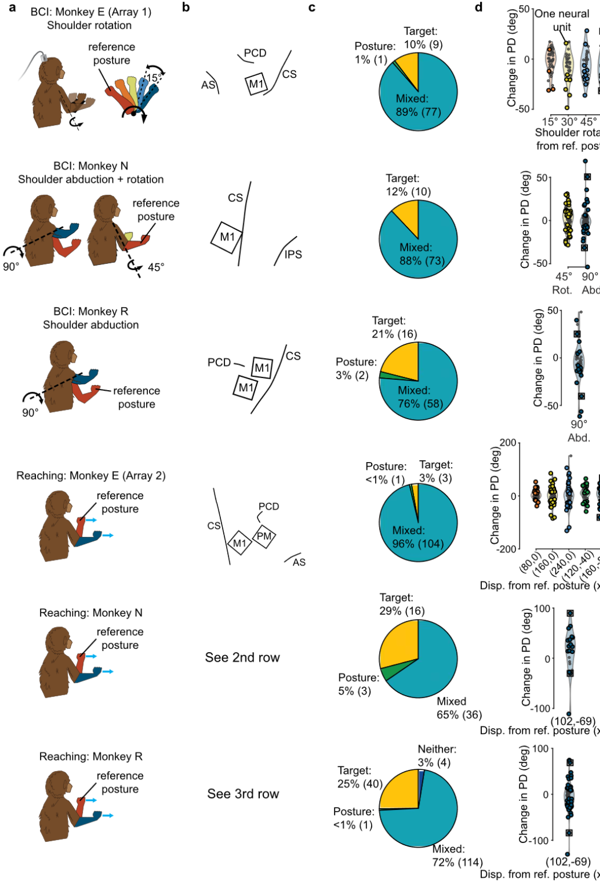
Implant Information
Monkey E, Array 1: one 96-channel array close to the shoulder regions of M1 and dorsal PMd, left hemisphere. Monkey E, Array 2: after retraining with the left arm, two 64-channel arrays (one PMd, one M1) in the right hemisphere
Monkey N: one 96-channel array in M1, left hemisphere
Monkey R: two adjacent 96-channel arrays in M1, left hemisphere
M1 and PMd recordings were pooled

Slide 7
Recording
Spikes were detected by threshold crossing at 3x (E) or 3.5x (N, R) the RMS voltage
Channels that looked like noise or electrical shorts were excluded
Monkey E: each channel treated as one unsorted unit
Monkeys N and R: waveforms sorted online
Units per session (mean ± SD): E Array 1: 87.5 ± 0.5; E Array 2: 109.6 ± 0.9; N: 64.3 ± 13.5; R: 120.75 ± 48.9
  Unit counts vary widely across sessions for N and R (64.3 ± 13.5 and 120.75 ± 48.9)
Hand kinematics (reaching): infrared LED marker tracked at 120 Hz (E, PhaseSpace) or 60 Hz (N, R, Optotrak 3020). Also recorded for some of E's BCI and isometric sessions
Hand forces (E): ATI Mini40 force transducer on a metal cylindrical handle. All force thresholds are expressed relative to the rest force of the resting arm

Slide 8
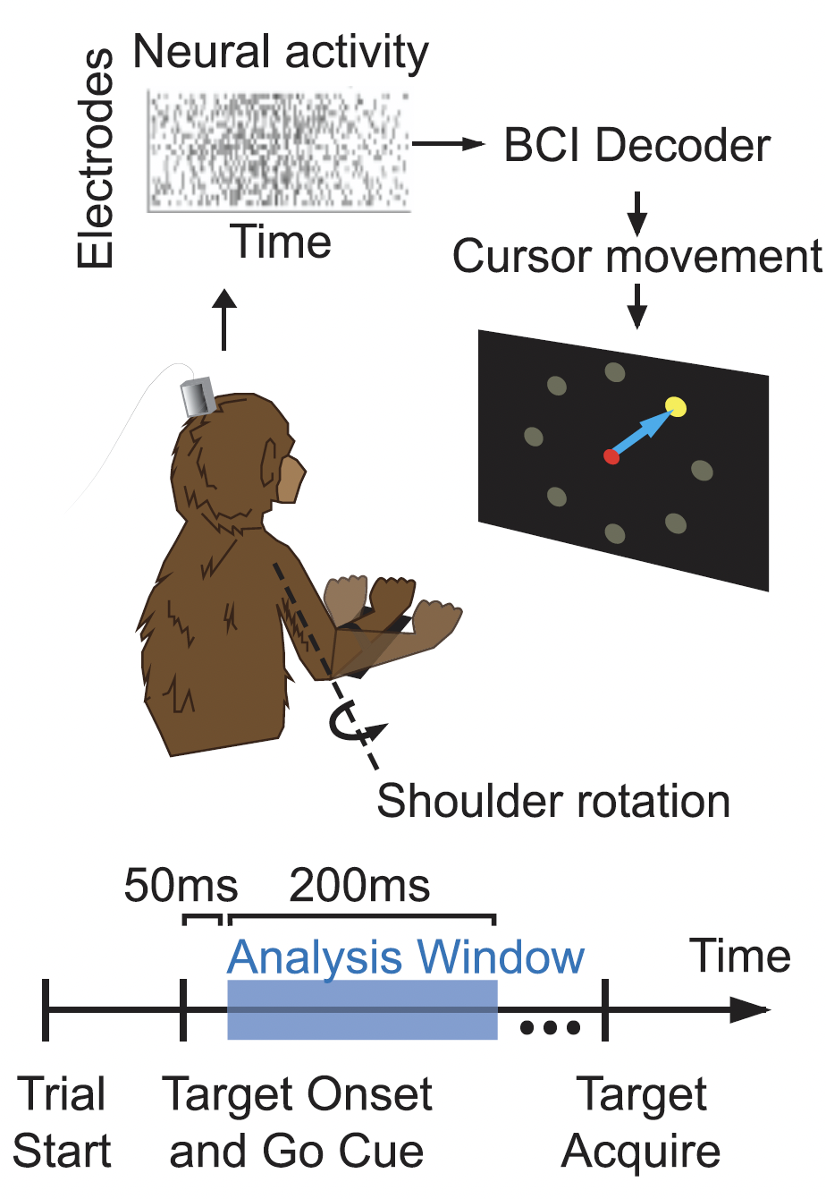
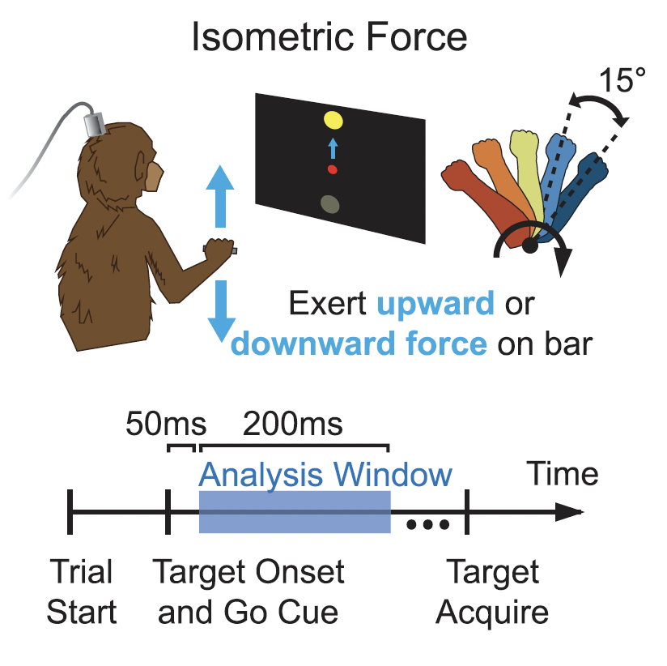
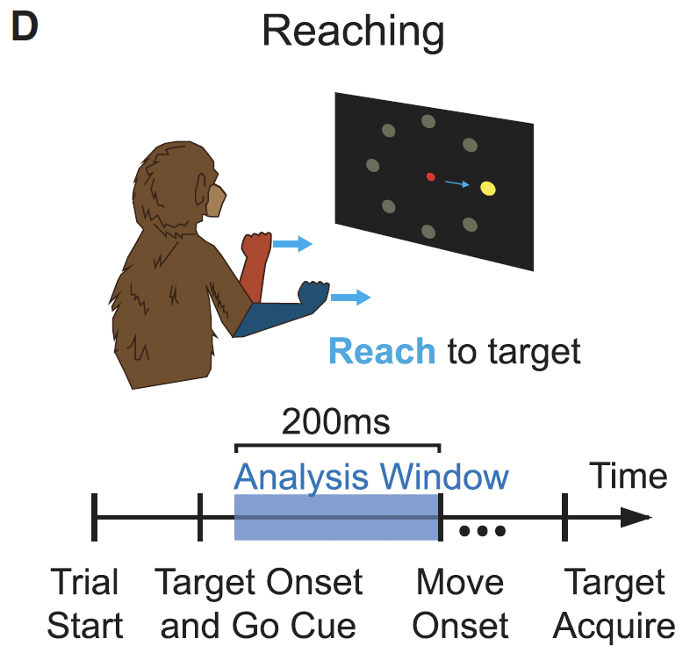
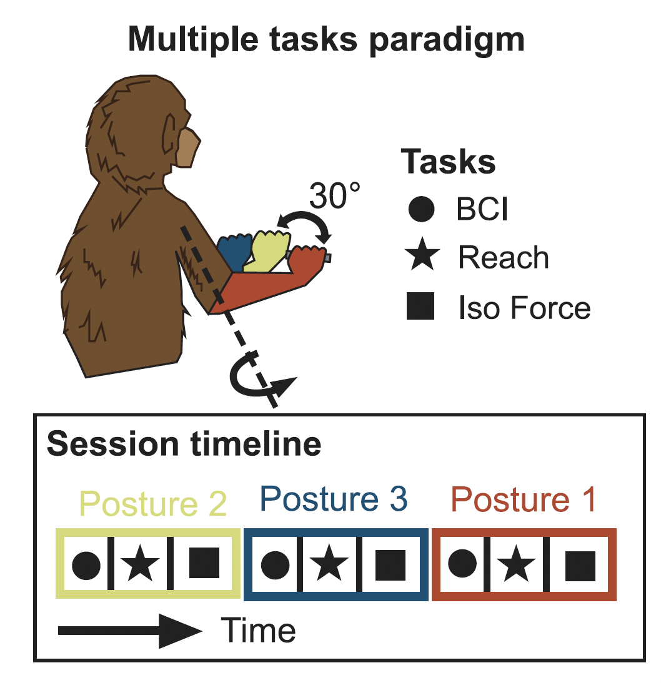
Tasks
BCI: 8-target center-out, arm still, and a new decoder calibrated for each posture (100–200 trials per block)
Isometric force (E only): up/down force to a peripheral target (4.75 ± 0.62 N), with five shoulder-rotation postures
Reaching: center-out for N and R (posture = 2 initial hand locations, 123.7 mm apart) and delayed center-out for E Array 2 (7 initial hand locations)
Multi-task (E only): BCI, isometric and reaching in a single session at the same three postures (neutral, ±30° shoulder rotation)
Posture manipulation:
  E fine: 15° steps about the shoulder or elbow via a mechanical device
  N and R coarse: 45° forearm rotation, or 90° upper-arm abduction, via a brace

Slide 9
Methods - Analysis
Windows: BCI and isometric 50–250 ms after go cue; reaching the 200 ms before movement onset. Rates were smoothed with a 25 ms Gaussian and z-scored, and electrodes with mean rate <3 Hz were dropped
PCA to the top 10 PCs (90 ± 4% of variance), and dPCA (time/posture/goal marginalizations) for visualization
Cross-projection alignment test: 2D posture and goal subspaces identified on one fold and variance captured measured on the held-out fold (10,000 splits), compared against random 2D subspaces
Posture consistency across tasks: LDA plus max-likelihood classification (within task, train on all, train on one and test on the others), 5-fold
Trajectory similarity: translate one trajectory onto another, normalize to the within-condition floor, and use adjacent targets (45° apart) as the reference

Slide 10
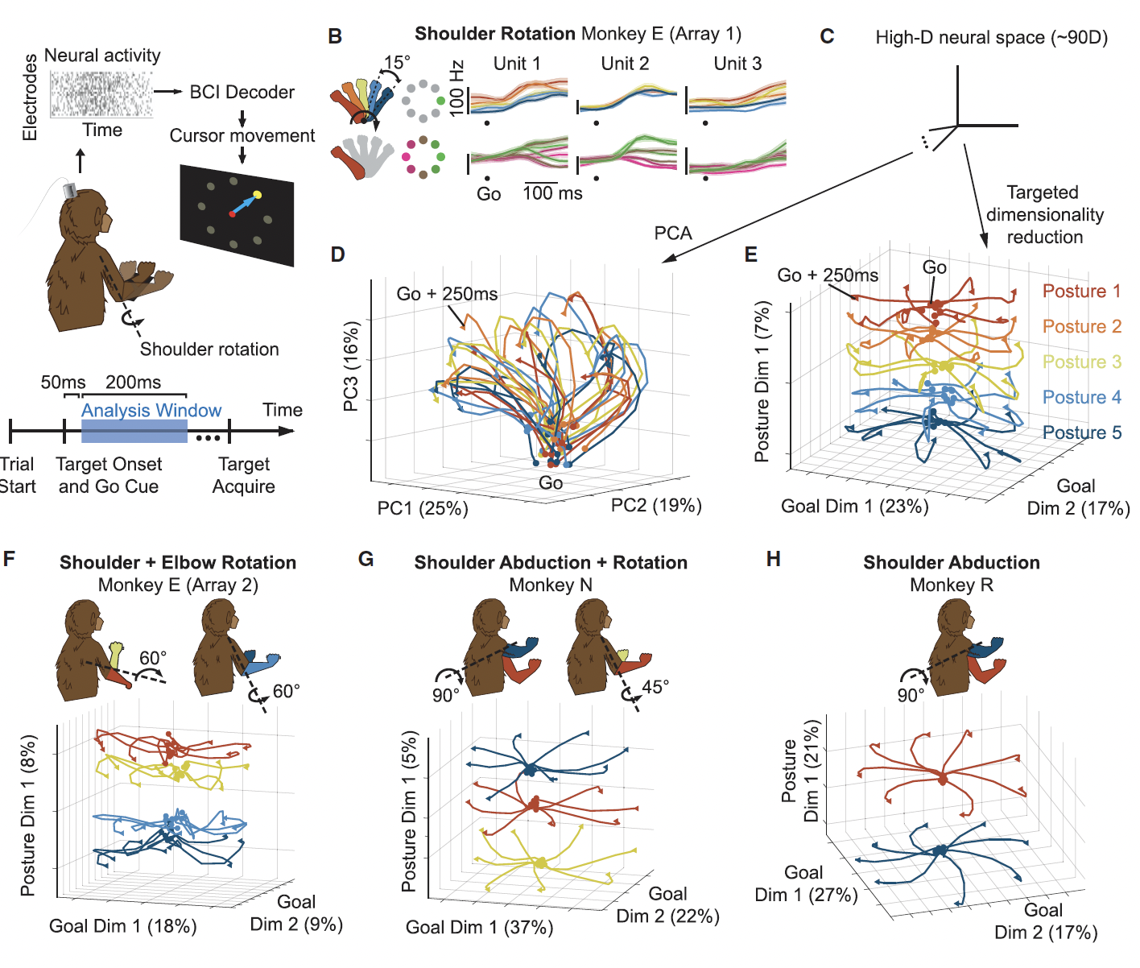
Results – Posture and goal occupy separate Dimensions
Method: dPCA on 50–250 ms activity
Single units: mostly mixed tuning to posture and goal (E 89%, N 88%, R 76%)
PCA: no discernible organization (PC1–3: 25%, 19%, 16%)
dPCA: goal dimensions fan trajectories out by target. Posture offsets whole trajectories with shape conserved, ordered by arm angle
Replicated for shoulder rotation (E), elbow rotation (E Array 2) and shoulder abduction (N, R)
Notes:
The posture dimension explains little variance, at 7% (E shoulder), 8% (E elbow), 5% (N) and 21% (R). The authors suggest across-animal differences may reflect array location, the postural manipulation used, or cursor kinematics
The decoder control was done in a single experiment in Monkey E
Kinematic control: the cursor difference rose significantly from within-condition to 15° (p < 10⁻³²), then not from 15→30° (p=0.52), 30→45° (p=0.09) or 45→60° (p=0.63). Isometric force showed the same pattern (p=0.01, then 0.56, 0.34, 0.77). So a posture change of any size produced some kinematic difference but no monotonic growth

Slide 11
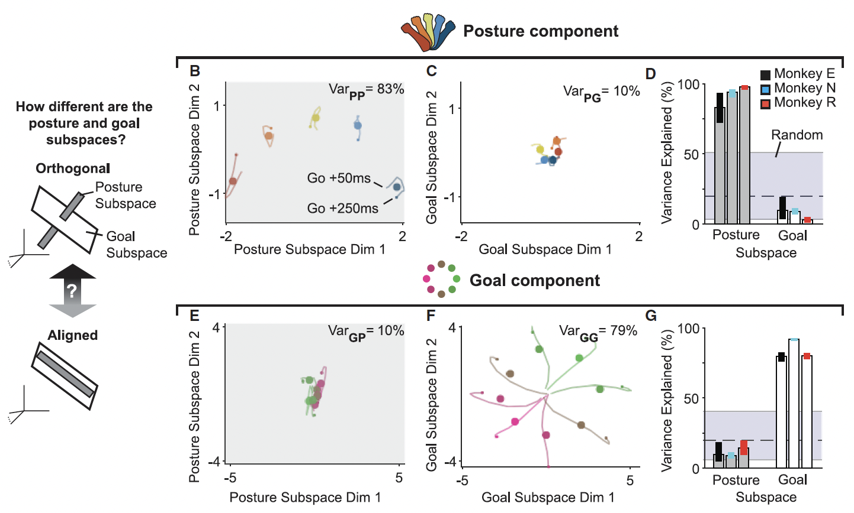
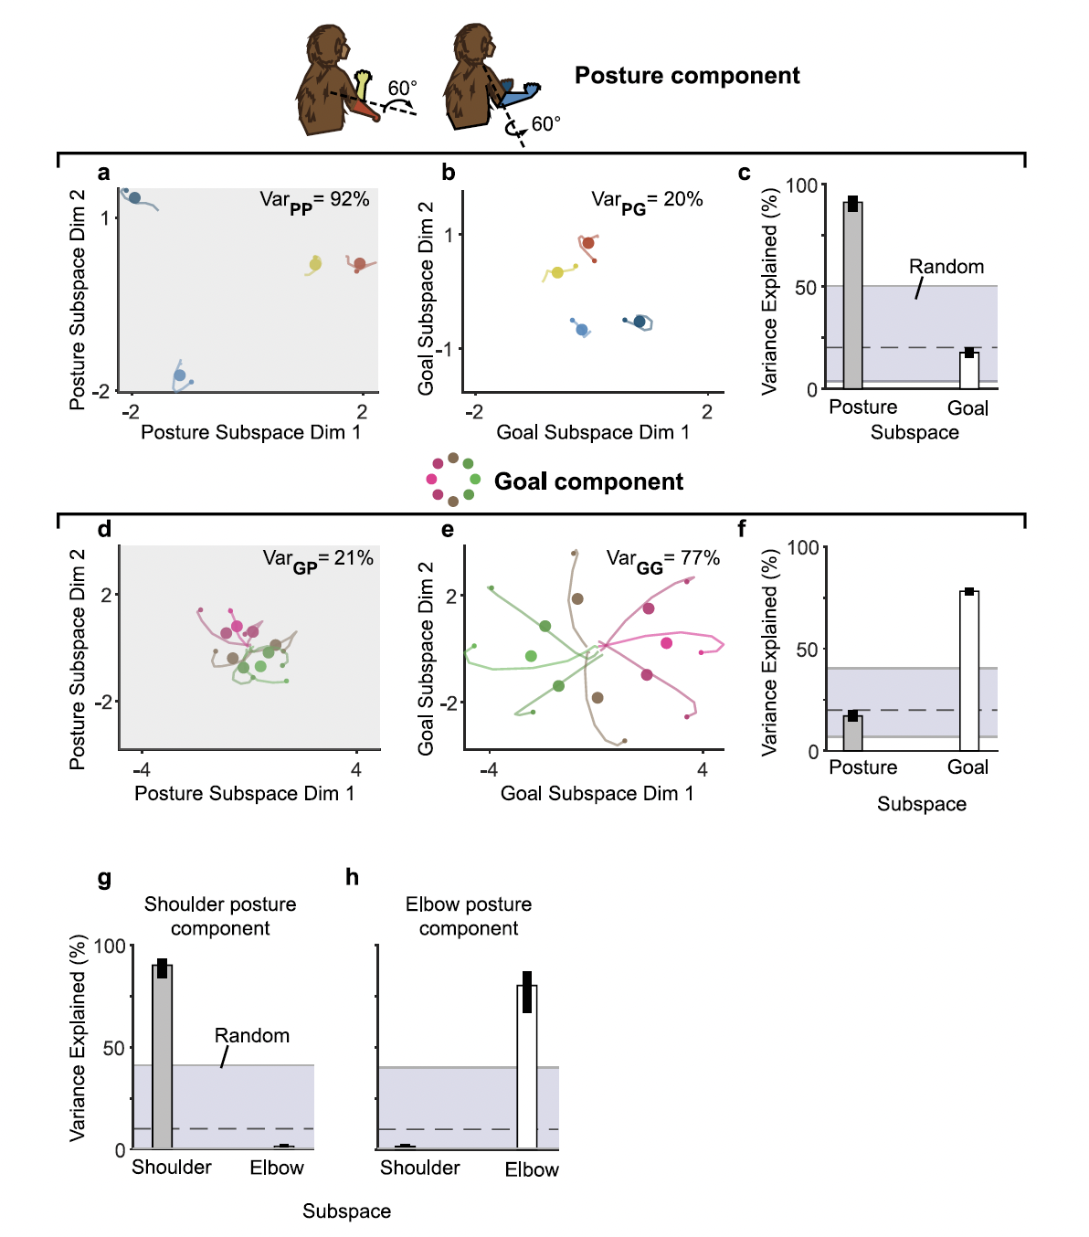
Results – Posture and goal subspaces are nearly orthogonal
Method: cross-projection alignment test
Example (E): posture subspace captures 83% of posture variance, goal subspace only 10%. Goal subspace captures 79% of goal variance, posture subspace 10%
Consistent in every session and animal, with goal-subspace capture of posture variance at the low end of the random-subspace distribution
Two-joint session (E): combined posture subspace 92% (goal subspace 20%). Shoulder and elbow subspaces were also nearly orthogonal to each other
Notes:
"Nearly", not fully, orthogonal. Cross-captured variance is about 10–21%
In the two-joint session the cross-captured value (about 17–21% in Fig S5) sits close to the random-subspace mean (dashed line, about 20%). The authors call it the low end of the random distribution
Reported p < 10⁻²⁵ (see the bootstrap note on Slide 8)
Figures: 3, S5

Slide 12
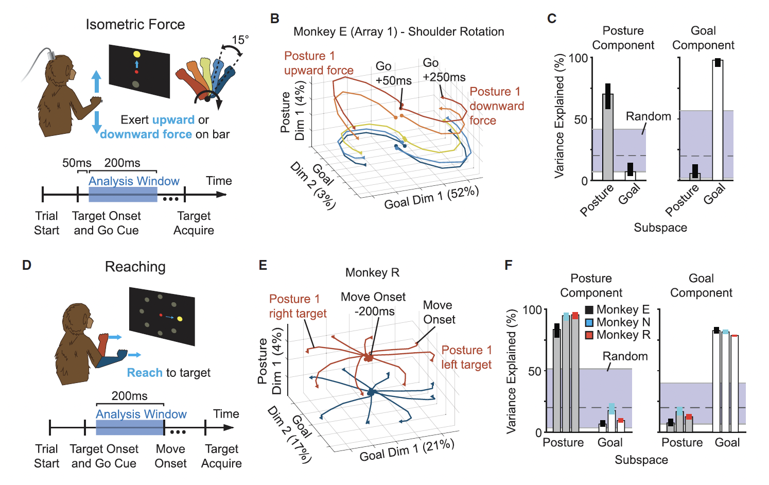
Results – The same organization holds in overt tasks
Method: same dPCA and alignment analysis, in isometric force (E) and reaching (E, N, R)
Isometric: trajectories have similar shapes across the five postures and are offset along the posture dimension (4%), and the subspaces are nearly orthogonal (p < 10⁻²⁵)
Reaching: same result (example R: posture 4%, goal 21% and 17%)
Controls: shifting the visual workspace did not change goal-subspace activity, so it follows reach direction. Once the arm moves, the posture dimension does not closely track hand position (Fig S7)
Notes:
Reaching is the only task with systematic kinematic changes across postures (p < 0.002 for all comparisons). The authors argue this can't explain the posture subspace, because BCI and isometric lack such changes and the subspace is shared across tasks
Reaching "posture" is initial hand location, so posture and hand position are confounded. The lack of hand-position tracking is explained only speculatively, via nonlinear spindle and muscle-length effects
Reaction times differ: E ≈ 310 ms in reaching, versus ≈ 200 ms for N and R
Isometric force is Monkey E only

Slide 13
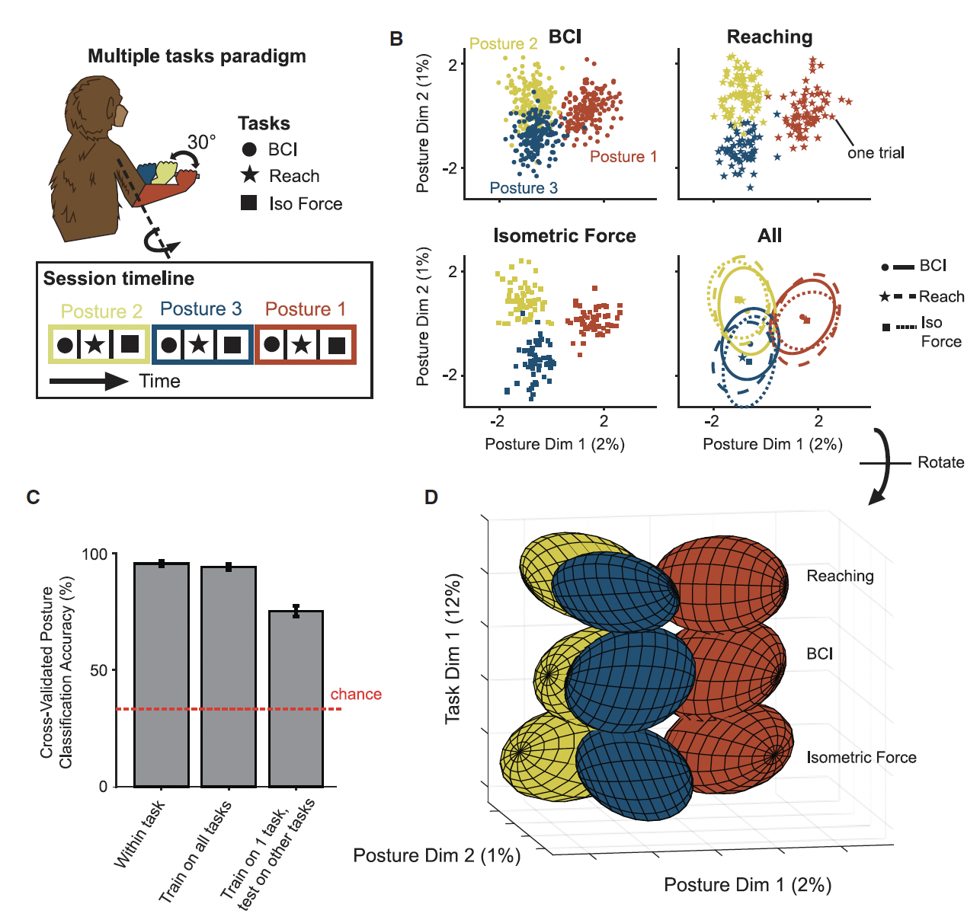
Results – The posture subspace is shared across tasks
Method: multi-task paradigm (E), with one LDA posture subspace and maximum-likelihood classification of posture
LDA projections look similar across BCI, isometric and reaching
Classification accuracy: within task 96.7%, one classifier on all tasks 95.4%, train on one task and test on the others 77.8% (chance 33.3%)
Overall activity differs strongly between tasks (Task Dim 1 = 12%), so a shared posture signal is not simply shared overall activity
Notes:
One session, one animal, and only three postures (30° apart)
Cross-task generalization drops about 18 points relative to the pooled classifier, so the subspace is shared but not identical
Posture dims explain very little variance here (2% and 1%). The authors note this is smaller than in Fig 2 because of the added across-task variability
BCI in this paradigm is center-out-across with a 500 ms freeze period, slightly different from the standalone BCI task

Slide 14
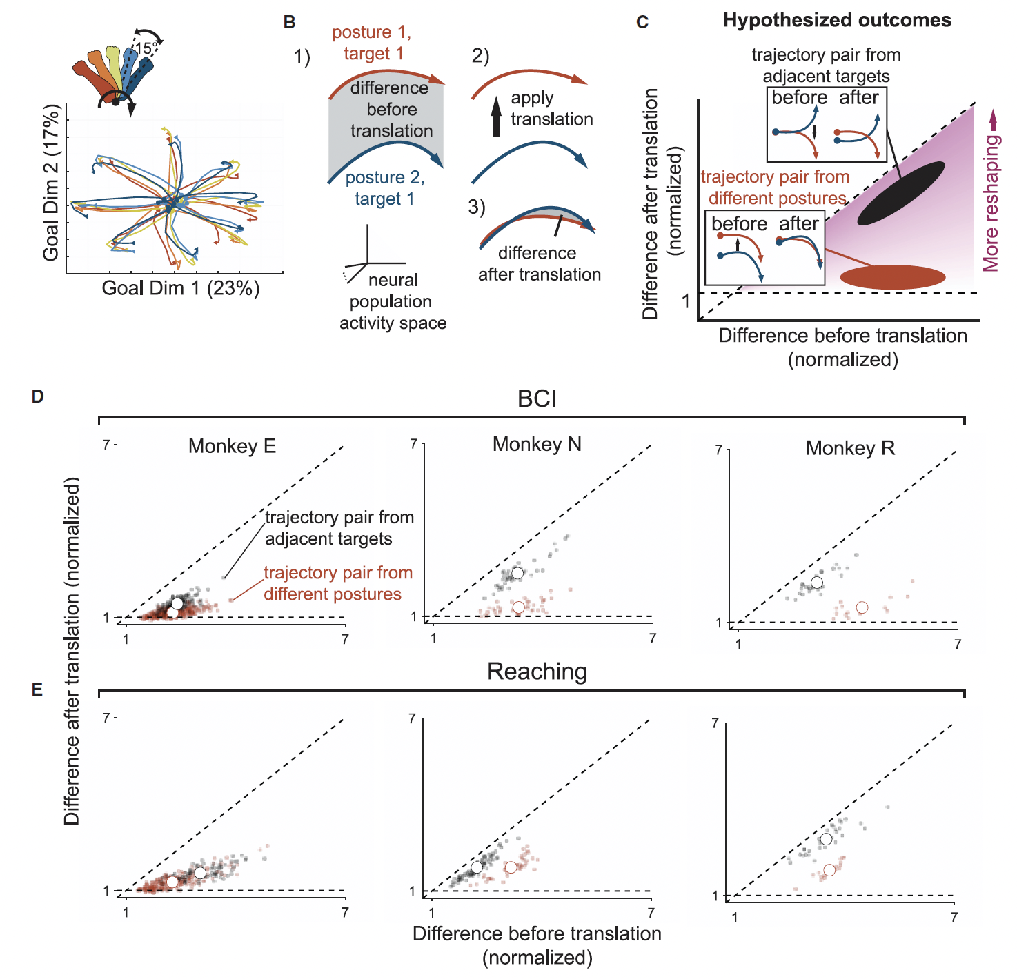
Results – Trajectory shapes are similar across postures
Method: translation-only alignment of trajectories from different postures (same target), normalized so 1 = the floor set by finite trials, with adjacent targets (45° apart) as reference
Translation removed most of the difference: BCI 89% (E), 85% (N), 83% (R); reaching 73% (E), 58% (N), 63% (R)
Across-posture differences after translation were smaller than across-adjacent-target differences: BCI E p<10⁻⁹, N p<10⁻⁶, R p<0.01. Reaching E p=0.03, N p<10⁻³, R p<10⁻⁷
Notes:
Not all difference is removed. Values stay above 1, so posture causes some reshaping even in BCI. Reshaping is larger in reaching, which the authors attribute to posture-dependent proprioceptive feedback or outgoing muscle commands
Reaching E is marginal (p=0.03)
Monkey R BCI is based on only 3 bin differences (7 for N reaching, 12 for N BCI; Table S1)
Monkey N reaching: within each bin the red points sit below the black points, but the overall means are not different
Isometric force was excluded because it has only two targets 180° apart, so the analysis was uninformative
Translation only (no scaling), and normalized values can be below 1

Slide 15
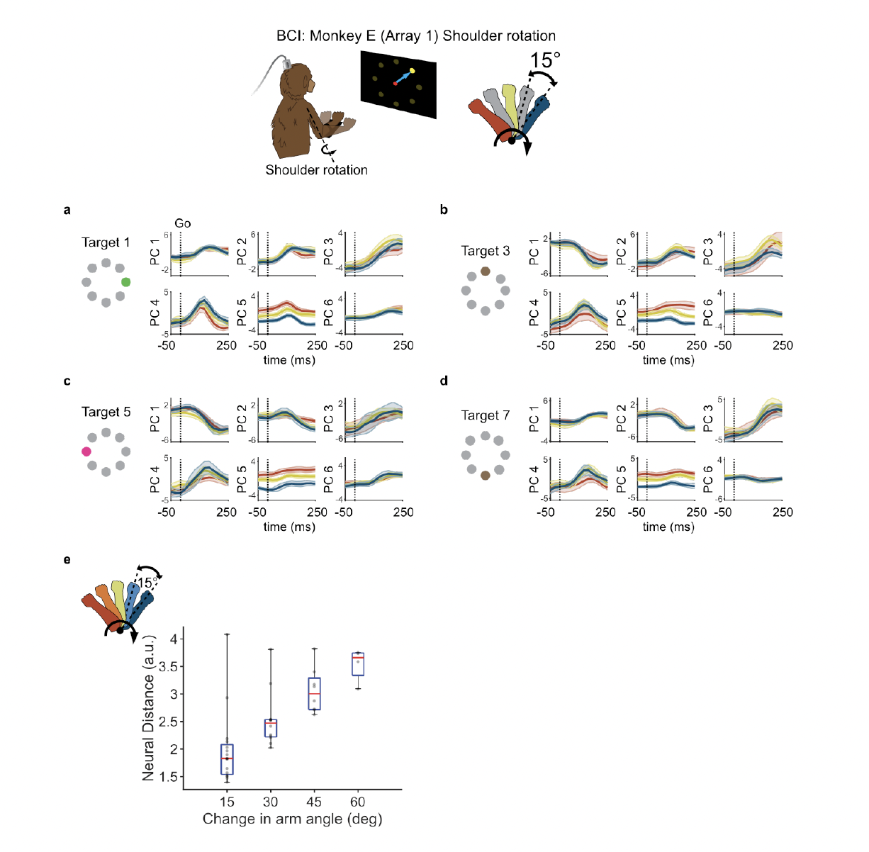
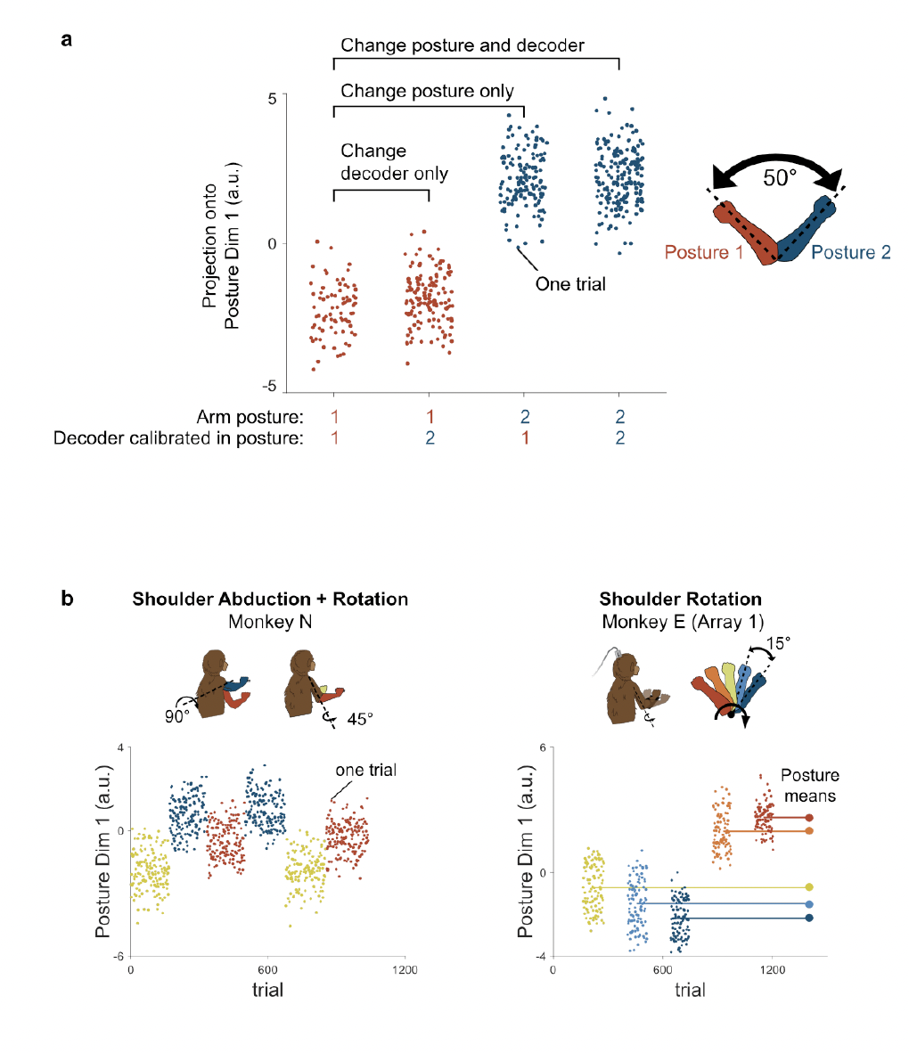
DPCA is not necessary and drift doesn’t account

Slide 16
Discussion
M1 organizes posture and goal into separate, nearly orthogonal subspaces that are preserved across tasks, with trajectory shape conserved across postures
This is simpler than single-unit complexity suggests; complicated single-unit effects likely reside in low-variance dimensions
Proposed benefits of separating posture from goal:
  Goal signals can be reused across postures, allowing compositional coding and generalization to new postures
  Different dynamical flow fields can be learned per posture. Posture could act as an input that "selects" the appropriate dynamics, and the small shape changes seen may reflect slight flow-field differences
  Posture information can enter M1 without immediately causing limb movement, because it avoids the "output-potent space". M1 can process it before it affects movement, so it is used in a goal-dependent way and not mapped one-to-one to muscles as in a simple reflex
Joins a growing list of non-motor-output signals in M1: arousal, reward, uncertainty, somatosensory feedback, memory

Slide 17
Origin of the signal and clinical BCI implications
Likely origin: proprioceptive input (arm was passive during analysis, so not an efferent posture-maintenance signal)
Orthogonality may reflect separate somatosensory/premotor pathways, or be learned to gain the benefits above
Similar goal geometry in BCI and reaching may reflect motor planning transferring from reach training to BCI use
Clinical BCI implications:
  Sampling enough postures could yield a single decoder robust to posture change
  Decoders/stimulation could be designed to avoid the goal subspace
  Relevant for users with residual motor control or caregiver-adjusted posture

Slide 18
Limitations
Three monkeys. Only Monkey E had posture varied systematically around a single joint. N and R had only 2–3 coarse postures
Only proximal arm/shoulder/elbow postures were tested (whether this generalizes to the wrist, hand or other body postures is unknown), and the analysis windows were early (pre-movement / early execution)
Multi-task paradigm had only one session in one animal
M1 and PMd recordings were pooled, and unit definition differed by lab (unsorted channels for E vs sorted units for N and R)
Correlational: no causal test of the posture signal's origin (proprioceptive is inferred), or of the mechanism producing orthogonality
Reaching posture was confounded with hand location and systematic kinematic changes, and the trajectory-similarity analysis was not shown for isometric force. Trajectories were not perfectly reshaped-free (values remain above 1)
Some Fig 6 comparisons rest on few data points (e.g. 3 bin differences for Monkey R BCI)
Analyses (PCA, dPCA, LDA) are linear, so nonlinear structure may be missed
Animals were trained on reaching before BCI, so BCI geometry may partly reflect reaching strategies → no effect on learning on these representations

Slide 19
What can we Take
Posture is a confound to plan for. Arm posture shifts M1 activity along a consistent, low-variance dimension, so systematically varying posture (and calibrating or controlling for it) is worth building into BCI datasets → How does this translate to ECoG?
Is it worth only looking at premovement epochs to understand this?
Posture-invariant decoding: if the goal subspace is stable, pooling several postures to train the decoder could reduce recalibration when a patient's posture changes
The cross-projection alignment test is a good way to quantify overlap between subspaces (e.g. across gestures, sessions, or array regions), and is more informative than principal angles alone
Choose analysis windows that avoid proprioceptive feedback, and check trajectory shape reuse with the translation analysis
Demixed methods (dPCA, LDA) can pull out effects that PCA hides in low-variance dimensions

Slide 20
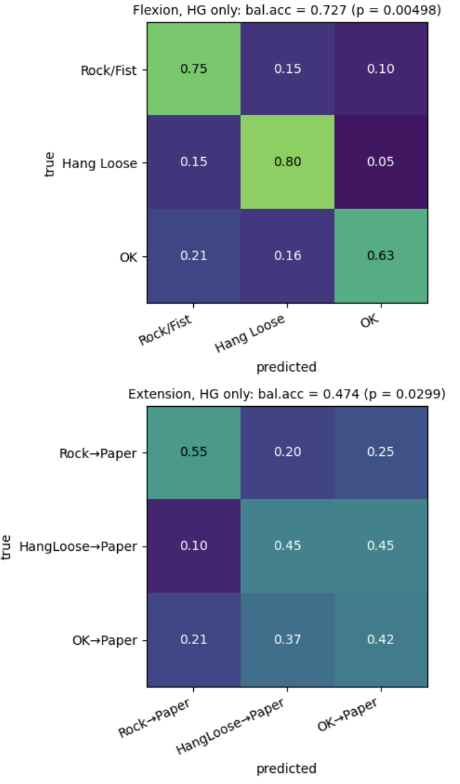
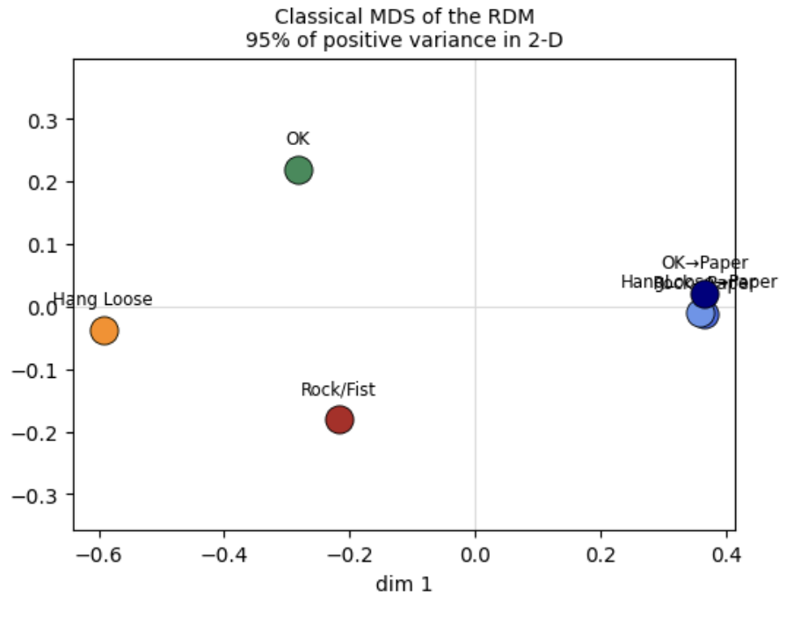
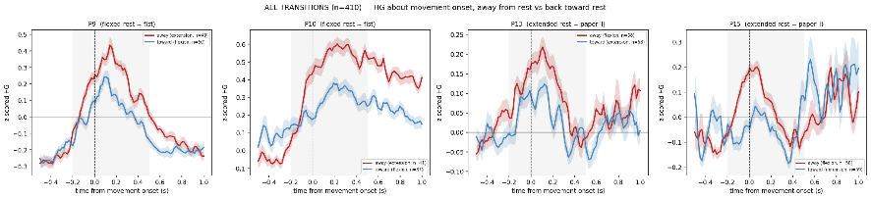
Our Data
We seem to see only Goal-Directed Activity with P15, with a lack of postural representations
We see differences in HG response based on starting positions (aligned to goal) across patients and locations on M1
We see an away and to rest effect which they cannot test
Notes:
Not all difference is removed. Values stay above 1, so posture causes some reshaping even in BCI. Reshaping is larger in reaching, which the authors attribute to posture-dependent proprioceptive feedback or outgoing muscle commands
Reaching E is marginal (p=0.03)
Monkey R BCI is based on only 3 bin differences (7 for N reaching, 12 for N BCI; Table S1)
Monkey N reaching: within each bin the red points sit below the black points, but the overall means are not different
Isometric force was excluded because it has only two targets 180° apart, so the analysis was uninformative
Translation only (no scaling), and normalized values can be below 1

