Slide 1
JOURNAL CLUB
Distinct roles of the human cuneiform and pedunculopontine nuclei in gait and freezing of gait
Yeche & Collomb-Clerc et al. | Brain, 2026 (accepted manuscript, awag259) | Welter lab, Paris Brain Institute
CuN
PPN
FOG
First simultaneous recording from both MLR nuclei in humans, in four patients.
Pedro Borges | Cajigas Lab
Notes:
Opening line: this is the first study to record local field potentials from the cuneiform nucleus and the pedunculopontine nucleus at the same time, in the same human patients, while they walk.
Frame the stakes up front: MLR deep brain stimulation trials for freezing of gait have been inconsistent for fifteen years, and almost all of them targeted the PPN. This paper argues that the target may have been wrong.
Note the sample: four patients. Say that out loud early so nobody is surprised later. The value is the rarity of the recording, not the power.

Slide 2
WHY THIS PAPER
Freezing of gait is the symptom we cannot treat
The symptom
What fails
The proposed target
Sudden, transient inability to step
Leading cause of falls and loss of independence in PD
Episodic and context-dependent, not continuous
Poor response to levodopa
Poor response to STN and GPi DBS
No reliable physiological marker to target
Mesencephalic locomotor region (MLR) in the brainstem
Conserved locomotor hub across species
Trials since 2007, results inconsistent
The unexamined assumption
Every human MLR-DBS trial has treated the region as a single target, and has essentially targeted the PPN.
But the MLR contains two nuclei with no sharp anatomical boundary, and animal work says they do opposite things.
If they do opposite things, averaging across them would produce exactly the inconsistent trial results we have.
Notes:
Keep this to about ninety seconds. Most of the room knows what freezing is, so the point of the slide is the last block, not the first.
The argument to land: MLR-DBS has been tried since Stefani 2007 and Ferraye 2010 and the results never replicated cleanly. The usual explanations offered are small samples, variable lead placement, and stimulation parameters. This paper offers a different explanation: the region was never one target.
If someone asks why nobody separated them before: you cannot separate them on standard clinical MRI, there is no visible boundary, and you need a histological atlas plus a deliberately oblique trajectory to get contacts in both.

Slide 3
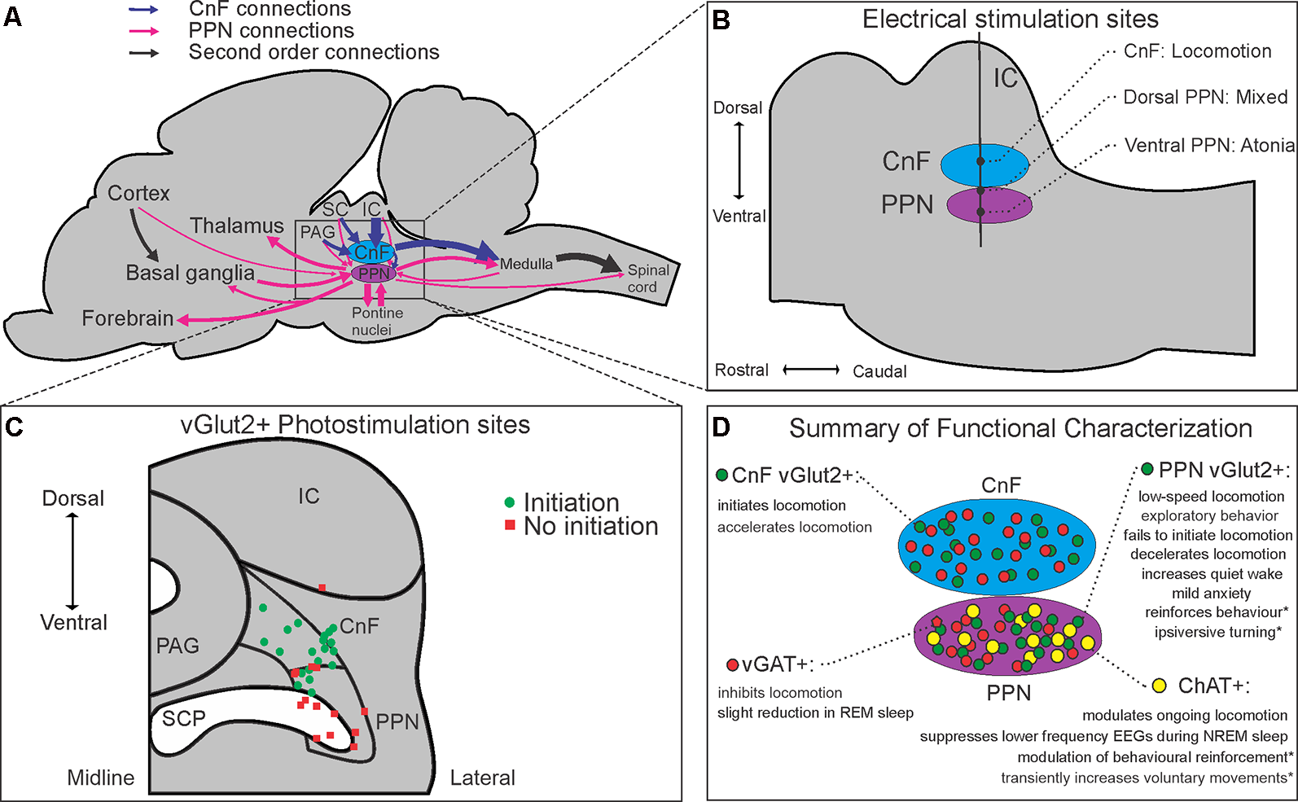
Preliminary info
Mesencephalic Locomotor Region
Chang SJ, Cajigas I, Opris I, Guest JD and Noga BR (2020) Dissecting Brainstem Locomotor Circuits: Converging Evidence for Cuneiform Nucleus Stimulation. Front. Syst. Neurosci. 14:64. doi: 10.3389/fnsys.2020.00064
Anatomical, neurochemical, and connectome-based characterizations of the mesencephalic locomotor region (MLR). Schematic summaries of (A) major inputs and outputs of the CnF and PPN in rodents, (B) anatomical electrical mapping of the MLR in cats from Takakusaki et al. (2016); (C) CnF and PPN vGlut2+ photostimulation results from Josset et al. (2018) and (D) cell-type-specific functional characterizations of the CnF and PPN reported in the literature. Abbreviations: ChAT, choline acetyltransferase; CnF, cuneiform nucleus; IC, inferior colliculus; PAG, periaqueductal gray; PPN, pedunculopontine nucleus; SC, superior colliculus; SCP, superior cerebellar peduncle; vGAT, vesicular GABA transporter; vGlut2, vesicular glutamate transporter 2. *Denotes behavioral effects elicited from subsets of a neurochemical population projecting to specific targets.
Notes:
Keep this to about ninety seconds. Most of the room knows what freezing is, so the point of the slide is the last block, not the first.
The argument to land: MLR-DBS has been tried since Stefani 2007 and Ferraye 2010 and the results never replicated cleanly. The usual explanations offered are small samples, variable lead placement, and stimulation parameters. This paper offers a different explanation: the region was never one target.
If someone asks why nobody separated them before: you cannot separate them on standard clinical MRI, there is no visible boundary, and you need a histological atlas plus a deliberately oblique trajectory to get contacts in both.

Slide 4
BACKGROUND
Two nuclei, two circuit identities
CuN
Cuneiform nucleus (dorsal)
PPN
Pedunculopontine nucleus (ventral)
Weak basal ganglia input, and what there is comes from limbic circuits (ventral striatum and pallidum)
Dominant input from threat-detection centres: superior colliculus, periaqueductal grey
Excitatory output straight to medullary reticular formation, bypassing fine postural circuits
Mice: optogenetic drive of glutamatergic CuN neurons produces fast, physiological locomotion
Prediction: a go signal, tied to rhythm and speed
Densely embedded in basal ganglia loops: massive input from SNr and GPi
Integrates sensorimotor and associative information; ascending feedback to thalamus
Output to pontine reticular formation
Mice: cholinergic, glutamatergic and GABAergic populations; can slow, modulate posture, or halt locomotion
Prediction: postural set and online modulation, not rhythm generation
Human evidence before this paper: CuN neurons fire during simulated stepping, CuN stimulation can evoke rhythmic leg EMG, and PPN LFPs show theta and alpha modulation during imagined gait. Nobody had recorded both at once.
Notes:
This is the slide that makes the whole paper make sense, so do not rush it. Everything downstream is a test of the two predictions in the bottom row of each column.
The cleanest way to say it: the CuN is wired like an accelerator that reports to escape and arousal circuits. The PPN is wired like a gearbox that reports to the basal ganglia. If you put one electrode across both and stimulate blindly, you have no idea which one you are driving.
Worth saying explicitly: almost all of this dissociation comes from mice. The human claim is an inference. That is a fair thing to push on later.
Optional: if you want an image here, Figure 1A gives you the atlas view with purple PPN and green CuN. But you will show Figure 1 properly in three slides, so it may be better to keep this one as text and let the anatomy land visually later.

Slide 5
AIMS
The gap and the three questions
No study had ever recorded from the CuN and the PPN simultaneously in a human. So it was unknown whether the two nuclei carry different signals during walking, and whether either signal relates to freezing.
1
Do the CuN and PPN show distinct electrophysiological signatures during gait initiation?
Compare time-frequency activity between nuclei, aligned to postural and stepping events.
2
Does that organisation break down before a freezing episode?
Compare trials that later froze (FOG+) with trials that did not (FOG-), and correlate LFP with gait mechanics.
3
Does stimulating the two nuclei produce different clinical effects?
Double-blind randomised cross-over of CuN DBS, PPN DBS, and sham, in the same patients.
Notes:
Say the three questions out loud and then say that the results section follows them in exactly this order. That gives the room a map and you will not have to re-orient them at each figure.
Point out the design asymmetry, because it matters for how much weight each result carries. Questions 1 and 2 are observational and come from a single recording session in the first days after surgery. Question 3 is a genuine randomised double-blind cross-over. The strongest design is attached to the weakest mechanistic claim, and vice versa.
One phrasing to be careful with: the paper says freezing was 'predicted'. It was not predicted prospectively. Trials were sorted after the fact by whether freezing happened later. Flag it here lightly and come back to it at the limitations slide.

Slide 6
01
METHODS
Who, what was implanted, and how it was measured
Four patients, eight leads, twenty-eight recording dipoles, one hundred and fifty-three gait trials.

Slide 7
METHODS
Patients: a rare and very selected group
6
4
153
38 / 115
enrolled in the parent
MLR-DBS cross-over trial
(NCT02931097)
completed the post-operative
LFP session (2 were too
fatigued to participate)
gait initiation trials
analysed across the
four patients
trials with (FOG+) and
without (FOG-) a subsequent
freezing episode
Inclusion criteria worth stating
Why this matters for interpretation
Idiopathic PD by UK Brain Bank criteria, age 18 to 70
Gait or balance impairment NOT responsive to dopamine (MDS-UPDRS II item 2.12 or 2.13, or III item 3.11 or 3.12, score > 1 in the ON state)
Levodopa responsiveness > 40% for other motor symptoms
No dementia (Mattis > 129), stable medication for 3 months
By design, these are patients whose gait does not respond to dopamine, so they are not representative of PD generally
They still respond to dopamine for limb symptoms, so the dissociation is real and not just advanced disease
Every patient froze during the session, which is what made the FOG+ / FOG- comparison possible at all
All four patients contributed at least one recording dipole in each nucleus, so every within-subject CuN versus PPN comparison is genuinely paired.
Notes:
The number to dwell on is four. Say it plainly and then say why it is still worth an hour of everyone's time: there are only a handful of human MLR recordings in existence, and none with both nuclei at once.
The inclusion criteria are doing real work here. Requiring dopa-resistant gait but preserved dopa response elsewhere is what makes this a clean freezing population rather than a late-stage PD population. Worth pointing out.
Also note the denominator problem you will return to later: 153 trials from 4 patients. Most of the statistics treat trials as the unit, with patient as a random effect. With four levels, a random effect is barely estimable.
Detail if asked: FOG+ trials were 12 OFF medication and 26 ON, while FOG- trials were 57 OFF and 58 ON. So freezing was over-represented in the ON state. The paper does not comment on that.

Slide 8
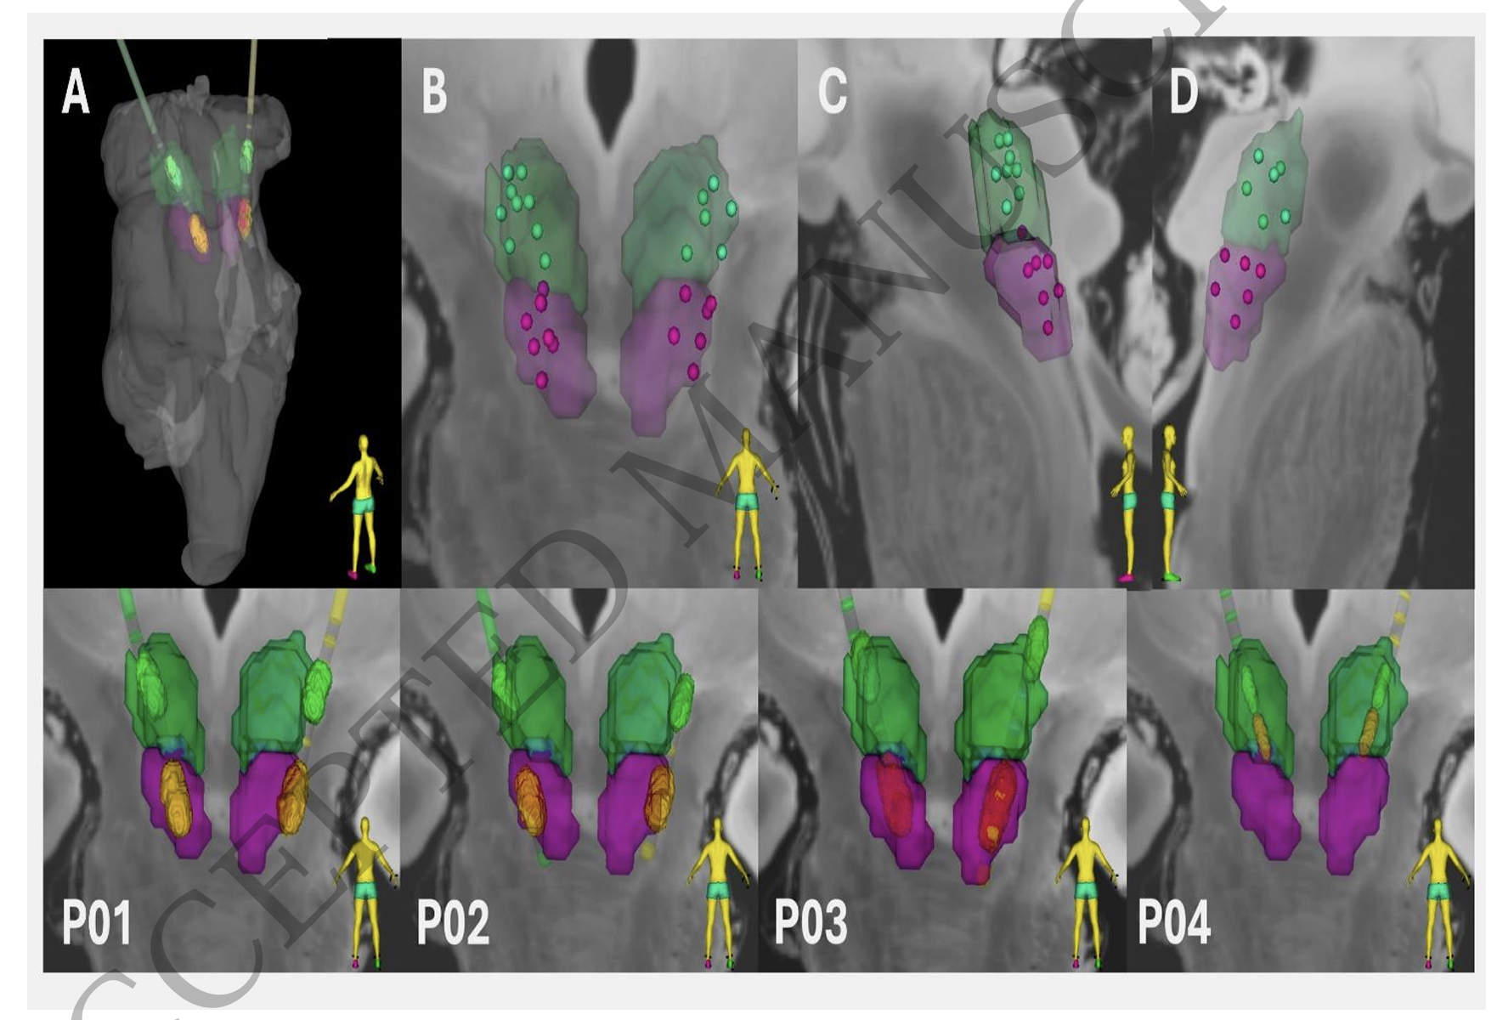
METHODS | FIGURE 1
The electrodes: one lead, deliberately crossing both nuclei
Boston Scientific DB-2201, 8 contacts, implanted bilaterally and externalised for recording
Trajectory is intentionally oblique in both the anteroposterior and dorsoventral planes, so one lead spans both nuclei
Targeting used a 3D histological deformable atlas of the human brainstem built from 11.7T MRI plus immunohistochemistry, warped to each patient's T1
Post-op CT co-registered to pre-op MRI and overlaid on the atlas to assign each contact
56 bipolar dipoles recorded (7 per lead). Only 28 fell inside a defined territory: 15 CuN, 13 PPN
Deeper contacts = PPN. More dorsal = CuN. Because of the oblique angle, CuN contacts also sit anterior to PPN contacts
CuN n=15
PPN n=13
Notes:
This is the slide where you earn credibility with the surgeons in the room, so give it time.
The key methodological move is the oblique trajectory. It is what makes the within-patient comparison possible. Both nuclei, same lead, same patient, same session. Every difference you see later is therefore not a between-subject difference.
Be precise about the atlas, because the entire nucleus assignment rests on it. It is a probabilistic histological atlas with density maps of cholinergic and non-cholinergic populations, nonlinearly registered to each patient. The PPN is defined as the cholinergic territory at the pontomesencephalic junction; the CuN is the dorsal, more GABAergic territory above it.
Then state the soft spot honestly: there is no sharp anatomical boundary between these nuclei in a real brainstem. The labels come from a warped probabilistic atlas, not from the patient's own histology. Contacts near the border could be misassigned, and a 1.5 mm contact recording an LFP is sampling a volume larger than the separation between some of these dipoles.
Also note that 28 of 56 dipoles were used. The other 28 fell outside either territory and were dropped. Nobody reports what was in them.

Slide 9
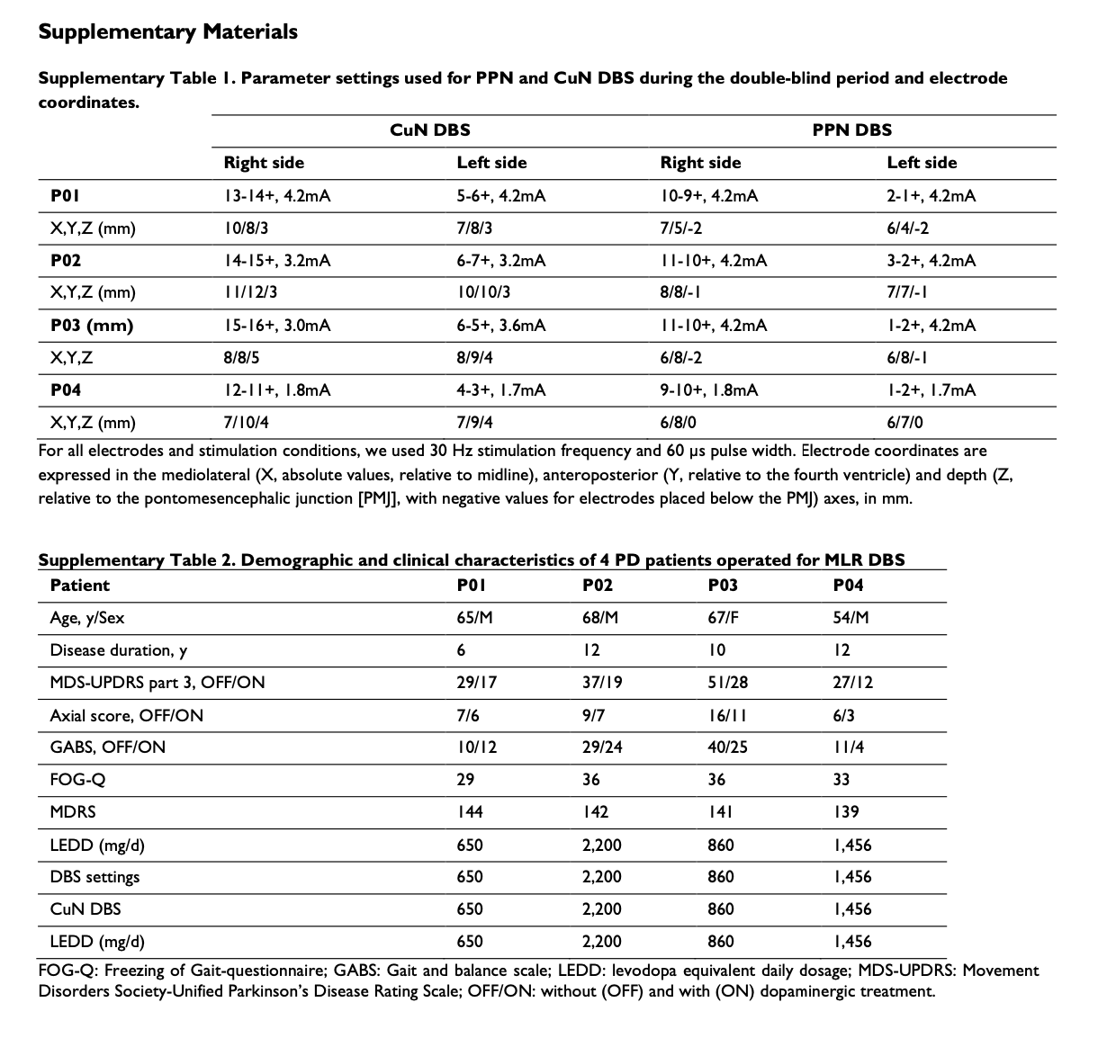

Slide 10
METHODS
Study structure: one session, then a blinded cross-over
1
Baseline
2
Surgery
3
Day 1 to 4
4
Month 2 to 8
Pre-op clinical
evaluation
Bilateral MLR leads,
externalised
LFP SESSION
DOPA OFF and ON
All Fig. 2 to 5 data
Three 2-month blocks:
CuN DBS / PPN DBS / sham
Randomised, double-blind
What was compared, and against what
Stimulation parameters
FOG+ versus FOG- trials (freezing imminence)
DOPA OFF versus DOPA ON (within every session)
CuN versus PPN dipoles (within every patient)
DBS CuN versus DBS PPN versus DBS OFF (sham)
Bipolar, adjacent contacts as anode and cathode
30 Hz, 60 microsecond pulse width, 1.7 to 4.2 mA
Amplitude set below side-effect threshold per patient and held constant within a block
Mean contact coordinates: CuN 8.5 / 9.2 / 3.6 mm; PPN 6.5 / 6.9 / -1.1 mm (lateral / AP from 4th ventricle / depth from PMJ)
Note the two-timescale design: all of the neural data comes from step 3, all of the stimulation data from step 4, months apart.
Notes:
There is no figure in the paper for the overall study timeline, which is part of why it is confusing on first read. This slide is the one thing you are giving the room that the paper does not.
The point in the orange line at the bottom is the one people miss. The LFP recordings happened in the first four days after surgery, through externalised leads. The stimulation experiment happened two to eight months later through the implanted generator. So when Figure 6 says alpha power predicts DBS response, it is relating a signal recorded in the immediate post-operative period to a behavioural outcome measured months afterwards.
That cuts both ways and you should say both. It is a limitation, because the post-operative period has a stun or microlesion effect and the brain is not in a steady state. It is also arguably a strength, because a marker that survives a months-long gap and still predicts is a more impressive marker than one measured concurrently.
Small thing worth flagging if the room is detail-minded: the paper writes '60 s pulse width', which is obviously a typo for 60 microseconds. Also, the Methods describe the lead as a DB-2201 with 2 mm contact spacing in one paragraph and as a Cartesia with 0.5 mm spacing in another. Those are different leads. It is an accepted manuscript, so it is probably an uncorrected error, but contact spacing determines what a bipolar dipole actually samples, so it is not trivial.

Slide 11
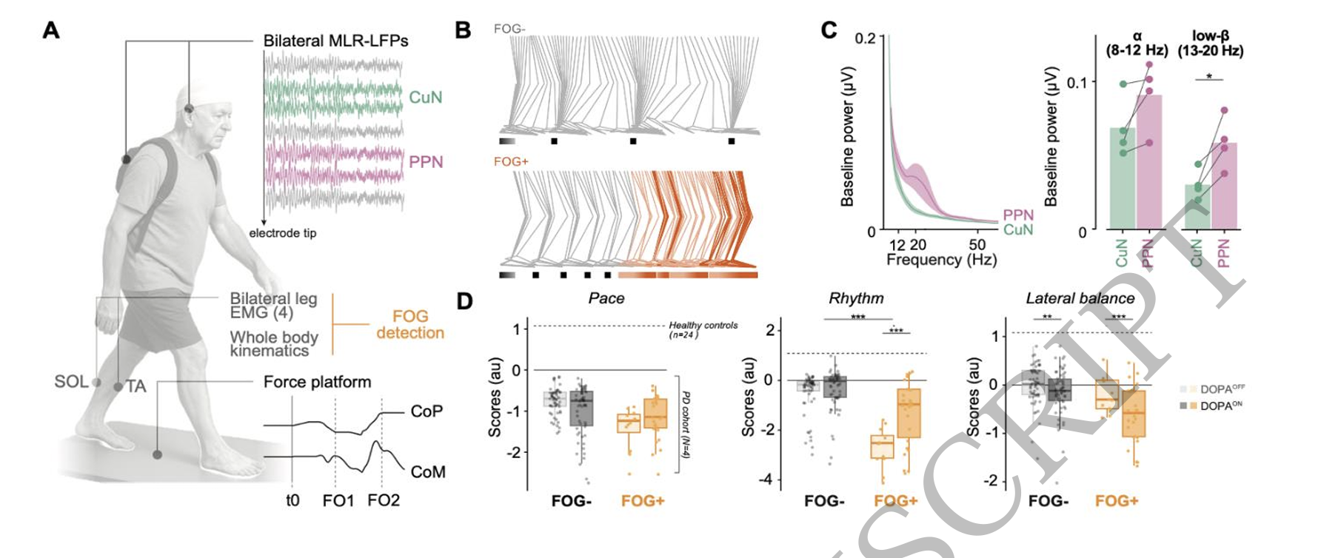
METHODS | FIGURE 2A
The task: self-paced gait initiation, fully instrumented
The recording stack:
Force platform 0.9 x 1.8 m (AMTI), ground reaction forces and moments at 1000 Hz
32-marker motion capture (Vicon) for whole-body kinematics during walking and turning
Surface EMG, soleus and tibialis anterior bilaterally, 2000 Hz
LFP amplified and transmitted by Bluetooth from a portable amplifier in a backpack
Trial: quiet standing, visual cue, walk 6 to 8 m, turn, walk back
Gait initiation split into two phases: APA (t0 to first foot-off, FO1) and step execution (FO1 to first foot contact)
(A) Schematic of experimental setup combining simultaneous MLR-LFP recordings (via externalized DBS 34) with whole-body motion capture, force platform dynamometry (Center of Pressure, 1 CoP; Center of Mass, CoM), and surface electromyography (EMG) of soleus (SOL) and 2 tibialis (TA). Temporal events are defined as: t0 (onset of anticipatory postural adjustment 3 phase, APA), FO1 (foot-off, first step) and FO2 (foot-off, second step). (B) Reconstruction of 4 leg kinematics in one patient for one trial without FOG (FOG-, upper panel) and one trial 5 with FOG (FOG+, bottom panel, orange). (C) Baseline mesencephalic power spectra. Left: 6 Mean power spectral density (PSD) at rest for CuN and PPN. Right: Comparison of average 7 baseline power in the alpha (8–12 Hz) and low-beta (13–20 Hz) bands. Dots indicate 8 patient-level averages across contacts (n = 4 patients). *p < 0.05, paired t-test.(D) Gait 9 initiation mechanics with and without freezing. Box plots showing kinetic sub-scores, i.e. 10 Pace, Rhythm, and Lateral balance, for trials with (FOG+) and without (FOG−) freezing 11 episodes, in DOPAOFF and DOPAON states. ***p<0.001, LMM, Bonferroni corrected. Box 12 elements: center line, median; box limits, upper and lower quartiles; whiskers, 1.5 times 13 interquartile range; dots, individual trials.
Notes:
The reason to spend time here is that the entire paper hangs on the alignment between the neural data and one biomechanical event, t0, the onset of the anticipatory postural adjustment.
Explain the APA to anyone who does not do movement work, because it is the crux. Before you can lift a foot, you have to shift your weight onto the other one. That weight shift is the anticipatory postural adjustment. It shows up on the force platform as a backward and lateral displacement of the centre of pressure. It is entirely automatic, it precedes the voluntary step, and it is exactly what fails in freezing.
So the segmentation is: t0 is when the APA begins, FO1 is when the lead foot leaves the ground, and everything neural is aligned to t0.
Two things to flag. First, trials where t0 could not be reliably identified were excluded, and the paper does not say how many. Since t0 detection is probably hardest in exactly the worst trials, that exclusion is not obviously random. Second, the freezing episodes themselves happened during walking or turning, not at initiation, so this instrumented platform captured the initiation of trials that later went wrong, not the failures themselves.

Slide 12
METHODS
LFP preprocessing, step by step
Acquisition
Offline processing
Bipolar montage from 7 adjacent contact pairs per lead
Recorded continuously during initiation and walking
Band-pass 0.25 to 300 Hz, sampled at 512 Hz
Porti 32 (TMSi) amplifier, Bluetooth to recording PC
Synchronised with kinetics, exported through a MATLAB biomechanical toolkit
High-pass at 1 Hz, notch at 50 Hz
Epoched from 2 s before the cue to the end of the second swing phase
Multitaper time-frequency (Chronux), 3 orthogonal tapers, 500 ms sliding window, 30 ms steps
Power 1 to 50 Hz, baseline-normalised to an 800 ms pre-trial window, expressed in dB (10 x log10)
Bands of interest: alpha 8 to 12, low beta 13 to 20, high beta 20 to 35 Hz
Comparisons
Bipolar re-referencing!
Baseline normalization is to an 800 ms pre-trial window in the same trial. So, every result is a change from that trial's own standing baseline, not an absolute power. This matters for Figure 4: a group difference could reflect a difference in the baseline rather than in the response.
Notes:
Do not read the pipeline out line by line. Put it on screen, say it is a standard multitaper pipeline with nothing exotic in it, and spend your time on the orange box.
The bipolar point is the important one for a brainstem recording during walking. Monopolar LFP from an externalised lead in a walking patient would be dominated by cable movement. Bipolar rejects the common signal. But the same subtraction that saves the recording is what limits your spatial claim, and the spatial claim is the whole paper.
The baseline point is a nice one to raise if the room is quantitative. Everything is reported in dB relative to that trial's own standing baseline. Figure 2C separately shows that the standing baselines actually differ between nuclei, with more low beta in the PPN. So when Figure 3 shows more beta desynchronisation in the PPN, some of that is because the PPN had more beta there to lose.
A technical nitpick you can keep in your pocket: a 300 Hz anti-aliasing filter with a 512 Hz sampling rate puts the filter corner above Nyquist. It does not affect the alpha and beta results because they only analysed 1 to 50 Hz, but it is a genuine error in the acquisition description.

Slide 13
METHODS
Quality control: what got thrown away, and who decided
The paper applies three independent screens. Two of them are human and blinded to nothing in particular, which is worth discussing.
Automated artifact rejection
Two-examiner visual screen
Two-rater FOG annotation
Trial excluded if mean power exceeded 5.7 times baseline
Trial excluded if peak power exceeded 7.5 dB within -0.5 to +0.5 s of gait initiation onset, over 1 to 100 Hz
No justification given for either threshold, and no count of trials removed
Every trial inspected by at least two independent examiners
Looking for amplifier saturation, spectral smearing, and movement or cable artifact
No inter-rater agreement statistic reported, and no stated rule for resolving disagreement
Episodes marked online during acquisition, then verified offline by two independent raters
Definition: transient inability to initiate or continue stepping, with bursty co-contraction of antagonist muscles on EMG
The EMG criterion is objective, which is better than most FOG papers manage
The question to put to the room: independent raters protect against one kind of error, but not against the one that matters here. Nobody was blinded to trial condition, and the FOG+ versus FOG- label is the paper's main independent variable. If a rater knows a trial ended in a freeze, that could plausibly shape how hard they scrutinise its LFP for artifact.
Notes:
You said you wanted to cover this properly, and it is a good thing to slow down on because most journal club presentations skip it entirely.
The structure to communicate: there are three screens, and they do different jobs. The automated one catches gross amplifier failures. The two-examiner one catches the things an algorithm cannot name, particularly cable motion and spectral smearing. The two-rater FOG annotation defines the outcome variable.
Credit where it is due. Requiring bursty antagonist co-contraction on EMG rather than relying on visual judgement alone is genuinely better practice than most of the freezing literature. Freezing is usually scored from video by consensus, which is notoriously unreliable.
Then the criticism, and phrase it as a question rather than an accusation. Two independent raters tells you about reliability. It tells you nothing about bias if both raters share the same expectation. And here the artifact screen and the outcome label are not independent of each other: the trials that ended in freezing are the trials with more irregular movement, therefore more movement artifact, therefore more likely to be flagged or scrutinised. Without a reported rejection rate broken down by FOG+ and FOG-, you cannot rule out that differential exclusion is doing some of the work.
Concrete thing to ask the room: what would you want to see? Answers might include rejection counts by condition, a kappa for the two raters, and artifact screening done blind to trial outcome.

Slide 14
METHODS
From 17 gait parameters to 3 interpretable scores
17 parameters
Varimax-rotated PCA
5 components, 73% of variance
Spatiotemporal measures
extracted per trial from
force platform data
Component space derived in a
SEPARATE prior cohort of 38 PD
patients, then projected onto
this dataset
Named by correlation with the
original parameters. Three are
reported here
RPC1
RPC2
RPC5
PACE
RHYTHM
LATERAL BALANCE
Step length, propulsion, stepping vigour. How forcefully you move forward.
Step times and cadence. The timing regularity of stepping.
Step width and lateral centre-of-mass speed. Side-to-side control.
Sign convention, and you must say this before Figure 6: a HIGHER score means WORSE performance. So an improvement appears as a negative coefficient. The paper never states this in plain language, and it makes several results read backwards on first pass.
Notes:
Two genuinely good things about this step, and one warning.
Good thing one: the component space was derived in a completely different cohort of 38 patients in an earlier study, and then projected onto this data. That means there is no double dipping. They did not find components in these 153 trials and then test hypotheses about those same components. This is the right way to do it and it deserves an explicit compliment.
Good thing two: the components were compared against 24 age-matched healthy controls, so the scores have an external reference point.
The warning: five components were extracted and only three are ever discussed. RPC3 and RPC4 are never named or reported. Bonferroni correction is applied for n equals 5, so they were tested. Ask the room whether silently dropping two of five components is fine, given the correction implies all five were examined.
And hammer the sign convention. Higher equals worse. When Figure 6 shows CuN DBS improving Rhythm, the reported coefficient is negative 0.27. If you do not prime the room for that, half of them will read the improvement as a deterioration.

Slide 15
METHODS
The statistical model, and where to be careful
What they did
Multiple comparisons
Linear mixed-effects models throughout (R 4.2.2, lme4 and emmeans)
Behaviour: FOG imminence and dopaminergic state, fully interacting, patient as random effect
Neural: an LMM fitted at every pixel of the time-frequency map, with FOG imminence, dopamine state and nucleus fully interacting
Random effect there: recording dipole nested within subject
Follow-up tests in 500 ms windows within predefined bands
Behavioural RPC results: Bonferroni for n = 5 components, corrected p reported as Pc
Time-frequency maps: false discovery rate correction, adjusted p < 0.05
Dopamine states were pooled for the neural analyses after no alpha or beta difference was found, with medication retained as a covariate
Three things to raise
Four levels of the random effect. A random intercept estimated from four patients is, in practice, barely distinguishable from no random effect at all. The degrees of freedom in these models come overwhelmingly from trials and dipoles, which are not independent observations.
Pixelwise LMMs on a time-frequency map means tens of thousands of models. FDR controls the expected false discovery proportion, but it does not solve the fact that neighbouring pixels are massively correlated through the 500 ms multitaper window. A cluster-based permutation test is the conventional answer and it is not used here.
Pooling across dopamine states is justified by a null result. Accepting a null at this sample size is a weak basis for collapsing a condition, especially since dopamine did change CuN theta and did change the behavioural scores.
Notes:
You do not need to turn this into a statistics seminar, but this slide is where a good journal club separates itself from a summary. Pick whichever of the three points suits your audience and let the others sit on the slide for people to read.
If the room is clinical, lead with the first point. Four patients, and the model is fit over trials and dipoles. Every p value in the paper is computed over units that are nested inside four people. That does not make the findings wrong, but the confidence intervals are almost certainly optimistic.
If the room is methodological, lead with the second. Pixelwise mixed models with FDR across a smoothed time-frequency map is not the field standard. Cluster-based permutation testing exists precisely because adjacent pixels are not independent. The significance contours in Figures 3 and 4 should be read as descriptive regions, not as hypothesis tests.
The third point is the subtlest and the most interesting. They pooled dopamine ON and OFF for the neural analysis because they found no difference. But dopamine clearly mattered for behaviour, and the FOG+ trials were skewed toward the ON state, 26 of 38. So dopamine is correlated with the grouping variable and then collapsed. Asking whether that is safe is a good question to pose to the room rather than answer yourself.

Slide 16
02
RESULTS
Baseline and behaviour
Dissociation and breakdown
brain to behaviour
stimulation.

Slide 17
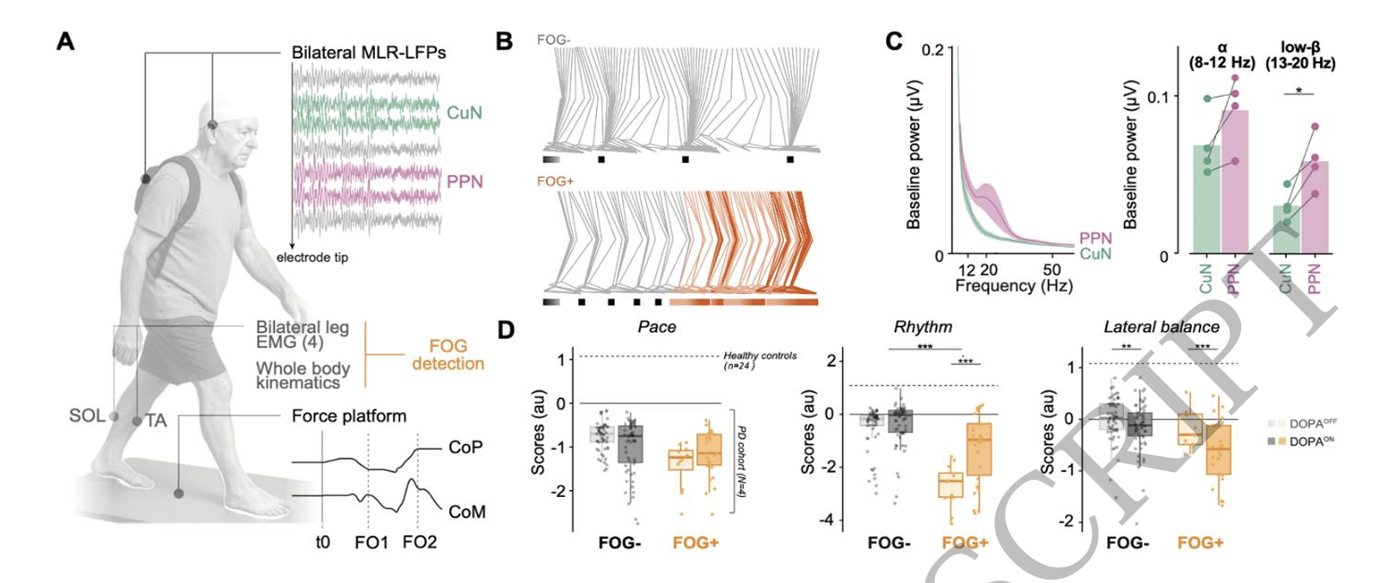


RESULTS | FIGURE 2C-D
Baseline differs, and freezing trials start badly before they fail
What to point at:
2C: at rest, PPN has higher low-beta power than CuN (t(3) = -3.46, p = 0.041). Alpha does not differ (p = 0.14)
Only 4 points per comparison in 2C, since dots are patient-level averages
2D Pace: no effect of freezing imminence (Pc = 0.99) and none of dopamine (Pc = 0.99)
2D Rhythm: significantly impaired when freezing is coming (Pc < 0.001), and worse OFF medication
2D Lateral balance: unaffected by freezing imminence, but significantly WORSE ON medication (Pc < 0.001)
In FOG+ trials dopamine pulls in opposite directions: it rescues Rhythm and damages Lateral balance
PASTE FIGURE 2C AND 2D HERE
2C: resting power spectra, CuN versus PPN
2D: Pace, Rhythm and Lateral balance by FOG and dopamine state
Figure 2 Multimodal profiling of MLR dynamics during gait initiation. (A) Schematic of 33 the experimental setup combining simultaneous MLR-LFP recordings (via externalized DBS 34 leads) with whole-body motion capture, force platform dynamometry (Center of Pressure, 1 CoP; Center of Mass, CoM), and surface electromyography (EMG) of soleus (SOL) and 2 tibialis (TA). Temporal events are defined as: t0 (onset of anticipatory postural adjustment 3 phase, APA), FO1 (foot-off, first step) and FO2 (foot-off, second step). (B) Reconstruction of 4 leg kinematics in one patient for one trial without FOG (FOG-, upper panel) and one trial 5 with FOG (FOG+, bottom panel, orange). (C) Baseline mesencephalic power spectra. Left: 6 Mean power spectral density (PSD) at rest for CuN and PPN. Right: Comparison of average 7 baseline power in the alpha (8–12 Hz) and low-beta (13–20 Hz) bands. Dots indicate 8 patient-level averages across contacts (n = 4 patients). *p < 0.05, paired t-test.(D) Gait 9 initiation mechanics with and without freezing. Box plots showing kinetic sub-scores, i.e. 10 Pace, Rhythm, and Lateral balance, for trials with (FOG+) and without (FOG−) freezing 11 episodes, in DOPAOFF and DOPAON states. ***p<0.001, LMM, Bonferroni corrected. Box 12 elements: center line, median; box limits, upper and lower quartiles; whiskers, 1.5 times 13 interquartile range; dots, individual trials.
Notes:
Two separate messages on this slide, so signpost the switch from 2C to 2D clearly.
Panel 2C is a small result with an outsized role. It establishes that the two sets of contacts are recording physiologically different tissue at rest, before any task. That is your evidence that the atlas-based assignment is picking up something real and not just splitting one population in half. Say that explicitly, because it is the paper's best answer to the localisation objection. Then be honest that it is a paired t test on four patients with p equal to 0.041.
Panel 2D is the behavioural core. The headline is that freezing does not announce itself as general slowness. Pace, which is the propulsion and vigour component, is completely unaffected. What is broken is Rhythm, the timing. Twelve or thirteen steps before a freeze, the timing of gait initiation is already off while the force of it is normal.
The dopamine finding in the balance component deserves a beat of its own, because it is clinically familiar. Levodopa improved the timing and worsened the lateral balance. That dissociation is exactly why these patients fall, and it is why they were recruited.
Good moment to ask the room: how surprised are we that Pace is intact? If you think freezing is a failure of locomotor drive, you would expect Pace to suffer. It does not. That already argues against the simple hypofunction account.

Slide 18
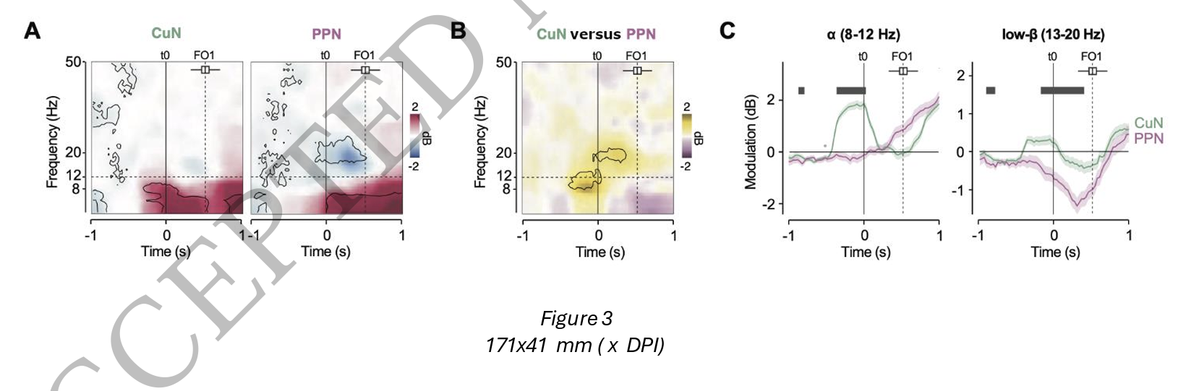
RESULTS | FIGURE 3
The central finding: two nuclei, two bands, two moments
CuN: alpha power rises BEFORE the APA begins, then falls during it, then rises again at foot-off
PPN: no pre-APA alpha peak. Instead a pronounced low-beta desynchronisation DURING the APA, then alpha rising afterwards during step execution
Direct contrast, pre-APA alpha stronger in CuN: -0.35 to 0.04 s, beta = 1.22 +/- 0.36 dB, p = 0.0026
Direct contrast, post-APA low-beta desynchronisation stronger in PPN: -0.17 to 0.40 s, beta = 0.88 +/- 0.25 dB, p = 0.0012
Both contrasts are within-patient, since every patient had dipoles in both nuclei
Temporal Dissociation between CuN and PPN activity. Spectrograms show grand averages 28 event-related power modulations across trials and patients (relative to baseline) aligned 29 with the onset of anticipatory postural adjustments (t0). The dashed vertical line indicates 30 the average time of the first foot-off (FO1); the horizontal boxplot above illustrates the 31 distribution of FO1 timings across all trials. Significant differences are outlined in black (p < 32 0.05, LMM). (B) Functional contrast map. Time-frequency plot illustrating the direct 33 statistical comparison between PPN and CuN power modulation (PPN – CuN). Warm 34 colors indicate higher power in CuN; cool colors indicate higher power in PPN. Significant 35 differences are outlined in black (p < 0.05, LMM). (C) Frequency-specific temporal dynamics. Averaged power modulation time-courses for the alpha (8–12 Hz) and low-beta 1 (13–20 Hz) bands in the CuN (green) and PPN (purple). Black bars at the top indicate time 2 points with significant divergence between the two nuclei (p < 0.05, LMM). Shaded areas 3 represent standard error of the mean (SEM).
CuN alpha
PPN beta
Notes:
This is the slide the talk is built around. Everything before it was setup and everything after it is consequence. Give it four or five minutes.
Teach the audience to read the panels before you interpret them. Panel A is two time-frequency maps, x is time relative to t0, y is frequency, colour is power change from baseline in decibels, and the black contours are significance. Panel B is the subtraction of one from the other, so warm means more in CuN and cool means more in PPN. Panel C collapses that into two band-limited time courses so you can see the timing directly.
Then the interpretation, and keep it concrete. The CuN is doing something before the body has started moving. The alpha increase precedes the anticipatory postural adjustment, which itself precedes the step. The PPN is doing something during the postural adjustment, and it is doing it in beta, which is the band we already associate with basal ganglia movement preparation.
Say why that maps onto the anatomy from earlier. The PPN is embedded in basal ganglia loops and shows the beta desynchronisation you would expect from a basal ganglia structure preparing a movement. The CuN sits outside those loops and shows an earlier, alpha-band signal.
The honest caveats to give the room. First, these are two nuclei separated by a few millimetres, recorded with 1.5 mm contacts. Volume conduction between them is not zero, and the fact that the signals differ is more convincing than any claim about where exactly they arise. Second, the significant windows are short and the effects are around 1 dB. Third, alpha in a walking human is also where you find movement and ocular artifact, which is why the artifact screening slide mattered.
Good question for the room: if you only had the PPN electrode, as every previous human study did, what would you have concluded? You would have seen beta desynchronisation during postural adjustment and called the MLR a basal-ganglia-like postural structure. The CuN channel is what changes the story.

Slide 19
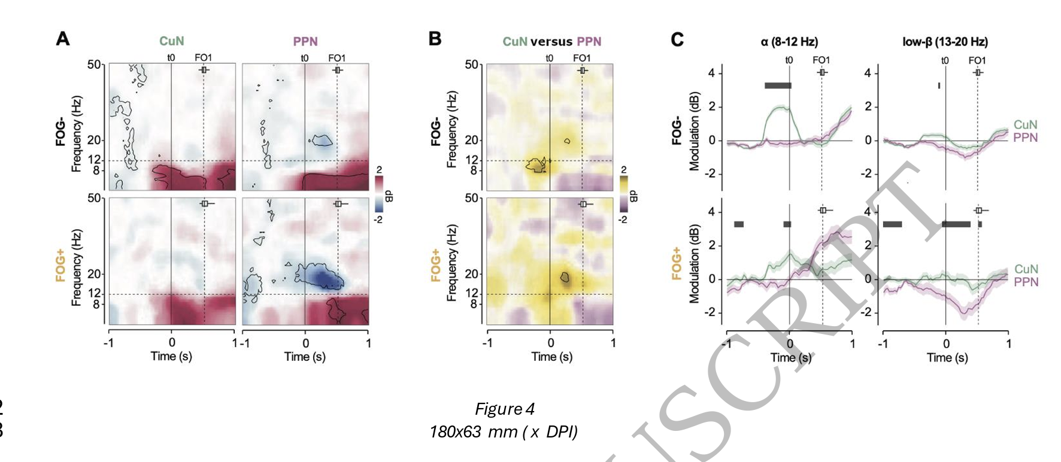
RESULTS | FIGURE 4
Before a freeze, the organisation collapses
Pre-APA CuN alpha TENDS DOWN in FOG+ trials, but this is not significant (p = 0.31). The paper leans on it anyway
During the APA, alpha INCREASES in both nuclei in FOG+ trials (0.04 to 0.67 s, beta = 1.09 +/- 0.29 dB, p = 0.0002)
And the CuN versus PPN difference disappears in FOG+ (beta = 0.11 +/- 0.56, p = 0.84). This is the collapse
PPN low-beta desynchronisation is STRONGER in FOG+ (0.43 to 0.67 s, beta = 1.09 +/- 0.44 dB, p = 0.0137)
Panel B is the clearest one: the significant contrast present in FOG- largely vanishes in FOG+
Figure 4 Mesencephalic neural signatures of freezing vulnerability. (A) State-dependent 12 spectral dynamics. Time-frequency maps showing LFP power modulation (relative to 13 baseline) in the CuN and PPN, separately for effective gait initiation without subsequent 14 freezing (FOG−, upper row) and trials where successful gait initiation led to freezing (FOG+, 15 lower row). Data are aligned to the APA onset (t0). Statistical significance was assessed 16 using LMMs (p < 0.05) and is indicated by black contours. (B) Collapse of functional 17 segregation. Time-frequency plots showing the difference in power modulation between 18 PPN and CuN (PPN - CuN) during FOG− and FOG+ trials. Significant spatial dissociation 19 (black contours, p < 0.05) is prominent in FOG− trials but diminishes in FOG+ trials. (C) 20 Frequency-specific breakdown. Temporal profiles of alpha (8-12 Hz) and low-beta (13-20 21 Hz) power modulation in CuN (green) and PPN (purple) for FOG− versus FOG+ conditions. 22 Shaded areas represent SEM. Black bars indicate significant differences between nuclei (p 23 < 0.05, LMM
FOG+
FOG-
Notes:
The finding here is a loss of a difference, which is a harder thing to present than a gain. Panel B is the panel that makes it visible, so consider showing B first and A second.
The framing that works: in normal trials the two nuclei are doing different things at different times. In trials that will end in a freeze, they are doing the same thing at the same time. The drive has not switched off. The division of labour has.
Now three problems to put on the table honestly.
First, a null result is carrying rhetorical weight. The abstract says freezing was preceded by exaggerated alpha synchronisation. The results say the pre-APA CuN alpha decrease was not significant, p equals 0.31, and the discussion then describes it as attenuated. A non-significant trend is being narrated as a finding. Point at it.
Second, absence of a significant difference between CuN and PPN in the FOG+ condition is not evidence that the difference is gone. With 38 trials, that comparison is underpowered. The correct test is an interaction between nucleus and condition, not two separate tests where one is significant and one is not. This is the classic error of comparing significance instead of testing the difference in effects.
Third, the beta result runs the wrong way for the story. More desynchronisation usually means more movement-related engagement. The paper finds more desynchronisation before a freeze and calls it compensatory recruitment. That is a post hoc explanation and you should say so. Ask the room whether they buy it.
Do not let the criticism swamp the finding though. The core observation, that the two signals become interchangeable before a freeze, is interesting and is not something you could have seen with one electrode.

Slide 20
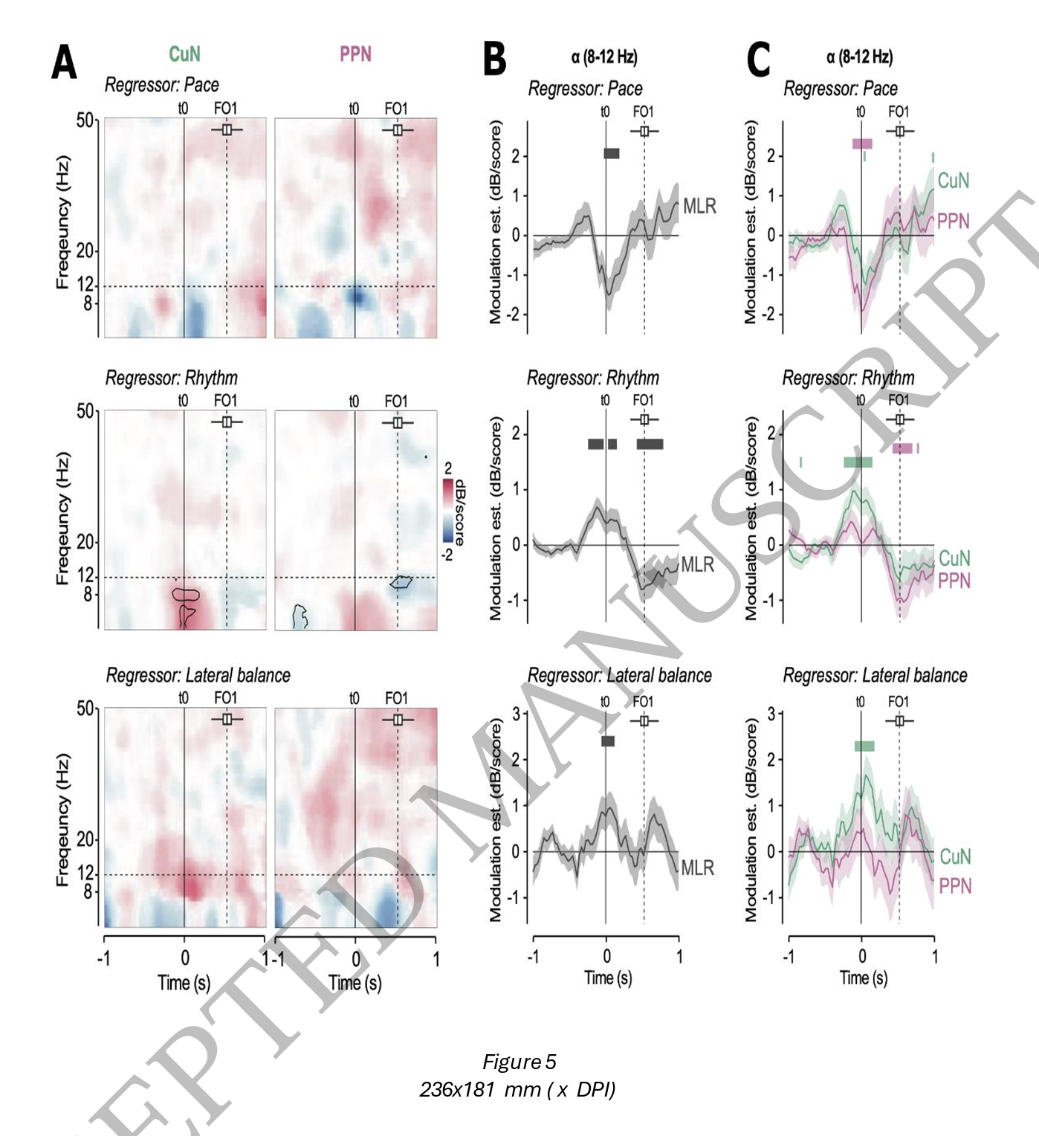
RESULTS | FIGURE 5
Linking the signal to the mechanics
Figure 5 Alpha-band dynamics encode gait initiation quality. (A) Spectral correlates of 34 gait mechanics. Time-frequency maps display the statistical relationship (LMM coefficients) between LFP power in CuN (left column) and PPN (right column) and 1 biomechanical scores: Pace, Rhythm, and Lateral Balance. Data are aligned to APA onset 2 (t0). The horizontal boxplot above shows the distribution of first foot-off (FO1) times; the 3 dashed vertical line marks the mean FO1. Warm colors indicate positive correlations; cool 4 colors indicate negative correlations. Black contours outline significant clusters (p < 0.05, 5 LMM). (B) Alpha-band specific encoding across MLR. Temporal profiles of the correlation 6 between alpha power (8–12 Hz) and biomechanical scores. Shaded areas represent SEM. 7 Black bars denote time points where the correlation strength significantly differs from zero 8 (p < 0.05, LMM). (C) Alpha-band specific encoding for CuN and PPN. Temporal profiles of 9 the correlation between alpha power (8–12 Hz) and biomechanical scores for CuN (green) 10 and PPN (purple). Green and purple bars indicate time points during which the correlation 11 is significant for CuN and PPN, respectively (p < 0.05). Shaded areas represent SEM. Black 12 bars denote time windows where the correlation strength differs significantly between 13 nuclei (p < 0.05, LMM).
CuN alpha at APA onset correlates POSITIVELY with Rhythm (-0.23 to 0.16 s, beta = 0.73 +/- 0.21 dB, p = 0.0005) and with Lateral balance (beta = 1.33 +/- 0.39 dB, p = 0.0006)
PPN alpha at APA onset correlates NEGATIVELY with Pace (-0.11 to 0.16 s, beta = -1.50 +/- 0.47 dB, p = 0.002)
PPN alpha at foot-off correlates negatively with Rhythm (0.43 to 0.70 s, beta = -0.90 +/- 0.30 dB, p = 0.0041)
No significant low-beta correlations with any gait score (Supplementary Fig. 7)
So the dissociation is not only in timing: the two nuclei predict different aspects of the movement
CuN
PPN
Notes:
Remind the room of the sign convention before you say a single number, because otherwise this slide is unreadable. Higher score equals worse performance. So a positive correlation between CuN alpha and Rhythm means more CuN alpha goes with worse timing.
Careful, because the paper's own prose is slippery here. The results text says CuN alpha positively correlated with Rhythm and Lateral balance scores. The figure alt-text says increased CuN alpha is associated with better rhythm and balance. Those are opposite claims given the sign convention. Read the axis on the actual figure when you have it in front of you and tell the room which one is right. This is a genuine internal inconsistency in the accepted manuscript and it is a fair thing to raise.
The structural point, whichever way the signs resolve, is that CuN alpha and PPN alpha relate to different components of the same movement. Same frequency band, same time window, different behavioural correlate depending on where you record. That is a strong argument that the two contact groups are not sampling one signal twice.
Also worth noting what is absent. No beta correlations with anything. So the beta finding in Figure 4 has no behavioural anchor, which weakens the compensatory story you discussed on the previous slide.
Finally, these are correlations across trials pooled within patients. Between-subject and within-subject variance are not separated in what is reported, so a correlation could be driven mostly by one patient having both high alpha and poor rhythm.

Slide 21
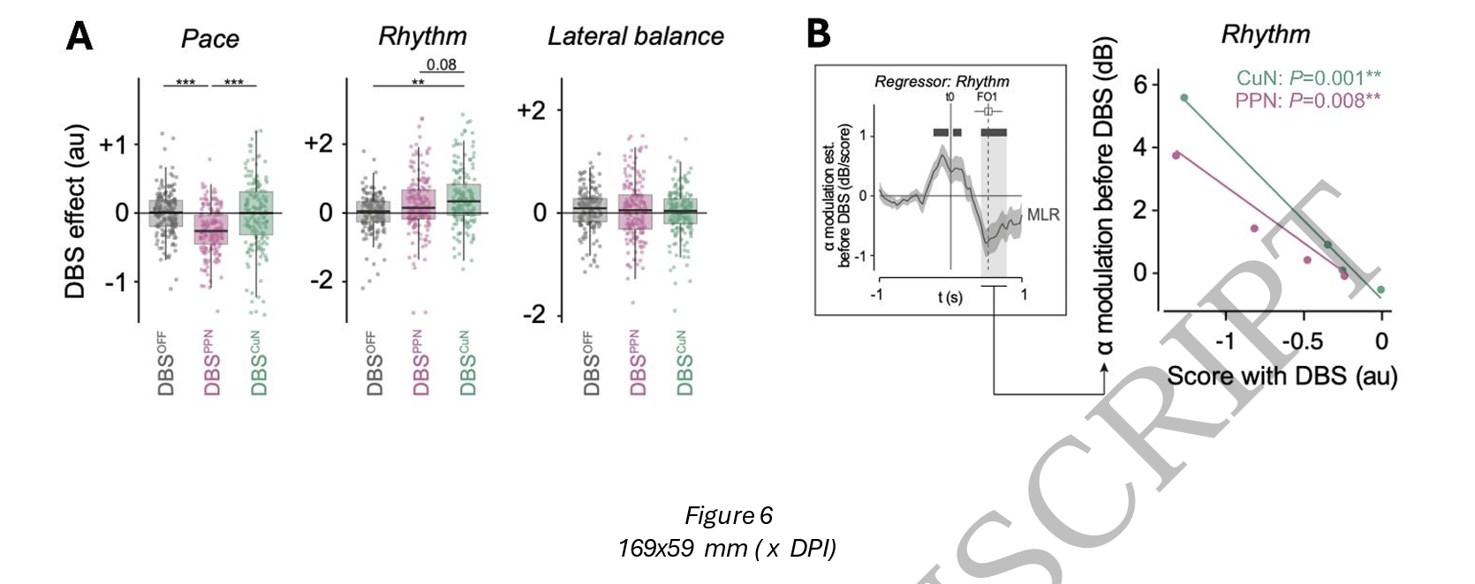
RESULTS | FIGURE 6
Stimulation respects the same division
CuN DBS improved Rhythm versus sham (beta = -0.27 +/- 0.08, Pc = 0.0023). PPN DBS did not (Pc = 1.00)
PPN DBS worsened Pace versus sham (beta = 0.30 +/- 0.04, Pc < 0.001) and versus CuN DBS (Pc < 0.001). CuN DBS did not affect Pace (Pc = 0.11)
Neither affected Lateral balance
Panel B: stronger alpha during APA predicted WORSE Rhythm under both CuN DBS (beta = -4.26, p = 0.0001) and PPN DBS (beta = -3.14, p = 0.0019)
Holds in both FOG+ (p < 0.0001) and FOG- (p = 0.0094) trials
Remember: the alpha was recorded days after surgery, the DBS outcome months later
CuN DBS
PPN DBS
Notes:
This is the slide with the clinical punchline, so slow down and let it land.
Say it in plain terms first. The nucleus that the field has been stimulating for eighteen years, the PPN, made forward propulsion worse. The nucleus nobody targets, the CuN, improved stepping rhythm. If that replicates, the target has been wrong.
Then say why it is coherent rather than surprising. It is exactly what the recordings predicted and exactly what the mouse work predicts. Driving glutamatergic CuN neurons initiates and speeds locomotion. Driving PPN populations can slow or halt it. Getting the same dissociation from recording, from behaviour, and from stimulation in the same four patients is the paper's strongest structural argument, and it is worth complimenting even while you criticise the sample.
Now the caveats, and there are several.
The number of patients in the stimulation arm is never stated in the main text. Six were enrolled in the parent trial, four had recordings. Which subset produced Figure 6 is not clear from the text. That is a reasonable thing to say you could not determine.
The unit of analysis in the box plots is individual trials, with dots shown per trial. With a handful of patients and many trials each, a difference can be produced by one patient contributing disproportionately.
Bipolar 30 Hz stimulation in the brainstem spreads several millimetres. The CuN and PPN contacts are around 4 mm apart. The authors say this themselves in the limitations: stimulation cannot isolate a nucleus, and these should be read as supportive observations rather than causal evidence. Give them credit for saying it, then hold them to it, because the abstract and the conclusion are noticeably less hedged than the limitations paragraph.
Panel B is the adaptive DBS pitch. Frame it as what it is: a proof of concept that a physiological marker recorded once might stratify who benefits. It is not a closed-loop demonstration and nothing here was done in closed loop.

Slide 22
RESULTS ROADMAP
How the five results figures build the argument
Fig. 2C-D
Baseline and behaviour
PPN has more resting low beta than CuN. Freezing trials had impaired Rhythm at initiation, but normal Pace.
Fig. 3
The dissociation
CuN alpha rises BEFORE the postural adjustment. PPN beta drops DURING it. Different nuclei, different times, different bands.
Fig. 4
The breakdown
When freezing is coming, alpha becomes excessive and mistimed across both nuclei, and the CuN to PPN difference collapses.
Fig. 5
Brain to behaviour
CuN alpha tracks Rhythm and Balance. PPN alpha tracks Pace. Links the signal to the mechanics.
Fig. 6
Stimulation
CuN DBS improves Rhythm. PPN DBS worsens Pace. High alpha predicts a poor response to either.
One sentence version: two nuclei, two jobs, two moments. Freezing is that timing falling apart, not the drive switching off.
Notes:
Put this up and read it. Twenty seconds per row at most. Its only job is to make sure that when a figure appears, nobody is asking themselves why they are looking at it.
You might also say this is the structural strength of the paper. The figures really are ordered as an argument rather than as a list of analyses, which is not always true. Each one is only interpretable given the one before it. Figure 4 means nothing without Figure 3, because the finding is the loss of a pattern that Figure 3 established.
If you are running short on time, this slide plus Figures 3, 4 and 6 is a complete talk.

Slide 23
03
DISCUSSION
A functional dissociation, a candidate biomarker, and a target that may need to move.

Slide 24
SYNTHESIS
The paper in one picture
Normal gait initiation
Before a freeze
Under stimulation
CuN alpha rises before the postural adjustment, and tracks the rhythm that follows
PPN beta desynchronises during the postural adjustment, then PPN alpha rises at step onset
Two nuclei, two bands, two moments, in sequence
Alpha becomes excessive and mistimed across both nuclei during the postural adjustment
PPN low-beta desynchronisation is exaggerated
The CuN to PPN difference collapses. Locomotor drive is not lost, its organisation is
CuN DBS selectively improves rhythm
PPN DBS worsens forward propulsion
High MLR alpha predicts a poor response to either, in both freezing and non-freezing trials
The claim
Freezing of gait is a failure of temporal coordination within the mesencephalic locomotor region, not a uniform loss of locomotor drive. That reframes the therapeutic problem from how much to stimulate to where and when.
Notes:
Use this as the pivot from reporting to discussing. Three columns, one sentence each, then read the claim at the bottom and stop talking for a second.
The conceptual shift is the thing worth emphasising, because it is bigger than this paper. The field has mostly modelled freezing as insufficient output from a locomotor centre, which motivates stimulating harder or finding the right amplitude. This paper argues it is a coordination failure between two adjacent structures, which motivates stimulating a different place, and possibly only at particular moments.
If you want one line to close the reporting section on: the drive is still there, it just stops being organised.

Slide 25
APPRAISAL
Limitations: the authors' list, and ours
Acknowledged by the authors
Worth adding
Four patients. Generalisability is limited and they say so
Stimulation spreads. DBS within the MLR affects multiple populations and neighbouring structures, so it cannot isolate a nucleus. They explicitly downgrade the stimulation results to supportive observations
Movement and cable artifact made it impossible to analyse LFP during continuous walking, during turning, or during the freezing episodes themselves
They therefore cannot exclude that freezing arising at initiation, during straight walking, and during turning have different neural signatures
Limbic and sensory inputs to the MLR, which plausibly matter for a stress-sensitive symptom, were not examined
Nothing was predicted prospectively. Trials were labelled after the fact by whether a freeze followed roughly 13 steps later. 'Predicted' overstates it
The collapse in Figure 4 rests on a non-significant difference, and on comparing two tests rather than testing their interaction
Pixelwise LMMs with FDR across a smoothed time-frequency map, where a cluster-based permutation test is the field standard
Statistics run over trials and dipoles nested in four patients, so precision is likely overstated
Two of five components are never reported, though the Bonferroni correction implies all five were tested
The results text and the figure alt-text describe the Figure 5 correlations in opposite directions
Lead hardware is described two different ways in the Methods, with 2 mm and 0.5 mm contact spacing
Notes:
Split the slide deliberately: what they told you, and what you had to work out. The left column is a credit to them, so present it that way. Their limitations paragraph is more candid than most.
From the right column, pick two or three rather than reading all seven. The strongest are the first three.
The prediction point is the most important and the easiest to state. Nothing was predicted. Trials were sorted retrospectively into those followed by a freeze and those not, and then the groups were compared. That is a valid design, but it is a case-control comparison, not prediction, and the abstract's language does not reflect that.
The interaction point is the one most likely to be new to a clinical audience. When you show that A differs from B in condition one and does not differ in condition two, you have not shown that the difference changed. You have to test the interaction. This is a common and well-documented error and it is worth two minutes if the room is interested.
The internal inconsistencies at the bottom, the two lead descriptions and the opposite-direction correlations, are worth mentioning once and not labouring. It is an accepted manuscript and these will probably be fixed. But the lead spacing one genuinely matters, because contact spacing determines what a bipolar dipole samples, and the spatial claim is the paper.
Land on the closing line. It is a fair verdict and it keeps the discussion constructive.

