Slide 1
SETTING UP YOUR GITHUB REPO
Reid Offringa, PhD
Data Scientist, Glooko

Slide 2
FIRST STEPS
HOMEWORK SUBMISSION WILL BE VIA GIT
Create a new REPO
Local folder should be OUTSIDE of the class folder
Push a readme.md file to your repo
Include a brief bio about yourself – link to a photo if you can
Please submit each homework in a folder with all contents necessary for code to run

Slide 3
EXPERIMENTAL DESIGN AND PANDAS
Reid Offringa, PhD
Data Scientist, Glooko

Slide 4
LEARNING OBJECTIVES
EXPERIMENTAL DESIGN AND PANDAS
Identify two common ways of structuring data
Define relationship between problem and available data
Go over the data science workflow
Apply the data science workflow in the pandas context
Create an iPython Notebook to import, format, and clean using the Pandas library

Slide 5
OPENING
EXPERIMENTAL DESIGN AND PANDAS

Slide 6
WHY DATA TYPES MATTER
Different data types have different limitations and strengths.
Certain types of analyses aren’t possible with certain data types.
FOCUS ON TWO:
CROSS SECTIONAL
LONGITUDINAL

Slide 7
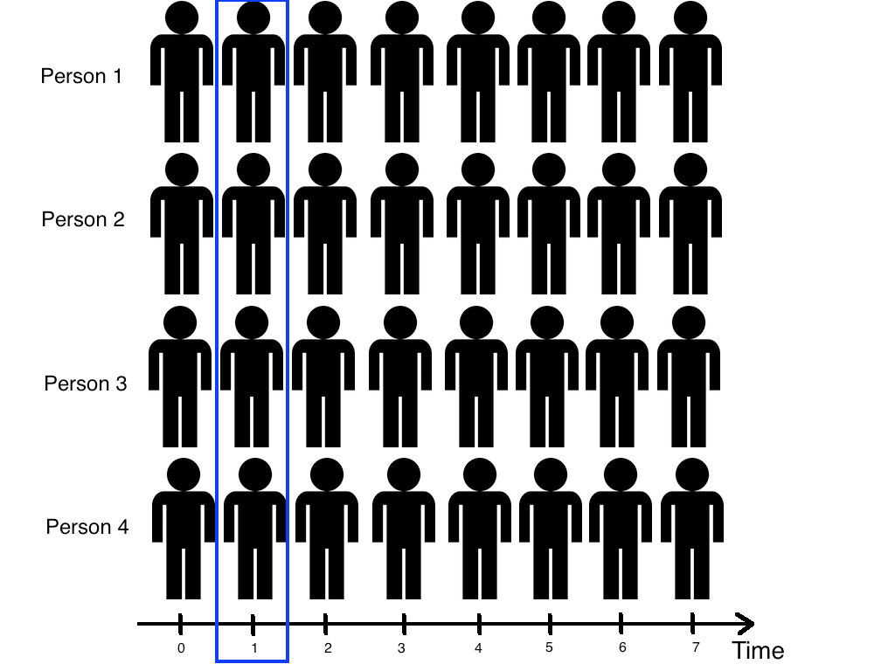
CROSS-SECTIONAL DATA

Slide 8
CROSS-SECTIONAL DATA
All information is determined at the same time; all data comes from the same time period.
Issues: There is no distinction between exposure and outcome

Slide 9
CROSS-SECTIONAL DATA
Strengths
Often population based
Generalizability
Reduce cost compared to other types of data collection methods
Weaknesses
Separation of cause and effect may be difficult (or impossible)
Variables/cases with long duration are over-represented

Slide 10
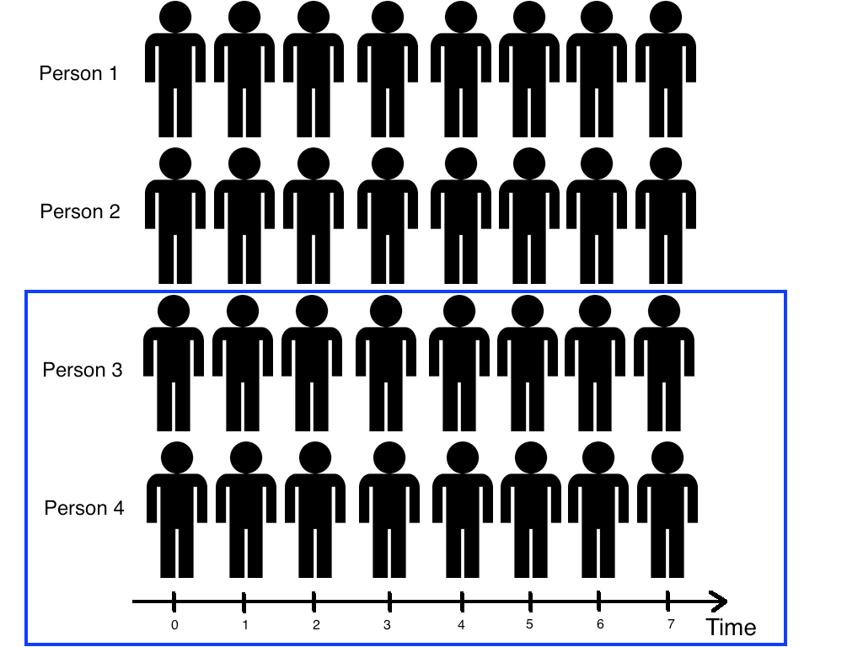
TIME SERIES/LONGITUDINAL DATA

Slide 11
TIME SERIES/LONGITUDINAL DATA
The information is collected over a period of time
Strengths
Unambiguous temporal sequence - exposure precedes outcome
Multiple outcomes can be measured
Weaknesses
Expense
Takes a long time to collect data
Vulnerable to missing data

Slide 12
Exercise
Download NHANES dataset for 2009-2010
I’ll slack this to you:
https://wwwn.cdc.gov/nchs/nhanes/ContinuousNhanes/Default.aspx?BeginYear=2009
Read it in with code provided in Starter Code folder

Slide 13

ACTIVITY: KNOWLEDGE CHECK
ANSWER THE FOLLOWING QUESTIONS (5 minutes)
EXERCISE
What type of data is the NHANES demographics data?
What about food data?
Can you create a cross-sectional analysis from a longitudinal data collection? How?
DELIVERABLE
Answers to the above questions

Slide 14
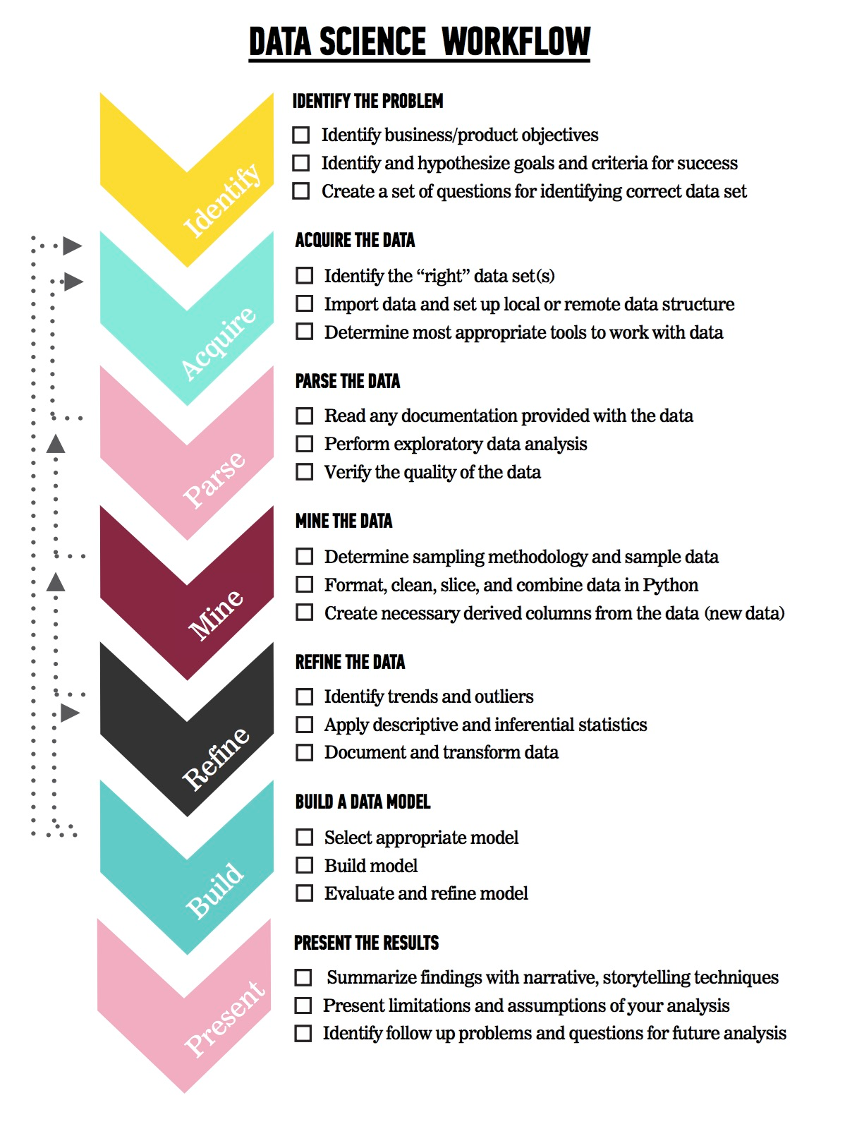
LET’S REVIEW THE DATA SCIENCE WORKFLOW
The steps:
Identify the problem
Acquire the data
Parse the data
Mine the data
Refine the data
Build a data model
Present the results

Slide 15
TODAY
We’re going to focus on steps 1-2 (Identify the Problem and Acquire the Data).
We’ll cover steps 3-5 in the next few classes

Slide 16
INTRODUCTION
ASKING A GOOD QUESTION

Slide 17
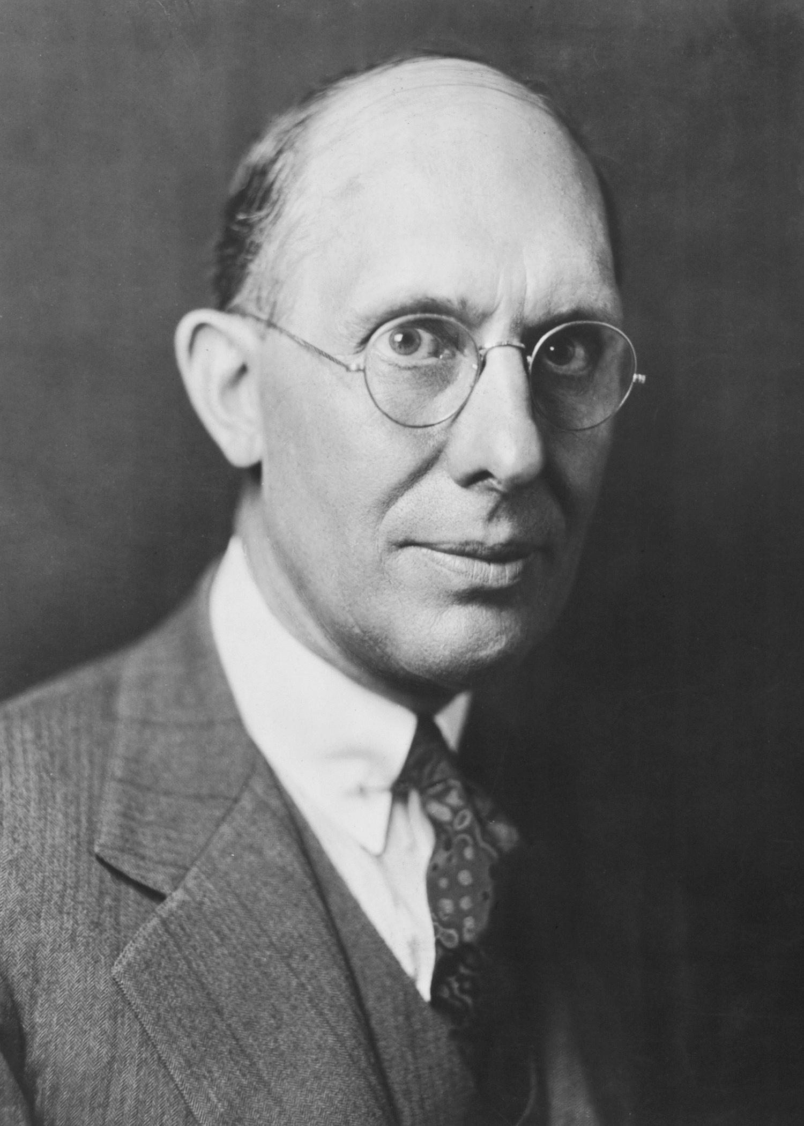
WHY DO WE NEED A GOOD QUESTION?
“A problem well stated is half solved.” -Charles Kettering
Sets yourself up for success as you begin analysis
Establishes the basis for reproducibility
Enables collaboration through clear goals

Slide 18
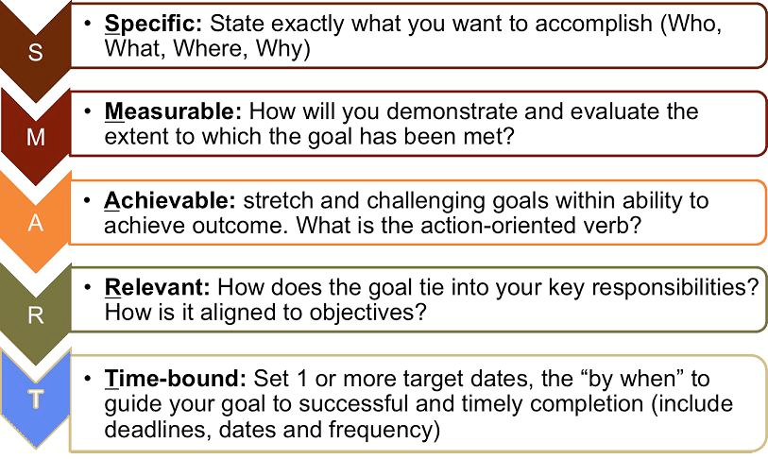
WHAT IS A GOOD QUESTION?
Goals are similar to the SMART Goals Framework.
S: specific
M: measurable
A: attainable
R: reproducible
T: time-bound

Slide 19
WHAT IS A GOOD QUESTION?
Specific: The dataset and key variables are clearly defined.
Measurable: The type of analysis and major assumptions are articulated.
Attainable: The question you are asking is feasible for your dataset and is not likely to be biased.
Reproducible: Another person (or future you) can read and understand exactly how your analysis is performed.
Time-bound: You clearly state the time period and population for which this analysis will pertain.

Slide 20
WHAT IS A GOOD QUESTION?

Slide 21
DEMO
DIAGRAMMING
AN AIM

Slide 22
EXAMPLE AIM
Determine the association of demographics with dietary intake.
Use one 24-hour recall from the cross-sectional NHANES 2009-2010
We will test if reported education levels are associated with more:
fruits, dark green vegetables, low fat milk or sugar sweetened beverages

Slide 23

HYPOTHESIS
Higher education levels will be more likely to eat healthy, compared to lower levels of education.

Slide 24
SPECIFIC
How data were collected:
24-hour recall, self-reported
What data were collected:
Reported education levels
Fruits, dark green vegetables, low fat milk or sugar sweetened beverages, always vs. rarely available
How data will be analyzed:
Comparative frequency between groups
The specific hypothesis & direction of the expected associations:
More educated respondents will eat more healthy food

Slide 25
MEASURABLE
Determine the association of foods with education.
We will test if higher educational groups exhibit an increase in healthy food intake.

Slide 26
ATTAINABLE
Cross-sectional data has inherent limitations; one of the most common is that causal inference is typically not possible.
Note that we are determining association, not causation.

Slide 27
REPRODUCIBLE
With all the specifics, it would be straightforward to pull the data from NHANES and reproduce the analysis.

Slide 28
TIME BOUND
Using one 24-hour recall from NHANES 2009-2010, we will determine the factors associated with food available in the homes of American children and adolescents.

Slide 29
CONTEXT IS IMPORTANT
The previous example laid out research goals.
In a business setting, you will need to articulate business objectives.
Example: Success for the Netflix recommendation engine may be if 70% of customers over the age of 18 select a movie from the recommended queue during Q3 of 2015.
Regardless of setting, start your question with the SMART framework to help achieve your objectives.

Slide 30
ACTIVITY: KNOWLEDGE CHECK
ANSWER THE FOLLOWING QUESTIONS (5 minutes)
Which of the following uses the SMART framework? Why? What is missing?
I am looking to see if there is an an associate between demographics and food intake.
Determine if higher levels of education report more green, healthy food, compared to lower levels of education, using 24 hours of retrospective food reports.
EXERCISE
DELIVERABLE
Answers to the above questions

Slide 31
Watch How you Phrase a Research Question
Pay attention to the words you use – especially visual language
“Look at…”
“See if…”
For most datasets you can’t ”look around” – they’re too big!
You’ll need a good research question to guide you
Even if that question is exploratory!

Slide 32
GUIDED PRACTICE
WRITE A RESEARCH QUESTION WITH RAW DATA

Slide 33
ACTIVITY: WRITE A RESEARCH QUESTION WITH RAW DATA
DIRECTIONS (10 minutes)
EXERCISE
Individually, look at the data from NHANES database and write a high quality research question.
Make sure you answer the following questions:
What type of data is this, cross-sectional or longitudinal?
What will we be measuring?
What is the SMART aim for this data?
When finished, split into pairs and share your answers with each other.
DELIVERABLE
Research Question

Slide 34
INTRODUCTION
DATA SCIENCE WORKFLOW: ACQUIRE & PARSE

Slide 35
DATA SCIENCE WORKFLOW: ACQUIRE & PARSE
For the remainder of class, we’ll talk about steps 2 & 3 of the data science workflow: acquire and parse
We’ll be using iPython Notebook
First a demo, then a codealong
Finally, some hands on practice in a lab

Slide 36
DEMO
WALKTHROUGH ACQUIRE & PARSES WITH PANDAS

Slide 37
ACQUIRE
Where we determine if we have the “right” dataset for our problem
Questions to ask:
What type of data is it, cross-sectional or longitudinal?
How well was the data collected?
Is there much missing data?
Was the data collection instrument validated and reliable?
Is the dataset aggregated?
Do we need pre-aggregated data?

Slide 38
LOGISTICS OF ACQUIRING YOUR DATA
Data can be acquired through a variety of sources
Web (Google Analytics, HTML, XML)
File (CSV, XML, TXT, JSON)
Databases (SQL, NOSQL, etc)
Today, we’ll use a CSV (comma separated file)

Slide 39
PARSE: UNDERSTANDING YOUR DATA
You need to understand what you’re working with.
To better understand your data
Create or review the data dictionary
Perform exploratory surface analysis
Describe data structure and information being collected
Explore variables and data types

Slide 40
INTRO TO DATA DICTIONARIES AND DOCUMENTATION
Data dictionaries help judge the quality of the data.
They also help understand how it’s coded.
Does gender = 1 mean female or male?
Is the currency dollars or euros?
Data dictionaries help identify any requirements, assumptions, and constraints of the data.
They make it easier to share data.

Slide 41
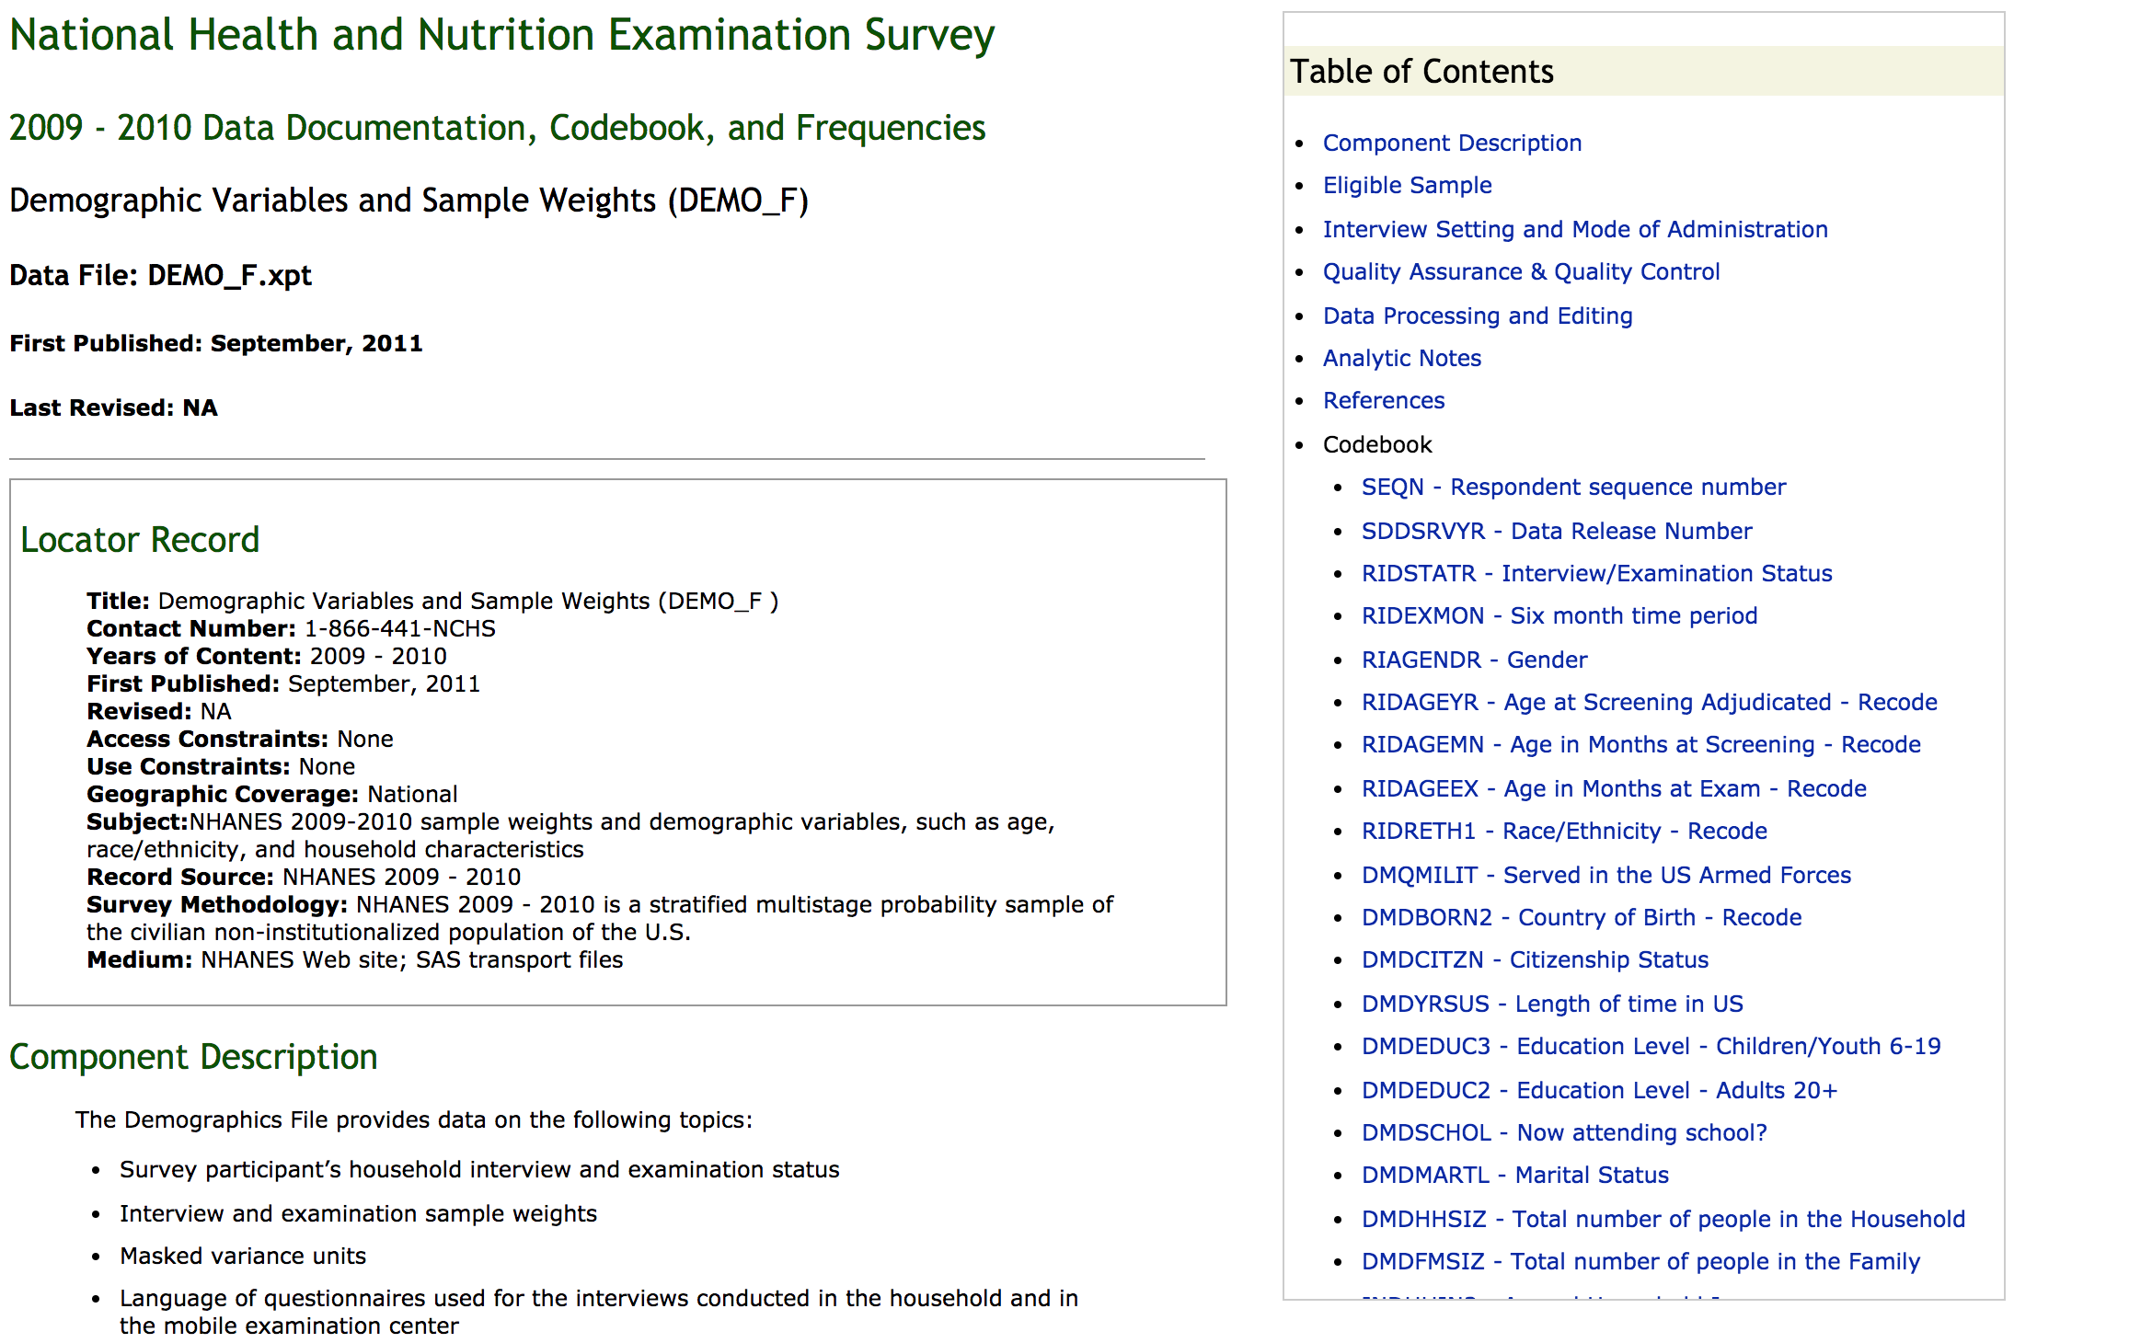
DATA DICTIONARY EXAMPLE: NHANES
https://wwwn.cdc.gov/Nchs/Nhanes/2009-2010/DEMO_F.htm

Slide 42
CODEALONG
NUMPY AND PANDAS

Slide 43
NUMPY AND PANDAS
What are Numpy and Pandas? Python packages
Pandas is built on Numpy.
Numpy uses arrays (lists) to do basic math and slice and index data.
Pandas uses a data structure called a Dataframe.
Dataframes are similar to Excel tables; they contain rows and columns.

Slide 44
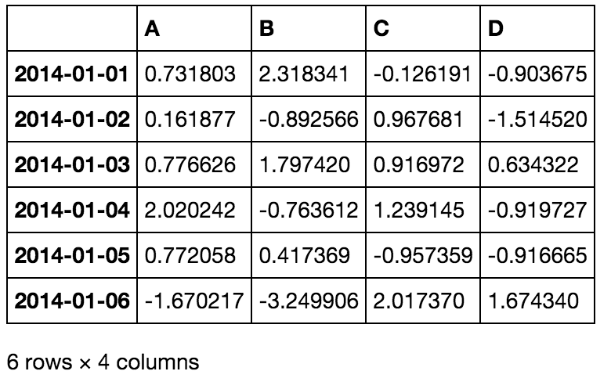
NUMPY AND PANDAS INTRO

Slide 45
NUMPY AND PANDAS INTRO
With these packages, you can select pieces of data, do basic operations, calculate summary statistics.
Follow along and code along as we learn about Numpy and Pandas.

Slide 46
NUMPY AND PANDAS INTRO
We often have to merge data together, correct missing data, and plot our findings.
Once again, follow and code along.

Slide 47
DEMO
LAB WALKTHROUGH

Slide 48
LESSON 2 LAB WALKTHROUGH
In this lab, you will merge two datasets: NHANES demo & food
By the end of the lab, you will:
Merge datasets
Check basic features of the data
Find and drop missing values
Find basic stats like mean and max
Answer our research question with a groupby statement

Slide 49
CONCLUSION
TOPIC REVIEW

Slide 50
REVIEW
Let’s go through the lab. Any questions?
Today, we’ve talked about
Defining a problem
Types of data
Acquiring and parsing data
Using Pandas

Slide 51
COURSE
BEFORE NEXT CLASS

Slide 52
DUE DATE
BEFORE NEXT CLASS
Homework #1
Submit to github

Slide 53
LESSON
Q & A

Slide 54
LESSON
EXIT TICKET
DON’T FORGET TO FILL OUT YOUR EXIT TICKET

