Slide 1
Programming Languages
Swamp Tour

Slide 2
Agenda
Who Am I?
What problem are we exploring?
Programming Languages
  C
  C++
  Objective C
  Go
  Ruby
  Python
  Java
  Scala
  Javascript
  CoffeeScript
  Dart

Slide 3
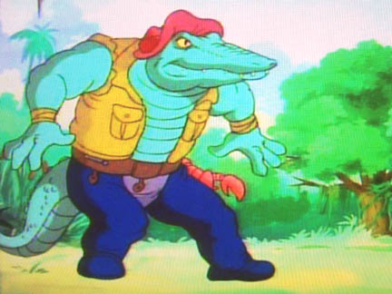
Who Am I
Allan Davis
Twitter: @cajun_code
Github: cajun-code
Bitbucket: cajun_code
Linked-in: www.linkedin.com/in/cajuncode

Slide 4
Number Guessing Game
Computer thinks of a number.
You Input a number between 1 and 100
If that is the number the computer is thinking print “You got it”
If it is lower than the number print “Higher”
If it's Higher than the number print “Lower”
If the guess is wrong have the user guess again

Slide 5
C
Developed By: Dennis Ritchie @ Bell labs
When: 1972
Procedural language that provides an efficient mapping to machine language.

Slide 6
C++
Developer: Bjarne Stroustrup @ Bell labs
When: 1983
Object Oriented Programming language based on C

Slide 7
Objective C
Developer: Brad Cox and Tim Love @ Stepstone
When: 1983
Adding concepts from Smalltalk to C

Slide 8
GO
Developer: Robert Griesemer, Rob Pike, and Ken Thompson
When: 2009
Functional Concurrent Programming Language by Google

Slide 9
Java
Developer: James Gosling @ Sun Microsystems
When: 1995
Object Orientated Programming Language derived from C++ without low level functionally

Slide 10
Scala
Developer: Martin Odersky
When: 2003
Object Orientated Language with features of a Functional language

Slide 11
Python
Developer: Guido van Rossum
When: 1991
Object-oriented, imperative and functional programming Language

Slide 12
Ruby
Developer: Yukihiro Matsumoto
When: 1995
Dynamic Typed Multi-Paradigm Programming Language

Slide 13
JavaScript/ ECMAScript
Developer: Brendan Eich
When: 1994
Prototype-based scripting language

Slide 14
CoffeeScript
Developer: Jeremy Ashkenas
When: 2009
Javascript Pre-compiler adding Ruby/Python syntax

Slide 15
Dart
Developer: Google
When: 2011
Static typed language designed to replace javascript

Slide 16
Other languages and tools
Perl
PHP
Lisp
And Many More ...

Slide 17
Questions?

