Slide 1

DOKUZ EYLÜL UNIVERSITY
DEPARTMENT OF COMPUTER ENGINEERING
CME 4403-MACHINE LEARNING
TERM PROJECT
By
AKİF ÇAKAR
ULAŞ YURT
GÖKTUĞ KAYA

Slide 2
Dataset Description

Slide 3
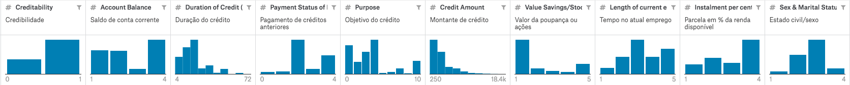
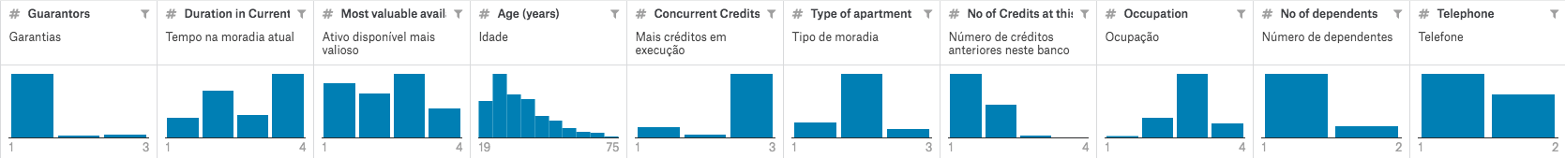
Dataset Columns

Slide 4
Dataset Example Section
Creditability | Account Balance | Duration of Credit (month) | Payment Status of Previous Credit | Purpose | Credit Amount | Value Savings/Stocks | Length of current employment | Instalment per cent | Sex & Marital Status | Guarantors | Duration in Current address | Most valuable available asset | Age (years) | Concurrent Credits | Type of apartment | No of Credits at this Bank | Occupation | No of dependents | Telephon
1 | 1 | 1 | 18 | 4 | 2 | 1049 | 1 | 2 | 4 | 2 | 1 | 4 | 2 | 21 | 3 | 1 | 1 | 3 | 1 | 1
2 | 1 | 1 | 9 | 4 | 0 | 2799 | 1 | 3 | 2 | 3 | 1 | 2 | 1 | 36 | 3 | 1 | 2 | 3 | 2 | 1
3 | 1 | 2 | 12 | 2 | 9 | 841 | 2 | 4 | 2 | 2 | 1 | 4 | 1 | 23 | 3 | 1 | 1 | 2 | 1 | 1
4 | 1 | 1 | 12 | 4 | 3 | 2122 | 1 | 3 | 3 | 3 | 1 | 2 | 1 | 39 | 3 | 1 | 2 | 2 | 2 | 1
5 | 1 | 1 | 12 | 4 | 0 | 2171 | 1 | 3 | 4 | 3 | 1 | 4 | 2 | 38 | 1 | 2 | 2 | 2 | 1 | 1
6 | 1 | 1 | 10 | 4 | 0 | 2241 | 1 | 2 | 1 | 3 | 1 | 3 | 1 | 48 | 3 | 1 | 2 | 2 | 2 | 1
7 | 1 | 1 | 8 | 4 | 0 | 3398 | 1 | 4 | 1 | 3 | 1 | 4 | 1 | 39 | 3 | 2 | 2 | 2 | 1 | 1
8 | 1 | 1 | 6 | 4 | 0 | 1361 | 1 | 2 | 2 | 3 | 1 | 4 | 1 | 40 | 3 | 2 | 1 | 2 | 2 | 1
9 | 1 | 4 | 18 | 4 | 3 | 1098 | 1 | 1 | 4 | 2 | 1 | 4 | 3 | 65 | 3 | 2 | 2 | 1 | 1 | 1

Slide 5
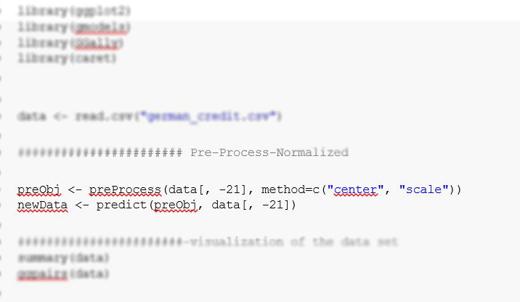
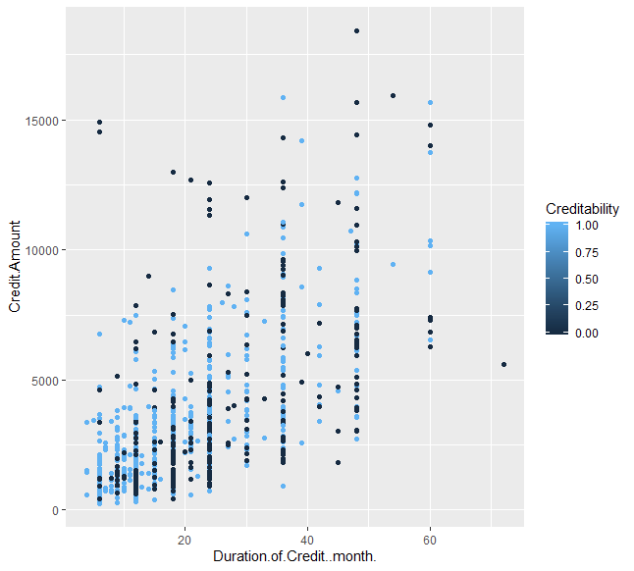
Pre-Processing

Slide 6
Machine Learning Models
k-NN Algorithm

Slide 7
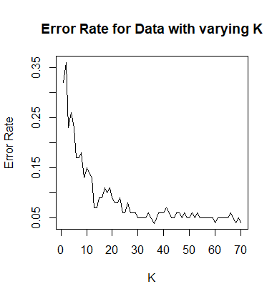
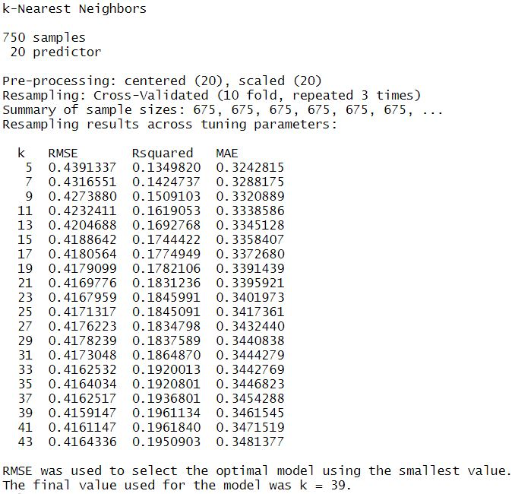
‘k’ Value Calculation

Slide 8
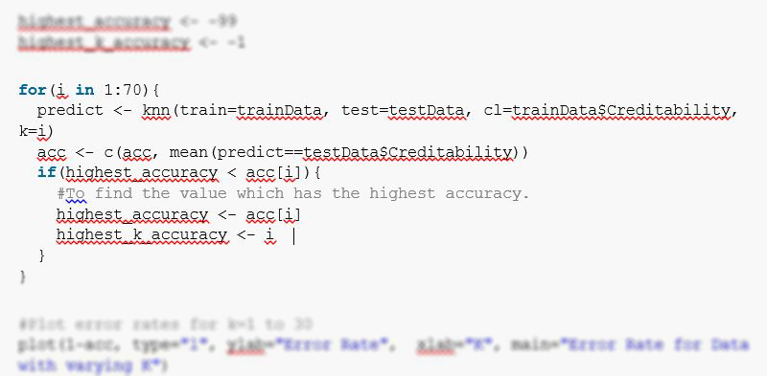
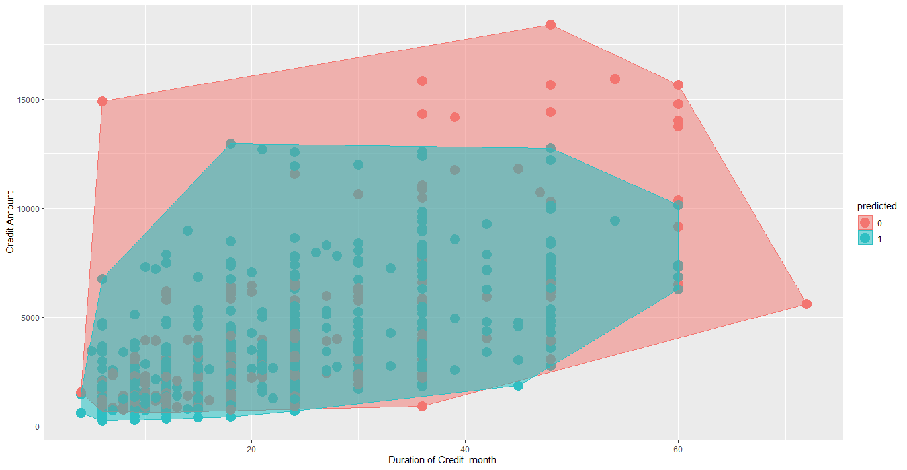
k-NN Mapping & Implementation

Slide 9
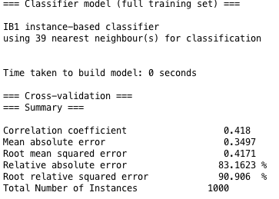
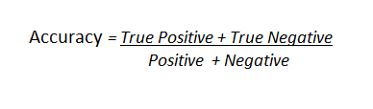
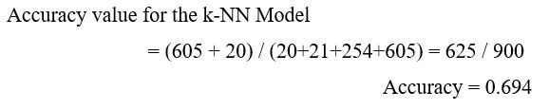
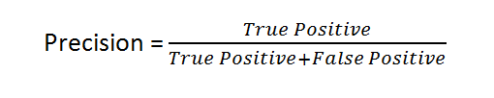
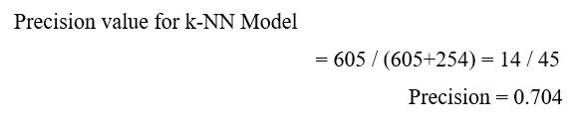

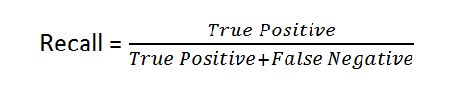
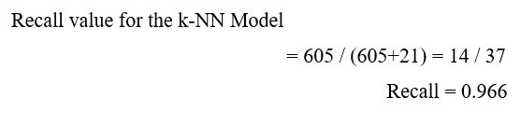
k-NN Validation & Analysis
NEGATIVE (Predicted) | POSITIVE (Predicted)
True Negative | False Positive | NEGATIVE (Actual)
False Negative | True Positive | POSITIVE (Actual)

Slide 10
Machine Learning Models
Naive Bayes Algorithm

Slide 11
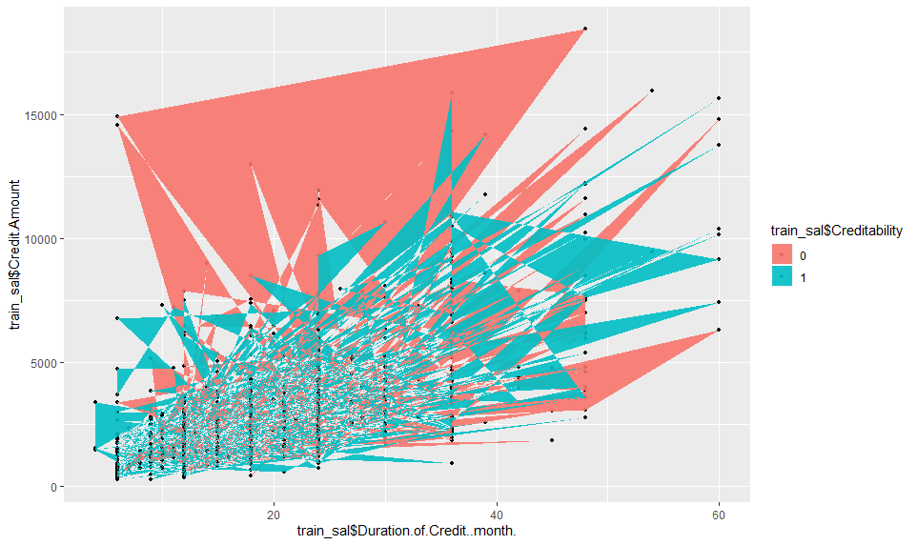
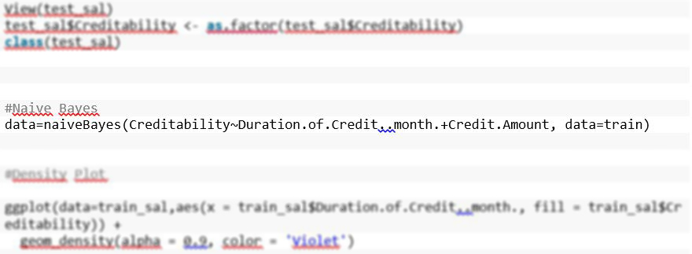
Naive Bayes Mapping & Implementation

Slide 12
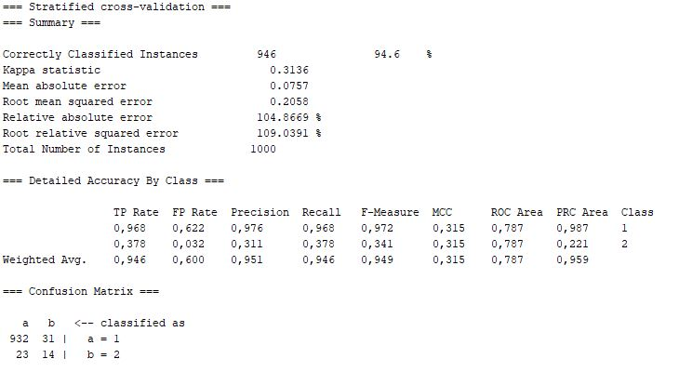
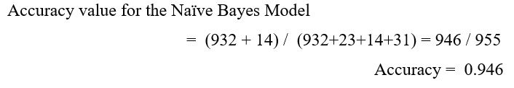
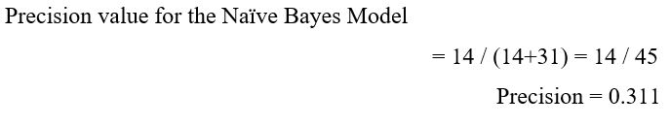
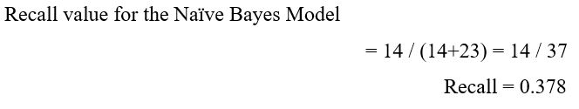
Naive Bayes Validation & Analysis
NEGATIVE (Predicted) | POSITIVE (Predicted)
True Negative | False Positive | NEGATIVE (Actual)
False Negative | True Positive | POSITIVE (Actual)

Slide 13
Machine Learning Models
Decision Tree Algorithm

Slide 14
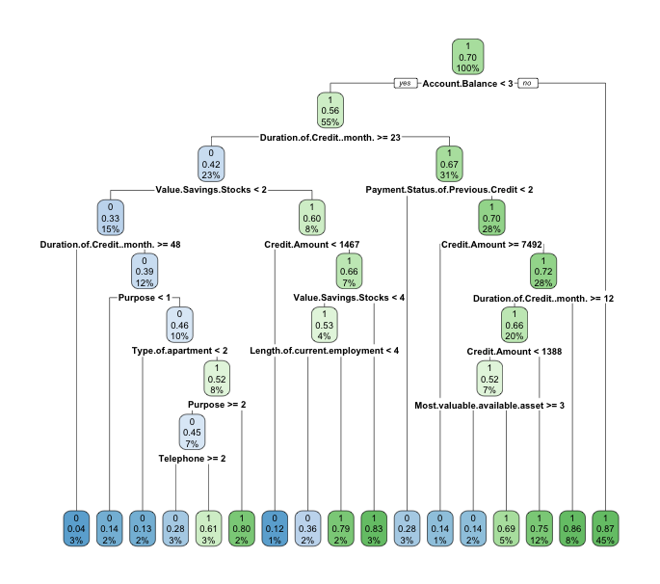
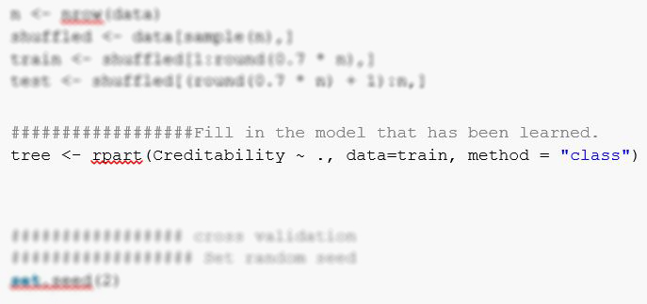
DT Structure & Implementation

Slide 15
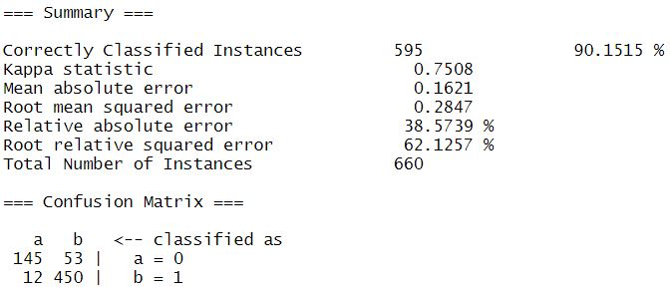
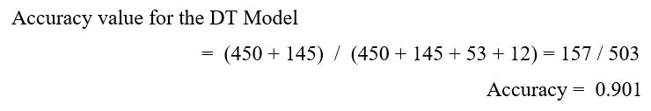
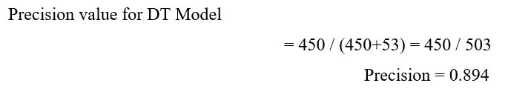
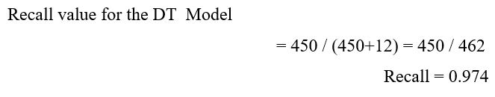
DT Validation & Analysis
NEGATIVE (Predicted) | POSITIVE (Predicted)
True Negative | False Positive | NEGATIVE (Actual)
False Negative | True Positive | POSITIVE (Actual)

Slide 16


