Slide 1


IoT Security : Anomaly-based Intrusion Detection
Presented by – Rhishabh Hattarki
(305218)
Guided by – Prof. M. R. Dhage

Slide 2

contents
IoT security and its need
Growth of IoT Devices
Mirai Attack
Intrusion Detection System
Analogy
Types
Signature vs anomaly based
Hybrid Model
Functionality overview
Confusion matrix
NSL-KDD dataset
Algorithm
Results
Conclusion and Future Work
References
Notes:
The overview of the presentation will be as follows:
We’ll talk about iot security and its need
That will be followed by the explanation of what the topic is about
Then the hybrid ml model used to implement this technique will be explained
It will end with the conclusion and future scope for this method

Slide 3

IoT Security and its need
Notes:
The question arrives as to why iot security is needed. Some users might argue that the iot devices being low powered and containing very little information will not give away much to the adversaries even when hacked. However iot security experts often say that even when the iot devices do not contain much of the personal information, the hacker can use these seemingly worthless dispensable devices to gain access to the main network where they reside and then get access to the sensitive information.

Slide 4
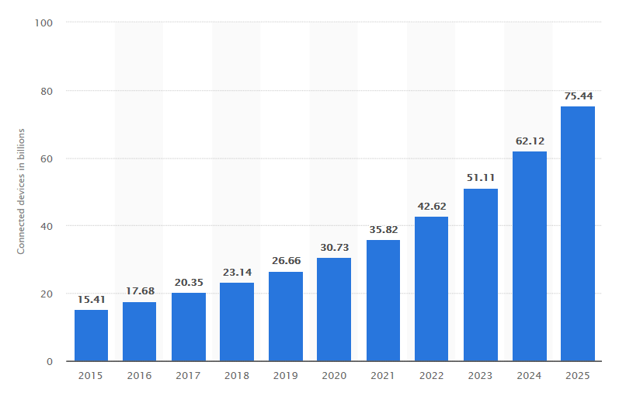
Growth of iot devices
Notes:
Iot devices are growing expeditiously, the number of devices is already in the billions. According to these statistics from the website statista, the number of connected devices will grow all the way to 75B by the year 2025. There will be a huge amount of data moving around these devices. If not secured properly, it can be used maliciously to cause harm to users. One such example of an Iot attack due to its vast yet insecure network is the Mirai botnet.

Slide 5
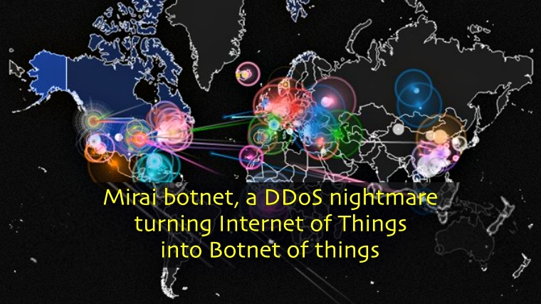
Example of iot attack - mirai
Notes:
Mirai, popularly known for its Dyn attack. It is a self propagating botnet virus. It targeted the DNS provider Dyn which caused crashes of popular websites hosted by Dyn like Netflix, Quora, Soundcloud, Reddit, etc. It took advantage of the insecure Iot devices in a simple yet clever way. It scanned big blocks of internet for open telnet ports, then attempted to log in to default passwords. This was possible because most iot manufacturers published their default credentials on their own websites. They used a set of 61 default username/password combos. This botnet was then used to send DNS lookup requests to Dyn from tens of millions of infected devices.

Slide 6
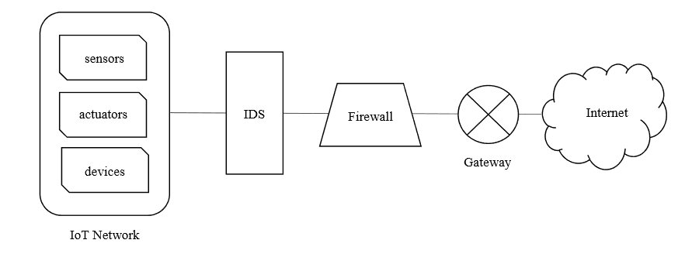
Intrusion detection system
IDS
Notes:
There are multiple security measures in place for Iot networks and devices. One of them is the intrusion detection system. It sits right between the iot network and the firewall. It can be said that it is the second line of defense after the firewall. A firewall acts as a filter. It is a device or application that analyzes packet headers and enforces policy based on protocol type, source address, destination address, source port, and/or destination port. Packets that do not match policy are rejected. However, the IDS passively monitors the traffic, analyzes whole packets, both header and payload, looking for known events/anomalies. When a suspicious activity is detected a log message is generated detailing the event.

Slide 7



Understand ids with an analogy
IDS
firewall
intruder
system
Notes:
It can be understood better with this analogy. Here, the house is the system that we’re trying to protect. The compound wall gate is the firewall. It filters who can get in and go out. The burglar here, is the attacker/intruder. If the burglar somehow bypasses the firewall, and gets in, the guard dog, starts barking and notifies the owner. That is, the intrusion detection system detects the attack and notifies the user. That is why it is said that the IDS is the second line of defense after the firewall.

Slide 8
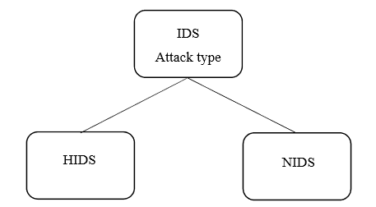
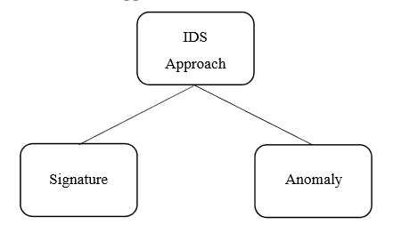
Types of ids
Notes:
The IDS can be divided into types according to the attack type and the approach. Considering the attack type, it is divided into HIDS and NIDS. HIDS is Host based intrusion detection system. Here the IDS is placed at every node in the IoT network and has direct access to internet and company network. In NIDS, the IDS is placed at a strategic location, to prevent intrusions to the entire network, usually at the gateway. The HIDS is more powerful as it can detect infections from within the network as well as the ones that are generated by the host itself that it might try to spread to the rest of the network.
According to the approach, it can be divided into signature based and anomaly based IDS. It can be better understood by the next slide.

Slide 9
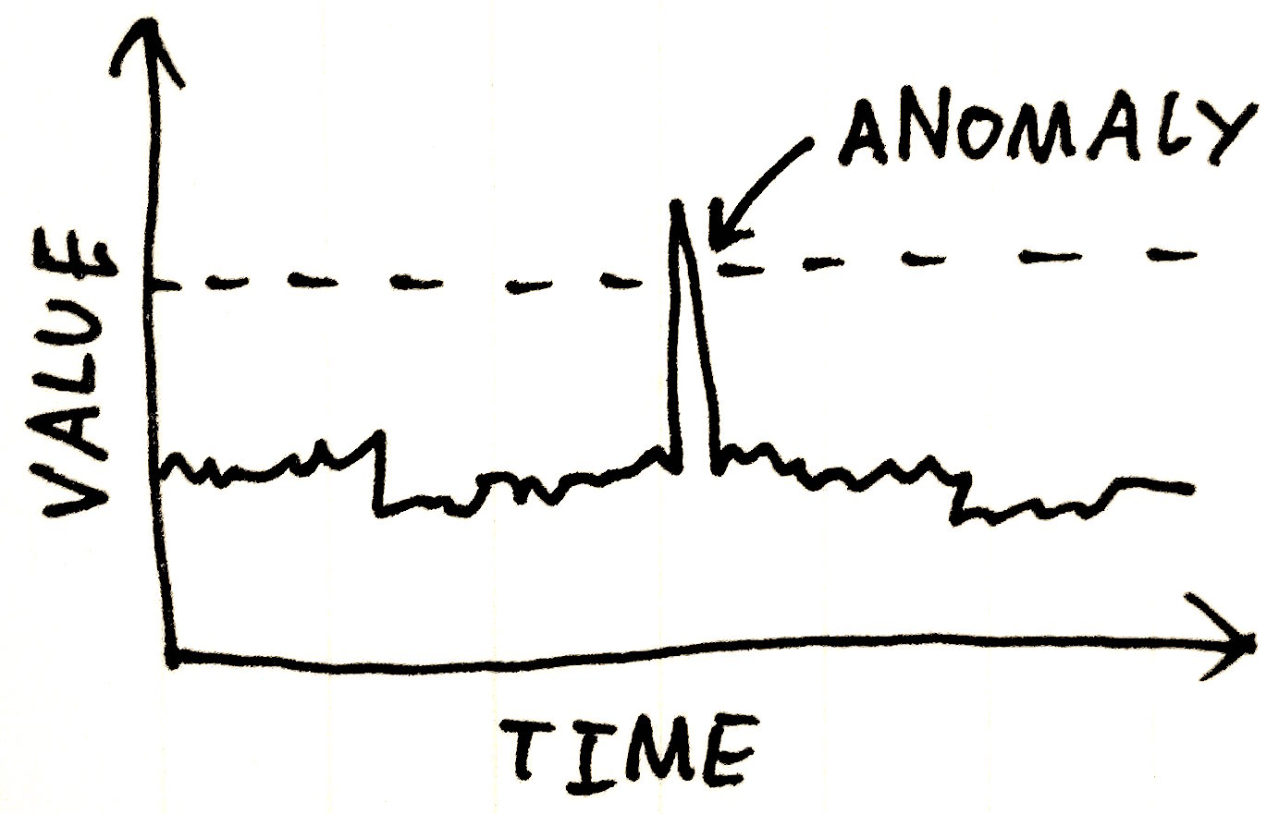

Signature based vs anomaly based
Signatures list
match
Notes:
In the signature based approach, the signature of the suspicious activity is compared with a list of preconfigured signatures and it is detected with the help of pattern matching. The signature based approach is not preferable as they need to be manually created by the security experts, and they can sometimes go upto 1000s of signatures. An attack with slight variations of existing attacks out of those 1000 would pass the system easily. Here is where the anomaly based system shines. It creates a baseline of normal behavior and the outlier that appears out of the ordinary and does not match the normal behavior is considered as the anomaly. Eg. A worm entered in the system will start sending more tcp connection requests than usual and will be caught as an anomaly.

Slide 10
Anomaly detection ML hybrid model
J48
Meta Pagging
Random Forest
REPTree
AdaBoostM1
Decision Stump
Naïve Bayes
Hybrid Model
Notes:
The method we’re going to discuss is a machine learning based hybrid model created using J48, Meta pagging, random forest, REPTree, AdaBoostM1, Decision Stump and Naïve Bayes.
J48 – decision tree
Random forest – ensemble of decision tree
reptree – fast decision tree learner
Adaboostm1 – meta algorithm, used in conjunction with other algorithms to boost performance
Decision stump – 1 level decision tree, often used as a weak learner in ensemble methods

Slide 11
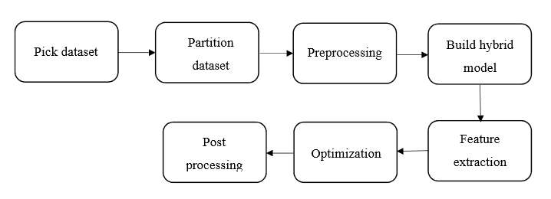
Functionality overview
Notes:
The method starts with
Picking the necessary dataset consisting of quality data such as the NSL-KDD.
Partitioning the dataset into 80% train and 20% test.
Preprocessing phase – involves the conversion of non-numerical values to numerical values, eliminating redundant data.
Building a hybrid model consisting of the classifiers J48, Meta Pagging, Random Forest, REPTree, AdaBoostM1, Decision Stump, Naïve Bayes. The classification phase involves learning(supervised/unsupervised) and recognition/decision step.
Feature extraction – involves determining the right parameters that need to be used in the classification model, which can help improve the accuracy of the classification. VOTE scheme and Information Gain (IG) are used.
Develop the model that is optimized to provided the best accuracy and performance.
Correction methods are implemented in post processing phase to give better recognition rate

Slide 12
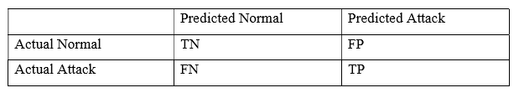
Confusion matrix
TN = True negatives
FP = False Positives
FN = False Negatives
TP = True Positives
Accuracy = (TN+TP)/(TN+FP+FN+TP)
True positive rate = TP/(FN+TP)
False positive rate = FP/(TN+FP)
True negative rate = TN/(TN+FP)
False negative rate = FN/(FN+TP)
Notes:
The confusion matrix is used to understand the term used in the anomaly detection system. The true negatives mean the activity is normal and also predicted as normal. False positives – when activity is normal, but predicted as attack. False negatives – when activity is an attack is predicted as normal. True positive when attack is corrected identified as an attack. These terms are useful to understand the results later on. The anomaly detection systems are known to have a high false alarm rate, ie. False positive – when normal attack is termed as an attack.

Slide 13
Nsl-kdd dataset: attack type classification
Attack
Denial of Service (DoS)
User-to-root (U2R)
Remote-to-local (R2L)
PROBE
Notes:
NSL-KDD dataset is a popular dataset used by researchers, commonly used to come up with effective IDSs. It is a refined version of KDDcup99 dataset. It is made up of a large amount of data (over 140,000 datapoints). For the purpose of experiments, 10% of the main dataset was under consideration for training. It consists of 41 attributes representing different flow features. Each sample is labeled either normal or attack type. It takes into account the following protocols: UDP, TCP, ICMP.

Slide 14
Algorithm
1. procedure model()
2. InputFn = NSL-KDD data set possessing 41 features f1, f2, f3… f41
3. Reduce 41 features to 8 features based on a number of the proposed filters
4. Use Vote scheme
5. Develop a robust model M
6. Propose the model
7. for every feature Fn
8. Provide Fn to J48, Meta pagging, RandomForest, REPTree, AdaBoostM1, DecisionStump and Naïve Bayes using NSL-KDDTrain+20%
9. Calculate
Notes:
This shows the algorithm of creating the hybrid model.

Slide 15
Algorithm (continued)
10. A1=J48 model accuracy
11. A2=Meta Pagging model accuracy
12. A3=RandomForest model accuracy
13. A4=REPTree model accuracy
14. A5=AdaBoostM1 model accuracy
15. A6=DecisionStump model accuracy
16. A7=NaiveBayes model accuracy
17. E=Ensemble representing J48, Meta Pagging, Random Forest, REPTree, AdaBoostM1, DecisionStump and NaiveBayes with NSL-KDDTrain+20%
18. Compare of the accuracy of A1, A2, A3, A4, A5, A6, A7, E
19. Select the best model M=E.

Slide 16
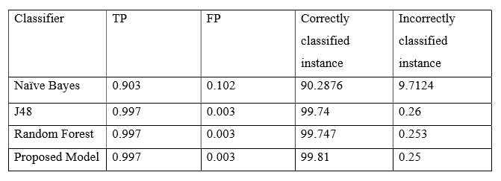
Discussion of results
Notes:
The hybrid model has the highest correctly classified instances. And lowest incorrectly classified instances. It outperforms the other classifiers in terms of accuracy. Another set of comparison of results is given in the report which classifies it into the 4 attack types. Even there, hybrid model performs better than the other models. Hence, the hybrid model is superior to the other models.

Slide 17
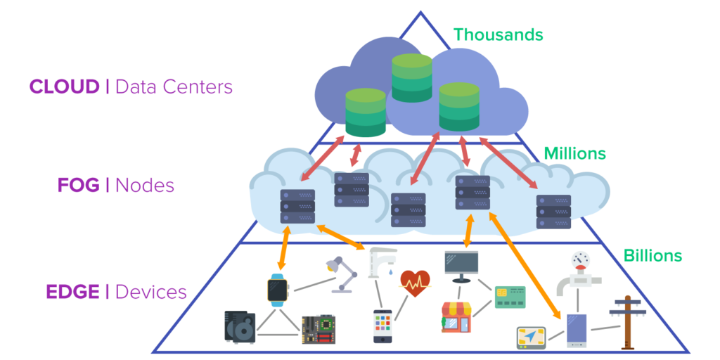
Conclusion and future work
Security is integral in IoT development
IoT is heterogeneous
IDS – second line of defense
Hybrid model is more effective than individual models
New dataset – ADFA can be used
Fog computing can be integrated
Notes:
Security is integral in the development of IoT. With the heterogeneous nature of IoT consisting of various types of devices, different protocols used and massive amounts of information generated and the architectural constraints that exist, a second line of defense against adversaries is beneficial, which comes in the form of intrusion detection system. The hybrid efficient model proposed consisting of J48, Meta Pagging, Random Forest, REPTree, AdaBoostM1, Decision Stump and Naïve Bayes is an anomaly based intrusion detection system. It is trained and tested on the NSL-KDD dataset and outperforms other machine learning models like the J48, SVM and Naïve Bayes in terms of accuracy in detecting the attacks.
To further improve on the intrusion detection, the system should be integrated with fog network. It sits between the devices and the cloud. As it is closer to the iot network, the transfer time is less and at the same time, it also provides more processing power as the computations would be done away from the low power iot devices.
Also, this new system can be trained using the newer, more updated, ADFA dataset.

Slide 18
references
[1] Abebe A. Diro., Naveen C., "Distributed attack detection scheme using deep learning approach for Internet of Things", Future Generation Computer Systems, 82, 2017, 761-768
[2] Ashima C., Brian L., Sheila F., Paul J., "Host based Intrusion Detection System with Combined CNN/RNN Model", IWAISe 2018- ECML PKDD Conference, 2018
[3] Bayu A. T., Kyung-Hyune R., "An Integration of PSO-based Feature Selection and Random Forest for Anomaly Detection in IoT Network", MATEC Web of Conferences, vol 159, 2018
[4] Dorothy E. D., "An Intrusion-Detection Model", IEEE Transactions on software engineering, vol SE-13, No. 2, 1987, 222-232
[5] Ebelechukwu N., Andre C., Gedare B., "Anomaly-based Intrusion Detection of IoT Device Sensor Data using Provenance Graphs", 1st International Workshop on Security and Privacy for the Internet-of-Things (IoTSec), 2018
[6] Jacob W., Khoa H., Orlando A., Ahmad-Reza S. et. al., "Security analysis on consumer and industrial IoT devices", 21st Asia and South Pacific Design Automation Conference (ASP-DAC), 2016
[7] Jesus P., Salim H., "IoT Security Framework for Smart Cyber Infrastructures", IEEE 1st International Workshops on Foundations and Applications of Self* Systems, 2016, pp. 242247
[8] John P., "The Evolution of Intrusion Detection/Prevention: Then, Now and the Future", https://www.secureworks.com/blog/the-evolution-of-intrusion-detection-prevention, 2017
[9] Ke W., Salvatore J. S., "Anomalous Payload-Based Network Intrusion Detection", Recent advances in intrusion detection: 7th international symposium, vol. 3224, 2004, pp 203-222
[10] Margaret R., "intrusion detection system (IDS)", https://searchsecurity.techtarget.com/definition/intrusion-detection-system, 2018
[11] Minhaj A. K., Khaled S., "IoT security: Review, blockchain solutions, and open challenges", Future Generation Computer Systems, 82, 2018, 395-411
[12] Shadi A., Monther A., Muneer B. Y., "Anomaly-based intrusion detection system through feature selection analysis and building hybrid efficient model", Journal of Computational Science, 25, 2018, 152-160
[13] Shadi A. A., Radhakrishna V., "GARUDA: Gaussian dissimilarity measure for feature representation and anomaly detection in Internet of things", The Journal of Supercomputing, 2018, pp 1-38
[14] Statista, "Internet of Things (IoT) connected devices installed base worldwide from 2015 to 2025 (in billions)", https://www.statista.com/statistics/471264/iot-number-of-connecteddevices-worldwide/
[15] TagyAldeen M., Takanobu O., Takayuki I., "Towards Machine Learning Based IoT Intrusion Detection Service", Recent Trends and Future technology in Applied Intelligence, 2018, 580-585
[16] Wikipedia, "Internet of things", https://en.wikipedia.org/wiki/Internet_of_things#cite_note-Linux_Things-1

Slide 19
Thank YOu

