Slide 1

Security and privacy on blockchain
Rui Zhang, and Rui Xue
University of Chinese Academy of Science
Ling Liu, Georgia Institute of Technology
Comp4060 Shuo Zhang
Notes:
University of Chinese Academy of Science is

Slide 2
New learn
basically almost all the points here are discussed in previous papers
but I still learn a ton in this paper
it is written in much more detailed and plain English
Especially in the explaining of the tampering, the malicious attacks, the proof of work and signatures
so compare to other papers we’ve read, this paper is math mild
The paper explains the underlying technology of blockchain and its alternatives

Slide 3
introduction
2019 predicted reach $19.9 billion by 2025
but already over $200 billion
10 times beyond their imagination

Slide 4
the purpose
show the degree of trust that blockchain may provide
shed light on the root causes of vulnerability
provide foresight and technological innovation on defense techniques
gain better understanding of security and privacy properties of blockchain
explore the cutting edge security and privacy techniques of blockchain

Slide 5
how does blockchain work
Bitcoin blockchain succeeded att
prevent double spending
stop the retrospective modification of any data
By using
Hash chained storage, Merkle tree, Digital signature, Elliptic Curve Digital Signature Algorithm

Slide 6
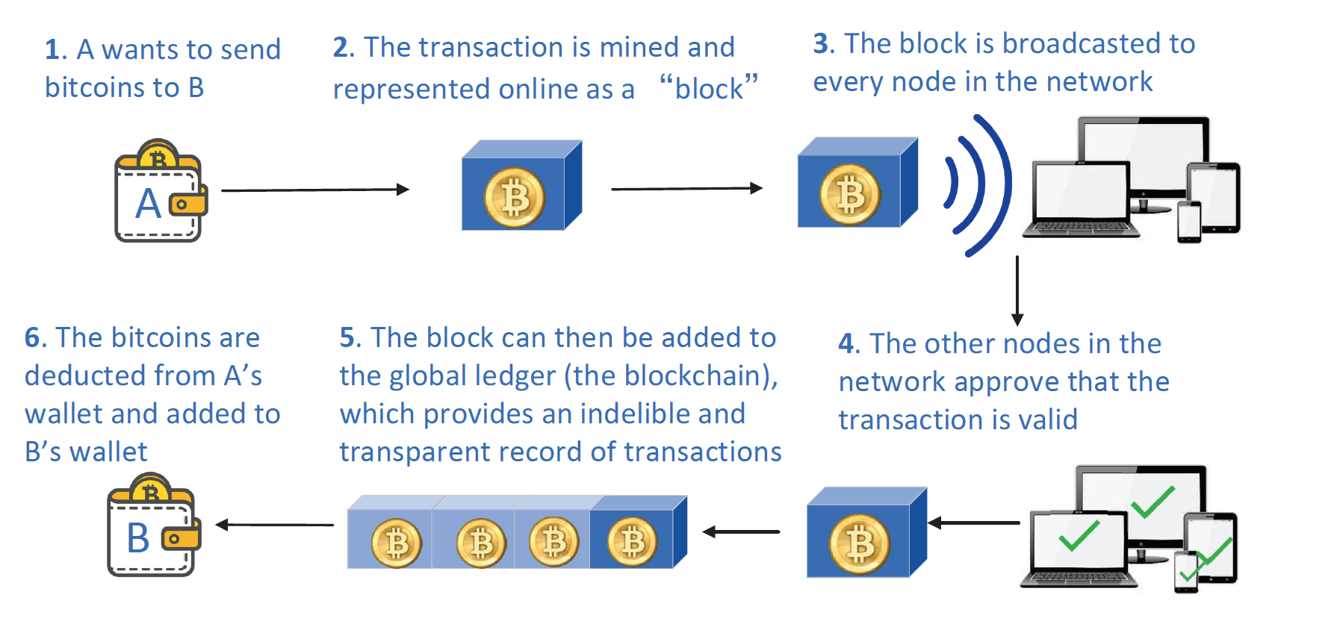
how does bitcoin work

Slide 7
consensus
each node has the option to add that block to their copy of the global ledger or to ignore it
the network as a whole should be resilient to the partial failures and “attacks
through consensus, it ensures the consistency state and prevents the double spending problem

Slide 8
Transactions
UTXO
a block should not be considered as confirmed until w blocks are added after it
default w is 6
relatively stronger now, since 6 blocks is small number now
In contrast to UTXO is Account-Based Online Transaction Model
adopted and extended in Ethereum

Slide 9
CAP Properties in Blockchain
Consistency: where each computing node receives the most recent write.
Availability: where any requests for some data is always available.
Partition tolerance: where the distributed systems is always operational, even when some subset of nodes fail to operate.

Slide 10
Classification and Evolution of Blockchains
Public blockchain
Consortium blockchain
Private blockchain
Over the past 10 years, blockchain has evolved beyond digital currency (Blockchain 1.0),to smart contracts (Blockchain 2.0), and to many other forms of decentralized collaborations with high accountability and high level of security and trust (Blockchain 3.0).

Slide 11
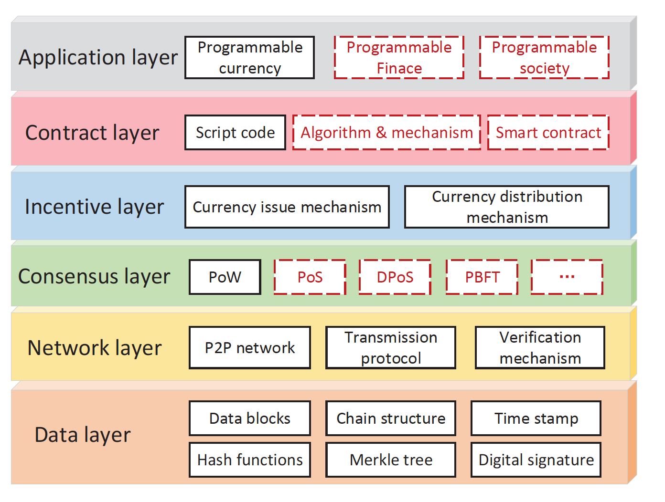
The architecture of blockchain

Slide 12
requirement of Security and privacy
broadly categorize into seven types
targeted at one type of known vulnerabilities.
Consistency of The Ledger across Institutions
Integrity of Transactions
Availability of System and Data
Prevention of Double-Spending
Confidentiality of Transactions
Anonymity of Users’
Unlinkability of Transactions.

Slide 13
basic security property
the strong consistency
In contrast, the eventual consistency model: gets consistent eventually
tamper resistance: cannot tampered during and after the process of block generation
Resistance to DDoS Attack: distributed attack
DoS: overload the host system by flooding with superfluous requests

Slide 14
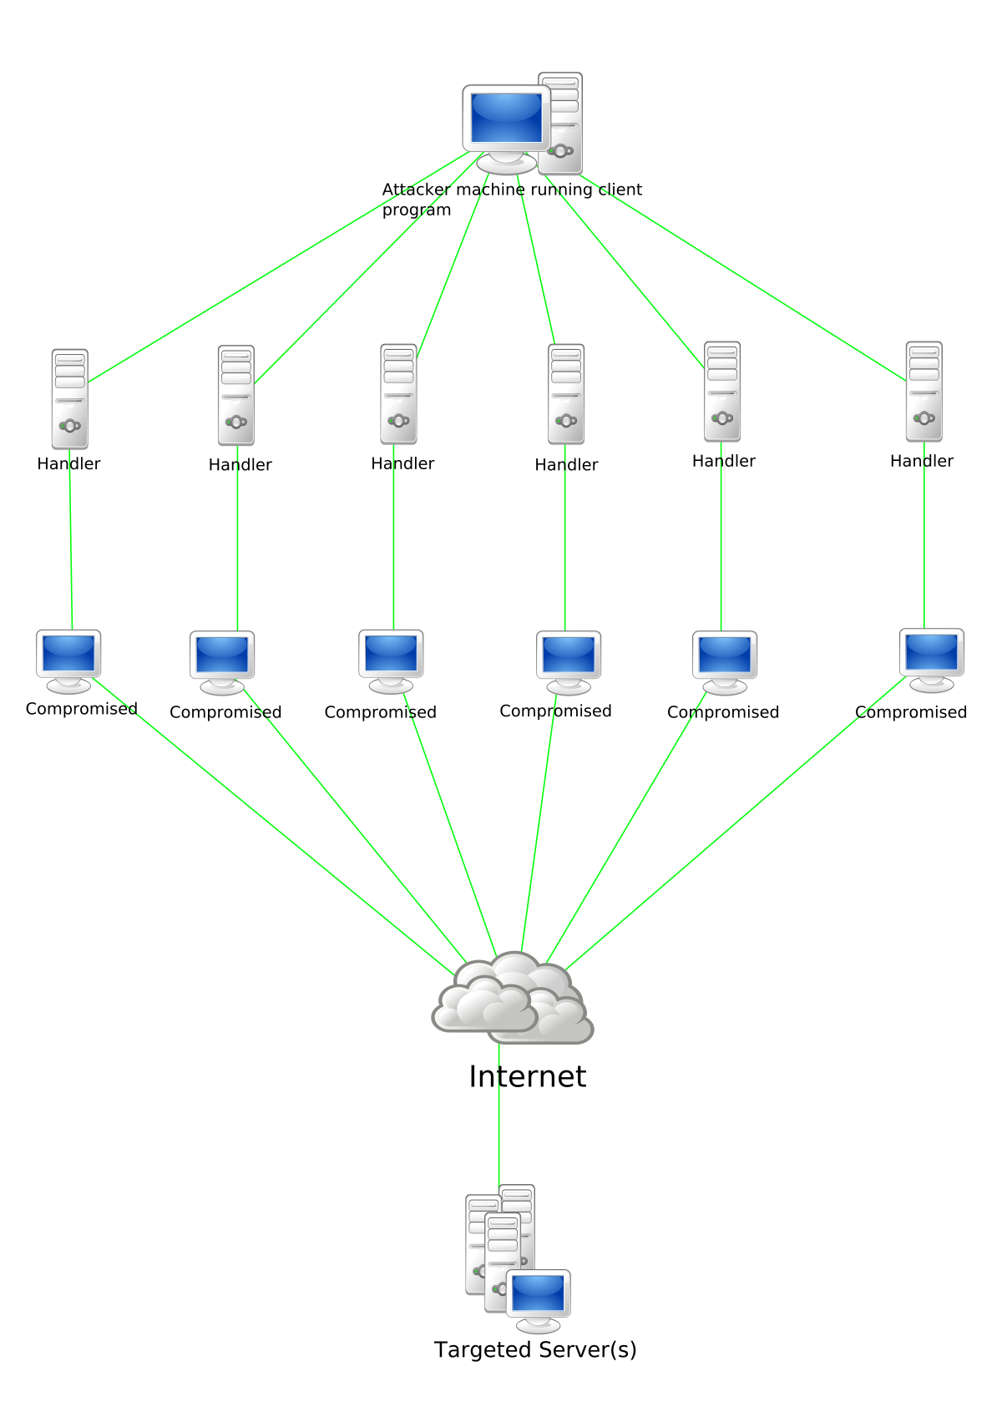
DDOS attack

Slide 15
pseudonymity
Bitcoin only achieves pseudonymity but not unlinkability
it is critical to design and implement stronger protection mechanisms for privacy-preserving smart contracts

Slide 16
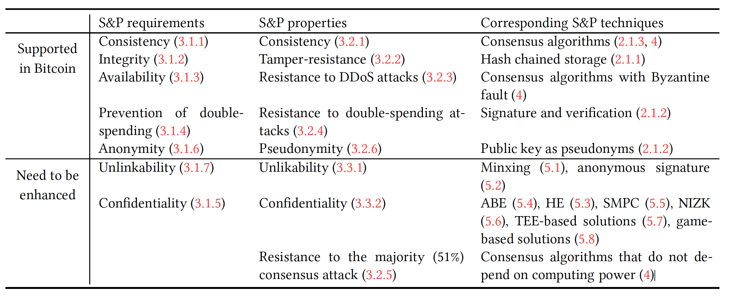

Slide 17
majority voting v.s. consensus
a consensus emphasizes that the entire group as a whole could benefit by reaching a consensus

Slide 18
proof of work
Append a “nonce" (usually start with zero) to the original message
Apply hash to the nonce augmented message and check if the hashing result is less than or equal to a preset value
Finding the right nonce can be time consuming and computationally expensive
effective in solving the Byzantine Generals problem
an extremely inefficient process due to high computation complexity and low probability of successful generation of the proof of work.
consider trade-off between efficiency and strong consistency

Slide 19
BFT inefficient
consume too much energy
limited application
Example: asking healthcare providers to spend a lot of computing resources to hashing data is not only very inefficient, but also completely unrealistic

Slide 20
proof of state
breaks the dependency on rewards for security by promoting penalties-based solutions
become a validator by sending a special type of transaction to lock up certain amount of their coins into a validator deposit
pseudo-randomly selects a validator

Slide 21
interesting selection of validator
Peercoin: use coinage
The coin age is
defined for each coin by the number of days in which the coin has not been spent
you can require only the 60days old coin can vote

Slide 22
Recall Last time..
How Bitcoin works
Transaction technology
architecture of Blockchain
DDoS Attack
Requirement of Security and Privacy
BFT problem
Both proof of Work and Proof of State

Slide 23
security and privacy
Blockchain is created and maintained as a open secure ledger for online transactions
the security and privacy of blockchains continue to be at the center of the debate
essential requirements and building blocks for cryptocurrency systems
defense attacks
avoid vulnerabilities exploited
explore the cutting edge security and privacy techniques
security and privacy attributes are inherent and desired

Slide 24
7 types requirements of blockchain
consistency of the ledger across institutions
integrity of transactions: prevent from tampered with
availability of system and data: access at any time
prevention of double-spending: prevent spending a coin more than once

Slide 25
7 types requirements of blockchain
5. confidentiality of transactions:
users’ transaction, identity, any data cannot be accessed by any unauthorized others
6. anonymity of Users
7. unlikability of transactions

Slide 27
consistency
In all nodes, a distributed global ledger has the same ledger at the same time
Bitcoin transactions are grouped in blocks, miner nodes will mine and add a block to the blockchain network
the blockchain network is the longest chain, and the miners who obtain w confirmations is the winner and get rewards
default w = 6
if w = 0 means zero confirmation is required, highest consistency
6 blocks is a relatively small number, Bitcoin is consistent

Slide 28
tamper resistance
resistance to any type of intentional tampering
Tamper-resistance : cannot be tampered during and after the process of block generation
Example: a miner may attempt to change the payee address to himself
a SHA-256 hash signature is signed by the payer, guaranteed by the unforgeability of the secure signature algorithm
Bitcoin also using a hash function with collision-resistance, two different inputs with an overwhelming low probability
Bitcoin is signed and distributed over all nodes, practically impossible to tamper transaction data

Slide 29
Resistance to DDoS attacks
DDoS: distributed Dos Attack
Dos attack: disrupt the hosted internet service by making the host unavailable to its intended users, overload the host system by flooding with superfluous requests
DDos: controlee a set of individual computer to attack another computer, the attack may send huge amounts of data to a hosting website
DDoS attacker can make the blockchain unavailable by knocking out a partial or the whole network
But as the Bitcoin blockchain become lager and larger, the harder it is to succeed in such large-scale DDoS attack

Slide 30
Resistance to the 51% consensus attack
if a miner controls more than 50% of the computing power
various security and privacy attacks may be launched
need to be enhanced

Slide 31
pseudonymity
a state of disguised identity
Bitcoin hashes of public keys of a user
risks of revealing identity information of users

Slide 32
Unlinkability
unlinkability: inability of link two things together with high confidence
hard to launch deanonymization inference attacks
Bitcoin is public blockchain, perform de-anonymization attack silently and secretly without the target user knowing
Bitcoin only achieves pseudonymity butt not unlinkability

Slide 33
confidentiality
require confidentiality for all data or certain sensitive data
confidentiality of transaction information
is not supported in Bitcoin system
confidentiality and privacy pose a major challenge for blockchain and its applications

Slide 34
Consensus algorithms
protocol for reaching agreement dynamically in a group
but this dynamic may be tampered by malicious actors and faulty processes
This problem is so called “Byzantine Generals Problem”
the consensus algorithms then provide a probabilistic solution to BGP

Slide 35
proof of work
Designed by Satoshi Nakamoto: aim to reach a coordinated consensus
Difficult and time-consuming to meets certain proof requirement
easy and fast for verify
a ”nonce” is appended to the original message, the message is hashed, try change the nonce until the right value with required number of zeros is obtained
Bitcoin limits the rate of creating and adding new blocks roughly every 10 minutes
Although PoW is effective solving BGP, extremely inefficient,

Slide 36
51% risk
over 70% hash rate is divided among top five independent mining farms(2018)
they could acquire 51% attack
however, convincing all nodes is much harder
social layer of consensus can also be the protection
backward and forward attack due to this 51% protection

Slide 37
Proof of state(Pos)
ensures CAP properties, breaks the dependency on rewards for security by promoting penalties-based solutions
consistency, availability, partition tolerance
locked up their capital as deposits(stake) are qualified to be chosen as miners
the probability of being selected is proportional to their bet
the algorithm pseudo-randomly selects a validator (every 10s)

Slide 38
Pos punishment
reward: transaction fee to all for validators in addition to the proportion of the bets
chain spits are avoided by penalty
an implicit penalty for creating a block on the wrong chain
cost miners more physical hashing power to mine on the wrong chain, preferred on the longest chain

Slide 39
Pos algorithms for selecting validator
NxT and Blackcoin use random selection
PeerCoin combine random and coinage
avoid using large stakes to dominate the blockchain

Slide 40
BFT based consensus algorithm
example: each player holds a possibly different value, need to agree on a single value by obeying a consensus protocol
the system has to tolerant when a minority of the players are malicious
most traditional systems have central authorities
blockchain prevent the occurrence of the BF rely on PoW and PoS, but neither is perfect
the first BFT introduced by Lamport, Shostak, and Pease in 1982

Slide 41
AlgoRANd
AlgoRAND is a new Byzantine agreement protocol much more efficient
chooses its players in a much smaller subset by an algorithm cryptographic sortition
a random process of choosing officials from a large sett of eligible users

Slide 42
other consensus algorithm
Sleepy Consensus.
Proof of Elapsed Time (PoET)
Proof of Authority (PoA)
Proof of Reputation (PoR).

Slide 43
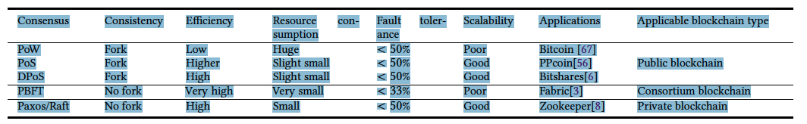

Slide 44
Privacy
Introduce some techniques that can be leveraged to enhance the security and privacy
mixing
anonymous signatures
homomorphic encryption
attribute based encryption
security multi-party computation
Non-interactive zero-knowledge proof
The trusted execution environment based smart contract
Game-based smart contract

Slide 45
Privacy: Mixing
Bitcoin’s blockchain does not guarantee anonymity for users
mixing services (or tumblers) was designed to prevent users’ addresses from being linked
Mixcoin 2014, CoinJoin 2013. CoinShuffle 2014

Slide 46
anonymous signatures
some signature schemes provide the ability of anonymous signatures
Group signature
a cryptography scheme, any members can sign a message for the entire group anonymously by using her personal secret key
reveals nothing but the membership of the group
2. ring signature
also can achieve anonymous through signing by any member of a group users
differ: no group manager, any users can group a ring by themselves

Slide 47
Homomorphic encryption
a powerful cryptography
perform computations directly on ciphertext
Ciphertext is encrypted text transformed from plaintext using an encryption algorithm.
ensures that the operations performed on the encrypted data
one can use Homomorphic encryption techniques to sore data without significant changes

Slide 48
attribute based encryption
attributes are the defining and regulating factors for the ciphertext encrypted using the secret key
but few applications, due to the lack of understanding of core concepts and efficient implementation
it tis a remaining open challenge to be implemented

Slide 49
Secure multi party computation
multi-party protocol to carry out some computation jointly
such that an adversary learns nothing about the input of an authentic party but the output of the joint computation
a two-party computation was developed by Andrew Yao in 1982
In recent years, a decentralized SMP platform, Enigma, is proposed in 2015
employs a verifiable secret sharing scheme to guarantee privacy

Slide 50
Non interactive zero knowledge proof
proposed in early 1980s
a formal proof can be formulated to verify some input privately known and produce some publicly open output twithought the disclosure of any other information
Zcash used another variation of zero knowledge

Slide 51
the trusted execution environment based smart contracts
provides completely isolated environment for application execution
the intel software guard eXtensions
Enigma utilized TEE in its current version
current version allow users to create privacy preserving smart contracts using a decentralized credit scoring algorithm

Slide 52
Game based smart contract
very recent developments
encourage players to check computation tasks and find bugs
securely perform a computation task with verifiable properties
Arbitrum has designed an efficient challenge protocol to identify and penalize the dishonest parties

Slide 53
techniques
ABE: Aribute-Based Encryption
SMPC: Secure Multi-Party Computation
HE: Homomorphic Encryption
NIZK: Non-Interactive Zero-Knowledge (NIZK) Proof
TEE: The Trusted Execution Environment (TEE) Based Smart Contract

Slide 54
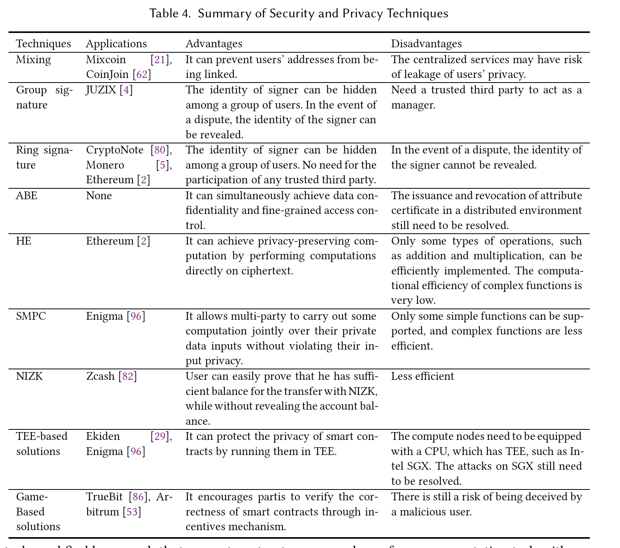

Slide 55
privacy summary
needs to meet multiple security and privacy requirements
no single technology is a panacea
no technology that has no defects or is perfect in all aspects
there is always trade-off between security privacy and efficiency

Slide 56
Questions:
1. how’s he ability of Bitcoin in resisting to the Majority (51%) Consensus Attack.
2. PoW solved the BFT, what’s the downside of using PoW?

