Slide 1
Tracking Ransomware End-to-end
Presented By :-
Rahul
Graduate Student
Danny Yuxing Huang, Maxwell Matthaios Aliapoulios, Vector Guo Li, Luca Invernizzi, Kylie McRoberts, Elie Bursztein, Jonathan Levin, Kirill Levchenko, Alex C. Snoeren, Damon McCoy
Princeton University New York University University of California, San Diego Google Inc Chainalysis

Slide 2
Introduction
Ransomware is type of malware that encrypts victim’s data and asks for payment
Bitcoin adopted as form of payment to ransomware families to stay anonymous.
$16 million USD is an estimated amount over 2 years from 19,750 potential victims
This paper is large scale study of two years ransomware payments, victims, operators

Slide 3
Background Information
Ransomware families are such as Lockey, Cerber, WannaCry, CryptoDefense
Delivery
(using emails, LAN)
Execution(Binary executes and encrypts data)
Payment(Note indicating address)
Liquidation(Cash out to fiat currencies)
Decryption(Guide to decrypt)

Slide 4
Discovering ransom deposit address
Discovered ransom seed addresses associated with victim provided images from reports in public forums such as Bleeping Computer – 25 seed ransom addresses
Obtain binaries of Locky and Cerber from VirusTotal.- 32 addresses

Slide 5
Discovering additional ransom address
Need ?- Locky, Cerber use unique addresses for each ransom therefore hard to find associated addresses
How?- By Clustering and Micropayments
Clustering using co-spent heuristics.
Micropayments- 0.001 bitcoins to ransom addresses and observe subsequent flow.

Slide 6
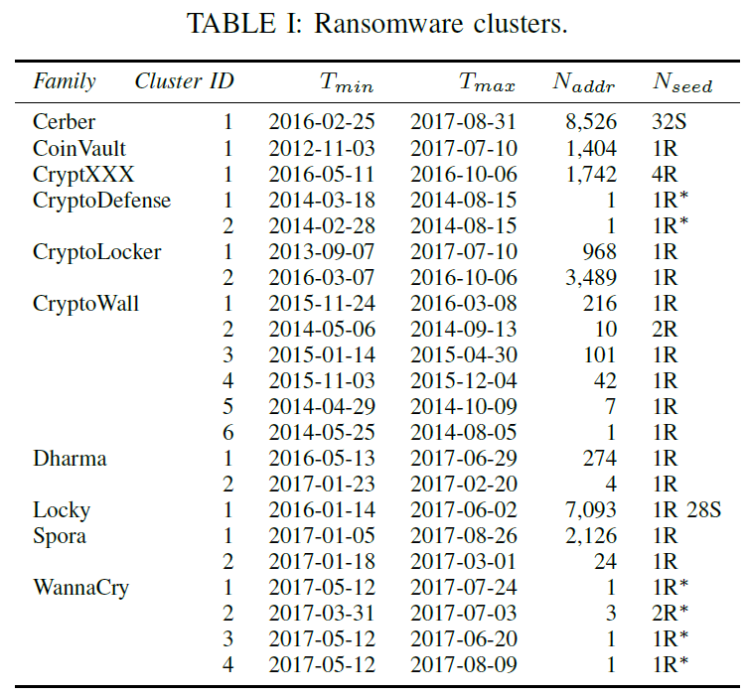
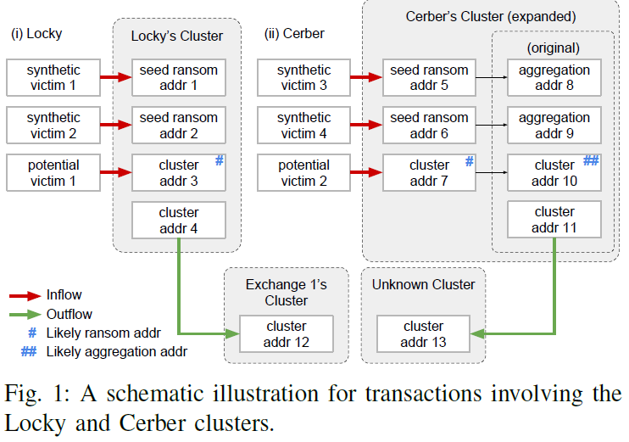
Discovering additional ransom address

Slide 7
Limitations of Co-spending Heuristic and Micropayments
Victim reported two ransom address of Sage but never did transaction
Micropayments made to Sage family never moved
Ransomware operator may decide to completely switch to different wallet cluster after receiving payment.

Slide 8
Coverage of Clusters
There is chance of potentially missing cluster of ransomware family.
To determine , study of timing of Bitcoin inflow with external indicators
Google Searches
Number of Binaries in VirusTool

Slide 9
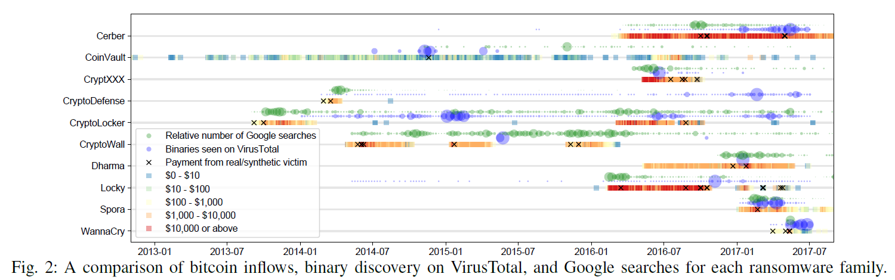
Results of study of comparisons

Slide 10
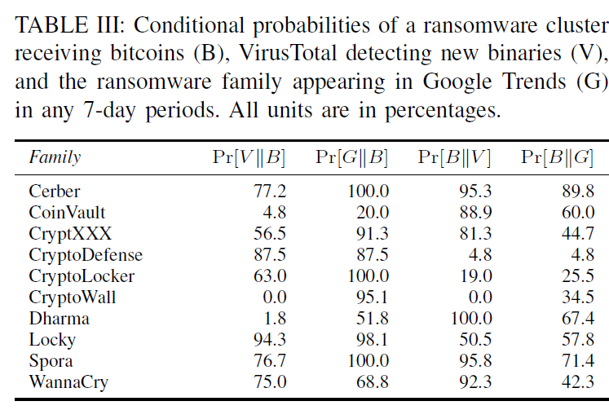
Overlapping of three events:-
Now it is easy to deduce where are we missing binaries or clusters

Slide 11
Filtering Transactions
Filter 1 : Inflow should be consistent with ransom payment patterns
Any payment received by seed ransom address is potentially victim payment.
Filter 2 : Inflow sends payment from exchange cluster to ransomware cluster.
Chainalysis is a proprietary online service that links clusters of wallet addresses to the likely real-world identities such as exchanges.

Slide 12
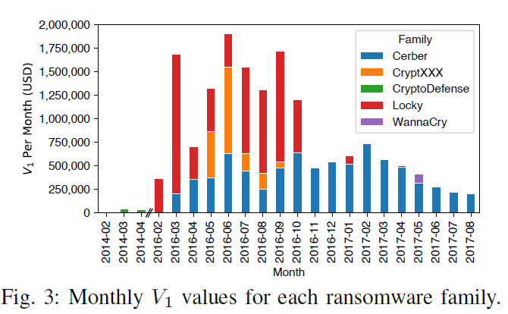
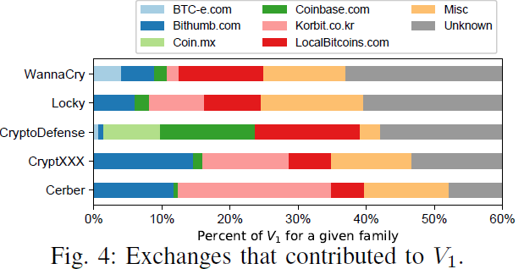
Results after Filtering Transactions
Able to trace $16,322,006 US Dollars in 19,750
likely victim ransom payments for 5 ransomware families over 22 months.

Slide 13
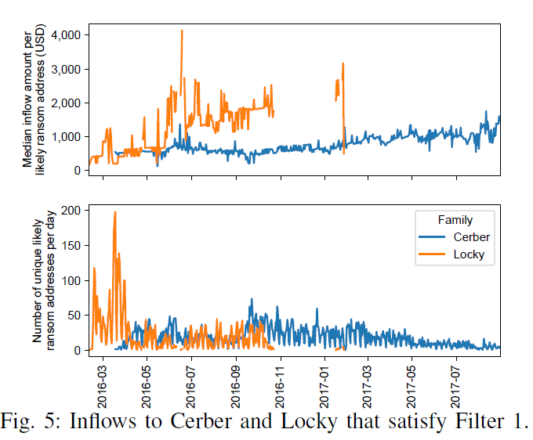
Payment Dynamics
Overall, both charts suggest that a potential Locky victim probably pays a higher ransom than a potential Cerber victim

Slide 14
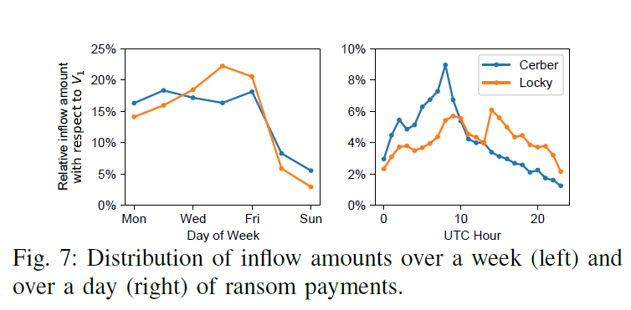
Payment Timings
It is likely that most of the paying victims of Cerber were located in Asia

Slide 15
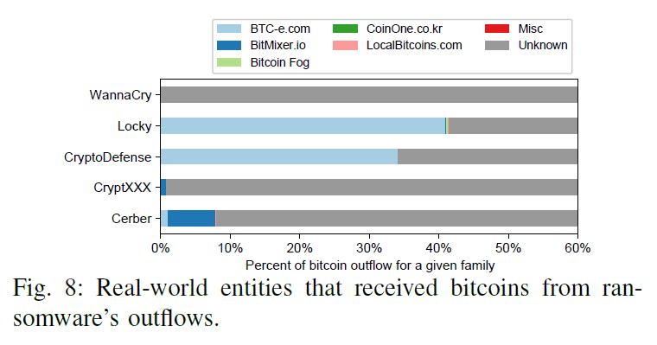
Characterizing Potential Cash out
In the median case, the bitcoins remained in WannaCry’s cluster for 79.8 days, while for Cerber and Locky, the median holding durations for Cerber and Locky are 5.3 and 1.6 days respectively.

Slide 16
Future Works :-
What is the probability the victim might make a payment to ransomware family?
Need of improved filtering methods to cover more families
What if we don’t have binary?
Investigate methods of tracing cash-out that traverse mixers

Slide 17
Conclusions & Questions:-
Detailed 2 year end to end examination of ransomware ecosystem.
Estimated 16 million USD extorted from an order of 20,000 victims.
Questions
What is CoinJoin transactions? Can you cluster two addresses used in CoinJoin transactions using same owner heuristics?
What are the possible heuristics(except co-spending addresses belongs to same owner) for clustering the addresses?

Slide 18
Exploiting Blockchain Data to detect Smart Ponzi Schemes on Ethereum
Presented By :-
Rahul
Graduate Student
WEILI CHEN 1,2, ZIBIN ZHENG 1,2, EDITH NGAI 3, PEILIN ZHENG1,2, AND YUREN ZHOU
1 School of Data and Computer Science, Sun Yat-sen University, Guangzhou 510006, China
2 National Engineering Research Center of Digital Life, Sun Yat-sen University, Guangzhou 510006, China
3 Department of Information Technology, Uppsala University, 751 05 Uppsala, Sweden
Received February 14, 2019, accepted March 6, 2019, date of publication March 18, 2019, date of current version April 5, 2019.

Slide 19
Introduction
Ethereum is famous open source blockchain-based distributed platform.
Smart contract is a set of promises and protocols specified in digital form
Blochchain, as an emerging technology also attracts lot of spams due to anonymity.
The studies found that 7 million USD has been gathered during 9/2/2013 to 9/9/2014 by scams in Bitcoin

Slide 20
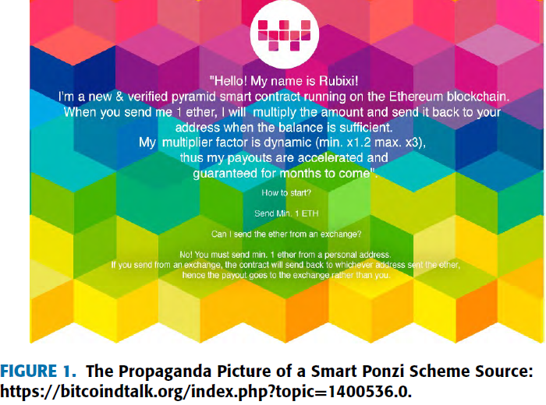
Smart Ponzi Scheme

Slide 21
Significance of detecting Ponzi Schemes
Investors and users lacking the knowledge of what Blockchain is, therefore trapped by scam
Imperative for health and rightfulness of Blockchain market.

Slide 22
Detecting Smart Ponzi Schemes is not easy
Enough verified samples must be collected
Inefficient to manually check smart contracts with large influx of Ethereum smart contracts each day.
More than 2 million smart contracts running out of which 1% has source code.

Slide 23
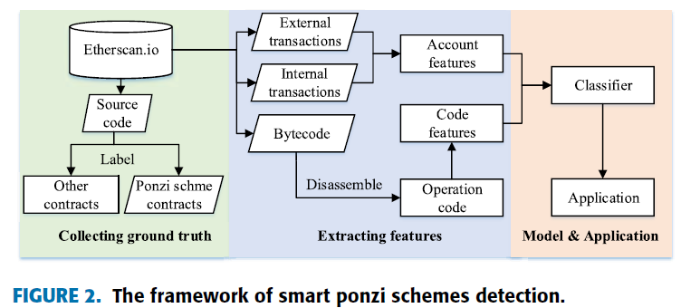
Framework adopted in study:-

Slide 24
Ethereum, Smart Contract in Nutshell
EVM is runtime environment for EVM bytecode.
Smart contracts written in high level language such as Solidity.
EVM compiler compiles source code to bytecode.
External transactions and Internal transactions
External accounts and contract accounts

Slide 25
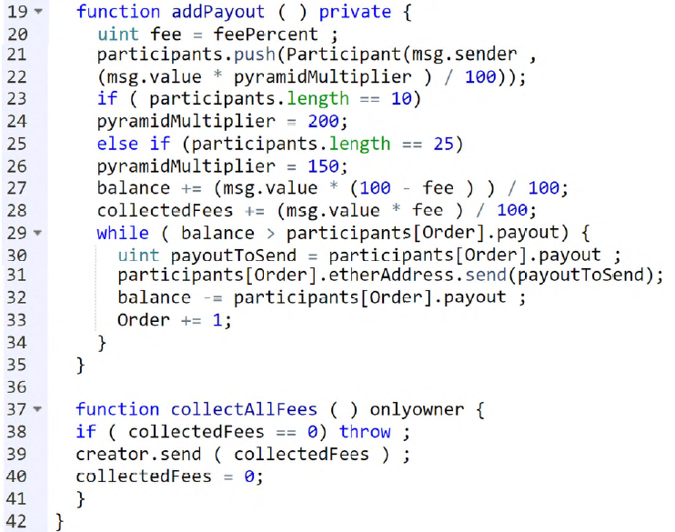
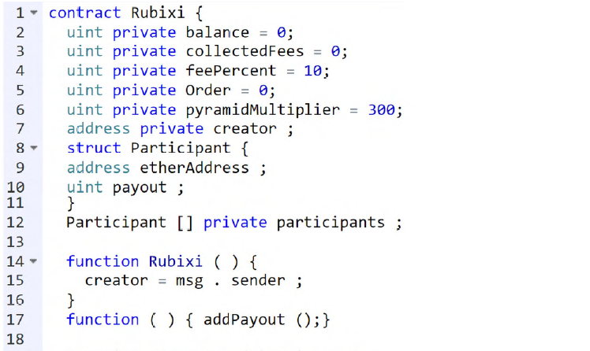
Source Code Snippet of Smart Ponzi Scheme
It is possible to identify a smart Ponzi scheme from its transactions history if source code is not available.

Slide 26
Data Collection
Collect all the open source code smart contract created before 9/7/2017 from the etherscan.io and manually check whether they are Ponzi scheme contracts
200 Ponzi scheme contracts and 3580 non-Ponzi scheme contracts are identified.
Transaction history collection from 7/30/2015 to 9/7/2017
Data available at :- https://pan.baidu.com/s/1TNBPjubIDc0GJ1kLKjiJyw

Slide 27
Feature Extraction(Account Features)
Analysis of Rubixi Transactions history leads to
Contract pays to known account
Many participants receive nothing from contract
Some participant has more payment transactions than investment transactions.

Slide 28
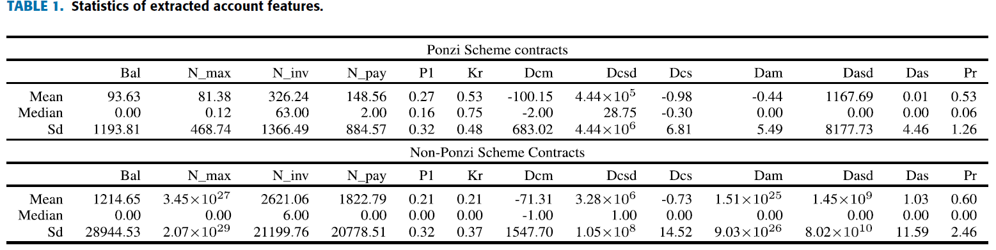
Feature Extraction(Account Features)-contd.
Introduced 2 difference vectors v1, v2 that is difference of counts and amounts between payment and investment for all participants

Slide 29
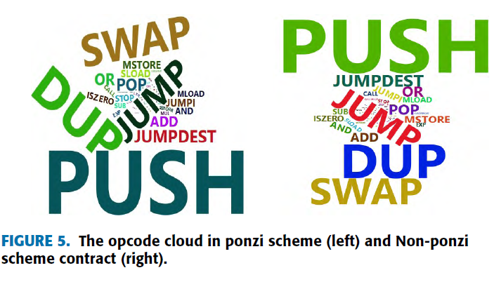
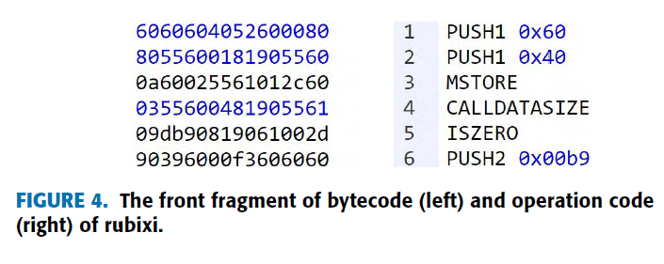
Feature Extraction(Code Features)
64 different opcodes found in 3780 contracts, Thus code feature is 64 dimension

Slide 30
Classification Model
Adopted bagging based algorithm(Random forest)
A Random Forest (RF) is a combination of Decision Trees, trained by the training sets obtained by the bagging method.
N-training sets -> N decision trees -> Result from voting
Classification methods such as Decision Trees or Support Vector Machine
Anomaly detection methods such as One class SVM and Isolation Forest.
Two Steps methods

Slide 31
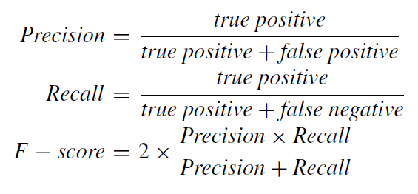
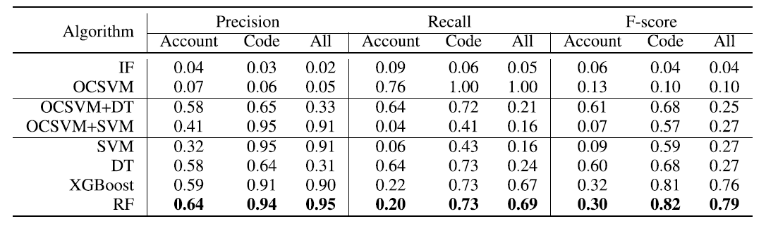
Evaluation Metrics

Slide 32
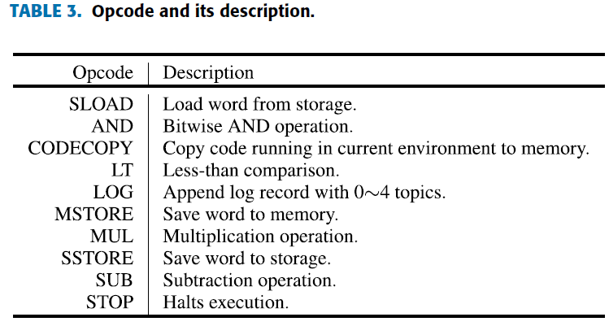
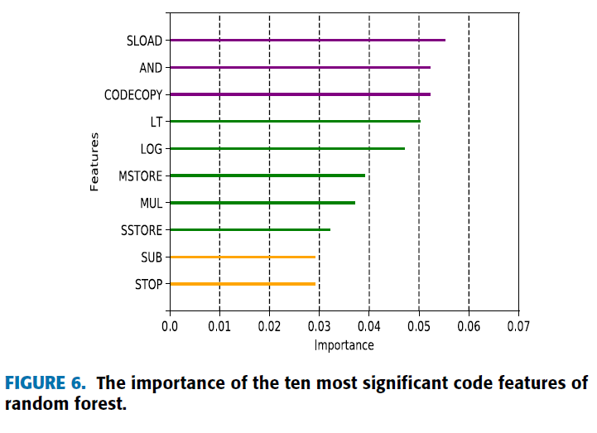
Important Code Features to detect Smart Ponzi

Slide 33
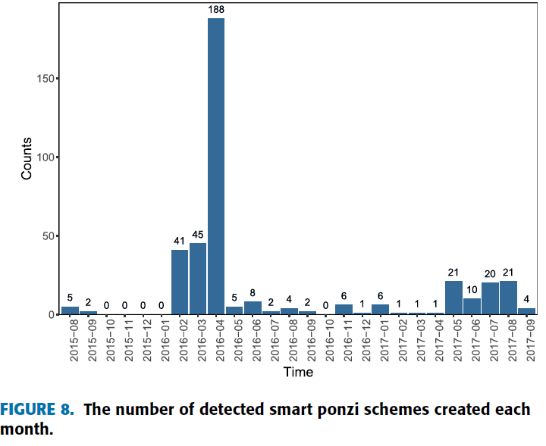
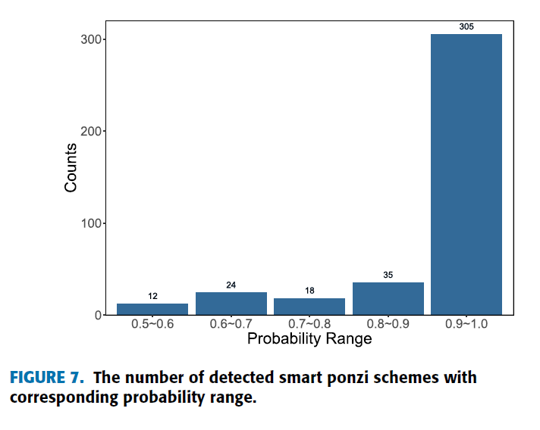
Number of Smart Ponzi Schemes detected

Slide 34
Conclusion and Future Works
Proposed Machine learning approach to detect Smart Ponzi schemes.
Estimated that more than 500 Smart Ponzi schemes exist
Future work to built more efficient classification model
Future work on detecting impact and type of Smart Ponzi.

Slide 35
Questions
What are the advantages for operators of Smart Contract Ponzi schemes?
Is there any possibility of Ponzi schemes or similar schemes in other Blockchain platforms?

Slide 36
References
[1] Danny Yuxing Huang1, Maxwell Matthaios Aliapoulios2, Vector Guo Li3, Luca Invernizzi4, Kylie McRoberts4, Elie Bursztein4, Jonathan Levin5 Kirill Levchenko3, Alex C. Snoeren3, Damon McCoy,’ Tracking Ransomware End-to-end’
[2] WEILI CHEN 1,2, ZIBIN ZHENG 1,2, EDITH NGAI 3, PEILIN ZHENG1,2, AND YUREN ZHOU, Exploiting Blockchain Data to Detect Smart Ponzi Schemes on Ethereum, Received February 14, 2019, accepted March 6, 2019, date of publication March 18, 2019, date of current version April 5, 2019.

Slide 37

Questions!
Thank you for your time

