Slide 1
SoK
By Samuel Idowu
Systematization of knowledge – off the chain transactions

Slide 2
authors
Lewis Gudgeon Pedro Moreno-Sanchez
Imperial College TU Wien
Stefanie Roos
TU Delft
Patrick McCorry Arthur Gervais
King’s College London Imperial College London

Slide 3
Outline
Introduction
Channels
Channel Hubs
Commit-Chain
Anonymity and Privacy

Slide 4
Introduction
Blockchain offers a platform through which mistrusting entities can cooperate in the absence of a trusting third party.
Use of broadcast in non-custodial protocols limit scalability to about 10 Transactions-per-second.
Layer-Two protocols are classified as orthogonal, and they scale blockchains without changing the layer-one trust assumptions, with no additional consensus mechanism introduced.
Layer-Two affords users the luxury to perform off-chain transactions through private communication rather than broadcasting the transaction on the parent network, reducing transaction load on the blockchain, and also backward compatible

Slide 5


Systematization of Knowledge
The following myths are scrutinized
Myth 1: Blockchains cannot scale significantly — either in terms of throughput and computational complexity — without advances at layer-one, such as through novel or more efficient consensus mechanisms.
Myth 2: Layer-two solutions can only be secure if the off- chain transaction volume is fully collateralized.
Myth 3: By default, off-chain transactions offer privacy.
Myth 4: Blockchain transaction fees depend on their size or computational complexity, not on the transaction value.

Slide 6

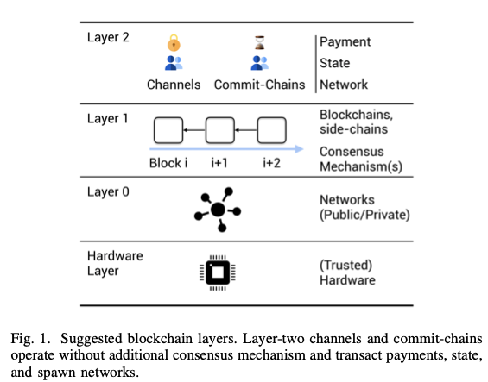


An overview of the Blockchain System

Slide 7
Four different layers of the blockchain system
Hardware Layer - Trusted Execution Environments (TEE) substitute the need for a blockchain clock with a trusted hardware assumption, thus enabling efficient protocols at other layers such as off-chain payments, the removal of dispute processes and backward compatibility.
Network layer - peer-to-peer layer on which blockchain nodes exchange information asynchronously. Important for scalability, security and privacy of a blockchain. Blockchain miners are connected through dedicated miners P2P networks in addition to the public blockchain P2P networks.
The Blockchain layer – hosts immutable add-only chain of blocks that accumulates transactions from parties in a network. Integrity of the blockchain is ensured by means of a consensus algorithm, Proof of Work. Bitcoin-like blockchains are based on a restricted Script language and operate via a set of Unspent Transaction Outputs (UTXO)
The Off-chain Layer – assumes two properties, integrity and eventual synchronicity with an upper time bound. The layer does not publish every transaction on the blockchain immediately, and they heavily rely on the consensus algorithm of a parent chain. Two different protocols are discussed, Channels and Commit Chains.

Slide 8
CHANNELS
A channel establishes a private peer-to-peer medium, governed by pre-set rules allowing the involved parties to consent to state updates unanimously by exchanging authenticated state transitions off-chain
Lifetime consists of three phases
Channel establishment – parties cooperatively open a channel by locking collateral on blockchain
Transition - Once the channel is open, all parties can update the channel’s state in a two-step process
Disputes - If an honest party does not receive n signatures before a local timeout, it can trigger a layer-one dispute and enforce a new state transition without the cooperation of the other parties,.

Slide 9
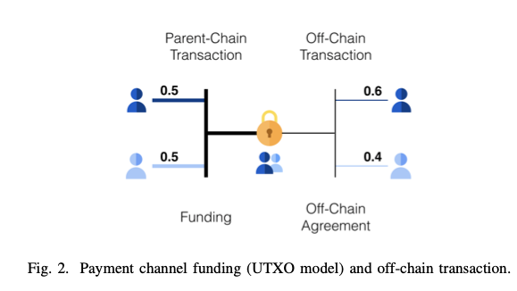
Channel Establishment

Slide 10
State Replacement
Four state replacement techniques which assume that participants in a channel are rational and follow the strategy with the highest payoff (e.g. a user publishes an older state if it represents a payment of higher value for this user)
Replace by Incentive (RbI)
Replace by Time Lock (RbT).
Replace by Revocation (RbR).
Replace by Version (RbV).

Slide 11
Payment Channel
Replace by Incentive - channel allows a sender to issue payments to a recipient, but the recipient cannot send the funds back through the same channel. To create a channel, the sender locks a deposit on-chain.
Replace by Time Lock - In a UTXO-based blockchain, RbT allows the construction of bidirectional payment channels. Limitation to this is that the party, else the counterparty can broadcast an older state update attempting to reverse payment. Duplex Micropayment Channels (DMC) solves this problem
Replace by Revocation - Also known as lightning channels, allows both parties to agree on the channel’s new state before revoking the old state. To revoke, both parties exchange revocation secrets (i.e. a preimage of a hash) and retain those during the channel’s lifetime. A penalty mechanism discourages parties from broadcasting older states. It require both parties to remain online and fully synchronized with the blockchain to observe malicious closure attempts. RbR entails O(N) storage as the watching service must store evidence for every in-channel update to prove an authorized state as revoked.
Replace by Version (UTXO-blockchains) – uses floating transactions, transactions attachable to an output of any preceding transaction. There is no expiry time and no limitation on the channel’s throughput.

Slide 12
State Channels
extend the payment channel concept towards the execution of arbitrary applications and typically involve two smart contracts
For the state channel itself
For the program to be executed
Rely on Replace by Version(RBV) as state replacement technique with O(1) storage requirement for watching service.
Closure Disputes - one party triggers a dispute to close the channel and to continue the application’s execution exclusively on layer-one
Command Disputes - A command dispute aims to exe- cute a specific command on the parent-chain, and then resume execution off-chain

Slide 13
Channel Hierarchy
Increase the flexibility of channels with regard to applications and participants
Multiple Applications
Channel factories
Channel Synchronization
Is it possible for two (or more parties) to avoid setting up a new direct channel on the parent blockchain (and thus avoid prohibitive fees) if there is a path of channels that connect them on the network ?
channel synchronization requires every hop along the path to set up conditional transfers with their counterparty. It is crucial that all synchronization techniques guarantee no counterparty risk and atomicity of the transaction, such that no honest parties along the path are at risk of coin loss (or theft).

Slide 14
Channel Synchronization
Hashed Time-Locked Contracts (HTLC)
enable cross-channel synchronization by allowing A to lock x coins from A and B’s channel that are only redeemable if the contract’s conditions are fulfilled.
HTLC(A, B, y, x, t) rely on a collision-resistant hash function H, a hash value y = H(S), where S is chosen uniformly at random, the amount of coins x and a timeout t
A key concern for HTLCs is whether sufficient collateral is available when setting up a path
In the worst-case, the collateral cost is θ(l2X∆), where l is the number of channels, X is the payment amount and ∆ is the time that an on-chain transaction takes longer than an off-chain exchange.
HTLCs suffer from the severe wormhole attack, which prevents users from successfully executing the synchronization protocol and allows an adversary to steal the synchronization reward

Slide 15
Channel Synchronization
Global Preimage Manager
PreimageManager smart contract allows a single dispute to atomically finalize the synchronized transfer for all hops along the path, reducing the collateral lock up time for synchronizing a payment across l channels to θ(lX∆).
All parties along the path introduce a new conditional transfer that asserts the transfer is only considered complete if the preimage x of hash h = H(x) was published in the PreimageManager before time t
Scriptless Multi-Hop Locks
MHL allows A to lock x coins in A and B’s channel that can only be released if a set of conditions are fulfilled.
cryptographic hardness condition is no longer encoded in the underlying blockchain’s scripting language
this approach provides provable security, privacy guarantees and solves the wormhole attack

Slide 16
Channel Synchronization
Virtual channels
Path intermediaries in a channel synchronization are NOT required to remain online and explicitly confirm all mediated transactions, reducing the transaction latency
limited by the need to recursively set up a new virtual channel for every intermediary along the path
Trusted Execution Environments
TEE enable expressive and off-chain smart contracts on restricted Bitcoin-based blockchain
No collateral lockup
Interoperability
Parallelized Disputes
No wormhole attacks
TEEs suffer from their own security concerns such as rollback and side-channel attacks

Slide 17
Routing
The goal of a payment channel routing algorithm is to change the state of the traversed channels to secure the asset delivery from sender to receiver
Properties
Effectiveness
Efficiency
Scalability
Cost-Effectiveness
Privacy
Global Routing
also called Source routing. Implemented by SpiderNetwork
each node maintains a local snapshot of the complete PCN topology
algorithms based on a global view exhibit low latencies and communication over- heads.
Local Routing
operates on local information. Implemented by SilentWhispers

Slide 18
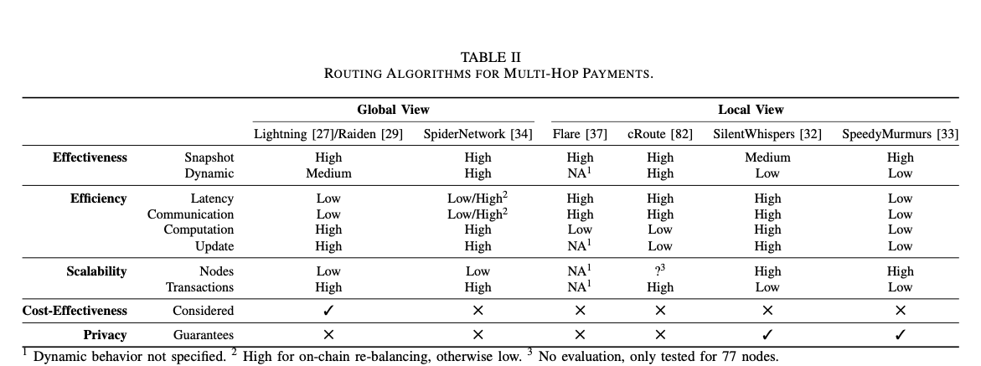
ROUTING ALGORITHMS FOR MULTI-HOP PAYMENTS

Slide 19
Routing
Deadlocks
Multi-path Routing
Watching Services
Users outsource their latest state to the watching service before parting offline
Watching services then act on behalf of the users to secure their funds
WatchTower, PISA, DCWC are some platforms that engage watching services.
Payment Channel Hubs
reduced path length implies a reduction in collateral cost and route discovery complexity.

Slide 20
Commit-chains
maintained by one single party that acts as an intermediary for transactions
payment channel hubs with protocols specifically optimized for this scenario
relies on a centralized but untrusted intermediary that facilitates the communication among transacting parties
operator collects commit-chain transactions from users and periodically submits a commitment to all collected transactions to the parent-blockchain.
an always ongoing state once launched
users can withdraw or exit their assets any time

Slide 21
Attributes of Commit-chains
Periodic Checkpoint Commitments
users may periodically return online to observe on-chain checkpoint commitments.
Data Availability
users must retrieve/maintain data required to (partially) exit a commit-chain, commonly referred to as the data availability requirement.
Centralized but Untrusted Intermediary
Eventual Transaction Finality
Reduced Routing Requirements

Slide 22
Security Properties for users on commit-chain
Free Establishment
Agreed Transition
Balance Security
State Progression
Commitment Integrity

Slide 23
NOCUST
an account-based commit-chain where an on-chain address is associated to a commit-chain account
expects to periodically receive a constant-sized commitment to the state of the commit-chain ledger from the operator, containing each user’s account in the collateral pool.

Slide 24
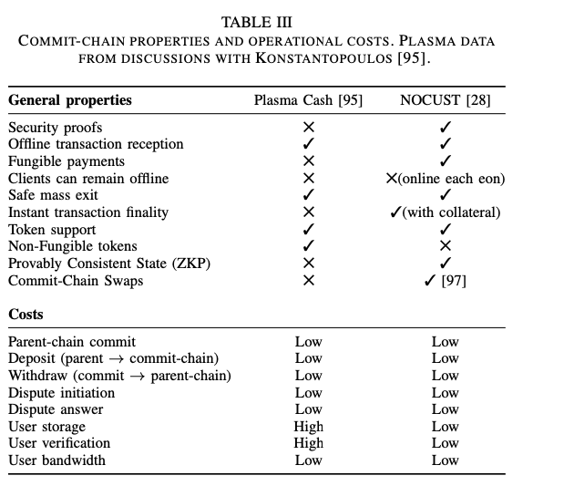
COMMIT-CHAIN PROPERTIES AND OPERATIONAL COSTS. PLASMA DATA FROM DISCUSSIONS WITH KONSTANTOPOULOS

Slide 25
plasma
high-level specification of a UTXO-based commit-chain.
all coins are represented as serial numbers and every transfer allocates a new owner for the respective coin
users can detect invalid commitments and it is expected that they eventually withdraw their coins from the commit-chain
achieves balance security as an honest party can always withdraw their coins from the commit-chain, even if an invalid commitment is posted

Slide 26
Layer-Two Privacy Notions
Payment Hub Privacy Notions
Payment Anonymity
Unlinkability
Multi-Hop Privacy Notions
Off-path Value Privacy
On-path Relationship privacy

Slide 27
Privacy enhancing Protocols
Privacy Enhancing Payment Channel Hubs
TumbleBits
prevent an adversary from linking a payment from a particular payer to a particular payee
threats include intersection, abort and n-1 attacks
unlinkability, no payment anonymity
Bolt
Offer privacy-preserving payment channels such that payments are unlinkeable
Anonymous
Privacy Enhancing Multi-Hop Payment Protocols
Rayo and Fulgor
Uses cryptography
Prevents linkability of payment
Anonymous MHL
Embeds synchronization condition
Efficiency and Privacy

Slide 28
SECURITY
Security Threats
Hot Wallets
Online assumption
Blockchain Reliability and Mass Exits
Consistency Proofs
Security of Synchronizing payment
Layer-Two Security Notions
the adversary cannot extract more funds than previously allocated in the channel’s funding
honest users do not lose funds even when other parties collude

Slide 29
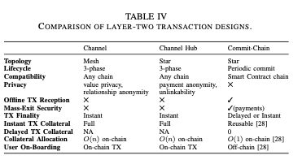
COMPARISON OF LAYER-TWO TRANSACTION DESIGNS.

Slide 30
Question
Why must the operator agree to the payment with the sender before a transaction can be considered final ?
what type of collateral does the operator stake towards the recipient, to offer state progression ?
Is the operator a software system, an individual or a collection of individuals ?

