Slide 1
Listening to Whispers of Ripple: Linking Wallets and Deanonymizing Transactions in the Ripple Network
Authors: Pedro Moreno-Sanchez, Muhammad Bilal Zafar, and Aniket Kate
Published in Proceedings on Privacy Enhancing Technologies, 2016
Monika Sharma
COMP 7570 Blockchain Data Analytics

Slide 2
Objective
Analyze visible logs and characterize privacy issues
2 Novel Heuristics
Deanonymization of Users in Ripple Network

Slide 3
Ripple- Features
Third-largest cryptocurrency after Bitcoin and Ethereum
Fast & Efficient for same & cross-currency payments
“I owe you” (IOU) transaction network
Wallets are pseudonymous
170k user wallets, network value of $790 million and daily transaction volume of over $1 million

Slide 4
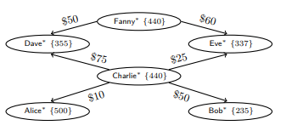
Ripple IOU Network
Hashed public keys are replaced with names
{} represents currency balance
Edge shows IOU credit

Slide 5
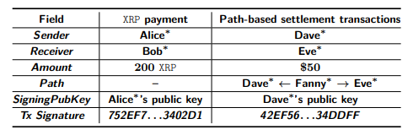
Ripple- Types of transaction
Direct XRP payments
Path-based settlement transactions

Slide 6
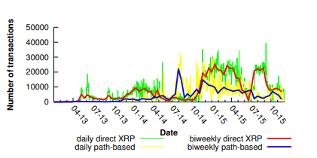
Ripple Network
Evolution of Ripple transactions from Jan 2013-Dec 2015
Direct XRP payments started earlier than path-based transactions
Spike in July 13- a documented spamming attack on Ripple network

Slide 7
Link Ripple Wallets to Bitcoin Wallets
User pays a certain amount of BTC to gateway and gateway issues corresponding IOU.
Publicly available information regarding deposit and withdrawal transactions at the gateways to link together Ripple and Bitcoin wallets that belong to the same user.
Verification: Wallets published by DividendRippler were identified with their links.
Privacy Impact: All the wallets linked to a business are deanonymized.

Slide 8
Link Ripple Wallets with Cold Wallets
Hot-Cold Wallet
Cold wallet is publicly visible.
Actual transactions are made by Hot Wallet.
Hot wallet is online and Cold wallet is offline.
Transaction between hot wallet and cold wallet can be done offline.
Verification: Based on the pattern followed to transfer IOUs, wallets were linked and verified by their actual users(Bitstamp and RippleFox).
Privacy Impact: Pattern analysis can be done to deanonymize the wallets linked to a business.

Slide 9
Reconstructing gateways businesses
Single gateway business
DividendRippler announced one public wallet.
More than 1000 bitcoins have been transacted.
Several gateways business
DividendRippler, DYM and Chriswen were identified.
Applying previous heuristics, DividendRippler and DYM are operated by the same owner.

Slide 10
Conclusions
Patterns of the use of wallets for transactions can breach security.
Wallets of other blockchain-based cryptocurrency can be clustered together.
Deanonymization of more than 78% of clustered transactions which allows to construct the complete trade of most popular gateway deployed in Ripple Network.

Slide 11
Questions
What is a gateway and why is it needed?
If all the users will re-set an upper bound on the IOU edge, wouldn’t the amount flowing in the network be limited?

Slide 12
Paper 2
An Empirical Analysis of Anonymity in Zcash
Authors: George Kappos, Haaroon Yousaf, Mary Maller, and Sarah Meiklejohn
Published in: 2018

Slide 13
Objective
To analyze the anonymity in Zcash’s transactions

Slide 14
Zcash
Market capitalization of over 1 billion USD
Uses shielded pool to improve security
Does not require all transaction to take place in shielded pool
All newly generated coins must pass through shielded pool before being spent
12.5 ZEC block mining reward

Slide 15

Zcash Transactions
Transparent transactions
Shielded transactions
Private transactions
Deshielded transactions

Slide 16
Zcash- Shielded Transactions vJoinSplit
Input | Output
1) List of input t-addresses 2) Two double spending tokens 3) Zero knowledge proof | 1) List of output t-addresses with funds 2) Two shielded outputs 3) An encrypted memo field

Slide 17
Zcash- Types of users
4 Types of Participants in Zcash
Founders- addresses are specified in Zcash Chain parameters, receive 20% of newly generated coins
Miners
Services
Users

Slide 18
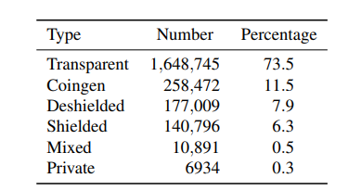
Zcash Statistics
Blocks Parsed: 258,472 blocks
Network Value: 3,106,643 ZEC
No. of transactions: 2,242,847 transactions

Slide 19
Zcash Statistics
No. of t-addresses: 1,740,378
Inputs in a t-to-z transaction: 8,727
Outputs in a z-to-t transaction: 330,780

Slide 20
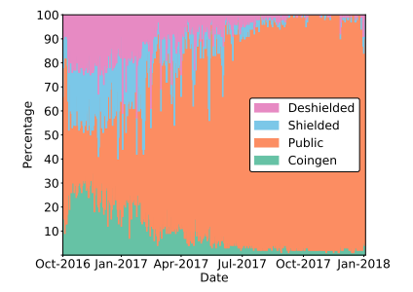
Zcash Statistics

Slide 21
T-Address Clustering
Heuristic 1: If two or more t-addresses are inputs in the same transaction (whether that transaction is transparent, shielded, or mixed), then they are controlled by the same entity.
Heuristic 2: If one (or more) address is an input t address in a vJoinSplit transaction and a second address is an output t-address in the same vJoinSplit transaction, then if the size of zOut is 1 (i.e., this is the only transparent output address), the second address belongs to the same user who controls the input addresses.

Slide 22
Tagging addresses
Top 10 exchange services were tagged using several deposits.
Publicized addresses of the founders from Zchain Explorer.
Mining addresses were tagged - recipient of the coingen transaction
123 founder addresses and 110,918 miner addresses were tagged

Slide 23
Results of Clustering & Tagging
Top 5 clusters carried out 11.2% of the total transactions.
Mining pools and founders hold large share of activity in Zcash.
Miners and founders used the same small set of transaction addresses.

Slide 24
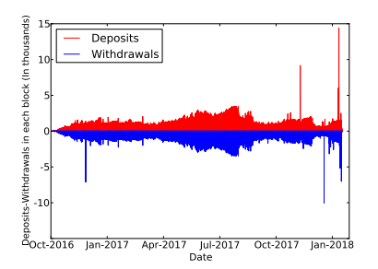
Zcash- Shielded Pools
Over time, 3,901,124 ZEC have been deposited into the pool and 3,788,889 have been withdrawn.
Most users not only withdraw the exact number of ZEC they deposit into the pool, but do so very
quickly after the initial deposit.

Slide 25
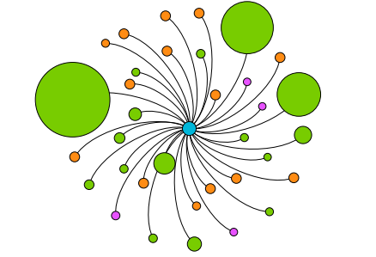
Shielded transactions
The addresses that have put more than 10,000 ZEC into the shielded pool over time, where the size of each node is proportional to the value it has put into the pool. The addresses of miners are green, of founders are orange, and of unknown ‘other’ participants are purple

Slide 26
Founders in Shielded Transactions
At any given time, only one address is “active,” meaning it receives rewards and deposits them into the pool.
The amount deposited was often the same: exactly 249.9999 ZEC, which is roughly the reward for 100 blocks.
These patterns were sufficient to identify deposits and withdrawal by founders.
Heuristic 3: Any z-to-t transaction carrying 250.0001 ZEC in value is done by the founders.

Slide 27
Miners in Shielded Transactions
19 t-addresses were identified that were associated with Zcash mining pools, using the scraping methods.
Heuristic 4: If a z-to-t transaction has over 100 output t-addresses, one of which belongs to a known mining pool, then we label the transaction as a mining withdrawal (associated with that pool), and label all non-pool output t-addresses as belonging to miners.

Slide 28
Others in Shielded Transactions
Heuristic 5: For a value v, if there exists exactly one t-to-z transaction carrying value v and one z-to-t transaction carrying value v, where the z-to-t transaction happened after the t-to-z one and within some small number of blocks, then these transactions are linked.

Slide 29
Case Study: The Shadow Brokers
TSB- Hacker that leaks tools supposedly created by NSA.
In September 2017, Zcash was the only mode of payment
Identification of Potential Zcash Customers
Not a frequent user
Transactions with only t-address

Slide 30
Conclusion
Most of the users are not taking advantage of shielding feature.
Those who are using are still identifiable.

Slide 31
Questions
Why can’t we have only private transactions Zcash?
2) Why do we need 2 shielded outputs and 2 double spending tokens in Zcash transactions?

Slide 32
Thank You!

