Slide 1

Forecasting Bitcoin Price with Graph Chainlets
Cüneyt G. Akçora, Asim K. Dey, Yulia R. Gel, Murat Kantarcioglu
Computer Science and Statistics
University of Texas at Dallas
Supported by NSF BIGDATA IIS-1633331, NIH 1R01HG006844, NSF CNS-1111529
Notes:
1

Slide 2
Outline
A brief history of Blockchain
Building blocks of Blockchain
Blockchain graph representation
The Chainlet model
Chainlet types and clusters of Chainlets
Chainlets in Bitcoin price prediction
Conclusion
2
Notes:
2

Slide 3









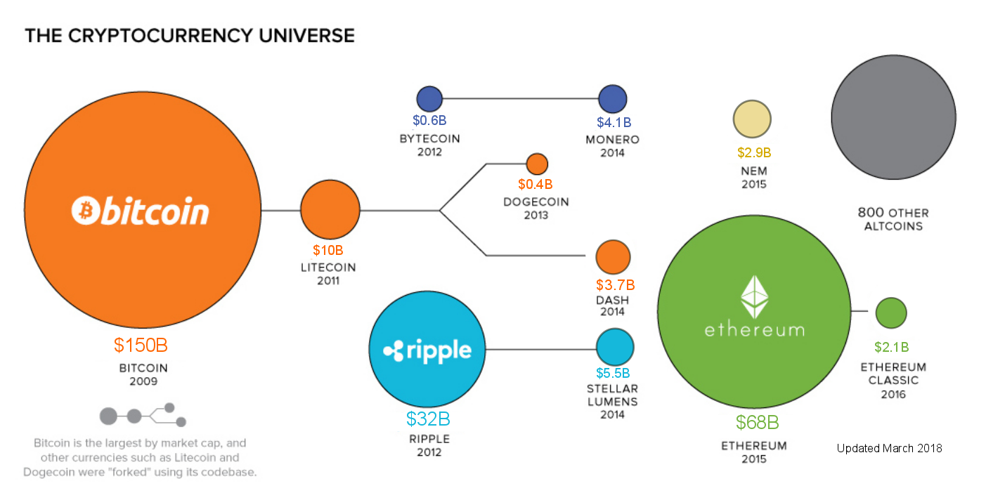
Core Blockchain
10/31/2008: Satoshi Nakamoto posts the Bitcoin white paper to a forum.
1/3/2009: The first data block in the Bitcoin.
Bitcoin: A peer to peer Electronic Cash System
Smart contracts, lightning networks, added privacy
Coin Timeline*
* By JEFF DESJARDINS. Image retrieved from VisualCapitalist.com and updated.
3
Notes:
3

Slide 4
Bitcoin Network
Every node has the full copy of the data.
New nodes appear and existing ones disappear all the time.
Every node runs the same software to verify data blocks.
Each node is connected to a few other nodes only.
There is no trusted node.
4
Notes:
4

Slide 5
Bitcoin
Blockchain: a distributed ledger (i.e., “a book laying or remaining regularly in one place”).
Chain data contains
financial transactions.
Block
1
2
3
4
5
6
Blockchain: a chain of data blocks
Malicious
Peer-to-peer network
Which peer to believe about block 4?
5
Notes:
5

Slide 6
Bitcoin
Two inherent problems:
Authenticity (You really have the funds)
Double spending (You are not using the same funds twice)
2 bitcoins
1 bitcoins
1MB block size =
~ 2K transactions
2 bitcoins
From: Jim
To: Chris (2BTC).
Use the 2 bitcoins I received in Block 2 transaction 1.
Signed: Jim
From: Jim
To: Chris (2BTC).
Use the 2 bitcoins I received in Block 2 transaction 1.
Signed: Jim
From: Cuneyt
To: Joe (1BTC), Tim (2BTC).
Use the 3 bitcoins I received in Block 1 transaction 3.
Signed: Cuneyt
From: Cuneyt
To: Joe (1BTC), Tim (2BTC).
Use the 3 bitcoins I received in Block 1 transaction 3.
Signed: Cuneyt
Authenticity is solved with encrypted signatures, and showing the proof of funds.
Confirmation of payments requires more effort: the double spending problem
6
Notes:
6

Slide 7
Core Blockchain
5
6
Fork 1
1
2
3
4
5
6
Fork 2
If everyone can create blocks, the blockchain may never stabilize.
Proof-of-Work: Spending time and effort to create (mine) a block.
Miner: Any node that mines a block.
Proof-of-Work was first used in email spam detection
From: Cuneyt
To: Alice
Date: 1/1/2027
…..mail content….
This mail has 35 words
If the proof of work is not attached, it is spam!
Else count the words
If the word count in proof of work is wrong
Discard the email, spam! Else email might be spam, run spam detector.
Algorithm used by the email service provider
Bitcoin uses a hash function for Proof of work.
Hash(University) = 7FDD903AF601C14E71D4938B2F7AB58A78C03C36D43485BB1937826B90DEFDD0
Hash(Univarsity) = 7E984B4F8807A0092C65AE3D897DD186943D95435C0A56F8350A0C7F82ACEF03
7
Notes:
7

Slide 8
Core Blockchain
1
2
3
4
5
6
Hash of block content (
) = hash
For(nonce = 1 to infinity)
blockHash = Hash( [hash + hashOfPreviousBlock + moreDataPieces]+ nonce)
If(blockHash satisfies difficulty)
block mined successfully!
Hash of Bitcoin Block #509224 (February 2018)
0000000000000000003f3a4b3fa2171057813c4645ddf4b5a863ba437c93cb74
From: Jim
To: Chris (2BTC).
Use the 2 bitcoins I received in Block 2 transaction 1.
Signed: Jim
Miner
8
Notes:
8

Slide 9
Bitcoin
Each block is expected to take ~10 minutes to find. Difficulty is adjusted every 2016 blocks.
Tim Swanson: “Bitcoin is a peer-to-peer heat engine”.
Block reward halves every 4 years. Starting with 50 bitcoins per block, this will create 21M bitcoins in total.
Transaction fee is the amount unspent from inputs to outputs.
From: Cuneyt
To: Joe (0.8 BTC), Tim (2 BTC).
Use the 3 bitcoins I received in Block 1 transaction 3.
Signed: Cuneyt
Sum of all transaction fees
0.8 bitcoin
Block reward
2 bitcoins
transaction fee = 0.2 bitcoins
*https://bitcoinwisdom.com/bitcoin/difficulty
9
Notes:
9

Slide 10
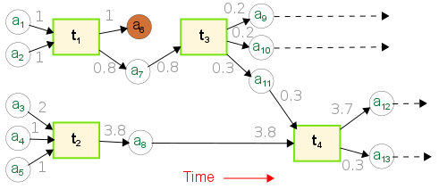
Predicting Blockchain Dynamics
Blockchain is a distributed ledger where records are permanent and public.
Graphs provide a high fidelity representation of Blockchain transactions between addresses and entities.
Existing works extract global network characteristics and compute standard global features such as: average degree, clustering coefficient.
So far, these standard features do not exhibit predictive utility for Bitcoin price!
10
Notes:
10

Slide 11
Blockchain Analysis - The Graph
Local higher-order structures are found to be an indispensable tool for network analysis in various domains:
biological, social, infrastructural networks.
Network motif: a particular subgraph that occurs more or less frequently than the expected baseline occurrence. Motifs are statistically significant subgraphs of a network.
11
Notes:
11

Slide 12
Our Graph Model
address
transaction
Three Graph Rules for Bitcoin
1- All coins gained from a transaction must be spent in a single transaction.
2- Coins can be gained from multiple transactions. These can spent at once or separately.
Heterogeneous graph model
3 - In a Bitcoin transaction the input-output address mappings are not explicitly recorded.
12
Notes:
12

Slide 13
Existing Graph Approaches
1- Transaction graph: Edges between transactions.
Cannot capture unspent coins.
Cannot distinguish transactions with differing inputs/outputs.
2- Address graph: Edges between addresses.
Edges are multiplied between inputs and outputs (creates bias).
Traditional Graph Analysis
Unsuitable graph models, unnecessary computations.
Inapplicable for the forward branching tree of Bitcoin!
Transaction graph
Address graph
13
Notes:
13

Slide 14
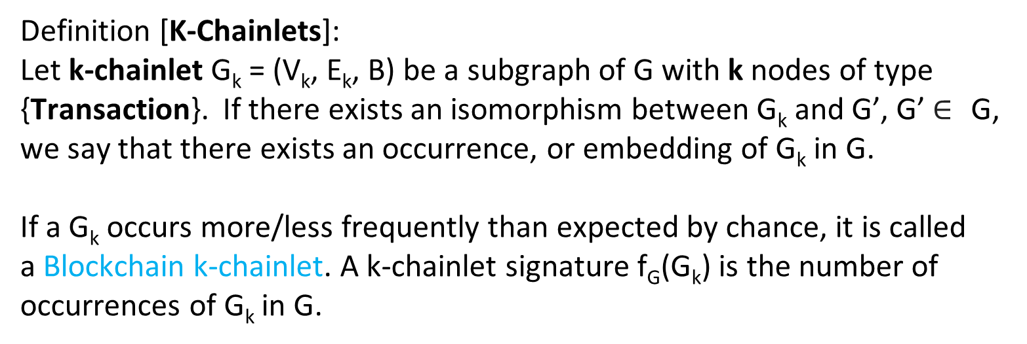
Blockchain Graph - Chainlets
Rather than individual edges or nodes, we use a subgraph as the building block in our Bitcoin analysis.
We use the term chainlet to refer to such subgraphs.
Tx 1
Tx 2
Tx 3
Tx 4
Definition [K-Chainlets]:
Let k-chainlet G_{k} = (V_{k}, E_{k}, B) be a subgraph of G with k nodes of type {Transaction}. If there exists an isomorphism between G_{k} and G’, G’$∈$ G, we say that there exists an occurrence, or embedding of G_{k} in G.
If a G_{k} occurs more/less frequently than expected by chance, it is called
a Blockchain k-chainlet. A k-chainlet signature f_{G}(G_{k}) is the number of occurrences of G_{k} in G.
14
Notes:
14

Slide 15
Blockchain Chainlets
Tx 1
Tx 2
Chainlets have distinct shapes that reflect their role in the network.
We aggregate these roles to analyze network dynamics.
Tx 3
Tx 4
Tx 1
Tx 2
Tx 3
Tx 4
Three distinct types of 1-chainlets!
15
Notes:
15

Slide 16
Aggregate Chainlets
C_{x→y} : chainlet with x inputs and y outputs.
Transition Chainlets imply coins changing address: x = y.
Transition. Ex: Chainlet C_{3→3}
Split Chainlets may imply spending behavior: y > x.
Split. Ex: Chainlet C_{1→2}
But, community practice against address reuse can also create split chainlets.
Merge Chainlets imply gathering of funds: x > y.
Merge. Ex: Chainlet C_{3→1}
16
Notes:
16

Slide 17
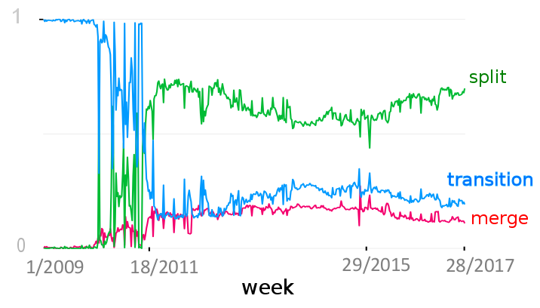
Aggregate Chainlets
Percentage of aggregate chainlets in the Bitcoin Graph (weekly snapshots)
17
Notes:
17

Slide 18
Chainlet Matrix
Representing the network in time
For a given time granularity, such as one day, we take snapshots of the Bitcoin graph.
Chainlet counts obtained from the graph are stored as an N×N matrix.
Outputs
1
2
3
1
0
0
0
inputs
0
2
1
2
3
0
0
1
N: How big should the matrix be?
18
Notes:
18

Slide 19
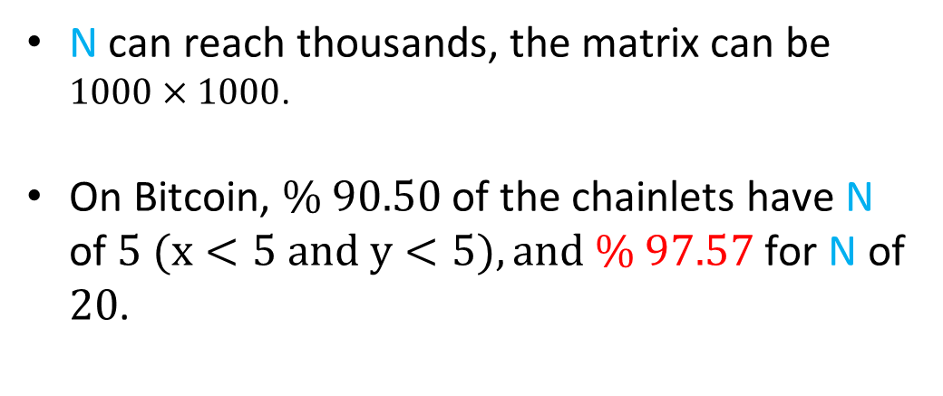
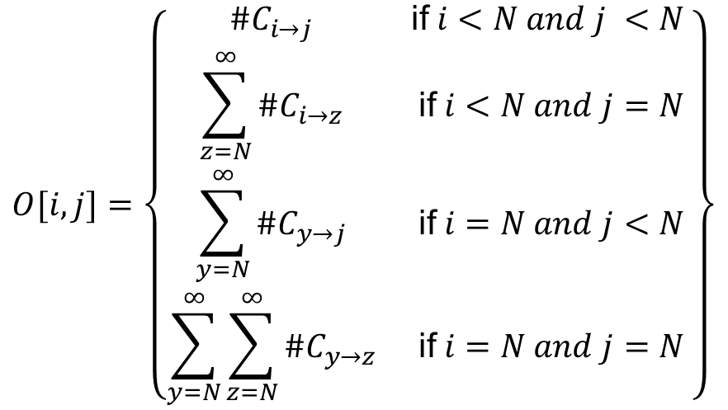
Extreme Chainlets
N can reach thousands, the matrix can be $1000×1000$.
On Bitcoin, $\% 90.50$ of the chainlets have N of $5 (x<5 and y<5), and \% 97.57$ for N of $20$.
Outputs
1
2
3
1
0
0
0
Occurrence matrix
inputs
0
4
2
2
1
$$O[i,j]=\left\{\begin{matrix}\#C_{i→j} & \text{if} i<N and j <N \\ \sum_{z=N}^{∞}{\#C_{i→z}} & \text{if} i<N and j=N \\ \sum_{y=N}^{∞}{\#C_{y→j}} & \text{if} i=N and j<N \\ \sum_{y=N}^{∞}{\sum_{z=N}^{∞}{\#C_{y→z}}} & \text{if} i=N and j=N\end{matrix}\right\}$$
3
0
0
1
Extreme chainlets are the last column/row of the chainlet matrix.
They imply big coin movements in the graph!
19
Notes:
19

Slide 20
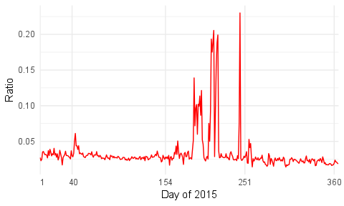
Extreme Chainlets
Bitcoin companies stopped all business in New York State because of new regulations.
The New York Business Journal called this the "Great Bitcoin Exodus".
Percentage of extreme chainlets in the Bitcoin Graph (N = 20, daily snapshots)
20
Notes:
20

Slide 21
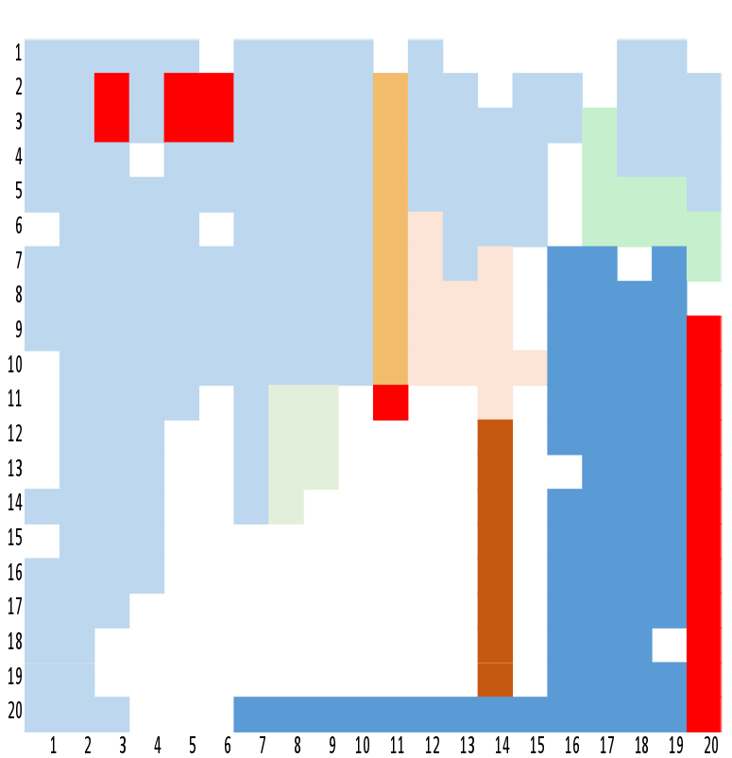
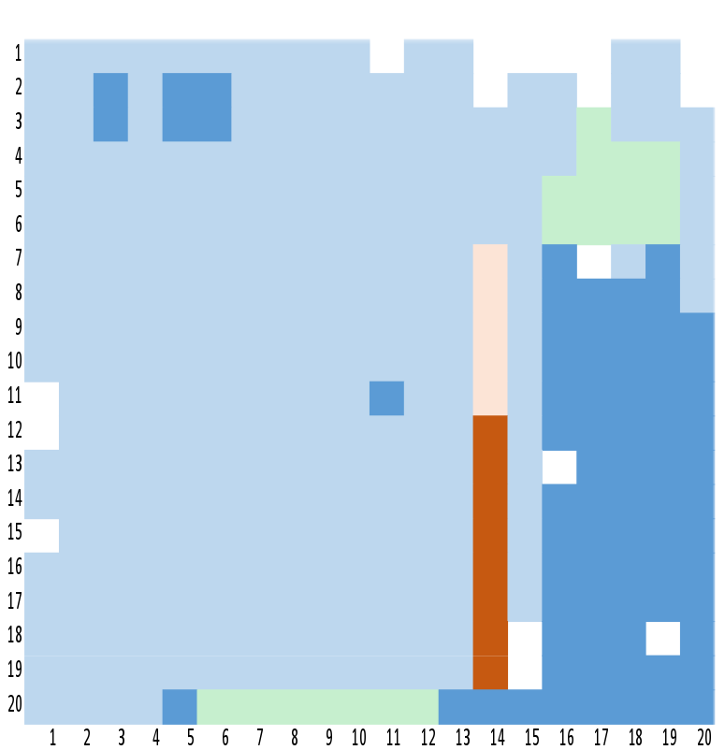
Clustering the Chainlets
A hierarchical clustering of chainlets by using Cosine Similarity over chainlet signatures in time.
We used a similarity cut threshold of 0.7 to create clusters from the hierarchical dendogram.
Most common chainlets
Extreme and correlated chainlets
Chainlet clusters for daily snapshots
Chainlet clusters for weekly snapshots
21
Notes:
21

Slide 22
Prediction with Chainlets
We are primarily interested in two interlinked questions:
Do changes in chainlet characteristics exhibit any causal effect on future Bitcoin price and Bitcoin returns?
Given more conventional economic variables and non-network blockchain characteristics, do chainlets convey unique information about future Bitcoin prices?
Granger causality tests for predictive utility of individual/aggregate chainlets, and chainlet clusters in analysis of the Bitcoin price and its log return.
22
Notes:
22

Slide 23
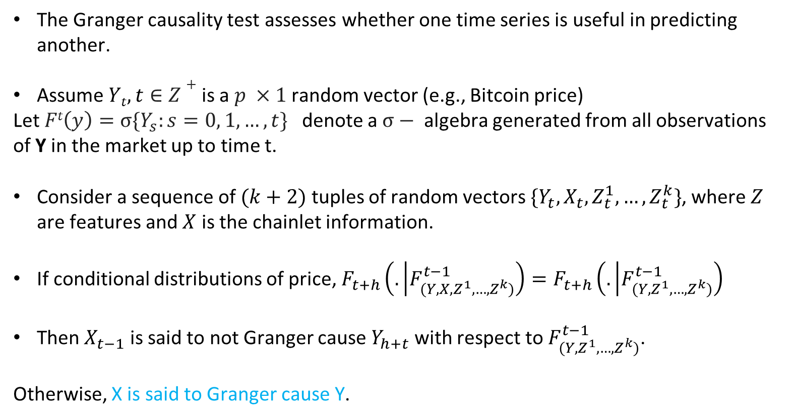
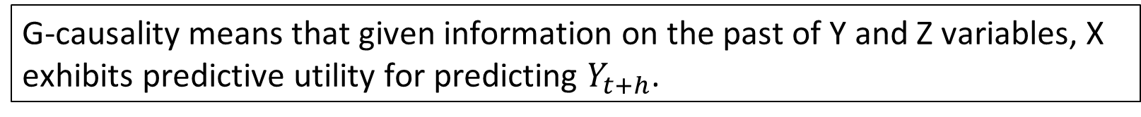
Prediction with Chainlets
The Granger causality test assesses whether one time series is useful in predicting another.
Assume $Yt,t∈Z+$ is a $p ×1$ random vector (e.g., Bitcoin price)
Let $Ft\left(y\right)=σ\{Y_{s}:s=0, 1, …, t\}$ denote a $σ−$ algebra generated from all observations of Y in the market up to time t.
Consider a sequence of $(k+2)$ tuples of random vectors $\{Y_{t},X_{t}, Z_{t}^{1},…,Z_{t}^{k}\}$, where $Z$ are features and $X$ is the chainlet information.
If conditional distributions of price, $F_{t+h}\left(. | F_{(Y, X,Z^{1}, …,Z^{k})}^{t−1}\right)=F_{t+h}\left(. | F_{(Y,Z^{1}, …,Z^{k})}^{t−1}\right)$
Then $X_{t−1}$ is said to not Granger cause $Y_{h+t}$ with respect to $F_{(Y, Z^{1}, …,Z^{k})}^{t−1}$.
Otherwise, X is said to Granger cause Y.
G-causality means that given information on the past of Y and Z variables, X exhibits predictive utility for predicting $Y_{t+h}$.
23
Notes:
23

Slide 24
Chainlets in Price Prediction
Covariate types | Causality | Outcome with lag effects
 |  | 1 | 2 | 3 | 4 | 5
Number of trans. | Total # trans. → Outcome | LR | LR | P/LR | P/LR | -
Aggregate chainlets | Merge Chainlets → Outcome | - | - | - | - | -
 | Split Chainlets → Outcome | - | LR | P/LR | P | -
 | Trans. Chainlets → Outcome | - | - | - | - | -
Extreme chainlets | C_{20→2}→ Outcome | LR | P/LR | P/LR | P/LR | P
 | C_{20→3}→ Outcome | P | P | P | P | P
 | C_{20→3}→ Outcome | - | - | P | P | P
Chainlet clusters | Cluster 35 → Outcome | LR | LR | P/LR | P/LR | -
 | Cluster 16 → Outcome | - | LR | - | - | -
Spending behavior!
Only some merge chainlets have a causality!
Table 1: Causality of Chainlets. P and LR denote significance in price & log returns, respectively; blank space implies no significance. Confidence level is 95%.
24
Notes:
24

Slide 25
Chainlets in Price Prediction
Various predictors can be created by combining chainlets and clusters of chainlets. We use the predictors in a Random Forest time series prediction model.
Model | Predictors
Model 0 | Price lag 1, Price lag 2, Price lag 3
Model 1 | Price lag 1, Price lag 2, Price lag 3 #Trans lag 1, #Trans lag 2, #Trans lag 3
Model 2 | Price lag 1, Price lag 2, Price lag 3 Split Pat. lag 1, Split Pat. lag 2, Split Pat. lag 3 Cluster 8 lag 1, Cluster 8 lag 2, Cluster 8 lag 3
Model 5 | Price lag 1, Price lag 2, Price lag 3 C_{1→7} lag 1, C_{1→7} lag 2, C_{1→7} lag 3 C_{6→1} lag 1, C_{6→1} lag 2, C_{6→1} lag 3 C_{3→3} lag 1, C_{3→3} lag 2, C_{3→3} lag 3
25
Notes:
25

Slide 26
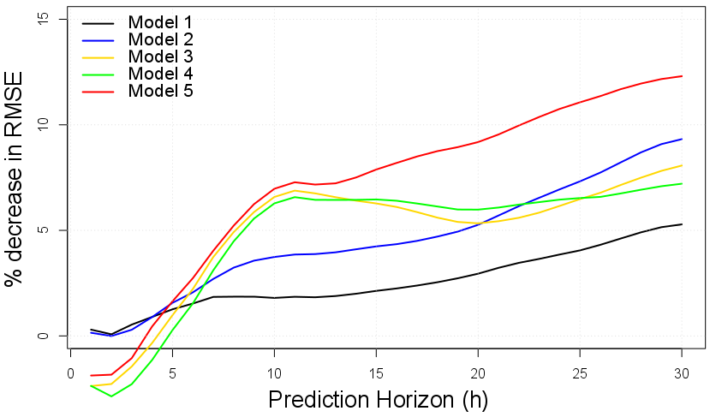
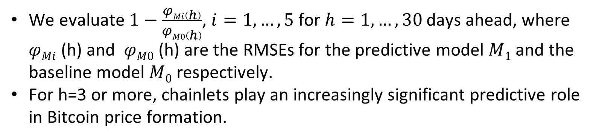
Chainlets in Price Prediction
We evaluate $1−\frac{φMi\left(h\right)}{φM0\left(h\right)}$, $i=1,…,5$ for $h=1,…,30$ days ahead, where $φMi$ (h) and $φM0$ (h) are the RMSEs for the predictive model $M1$ and the baseline model $M0$ respectively.
For h=3 or more, chainlets play an increasingly significant predictive role in Bitcoin price formation.
Price + 3 chainlets
Price + split + cluster
Price + # transaction
26
Notes:
26

Slide 27
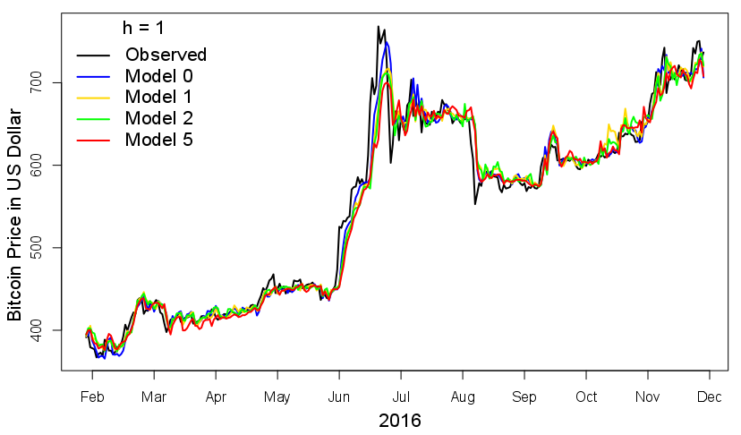
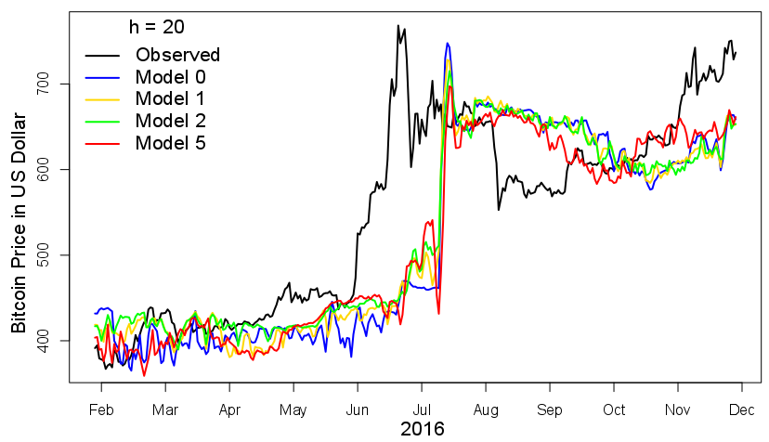
Chainlets in Price Prediction
For h = 1, all models deliver similar prediction accuracy and capture the variability of the data very well.
The prediction performance of all models deteriorates as forecasting horizon increases.
27
Notes:
27

Slide 28
Thanks for attending!
Cuneyt.Akcora@utdallas.edu

Slide 29
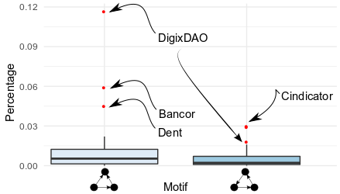
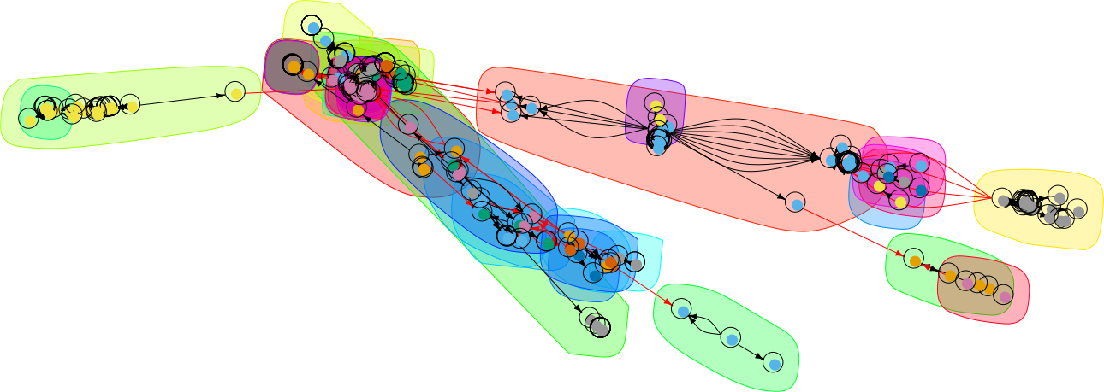
Topological Analysis of Ethereum
The largest connected component on the Storj token network on 13-1-2018.
Boxplots of motif distributions in 39 token networks for two closed triangle motifs.
The multidimensional nature of blockchain graphs where tokens, currencies and other data units circulate together poses interesting research problems.
For the analysis of multidimensional blockchain data, we introduce data-driven nonparametric methods such as Topological Data Analysis (TDA) and data depth.
29
Notes:
29

