Slide 1

Blockchain Data Analytics
Cüneyt Gürcan Akçora, Yulia R. Gel, Murat Kantarcioglu
Joint work with N. C. Abay, Y. Chen, A. K. Dey, U. Islambekov, Y. Li, E. Smirnova, B. Thuraisingham
Depts. of Statistics and Computer Science
University of Texas at Dallas
IEEE ICDM 2018 Blockchain Day
BlockchainTutorial.Github.io
Notes:
1

Slide 2
Outline
A brief history of Blockchain
Building blocks of Blockchain
Blockchain data models and structures
TXO and account based blockchains
Privacy and security in blockchains
By Yulia R. Gel: Financial analytics on blockchains
2
Notes:
2

Slide 3
1- Blockchain Data Analytics - Core Blockchain
How Blockchains appeared?
How do they work?
What are the design considerations?
What is the data stored on a blockchain?
Notes:
3

Slide 4









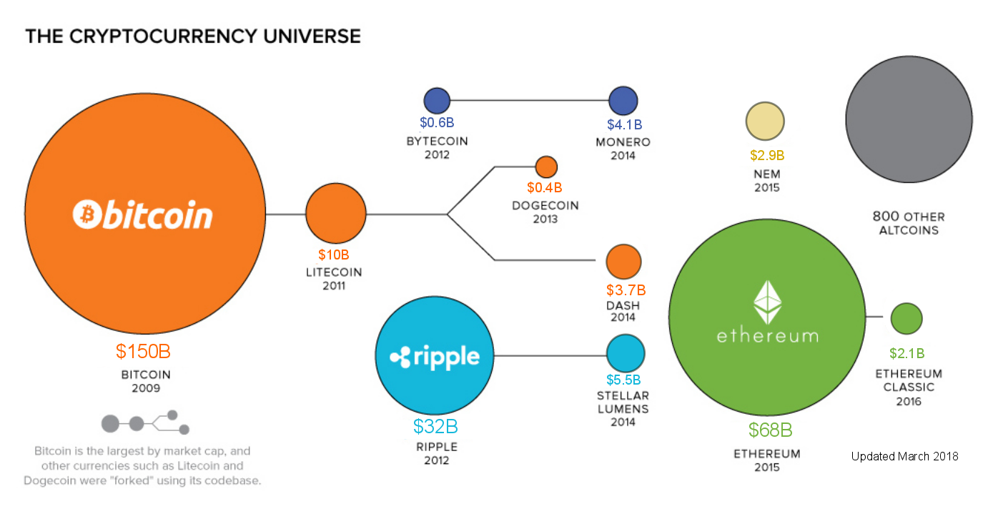
Core Blockchain
10/31/2008: Satoshi Nakamoto posts the Bitcoin white paper to a forum.
1/3/2009: The first data block in the Bitcoin.
Bitcoin: A peer to peer Electronic Cash System
Smart contracts, lightning networks, added privacy
Coin Timeline*
* By JEFF DESJARDINS. Image retrieved from VisualCapitalist.com and updated.
4
Notes:
4

Slide 5
Blockchain Network
Every node has the full copy of the data.
New nodes appear and existing ones disappear all the time.
Every node runs the same software to verify data blocks.
Each node is connected to a few other nodes only.
There is no trusted node.
Goal: Having a single truth about data, that can be verified by everyone.
5
Notes:
5

Slide 6
Bitcoin: A financial application of Blockchain
Blockchain: a distributed ledger (i.e., “a book laying or remaining regularly in one place”).
Bitcoin: chain data contains financial transactions.
Block
1
2
3
4
Blockchain: a chain of data blocks
1
2
3
4
False data
True data
a
Which peer should the node a believe about block 4?
6
Notes:
6

Slide 7
Bitcoin
Two inherent problems:
Authenticity (You really have the funds)
Double spending (You are not using the same funds twice)
2 bitcoins
1 bitcoins
1MB block size =
~ 2K transactions
2 bitcoins
From: Jim
To: Chris (2BTC).
Use the 2 bitcoins I received in Block 2 transaction 1.
Signed: Jim
From: Jim
To: Chris (2BTC).
Use the 2 bitcoins I received in Block 2 transaction 1.
Signed: Jim
From: Cuneyt
To: Joe (1BTC), Tim (2BTC).
Use the 3 bitcoins I received in Block 1 transaction 3.
Signed: Cuneyt
From: Cuneyt
To: Joe (1BTC), Tim (2BTC).
Use the 3 bitcoins I received in Block 1 transaction 3.
Signed: Cuneyt
Authenticity is solved with encrypted signatures, and showing the proof of funds.
Confirmation of payments requires more effort: the double spending problem.
7
Notes:
7

Slide 8
Core Blockchain
If everyone can create blocks, the blockchain may never stabilize.
5
Fork 1
1
2
3
4
5
Fork 2
From: Jim
To: Chris (2BTC).
Use the 2 bitcoins I received in Block 2 transaction 1.
Signed: Jim
Jim is malicious: He is trying to use the same coins in two payments.
Jim is hoping that Chris and John will not notice the other payment.
1- If fork 1 becomes the canonical fork, John will be defrauded.
2- If fork 2 becomes the canonical fork. Chris will be defrauded.
5
From: Jim
To: John (2BTC).
Use the 2 bitcoins I received in Block 2 transaction 1.
Signed: Jim
5
8
Notes:
8

Slide 9
Core Blockchain
5
6
Fork 1
1
2
3
4
5
6
Fork 2
We cannot have a stable chain if we cannot be certain about blocks. There cannot be multiple long forks with alternative truths.
Solution: Make block creation difficult. Allow the network sometime between blocks, so that the current state will be learned by all (or most) nodes.
How can we stop people from creating blocks?
Ask a cryptographic puzzle!
9
Notes:
9

Slide 10
Core Blockchain
Proof-of-Work was first used in email spam detection
From: Cuneyt
To: Alice
Date: 1/1/2027
…..mail content….
This mail has 35 words
If the proof of work is not attached, it is spam!
Else count the words
If the word count in proof of work is wrong
Discard the email, spam! Else email might be spam, run spam detector.
This algorithm is used by the email service provider
Proof of work: In this simple example, it is counting words.
10
Notes:
10

Slide 11
Core Blockchain
Proof-of-Work: Spending time and effort to create (mine) a block.
The idea is to slow down attackers.
Bitcoin uses a hash puzzle for Proof of work.
Hash(University) = 7FDD903AF601C14E71D4938B2F7AB58A78C03C36D43485BB1937826B90DEFDD0
Hash(Univarsity) = 7E984B4F8807A0092C65AE3D897DD186943D95435C0A56F8350A0C7F82ACEF03
Proof of work: Find a hash value that satisfies a given difficulty.
11
Notes:
11

Slide 12
Core Blockchain
From: Jim
To: Chris (2BTC).
Use the 2 bitcoins I received in Block 2 transaction 1.
Signed: Jim
Miner
A node chooses to be a miner
12
Notes:
12

Slide 13
Mining
Mining is the process of gathering transactions that are in the system waiting, creating a block out of them and advertising it to the other nodes in the system.
Creating a block is the computational review process performed on transactions.
Each block is limited to 1MB. Can hold ~2K transactions only. A block can have 1 transaction only (as in many earlier blocks). Do you see a possible problem here?
Everyone can create transactions, but only miners can create blocks. (Nuclear scientist were caught running mining software in supercomputers).

Slide 14
Mining – Creating the block
Several issues must be addressed in mining:
Nothing is physical, the coins you spend may be fake (Verify source).
Even when the coins are not fake, you may have already spent it (Verify history).
Is the sender the real owner of these coins, is the receiver address correct? (Verify users).
Is the output, inputs amounts correct? (Verify the amount).
Miner checks and verifies all these.
There are many nodes, but few miners on most blockchains.
14
Notes:
14

Slide 15
Core Blockchain
Hash of block content (
) = hashOfBlock
For(nonce = 1 to infinity)
blockHash = Hash( [hashOfBlock + hashOfPrevBlock + …]+ nonce)
If(blockHash satisfies difficulty)
block mined successfully!
The miner increases the nonce until a useful blockHash is found.
If such a nonce does not exist, the miner can start over by re-arranging the blocks.
15
Notes:
15

Slide 16
Core Blockchain
1
2
3
4
5
6
Once the block is mined, the miner broadcasts it to all its peers. The block propagates in the network.
Mining a block does not guarantee that the block will be included in the blockchain.
Other miners need to build their blocks on top of the block.
Colluding miners can ignore a mined block. Furthermore, they can cooperate and build blocks on each other’s blocks only.
16
Notes:
16

Slide 17


Core Blockchain
Miner 1
1
2
3
4
5
6
Miner 2
?
Miner 3
$$t_{0}$$
$$t_{1}$$
Miner 4 arrives at $t_{1}$ to create a block, finds 3 competing last blocks.
Depending on which block to build on, Miner 4 has to exclude transactions that have already been mined.
17
Notes:
17

Slide 18


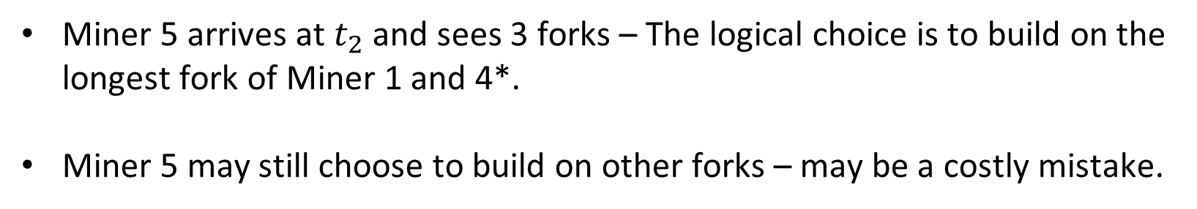

Core Blockchain
Miner 1
Miner 4
1
2
3
4
5
6
Miner 2
Miner 3
$$t_{0}$$
$$t_{1}$$
$$t_{2}$$
Let’s suppose that Miner 4 chooses to build on the block of Miner 1.
Miner 5 arrives at $t_{2}$ and sees 3 forks – The logical choice is to build on the longest fork of Miner 1 and 4*.
Miner 5 may still choose to build on other forks – may be a costly mistake.
*both length and difficulty are considered.
18
Notes:
18

Slide 19
Proof of Work: An example
How difficult is proof of work? Consider “Hello world!”+nonce
If the difficulty is three zeros (000….), we try 4251 nonce values
Hash("Hello, world!0”) => 1312af178c253f84028d480a6adc1e25e81caa44c749ec81976192e2ec934c64
Hash("Hello, world!4250”) => 0000c3af42fc31103f1fdc0151fa747ff87349a4714df7cc52ea464e12dcd4e9
Bitcoin uses an adaptive difficulty that changes with how much computing power exists in the mining business.

Slide 20
Core Blockchain – adjusting difficulty
Hash of Bitcoin Block #3 (January 2009) [8 zeros]
00000000b3322c8c3ef7d2cf6da009a776e6a99ee65ec5a32f3f345712238473
Hash of Bitcoin Block #350000 (March 2015) [17 zeros]
0000000000000000053cf64f0400bb38e0c4b3872c38795ddde27acb40a112bb
Hash of Bitcoin Block #547873 (October 2018) [20 zeros]
0000000000000000000064eb6ef4f94808938de0889695dd7bb8dca70b334cb2
The desired rate is one block every 10 minutes. This is periodically checked every 2016 blocks (2 weeks).
If 2016 blocks took less than two weeks, the difficulty is increased.
20
Notes:
20

Slide 21
Proof of Work: Bitcoin difficulty in time
Decreases are possible
Data from BTC.com
Bitcoin: more than ${10}^{21}$ tries to find a valid nonce!
With max possible difficulty we will need to try ${>10}^{77}$ nonce values.

Slide 22
Incentives for mining
Block reward halves every 4 years. Starting with 50 bitcoins per block, this will create 21M bitcoins in total.
Transaction fee is the amount unspent from inputs to outputs.
The fee may also be zero – but why would anyone mine your transaction?
From: Cuneyt
To: Joe (0.8 BTC), Tim (2 BTC).
Use the 3 bitcoins I received in Block 1 transaction 3.
Signed: Cuneyt
Sum of all transaction fees
0.8 bitcoin
Block reward
2 bitcoins
transaction fee = 0.2 bitcoins
22
Notes:
22

Slide 23
Around May 2020 the block reward will halve to 6.25 bitcoins.
2140 is the year when the reward will be practically zero.
Transactions fees will carry the system after block rewards become trivial.
November 2018: block reward is 12.5B, transaction fees are ~0.05B.
Fees are trivial if the market volume is low. Users leave aside lower fees.
In December 2017, fees were around 5-7B.
23
Notes:
23

Slide 24
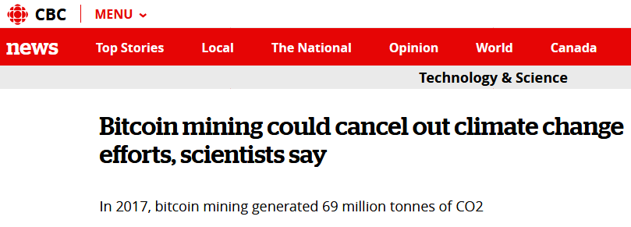
Bitcoin mining
One winning miner every 10 mins. Many others lose and waste electricity.
Eric Jennings: “The cost for having no central authority is the cost of that energy”.
Tim Swanson: “Bitcoin is a peer-to-peer heat engine”.
Narayanan: “Bitcoin mining has been an expensive way to bet that the price of Bitcoin would rise”.
24
Notes:
24

Slide 25
Proof-of-X
Proof-of-X is an umbrella term that covers Proof-of-Work alternatives in block mining.
Each alternative scheme expects miners to show a proof that they have done enough work or spent enough wealth before creating the block.
Proof-of-Stake: Stake = Coin×Age. The miner with the highest stake becomes the next miner in the chain. Once coins are used, their age becomes zero. Rich gets richer!
Proof-of-Burn: The miner sacrifices wealth: creates a transaction and sends some coins to a “verifiably unspendable” address. Reduces total supply!
Proof-of-Ownership, Proof-of-Publication, and others…
25
Notes:
25

Slide 26
Blockchains – why stop at cryptocurrencies?
Every node has the full copy of the data.
New nodes appear and existing ones disappear all the time.
Every node runs the same software to verify data blocks.
Each node is connected to a few other nodes only.
There is no trusted node.
26
Notes:
26

Slide 27
data
From: Cuneyt
To: Joe (0.8 BTC), Tim (2 BTC).
Use the 3 bitcoins I received in Block 1 transaction 3.
Signed: Cuneyt
0.8 bitcoin
2 bitcoins
Bitcoin: data are financial transactions.
Tschorsch, Florian, and Björn Scheuermann. Bitcoin and beyond: A technical survey on decentralized digital currencies. IEEE Communications Surveys & Tutorials 18, no. 3 (2016): 2084-2123.
27
Notes:
27

Slide 28
Data can be more:
Notary Documents
Pictures
Identity Documents
Shipping logs
Manufacturing logs
IOT data
1- On-chain storage
2- Off-chain storage:
Store hashes of data (as proof)
Store the address of data (Our data resides as IP: 145.178.14.29)
28
Notes:
28

Slide 29
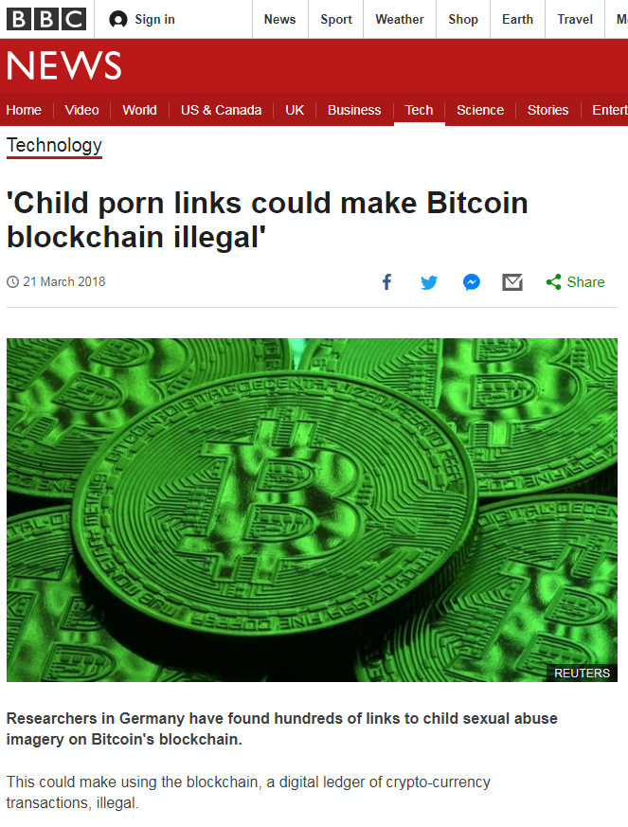
Ethereum – the World Computer
Bitcoin has a 80 byte log field for each transaction.
Bitcoin genesis block has this log message: “The Times 03/Jan/2009 Chancellor on brink of second bailout for banks”
Bitcoin multi-signatures (appeared later) and log messages inspired a platform approach.
From: Cuneyt
To: Joe (0.8 BTC), Tim (2 BTC).
Use the 3 bitcoins I received in Block 1 transaction 3.
message: 80bytes
Signed: Cuneyt
29
Notes:
29

Slide 30
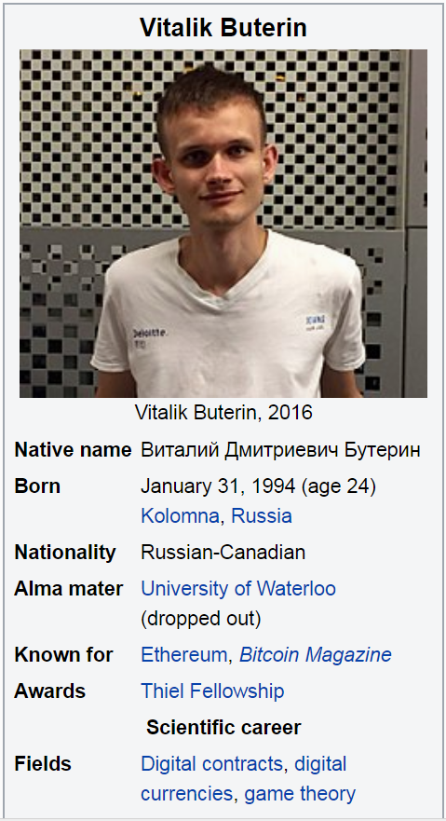

Blockchain Network – Beyond Cryptocurrencies
Ethereum has been created to store data and software code on a blockchain.
Similar to Bitcoin, Ethereum has a currency: Ether.
The code (a smart contract) is written in the proprietary coding language Solidity, which is compiled to bytecode and executed on the Ethereum Virtual Machine.
An analogy is the MYSQL snippets stored on a database.
Solidity
30
Notes:
30

Slide 31
Blockchain Network – Smart Contract
User creates a transaction to upload the Smart Contract code to an address.
The code at the address is replicated in all blockchain nodes.
In other words, you force other users to store your code.
The code is executed by passing transaction messages to its functions. Execution occurs at all nodes – hence the World Computer!
Contract creation is expensive.
All subsequent calls to the contract code are billed in terms of what operations they require.
31
Notes:
31

Slide 32
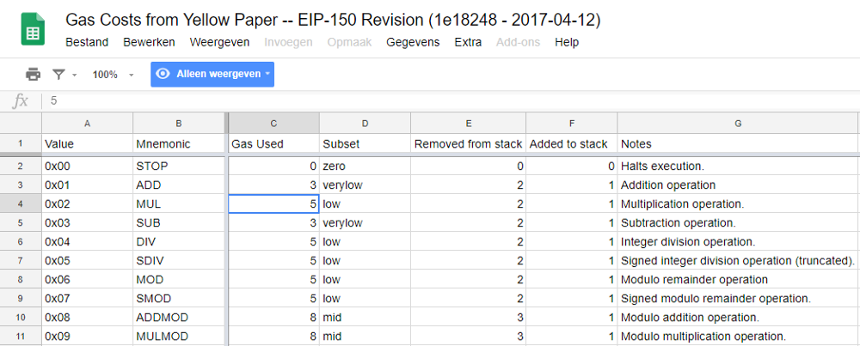
Blockchain Network – Contracts
Image: https://hackernoon.com/
Each operation has a gas price for executing it.
For example, using the ‘addition’ operation costs you 3 gas.
32
Notes:
32

Slide 33
Ethereum – the World Computer
Benefits of having code on a blockchain
Public code
Code can be analyzed by everyone.
Unmodifiable code
Code cannot be modified without leaving a trace.
Unstoppable execution
Code will run to completion.
Verifiable results
Results can be verified by all parties.
It is easy to see why platform creators called the code Smart Contract!
33
Notes:
33

Slide 34
Ethereum – the World Computer
Contracts gave rise to Smart Contract based tokens: exchanged data units that are used to buy/sell services in the real world.
For example, Storj token stores files on your hard disk, and pays you a fee through Ethereum.
Tokens can be bought or sold; they act as value stores. Token prices are arbitrated in the real world.
Companies create tokens, and sell them in Initial Coin Offerings to raise capital.
34
Notes:
34

Slide 35
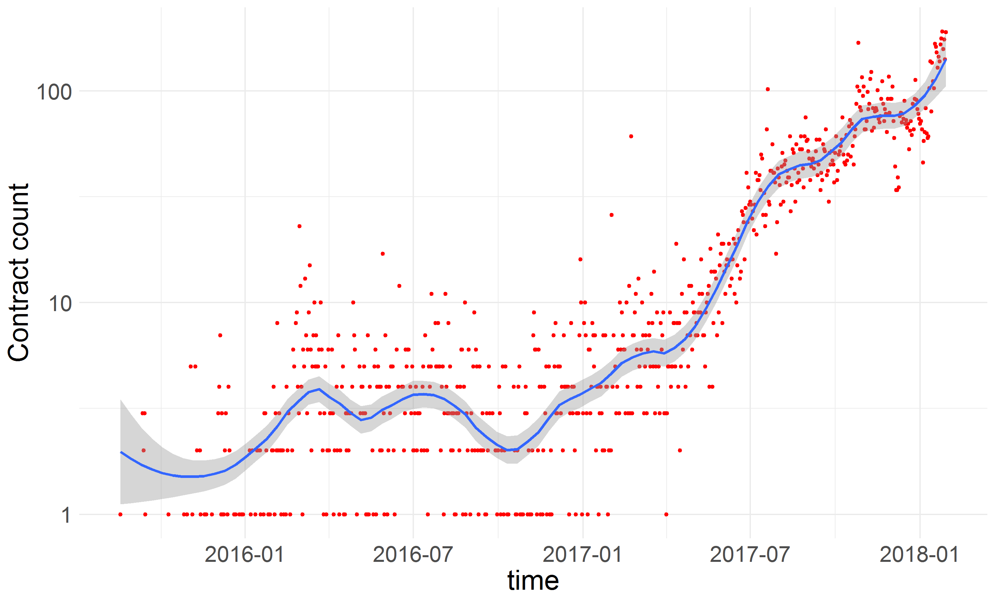
Blockchain tokens
New Ethereum token contracts in time (>5K transactions in early 2018)
35
Notes:
35

Slide 36
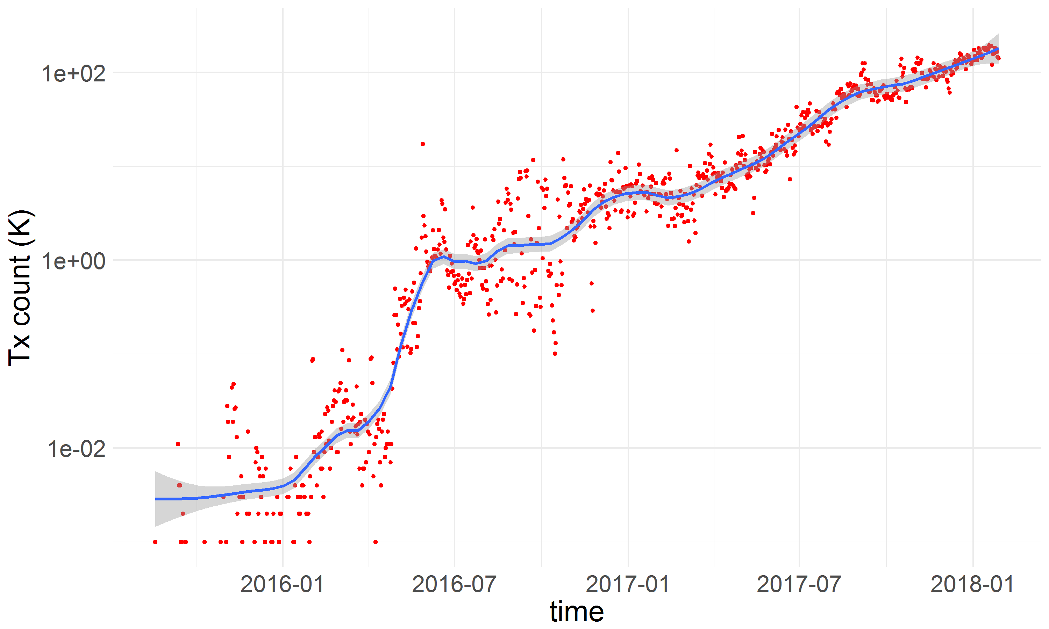
Blockchain tokens
Ethereum token transactions in time
36
Notes:
36

Slide 37
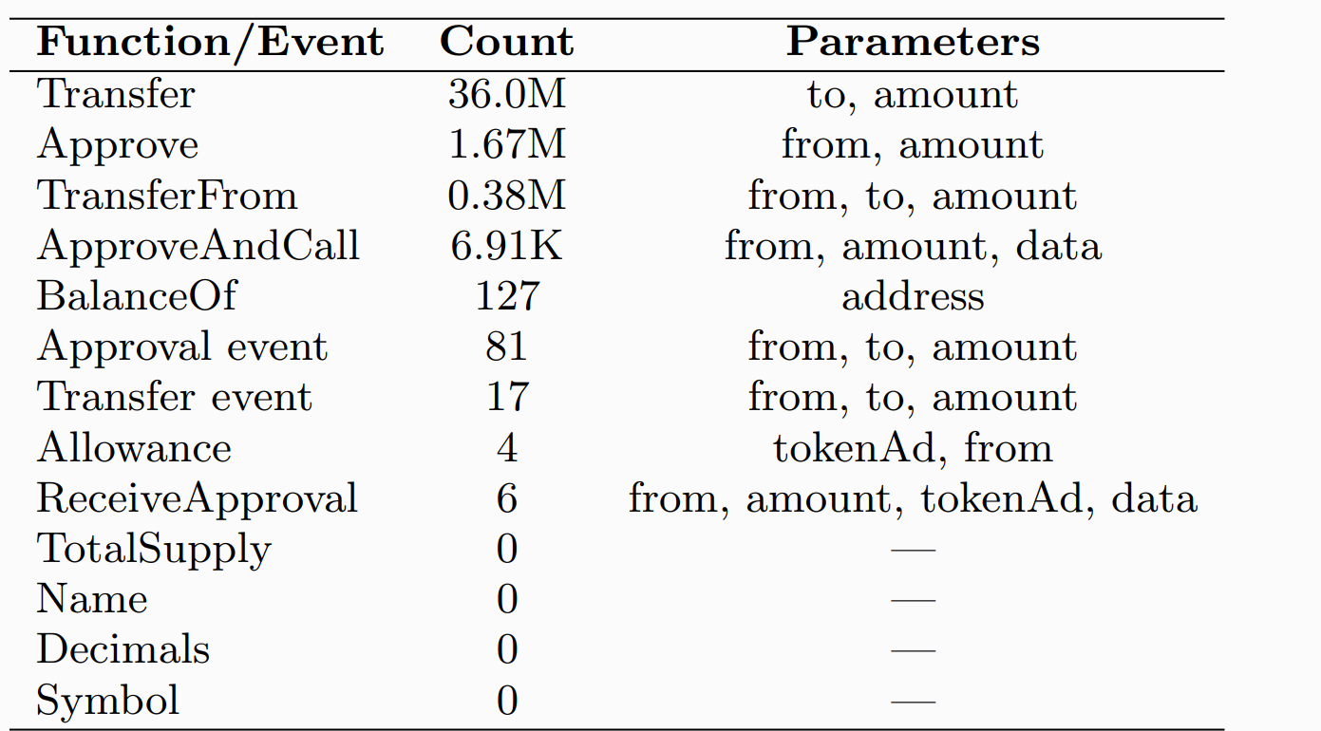
Platforms– Standardization Continues
Initially, tokens could implement a vital function (e.g., transfer) with any name (e.g., sell, transferTo, sendTo).
ERC20 standard enforces a list of functions that must be implemented by a token:
2018 May. Data from our Chartalist project
37
Notes:
37

Slide 38
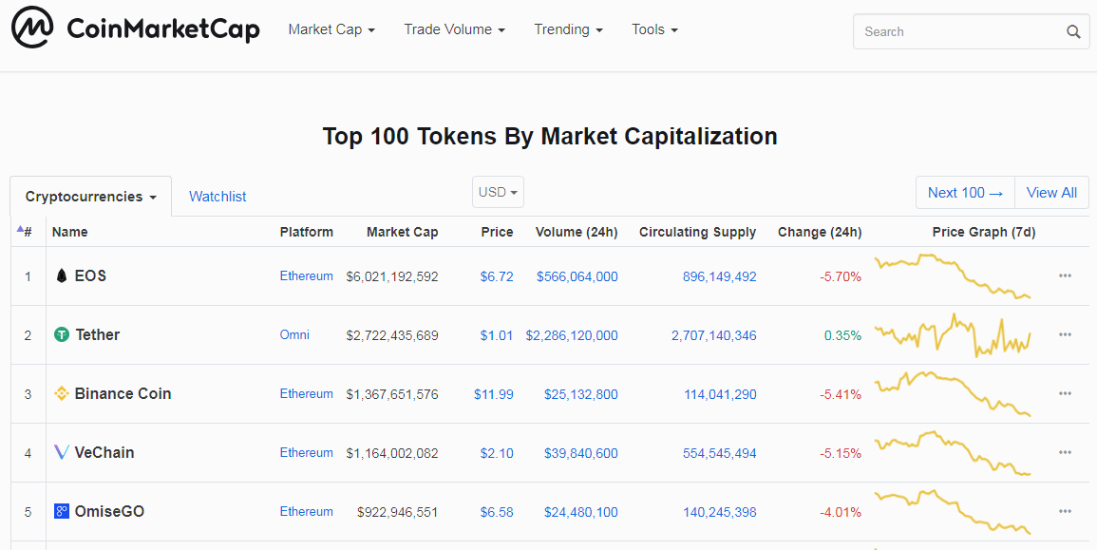
Blockchain tokens and platforms
Left Ethereum
38
Notes:
38

Slide 39
2- Blockchain Graph Analytics
Are transactions the same on all blockchains?
How can we model Blockchain data?
Notes:
39

Slide 40
Blockchain Graph Analytics
For data modelling, blockchains can be divided into two major categories:
Transaction output (TXO) based blockchains (e.g., Bitcoin, Litecoin)
Account based blockchains (e.g., Ethereum)
40
Notes:
40

Slide 41
2a - Transaction output based blockchains
41
Notes:
41

Slide 42
Transaction output (TXO) based blockchains
0.2B tx fee
Transaction 1
Address
0.8 bitcoin
a
0.8B
3B
a
2 bitcoins
b
2B
b
Next, if address b wants to spend its received 2B, it needs to show proof of funds:
“Use the 2B I received from Block 1, transaction 1 and to pay 1.5B to c and 0.3B to d”.
0.8B
c
3B
1.5B
2B
2B
d
b
0.3B
42
Notes:
42

Slide 43
Transaction output (TXO) based blockchains
Genesis block 0: The first block, created by Nakamoto.
Every block has one coinbase transaction that creates bitcoins (sum of block reward + transaction fees).
All other payments must show proof of funds (previous outputs).
Coinbase transaction
Block n
Time
Block n+1
43
Notes:
43

Slide 44


Three Graph Rules for TXO
1- Source Rule: Coins can be gained from multiple transactions. These can be spent at once or separately (dashed edges connect to unspecified addresses).
$$tx_{1}$$
b
$$tx_{2}$$
Address b can spend bitcoins at $tx_{1}$(once), or at $tx_{1} and tx_{2}$.
44
Notes:
44

Slide 45
Three Graph Rules for TXO
2- Balance Rule: All coins gained from a transaction must be spent in a single transaction. Addresses cannot keep change, must forward it.
Address reuse is rare
d
c
e
Two cases:
Same user?
i - c sold all its coins: c, d and e all belong to different people, or
ii - c paid to d, and forwarded the change to its new address e.
In many scenarios, we have to learn which addresses belong to the same entity.
45
Notes:
45

Slide 46
Three Graph Rules for TXO
3 – Mapping Rule: Multiple inputs can be signed separately and merged, but the input-output address mappings are not recorded.
A transaction can be considered a lake with incoming rivers, and outgoing emissaries. Coins mix in this lake.
1B
1B
1B
1B
Heuristics are developed to link inputs to outputs – we will cover them in the privacy section.
46
Notes:
46

Slide 47
Existing Graph Approaches
Different inputs/outputs
Blockchain graph
Transaction graph
Transaction graph: Edges between transactions only.
Cannot capture unspent coins.
Cannot distinguish transactions with differing inputs/outputs.
Dorit Ron and Adi Shamir. 2013. Quantitative analysis of the full bitcoin transaction graph. In International Conference on Financial Cryptography and Data Security. Springer, 6–24.
47
Notes:
47

Slide 48
Existing Graph Approaches
Blockchain graph
Address graph
2- Address graph: Edges between addresses only.
Edges are multiplied between inputs and outputs: creates 1 million edges for a 1000 input, 1000 output transaction.
Creates bias for average degree, even for median degree.
Michele Spagnuolo, Federico Maggi, and Stefano Zanero. 2014. Bitiodine: Extracting intelligence from the bitcoin network. In International Conference on Financial Cryptography and Data Security. Springer, 457–4
48
Notes:
48

Slide 49
Existing Graph Approaches
2- Address graph: is it worth the trouble searching for graph motifs?
Addresses are not supposed to re-appear in future.
Closed triangles are very rare.
Output/input address sets do not have edges to each other – our tools do not consider this, and search for edges in vain (linked transactions within a block are possible but rare).
Graph Analysis with single node type:
Not always useful for the forever forward branching tree of Bitcoin.
49
Notes:
49

Slide 50
Blockchain Graph – Substructure mining
Rather than individual edges or nodes, we use a subgraph as the building block in our Bitcoin analysis.
We use the term chainlet to refer to such subgraphs.
Definition [K-Chainlets]:
Let k-chainlet G_{k} = (V_{k}, E_{k}, B) be a subgraph of G with k nodes of type {Transaction}. If there exists an isomorphism between G_{k} and G’, G’$∈$ G, we say that there exists an occurrence, or embedding of G_{k} in G.
If a G_{k} occurs more/less frequently than expected by chance, it is called
a Blockchain k-chainlet. A k-chainlet signature f_{G}(G_{k}) is the number of occurrences of G_{k} in G.
50
Notes:
50

Slide 51
Blockchain Chainlets
Tx 1
Tx 2
Chainlets have distinct shapes that reflect their role in the network.
We aggregate these roles to analyze network dynamics.
Tx 3
Tx 4
Tx 1
Tx 2
Tx 3
Tx 4
Three distinct types of 1-chainlets!
51
Notes:
51

Slide 52
Aggregate Chainlets
C_{x→y} : chainlet with x inputs and y outputs.
Transition Chainlets imply coins changing address: x = y.
Transition. Ex: Chainlet C_{3→3}
Split Chainlets may imply spending behavior: y > x.
Split. Ex: Chainlet C_{1→2}
But, community practice against address reuse can also create split chainlets.
Merge Chainlets imply gathering of funds: x > y.
Merge. Ex: Chainlet C_{3→1}
52
Notes:
52

Slide 53
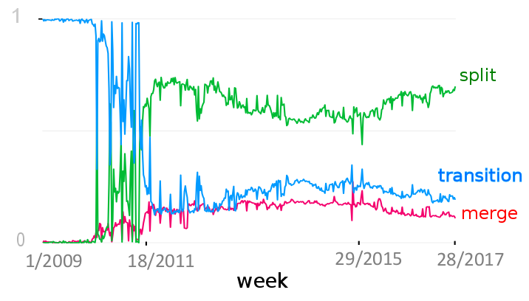
Aggregate Chainlets
Around here 2 pizzas are worth 10 thousand bitcoins. Non è il bel paese!
Percentage of aggregate chainlets in the Bitcoin Graph (weekly snapshots)
53
Notes:
53

Slide 54
Chainlet Matrix
Representing the network in time
For a given time granularity, such as one day, we take snapshots of the Bitcoin graph.
Chainlet counts obtained from the graph are stored in an N×N matrix.
Outputs
1
2
3
1
0
0
0
inputs
0
2
1
2
3
0
0
1
N: How big should the matrix be?
54
Notes:
54

Slide 55
Extreme Chainlets
N can reach thousands, the matrix can be $1000×1000$.
On Bitcoin, $\% 90.50$ of the chainlets have N of $5 (x<5 and y<5), and \% 97.57$ for N of $20$.
Outputs
1
2
3
1
0
0
0
Occurrence matrix
inputs
0
4
2
2
1
$$O[i,j]=\left\{\begin{matrix}\#C_{i→j} & \text{if} i<N and j <N \\ \sum_{z=N}^{∞}{\#C_{i→z}} & \text{if} i<N and j=N \\ \sum_{y=N}^{∞}{\#C_{y→j}} & \text{if} i=N and j<N \\ \sum_{y=N}^{∞}{\sum_{z=N}^{∞}{\#C_{y→z}}} & \text{if} i=N and j=N\end{matrix}\right\}$$
3
0
0
1
Extreme chainlets are the last column/row of the chainlet matrix.
They imply big coin movements in the graph!
55
Notes:
55

Slide 56
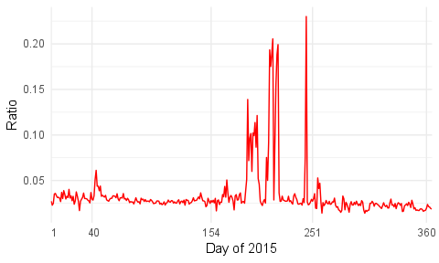
Extreme Chainlets
Bitcoin companies stopped all business in New York State because of new regulations.
The New York Business Journal called this the "Great Bitcoin Exodus".
Percentage of extreme chainlets in the Bitcoin Graph (N = 20, daily snapshots)
56
Notes:
56

Slide 57
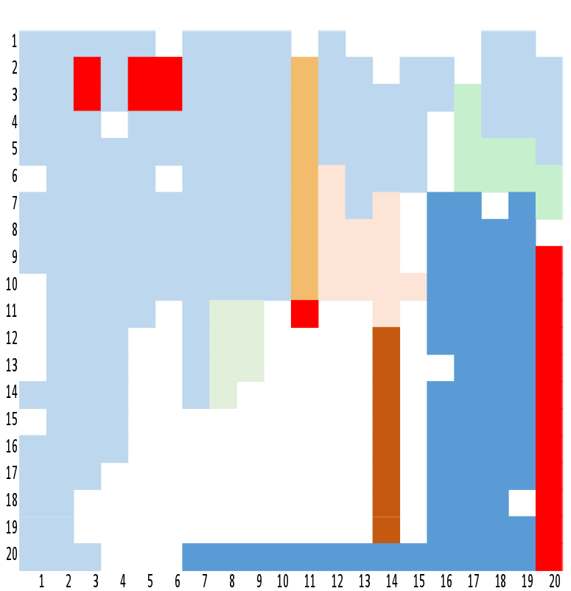
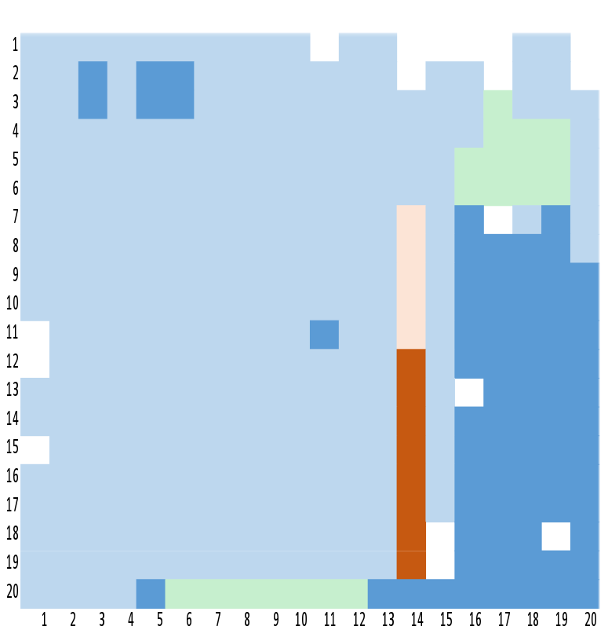
Clustering the Chainlets
A hierarchical clustering of chainlets by using Cosine Similarity over chainlet signatures in time.
We used a similarity cut threshold of 0.7 to create clusters from the hierarchical dendrogram.
Most common chainlets
Extreme and correlated chainlets
Chainlet clusters for daily snapshots
Chainlet clusters for weekly snapshots
57
Notes:
57

Slide 58
2b - Account based blockchains
58
Notes:
58

Slide 59
Account based blockchains
4E
On account based blockchains, transactions involve one input address and one output address.
An address spends coins from a balance, keeps the change.
Each transaction of an address has an order (called nonce). The nonce is the number of transactions sent to the network by the address.
A later transaction needs to wait for earlier transactions to be mined.
59
Notes:
59

Slide 60
Internal transactions
Account based blockchains have two types of “transactions”.
The first transaction type involves a transfer of the used cryptocurrency, such as Ether on Ethereum.
The second type are internal transactions, which involve a transfer of smart contract based tokens.
Internal transactions are created when smart contracts change states of addresses.
Internal transactions can be discovered in two ways: by parsing ordinary transactions’ messages, or by running the transaction message through the smart contract code.
The parsing method cannot discover failed transactions.
60
Notes:
60

Slide 61
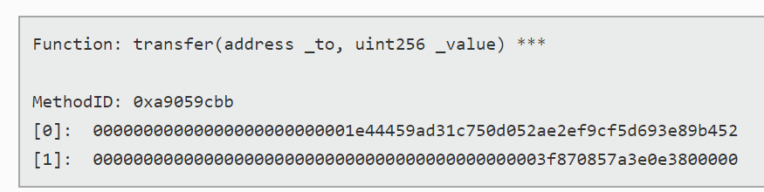

Internal transactions
Contract address
A transaction message on Ethereum
4E
Ordinary address
A transaction can transfer both currencies and tokens.
Contracts can start events as well, these are explicitly recorded.
An internal transaction can create multiple edges, although this is rare on Ethereum.
4E
2
4E
61
Notes:
61

Slide 62



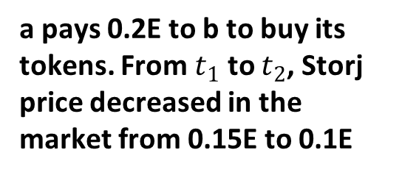
Trading tokens – a timeline
Storj token
b
Balances:
b: 2 Storj
$$t_{0}$$
0.3Ether
I want to buy 2 Storj tokens
a pays 0.2E to b to buy its tokens. From $t_{1}$ to $t_{2}$, Storj price decreased in the market from 0.15E to 0.1E
$$t_{1}$$
a
b
0.2Ether
b
Balances:
b: 0 Storj
a: 2 Storj
$$t_{2}$$
0Ether
Send my 2 tokens to address a
b
All edges on the Ethereum graph.
a
0.2E
0.3E
2
62
Notes:
62

Slide 63
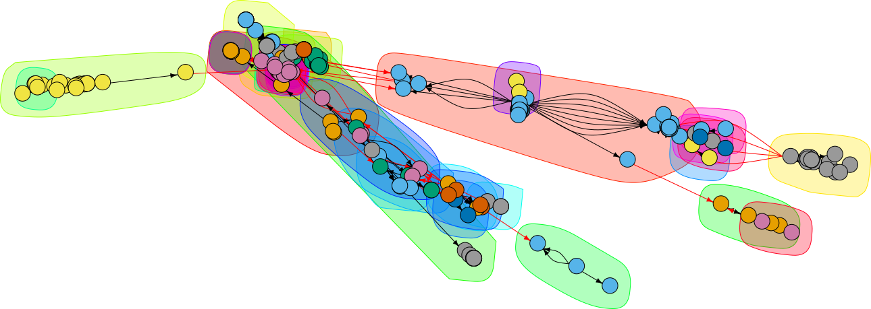
Account based blockchains
The largest connected component in Storj network on 13-1-2018.
We model account based blockchains as directed, weighted, multi-graphs.
The network of a single token is usually sparse, and devoid of community structure.
Daily networks may contain many disconnected components.
63
Notes:
63

Slide 64




Inter-token networks
Account based blockchains are global market places where goods are exchanged in terms of tokens. Ethereum is a successful example.
Blockchain platforms will allow us to view global market activity in real time.
64
Notes:
64

Slide 65
Research questions
Account based blockchains lend themselves to traditional network analysis tools and algorithms.
Motif analysis, core decomposition, centrality and clustering algorithms can easily be adapted to work on account based blockchains.
High granularity temporal data allows time series analyses.
The rich variety of cryptotokens being traded on the network brings many interesting research problems:
Token price prediction, price manipulation detection, token network health and robustness analysis, inter-token impact analysis, investor behavior analysis.
65
Notes:
65

Slide 66
3- Blockchain Privacy and Security
Permissionless (public) Blockchains
Permissioned (private) Blockchains
Bitcoin, Litecoin, Ethereum
Hyperledger, R3
By definition any user can join a public blockchain (e.g., Bitcoin).
For corporate settings, the transparency means that rivals can learn company finances and buy/sale relationships.
The permissioned blockchains were created for industrial settings.
Permissioned: Less power consumption, more secure, privacy aware, but for all purposes a gated community.
66
Notes:
66

Slide 67
3- Blockchain Privacy and Security
In public blockchains, data is considered public.
Tapscott: There are no honeypots of personal data on the blockchain.
Public blockchains are pseudo-anonymous: There is no registration to join the network, but all your transactions are public.
For security, TOR can be used to send transactions to the P2P network.
As a threat, most online exchanges are governed by know-your-customer rules that require customer registration.
Notes:
67

Slide 68
Blockchain communication graph
At its core, Bitcoin maintains a peer-to-peer architecture. Bitcoin peers create persistent TCP channels with each other and relay transactions.
Each peer seeks a minimum of 8, a maximum of 125 peers.
Each node forwards transactions arriving from a neighbor to other neighbors.
Transactions that await mining in the P2P network are contained in the mempool.
The first sender of a transaction is most likely to be the transaction owner.

Slide 69
Blockchain communication graph
t2, t5, t4
b
t1, t6, t4
t1, t3, t5
a
t1, t6, t4
t1, t2, t5
t6, t7, t8
t1, t6, t5
Nodes forward incoming transactions selectively to hinder time based address inference. This is called trickling.
In this network, b is connected to all neighbors of a – by observing relayed transactions, b can deduce that transaction t3 originated from a.
Andrew Miller, James Litton, Andrew Pachulski, Neal Gupta, Dave Levin, Neil Spring, and Bobby Bhattacharjee. 2015. Discovering bitcoin’s public topology and influential nodes. (2015).

Slide 70
Blockchain TXO content graph
Where do the bitcoins at address a come from?
From nine addresses!
Fungibility: Is a specific bitcoin worth a bitcoin everywhere? Taint analysis studies a bitcoin’s history.
a
Can we tell which addresses are controlled by the same user/entity/organization?
In order to answer this question, we first need to map inputs to outputs.

Slide 71
Blockchain TXO content graph
Heuristics are used to detect which input and output addresses are controlled by the same user.
4B
3B
1B
1B
1B
2B
1B
1B
Considering amounts may help in basic cases.
Schemes exist to use multiple rounds of flows with equal amounts to hide tracks.
Meiklejohn, Sarah, Marjori Pomarole, Grant Jordan, Kirill Levchenko, Damon McCoy, Geoffrey M. Voelker, and Stefan Savage. A fistful of bitcoins: characterizing payments among men with no names. In Proceedings of the 2013 conference on Internet measurement conference, pp. 127-140. ACM, 2013.

Slide 72
Heuristics to link addresses
1- Idioms of Use: posits that all input addresses in a transaction should belong to the same entity because only the owner could have signed the inputs with the associated private keys.
a
b
c
Addresses a, b and c belong to the same user.

Slide 73
Heuristics to link addresses
2- Transitive Closure: extends Idioms of Use: if a transaction has inputs from a and b, whereas another transaction has from a and c, b and c belong to the same user.
a
b
c
d
e
Addresses a, b, c, d and e belong to the same user.

Slide 74
Heuristics to link addresses
3- Change address: the following four conditions must be met:
the output address has not appeared in any previous transaction;
the transaction is not a coin generation;
there is no self-change address in the outputs
all the other output addresses in the transaction have appeared in previous transactions.
The heuristic then posits that the one-time change (output) address— if one exists— is controlled by the same user as the input addresses.

Slide 75
Obfuscation efforts
A measure to prevent matching addresses to users is known as Coin Mixing, or its improved version, CoinJoin.
The initial idea in mixing was to use a central server to mix inputs from multiple users.
1B
1B
2B
2B
2B
2B
2B
2B
2B
2B
2B
3B
3B
3B
5B
4B
Ruffing, Tim, Pedro Moreno-Sanchez, and Aniket Kate. CoinShuffle: Practical decentralized coin mixing for Bitcoin. In European Symposium on Research in Computer Security, pp. 345-364. Springer, Cham, 2014.

Slide 76
Obfuscation efforts – peeling chains
In a peeling chain, a single address begins with a relatively large amount of bitcoins.
A smaller amount is then “peeled” off this larger amount, creating a transaction in which a small amount is sent to one address and the remainder is sent to a one-time change address.
This process is repeated— potentially for hundreds or thousands of hops— until the larger amount is pared down
Narayanan, Arvind, and Malte Möser. Obfuscation in bitcoin: Techniques and politics. arXiv preprint arXiv:1706.05432 (2017).
Di Battista, Giuseppe, Valentino Di Donato, Maurizio Patrignani, Maurizio Pizzonia, Vincenzo Roselli, and Roberto Tamassia. Bitconeview: visualization of flows in the bitcoin transaction graph. In Visualization for Cyber Security (VizSec), 2015 IEEE Symposium on, pp. 1-8. IEEE, 2015.

Slide 77
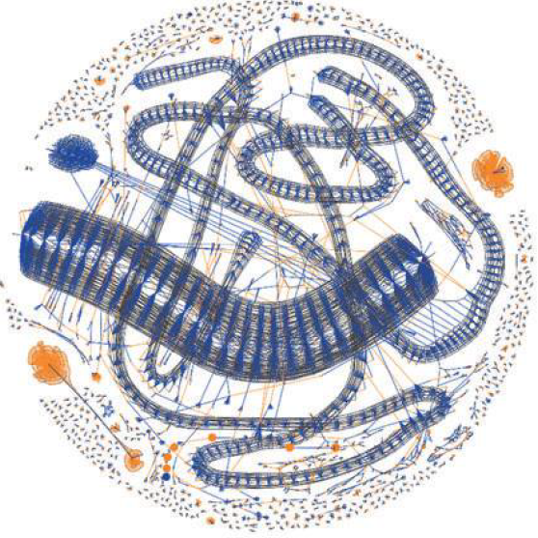
Obfuscation efforts – peeling chains
25B
0.5B
Exit to fiat currency
0.5B
0.5B
0.5B
…
Repeated patterns are frequently found on the Bitcoin blockchain.
McGinn, Dan, David Birch, David Akroyd, Miguel Molina-Solana, Yike Guo, and William J. Knottenbelt. Visualizing dynamic bitcoin transaction patterns. Big data 4, no. 2 (2016): 109-119.

Slide 78
Network clustering of addresses
By nature all user clustering heuristics are error prone.
Some community practices further complicate the issue.
For example, online wallets, such as coinbase.com, buy/sell coins among its customers without using transactions; ownership of an address is changed by transferring the associated private keys to another user.
Although the user associated with the address changes, nothing gets recorded in the blockchain.
Clustering can be further improved by considering IP locations and temporal patterns.

Slide 79
Research directions in taint analysis
Money laundering
M. Moser, R. Bohme, and D. Breuker. An inquiry into money laundering tools in the Bitcoin ecosystem. In: eCRS. IEEE. 2013, pp. 1-14.
Ransomware payments
Huang, Danny Yuxing, Maxwell Matthaios Aliapoulios, Vector Guo Li, Luca Invernizzi, Elie Bursztein, Kylie McRoberts, Jonathan Levin, Kirill Levchenko, Alex C. Snoeren, and Damon McCoy. Tracking ransomware end-to-end. In 2018 IEEE Symposium on Security and Privacy (SP), pp. 618-631. IEEE, 2018.
Illicit trade/use
Portnoff, Rebecca S., Danny Yuxing Huang, Periwinkle Doerfler, Sadia Afroz, and Damon McCoy. Backpage and bitcoin: Uncovering human traffickers. In Proceedings of the 23rd ACM SIGKDD International Conference on Knowledge Discovery and Data Mining, pp. 1595-1604. ACM, 2017.

Slide 80
Thanks for attending!
Cuneyt.Akcora@UtDallas.edu
BlockchainTutorial.Github.io
Further reading -> Blockchain: A graph primer.
C. G. Akcora, Y. R. Gel, M. Kantarcioglu.
[Updated regularly, online] ArXiv:1708.08749, pp 1-16, 2017.

