Slide 1

A Comparison of Apache Tez and Apache Spark
Cuneyt G. Akcora
Data Security and Privacy Lab,
University of Texas at Dallas
November 2016
Notes:
1

Slide 2
Outline
Apache Tez (Hortonworks)
Apache Spark (Amp Lab, Databricks, also Cloudera)
A comparison of frameworks: efficiency, popularity
Other alternatives
2
Notes:
2

Slide 3
Apache Tez Basics
Apache Tez is inspired by the Microsoft Dryad data flow framework. Tez comes from the Stinger initiative to speed up Hive
A dataflow graph where vertices represent the application logic and dataflow edges
Java API to express a DAG of data processing. The API has three components: DAG, Vertex and Edge
3
Notes:
3

Slide 4
Apache Tez Basics
The user creates a DAG object for each data processing job
The user creates a Vertex object for each step in the job
The user creates an Edge object and connects the producer and consumer vertices using it
4
Notes:
4

Slide 5
Apache Tez Basics
Output of the vertices can be persisted to a local file system or HDFS with or with out replication based on the reliability requirements
Pluggable vertex management modules gather runtime information, the execution engine uses this data to optimize and reconfigure execution plan downstream (e.g., increase number of reducers based on data size)
5
Notes:
5

Slide 6
Apache Tez: Bottom line
“MapReduce and Tez use the same logical programming paradigm, but Tez uses dataflow DAGs for resource optimization and data pipeline planning. This means that Tez provides an order of magnitude speed boost over MapReduce, but has the same overly rigid design limitations” [4].
“You are more likely to be using tools (e.g., Hive) powered by Apache Tez (as an execution engine) rather than Tez directly” Thejas Nair, Hortonworks
6
Notes:
6

Slide 7
Apache Spark Basics
Apache Spark was developed in 2009. Has APIs in Scala, Java, R, and Python
Interactive, iterative cluster computing platform [3]
1) abstraction over distributed memory on clusters 2) abstract transformations (e.g., sample, filter, join, collect) that apply the same operation to many data items
7
Notes:
7

Slide 8
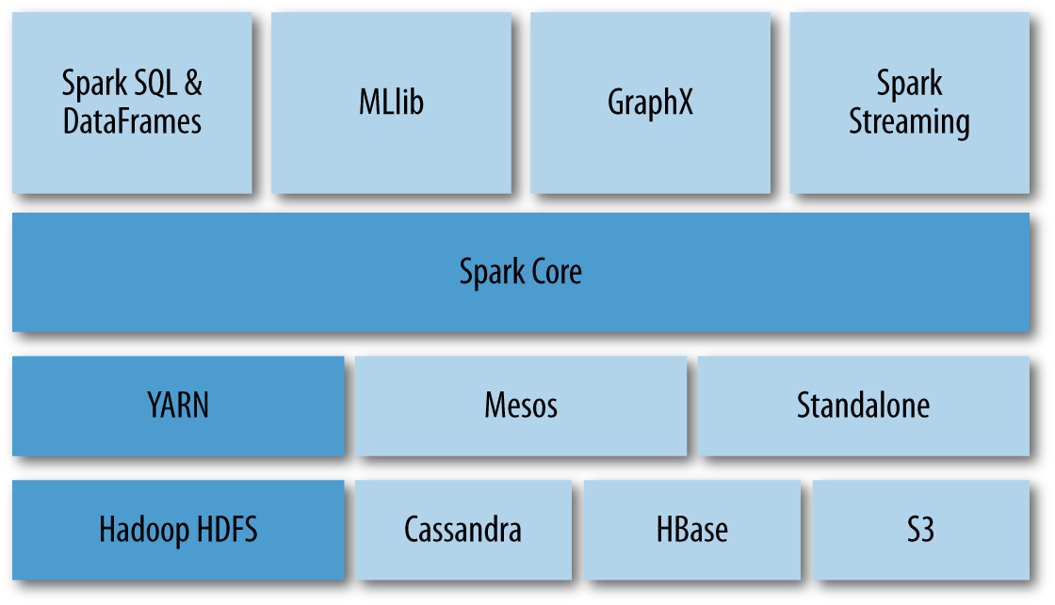
Apache Spark Basics
Spark converts all transformations (e.g., map()) and terminal actions (e.g, collect(), reduce()) into a DAG and executes it using a DAG execution engine similar to that of Dryad
8
Notes:
8

Slide 9
Apache Spark Basics
In-memory cluster computation enables Spark to run iterative algorithms, as programs can checkpoint data and refer back to it without reloading it from disk
RDD is a read-only, partitioned collection of records that can be created though deterministic operations on data in a stable storage or other RDD
A series of data flow transformations before performing some action that requires coordination like a reduction or a write to disk
9
Notes:
9

Slide 10
Apache Spark Basics
Spark focuses purely on computation rather than data storage
Typically run in a cluster that implements data warehousing and cluster management tools
When Spark is built with Hadoop, it utilizes YARN to allocate and manage cluster resources like processors and memory via the ResourceManager
10
Notes:
10

Slide 11
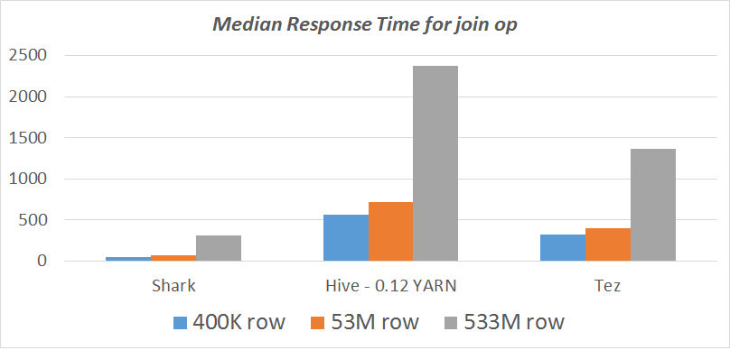
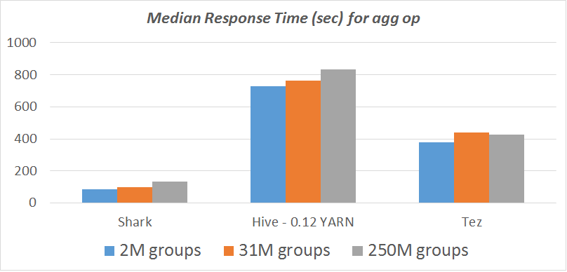
Comparisons
https://amplab.cs.berkeley.edu/benchmark/
11
Notes:
11

Slide 12
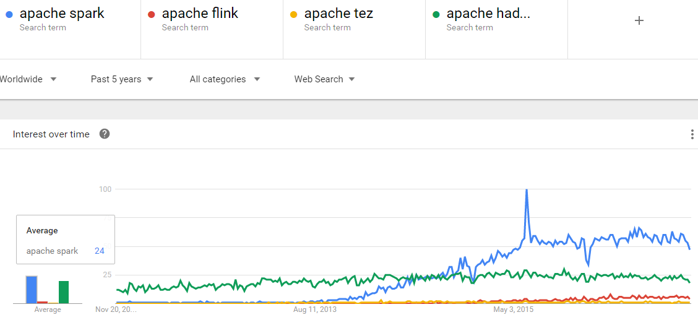
Popularity in time
12
Notes:
12

Slide 13
Other candidates
Apache Flink [1]:
Streaming dataflow engine
Can emulate batch processing, however at its core it is a native streaming engine
Has advanced streaming capabilities (such as windowing features, etc)
Apache Storm:
Has a compositional API
You build up your topology with basic building blocks like sources or operators
Used for streaming data
Source: Stefan Papp on Quora
13
Notes:
13

Slide 14
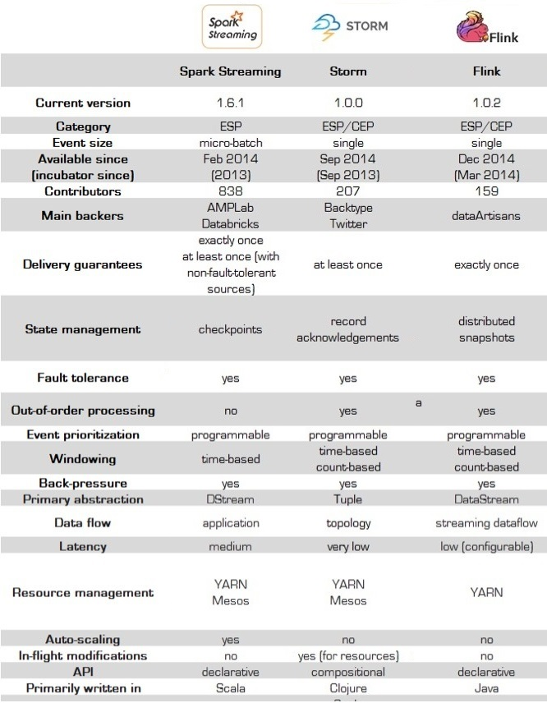
Attribute
Comparison
Source:
twitter.com/IanHellstrom
14
Notes:
14

Slide 15
References
[1] Beyond Hadoop MapReduce
Apache Tez and Apache Spark, Prakasam Kannan
[2] Coursera course on Big Data: https://www.coursera.org/learn/hadoop/lecture/KnDdc/yarn-tez-and-spark
[3] Data Analytics with Hadoop, Safari Books. Online at https://www.safaribooksonline.com/library/view/data-analytics-with/9781491913734/ch04.html
[4] The Tragedy of Tez, Paige Roberts. Online at http://bigdatapage.com/tragedy-tez/
15
Notes:
15

Slide 16
References
[5] I Like Tez, DevOps Edition (WIP), Gopal V., Online at https://github.com/t3rmin4t0r/notes/wiki/I-Like-Tez,-DevOps-Edition-%28WIP%29
16
Notes:
16

