Slide 1

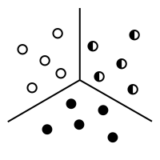

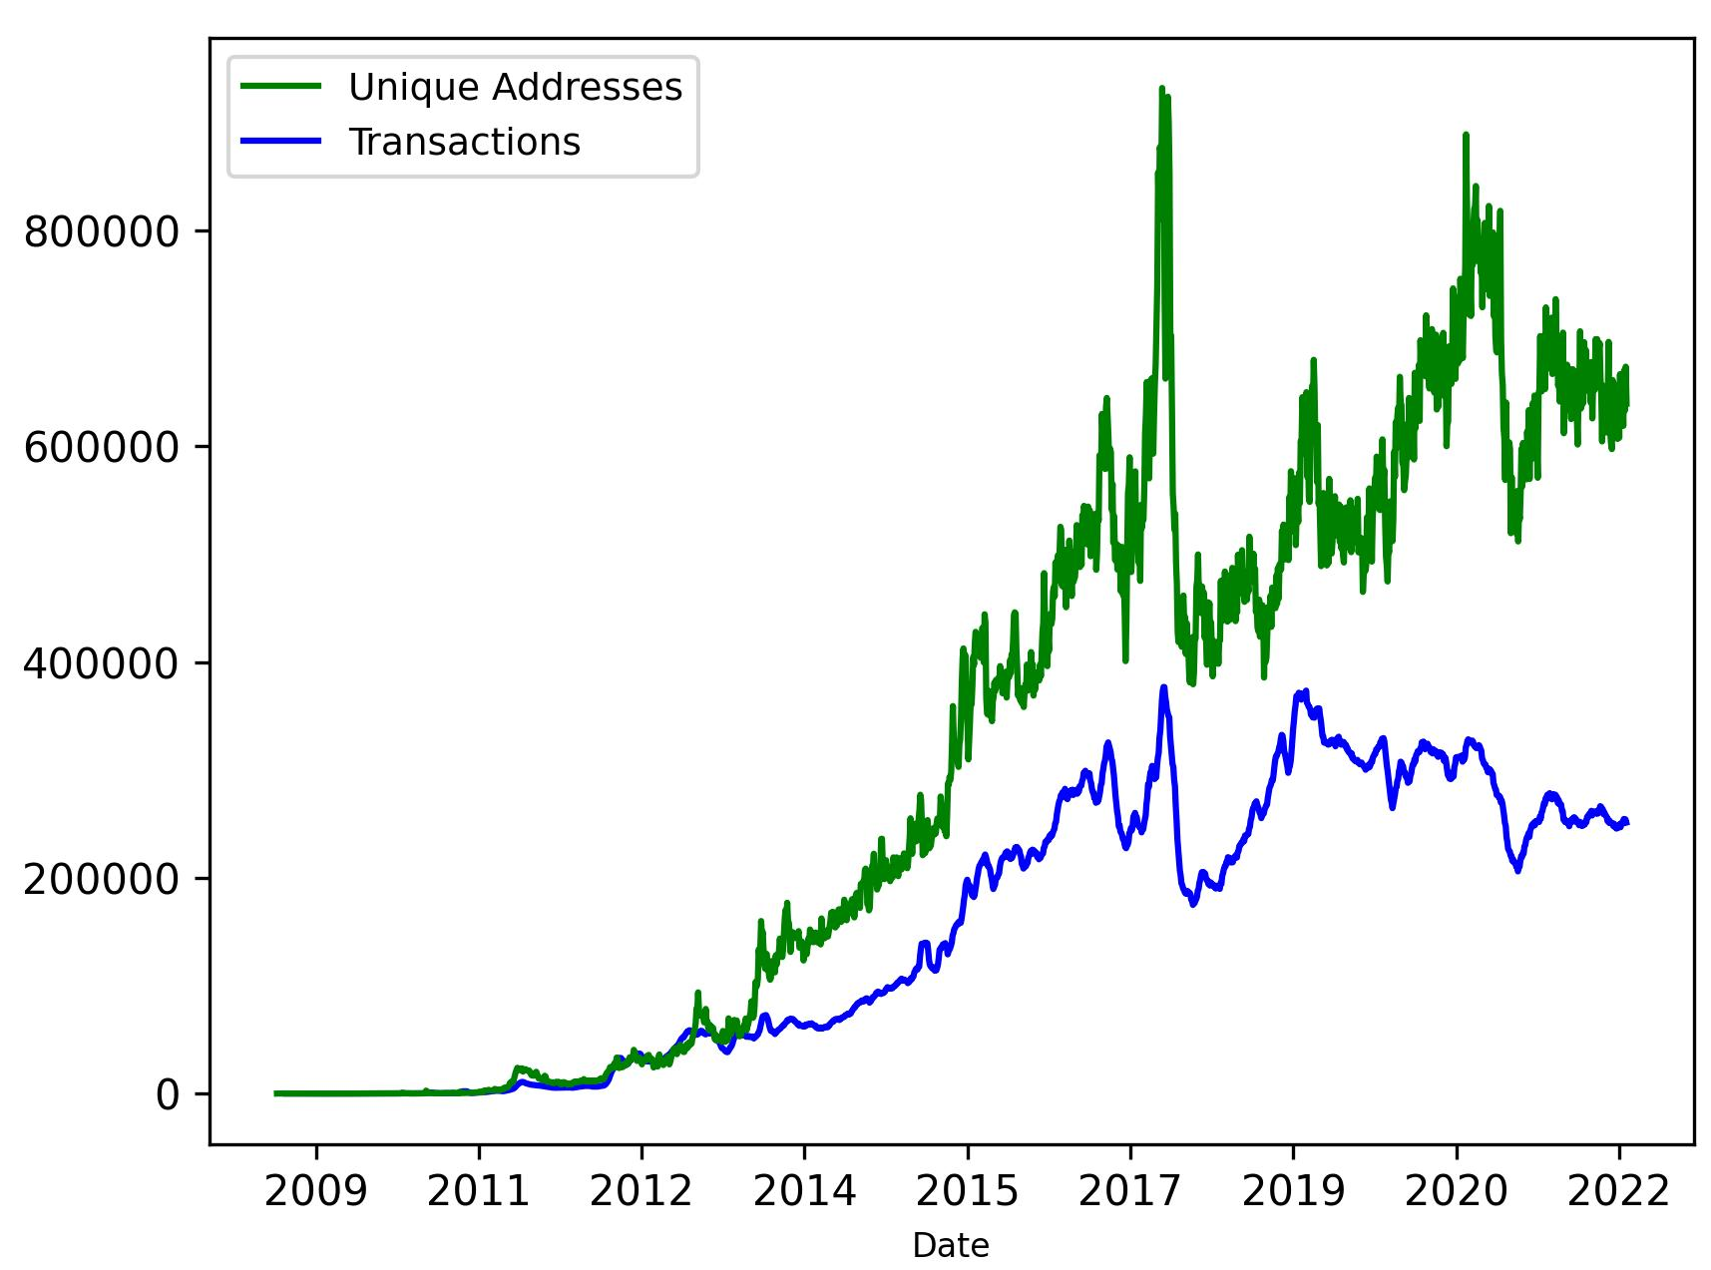


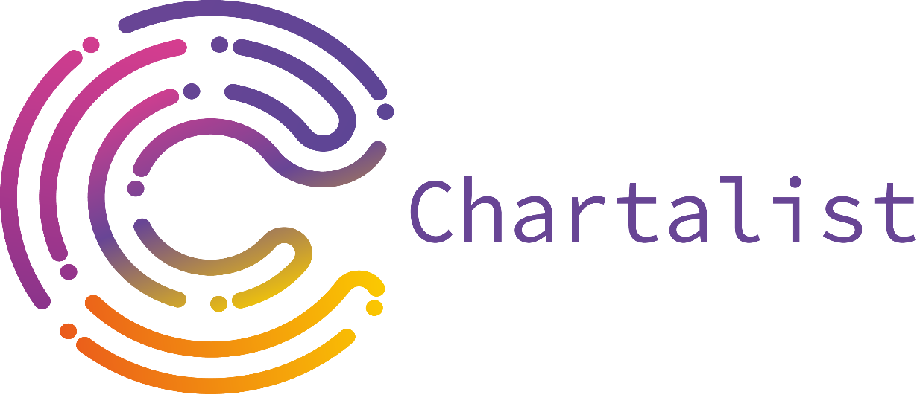






Chartalist: Labeled Graph Datasets for UTXO and Account-based Blockchains
Kiarash Shamsi, Friedhelm Victor, Yulia R. Gel, Murat Kantarcioglu, Cuneyt Akcora
Machine learning on blockchain graphs
Datasets and Learning Tasks
Main components
ML on blockchain graphs is an emerging field with many applications like ransomware payment tracking, crypto-asset price manipulation analysis, Money laundering detection, and address clustering and linkage.
However, analyzing blockchain data requires domain expertise and computational resources, which pose a significant barrier and hinder advancement in this field.
Address Clustering Task: Identifying which addresses are co-owned by an entity. Dataset: Chartalist Bitcoin transaction network. Size: 738K blocks, 11 splits with input and output addresses, approximately 100GB of data. Use Case: Finding co-ownership of addresses.
A holistic view of blockchains and formulations of graph machine-learning tasks.
A comprehensive ecosystem of tools and community resources to support blockchain data analytics.
A set of boards to support performance comparison and benchmark for the tasks.
Current state of blockchain data analysis
Address and Transaction Type Classification Task: Determining whether addresses and transactions belong to a specific class type. Dataset: Chartalist address and transaction type prediction dataset. Size: 2.9M labeled data points, approximately 100GB of data. Use Case: Ransomware address and transaction classification.
Main features
Significant efforts to extract the underlying graph by running a blockchain client.
Paying for commercial APIs to download transaction data.
Allocating considerable resources to construct blockchain graphs.
Blockchain research also lacks labeled data for many significant problems.
Different pipelines for UTXO and Account-based blockchain.
Chartalist contains cleaned and labeled data,
As well as open-source data loaders, and graph extractors for easy analysis.
Large-scale, dynamic multilayer networks where nodes, edges, and edge weights evolve.
Multilayer graphs with ground truth information on event anomalies.
Anomalous Transaction Pattern Detection Task: Identifying anomalous transactions so that, i.e., their distinct temporal patterns can be summarized. Dataset: Chartalist Bitcoin transaction network. Size: 737 900 Blocks, 11 Splits with input and output addresses, Approximately 100GB data Use Case: Identify transaction patterns that are used in illicit cases.
Boards to Support Performance Comparison
We introduce a baseline method for each task to benchmark new approaches.
Since blockchain data analytics is still a nascent field, and we do not have many results from other researchers on our tasks.
We designed a leaderboard for tasks which has been studied previously such as price prediction.
New baseline approaches will be added to our leaderboard.
Number of unique addresses and transactions for bitcoin network. The number of unique addresses (i.e., vertices in the transaction graph) has increased above 600K.
Multilayer Network Analysis Task: Predicting events and phenomena that emerge through the simultaneous use of multiple assets, which can be studied as multilayer networks. Dataset: Chartalist Ethereum multilayer networks. Size: 6 Token networks ~ 10MB (standard version) – 1701 token networks ~ 2GB (extended version). Use Case: Address classification, address clustering, anomaly detection.
The open-source Bitcoin parser BlockSci requires 60GB of memory to build the Bitcoin transaction graph.
Chartalist ML-ready datasets
Stablecoin Analysis Task: Analyzing stable coin market behavior and activity. Dataset: Chartalist stablecoin ERC20 transactions dataset Size: 6 token networks ~ 822MB. Use Case: Detect the time when the LunaTerra stablecoin crashed.
Chartalist is the first ML-ready data platform from unspent transaction output (UTXO) (e.g., Bitcoin) and account-based blockchains (e.g., Ethereum).
References
Cuneyt G. Akcora, Yitao Li, Yulia R. Gel, and Murat Kantarcioglu. “Bitcoinheist: Topological data analysis for ransomware prediction on the bitcoin blockchain” International Joint Conferences on Artificial Intelligence Organization, pages 4439–4445, 7 2020.
Cuneyt Gurcan Akcora, Yulia R Gel, and Murat Kantarcioglu. “Blockchain networks: Data structures of bitcoin, monero, zcash, ethereum, ripple, and iota” Data Mining and Knowledge Discovery, 12(1):e1436, 2022.
Rafael Belchior, André Vasconcelos, Sérgio Guerreiro, and Miguel Correia. “A survey on blockchain interoperability: Past, present, and future trends” ACM Computing Surveys (CSUR), 54(8):1–41, 2021.
Chartalist provides data science tools for making the execution of machine learning tasks on blockchains easier.
Price Analytics Task: Using observable blockchain activity to predict asset or coin prices. Dataset: Chartalist Bitcoin price analysis – Chartalist EtherumCurves price analysis Size: Bitcoin (9-year price) ~ 1MB – Ethereum (31 token networks) ~ 35MB Use Case: Bitcoin or Ethereum price prediction

