Slide 1
Geog 571 Final Project
International Fishing Activities in the Pacific Ocean
Keiko Nomura

Slide 2
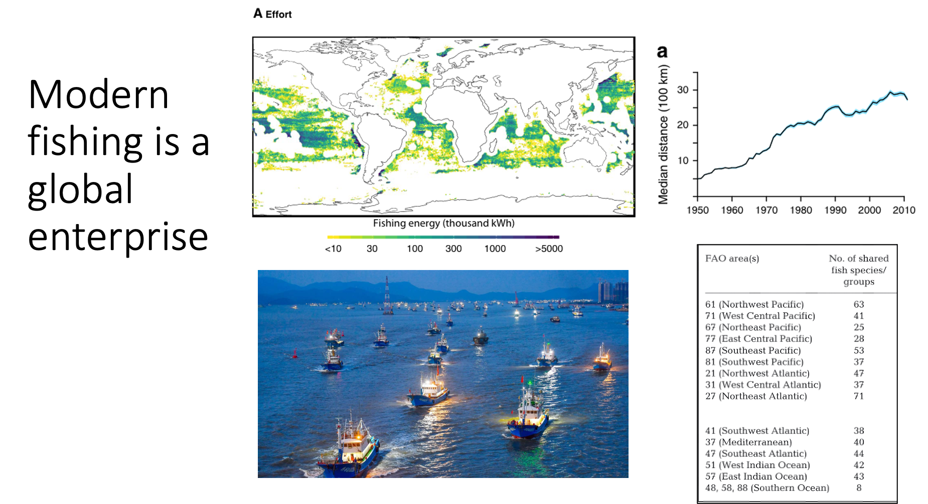

Slide 3
Project Goals
Visualize fishing distributions across the Pacific Ocean
Allow users to explore which areas of the Pacific:
(1) have high fishing activity
(2) have diverse international fishing presence
Takeaways: fishing effort is widespread, across jurisdictions

Slide 4
Workflow / Tools Used
Basemap
Stadia map through Leaflet
Data
Existing on-hand data: fishing diversity, fishing effort (rasters)
Acquired data: Exclusive Economic Zone boundaries (shp → json)
Interactivity
Toggle bars: fade the raster layers in and out
Mouseover on EEZs: highlights and provides info about country jurisdictions
Click on raster cells: retrieve values for diversity and fishing effort

Slide 5
Problems
Spatial projections and extents
Basemap in Web Mercator
Rasters in Mercator, because of difficulties reprojecting and getting correct coordinates
Something to do with coordinate extent values, or 0 to 360 versus -180 to 180 longitudes
Hosting on Github
Stadia basemap not happy

Slide 6
Next Steps
Click on raster in ocean → network of arrows point to which countries fish there
Fix EEZ highlighting to capture full EEZ boundaries
Fix projection of rasters
Add in more info outside of the map (bar charts, networks, etc.)
Fix basemap

