Slide 1
Graphics Programming
Texture, Transformations and Camera
3D Vision Lab
3.21., 2022

Slide 2
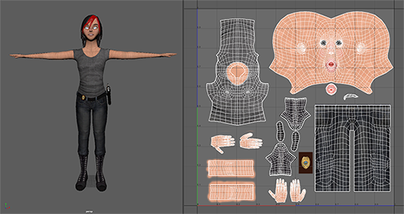
Texture
A texture is a 2D image used to add detail to an object graphics standard API (Silicon Graphics, 1992)

Slide 3
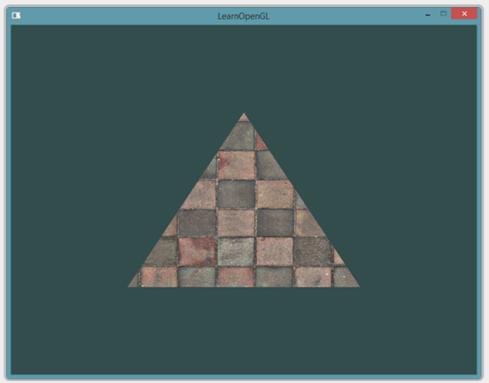
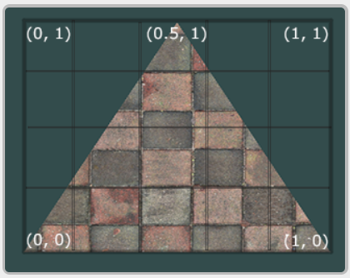
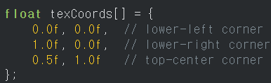
UV Coordinate
Each vertex has uv coordinate!!

Slide 4
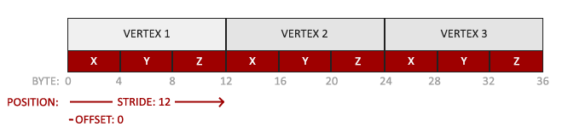
Texture as 2D VBO
Texture is basically a 2D array. → similar to VBO
Recall: VBO is an 1D array that contains position, normal, uv etc…

Slide 5
Texture as 2D VBO
VBO | Texture
glGenBuffer | glGenTexture
glBindBuffer | glBindTexture
glBufferData | glTexImage2D
Null VBO id= 0 | Null texture id = 0
glDeleteBuffer | glDeleteTexture

Slide 6
Texture as 2D VBO
VBO | Texture
glGenBuffer | glGenTexture
glBindBuffer | glBindTexture
glBufferData | glTexImage2D
Null VBO id= 0 | Null texture id = 0
glDeleteBuffer | glDeleteTexture

Slide 7

Loading and creating textures
Use stb_image library!
stb_image.h is a very popular single header image loading library
Stb_image.h file is already in assignment folder

Slide 8
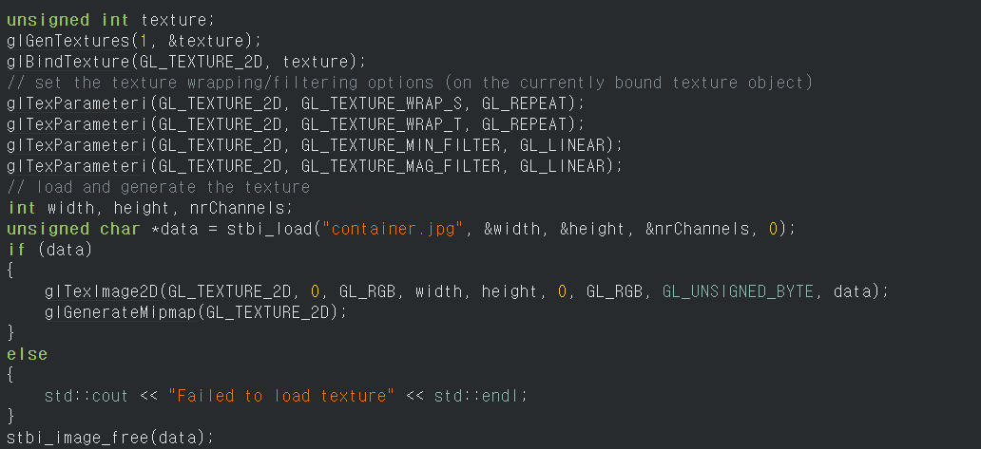
Generating Texture
Generate glTexture
Texture Params
(detail is on LearnOpenGL)
Load image
Load data to glTexture

Slide 9
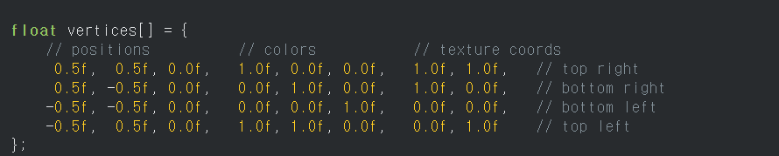
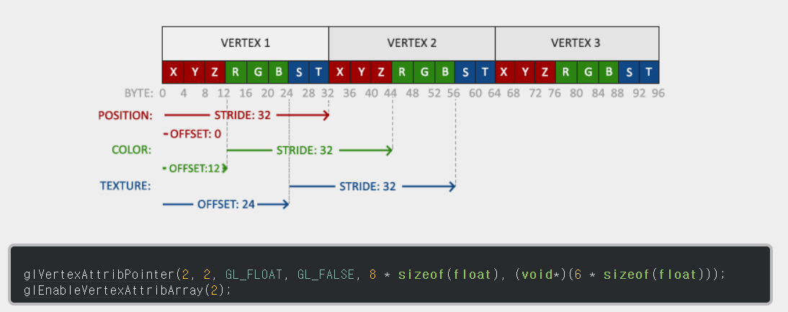
Applying Texture – Add UV to VBO
We need UV data!! (similar to color)
VBO
Add UV to VBO

Slide 10
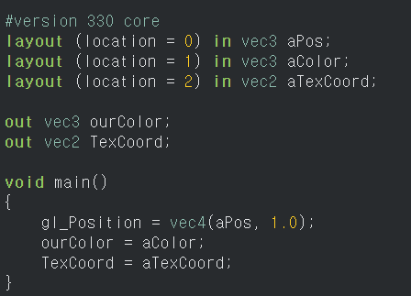
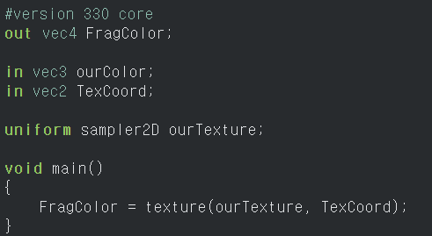
Applying Texture – Change Shader
Vertex Shader
Fragment Shader

Slide 11

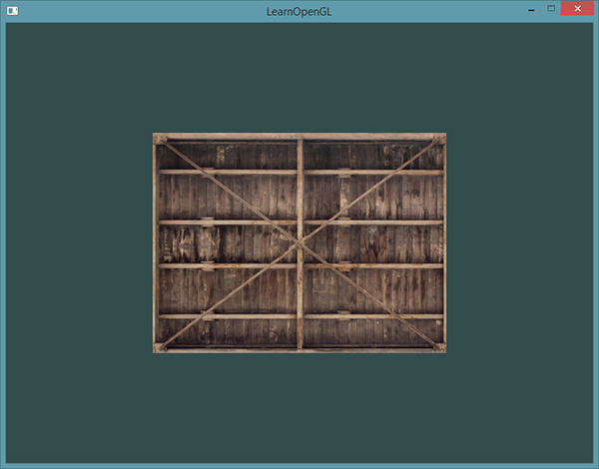
Applying Texture – Change rendering call
Every frame, call
Binding Texture is added

Slide 12
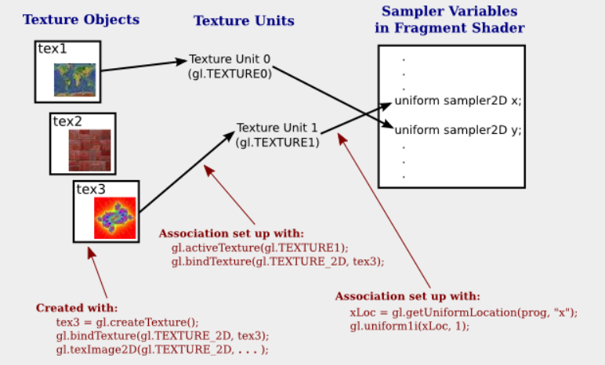
Mixing Two Textures

Slide 13
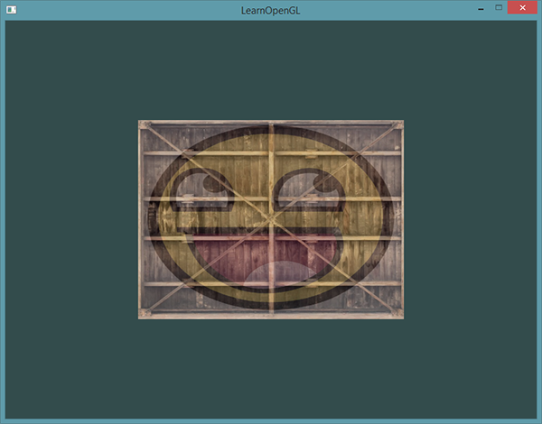
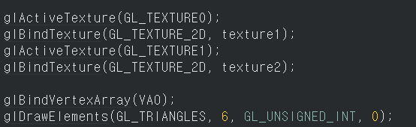
Mixing Two Textures
Need to manually register different uniform variable to each texture
Every frame, call

Slide 14
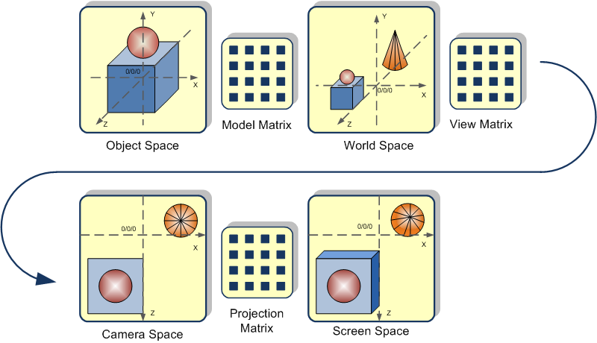
3D to 2D screen space

Slide 15
Model Matrix
Scale, Rotate, Translate
Model matrix is different for each entity even though they have same model.
Translate(0,4,2)
T
v
v=(x,y,z,1)
Rotate(30 degree in x-axis)
T
R
v
T
R
S
v
Scale(2)
In this order !!!
Model Matrix

Slide 16
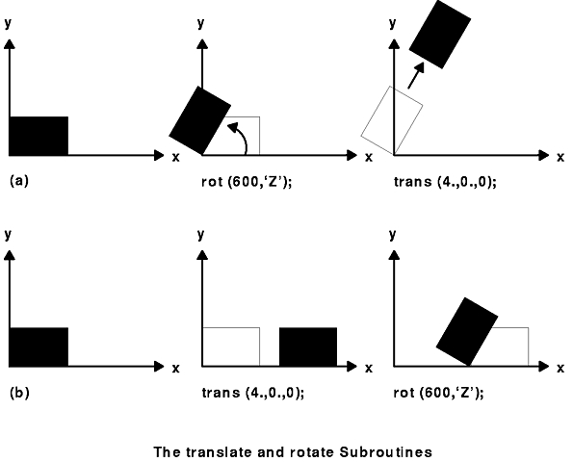
Model Matrix
Order is important!

Slide 17
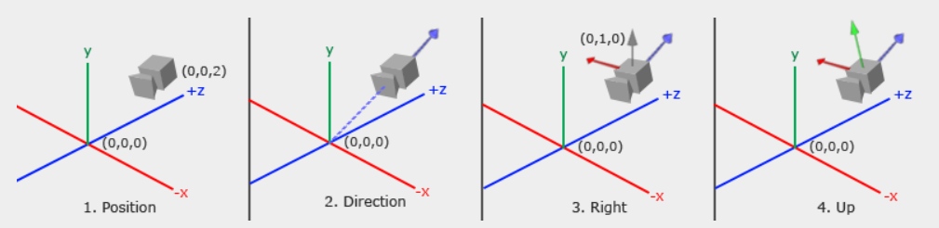
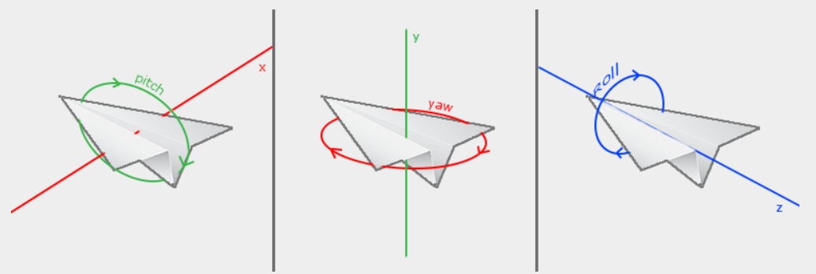
View Matrix

Slide 18
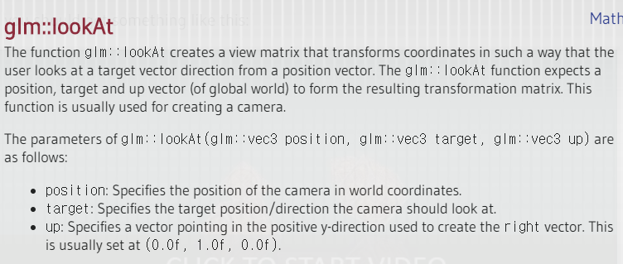
View Matrix

Slide 19
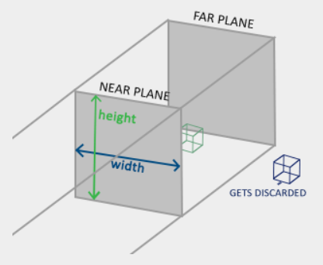
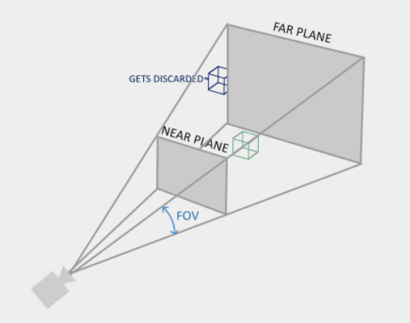
Projection Matrix
Ortho
Perspective

Slide 20
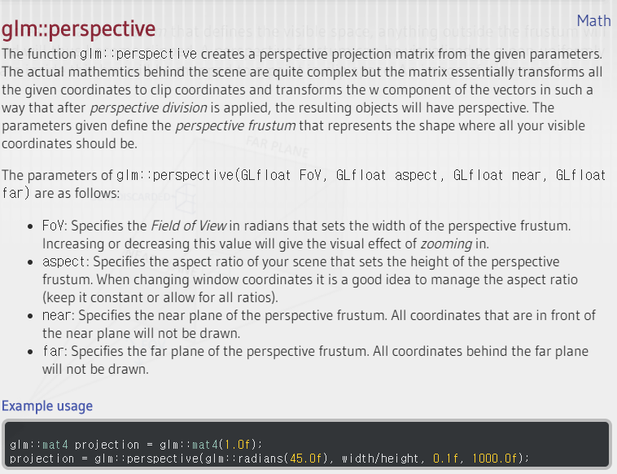

Slide 21
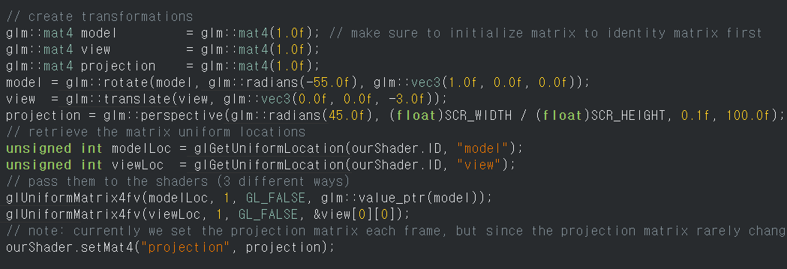
Applying Model View Projection Matrices

Slide 22
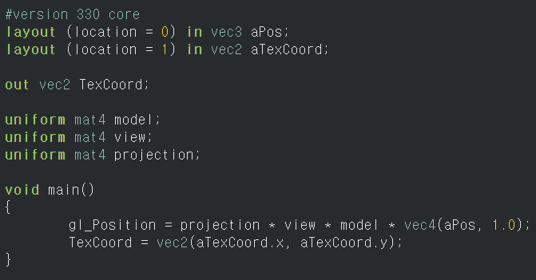
Applying Model View Projection Matrices
Vertex Shader

Slide 23

Don’t forget enabling Depth Test
Initialize (enable depth test)
Every frame, clear depth buffer

Slide 24
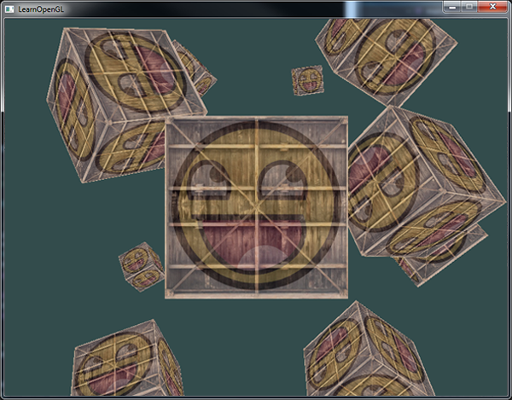
Today’s goal
Draw Multiple Textured Cubes with Fixed camera
Example:

Slide 25
Assignment 2
3D scene with controllable camera
Draw 10 cubes in 3D scene
WASD(translate), Mouse move(orientation), Mouse scroll(FOV)
Texture
Apply texture to cube
Cubemap(3D Texture) with multiple textures
Billboard
Use knowledge of transformation, camera and texture!
Quaternion
Interpolate camera smoothly using quaternion.

