Slide 1
Graphics Programming
Geometry and Tessellation Shader
3D Vision Lab
4.6., 2022

Slide 2
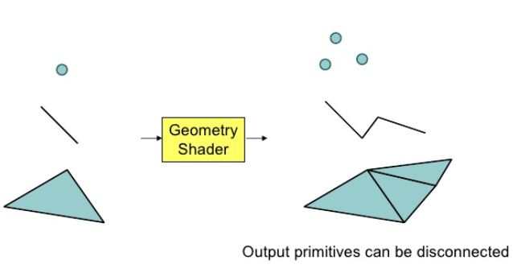
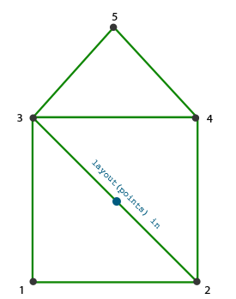
Geometry Shader
A Geometry Shader (GS) is a Shader program written in GLSL that governs the processing of Primitives. Core since version 3.2.

Slide 3
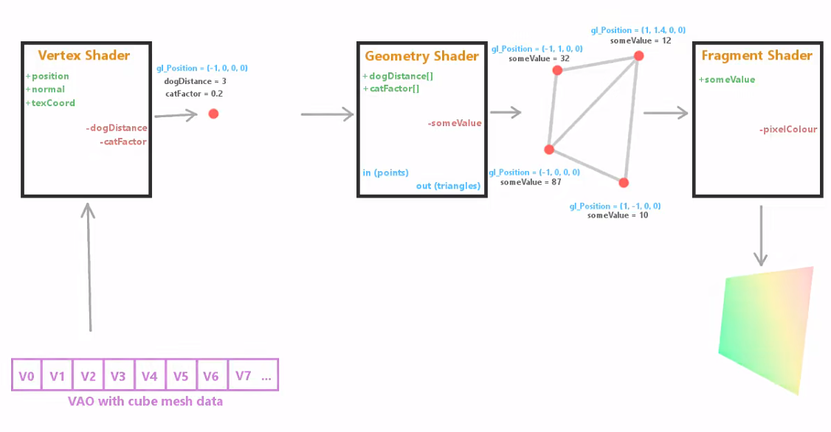
ThinMatrix OpenGL Tutorial

Slide 4
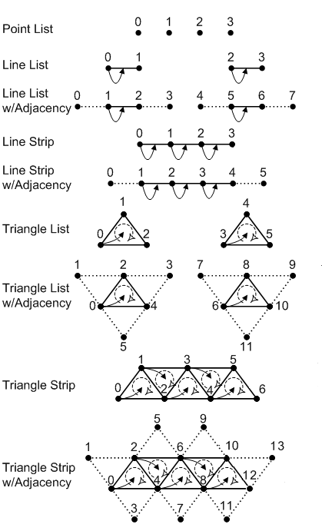
OpenGL Primitive
"Primitive“, also referred to as a "base primitive", refers to the result of the interpretation of a vertex stream

Slide 5
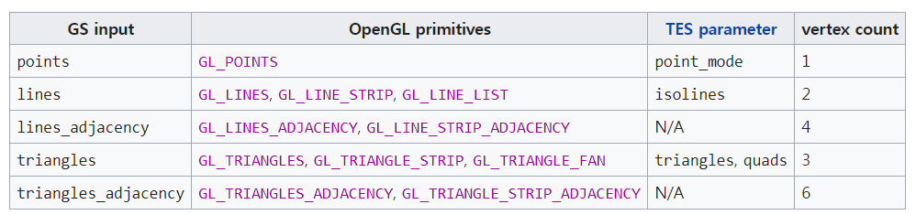

Geometry Shader Primitives
Input primitives:
layout(input_primitive​) in;
Output primitives:
layout(output_primitive​, max_vertices = vert_count​) out;

Slide 6
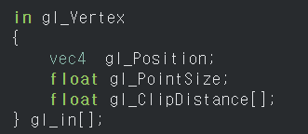
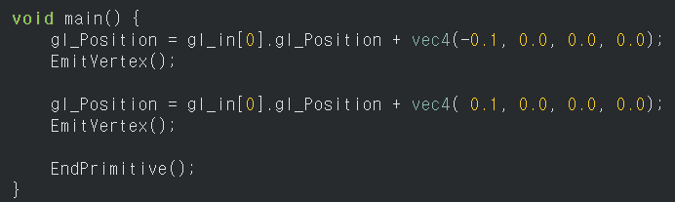
Geometry Shader Primitives
Input (from Vertex Shader) :
EmitVertex
EndPrimitive
This takes one vertex as input and emit line

Slide 7
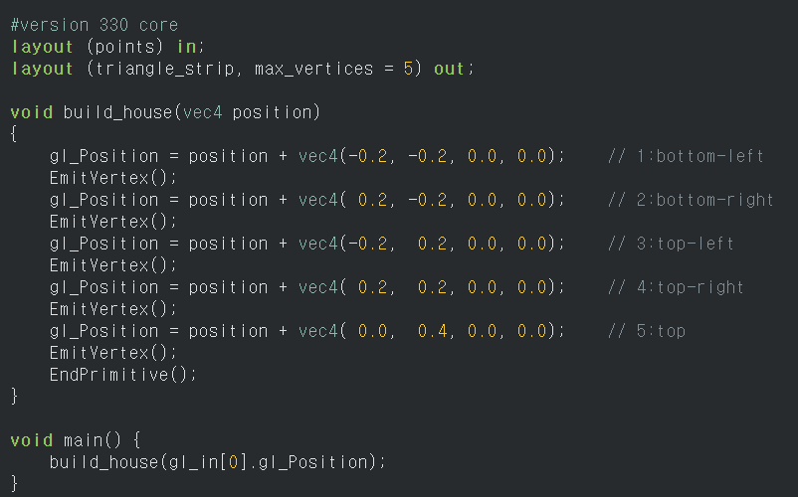
Example

Slide 8
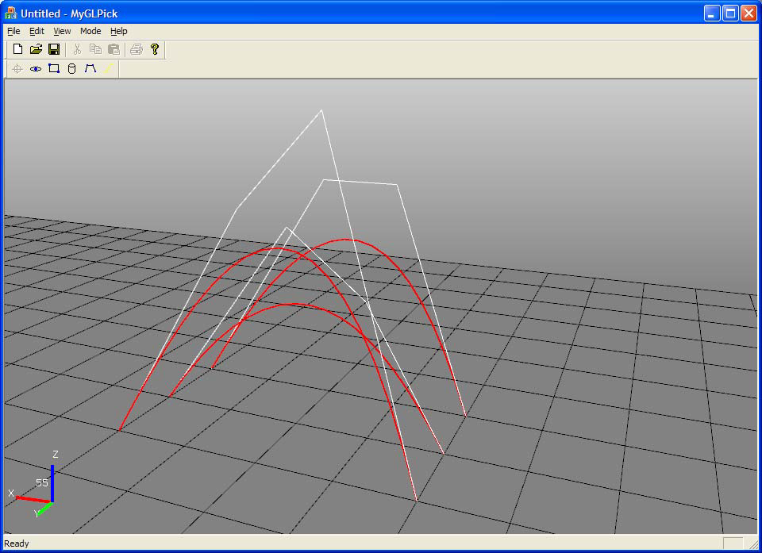
Bezier curve with four control points
(Source: Dongsoo Han)

Slide 9
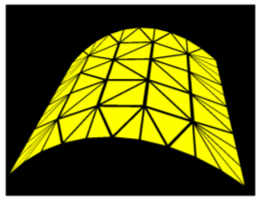
Tessellation Shader
Tessellation is the Vertex Processing stage in the OpenGL rendering pipeline where patches of vertex data are subdivided into smaller Primitives. (Core since version 4.0)
Why Tessellation Shader?
Adaptive subdivision (Level of Detail)
Apply displacement maps without additional detailed geometry

Slide 10
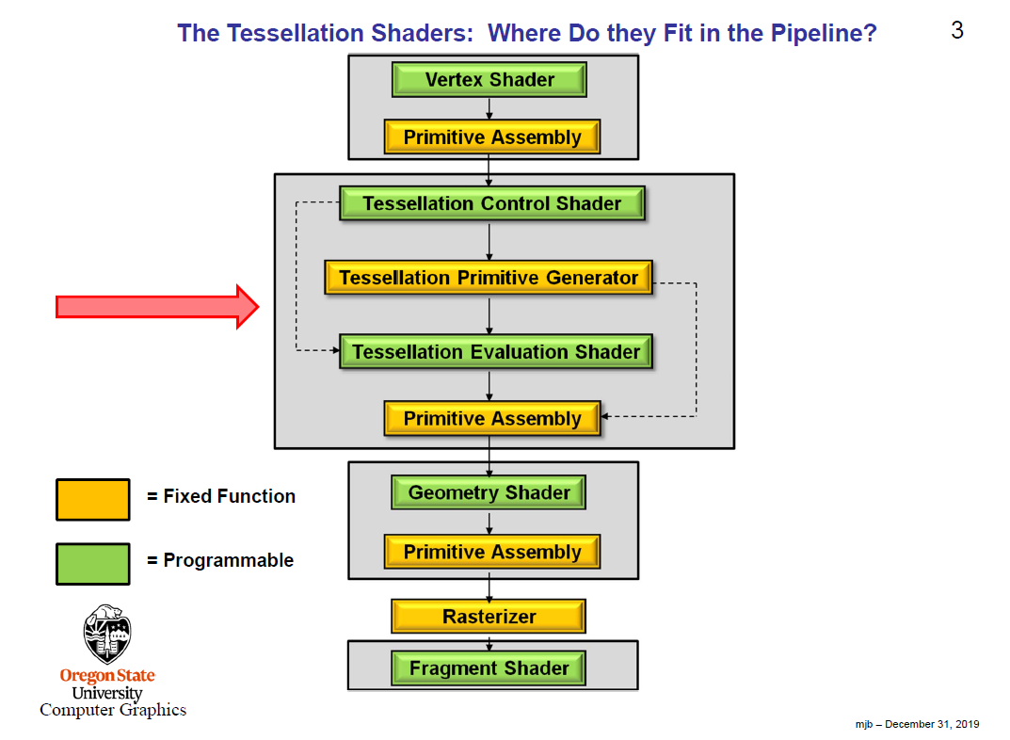
(Source: https://web.engr.oregonstate.edu/~mjb/cs519/Handouts/tessellation.1pp.pdf)

Slide 11
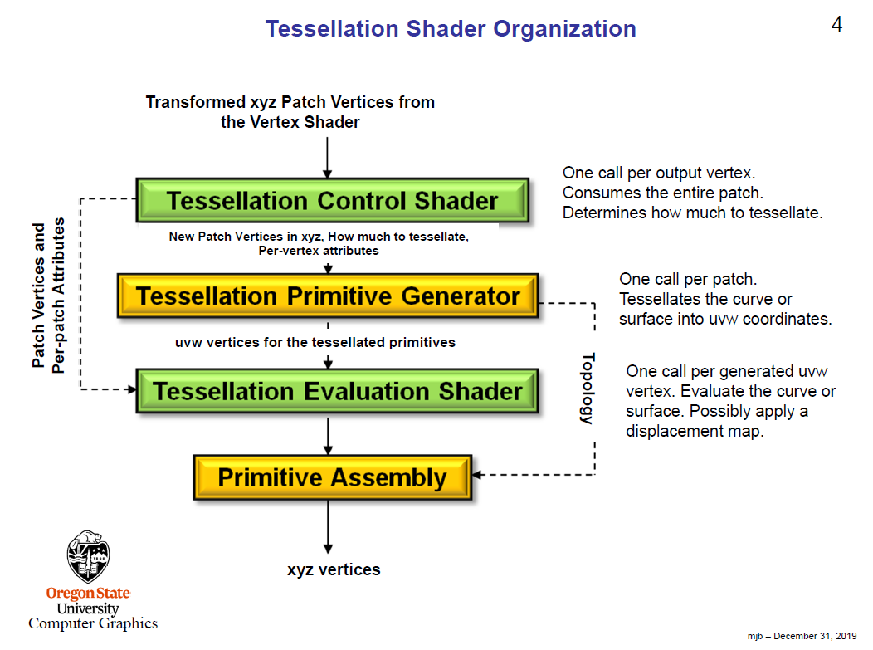
(Source: https://web.engr.oregonstate.edu/~mjb/cs519/Handouts/tessellation.1pp.pdf)

Slide 12
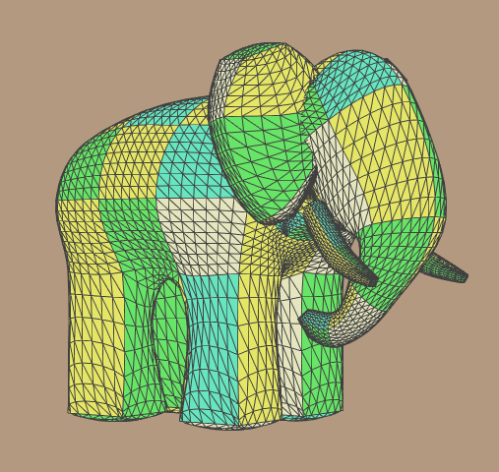
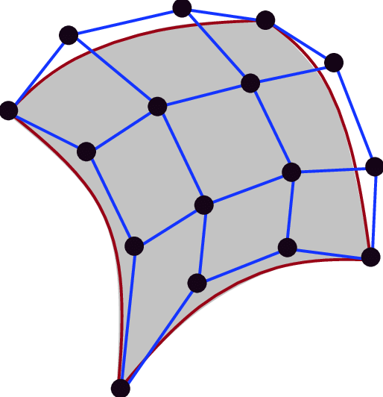
Bezier Surface
Bicubic Bezier Surface
Gumbo model with
Bezier surface patches

Slide 13
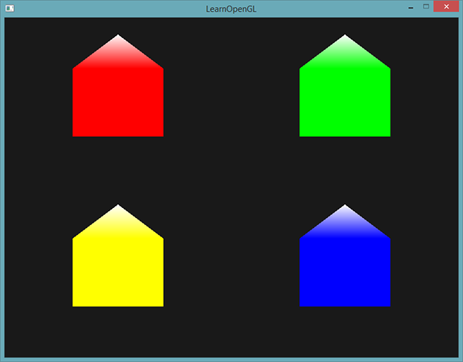
Today’s Goal
Simple geometry shader example from LearnOpenGL
Should be white!
https://learnopengl.com/Advanced-OpenGL/Geometry-Shader

Slide 14
Assignment 3
Spline with geometry shader
Bezier, B-Spline, Catmull-Rom.
Bezier surface with tessellation shader
Render models with Bezier surface patches.
Adaptive mesh subdivision (Level of Details dependent on camera distance)
You must geometry and tessellation shader to get full credit

