Slide 1
Graphics Programming
(Lab1) Introduction to OpenGL
3D Vision Lab
3.14.2022

Slide 2
Lab 1: Today’s Goal
Install OpenGL development environment.
Understand modern OpenGL rendering pipeline.
Understand shader.
Understand Vertex Array Object and Vertex Buffer Object.
Recommended to read LearnOpenGL ‘Getting started’ part, from ‘OpenGL’ to ‘Shaders’.

Slide 3



What is OpenGL?
Graphics standard API (Silicon Graphics, 1992)
Other graphics APIs
DirectX (Microsoft)
Vulkan (Kronos Group)

Slide 4
GLFW?
Creating a window is OS-specific task.
So we should implement it to use OpenGL APIs.
GLUT, SDL, SFML, GLFW are helping libraries for this task.
GLUT was widely used, but there are no updates no more.
We will use GLFW!

Slide 5
GLAD?
The location of most of OpenGL functions is not known at compile-time and needs to be queried at run-time
Retrieving those locations is OS-specific
GLAD is used for this task in C++

Slide 6

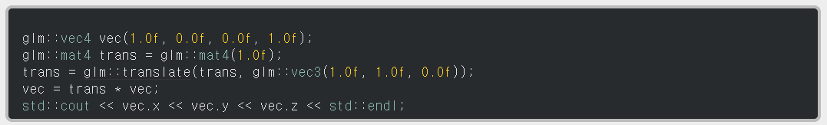
GLM(required for homework)
OpenGL Mathematics, header only

Slide 7
Environment Build Guide
Following installation guide is written assuming that you are using Visual Studio on Windows 10 64bit with CMake.
For Linux user, please check the original site. (https://learnopengl.com/Getting-started/Creating-a-window)
If you prefer to use other settings, it’s ok, but please install it by yourself.

Slide 8
Environment Setting
Git clone or download from https://github.com/JoeyDeVries/LearnOpenGL
Create your assignment folder (e.g., graphicsprogramming2022)
Copy dlls, includes, lib folder from LearnOpenGL.
Create assignments folder and unzip lab1.zip (uploaded).
Copy glad.c at src folder to assignments folder.
<folder structure>
graphicsprogramming2022
└ assignments
└ lab1
└ lab2 (to be created)
└ hw1 (to be created)
└ hw2 (to be created)
└ glad.c
└ dlls
└ includes
└ lib
glad.c will be commonly used for all future assignments/labs
All relevant libraries are found in /libs and all DLLs found in /dlls (pre-)compiled for Windows!

Slide 9
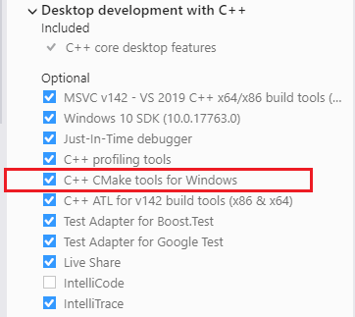
Visual Studio with CMake
Install C++ CMake tools for Windows
Or search “cmake” and install

Slide 10
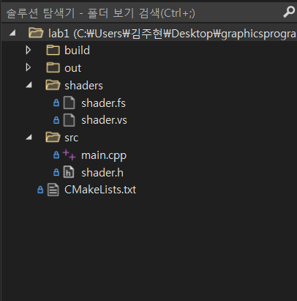
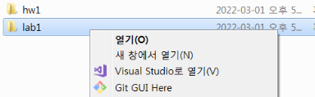
Visual Studio with CMake
Right click folder and click open at Visual Studio

Slide 11
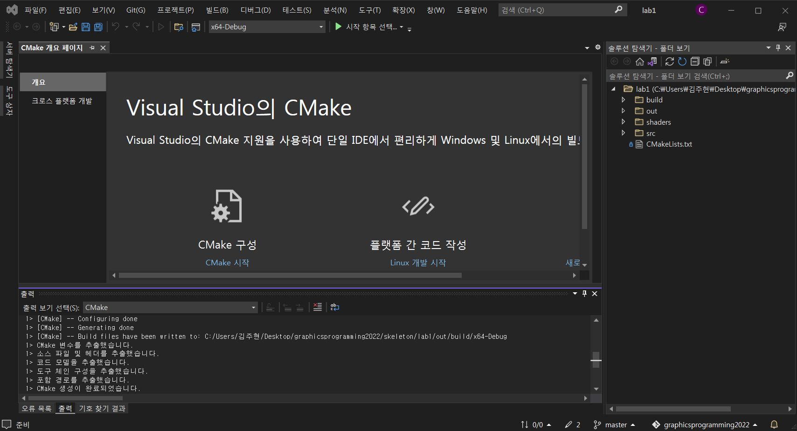
Visual studio will automatically perform CMake

Slide 12

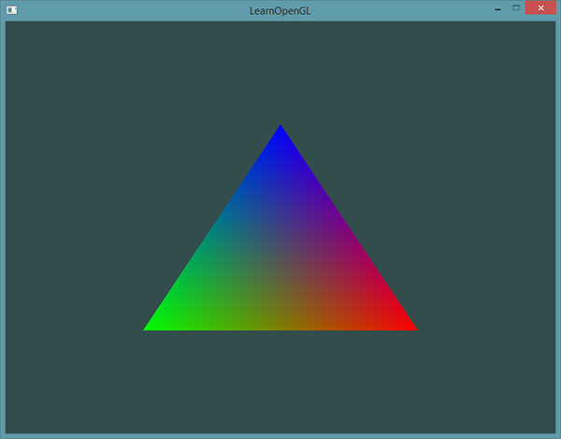
Setting up Visual Studio
All settings finished.
Press ctrl+F5
Make sure that your project setting is applied to the build config.
if a triangle below is drawn when you run the lab1 code, then your setting is correct.

Slide 13
Setting up for Linux
mkdir build
cd build
cmake ../
make
./main
if a triangle below is drawn when you run the lab1 code, then your setting is correct.

Slide 14
Graphics Pipeline
Shaders
enable programmers to design the rendering pipeline
GPU
We can control the shaders only
Vertex
Shader
Fragment
Shader
Rasterizer
3D data
screen
Calculate coordinates
3D → 2D
Calculate pixels

Slide 15
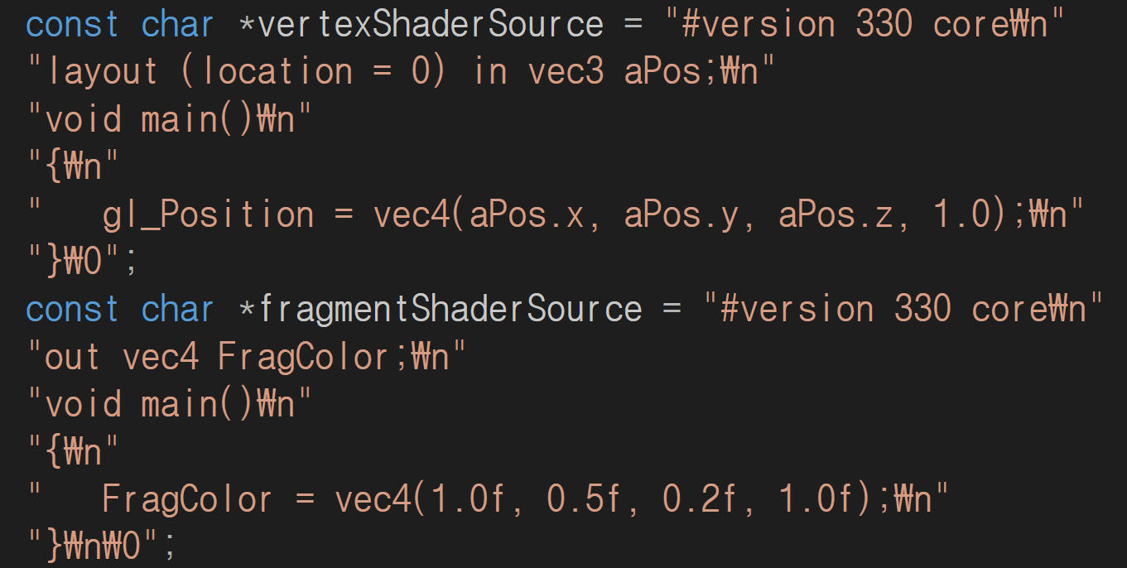
Drawing a triangle - simple shader program
Homogeneous coordinates
Red
Green
Blue
Alpha
code: https://learnopengl.com/Getting-started/Hello-Triangle

Slide 16
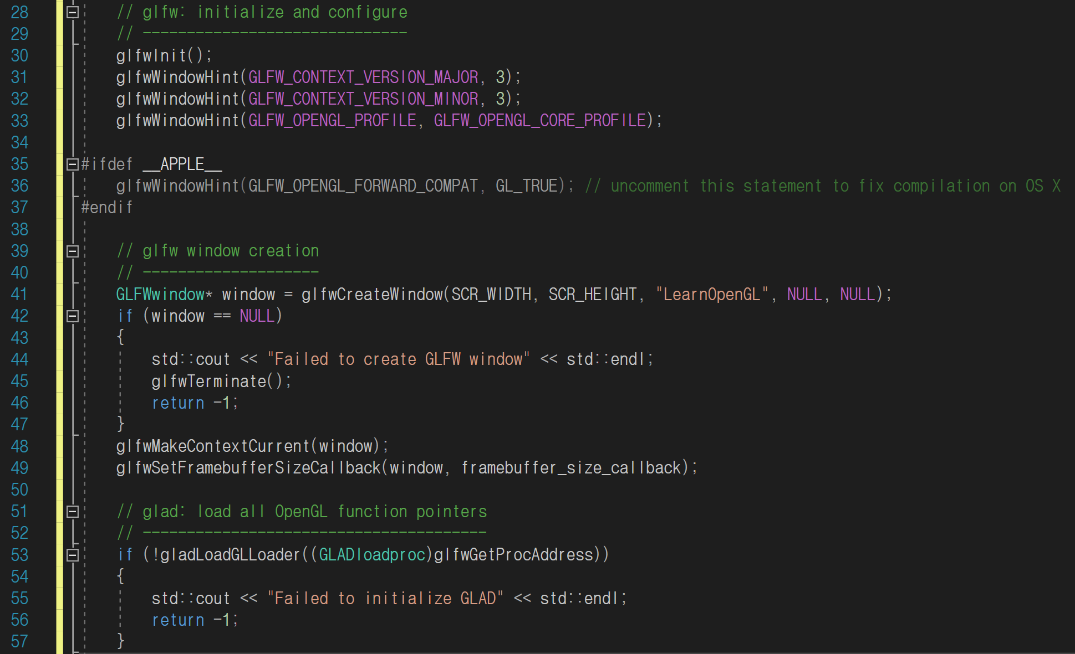
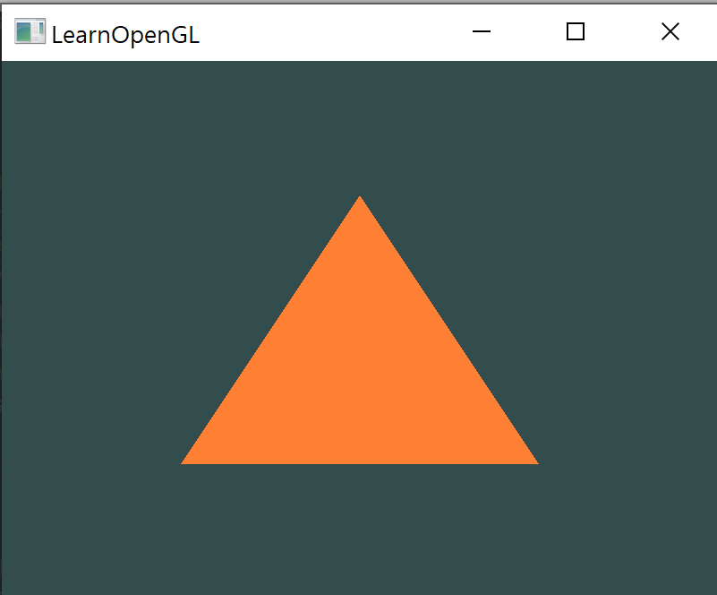
Drawing a triangle – initializing
Specify the ver. (3.3, core)
*Homogeneous coordinates
Red
Green
Blue
Alpha
called each time the window is resized
code: https://learnopengl.com/Getting-started/Hello-Triangle

Slide 17
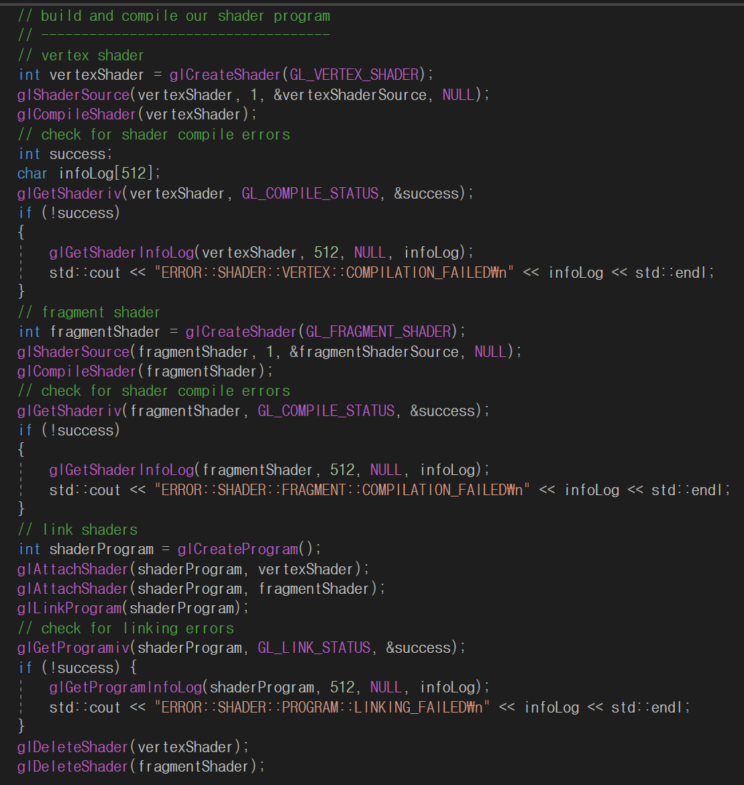
Drawing a triangle – build shader program
Compiling a
vertex shader
Compiling a
fragment shader
Linking shaders

Slide 18
Drawing a triangle – VAO & VBO
3D data
vertex coordinates, colors, normal vectors, texture coordinates…
difficult to handle
VAO(Vertex Array Object) & VBO(Vertex Buffer Object)
make handling 3d data easy
VAO includes vertex attribute pointers
VBO includes real data

Slide 19
Drawing a triangle – VAO & VBO
VAO
VBO 1 (Coordinates)
x1 y1 z1
x2 y2 z2
x3 y3 z3
Attribute Pointer 0
Attribute Pointer 1
VBO 2 (Colors)
Attribute Pointer 2
r1 g1 b1
r2 g2 b2
r3 g3 b3
VBO 3 (Normal Vectors of each vertices)
…
nx1 ny2 nz3
nx2 ny2 nz2
nx3 ny3 nz3
…
Attribute Pointer 15

Slide 20
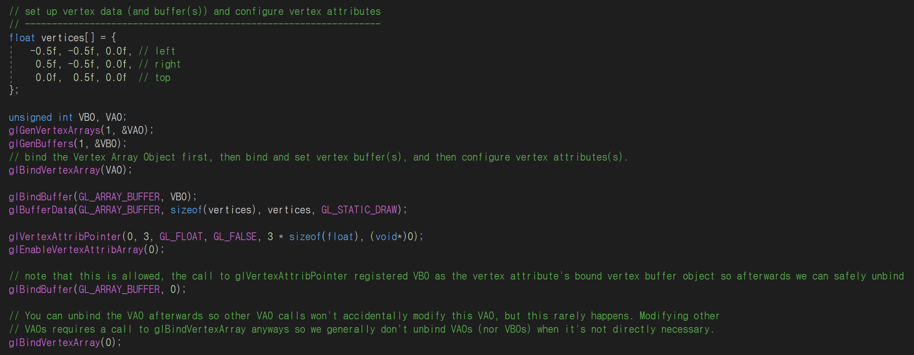
Drawing a triangle – VAO & VBO
Generate a VAO and a VBO
Bind the VAO
Bind and copy data in the VBO
Set the vertex attribute pointers and enable it
Unbind the VBO
Unbind the VAO
code: https://learnopengl.com/Getting-started/Hello-Triangle

Slide 21
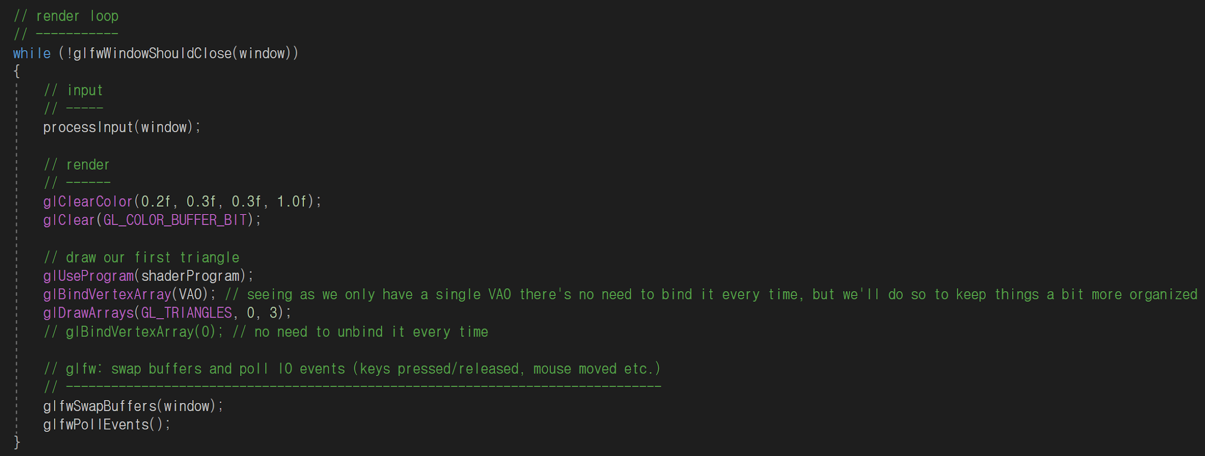
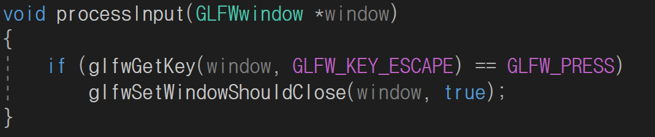
Drawing a triangle – rendering loop
Infinite loop
Make background
Draw a triangle using shaders
code: https://learnopengl.com/Getting-started/Hello-Triangle

Slide 22
More on Shaders
Little programs that rest on the GPU
Written in the C-like language GLSL
GPU
We can control the shaders only
Vertex
Shader
Fragment
Shader
Rasterizer
3D data
screen
Calculate coordinates
3D → 2D
Calculate pixels

Slide 23
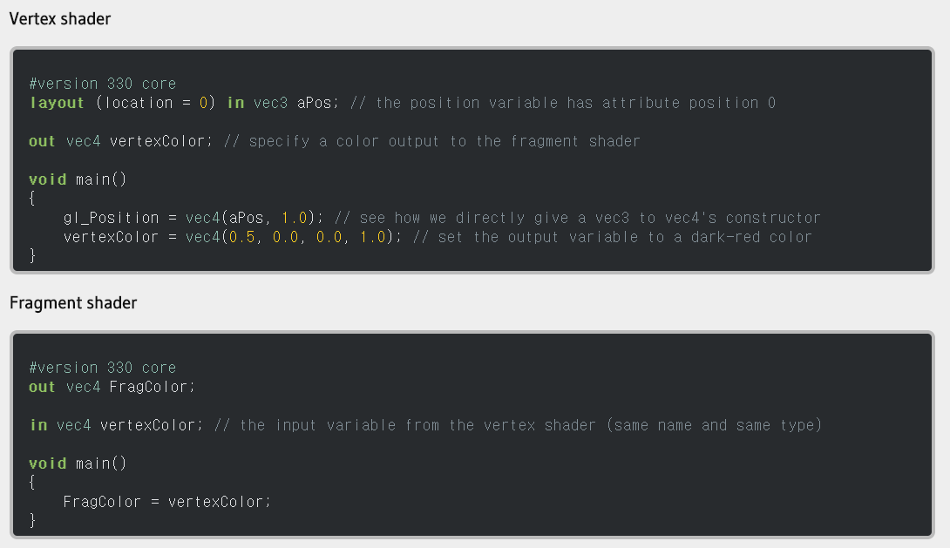
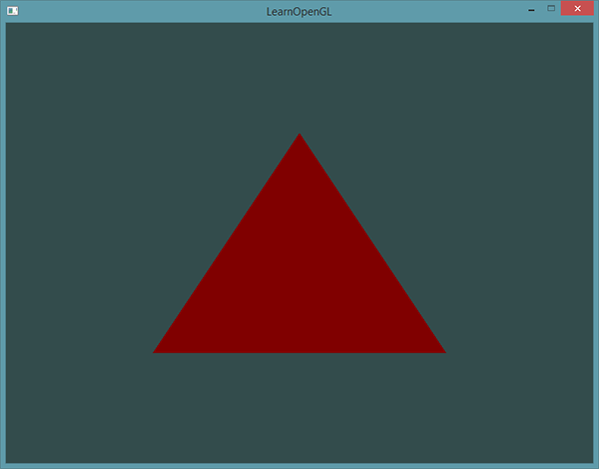
Vertex Shader & Fragment Shader
Output
code: https://learnopengl.com/Getting-started/Shaders

Slide 24
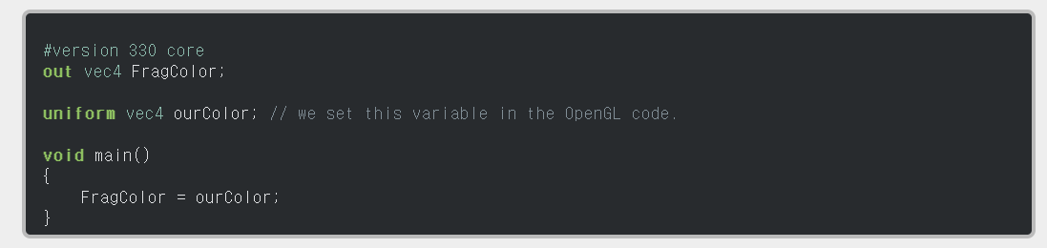

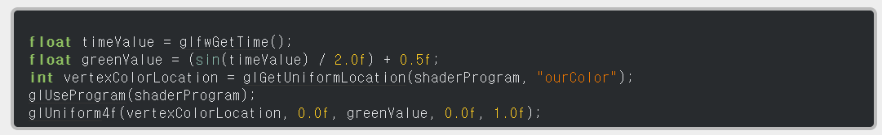
Uniform Variable
Pass data from our application on the CPU to the shaders on the GPU
Declare ‘ourColor’ uniform variable
Output
(Triangle color changes as time passes)
Fragment Shader
Upload ‘ourColor’ uniform variable
main.cpp
code: https://learnopengl.com/Getting-started/Shaders

Slide 25
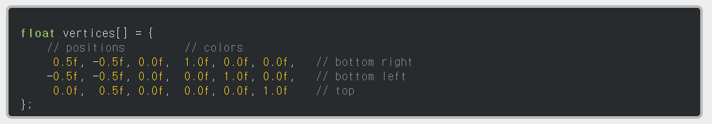
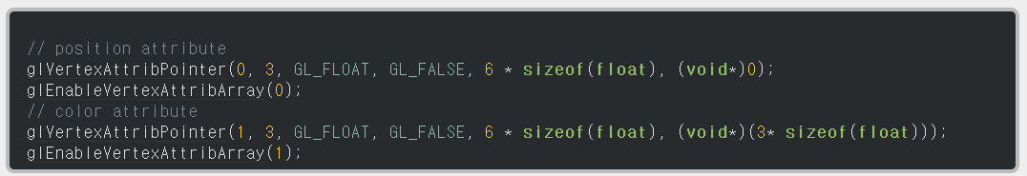
More Attributes
Data with position and colors
Declare ‘ourColor’ uniform variable
Set attrib pointer
Upload ‘ourColor’ uniform variable
Vertex shader with more input
code: https://learnopengl.com/Getting-started/Shaders

Slide 26
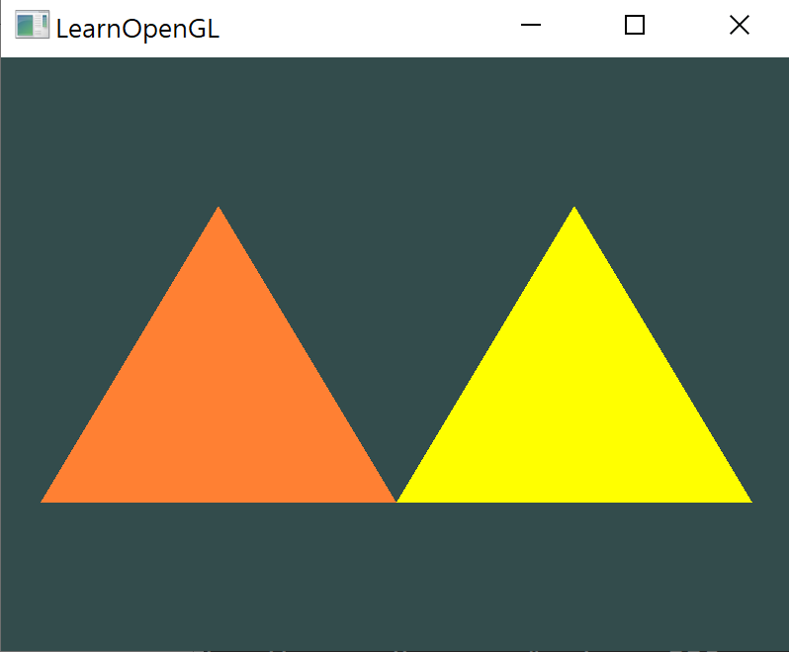
Today’s Goal
output:
We give LearnOpenGL code as a skeleton code.
Your goal: Draw two triangles with different colors.
You can use multiple VAO/VBOs, or use uniform variable.
Positions of vertices and colors are not specified. Draw what you want!
Example:
Instead of LearnOpenGL, write your Student ID and Name here!!!!
e.g) 2022-12345 Hong Gil Dong
Submit only screenshot like left on ETL until 3/14 11:59PM. It will be graded by on/off policy.

