Slide 1




Windows front-end
Linux back-end
1 App
Demo: Using Docker Swarm to run a Windows+Linux mixed-OS ‘containerized’ application
Kallie Bracken, Program Manager, Windows Container Networking

Slide 2
Part 1: Initializing the swarm cluster
Part 2: Setting up the “hello” application
Part 3: Scaling and load balancing using NGINX
Demo: Using Docker Swarm to run a Windows+Linux mixed-OS ‘containerized’ application
Kallie Bracken, Program Manager, Windows Container Networking

Slide 3
1 Application
= 2 Services – ‘web’ frontend and ‘db’ backend
- ‘web’ is a Windows/IIS service
- ‘db’ is a Linux/Redis service
Overview
Defined/managed using containers and Docker Swarm
Frontend Service: ‘web’
Backend Service: ‘db’
Container
‘web.1’
Container
‘db.1’
1 Application

Slide 4
1 Application
= 2 Services – ‘web’ frontend and ‘db’ backend
- ‘web’ is a Windows/IIS service
- ‘db’ is a Linux/Redis service
Overview
Defined/managed using containers and Docker Swarm
Frontend Service: ‘web’
Backend Service: ‘db’
Container
‘web.1’
Container
‘db.1’
What is Docker Swarm?
1 Application

Slide 5
1 Application
= 2 Services – ‘web’ frontend and ‘db’ backend
- ‘web’ is a Windows/IIS service
- ‘db’ is a Linux/Redis service
Overview
Defined/managed using containers and Docker Swarm
Frontend Service: ‘web’
Backend Service: ‘db’
Container
‘web.1’
Container
‘db.1’
1 Application

Slide 6
1 Application
= 2 Services – ‘web’ frontend and ‘db’ backend
- ‘web’ is a Windows/IIS service
- ‘db’ is a Linux/Redis service
Overview
Defined/managed using containers and Docker Swarm
Frontend Service: ‘web’
Backend Service: ‘db’
Container
‘web.1’
Container
‘web.3’
Container
‘db.1’
Container
‘web.2’
1 Application

Slide 7
Infrastructure view…
The Setup

Slide 8
Infrastructure view…
Container hosts
The Setup

Slide 9
Infrastructure view…
Physical hosts
2 Windows hosts
The Setup
Host 1 (Windows)
Host 2 (Windows)

Slide 10
Infrastructure view…
Container hosts
2 Windows hosts
1 Linux host
The Setup
Host 1 (Windows)
Host 2 (Windows)
Host 3 (Linux)

Slide 11
Infrastructure view…
Container hosts
2 Windows hosts
1 Linux host
Same network
The Setup
Host 1 (Windows)
Host 2 (Windows)
Host 3 (Linux)

Slide 12
Infrastructure view…
Container hosts
2 Windows hosts
1 Linux host
Same network
The Setup
Application
Host 1 (Windows)
Host 2 (Windows)
Host 3 (Linux)
Frontend Service: ‘web’
Backend Service: ‘db’

Slide 13
Infrastructure view…
Container hosts
2 Windows hosts
1 Linux host
Same network
The Setup
Application
‘web’ service (Windows containers)
Host 1 (Windows)
Host 2 (Windows)
Host 3 (Linux)
Frontend Service: ‘web’
Backend Service: ‘db’
Container
‘web.1’
Container
‘web.3’
Container
‘web.2’

Slide 14

Infrastructure view…
Container hosts
2 Windows hosts
1 Linux host
Same network
The Setup
Application
‘web’ service (Windows containers)
‘db’ service (Linux Redis container)
Host 1 (Windows)
Host 2 (Windows)
Host 3 (Linux)
Frontend Service: ‘web’
Backend Service: ‘db’
Container
‘web.1’
Container
‘web.3’
Container
‘web.2’
Container
‘db.1’

Slide 15
Infrastructure view…
Container hosts
2 Windows hosts
1 Linux host
Same network
The Setup
Application
‘web’ service (Windows containers)
‘db’ service (Linux Redis container)
‘hello_net’ overlay network
Host 1 (Windows)
Host 2 (Windows)
Host 3 (Linux)
Frontend Service: ‘web’
Backend Service: ‘db’
Container
‘web.1’
Container
‘web.3’
Container
‘web.2’
Container
‘db.1’
Overlay network: ‘hello_net’

Slide 16
That’s the setup!
Let’s make it happen…
(i.e. The deployment steps…)

Slide 17
Set up the swarm cluster…
Initialize swarm manager node
Join swarm worker nodes
Label hosts

Slide 18
Host 1 (Windows)
Host 2 (Windows)
Host 3 (Linux)

Slide 19
Host 1: “kallie1”
Host 2: “kallie2”
Host 3: “kallie4ubuntu”

Slide 20
Host 1: “kallie1”
Host 2: “kallie2”
Host 3: “kallie4ubuntu”
172.17.0.19
172.17.0.13
172.17.0.15

Slide 21
Initialize swarm manager node
C:\> docker swarm init --advertise-addr=172.17.0.19 --listen-addr=172.17.0.19:2377
Swarm Manager
Host 1: “kallie1”
Host 2: “kallie2”
Host 3: “kallie4ubuntu”
172.17.0.19
172.17.0.13
172.17.0.15

Slide 22
Join swarm worker nodes
C:\> docker swarm join --token <WORKER JOIN TOKEN> 172.17.0.19:2377
<WORKER JOIN TOKEN> = SWMTKN-1-65dci8xcj0zqhvkldrmyve80u36t9yd4bokwitwvejm5qq06mn-e9e087w3jvylt1o73y3r9r7i1
Host 1: “kallie1”
Host 2: “kallie2”
Host 3: “kallie4ubuntu”
172.17.0.19
172.17.0.13
172.17.0.15

Slide 23
Join swarm worker nodes
C:\> docker swarm join --token <WORKER JOIN TOKEN> 172.17.0.19:2377
<WORKER JOIN TOKEN> = SWMTKN-1-65dci8xcj0zqhvkldrmyve80u36t9yd4bokwitwvejm5qq06mn-e9e087w3jvylt1o73y3r9r7i1
Host 1: “kallie1”
Host 2: “kallie2”
Host 3: “kallie4ubuntu”
172.17.0.19
172.17.0.13
172.17.0.15

Slide 24
Join swarm worker nodes
C:\> docker swarm join --token <WORKER JOIN TOKEN> 172.17.0.19:2377
<WORKER JOIN TOKEN> = SWMTKN-1-65dci8xcj0zqhvkldrmyve80u36t9yd4bokwitwvejm5qq06mn-e9e087w3jvylt1o73y3r9r7i1
Host 1: “kallie1”
Host 2: “kallie2”
Host 3: “kallie4ubuntu”
172.17.0.19
172.17.0.13
172.17.0.15

Slide 25
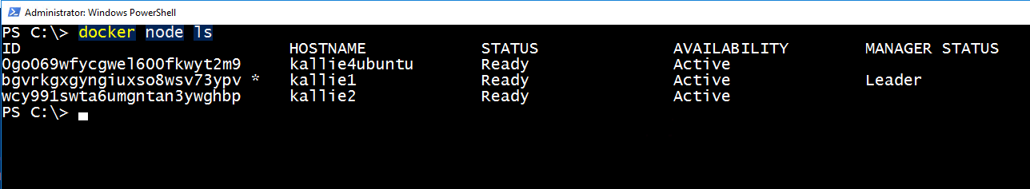
Join swarm worker nodes
C:\> docker swarm join --token <WORKER JOIN TOKEN> 172.17.0.19:2377
<WORKER JOIN TOKEN> = SWMTKN-1-65dci8xcj0zqhvkldrmyve80u36t9yd4bokwitwvejm5qq06mn-e9e087w3jvylt1o73y3r9r7i1
Host 1: “kallie1”
Host 2: “kallie2”
Host 3: “kallie4ubuntu”
172.17.0.19
172.17.0.13
172.17.0.15

Slide 26
Label hosts
C:\> docker node update --label-add os=windows kallie1
os=windows
Host 1: “kallie1”
Host 2: “kallie2”
Host 3: “kallie4ubuntu”
172.17.0.19
172.17.0.13
172.17.0.15

Slide 27
Label hosts
C:\> docker node update --label-add os=windows kallie1
C:\> docker node update --label-add os=windows kallie2
os=windows
os=windows
Host 1: “kallie1”
Host 2: “kallie2”
Host 3: “kallie4ubuntu”
172.17.0.19
172.17.0.13
172.17.0.15

Slide 28
Label hosts
C:\> docker node update --label-add os=windows kallie1
C:\> docker node update --label-add os=windows kallie2
C:\> docker node update --label-add os=linux kallie4ubuntu
os=windows
os=windows
os=linux
Host 1: “kallie1”
Host 2: “kallie2”
Host 3: “kallie4ubuntu”
172.17.0.19
172.17.0.13
172.17.0.15

Slide 29
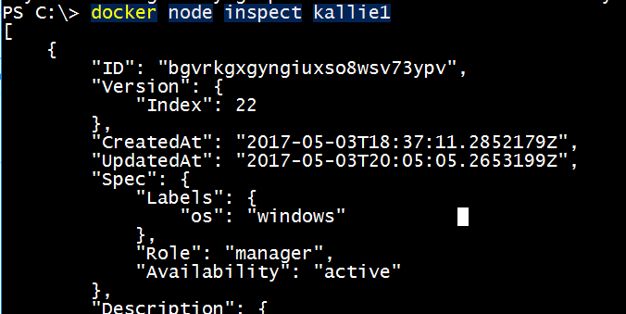
Label hosts
C:\> docker node update --label-add os=windows kallie1
C:\> docker node update --label-add os=windows kallie2
C:\> docker node update --label-add os=linux kallie4ubuntu
os=windows
os=windows
os=linux
Host 1: “kallie1”
Host 2: “kallie2”
Host 3: “kallie4ubuntu”
172.17.0.19
172.17.0.13
172.17.0.15

Slide 30
Set up the “hello” app…
Create application overlay network
Create “db” and “web” services

Slide 31
Create application overlay network
C:\> docker network create -d overlay hello_net
os=windows
os=windows
os=linux
Host 1: “kallie1”
Host 2: “kallie2”
Host 3: “kallie4ubuntu”
Overlay network: ‘hello_net’
172.17.0.19
172.17.0.13
172.17.0.15

Slide 32
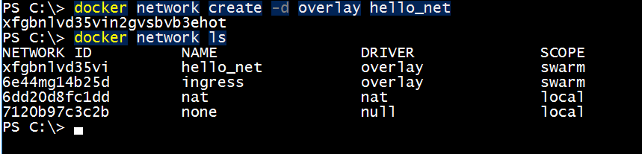
Create application overlay network
C:\> docker network create -d overlay hello_net
os=windows
os=windows
os=linux
Host 1: “kallie1”
Host 2: “kallie2”
Host 3: “kallie4ubuntu”
Overlay network: ‘hello_net’
172.17.0.19
172.17.0.13
172.17.0.15

Slide 33
Create “db” and “web” services
C:\> docker service create --name db --endpoint-mode dnsrr --network hello_net
--constraint 'node.labels.os==linux' redis:alpine
os=windows
os=windows
os=linux
Host 1: “kallie1”
Host 2: “kallie2”
Host 3: “kallie4ubuntu”
Backend Service: ‘db’
Container
‘db.1’
Overlay network: ‘hello_net’
172.17.0.19
172.17.0.13
172.17.0.15
Notes:
docker service create --name db --endpoint-mode dnsrr --network hello_net --constraint 'node.labels.os==linux' redis:alpine

Slide 34
Create “db” and “web” services
C:\> docker service create --name web --endpoint-mode dnsrr
--publish mode=host,target=8000 --network hello_net
--constraint 'node.labels.os==windows' hello-count-web-plus
os=windows
os=windows
os=linux
Host 1: “kallie1”
Host 2: “kallie2”
Host 3: “kallie4ubuntu”
Frontend Service: ‘web’
Backend Service: ‘db’
Container
‘web.1’
Container
‘db.1’
Overlay network: ‘hello_net’
172.17.0.19
172.17.0.13
172.17.0.15
Notes:
docker service create --name web --endpoint-mode dnsrr --publish mode=host,target=8000 --network hello_net --constraint 'node.labels.os==windows' hello-count-web

Slide 35
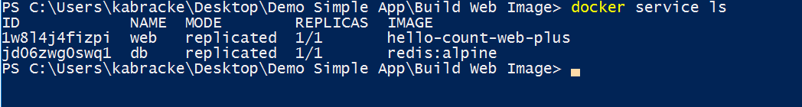
Create “db” and “web” services
C:\> docker service create --name web --endpoint-mode dnsrr
--publish mode=host,target=8000 --network hello_net
--constraint 'node.labels.os==windows' hello-count-web
os=windows
os=windows
os=linux
Host 1: “kallie1”
Host 2: “kallie2”
Host 3: “kallie4ubuntu”
Frontend Service: ‘web’
Backend Service: ‘db’
Container
‘web.1’
Container
‘db.1’
Overlay network: ‘hello_net’
172.17.0.19
172.17.0.13
172.17.0.15

Slide 36
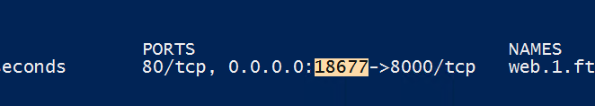
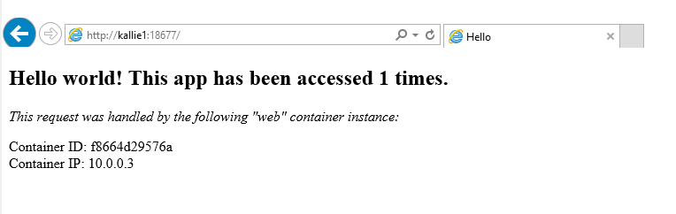
Let’s view the “hello” application ☺

Slide 37
Bonus: Scale the “hello” app…
Scale the “web” service
Use an external load balancer to access app

Slide 38
Scale “web” service
C:\> docker service scale web=3
os=windows
os=windows
os=linux
Host 1: “kallie1”
Host 2: “kallie2”
Host 3: “kallie4ubuntu”
Frontend Service: ‘web’
Backend Service: ‘db’
Container
‘web.1’
Container
‘web.3’
Container
‘web.2’
Container
‘db.1’
Overlay network: ‘hello_net’
172.17.0.19
172.17.0.13
172.17.0.15

Slide 39
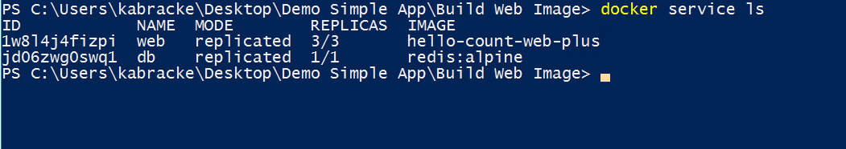
Scale “web” service
C:\> docker service scale web=3
os=windows
os=windows
os=linux
Host 1: “kallie1”
Host 2: “kallie2”
Host 3: “kallie4ubuntu”
Frontend Service: ‘web’
Backend Service: ‘db’
Container
‘web.1’
Container
‘web.3’
Container
‘web.2’
Container
‘db.1’
Overlay network: ‘hello_net’
172.17.0.19
172.17.0.13
172.17.0.15

Slide 40
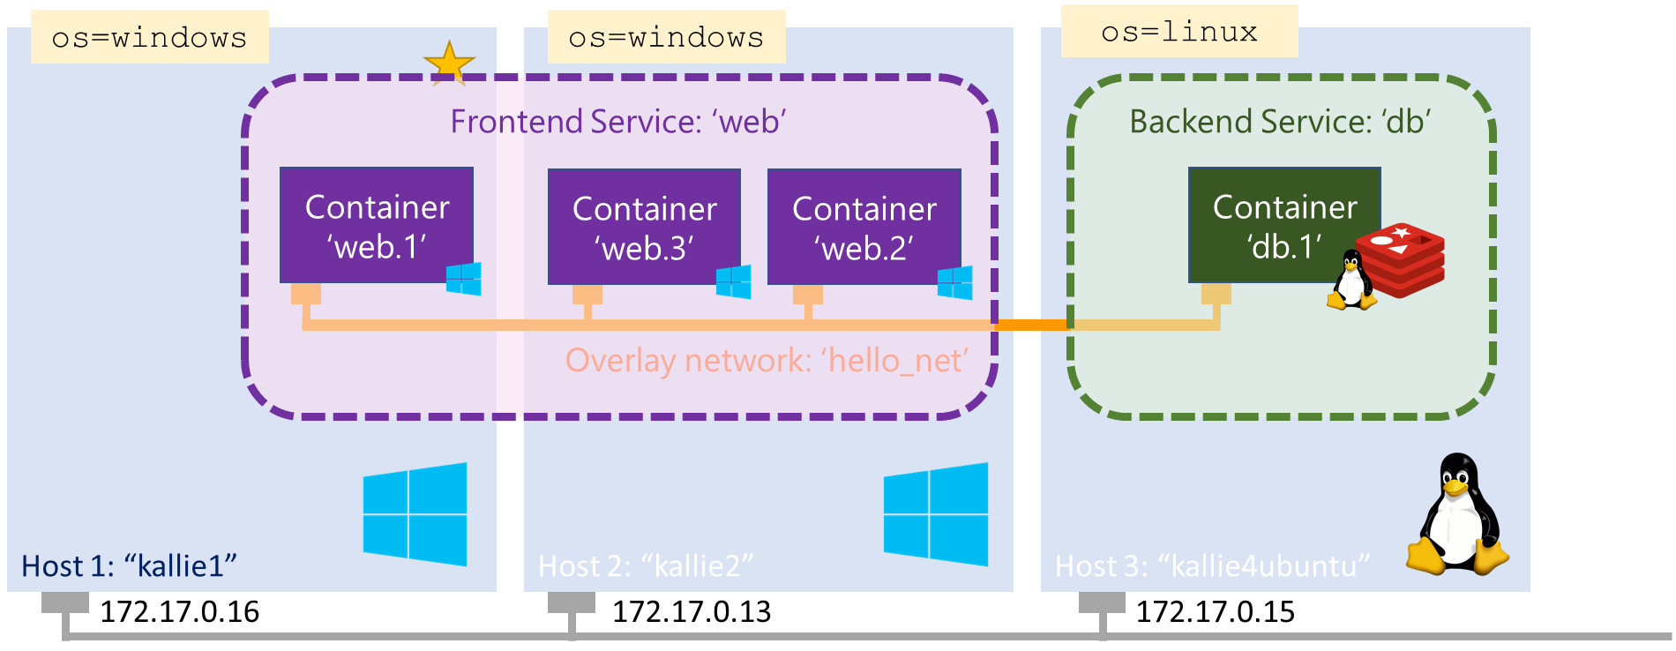
Scale “web” service
But how to access the “web” instances?

Slide 41

Host 4: “kallie3”
But how to access the “web” instances?
… An NGINX external load balancer ☺
Container
‘nginx’
172.17.0.14

Slide 42
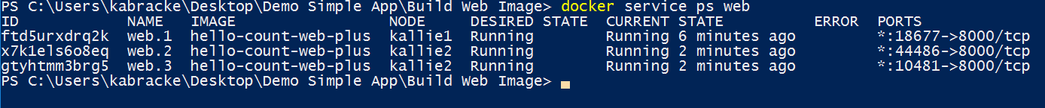
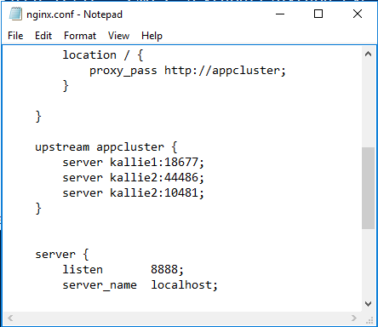
Host 4: “kallie3”
But how to access the “web” instances?
… An NGINX external load balancer ☺
Container
‘nginx’
172.17.0.14

Slide 43
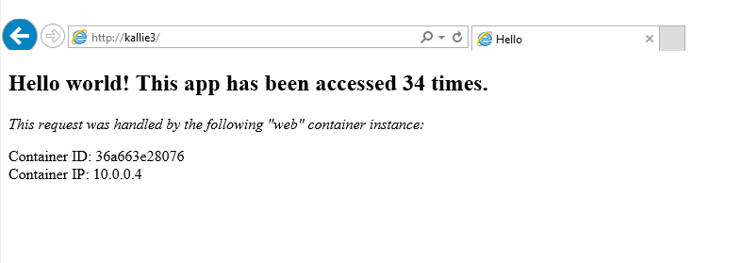
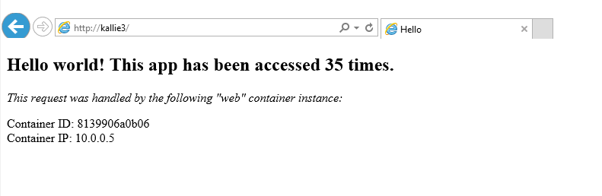
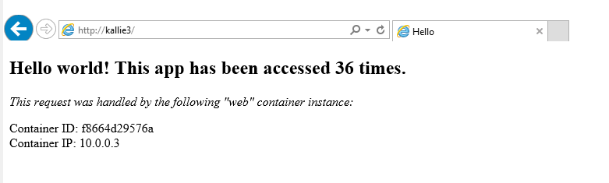
Let’s view the “hello” application ☺
This time we’re viewing via the NGINX load balancer running on “kallie3:80”
Notice the container ID/IP change as requests are routed to different tasks…

