Slide 1
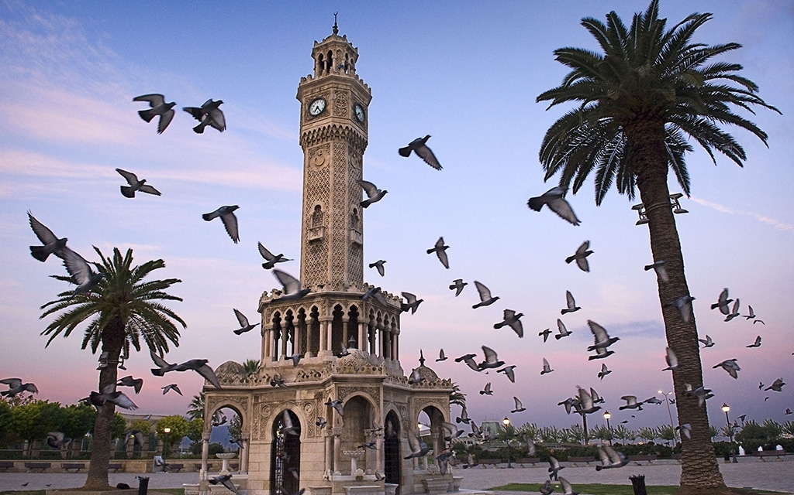
Prediction Potential Areas For Investment By Analyzing Venues Data And Sales Price Of Houses Sold Data
Onur Çakı

Slide 2
İzmir
3th most populous city in Turkey.
4th most populous city in Mediterranean Sea.
Izmir Alsancak Port
Primary port of Turkey for exports.
The biggest container port of Turkey
The intersection of industry, agriculture, and tourism
World’s second fastest growing metropolitan economy
House rents increase most recently:

Slide 3
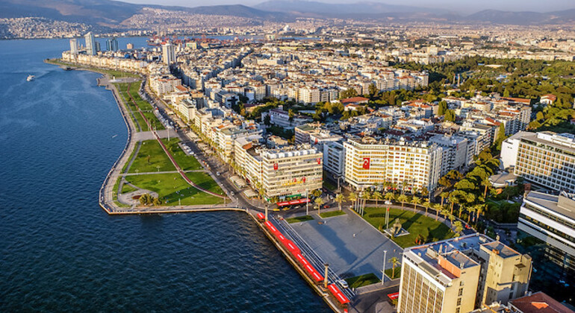
Izmir consist of 11 urban districts
Balcova, Bayrakli, Bornova, Buca, Cigli, Gaziemir, Guzelbahce, Karabaglar, Karsiyaka, Konak, and Narlidere
And additionally 19 rural districts
Aliaga, Bayindir, Bergama, Beydag, Cesme, Dikili, Foca, Karaburun, Kemalpasa, Kinik, Kiraz, Menderes, Menemen, Odemis, Seferihisar, Selcuk, Tire, Torbalı, Urla

Slide 4
Data
Longitude and latitude coordinates of the center of boroughs.
An open-source API: https://github.com/melihkorkmaz/il-ilce-mahalle-geolocation-rest-api
Retrieved by URL queries
The most common venues with their features in boroughs are retrieved from Foursquare API through URL query
https://developer.foursquare.com/
Retrieved by URL queries
The average sales price of houses sold in Izmir are taken from Endeksa that is one of the most popular property price index companies in Turkey.
https://www.endeksa.com/en/analiz/izmir/endeks/for-sale/house
The boundary of boroughs of Izmir are retrieved from Second-level Administrative Divisions of the Turkey from Spatial Data Repository of NYU.
The data of Izmir was parsed from all geojson files.
https://geo.nyu.edu/catalog/stanford-nj696zj1674

Slide 5
Methodology
Retrieve
Geolocation of Boroughs
Retrieve Venues in R=Radius With limit
Calculate Feature Vectors
mean of the frequency of occurrence of each category
Drop
non-discriminative features.
Feedback R
Feedback Feature
Feedback K
Analysis labeled Boroughs and house price
Analysis and
Evaluation of Clusters
Based on prior knowledge
K-mean
Clustering
Recommendation
Idea
Cluster boroughs based on venues that they have.
Compare clusters with the average sales price of houses sold.

Slide 6
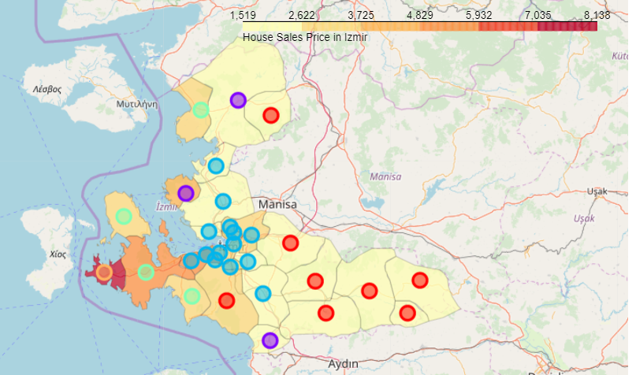
Analyzing Data
Cluster 0 → red label
Cluster 1 → purple label
Cluster 2 → blue label
Cluster 3 → green label
Cluster 4 → orange label
NOTE:
Cluster 4 → Cesme → Outlier:
fifth most expensive district of Turkey.
There are villas of the richest men of Turkey and ultra-luxury hotels.

Slide 7
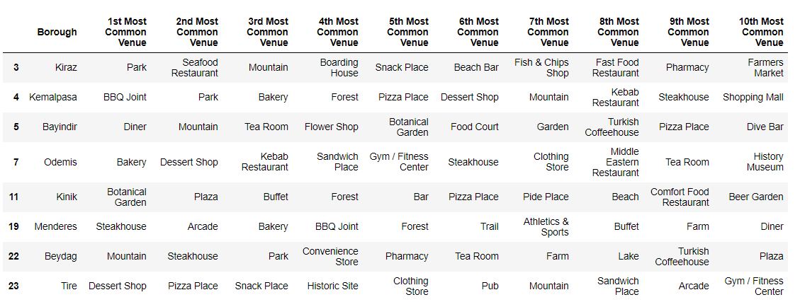
Cluster 0- Rural Boroughs

Slide 8
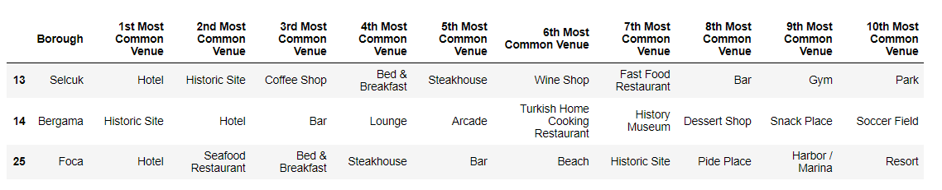
Cluster 1
Dominated by Hotels and Historic sites.
Many tourists come to Izmir to visit Selcuk and Bergama every year.
Ephesus Ancient City, House of Virgin Mary, Pergamon Ancient City in Bergama, …

Slide 9
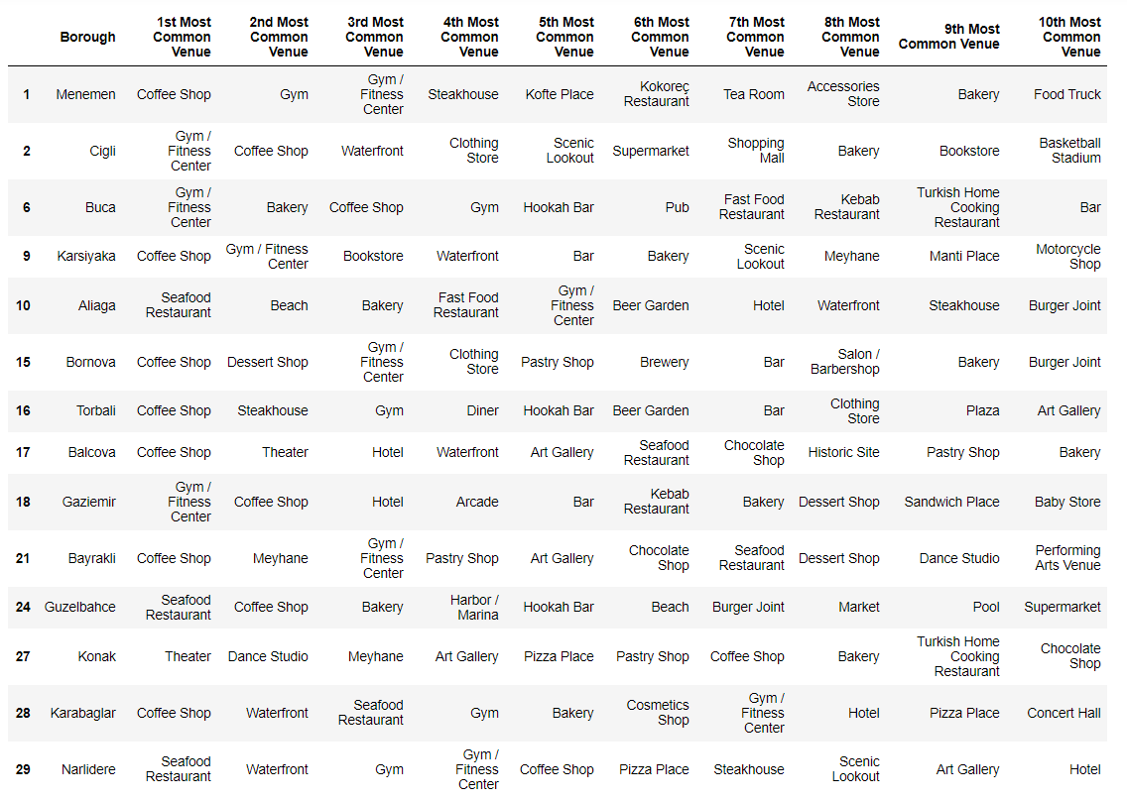
Cluster 2 – Urban Boroughs

Slide 10
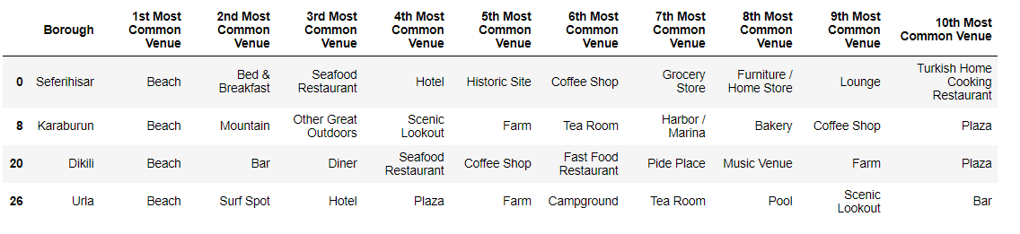
Cluster 3
Popular coastal holiday towns of Izmir in this cluster.
Intertwined with nature and sea
Many number of bars, beaches, hotels as well as farms, mountains.

Slide 11
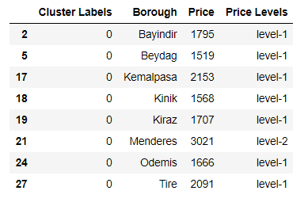
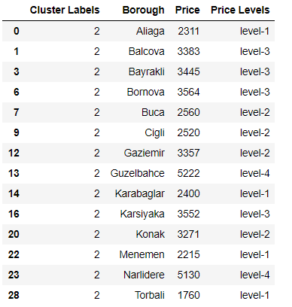
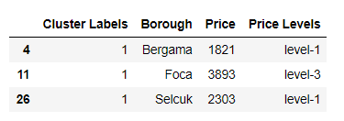

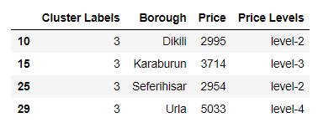
Divide Price into price-levels, Merge Cluster Labels, Price And Price Level

Slide 12
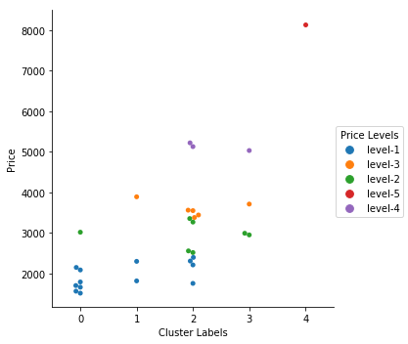
Results and Discussion
Cesme (Cluster 4) is outlier
Cluster 1: Selcuk and Bergama can be a great opportunity for investment.
similar to Foca
far cheaper than Foca.
two boroughs have beach although not as popular as Foca.
Cluster-2: Aliaga, Cigli, Buca may be a profitable investment
Cluster 3: Urla is one of the most valuable boroughs not only of Izmir but in Turkey.
Karaburun, Dikili, and Seferhisar are affordable despite their similarity to Urla.

Slide 13
Conclusion
In this project, I demonstrated a method to predict the best areas for investors or for those who think to buy a new home. In this method, boroughs were clustered by k-means algorithm based on venues that they have. Then, cluster labels were compared to house-prices. By analyzing both data, one can recommend the areas may have the potential to invest. This method can be developed by contributing other data sets into venues. Because many factors can affect boroughs similarity. Especially, urban boroughs need more features to be distinguished. Thereby, more accurate results can be obtained.

