Slide 1
Code_Legends Teamwork

Slide 2

Catch-up

Slide 3


Slide 4
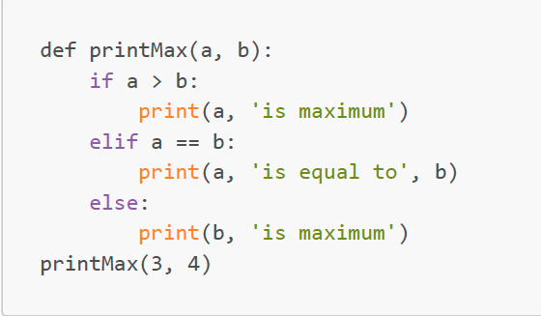
1. What will be the output of the following Python code?
A. 3
B. 4
C. 4 is maximum
D. 3 is maximum

Slide 5
1. What will be the output of the following Python code?
A. 3
B. 4
C. 4 is maximum
D. 3 is maximum

Slide 6
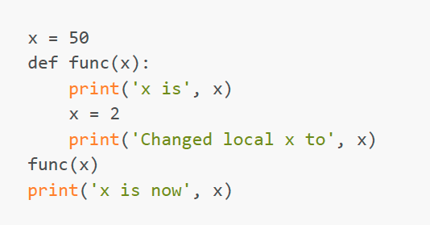
2. What is the output of the following program?
A. x is 50
Changed local x to 2
x is now 50
B. x is 50
Changed local x to 2
x is now 2
C. x is 50
Changed local x to 2
x is now 100
D. None of the mentioned

Slide 7
2. What is the output of the following program?
A. x is 50
Changed local x to 2
x is now 50
B. x is 50
Changed local x to 2
x is now 2
C. x is 50
Changed local x to 2
x is now 100
D. None of the mentioned

Slide 8
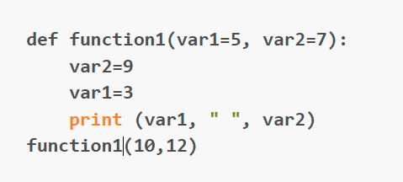
3. What will be the output of the following Python code snippet?
A. 5 7
B. 3 9
C. 10 12
D. error

Slide 9
3. What will be the output of the following Python code snippet?
A. 5 7
B. 3 9
C. 10 12
D. error

Slide 10
4. What is the purpose of the “def” keyword in Python?
A. It is slang that means "the following code is really cool"
B. It indicates the start of a function
C. It indicates that the following indented section of code is to be stored for later
D. b and c are both true

Slide 11
4. What is the purpose of the “def” keyword in Python?
A. It is slang that means "the following code is really cool"
B. It indicates the start of a function
C. It indicates that the following indented section of code is to be stored for later
D. b and c are both true

Slide 12
5. A computer that enables resource sharing by other computers on the same network.
A. Host
B. Throughput
C. RG-58
D. Core

Slide 13
5. A computer that enables resource sharing by other computers on the same network.
A. Host
B. Throughput
C. RG-58
D. Core

Slide 14
Throughput
Throughput refers to how much data can be transferred from one location to another in a given amount of time. It is used to measure the performance of hard drives and RAM, as well as Internet and network connections.

Slide 15
RG-58
RG-58 is a coaxial cable that is used for wiring purposes.

Slide 16
Core
Core network is the central element of a network that provides services to customers who are connected by the access network.

Slide 17
6. Which piece of hardware would reduce the size of a broadcast domain?
A. Hub
B. Router
C. Packet injector
D. Switch

Slide 18
6. Which piece of hardware would reduce the size of a broadcast domain?
A. Hub
B. Router
C. Packet injector
D. Switch

Slide 19
Hub
A hub is a physical layer networking device which is used to connect multiple devices in a network. They are generally used to connect computers in a LAN.

Slide 20
Packet Injection
Packet injection is one way hackers try to disrupt or intercept packets from already established network connections.
The way they do this is by injecting their own packets into the data stream. The packets injected by the hacker will appear as normal packets. This causes malicious activity to be overlooked and ignored.

Slide 21
Switch
Switches are networking devices operating at layer 2 or a data link layer of the OSI model. They connect devices in a network and use packet switching to send, receive or forward data packets or data frames over the network. A switch has many ports, to which computers are plugged in

Slide 22
7. What is the purpose of the OSI model?
A. Enable users to access the internet
B. Improve the network performance by compressing data
C. To provide a set of standards for manufacturers
D. Make network devices such as a router, switch, hub communicate with each other

Slide 23
7. What is the purpose of the OSI model?
A. Enable users to access the internet
B. Improve the network performance by compressing data
C. To provide a set of standards for manufacturers
D. Make network devices such as a router, switch, hub communicate with each other

Slide 24
8. 1,000,000,000 bits per second is nearly
A. 1 gigabit per second(Gbps)
B. 1 megabit per second(Mbps)
C. 1 kilobit per second(Kbps)
D. 1 terabit per second(Tbps)

Slide 25
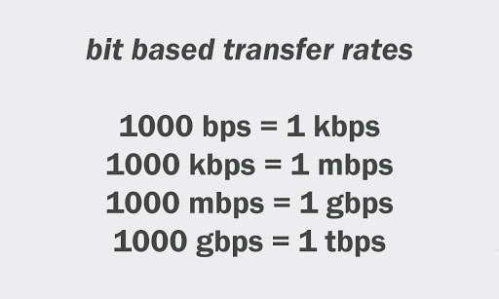
8. 1,000,000,000 bits per second is nearly

Slide 26
8. 1,000,000,000 bits per second is nearly
A. 1 gigabit per second(Gbps)
B. 1 megabit per second(Mbps)
C. 1 kilobit per second(Kbps)
D. 1 terabit per second(Tbps)

Slide 27
9. The seventh layer of the OSI model. This layer's protocols enable software programs to negotiate formatting, procedural, security, synchronization, and other requirements with the network.
A. Transmission Media
B. Session Layer
C. Application Layer
D. Physical Layer

Slide 28
9. The seventh layer of the OSI model. This layer's protocols enable software programs to negotiate formatting, procedural, security, synchronization, and other requirements with the network.
A. Transmission Media
B. Session Layer
C. Application Layer
D. Physical Layer

Slide 29
Transmission Media
Transmission media is a communication channel that carries the information from the sender to the receiver. Data is transmitted through the electromagnetic signals.
The main functionality of the transmission media is to carry the information in the form of bits through LAN(Local Area Network).

Slide 30
Session Layer
The Session Layer is the 5th layer in the OSI model. This layer allows users on different machines to establish active communications sessions between them. It is responsible for establishing, maintaining, synchronizing, terminating sessions between end-user applications.

Slide 31
Physical Layer
The physical layer is the lowest layer.
This layer provides mechanical, electrical and other functional aids available to enable or disable, they maintain and transmit bits about physical connections.
This may for example be electrical signals, optical signals (optical fiber, laser), electromagnetic waves (wireless networks) or sound.

Slide 32
10. “It is any device that can connect to a network. It can be used to describe endpoint devices, such as computers, laptops, servers, IP phones, smartphones, or printers, and connecting or forwarding devices, such as switches and routers.” Which of the following is described?
A. Node
B. Workstation
C. Server
D. Segment

Slide 33
Workstation
A workstation is a computer intended for individual use that is faster and more capable than a personal computer.
They're simply personal computers attached to a local area network (LAN) that in turn shares the resources of one or more large computers.

Slide 34
Server
A server is a computer that serves information to other computers. These computers, called clients, can connect to a server through either a local area network or a wide area network, such as the internet.

Slide 35
Segment
Network segmentation is a network security technique that divides a network into smaller, distinct sub-networks that enable network teams to compartmentalize the sub-networks and deliver unique security controls and services to each sub-network.

Slide 36
10. “It is any device that can connect to a network. It can be used to describe endpoint devices, such as computers, laptops, servers, IP phones, smartphones, or printers, and connecting or forwarding devices, such as switches and routers.” Which of the following is described?
A. Node
B. Workstation
C. Server
D. Segment

Slide 37
11. A type of transmission in which signals may travel in both directions over a medium simultaneously.
A. Flow Control
B. Half-duplex
C. Full-duplex
D. Convergence

Slide 38
11. A type of transmission in which signals may travel in both directions over a medium simultaneously.
A. Flow Control
B. Half-duplex
C. Full-duplex
D. Convergence

Slide 39
Flow control
Flow control is the management of data flow between computers or devices or between nodes in a network so that the data can be handled at an efficient pace. Too much data arriving before a device can handle it causes data overflow, meaning the data is either lost or must be retransmitted.

Slide 40
Half-duplex
Half-duplex data transmission means that data can be transmitted in both directions on a signal carrier, but not at the same time.

Slide 41
Convergence
Network convergence combines support for multimedia, telephone, and data on a single network.
Network convergence primarily serves large, complex organizations where mobile and Internet connections are regulated behind the same firewalls or sign-on credentials.
With network convergence, registered users access their Internet, Ethernet, Wi-Fi, and mobile connections through a single network that supports everything from email, VoIP, and web browsing to text messaging.

Slide 42
12. Encapsulation is the process of taking data from one protocol and translating it into another protocol, so the data can continue across a network.
A. True
B. False

Slide 43
12. Encapsulation is the process of taking data from one protocol and translating it into another protocol, so the data can continue across a network.
A. True
B. False

Slide 44

Interview Questions

Slide 45
1. What is SQL and What is a Database?
SQL stands for Structured Query Language , and it is used to communicate with the Database.
This is a standard language used to perform tasks such as retrieval, updating, insertion and deletion of data from a database.
Database is nothing but an organized form of data for easy access, storing, retrieval and managing of
data. This is also known as structured form of data which can be accessed in many ways.
Example: School Management Database, Bank Management Database.

Slide 46
2. What do you mean by a table and a field in SQL?
Organized data in the form of rows and columns is said to be a table. Here, rows and columns are referred to as tuples and attributes. The number of columns in a table is referred to as a field. In the record, fields represent the characteristics and attributes.

Slide 47

Video of the week ☺

Slide 48

Full Stack development explained

Slide 49

What is sql?

Slide 50

Retro Meeting on a personal and team level
What went well?
What could be improved?
What will we commit to do better in the next week?

Slide 51

Logical Reasoning questions

