Slide 1
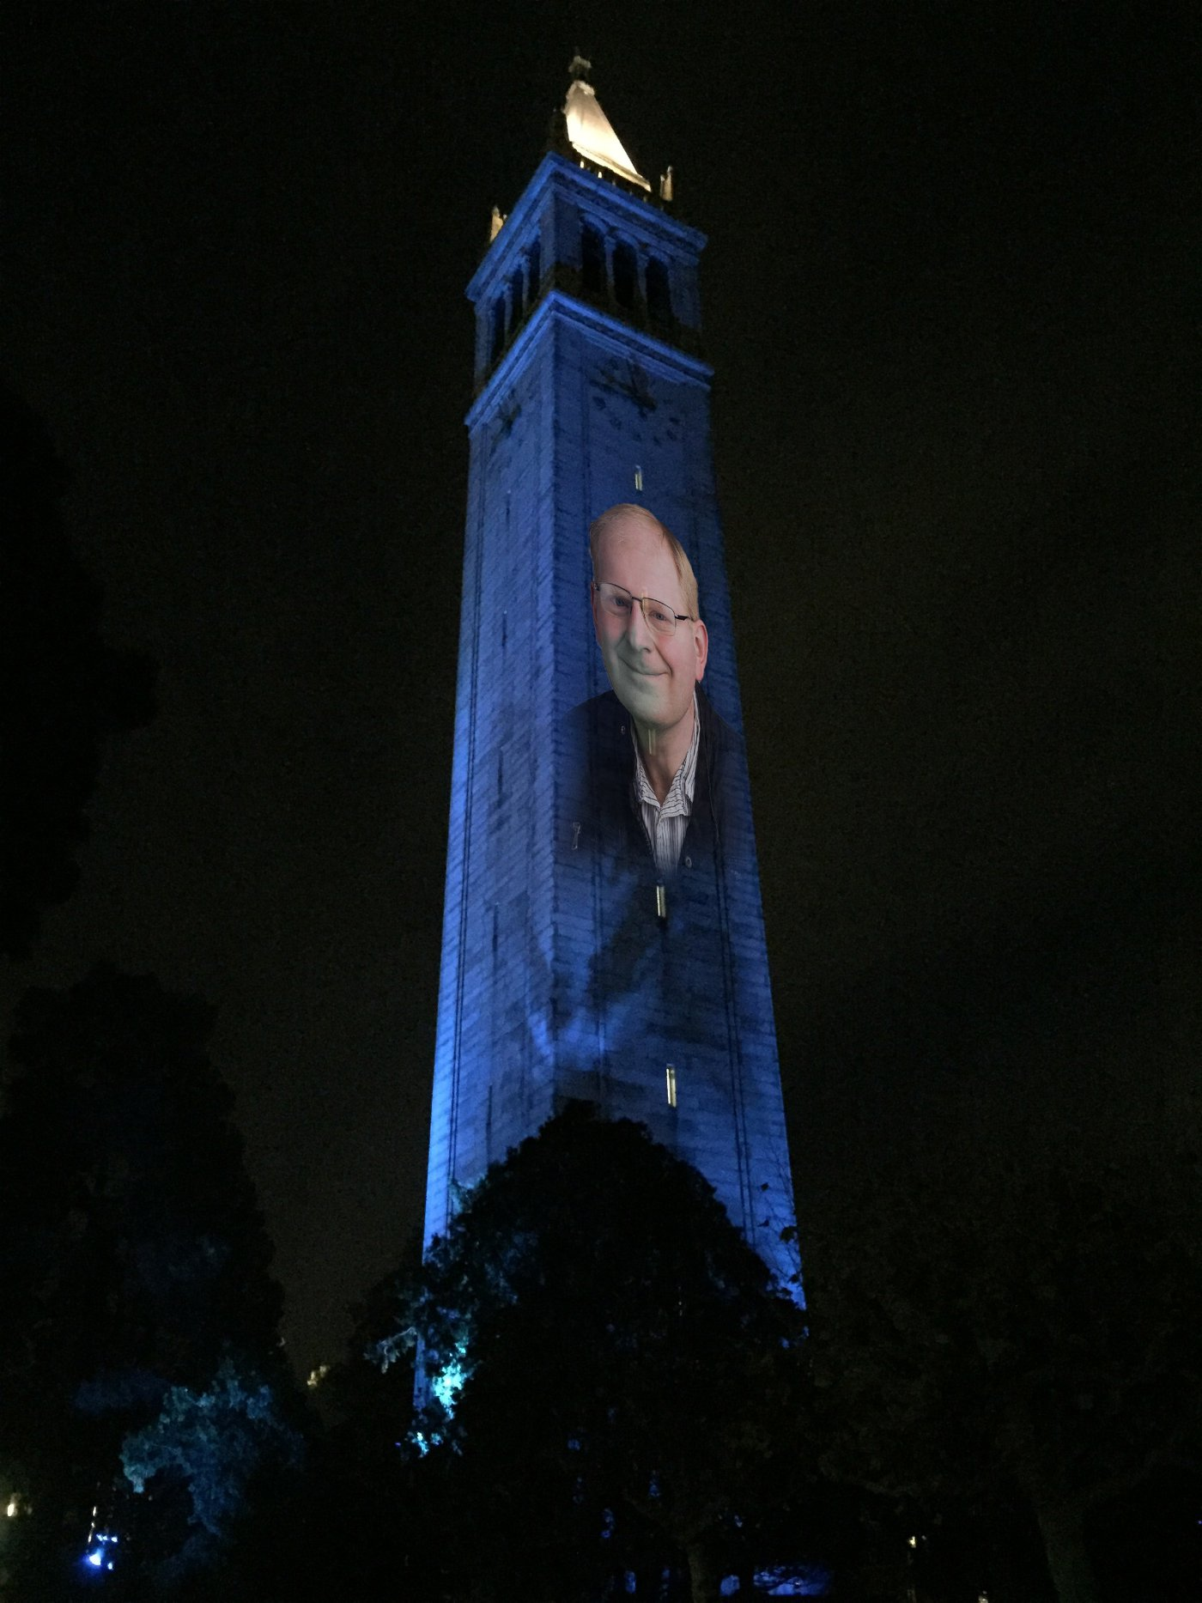
Homographies and Panoramas
with a lot of slides stolen from
Steve Seitz and Rick Szeliski
© Andrew Campbell
CS180: Intro to Computer Vision and Comp. Photo
Alexei Efros & Ren Ng, UC Berkeley, Fall 2026

Slide 2
Our visual world as a set of light rays

Slide 3
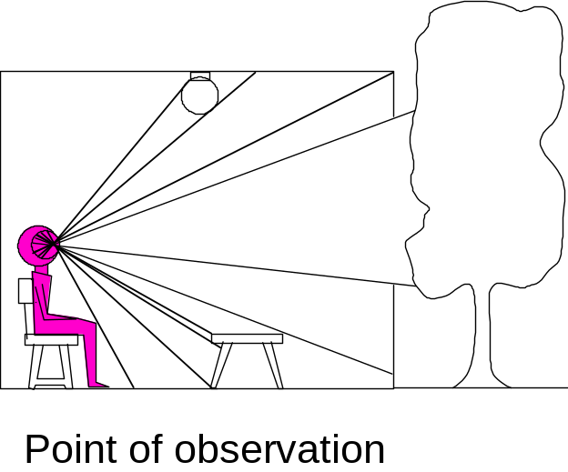
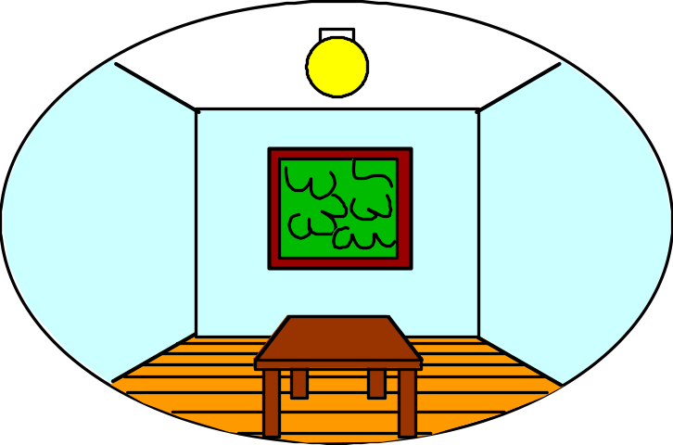
What do we see?
3D world
2D image
Figures © Stephen E. Palmer, 2002

Slide 4
What do we see?
3D world
2D image
Painted
backdrop

Slide 5
On Simulating the Visual Experience
Just feed the eyes the right data
  No one will know the difference!
Philosophy:
  Ancient question: “Does the world really exist?”
Science fiction:
  Many, many, many books on the subject, e.g. slowglass from “Light of Other Days”
  1990s take: The Matrix
Physics:
  Slowglass might be possible?
Computer Science:
  Virtual Reality
To simulate we need to know:
What does a person see?

Slide 6
Thought Exp: Record Every Possible Image
Imagine you want to record every possible image that a person could ever see while exploring this room.
You have unlimited cameras, storage, and time.
What would you need to record? How would you organize all those images so that someone could retrieve any view they wanted?
Think about what variables determine which image you see. Can you make a complete list of variables?
Think (30 sec): think, individually list the variables
Pair (90 sec): compare lists of variables and discuss

Slide 7
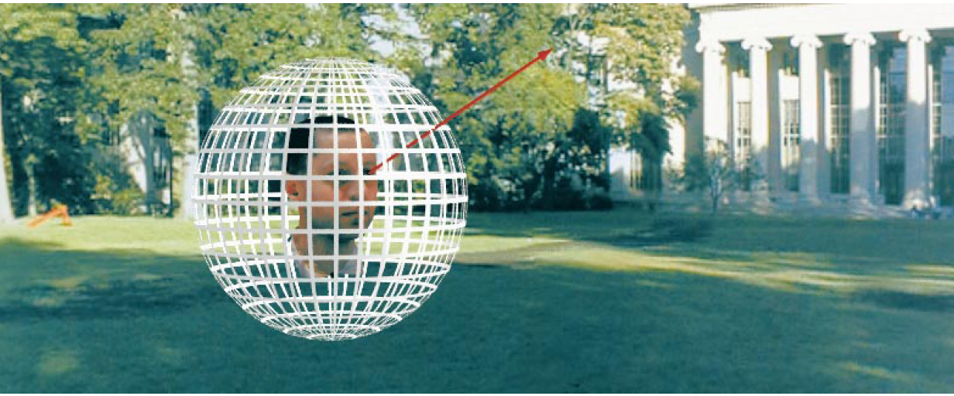
The Plenoptic Function
Figure by Leonard McMillan
Q: What is the set of all things that we can ever see?
A: The Plenoptic Function (Adelson & Bergen)
Let’s start with a stationary person and try to parameterize everything that this person can see…
Notes:
Ted Adelson – whom we saw when we talked about Image Pyramids

Slide 8
Grayscale snapshot
P(θ,φ)
is intensity of light
  Seen from a single view point
  At a single time
  Averaged over the wavelengths of the visible spectrum
(can also do P(x,y), but spherical coordinate are nicer)

Slide 9
Color snapshot
P(θ,φ,λ)
is intensity of light
  Seen from a single view point
  At a single time
  As a function of wavelength

Slide 10
A movie
P(θ,φ,λ,t)
is intensity of light
  Seen from a single view point
  Over time
  As a function of wavelength

Slide 11
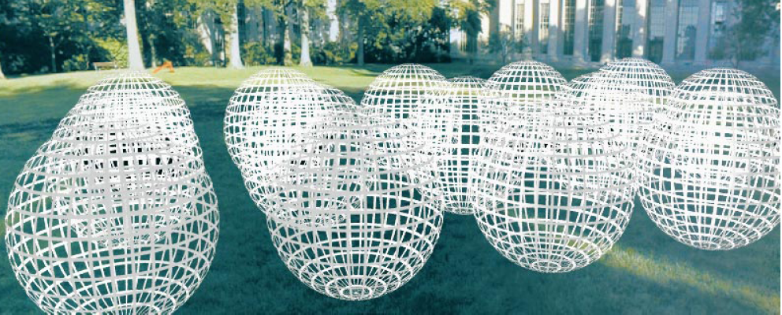
Holographic movie
P(θ,φ,λ,t,V_{X},V_{Y},V_{Z})
is intensity of light
  Seen from ANY viewpoint
  Over time
  As a function of wavelength

Slide 12
The Plenoptic Function
P(θ,φ,λ,t,V_{X},V_{Y},V_{Z})
  Can reconstruct every possible view, at every moment, from every position, at every wavelength
  Contains every photograph, every movie, everything that anyone has ever seen! it completely captures our visual reality! Not bad for a function…

Slide 13
Sampling Plenoptic Function (top view)
Just lookup -- Quicktime VR

Slide 14
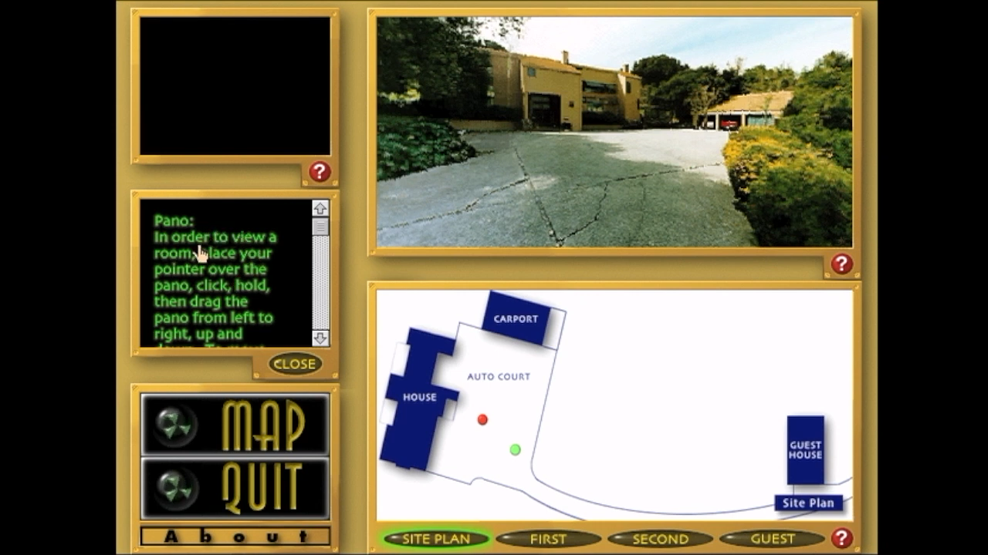
Apple Quicktime VR (1995)

Slide 15
Today: images from a single viewpoint

Slide 16
Plenoptic Function

Slide 17
Images from a single viewpoint

Slide 18
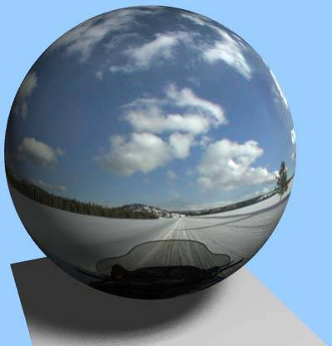

Spherical (“360”) Panorama
All light rays through a point form a ponorama
Totally captured in a 2D array -- P(θ,φ)
Where is the geometry???
Notes:
This is the fundamental idea behind spherical panorama: Normal image (with a transparent skull), nothing more than theta phi, even tho it looks cool

Slide 19
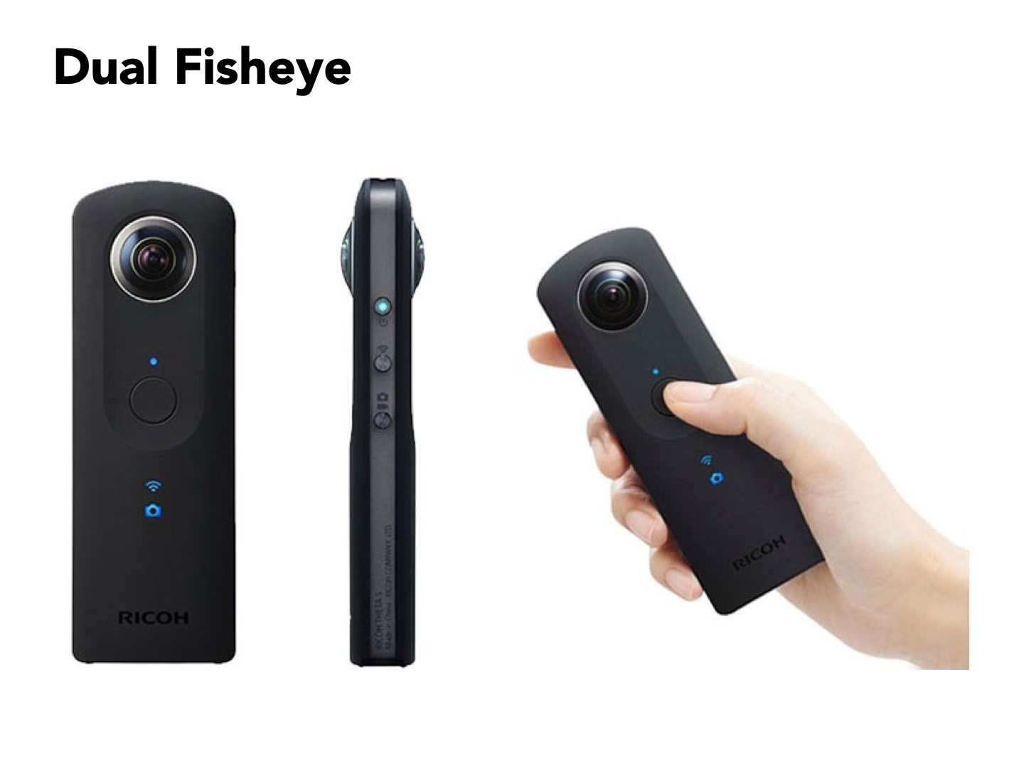
Spherical Imaging – e.g. Dual Fisheye Camera

Slide 20
Spherical Panoramas vs Photographs
A spherical panorama contains all images from a single viewpoint
Slide by Rick Szeliski and Michael Cohen
Notes:
what is the maximum information stored in an image? Even if you had the entire pencil (transparent back of head) all you have is a 2D structure

Slide 21
Spherical Panoramas vs Photographs
One photograph from this viewpoint
Notes:
image is just a subset of the rays from the pencil

Slide 22
Spherical Panoramas vs Photographs
real
camera
synthetic
camera
Can generate any synthetic camera view
as long as it has the same center of projection!

Slide 23
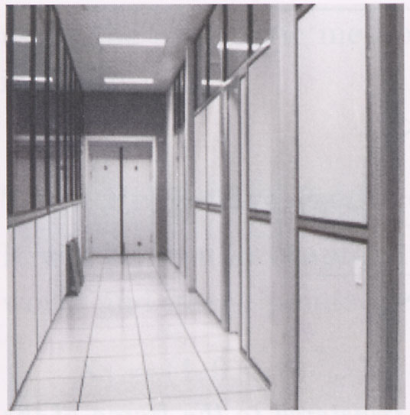
Image reprojection
image plane in front

Slide 24
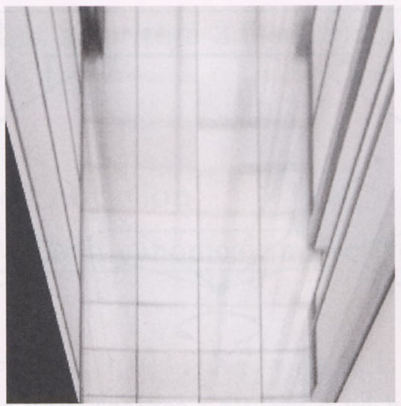
Image reprojection
image plane in front
image plane below
Notes:
Rotated down to look straight down, but there is no pixel data there. (If drawn, it would be all black.) That is why the pixels shown here have more perspective distortion.
A bit of a mind bender

Slide 25
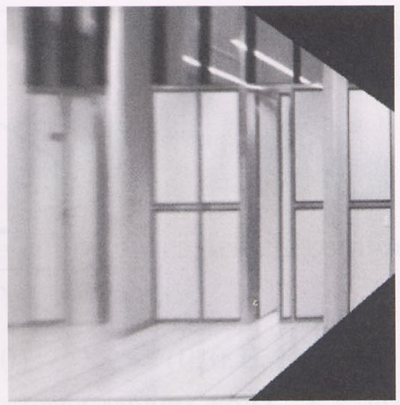
Image reprojection
image plane in front
image plane below
Notes:
Rotated down to look straight down, but there is no pixel data there. (If drawn, it would be all black.) That is why the pixels shown here

Slide 26
Reverse Engineer: Image Reprojection
image plane in front
image plane down
image plane to right
How many input images were needed here?
How would you compute this reprojection?
Think (30 sec): think individually
Pair (90 min): discuss and merge ideas

Slide 27
Image reprojection
Basic question
  How to relate two images from the same camera center?
    how to map a pixel from PP1 to PP2
PP2
Answer
  Cast a ray through each pixel in PP1
  Draw the pixel where that ray intersects PP2
PP1
But don’t we need to know the geometry
of the two planes in respect to the eye?
Observation:
Rather than thinking of this as a 3D reprojection,
think of it as a 2D image warp from one image to another

Slide 28
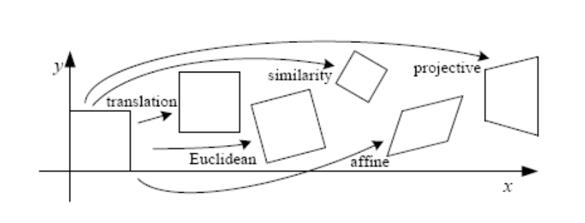
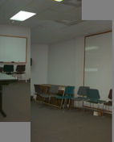
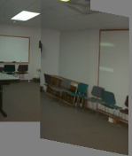
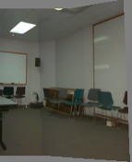
Back to Image Warping
Which t-form is the right one for warping PP1 into PP2?
    e.g. translation, Euclidean, affine, projective
Translation
Affine
Projective
2 unknowns
6 unknowns
8 unknowns

Slide 29
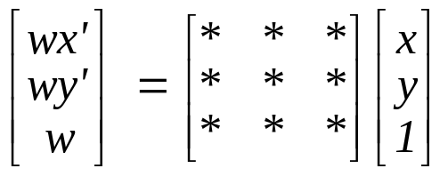
Homography
A: Projective – mapping between any two PPs with the same center of projection
  rectangle should map to arbitrary quadrilateral
  parallel lines aren’t
  but must preserve straight lines
  same as: unproject, rotate, reproject
called Homography
PP2
p’
H
p
PP1
To apply a homography H
  Compute p’ = Hp (regular matrix multiply)
  Convert p’ from homogeneous to image coordinates

Slide 30
This was warping one image with a homography
image plane in front

Slide 31
This was warping one image with a homography
image plane in front
image plane below
black area
where no pixel
maps to
Notes:
Rotated down to look straight down, but there is no pixel data there. (If drawn, it would be all black.) That is why the pixels shown here have more perspective distortion.
A bit of a mind bender

Slide 32
This was warping one image with a homography
image plane in front
image plane below
black area
where no pixel
maps to
Notes:
Rotated down to look straight down, but there is no pixel data there. (If drawn, it would be all black.) That is why the pixels shown here

Slide 33
Implementing image rectification
p’
p
To unwarp (rectify) an image
  Find the homography H given a set of p and p’ pairs
  How many correspondences are needed?
  Tricky to write H analytically, but we can solve for it!
    Find such H that “best” transforms points p into p’
    Use least-squares!

Slide 34
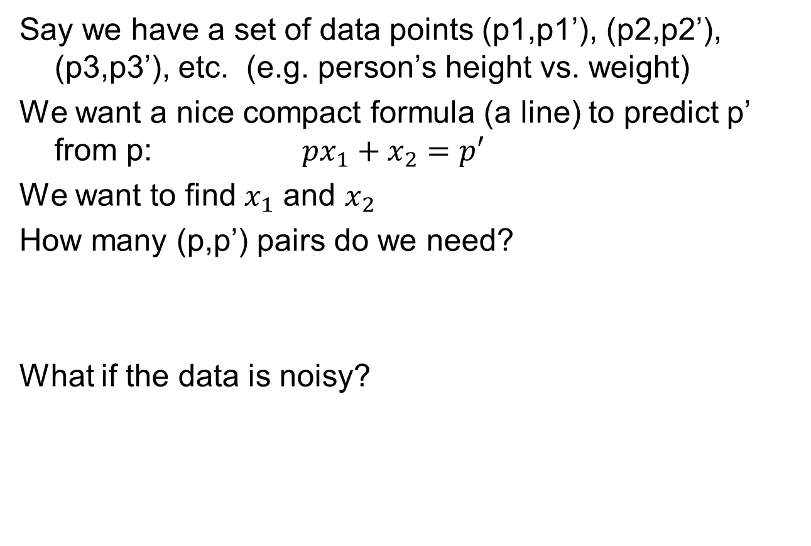
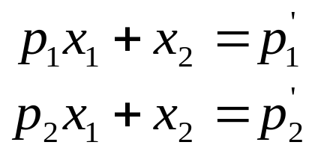
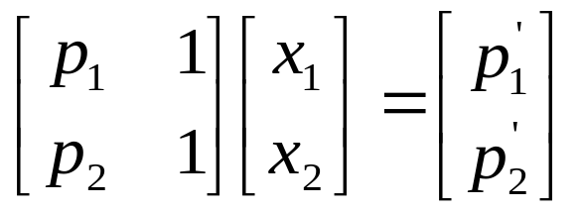
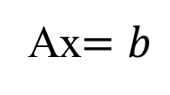
Least Squares Example

Slide 35
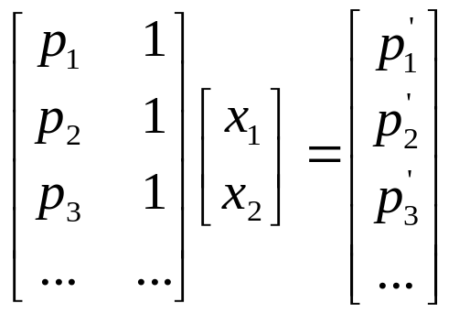
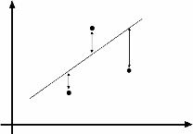
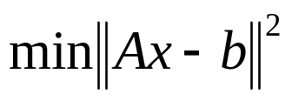
Least Squares Example
overconstrained

Slide 36
Least-Squares
d
Solve:
A x = b
(N,d)(d,1) = (N,1)
Normal equations
A^{T}A x = A^{T}b
(d,N)(N,d)(d,1) = (d,N)(N,1)
Solution:
x = (A^{T}A)⁻¹A^{T}b
A
N
rank(A)≤min(d,N)
assume rank(A)=d
implies rank(A^{T}A)=d
A^{T}A is invertible

Slide 37
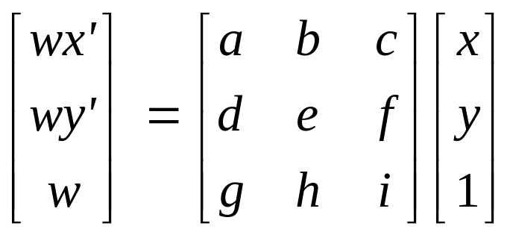
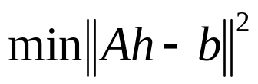
Solving for homographies
p’ = Hp
Can set scale factor i=1. So, there are 8 unkowns.
Set up a system of linear equations:
Ah = b
where vector of unknowns h = [a,b,c,d,e,f,g,h]^{T}
Need at least 8 eqs, but the more the better…
Solve for h. If overconstrained, solve using least-squares:
Can be done in Matlab using “\” command
  see “help lmdivide”

Slide 38
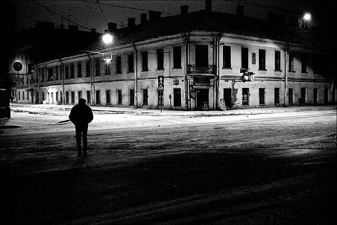
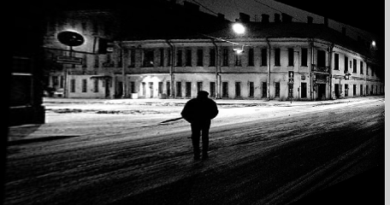
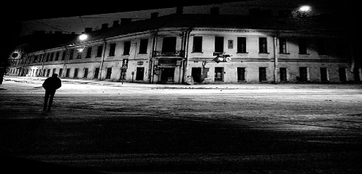
Image rectification
Original image
St.Petersburg
photo by A. Tikhonov
Virtual camera rotation
Notes:
Can we rectify the left or the right halves of the building façade?

Slide 39
Inverse rectification

Slide 40
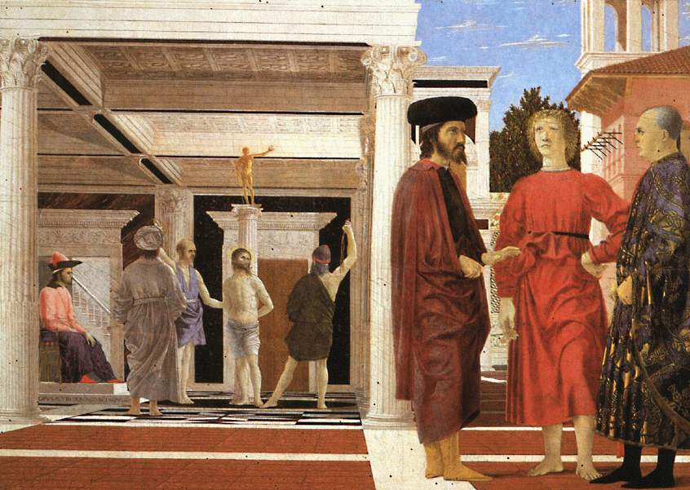
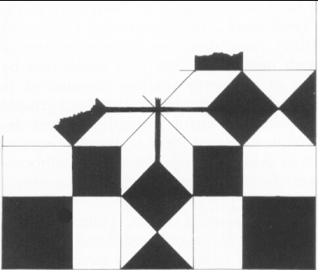

Image Rectification for Art Analysis
From Martin Kemp
The Science of Art
(manual reconstruction)
The floor (enlarged).
What is the shape of the floor pattern?
Slide adapted from Criminisi

Slide 41
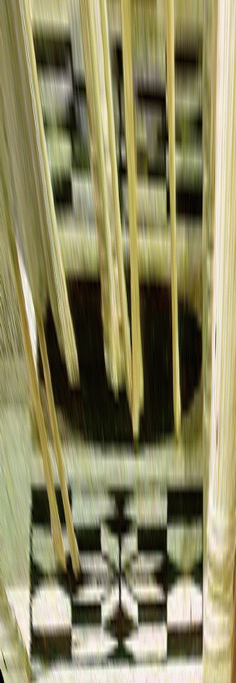
Image Rectification for Art Analysis
The floor (enlarged).
What is the shape of the floor pattern?
Rectified floor
(homography warp)
Slide adapted from Criminisi

Slide 42
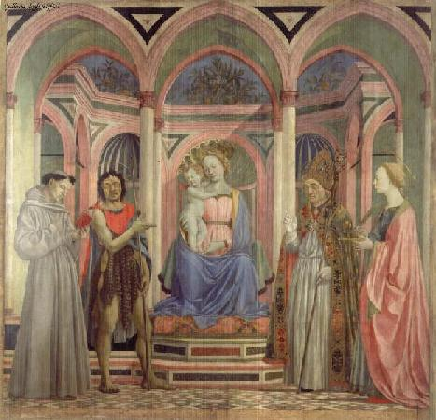
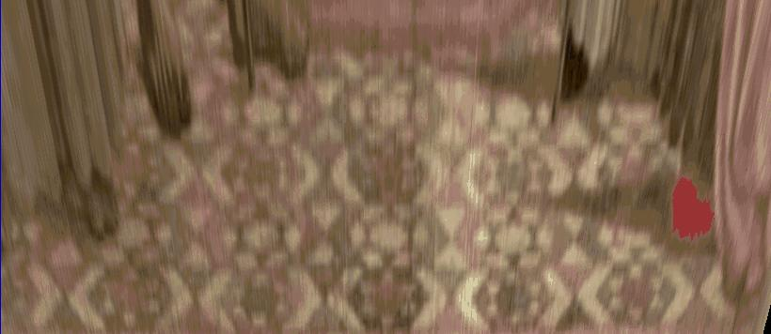
Analysing patterns and shapes
What is the (complicated)
shape of the floor pattern?
Automatically rectified floor
St. Lucy Altarpiece, D. Veneziano
Slide from Criminisi

Slide 43
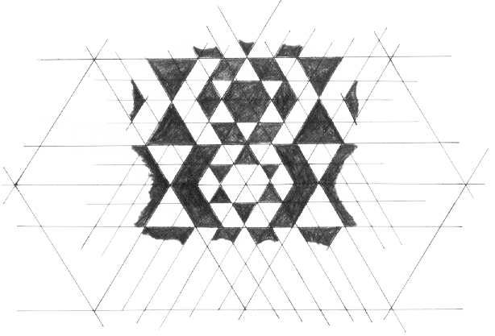
Analysing patterns and shapes
Automatic
rectification
From Martin Kemp, The Science of Art
(manual reconstruction)
Slide from Criminisi

Slide 44
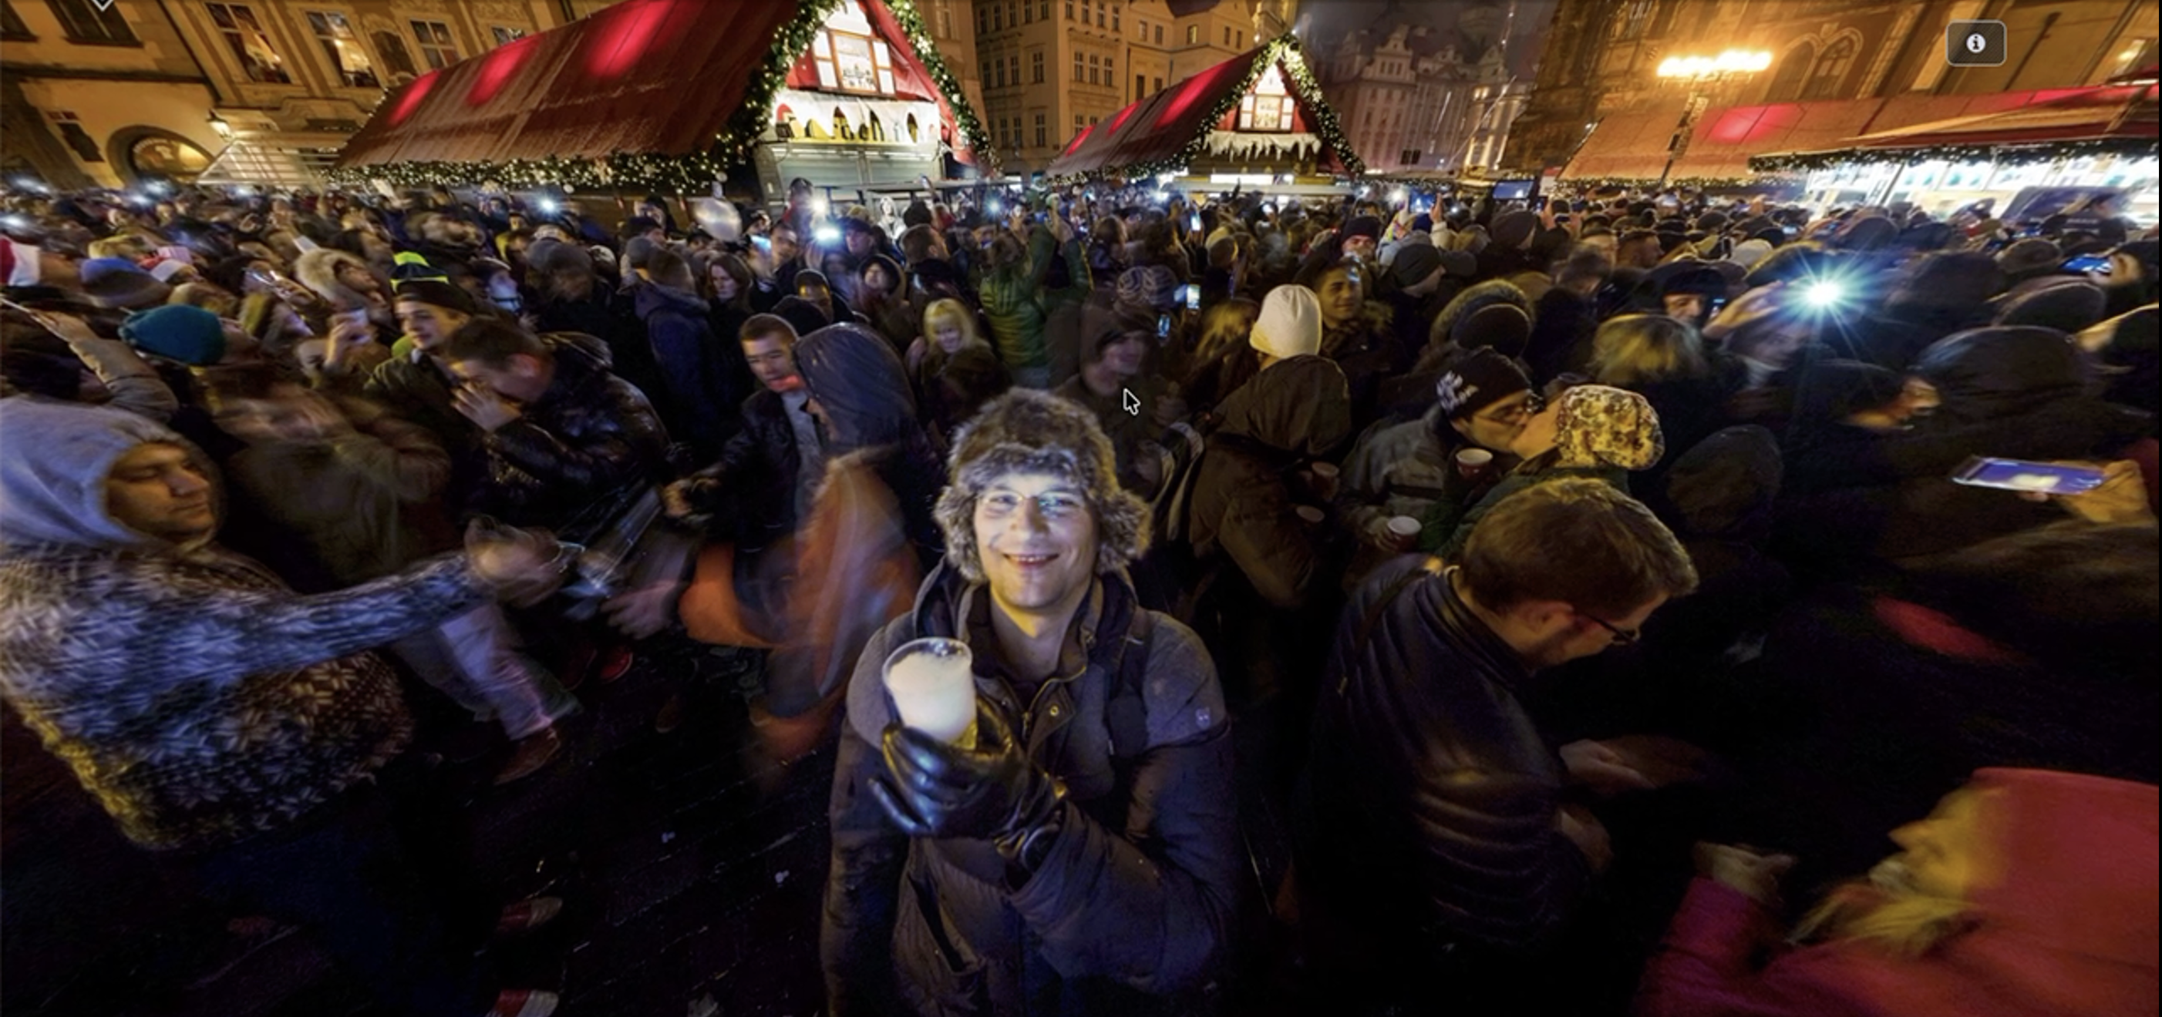
Interactive Spherical Panorama
https://www.360cities.net/curated_sets/90-new-year's-eve-celebrations
© Aleksandr Reznik, New Year in Prague
Notes:
https://www.360cities.net/curated_sets/90-new-year's-eve-celebrations
https://www.360cities.net/image/new-year-in-prague-2015-2016?curated_set=90

Slide 45
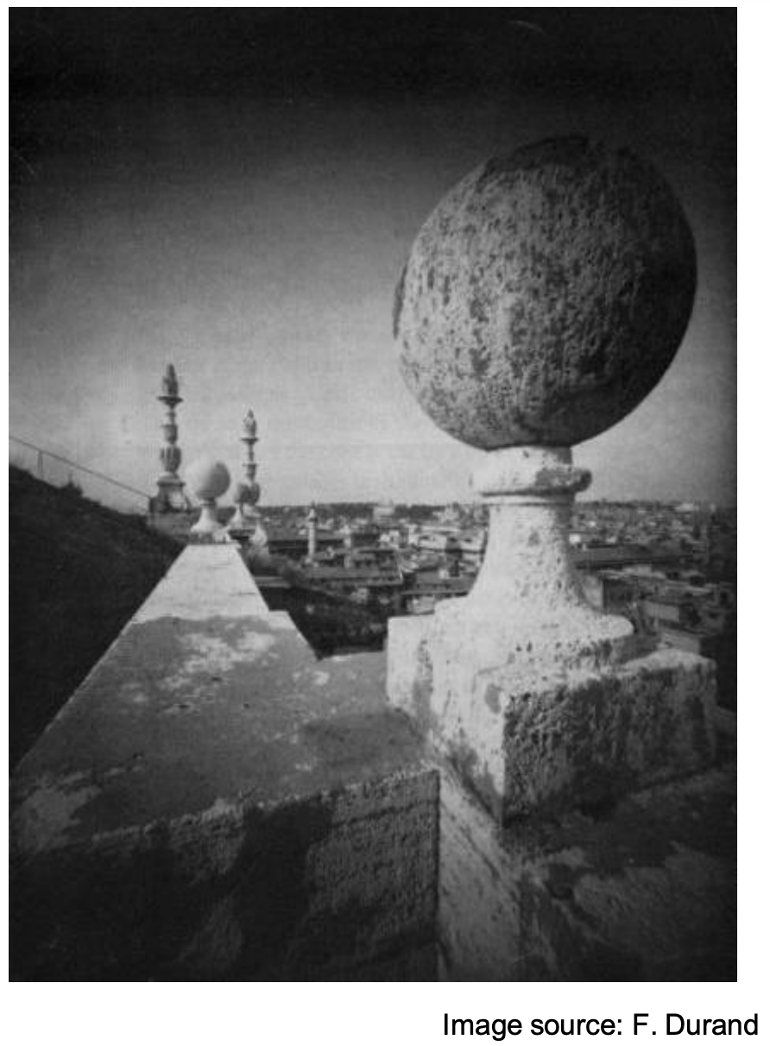
Perspective Distortion
Not due to lens flaws

Slide 46
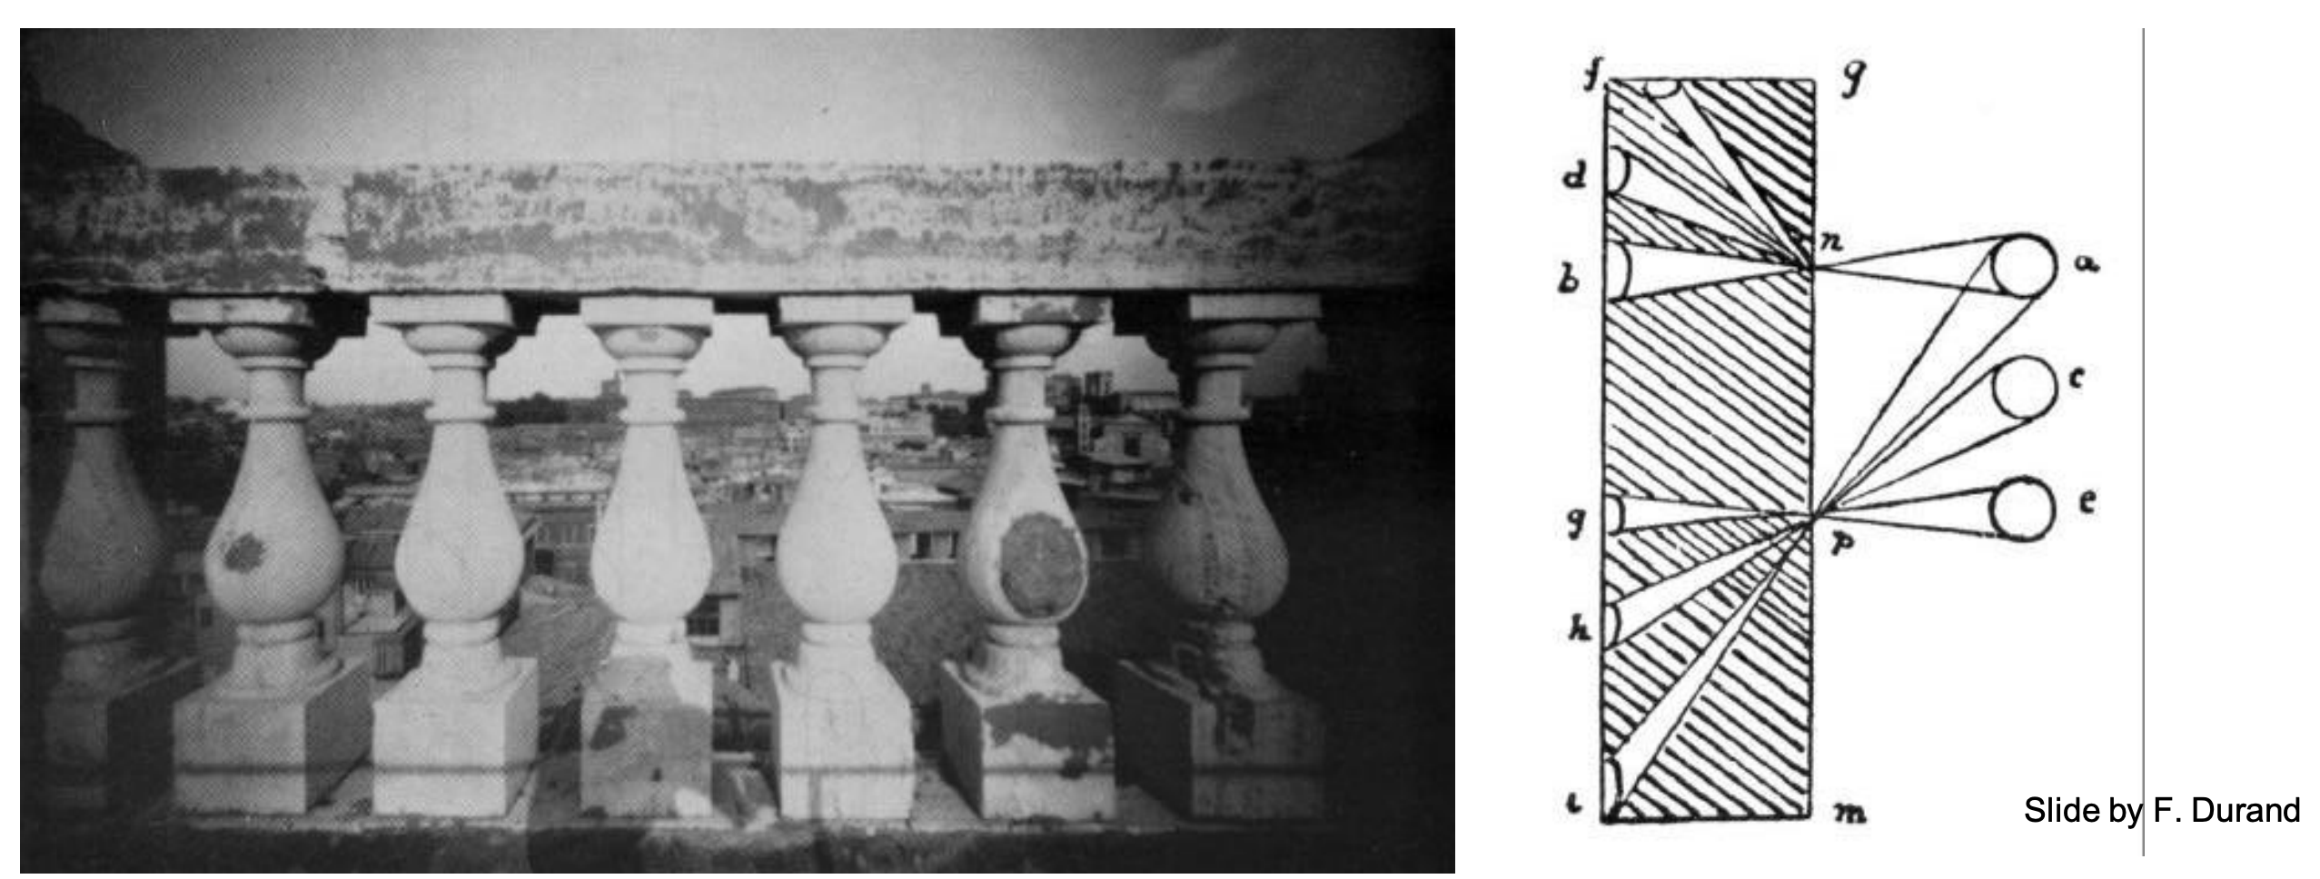
Problem pointed out by Da Vinci
The exterior columns appear bigger
Image Plane

Slide 47
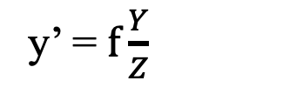
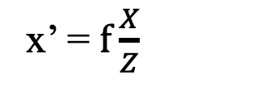
Perspective Distortion
Recall Perspective Projection:
x’ = $f\frac{X}{Z}$
y’ = $f\frac{Y}{Z}$
≠
Image Plane
COP

Slide 48
Perspective Distortion
With a spherical projection plane
≠
Image Plane
COP
Notes:
What is the effect as the object moves to the right (in the limit)?
What is the effect on the curved image plane?

Slide 49
Perspective Distortion
Less noticeable with long focal length (i.e. you see distortion more with wide-angle camera)
Image Plane
COP

Slide 50
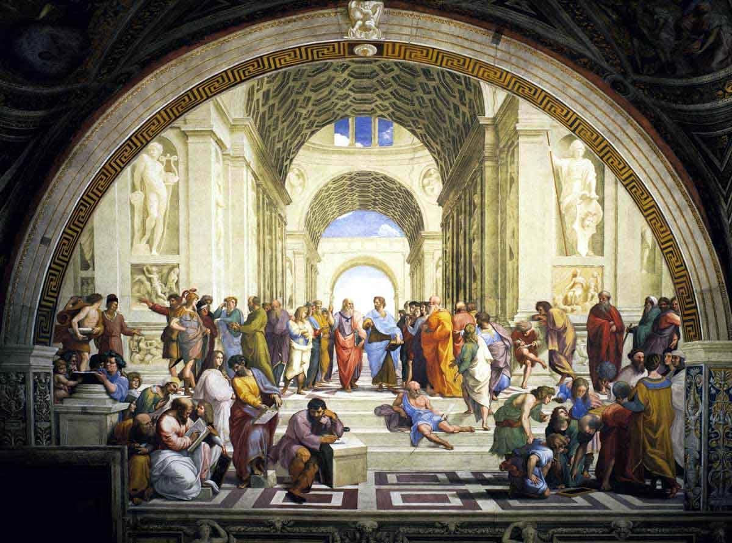
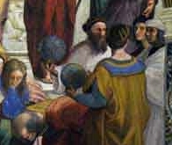
Renaissance Painters’ solution
“School of Athens”, Raffaello Sanzio ~1510
Give a separate treatment to different parts of the scene!!
Notes:
Fresco in Rome.

Slide 51
Personalized projections
“School of Athens”, Raffaello Sanzio ~1510
Give a separate treatment to different parts of the scene!!

Slide 52

Perspective Distortion
How about if the scene is planar?
Image Plane
COP
But this is a very special case..
Notes:
why is it special?

Slide 53

Perspective Distortion
More likely..
Image Plane
COP

Slide 54
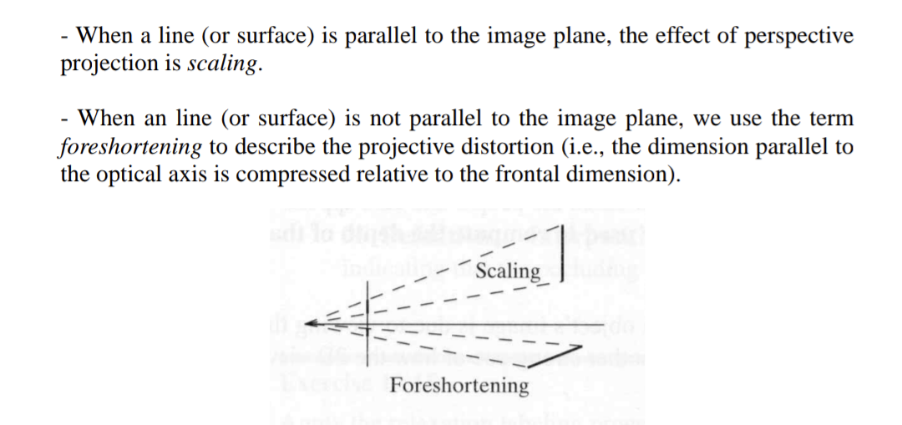
Foreshortening
Image Plane
COP

Slide 55
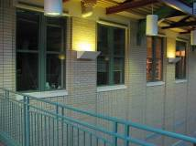
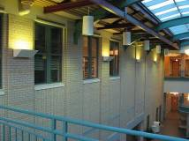
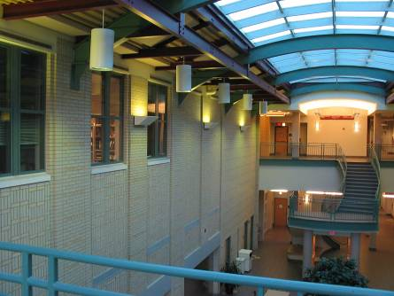
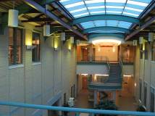
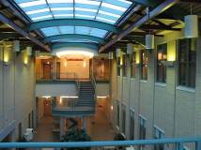
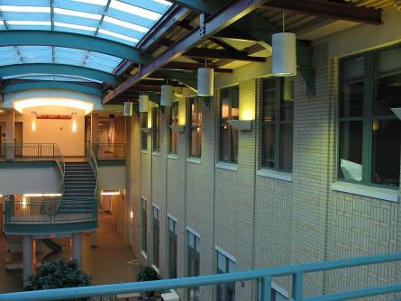
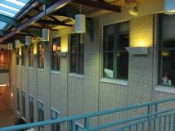
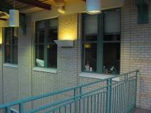

Mosaics: stitching images together
virtual wide-angle camera

Slide 56

Why Mosaic?
Are you getting the whole picture?
  Compact Camera FOV = 50 x 35°
Slide from Brown & Lowe

Slide 57

Why Mosaic?
Are you getting the whole picture?
  Compact Camera FOV = 50 x 35°
  Human FOV = 200 x 135°
Slide from Brown & Lowe

Slide 58

Why Mosaic?
Are you getting the whole picture?
  Compact Camera FOV = 50 x 35°
  Human FOV = 200 x 135°
  Panoramic Mosaic = 360 x 180°
Slide from Brown & Lowe

Slide 59

Naïve Stitching
left on top
right on top
  Translations are not enough to align the images

Slide 60
Image reprojection
mosaic PP
The mosaic has a natural interpretation in 3D
  The images are reprojected onto a common plane
  The mosaic is formed on this plane
  Mosaic is a synthetic wide-angle camera

Slide 61

Panoramas
Pick one image (red)
Warp the other images towards it (usually, one by one)
blend

Slide 62

Holbein, The Ambassadors

Slide 63
Programming Project #4 (part 1)
Homographies and Panoramic Mosaics
Capture photographs (and possibly video)
  Might want to use tripod
Compute homographies (define correspondences)
  will need to figure out how to setup system of eqs.
(un)warp an image (undo perspective distortion)
Produce panoramic mosaics (with blending)
Do some of the Bells and Whistles

Slide 64

Example homography final project

Slide 65
Think about this: When is this not true?
We can generate any synthetic camera view
as long as it has the same center of projection!
real camera
synthetic camera
What happens if there are two center of projection?
(you move your head)

