Slide 1
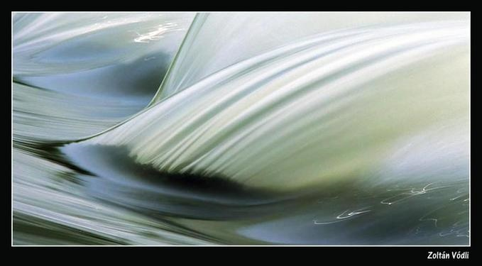
Convolution and Image Derivatives
CS180: Intro to Comp. Vision and Comp. Photo
Efros & Kanazawa, UC Berkeley, Fall 2025

Slide 2
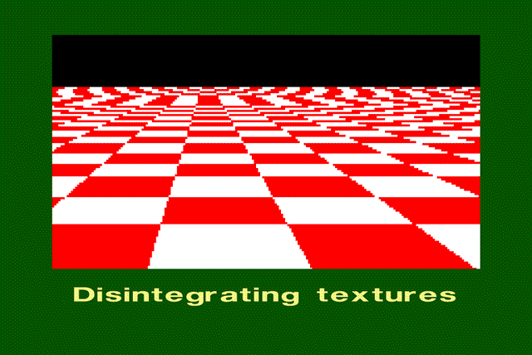
Aliasing in images

Slide 3
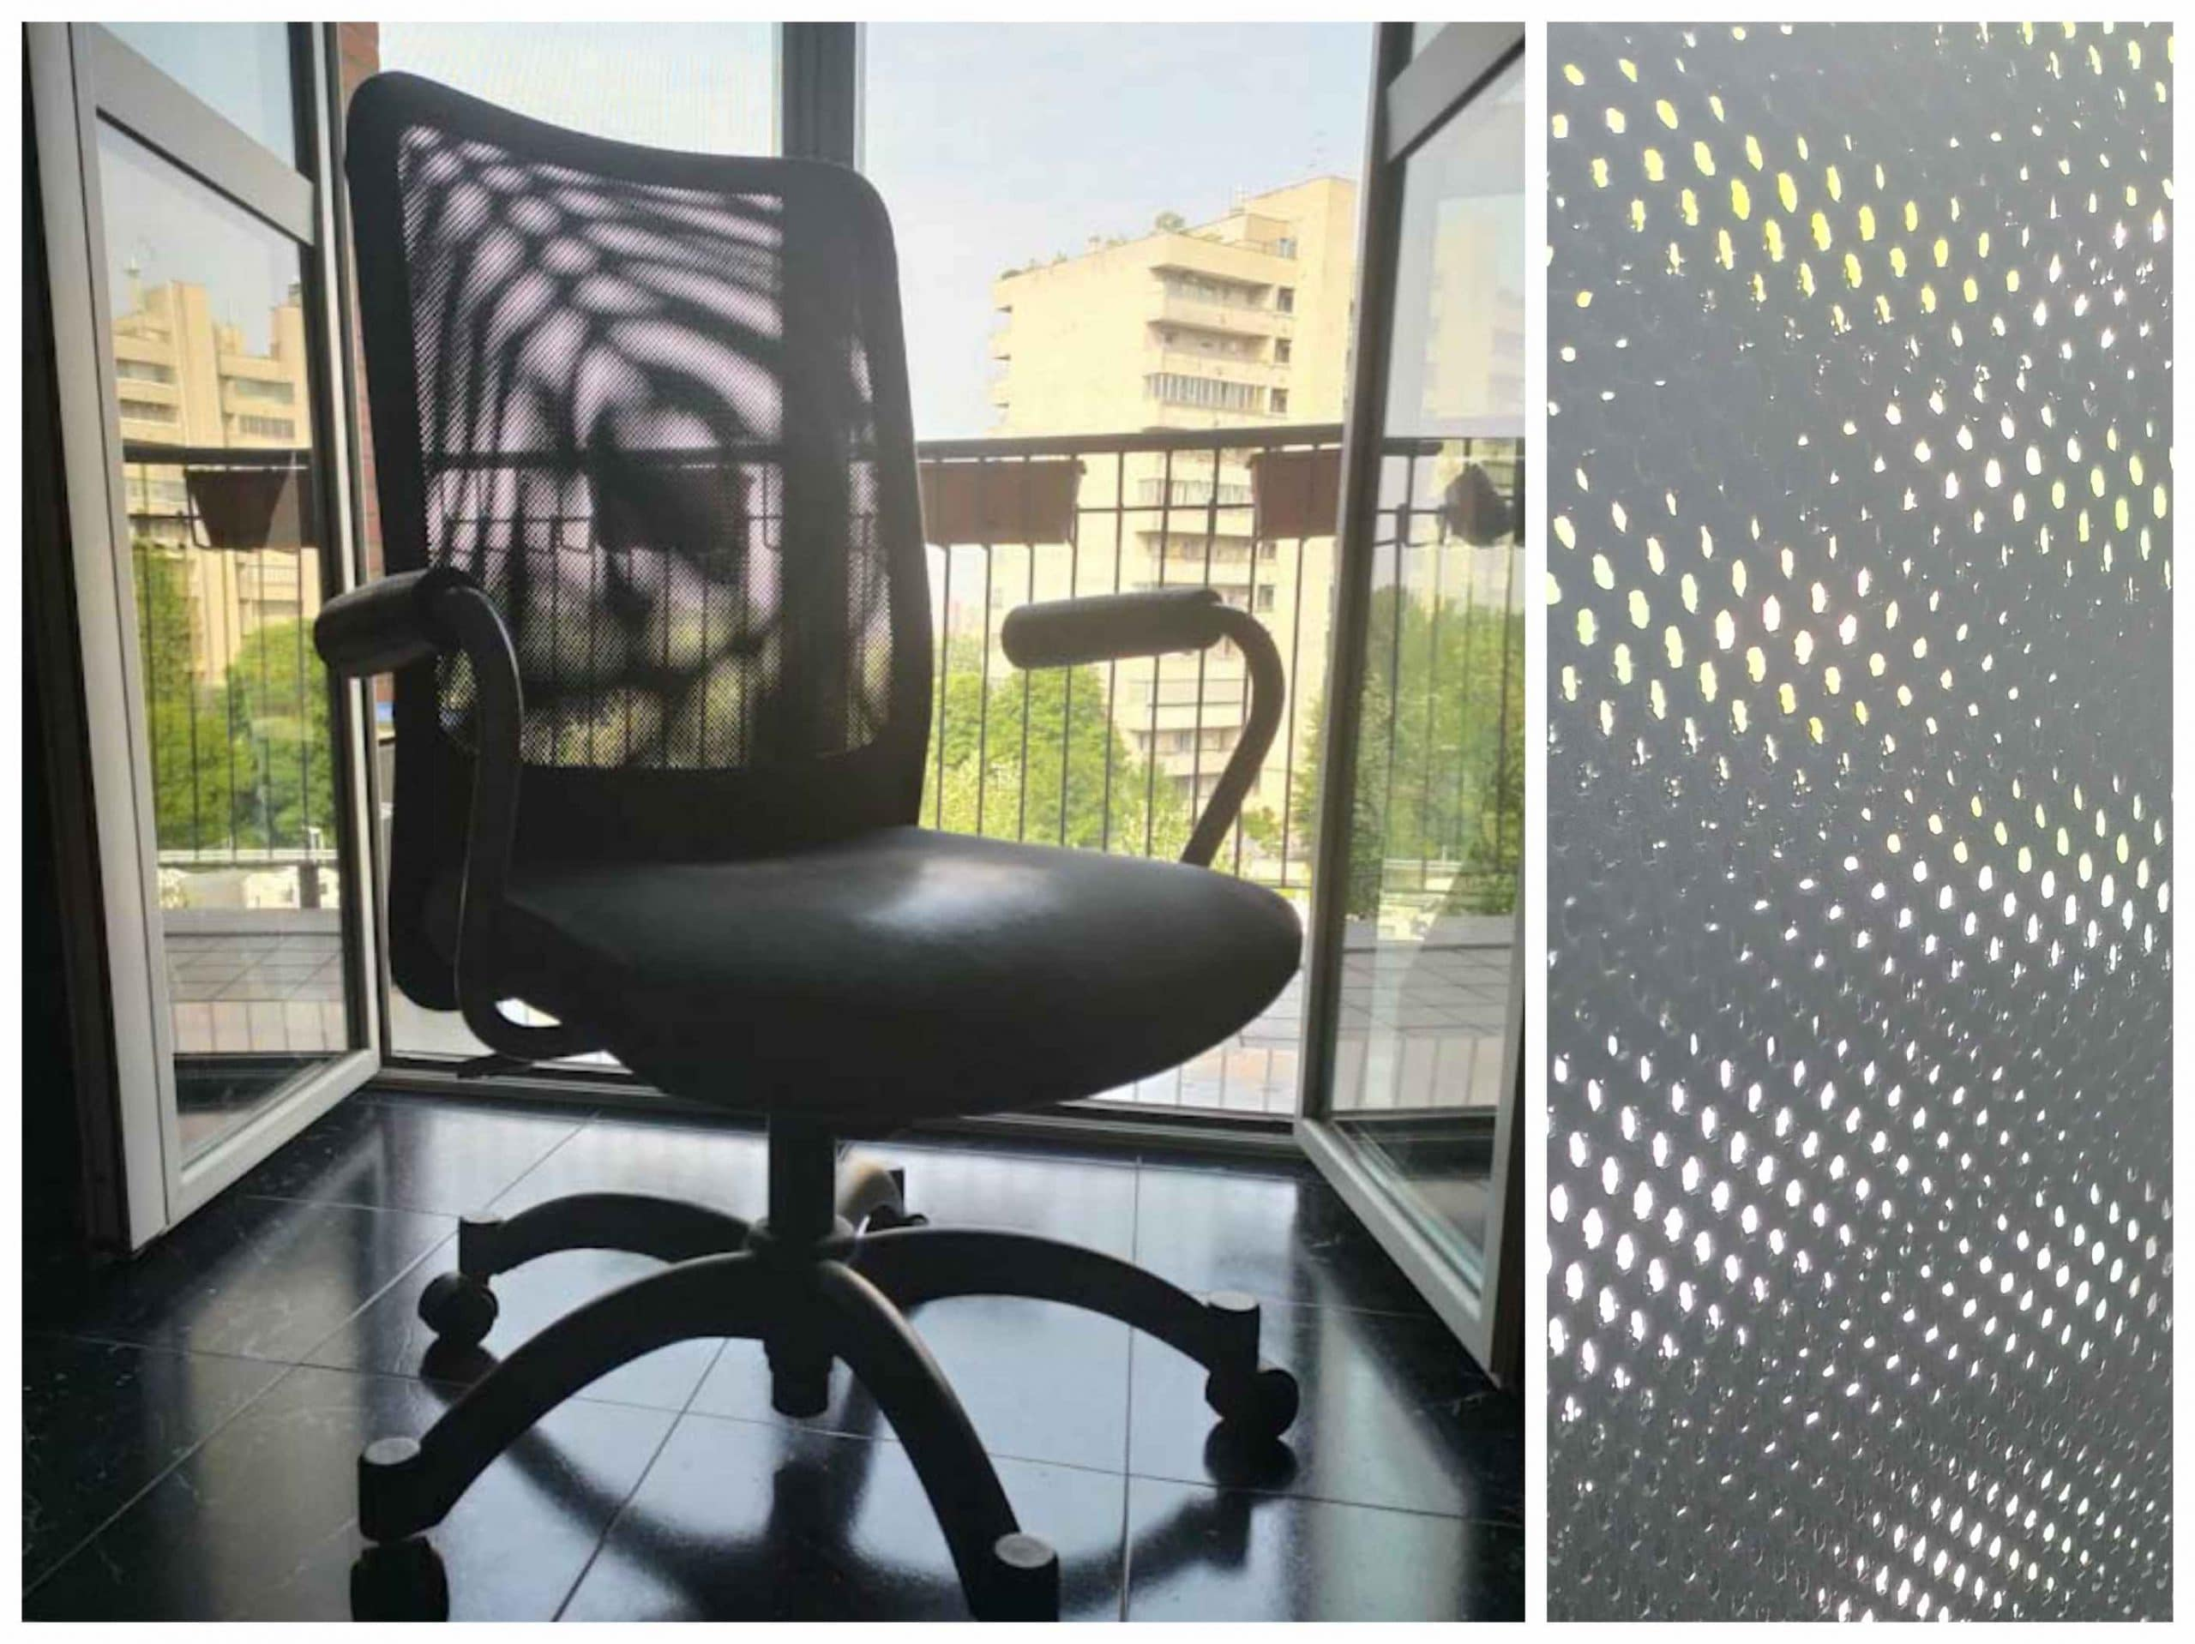
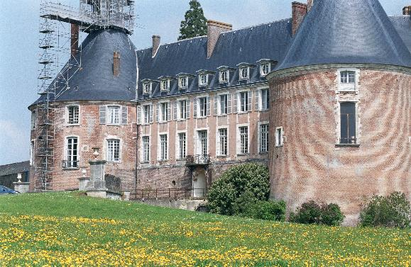
Aliasing in real images

Slide 4
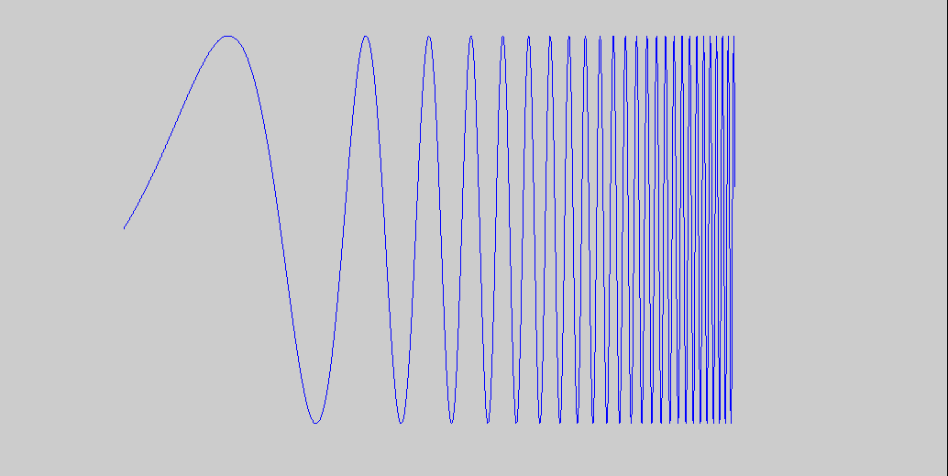
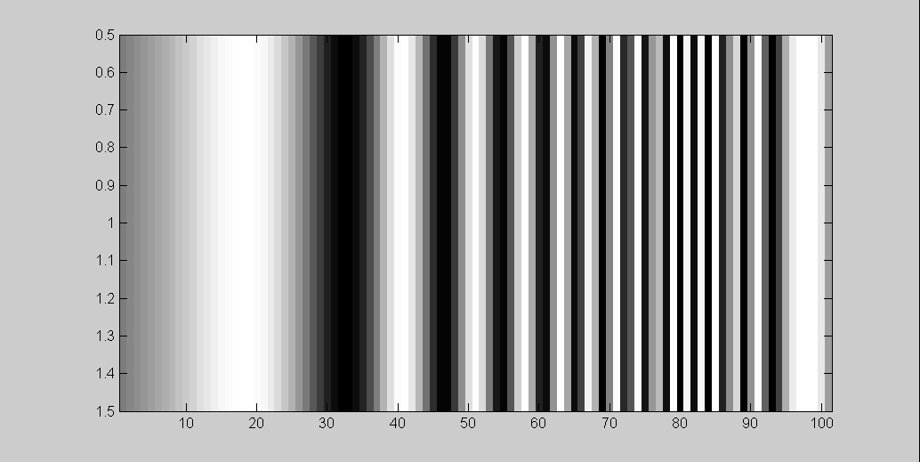
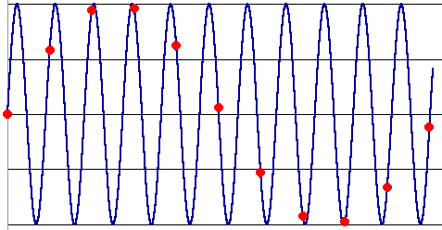
What’s happening?
Input signal:
Plot as image:
x = 0:.05:5; imagesc(sin((2.^x).*x))
Alias!
Not enough samples

Slide 5
Antialiasing
What can we do about aliasing?
Sample more often
Join the Mega-Pixel craze of the photo industry
But this can’t go on forever
Make the signal less “wiggly”
Get rid of some high frequencies
Will loose information
But it’s better than aliasing

Slide 6
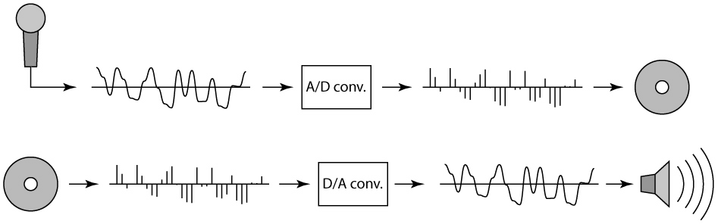
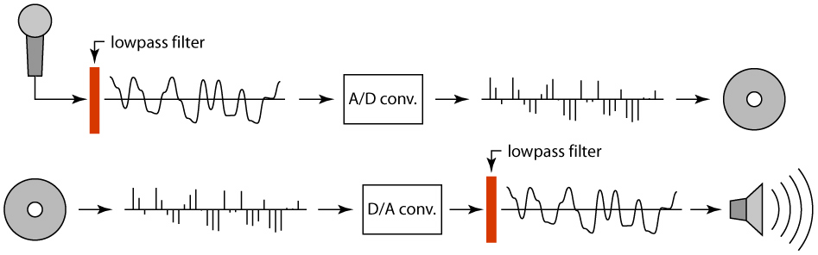
Preventing aliasing
Introduce lowpass filters:
remove high frequencies leaving only safe, low frequencies
choose lowest frequency in reconstruction (disambiguate)

Slide 7
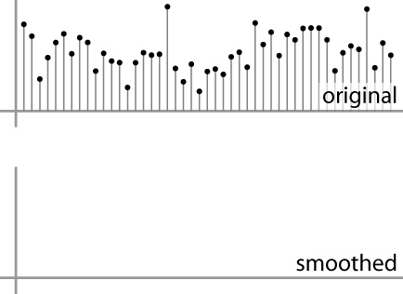
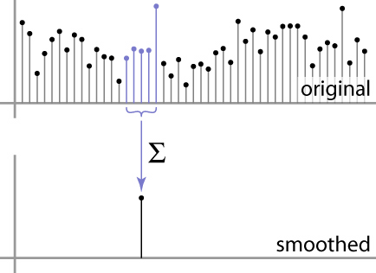
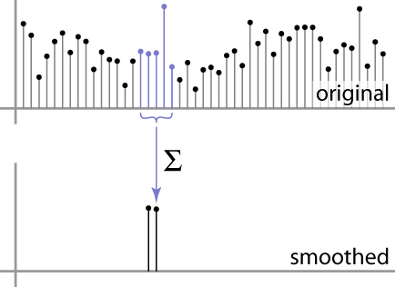
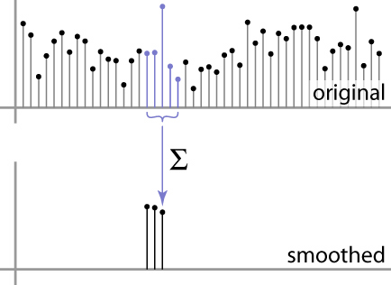
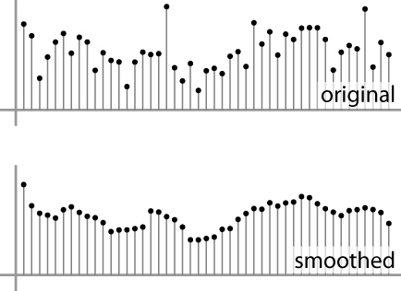
Moving Average
basic idea: define a new function by averaging over a sliding window
a simple example to start off: smoothing

Slide 8
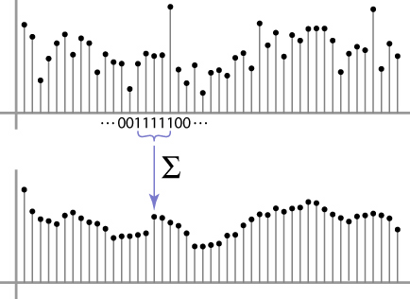
Moving Average
Can add weights to our moving average
Weights […, 0, 1, 1, 1, 1, 1, 0, …] / 5

Slide 9

In 2D: box filter
1
1
1
1
1
1
1
1
1
Slide credit: David Lowe (UBC)

Slide 10
Image filtering
1
1
1
1
1
1
1
1
1
0 | 0 | 0 | 0 | 0 | 0 | 0 | 0 | 0 | 0
0 | 0 | 0 | 0 | 0 | 0 | 0 | 0 | 0 | 0
0 | 0 | 0 | 90 | 90 | 90 | 90 | 90 | 0 | 0
0 | 0 | 0 | 90 | 90 | 90 | 90 | 90 | 0 | 0
0 | 0 | 0 | 90 | 90 | 90 | 90 | 90 | 0 | 0
0 | 0 | 0 | 90 | 0 | 90 | 90 | 90 | 0 | 0
0 | 0 | 0 | 90 | 90 | 90 | 90 | 90 | 0 | 0
0 | 0 | 0 | 0 | 0 | 0 | 0 | 0 | 0 | 0
0 | 0 | 90 | 0 | 0 | 0 | 0 | 0 | 0 | 0
0 | 0 | 0 | 0 | 0 | 0 | 0 | 0 | 0 | 0
 | 0
0 | 0 | 0 | 0 | 0 | 0 | 0 | 0 | 0 | 0
0 | 0 | 0 | 0 | 0 | 0 | 0 | 0 | 0 | 0
0 | 0 | 0 | 90 | 90 | 90 | 90 | 90 | 0 | 0
0 | 0 | 0 | 90 | 90 | 90 | 90 | 90 | 0 | 0
0 | 0 | 0 | 90 | 90 | 90 | 90 | 90 | 0 | 0
0 | 0 | 0 | 90 | 0 | 90 | 90 | 90 | 0 | 0
0 | 0 | 0 | 90 | 90 | 90 | 90 | 90 | 0 | 0
0 | 0 | 0 | 0 | 0 | 0 | 0 | 0 | 0 | 0
0 | 0 | 90 | 0 | 0 | 0 | 0 | 0 | 0 | 0
0 | 0 | 0 | 0 | 0 | 0 | 0 | 0 | 0 | 0
Credit: S. Seitz
Notes:
ones, divide by 9

Slide 11
Image filtering
1
1
1
1
1
1
1
1
1
0 | 0 | 0 | 0 | 0 | 0 | 0 | 0 | 0 | 0
0 | 0 | 0 | 0 | 0 | 0 | 0 | 0 | 0 | 0
0 | 0 | 0 | 90 | 90 | 90 | 90 | 90 | 0 | 0
0 | 0 | 0 | 90 | 90 | 90 | 90 | 90 | 0 | 0
0 | 0 | 0 | 90 | 90 | 90 | 90 | 90 | 0 | 0
0 | 0 | 0 | 90 | 0 | 90 | 90 | 90 | 0 | 0
0 | 0 | 0 | 90 | 90 | 90 | 90 | 90 | 0 | 0
0 | 0 | 0 | 0 | 0 | 0 | 0 | 0 | 0 | 0
0 | 0 | 90 | 0 | 0 | 0 | 0 | 0 | 0 | 0
0 | 0 | 0 | 0 | 0 | 0 | 0 | 0 | 0 | 0
 | 0 | 10
0 | 0 | 0 | 0 | 0 | 0 | 0 | 0 | 0 | 0
0 | 0 | 0 | 0 | 0 | 0 | 0 | 0 | 0 | 0
0 | 0 | 0 | 90 | 90 | 90 | 90 | 90 | 0 | 0
0 | 0 | 0 | 90 | 90 | 90 | 90 | 90 | 0 | 0
0 | 0 | 0 | 90 | 90 | 90 | 90 | 90 | 0 | 0
0 | 0 | 0 | 90 | 0 | 90 | 90 | 90 | 0 | 0
0 | 0 | 0 | 90 | 90 | 90 | 90 | 90 | 0 | 0
0 | 0 | 0 | 0 | 0 | 0 | 0 | 0 | 0 | 0
0 | 0 | 90 | 0 | 0 | 0 | 0 | 0 | 0 | 0
0 | 0 | 0 | 0 | 0 | 0 | 0 | 0 | 0 | 0
Credit: S. Seitz
Notes:
ones, divide by 9

Slide 12
Image filtering
1
1
1
1
1
1
1
1
1
0 | 0 | 0 | 0 | 0 | 0 | 0 | 0 | 0 | 0
0 | 0 | 0 | 0 | 0 | 0 | 0 | 0 | 0 | 0
0 | 0 | 0 | 90 | 90 | 90 | 90 | 90 | 0 | 0
0 | 0 | 0 | 90 | 90 | 90 | 90 | 90 | 0 | 0
0 | 0 | 0 | 90 | 90 | 90 | 90 | 90 | 0 | 0
0 | 0 | 0 | 90 | 0 | 90 | 90 | 90 | 0 | 0
0 | 0 | 0 | 90 | 90 | 90 | 90 | 90 | 0 | 0
0 | 0 | 0 | 0 | 0 | 0 | 0 | 0 | 0 | 0
0 | 0 | 90 | 0 | 0 | 0 | 0 | 0 | 0 | 0
0 | 0 | 0 | 0 | 0 | 0 | 0 | 0 | 0 | 0
 | 0 | 10 | 20
0 | 0 | 0 | 0 | 0 | 0 | 0 | 0 | 0 | 0
0 | 0 | 0 | 0 | 0 | 0 | 0 | 0 | 0 | 0
0 | 0 | 0 | 90 | 90 | 90 | 90 | 90 | 0 | 0
0 | 0 | 0 | 90 | 90 | 90 | 90 | 90 | 0 | 0
0 | 0 | 0 | 90 | 90 | 90 | 90 | 90 | 0 | 0
0 | 0 | 0 | 90 | 0 | 90 | 90 | 90 | 0 | 0
0 | 0 | 0 | 90 | 90 | 90 | 90 | 90 | 0 | 0
0 | 0 | 0 | 0 | 0 | 0 | 0 | 0 | 0 | 0
0 | 0 | 90 | 0 | 0 | 0 | 0 | 0 | 0 | 0
0 | 0 | 0 | 0 | 0 | 0 | 0 | 0 | 0 | 0
Credit: S. Seitz
Notes:
ones, divide by 9

Slide 13
Image filtering
1
1
1
1
1
1
1
1
1
0 | 0 | 0 | 0 | 0 | 0 | 0 | 0 | 0 | 0
0 | 0 | 0 | 0 | 0 | 0 | 0 | 0 | 0 | 0
0 | 0 | 0 | 90 | 90 | 90 | 90 | 90 | 0 | 0
0 | 0 | 0 | 90 | 90 | 90 | 90 | 90 | 0 | 0
0 | 0 | 0 | 90 | 90 | 90 | 90 | 90 | 0 | 0
0 | 0 | 0 | 90 | 0 | 90 | 90 | 90 | 0 | 0
0 | 0 | 0 | 90 | 90 | 90 | 90 | 90 | 0 | 0
0 | 0 | 0 | 0 | 0 | 0 | 0 | 0 | 0 | 0
0 | 0 | 90 | 0 | 0 | 0 | 0 | 0 | 0 | 0
0 | 0 | 0 | 0 | 0 | 0 | 0 | 0 | 0 | 0
 | 0 | 10 | 20 | 30
0 | 0 | 0 | 0 | 0 | 0 | 0 | 0 | 0 | 0
0 | 0 | 0 | 0 | 0 | 0 | 0 | 0 | 0 | 0
0 | 0 | 0 | 90 | 90 | 90 | 90 | 90 | 0 | 0
0 | 0 | 0 | 90 | 90 | 90 | 90 | 90 | 0 | 0
0 | 0 | 0 | 90 | 90 | 90 | 90 | 90 | 0 | 0
0 | 0 | 0 | 90 | 0 | 90 | 90 | 90 | 0 | 0
0 | 0 | 0 | 90 | 90 | 90 | 90 | 90 | 0 | 0
0 | 0 | 0 | 0 | 0 | 0 | 0 | 0 | 0 | 0
0 | 0 | 90 | 0 | 0 | 0 | 0 | 0 | 0 | 0
0 | 0 | 0 | 0 | 0 | 0 | 0 | 0 | 0 | 0
Credit: S. Seitz
Notes:
ones, divide by 9

Slide 14
Image filtering
1
1
1
1
1
1
1
1
1
0 | 0 | 0 | 0 | 0 | 0 | 0 | 0 | 0 | 0
0 | 0 | 0 | 0 | 0 | 0 | 0 | 0 | 0 | 0
0 | 0 | 0 | 90 | 90 | 90 | 90 | 90 | 0 | 0
0 | 0 | 0 | 90 | 90 | 90 | 90 | 90 | 0 | 0
0 | 0 | 0 | 90 | 90 | 90 | 90 | 90 | 0 | 0
0 | 0 | 0 | 90 | 0 | 90 | 90 | 90 | 0 | 0
0 | 0 | 0 | 90 | 90 | 90 | 90 | 90 | 0 | 0
0 | 0 | 0 | 0 | 0 | 0 | 0 | 0 | 0 | 0
0 | 0 | 90 | 0 | 0 | 0 | 0 | 0 | 0 | 0
0 | 0 | 0 | 0 | 0 | 0 | 0 | 0 | 0 | 0
 | 0 | 10 | 20 | 30 | 30
Credit: S. Seitz
Notes:
ones, divide by 9

Slide 15
Image filtering
1
1
1
1
1
1
1
1
1
0 | 0 | 0 | 0 | 0 | 0 | 0 | 0 | 0 | 0
0 | 0 | 0 | 0 | 0 | 0 | 0 | 0 | 0 | 0
0 | 0 | 0 | 90 | 90 | 90 | 90 | 90 | 0 | 0
0 | 0 | 0 | 90 | 90 | 90 | 90 | 90 | 0 | 0
0 | 0 | 0 | 90 | 90 | 90 | 90 | 90 | 0 | 0
0 | 0 | 0 | 90 | 0 | 90 | 90 | 90 | 0 | 0
0 | 0 | 0 | 90 | 90 | 90 | 90 | 90 | 0 | 0
0 | 0 | 0 | 0 | 0 | 0 | 0 | 0 | 0 | 0
0 | 0 | 90 | 0 | 0 | 0 | 0 | 0 | 0 | 0
0 | 0 | 0 | 0 | 0 | 0 | 0 | 0 | 0 | 0
 | 0 | 10 | 20 | 30 | 30
?
Credit: S. Seitz
Notes:
ones, divide by 9

Slide 16
Image filtering
1
1
1
1
1
1
1
1
1
0 | 0 | 0 | 0 | 0 | 0 | 0 | 0 | 0 | 0
0 | 0 | 0 | 0 | 0 | 0 | 0 | 0 | 0 | 0
0 | 0 | 0 | 90 | 90 | 90 | 90 | 90 | 0 | 0
0 | 0 | 0 | 90 | 90 | 90 | 90 | 90 | 0 | 0
0 | 0 | 0 | 90 | 90 | 90 | 90 | 90 | 0 | 0
0 | 0 | 0 | 90 | 0 | 90 | 90 | 90 | 0 | 0
0 | 0 | 0 | 90 | 90 | 90 | 90 | 90 | 0 | 0
0 | 0 | 0 | 0 | 0 | 0 | 0 | 0 | 0 | 0
0 | 0 | 90 | 0 | 0 | 0 | 0 | 0 | 0 | 0
0 | 0 | 0 | 0 | 0 | 0 | 0 | 0 | 0 | 0
 | 0 | 10 | 20 | 30 | 30
 |  |  |  | 50
?
Credit: S. Seitz
Notes:
ones, divide by 9

Slide 17
Image filtering
1
1
1
1
1
1
1
1
1
0 | 0 | 0 | 0 | 0 | 0 | 0 | 0 | 0 | 0
0 | 0 | 0 | 0 | 0 | 0 | 0 | 0 | 0 | 0
0 | 0 | 0 | 90 | 90 | 90 | 90 | 90 | 0 | 0
0 | 0 | 0 | 90 | 90 | 90 | 90 | 90 | 0 | 0
0 | 0 | 0 | 90 | 90 | 90 | 90 | 90 | 0 | 0
0 | 0 | 0 | 90 | 0 | 90 | 90 | 90 | 0 | 0
0 | 0 | 0 | 90 | 90 | 90 | 90 | 90 | 0 | 0
0 | 0 | 0 | 0 | 0 | 0 | 0 | 0 | 0 | 0
0 | 0 | 90 | 0 | 0 | 0 | 0 | 0 | 0 | 0
0 | 0 | 0 | 0 | 0 | 0 | 0 | 0 | 0 | 0
 | 0 | 10 | 20 | 30 | 30 | 30 | 20 | 10
 | 0 | 20 | 40 | 60 | 60 | 60 | 40 | 20
 | 0 | 30 | 60 | 90 | 90 | 90 | 60 | 30
 | 0 | 30 | 50 | 80 | 80 | 90 | 60 | 30
 | 0 | 30 | 50 | 80 | 80 | 90 | 60 | 30
 | 0 | 20 | 30 | 50 | 50 | 60 | 40 | 20
 | 10 | 20 | 30 | 30 | 30 | 30 | 20 | 10
 | 10 | 10 | 10 | 0 | 0 | 0 | 0 | 0
Credit: S. Seitz

Slide 18



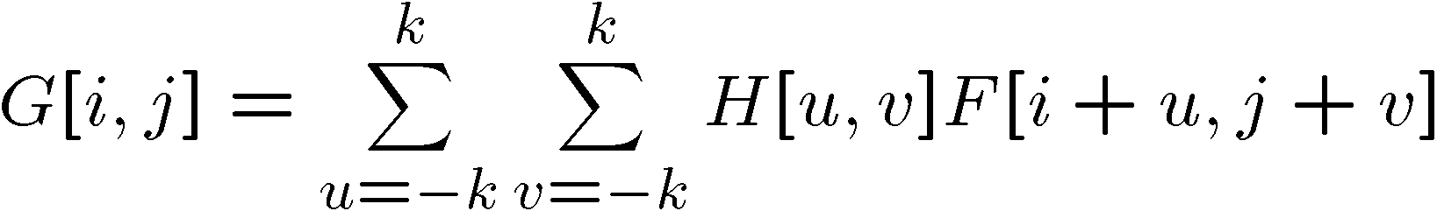

Cross-correlation
Let be the image, be the kernel (of size 2k+1 x 2k+1), and be the output image
Can think of as a “dot product” between local neighborhood and kernel for each pixel
This is called a cross-correlation operation:

Slide 19
Box Filter
What does it do?
Replaces each pixel with an average of its neighborhood
Achieve smoothing effect (remove sharp features)
1
1
1
1
1
1
1
1
1
Slide credit: David Lowe (UBC)

Slide 20
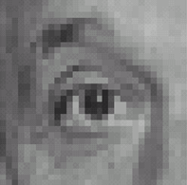
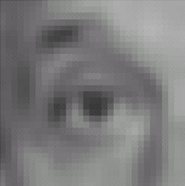
Linear filters: examples
1
1
1
=
1
1
1
1
1
1
Original
Blur (with a mean filter)
Source: D. Lowe

Slide 21
Practice with linear filters
0
0
0
?
0
1
0
0
0
0
Original
Source: D. Lowe

Slide 22
Practice with linear filters
0
0
0
0
1
0
0
0
0
Original
Filtered
(no change)
Source: D. Lowe

Slide 23
Practice with linear filters
0
0
0
?
0
0
1
0
0
0
Original
Source: D. Lowe

Slide 24
Practice with linear filters
0
0
0
0
0
1
0
0
0
Original
Shifted left
By 1 pixel
Source: D. Lowe

Slide 25
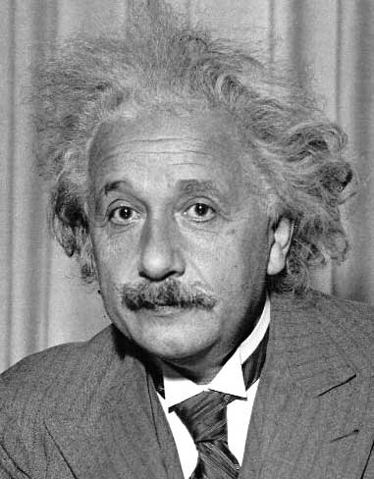
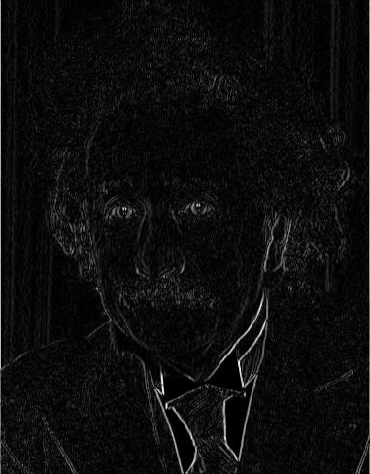
Other filters
1
0
-1
2
0
-2
1
0
-1
Sobel
Vertical Edge
(absolute value)

Slide 26
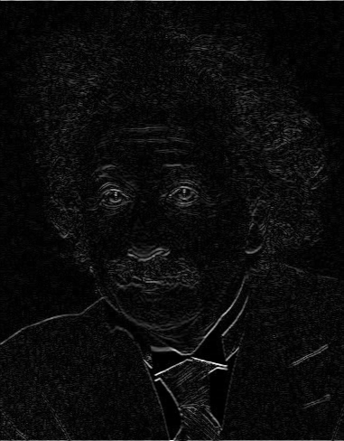
Other filters
Q?
1
2
1
0
0
0
-1
-2
-1
Sobel
Horizontal Edge
(absolute value)
Notes:
Questions at this point?
26

Slide 27
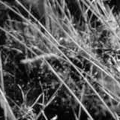
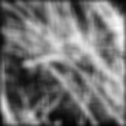
Back to the box filter

Slide 28
Moving Average
Can add weights to our moving average
Weights […, 0, 1, 1, 1, 1, 1, 0, …] / 5

Slide 29

Weighted Moving Average
bell curve (gaussian-like) weights […, 1, 4, 6, 4, 1, …]

Slide 30


Moving Average In 2D
What are the weights H?
0 | 0 | 0 | 0 | 0 | 0 | 0 | 0 | 0 | 0
0 | 0 | 0 | 0 | 0 | 0 | 0 | 0 | 0 | 0
0 | 0 | 0 | 90 | 90 | 90 | 90 | 90 | 0 | 0
0 | 0 | 0 | 90 | 90 | 90 | 90 | 90 | 0 | 0
0 | 0 | 0 | 90 | 90 | 90 | 90 | 90 | 0 | 0
0 | 0 | 0 | 90 | 0 | 90 | 90 | 90 | 0 | 0
0 | 0 | 0 | 90 | 90 | 90 | 90 | 90 | 0 | 0
0 | 0 | 0 | 0 | 0 | 0 | 0 | 0 | 0 | 0
0 | 0 | 90 | 0 | 0 | 0 | 0 | 0 | 0 | 0
0 | 0 | 0 | 0 | 0 | 0 | 0 | 0 | 0 | 0
Slide by Steve Seitz
Notes:
ones, divide by 9

Slide 31
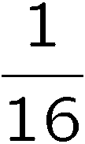
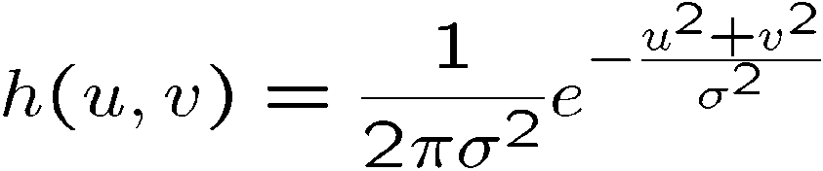
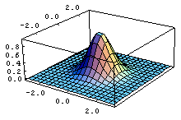
Gaussian filtering
A Gaussian kernel gives less weight to pixels further from the center of the window
This kernel is an approximation of a Gaussian function:
0 | 0 | 0 | 0 | 0 | 0 | 0 | 0 | 0 | 0
0 | 0 | 0 | 0 | 0 | 0 | 0 | 0 | 0 | 0
0 | 0 | 0 | 90 | 90 | 90 | 90 | 90 | 0 | 0
0 | 0 | 0 | 90 | 90 | 90 | 90 | 90 | 0 | 0
0 | 0 | 0 | 90 | 90 | 90 | 90 | 90 | 0 | 0
0 | 0 | 0 | 90 | 0 | 90 | 90 | 90 | 0 | 0
0 | 0 | 0 | 90 | 90 | 90 | 90 | 90 | 0 | 0
0 | 0 | 0 | 0 | 0 | 0 | 0 | 0 | 0 | 0
0 | 0 | 90 | 0 | 0 | 0 | 0 | 0 | 0 | 0
0 | 0 | 0 | 0 | 0 | 0 | 0 | 0 | 0 | 0
1 | 2 | 1
2 | 4 | 2
1 | 2 | 1
Slide by Steve Seitz

Slide 32
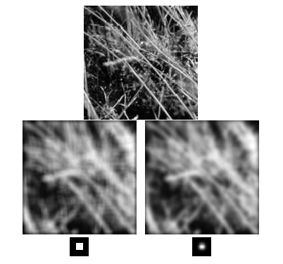
Mean vs. Gaussian filtering
Slide by Steve Seitz

Slide 33
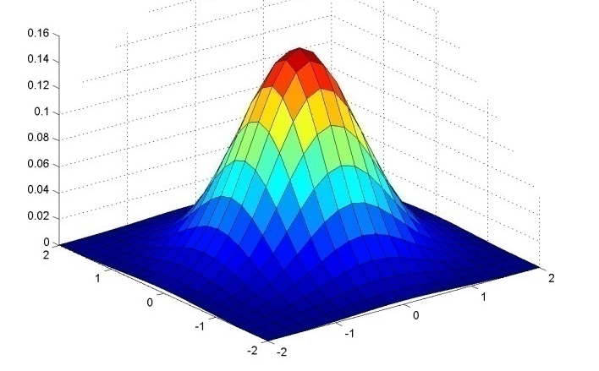
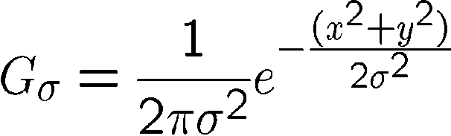
Important filter: Gaussian
Weight contributions of neighboring pixels by nearness
0.003 0.013 0.022 0.013 0.003
0.013 0.059 0.097 0.059 0.013
0.022 0.097 0.159 0.097 0.022
0.013 0.059 0.097 0.059 0.013
0.003 0.013 0.022 0.013 0.003
5 x 5, σ = 1
Slide credit: Christopher Rasmussen
Notes:
33

Slide 34
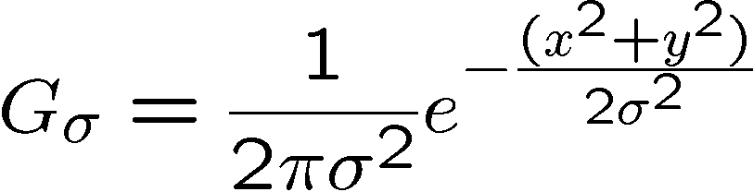
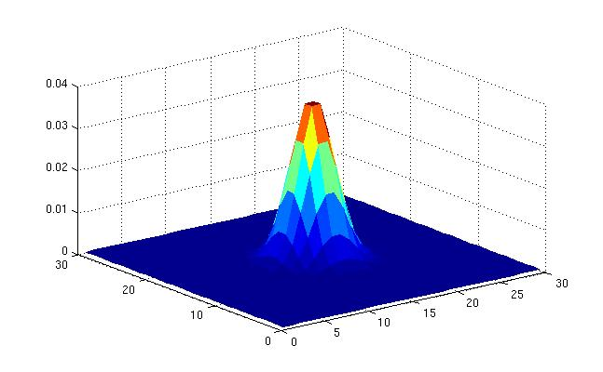
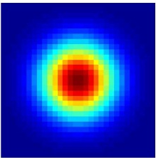
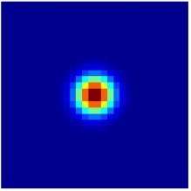
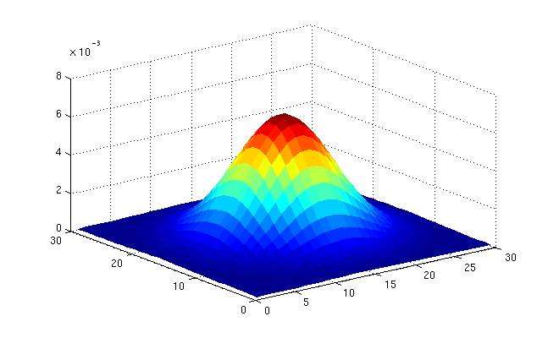
Gaussian Kernel
σ = 2 with 30 x 30 kernel
σ = 5 with 30 x 30 kernel
Standard deviation σ: determines extent of smoothing
Source: K. Grauman
Notes:
what happens if sigma is small? in the limit?
how about if sigma = infinite ?
sigma > kernel size

Slide 35
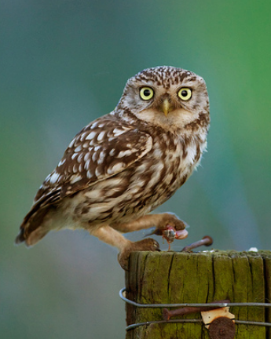
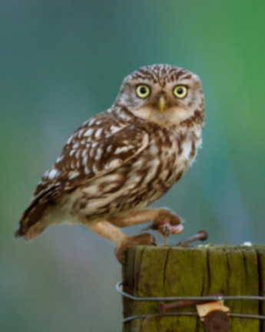



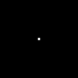




Gaussian filters
= 1 pixel
= 5 pixels
= 10 pixels
= 30 pixels

Slide 36
Choosing kernel width
The Gaussian function has infinite support, but discrete filters use finite kernels
Source: K. Grauman
Notes:
sigma is the main Acontrolling parameter, need to make sure that the kernel size is appropriate These are both not great gaussians, why?

Slide 37
Practical matters
How big should the filter be?
Values at edges should be near zero
Rule of thumb for Gaussian: set filter half-width to about 3 σ
Side by Derek Hoiem
Notes:
37

Slide 38

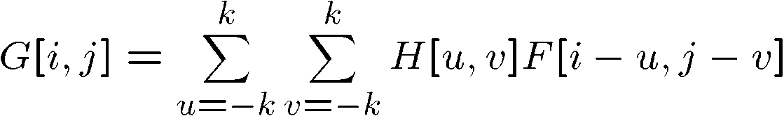

Cross-correlation vs. Convolution
cross-correlation:
A convolution operation is a cross-correlation where the filter is flipped both horizontally and vertically before being applied to the image:
It is written:
Slide by Steve Seitz
Notes:
what’s the difference?

Slide 39



Convolution
Adapted from F. Durand
Notes:
why do this crazy thing?

Slide 40
Cross-correlation vs. Convolution
cross-correlation:
A convolution operation is a cross-correlation where the filter is flipped both horizontally and vertically before being applied to the image:
It is written:
Convolution is commutative and associative
Slide by Steve Seitz
Notes:
what’s the difference?

Slide 41






Convolution is nice!
Notation:
Convolution is a multiplication-like operation
commutative
associative
distributes over addition
scalars factor out
identity: unit impulse e = […, 0, 0, 1, 0, 0, …]
Conceptually no distinction between filter and signal
Usefulness of associativity
often apply several filters one after another: (((a * b₁) * b₂) * b₃)
this is equivalent to applying one filter: a * (b₁ * b₂ * b₃)
Notes:
nice properties, nicer than cross correlation. → Do an example on the board (3~4 min)
Pre-convolve all filter in one Do you know about convolutional neural networks? what do they use? (even more annoying) – why is this ok?

Slide 42



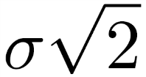
Gaussian and convolution
Removes “high-frequency” components from the image (low-pass filter)
Convolution with self is another Gaussian
Convolving twice with Gaussian kernel of width = convolving once with kernel of width
*
=
Source: K. Grauman
Notes:
Very useful in a little bit!

Slide 43
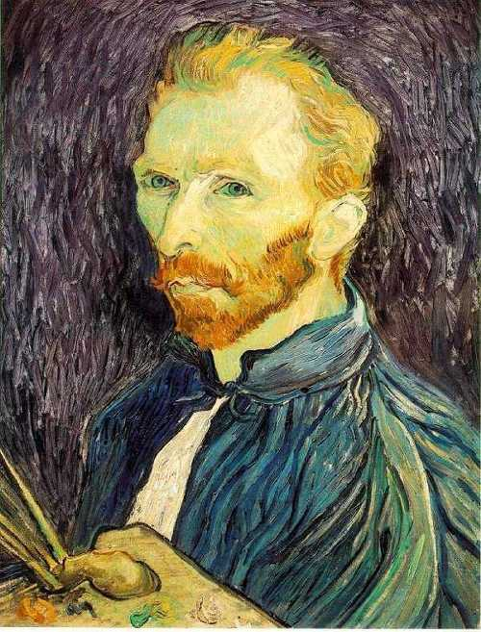
Image half-sizing
This image is too big to
fit on the screen. How
can we reduce it?
How to generate a half-
sized version?

Slide 44

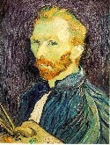

Image sub-sampling
1/8
1/4
Throw away every other row and column to create a 1/2 size image
- called image sub-sampling
Slide by Steve Seitz
Notes:
Just take every other pixel!

Slide 45
Image sub-sampling
1/2
1/4 (2x zoom)
1/8 (4x zoom)
Aliasing! What do we do?
Slide by Steve Seitz

Slide 46
Sampling an image
Examples of GOOD sampling

Slide 47
Undersampling
Examples of BAD sampling -> Aliasing
Notes:
bottom should be averageing

Slide 48



Gaussian (lowpass) pre-filtering
G 1/8
G 1/4
Gaussian 1/2
Solution: filter the image, then subsample
Filter size should double for each ½ size reduction. Why?
Slide by Steve Seitz

Slide 49
Subsampling with Gaussian pre-filtering
Gaussian 1/2
G 1/4
G 1/8
Slide by Steve Seitz

Slide 50
Compare with...
1/2
1/4 (2x zoom)
1/8 (4x zoom)
Slide by Steve Seitz

Slide 51
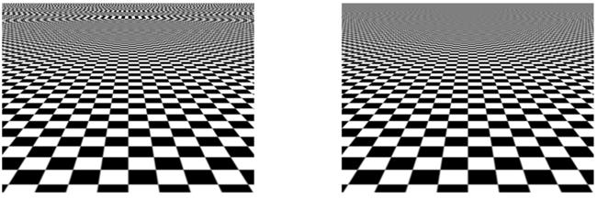
More Gaussian pre-filtering

Slide 52
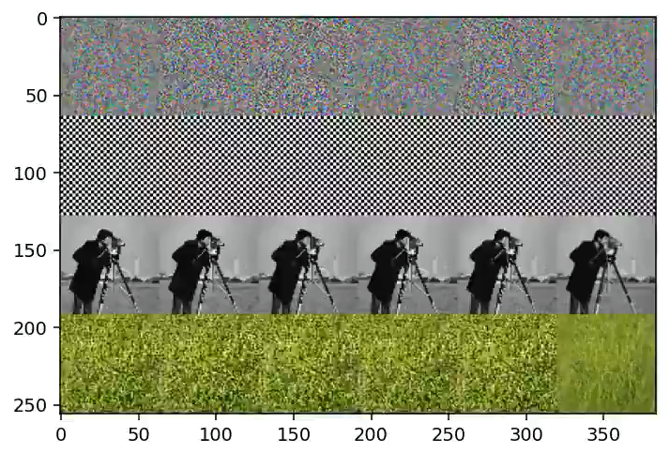
A real problem!
128 x 128 → 64x64
Open-CV: default, bicubic, Lanczos4
Pytorch: bilinear, bicubic
PIL: Lanczos
Credit: @jaakkolehtinen
Notes:
what does not doanti-aliasing? https://twitter.com/jaakkolehtinen/status/1258331829817487360

Slide 53
problems in ConvNets too
pip install antialiased-cnns
Making Convolutional Networks Shift-Invariant Again, Richard Zhang ICML 2019

Slide 54
Iterative Gaussian (lowpass) pre-filtering
G 1/8
G 1/4
Gaussian 1/2
filter the image, then subsample
Filter size should double for each ½ size reduction. Why?
How can we speed this up?
Slide by Steve Seitz
Notes:
3 conv, kernel bigger & bigger..

Slide 55
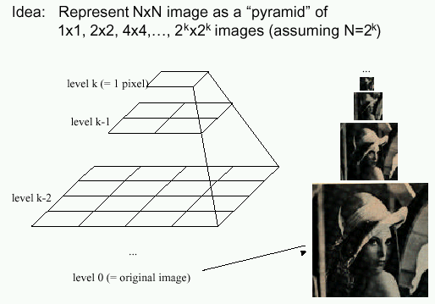
Image Pyramids
Known as a Gaussian Pyramid [Burt and Adelson, 1983]
In computer graphics, a mip map [Williams, 1983]
A precursor to wavelet transform
Slide by Steve Seitz

Slide 56
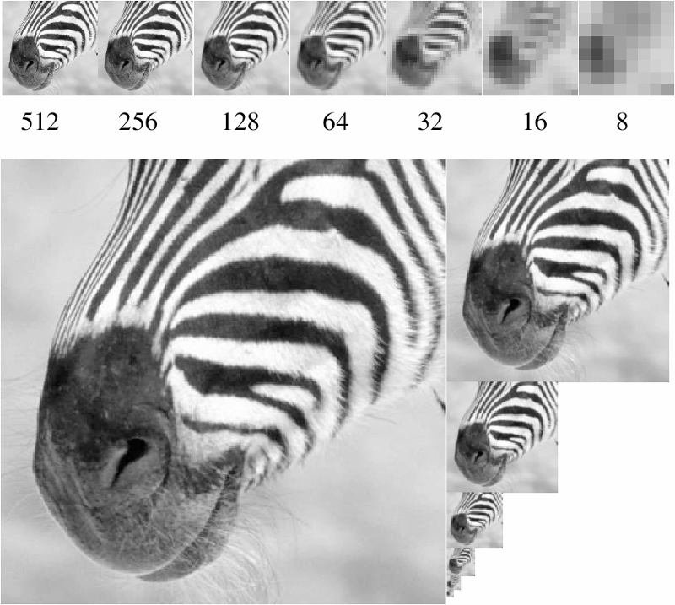
A bar in the big images is a hair on the zebra’s nose; in smaller images, a stripe; in the smallest, the animal’s nose
The whole pyramid is only 4/3 the size of the original image!
Figure from David Forsyth
Notes:
Geometric series: r = ¼, a = 1. sum_{k=0}^inf a*r^k = a / (1-r) for r < 1

Slide 57
Gaussian pyramid construction
filter mask
Repeat
Filter
Subsample
Until minimum resolution reached
can specify desired number of levels (e.g., 3-level pyramid)
Slide by Steve Seitz

Slide 58
What are they good for?
Improve Search
Search over translations
Classic coarse-to-fine strategy
Project 1!
Search over scale
Template matching
E.g. find a face at different scales
Notes:
ginormous gaussian vs small gaussians

Slide 59
What else are convolutions good for?
Taking derivative by convolution
(on board)
Notes:
in 1D ~6 min

Slide 60
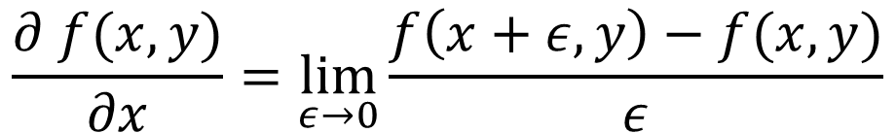
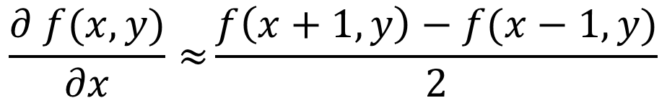
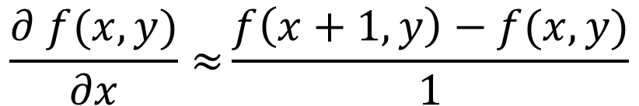
Partial derivatives with convolution
Image is function f(x,y)
$$\frac{∂ f(x,y)}{∂x}=\lim_{ε→0}{\frac{f\left(x+ε,y\right)−f(x,y)}{ε}}$$
Remember:
$$\frac{∂ f(x,y)}{∂x}≈{\frac{f\left(x+1,y\right)−f(x,y)}{1}}$$
Approximate:
-1
1
$$\frac{∂ f(x,y)}{∂x}≈{\frac{f\left(x+1,y\right)−f(x−1,y)}{2}}$$
Another one:
-1
0
1
Notes:
why would you chose one over the other? alignment (odd kernel = symmetric)

Slide 61
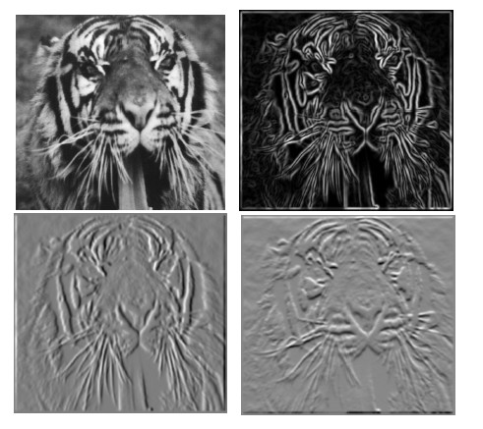
Partial derivatives of an image
-1 1
1 -1
-1 1
or
Which shows changes with respect to x?
Notes:
why 2 derivatives and not 1? when we’re on the hill… what if you’re a bird?

Slide 62
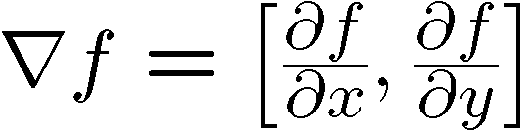





Image gradient
The gradient of an image:
The gradient points in the direction of most rapid increase in intensity
How does this direction relate to the direction of the edge?
The edge strength is given by the gradient magnitude
The gradient direction is given by
Source: Steve Seitz
Notes:
Gradient is just a vector form of derivative
give definition of partial derivative: lim h->0 [f(x+h,y) – f(x,y)]/h Exercise: Point the gradient at locations in the class-room (which walkable surface is the highest magnitude?)

Slide 63
Image Gradient

Slide 64



Partial Derivatives
Notes:
why look gray? – bc can be [-1, 1]. gray is 0, white is 1 (positive) black is -1 (negative)

Slide 65

Gradient magnitude
Notes:
Has no gray! why?

Slide 66


Gradient Orientation
atan2(dy,dx)
lightness is equal to gradient magnitude
Source: D. Fouhey

Slide 67

Image Gradient
all the gradients
Source: D. Fouhey

Slide 68
Image Gradient
Why is there structure at 1 and not at 2?
1
2
Source: D. Fouhey

Slide 69




Effects of noise
Consider a single row or column of the image
Plotting intensity as a function of position gives a signal
Where is the edge?
Source: S. Seitz
Notes:
annoying surprises! How to fix?

Slide 70




Solution: smooth first
f
g
f * g
To find edges, look for peaks in
Source: S. Seitz

Slide 71






Noise in 2D
Noisy Input
dx via [-1,01]
Zoom
Source: D. Fouhey

Slide 72






Noise + Smoothing
Smoothed Input
dx via [-1,01]
Zoom
Source: D. Fouhey

Slide 73
How many convolutions here?
f
g
f * g
can we reduce this?

Slide 74




Derivative theorem of convolution
This saves us one operation:

Slide 75


Derivative of Gaussian filter
* [1 0 -1] =

Slide 76


Derivative of Gaussian filter
x-direction
y-direction
Which one finds horizontal/vertical edges?

Slide 77

Compare to classic derivative filters
Source: K. Grauman
Notes:
Sobel looks like Derivative of gaussian filter. network also figures this out.

Slide 78



Low Pass vs. High Pass filtering
Image
Smoothed
-
Details
=
Notes:
What kind of frequency is this

Slide 79


Filtering – Sharpening
Image
Details
+α
“Sharpened” α=1
=

Slide 80
Filtering – Sharpening
Image
Details
+α
“Sharpened” α=0
=

Slide 81

Filtering – Sharpening
Image
Details
+α
“Sharpened” α=2
=

Slide 82
Filtering – Sharpening
Image
Details
+α
“Sharpened” α=0
=

Slide 83

Filtering – Extreme Sharpening
Image
Details
+α
“Sharpened” α=10
=

Slide 84


Unsharp mask filter (= sharpening filter)
image
blurred image
unit impulse (identity)
unit impulse
Gaussian
Laplacian of Gaussian
Notes:
f + a(f - f * g) = (1+a)f-af*g = f*((1+a)e-g)
Name is confusing.. “unsharp mask” → the mask is made by unsharped image.. High-pass filter!

Slide 85
Filtering: practical matters
What is the size of the output?
(MATLAB) filter2(g, f, shape) or conv2(g,f,shape)
shape = ‘full’: output size is sum of sizes of f and g
shape = ‘same’: output size is same as f
shape = ‘valid’: output size is difference of sizes of f and g
Pytorch conv2d ‘valid’ or ‘same’
full
same
valid
g
g
g
g
f
f
f
g
g
g
g
g
g
g
g
Source: S. Lazebnik
Notes:
85

Slide 86













Practical matters
What about near the edge?
the filter window falls off the edge of the image
need to extrapolate
methods:
clip filter (black)
wrap around (circular)
copy edge
reflect across edge
Source: S. Marschner
Notes:
86

