Slide 1
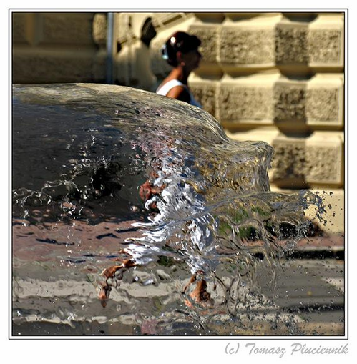
The Camera
CS180: Intro to Comp. Vision, and Comp. Photo
Efros & Kanazawa, UC Berkeley, Fall 2025

Slide 2
PHOTOGRAPHY
Etymology
light
drawing
/ writing

Slide 3
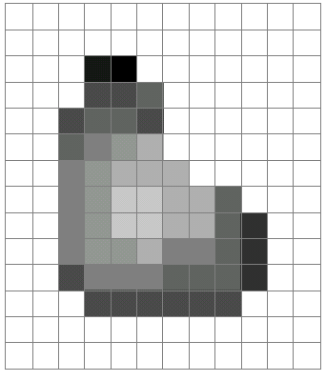
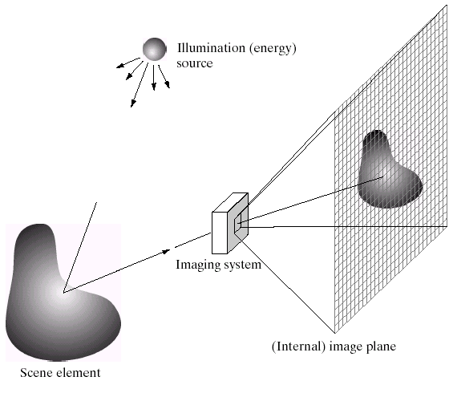
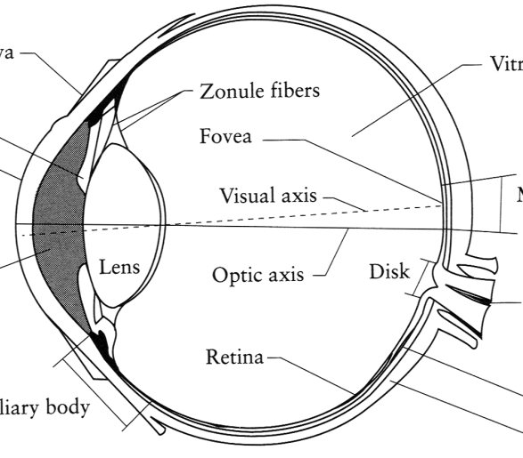
Image Formation
Digital Camera
Film
The Eye

Slide 4
How do we see the world?
Let’s design a camera
Idea 1: put a piece of film in front of an object
Do we get a reasonable image?
Slide by Steve Seitz

Slide 5
Pinhole camera
Add a barrier to block off most of the rays
This reduces blurring
The opening known as the aperture
How does this transform the image?
Slide by Steve Seitz
Notes:
It gets inverted

Slide 6
DIY Pinhole Camera

Slide 7
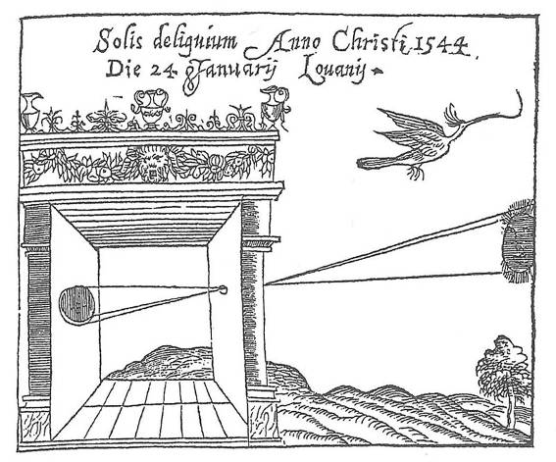
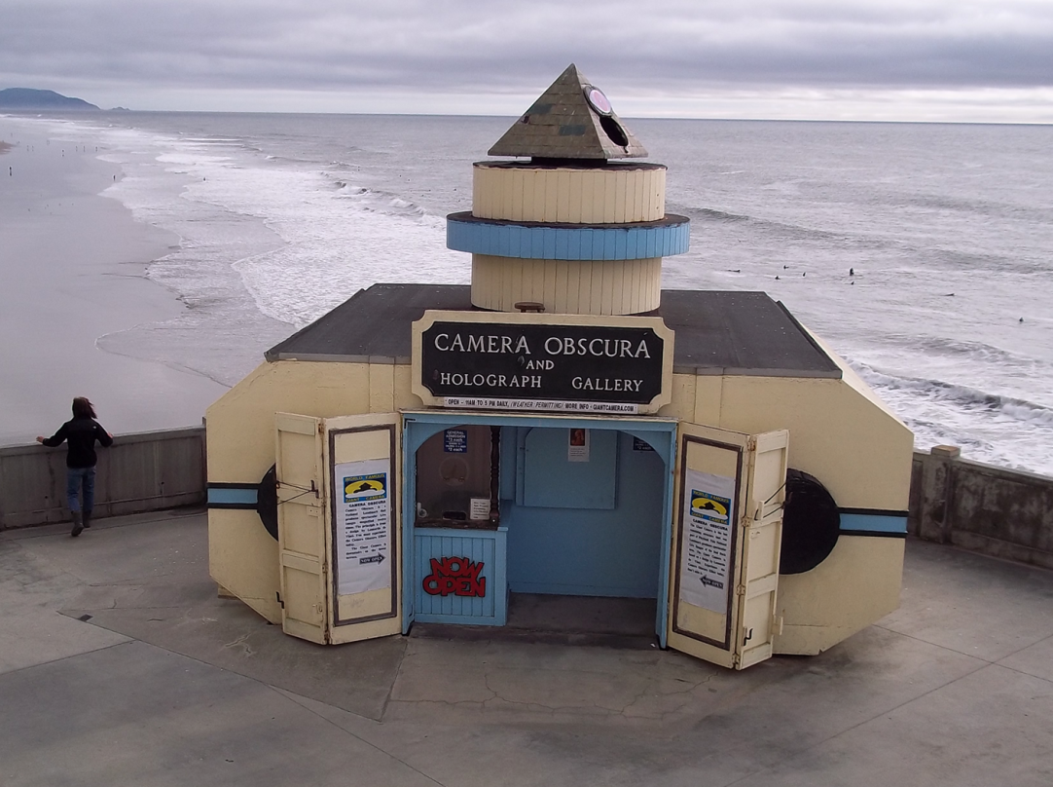
Camera Obscura: the pre-camera
First Idea: Mo-Ti, China (470-390 BC)
First build: Al Hacen, Iraq/Egypt (965-1039 AD)
Drawing aid for artists: described by Leonardo da Vinci (1452-1519)
Gemma Frisius, 1558
Camera Obscura near Cliff House

Slide 8
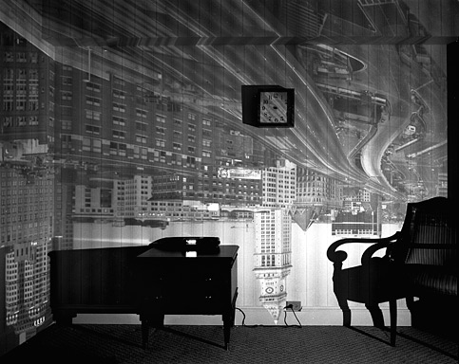
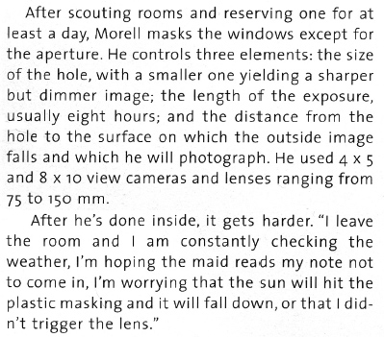
8-hour exposure (Abelardo Morell)
http://www.abelardomorell.net/books/books_m02.html
From Grand Images Through a Tiny Opening, Photo District News, February 2005

Slide 9
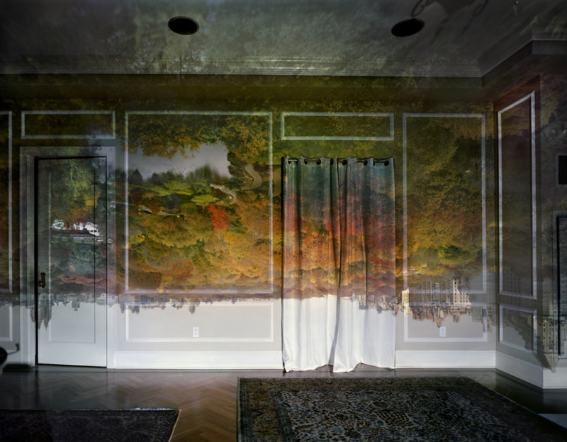

Slide 10
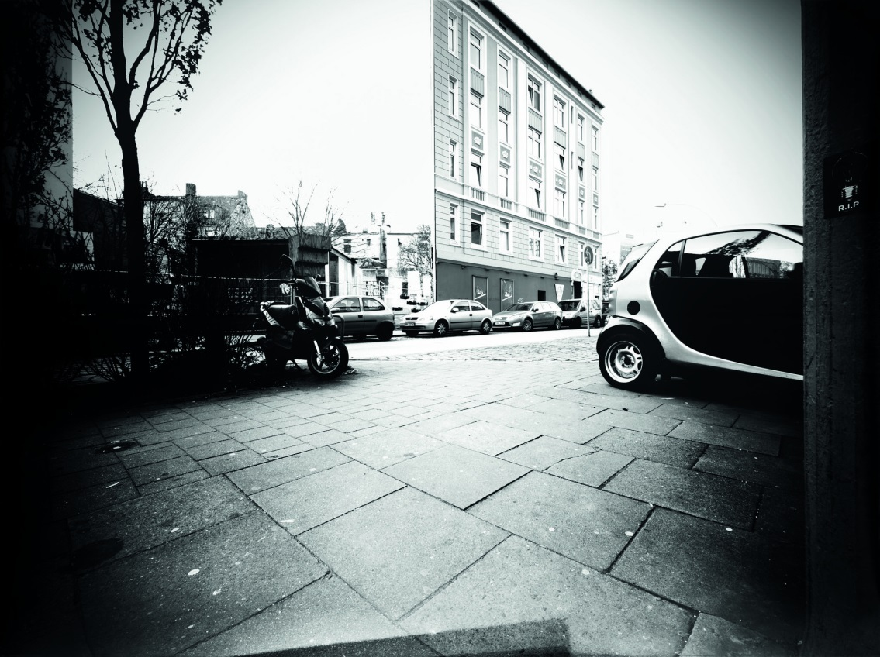

“Trashcam” Project
http://petapixel.com/2012/04/18/german-garbage-men-turn-dumpsters-into-giant-pinhole-cameras/

Slide 11
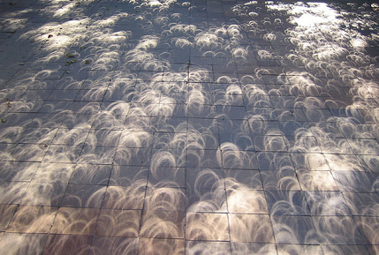
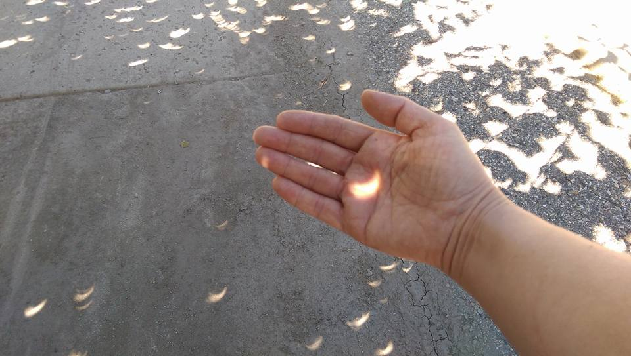
Pinhole cameras everywhere
Tree shadow during a solar eclipse
photo credit: Nils van der Burg http://www.physicstogo.org/index.cfm
© Trina Singley
Slide by Steve Seitz

Slide 12
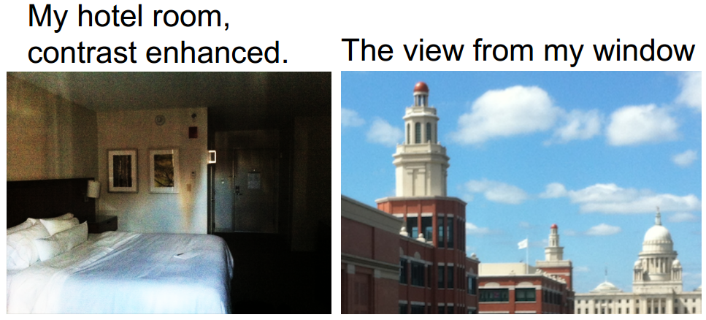
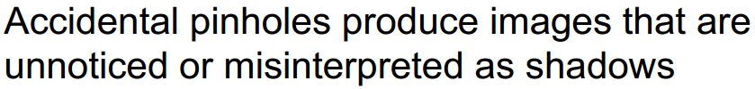
Accidental pinhole cameras
A. Torralba and W. Freeman, Accidental Pinhole and Pinspeck Cameras, CVPR 2012

Slide 13
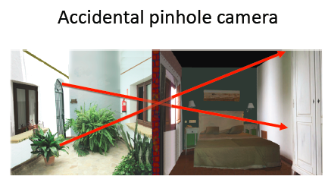
Torralba and Freeman, CVPR’12

Slide 14
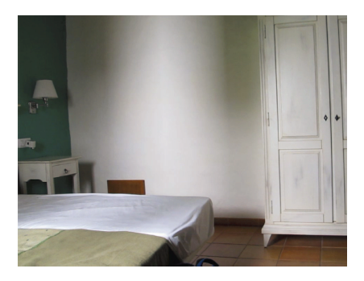

Slide 15
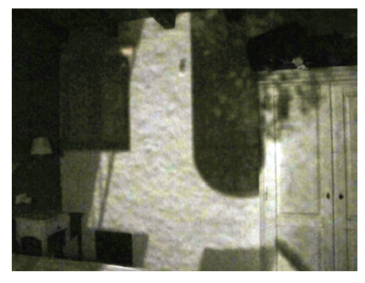

Slide 16
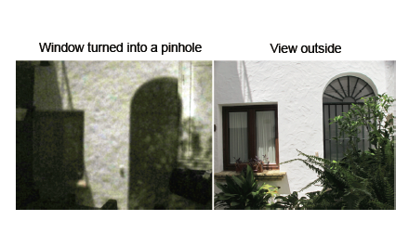

Slide 17
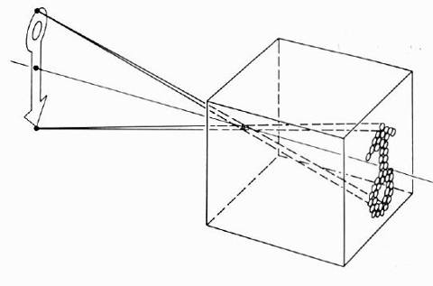
Pinhole camera model
Pinhole model:
Captures pencil of rays – all rays through a single point
The point is called Center of Projection (COP)
The image is formed on the Image Plane
Effective focal length f is distance from COP to Image Plane
Slide by Steve Seitz

Slide 18

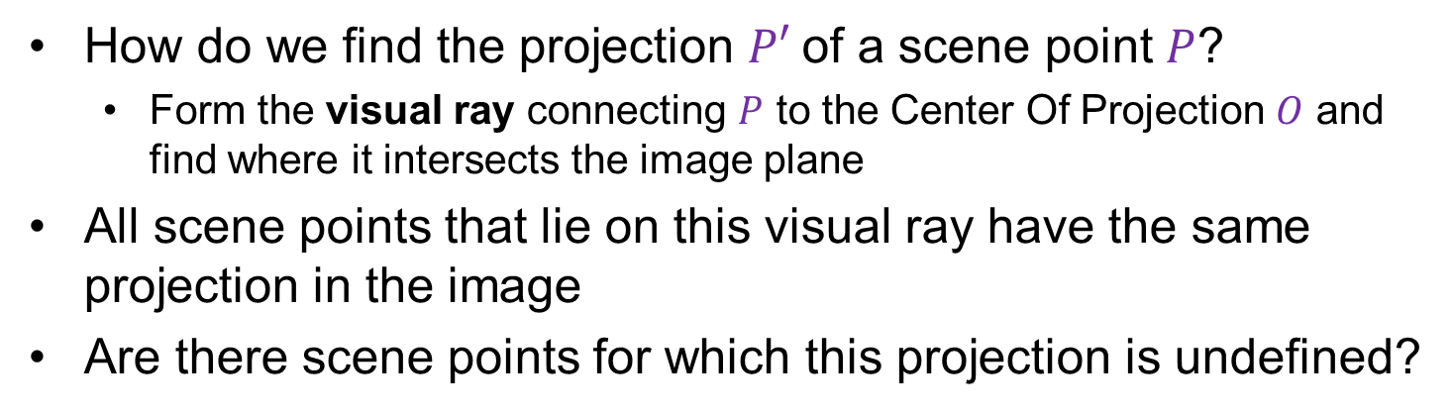


Modeling Projection
$$P$$
$$O$$
$$P′$$
How do we find the projection $P′$of a scene point $P$?
Form the visual ray connecting $P$ to the Center Of Projection $O$ and find where it intersects the image plane
All scene points that lie on this visual ray have the same projection in the image
Are there scene points for which this projection is undefined?
Slide by Lana Lazebnik

Slide 19

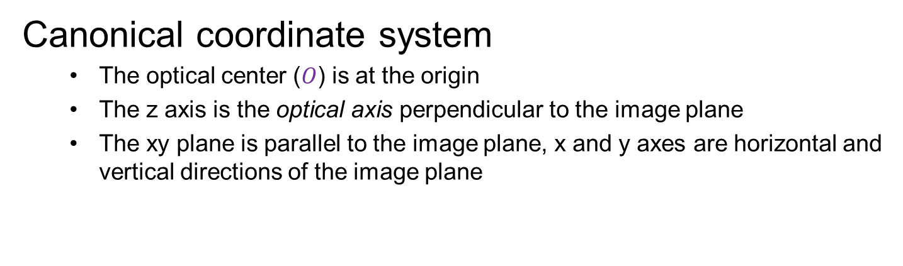


Modeling Projection
$$P$$
$$y$$
$$z$$
$$O$$
$$x$$
$$P′$$
Canonical coordinate system
The optical center ($O$) is at the origin
The z axis is the optical axis perpendicular to the image plane
The xy plane is parallel to the image plane, x and y axes are horizontal and vertical directions of the image plane
Slide by Lana Lazebnik

Slide 20








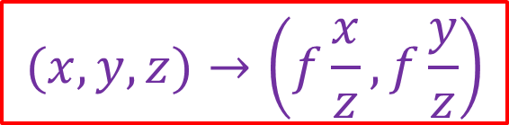
Deriving perspective projection
$$P$$
$$y$$
$$f$$
$$z$$
$$=f\frac{y}{z}$$
$$O$$
$$y^{′}$$
$$P′$$
$$(x,y,z)→\left(f\frac{x}{z},f\frac{y}{z}\right)$$
Slide by Lana Lazebnik

Slide 21
Avoiding Inversion
Instead of dealing with an image that is upside down, most of the time we will pretend that the image plane is in front of the camera center

Slide 22
Dimensionality Reduction Machine (3D to 2D)
3D world
2D image
But there is a problem…
Figures © Stephen E. Palmer, 2002

Slide 23
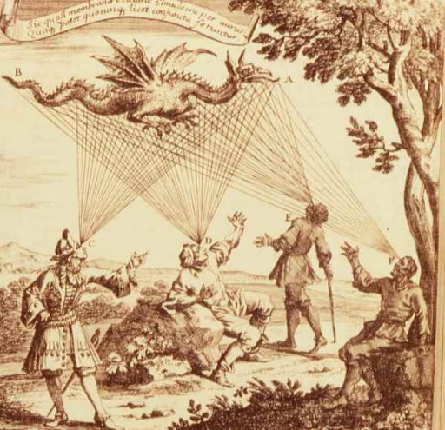

Emission Theory of Vision
“For every complex problem there is an answer that is clear, simple, and wrong.”
-- H. L. Mencken
Supported by:
Empedocles
Plato
Euclid (kinda)
Ptolemy
…
50% of US college students*
*http://www.ncbi.nlm.nih.gov/pubmed/12094435?dopt=Abstract
Eyes send out “feeling rays” into the world

Slide 24
How we see the world
3D world
2D image
Figures © Stephen E. Palmer, 2002

Slide 25
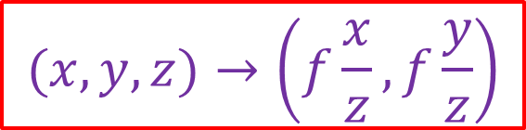
How we see the world
3D world
2D image
Painted
backdrop
$$(x,y,z)→\left(f\frac{x}{z},f\frac{y}{z}\right)$$

Slide 26
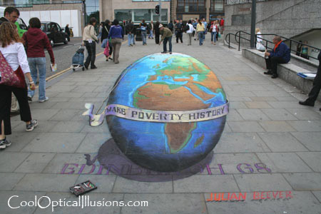
Fooling the eye

Slide 27
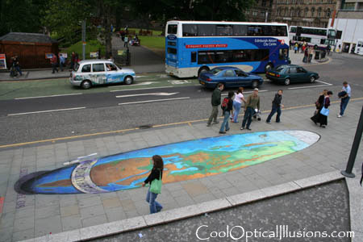
Fooling the eye
Making of 3D sidewalk art: http://www.youtube.com/watch?v=3SNYtd0Ayt0

Slide 28
Dimensionality Reduction Machine (3D to 2D)
3D world
2D image
Why did evolution opt for such strange solution?
Nice to have a passive, long-range sensor
Can get 3D with stereo or by moving around, plus experience

Slide 29
Dimensionality Reduction Machine (3D to 2D)
3D world
2D image
What have we lost?
Angles
Distances (lengths)
Figures © Stephen E. Palmer, 2002

Slide 30
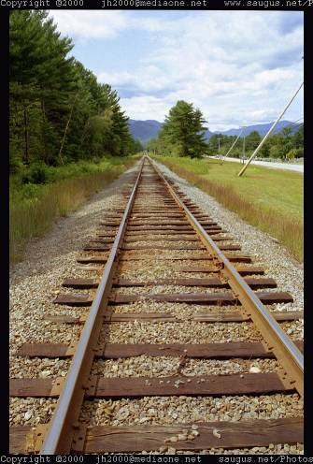
Funny things happen…

Slide 31
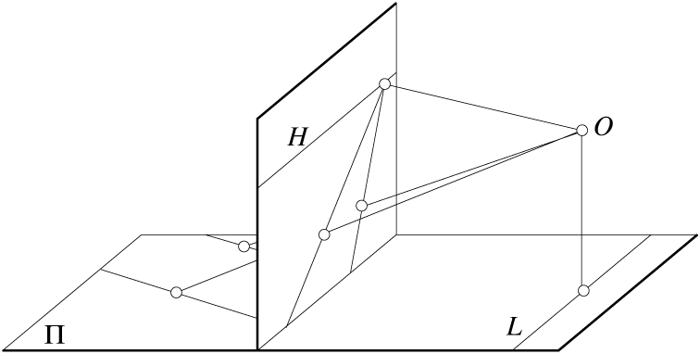
Parallel lines aren’t…
Figure by David Forsyth

Slide 32

Exciting New Study!

Slide 33
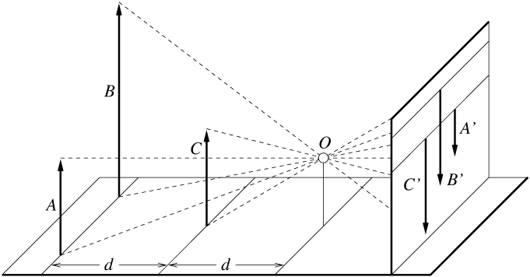
Lengths can’t be trusted...
A’
C’
B’
Figure by David Forsyth

Slide 34
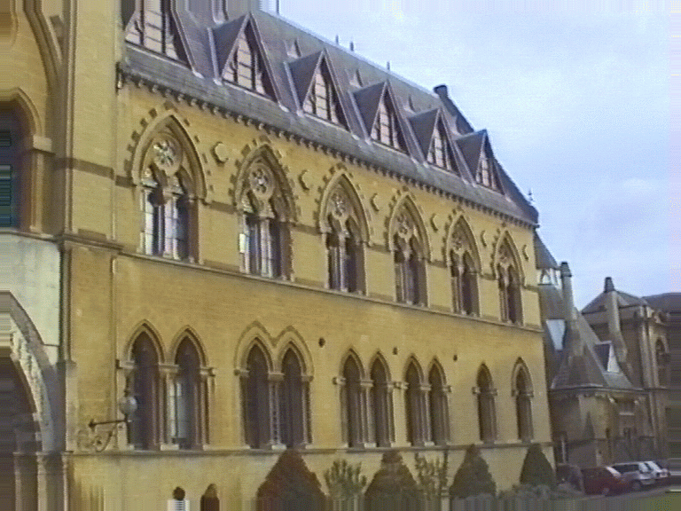
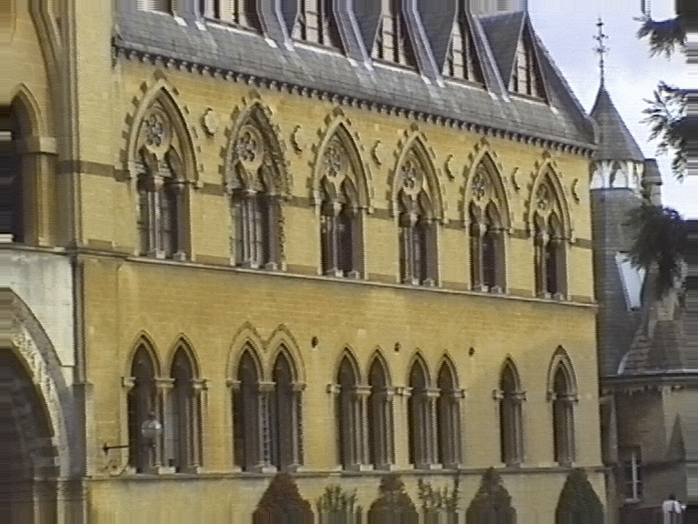
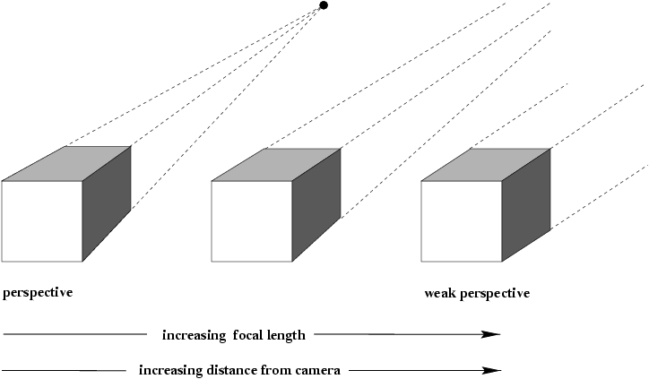
Orthographic or parallel projection
What happens if we walk infinitely far away and zoom infinitely far in?
Slide by Lana Lazebnik

Slide 35




Orthographic or parallel projection
Special case of perspective projection
Distance from center of projection to image plane is infinite
Projection equation: simply drop the z coordinate!
$$y$$
Image
World
$$z$$
$$x$$
$$(x,y,z)→\left(x,y\right)$$
Slide by Steve Seitz
Notes:
Is this a linear function?

Slide 36
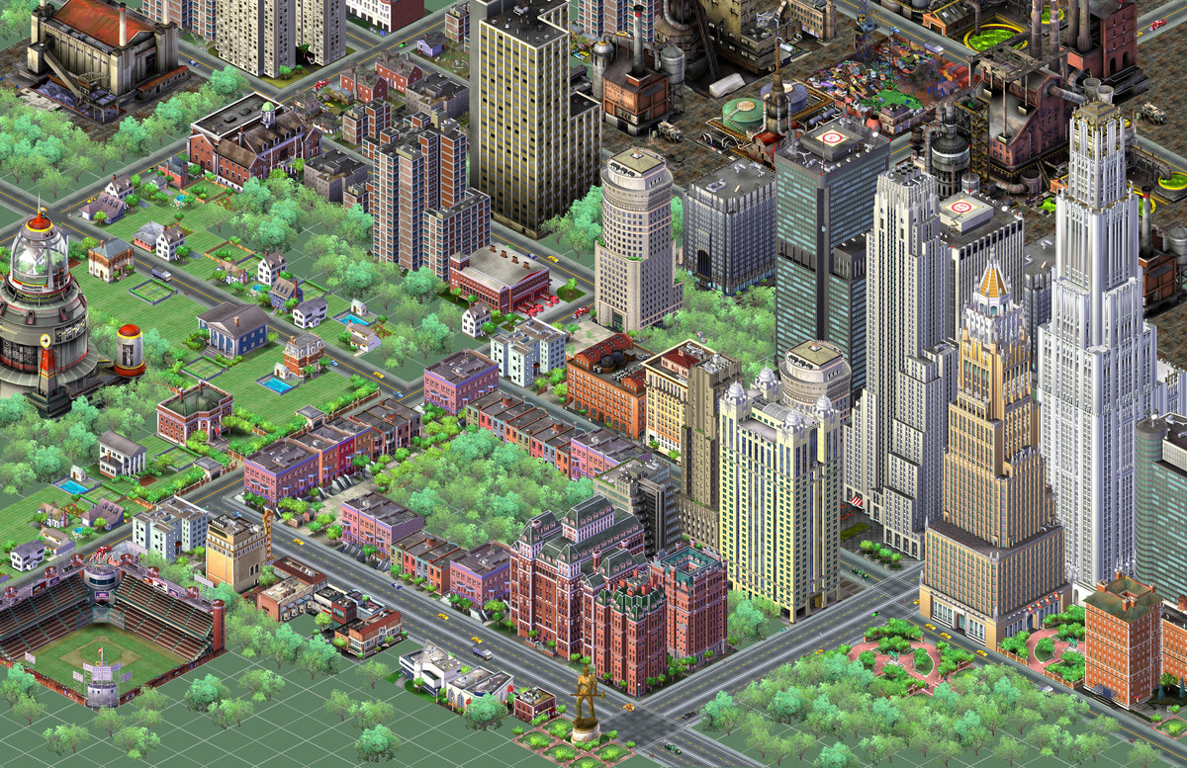
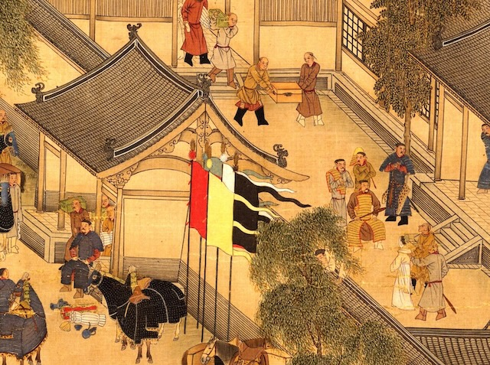
Orthographic or parallel projection
Special case of perspective projection
Distance from center of projection to image plane is infinite
Projection equation: simply drop the z coordinate!
SimCity 2000
12th century Chinese scroll
(via A. Hertzmann)
Slide by Lana Lazebnik
Notes:
Is this a linear function?

Slide 37
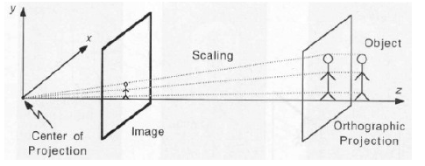
Scaled Orthographic or “Weak Perspective”

Slide 38
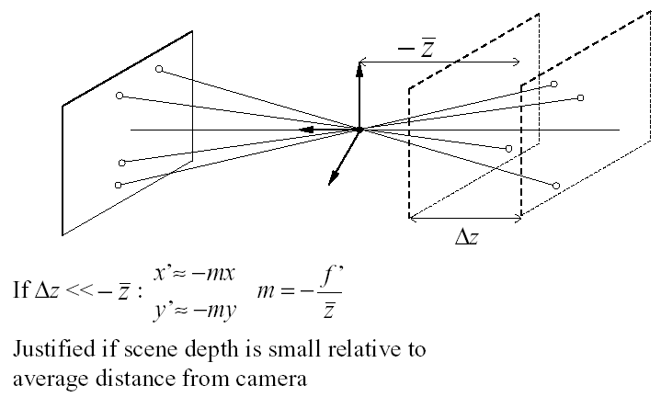
Scaled Orthographic or “Weak Perspective”

Slide 39
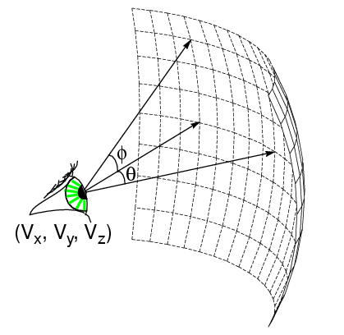
Spherical Projection
What if PP is spherical with center at COP?
In spherical coordinates, projection is trivial:
(θ,φ,f) −> (θ,φ)
Note: doesn’t depend on focal length f!

Slide 40
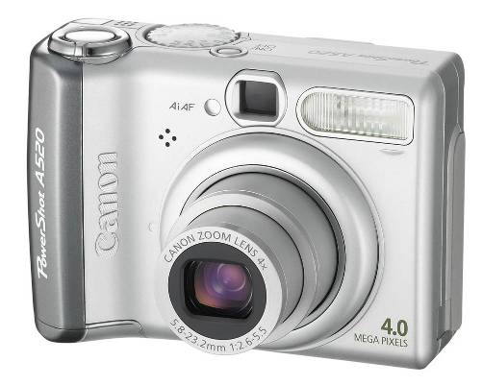
Building a real camera

Slide 41
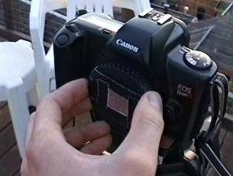
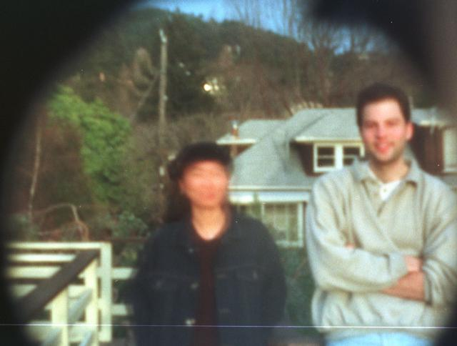
Another way to make pinhole camera
Why so
blurry?
http://www.debevec.org/Pinhole/

Slide 42
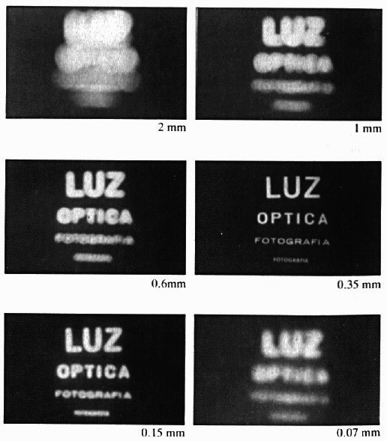
Shrinking the aperture
Less light gets through
Why not make the aperture as small as possible?
Less light gets through
Diffraction effects…
Slide by Steve Seitz

Slide 43
Shrinking the aperture

Slide 44
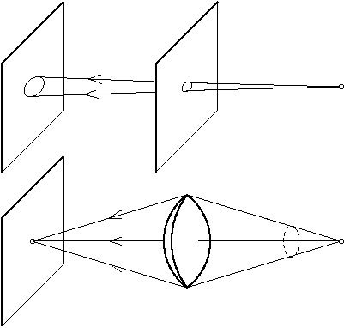
The reason for lenses
Slide by Steve Seitz

Slide 45
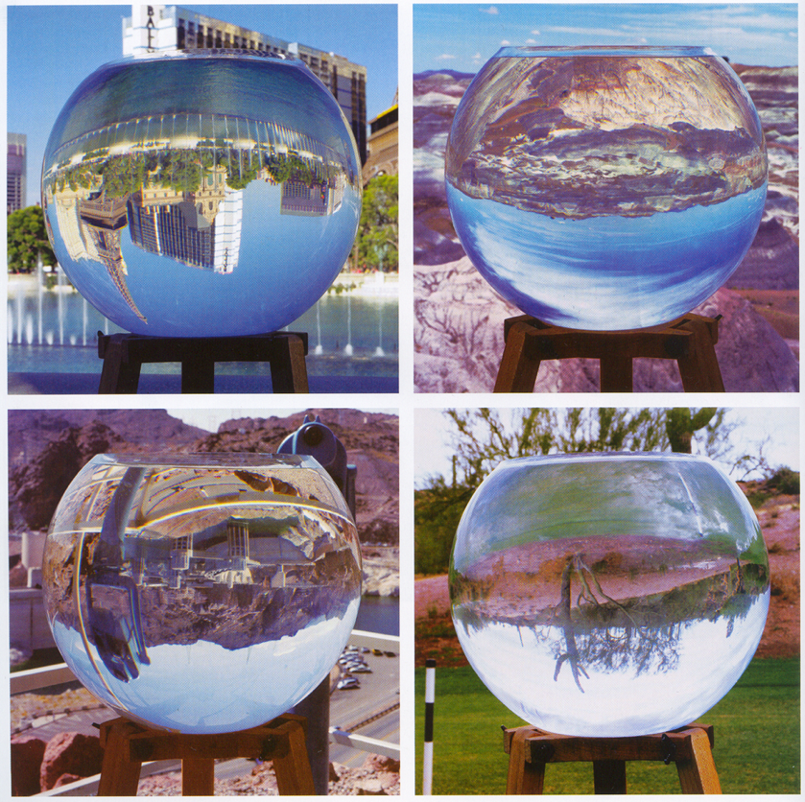
Replacing pinholes with lenses
Photography,
London et al

Slide 46
Focus

Slide 47
Focus and Defocus
“circle of
confusion”
A lens focuses light onto the film
There is a specific distance at which objects are “in focus”
other points project to a “circle of confusion” in the image
Changing the shape of the lens changes this distance
Slide by Steve Seitz

Slide 48
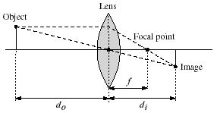
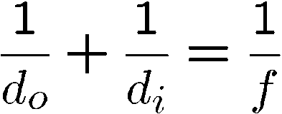
Thin lenses
Thin lens equation:
Any object point satisfying this equation is in focus
What is the shape of the focus region?
Thin lens applet: http://www.phy.ntnu.edu.tw/java/Lens/lens_e.html (by Fu-Kwun Hwang )
Slide by Steve Seitz
Notes:
focal point is where all the rays meet through the lens, the distance bwetetn the focal point and the lens is the focal length with lenses.

Slide 49
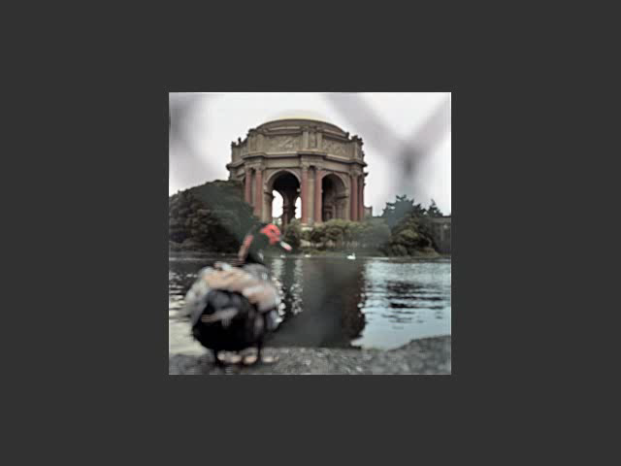
Varying Focus
Ren Ng

Slide 50
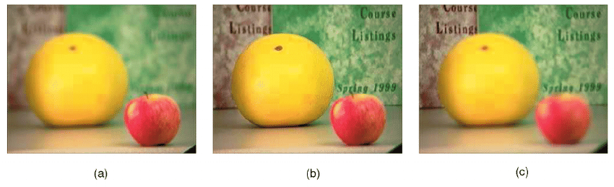
Varying Focus

Slide 51
Depth Of Field

Slide 52

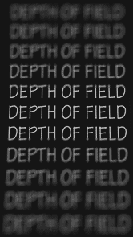
Depth of Field
http://www.cambridgeincolour.com/tutorials/depth-of-field.htm
Notes:
DoF = regions that look like are in focus (not a single plane)

Slide 53
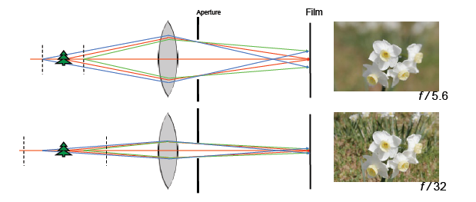
Aperture controls Depth of Field
Changing the aperture size affects depth of field
A smaller aperture increases the range in which the object is approximately in focus
But small aperture reduces amount of light – need to increase exposure
Notes:
phone cameras all have cheap lens and small aperture (everything is kind of in focus, expensive cameras give you stuf like above)

Slide 54

F-number: focal length / aperture diameter

Slide 55


Varying the aperture
Wide apeture = small DOF
Narrow apeture = large DOF

Slide 56

Nice Depth of Field effect

Slide 57
Field of View (Zoom)

Slide 58
Field of View (Zoom)

Slide 59
Field of View (Zoom) = Cropping

Slide 60


FOV depends of Focal Length
f
f
Smaller FOV = larger Focal Length

Slide 61

Expensive toys…

Slide 62



Field of View / Focal Length
Large FOV, small f
Camera close to car
Small FOV, large f
Camera far from the car
Sources: F. Durand

Slide 63

Focal length / distance in portraiture
Notes:
exaggerated perspective effects on the nose, step back and zoom in.

Slide 64
Perspective Compression

Slide 65
Dolly Zoom (“Vertigo Shot”)
http://filmmakermagazine.com/83872-hitchcock-to-scorcese-47-years-of-the-dolly-zoom/#.VBNtn_ldVac

Slide 66
Exposure

Slide 67
Shutter Speed
http://en.wikipedia.org/wiki/Shutter_speed
Notes:
Blur in time

Slide 68

Exposure: shutter speed vs. aperture
Notes:
why pick one over the other? When is the right preferable over the other? wide DoF which one do you want? (A: smaller aperture), if things are moving, then you open it up and won’t need to wait as much

Slide 69

Notes:
very long apertureso much that the earth moved (1hr~)

Slide 70


Fun with slow shutter speeds
Photos by Fredo Durand

Slide 71

More fun
http://vimeo.com/14958082

Slide 72
Lens Flaws

Slide 73

Lens Flaws: Chromatic Aberration
Dispersion: wavelength-dependent refractive index
(enables prism to spread white light beam into rainbow)
Modifies ray-bending and lens focal length: f(λ)
color fringes near edges of image
Corrections: add ‘doublet’ lens of flint glass, etc.

Slide 74




Chromatic Aberration
Slide by Carl Doersch

Slide 75


Chromatic Aberration
Near Lens Center
Near Lens Outer Edge

Slide 76

Radial Distortion (e.g. ‘Barrel’ and ‘pin-cushion’)
straight lines curve around the image center

Slide 77

Radial Distortion
No distortion
Pin cushion
Barrel
Radial distortion of the image
Caused by imperfect lenses
Deviations are most noticeable for rays that pass through the edge of the lens

Slide 78



Radial Distortion

Slide 79

Programming Project #1
Project out TONIGHT!

