Slide 1
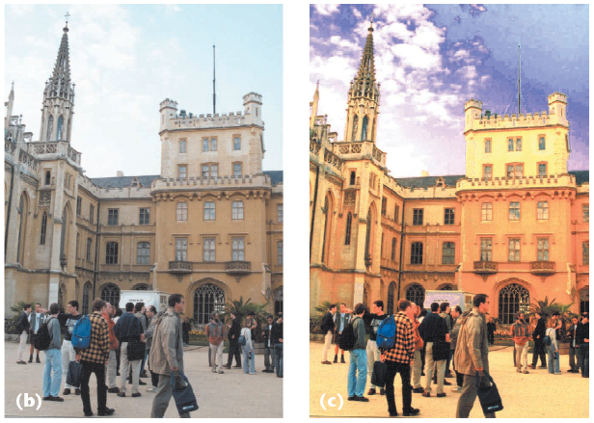
Pixels and Images
CS180: Intro to Comp. Vision, and Comp. Photo
Efros & Kanazawa, UC Berkeley, Fall 2025

Slide 2
What is an image?
We can think of an image as a function, f, from R² to R:
f( x, y ) gives the intensity at position ( x, y )
Realistically, we expect the image only to be defined over a rectangle, with a finite range:
f: [a,b]x[c,d] → [0,1]
A color image is just three functions pasted together. We can write this as a “vector-valued” function:
Notes:
As opposed to [0..255]

Slide 3
Images as functions
Notes:
Render with scanalyze????

Slide 4
How does a pixel get its value?
Light emitted
Fraction of light reflects into camera
Lens
Sensor

Slide 5
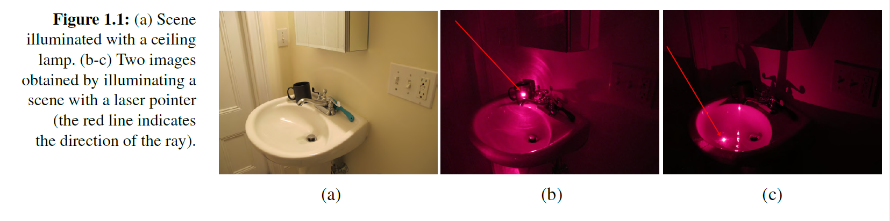
How does a pixel get its value?
Major factors
Illumination strength and direction
Surface geometry
Surface material
Nearby surfaces
Camera gain/exposure
Light emitted
Light reflected to camera
Sensor

Slide 6


Basic models of reflection
Specular: light bounces off at the incident angle
E.g., mirror
Diffuse: light scatters in all directions
E.g., brick, cloth, rough wood
specular reflection
incoming light
$$Θ$$
$$Θ$$
diffuse reflection
incoming light

Slide 7
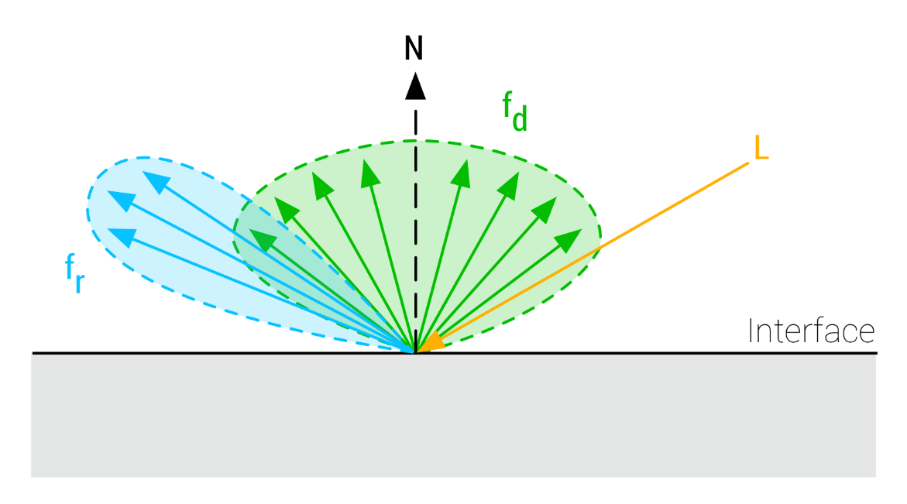
Diffuse vs. Specular

Slide 8



Lambertian reflectance model
Some light is absorbed (function of albedo$ρ$)
Remaining light is scattered (diffuse reflection)
Examples: soft cloth, concrete, matte paints
light source
light source
diffuse reflection
$$ρ$$
absorption
$$(1−ρ)$$
Notes:
albedo is the fraction of light reflected

Slide 9
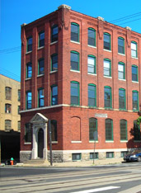
Intensity and Surface Orientation
1
2

Slide 10
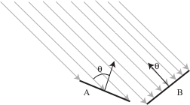
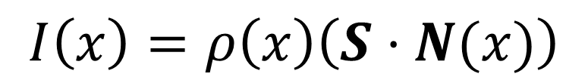
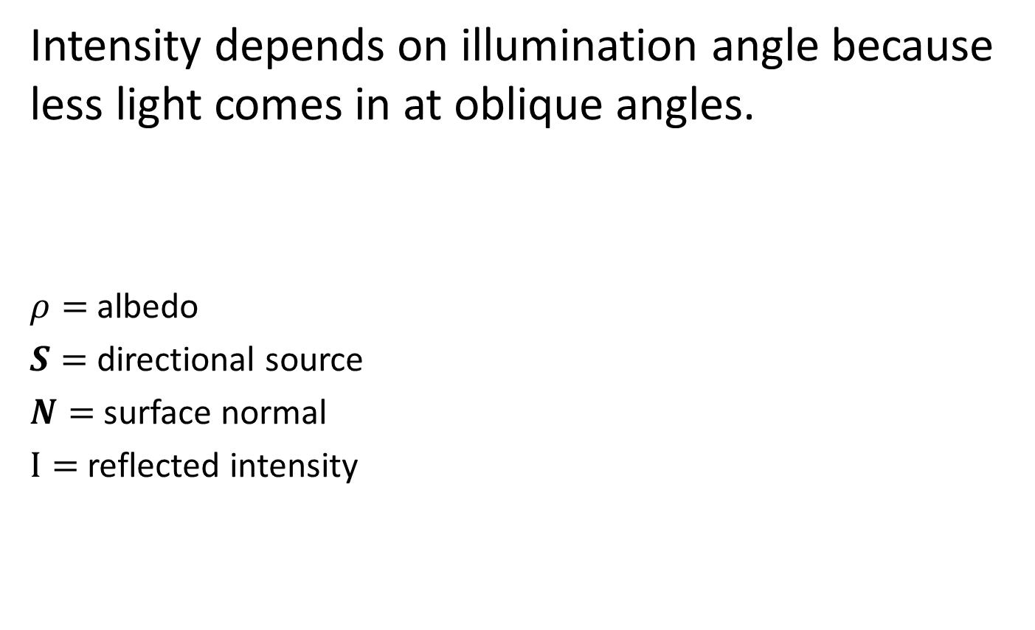
Intensity and Surface Orientation
Intensity depends on illumination angle because less light comes in at oblique angles.
$ρ=$albedo
$S=$ directional source
$N=$ surface normal
$I=$ reflected intensity
$$I\left(x\right)=ρ\left(x\right)\left(S⋅N(x)\right)$$
Slide: Forsyth

Slide 11

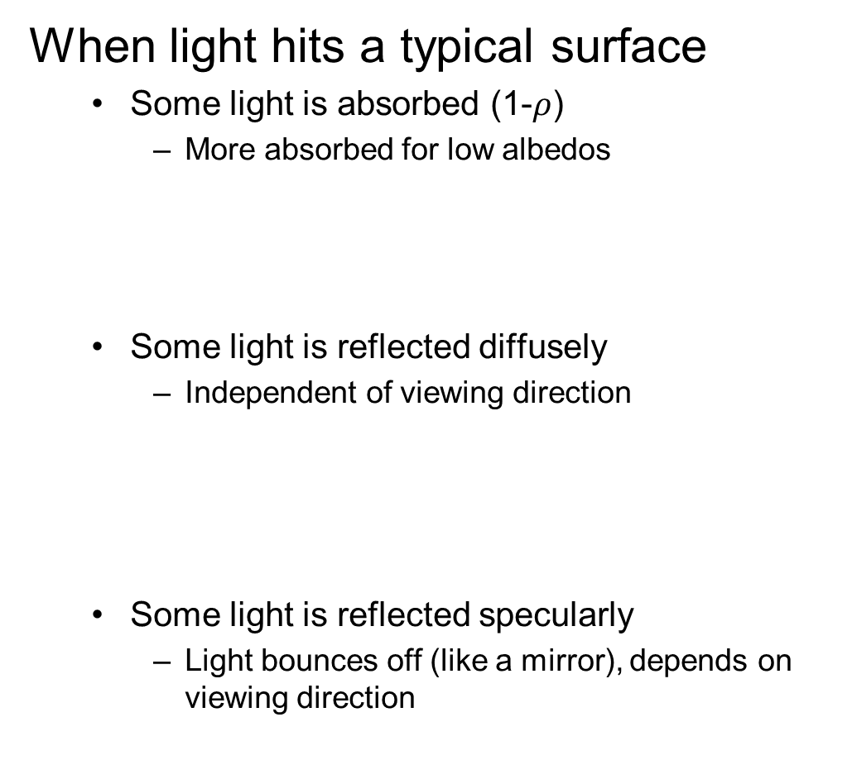

Recap
When light hits a typical surface
Some light is absorbed (1-$ρ$)
More absorbed for low albedos
Some light is reflected diffusely
Independent of viewing direction
Some light is reflected specularly
Light bounces off (like a mirror), depends on viewing direction
absorption
diffuse reflection
specular reflection
$$Θ$$
$$Θ$$

Slide 12
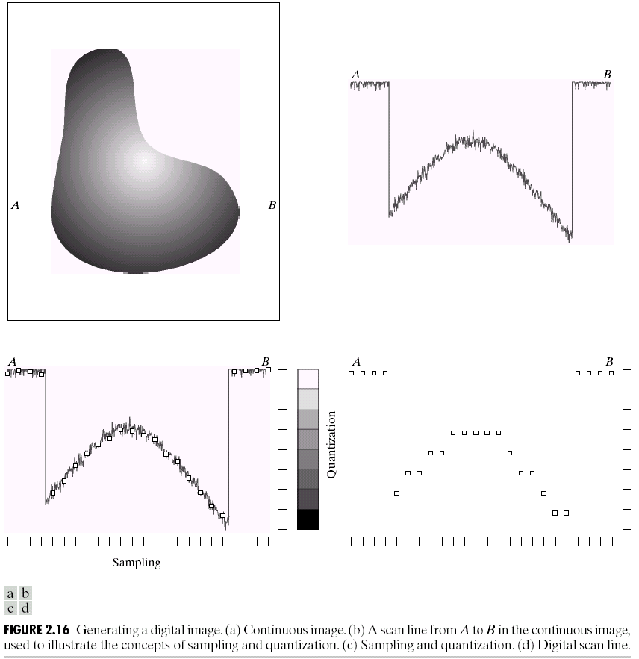
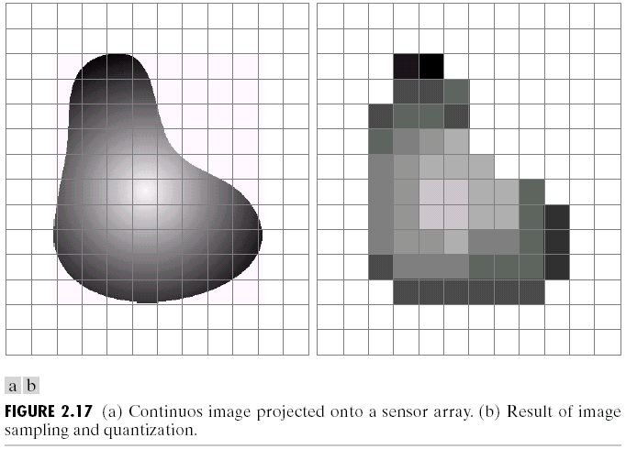
Sampling and Quantization

Slide 13
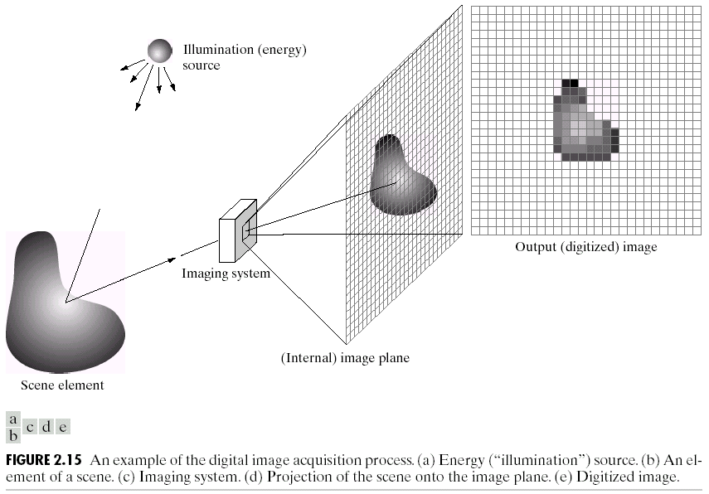
Image Formation
f(x,y) = reflectance(x,y) * illumination(x,y)
Reflectance in [0,1], illumination in [0,inf]

Slide 14
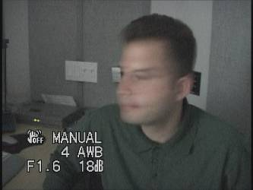
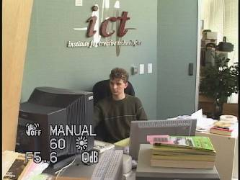
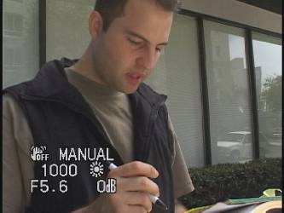
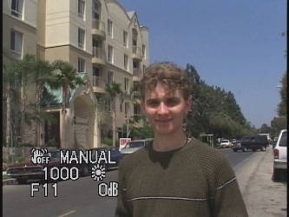
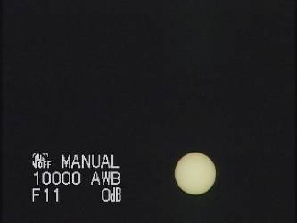
Problem: Dynamic Range
The real world is
High dynamic range
1
1500
25,000
400,000
2,000,000,000

Slide 15
Long Exposure
10⁻⁶
High dynamic range
10⁶
Real world
10⁻⁶
10⁶
Picture
^{0 to 255}

Slide 16
Short Exposure
10⁻⁶
High dynamic range
10⁶
Real world
10⁻⁶
10⁶
Picture
^{0 to 255}

Slide 17
Image Acquisition Pipeline
Lens
Shutter
scene
radiance
(W/sr/m )
sensor
irradiance
∫
sensor
exposure
2
Δt
CCD
ADC
Remapping
analog
voltages
digital
values
pixel
values
Notes:
3

Slide 18
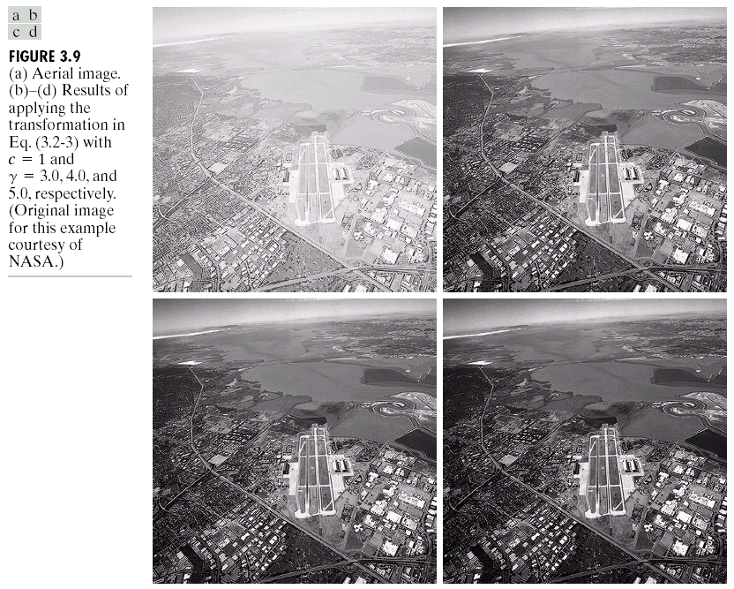
Simple Point Processing: Enhancement

Slide 19
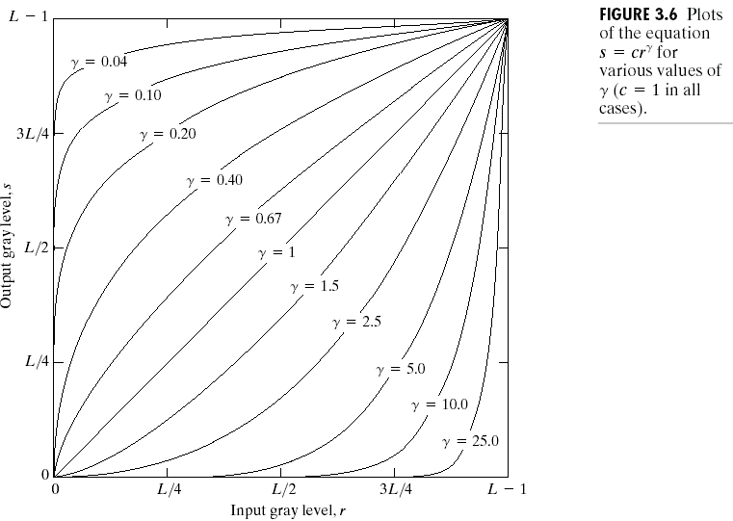
Power-law transformations

Slide 20
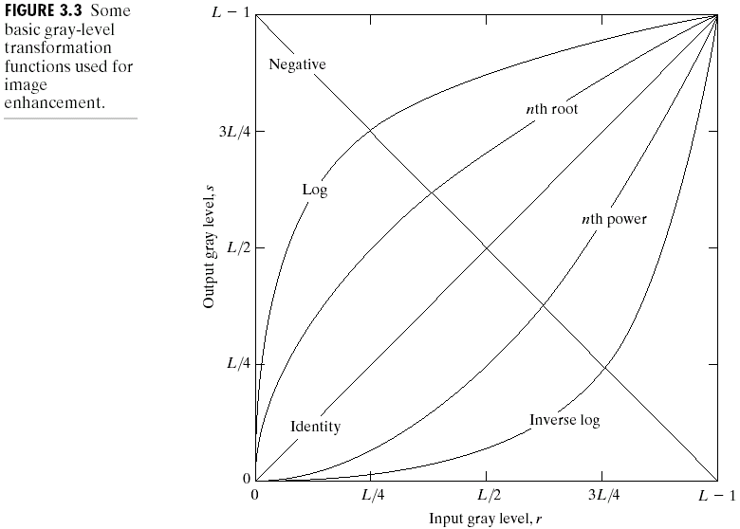
Basic Point Processing

Slide 21
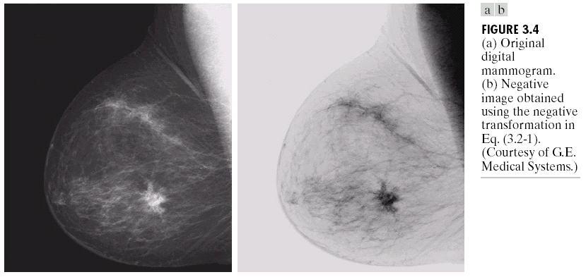
Negative

Slide 22
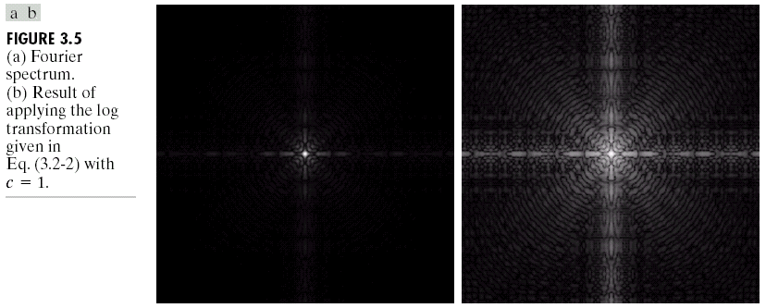
Log

Slide 23
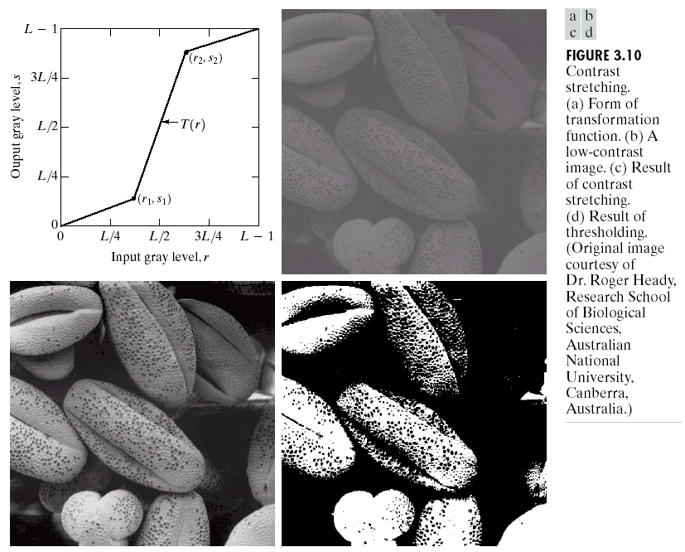
Contrast Stretching

Slide 24
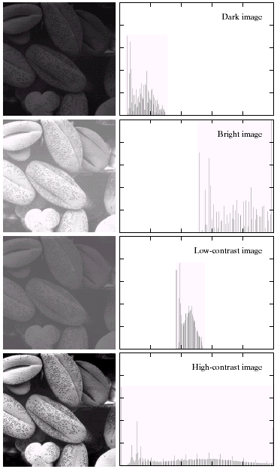
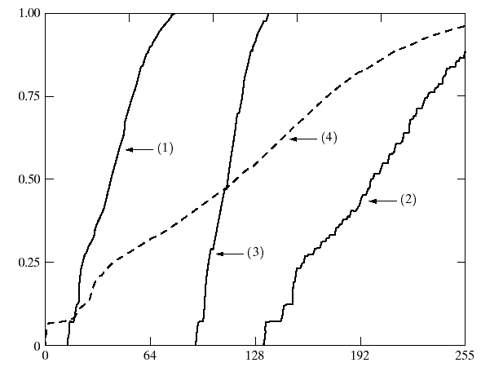

Image Histograms
Cumulative Histograms
s = T(r)

Slide 25
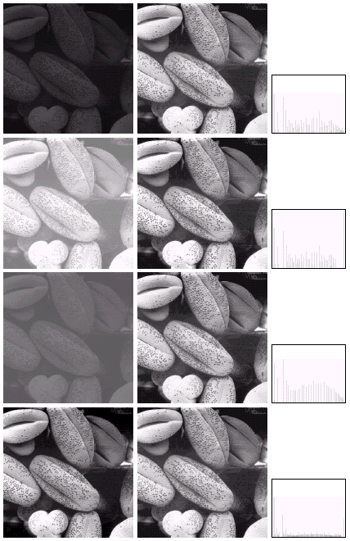

Histogram Equalization

Slide 26
Color Transfer [Reinhard, et al, 2001]
Erik Reinhard, Michael Ashikhmin, Bruce Gooch, Peter Shirley, Color Transfer between Images. IEEE Computer Graphics and Applications, 21(5), pp. 34–41. September 2001.

Slide 27
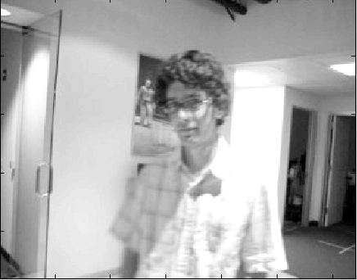
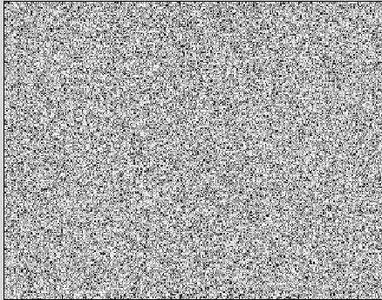
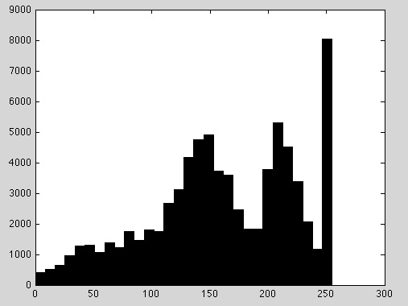
Limitations of Point Processing…
Slide by Erik Learned-Miller

Slide 28

Sampling and Reconstruction

Slide 29
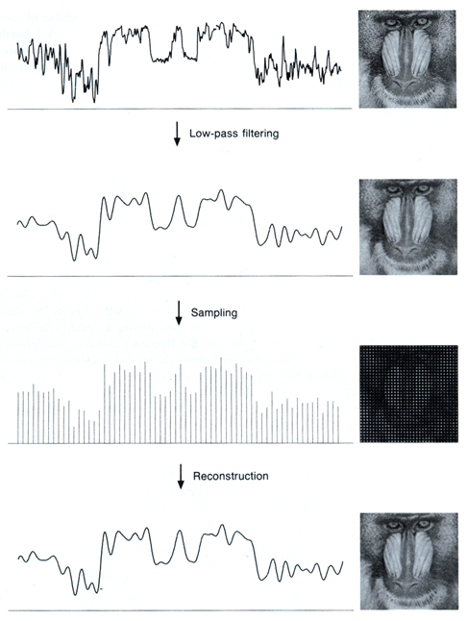
Sampled representations
How to store and compute with continuous functions?
Common scheme for representation: samples
write down the function’s values at many points
[FvDFH fig.14.14b / Wolberg]

Slide 30
Reconstruction
Making samples back into a continuous function
for output (need realizable method)
for analysis or processing (need mathematical method)
amounts to “guessing” what the function did in between
[FvDFH fig.14.14b / Wolberg]

Slide 31
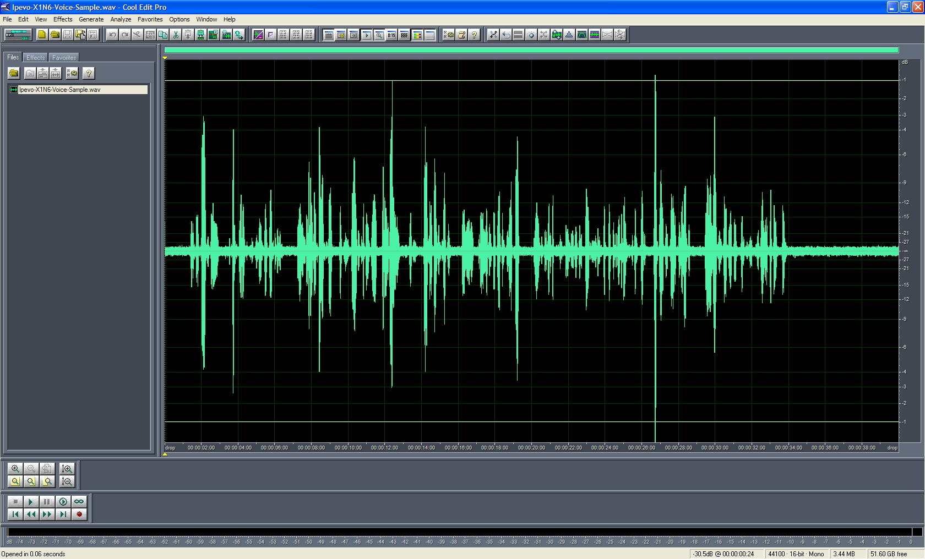
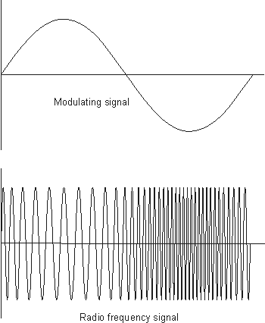
1D Example: Audio
low
high
frequencies

Slide 32
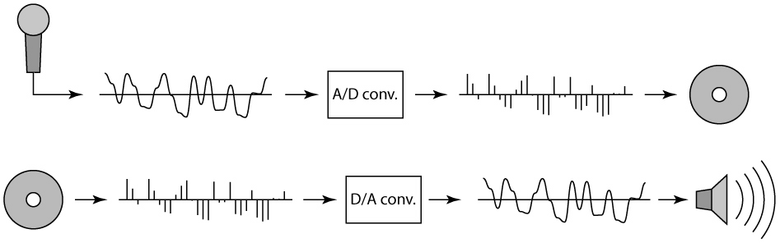
Sampling in digital audio
Recording: sound to analog to samples to disc
Playback: disc to samples to analog to sound again
how can we be sure we are filling in the gaps correctly?

Slide 33
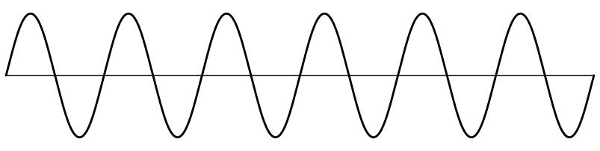
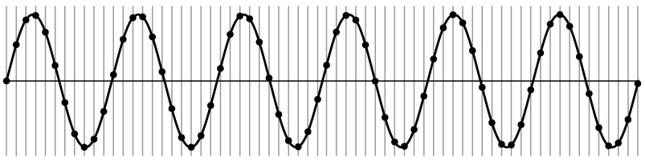
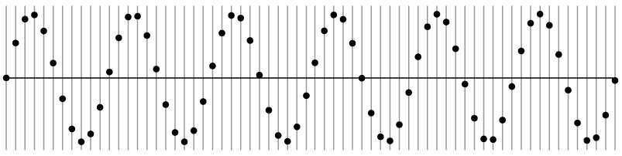
Sampling and Reconstruction
Simple example: a sign wave

Slide 34
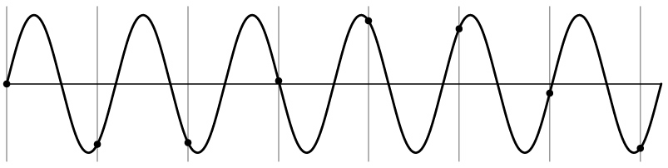
Undersampling
What if we “missed” things between the samples?
Simple example: undersampling a sine wave
unsurprising result: information is lost

Slide 35
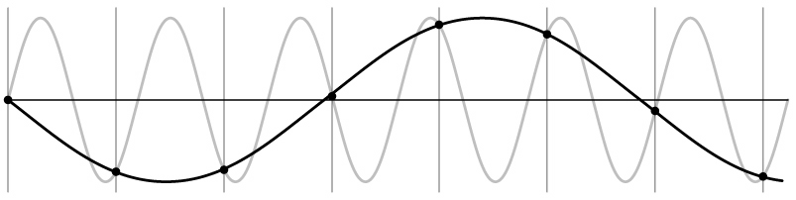
Undersampling
What if we “missed” things between the samples?
Simple example: undersampling a sine wave
unsurprising result: information is lost
surprising result: indistinguishable from lower frequency

Slide 36
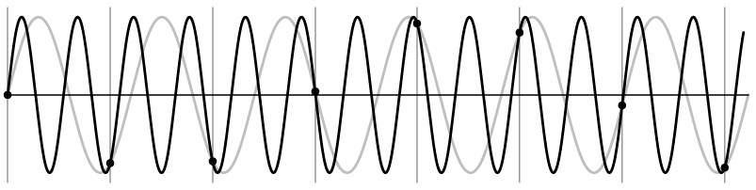
Undersampling
What if we “missed” things between the samples?
Simple example: undersampling a sine wave
unsurprising result: information is lost
surprising result: indistinguishable from lower frequency
also, was always indistinguishable from higher frequencies
aliasing: signals “traveling in disguise” as other frequencies

Slide 37
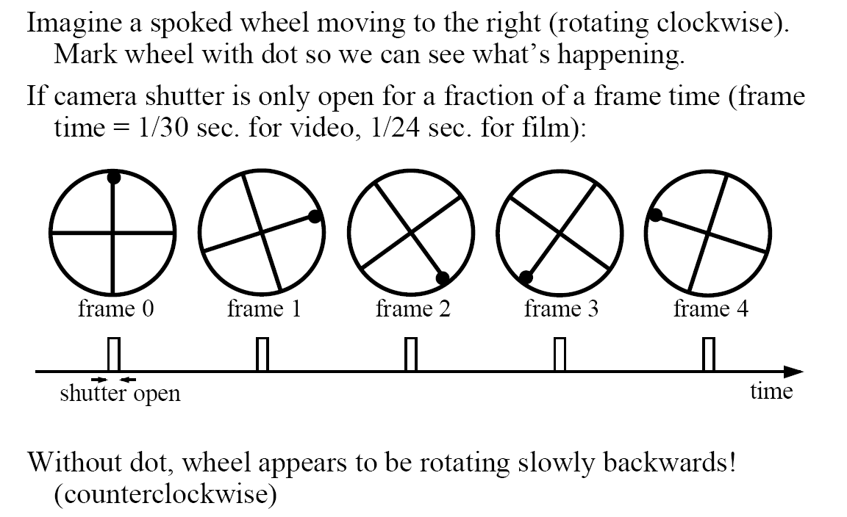
Aliasing in video
Slide by Steve Seitz

Slide 38
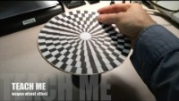

Slide 39
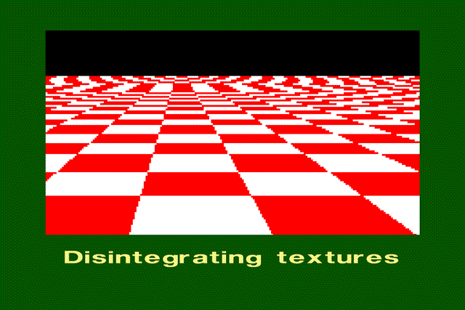
Aliasing in images

Slide 40
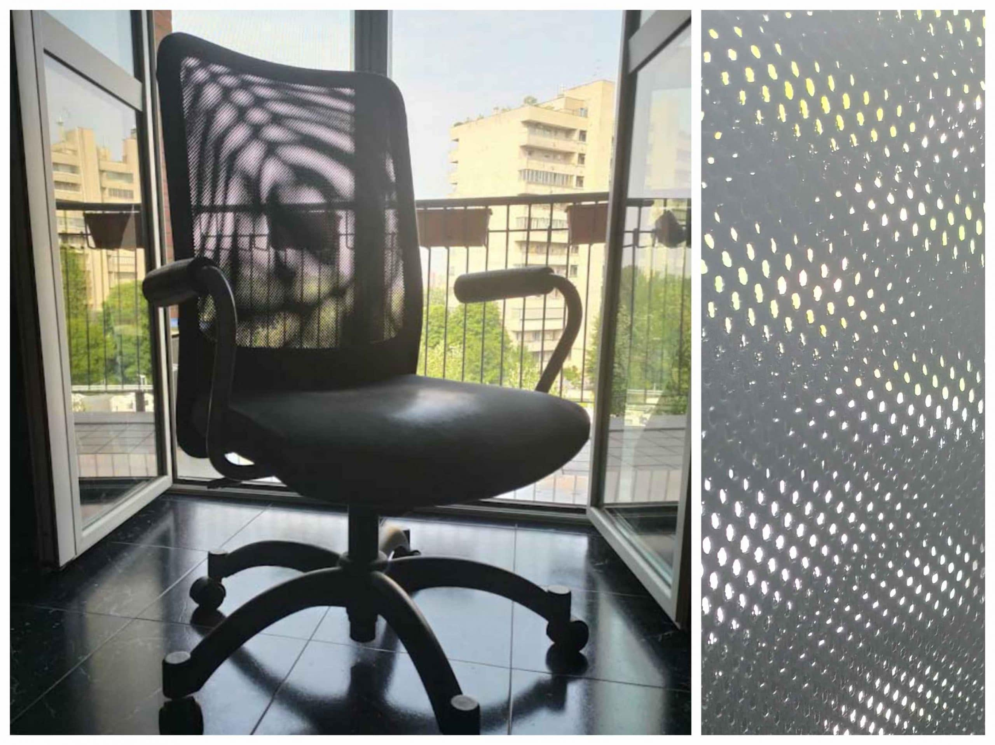
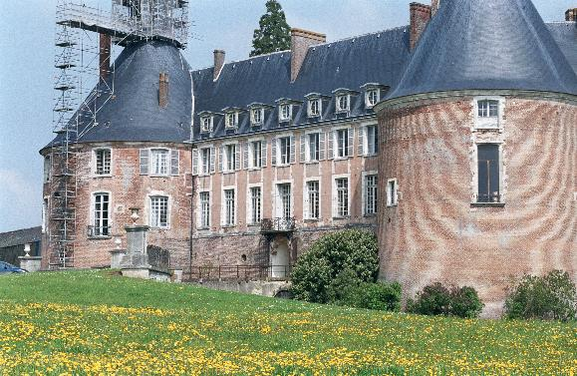
Aliasing in real images

Slide 41
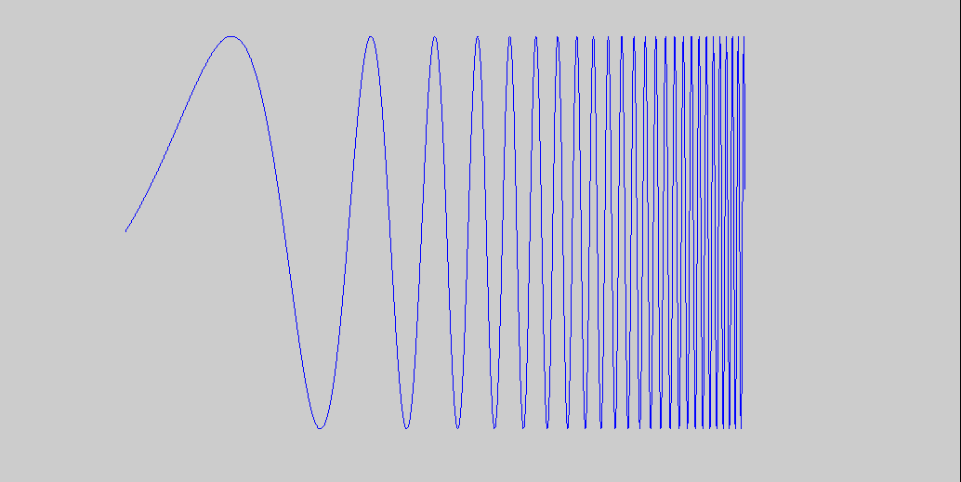
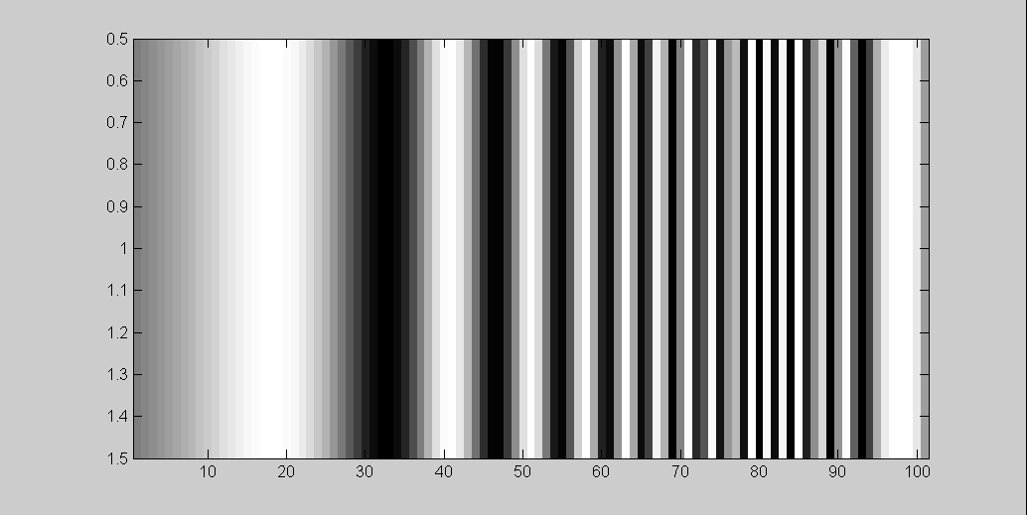
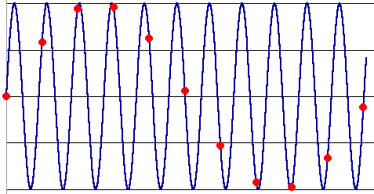
What’s happening?
Input signal:
Plot as image:
x = 0:.05:5; imagesc(sin((2.^x).*x))
Alias!
Not enough samples

Slide 42
Antialiasing
What can we do about aliasing?
Sample more often
Join the Mega-Pixel craze of the photo industry
But this can’t go on forever
Make the signal less “wiggly”
Get rid of some high frequencies
Will loose information
But it’s better than aliasing

Slide 43
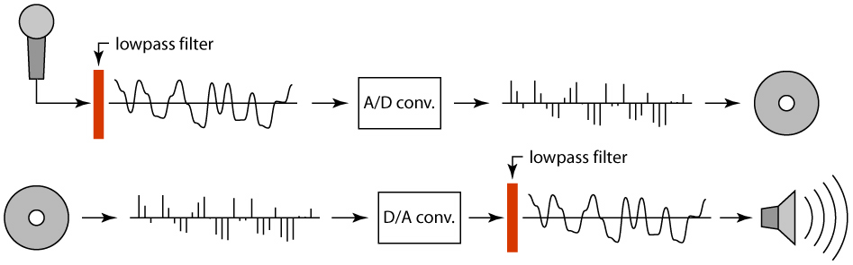
Preventing aliasing
Introduce lowpass filters:
remove high frequencies leaving only safe, low frequencies
choose lowest frequency in reconstruction (disambiguate)

Slide 44
Linear filtering: a key idea
Transformations on signals; e.g.:
bass/treble controls on stereo
blurring/sharpening operations in image editing
smoothing/noise reduction in tracking
Key properties
linearity: filter(f + g) = filter(f) + filter(g)
shift invariance: behavior invariant to shifting the input
delaying an audio signal
sliding an image around
Can be modeled mathematically by convolution

Slide 45
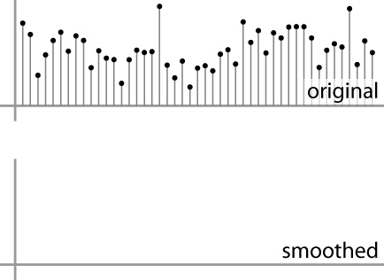
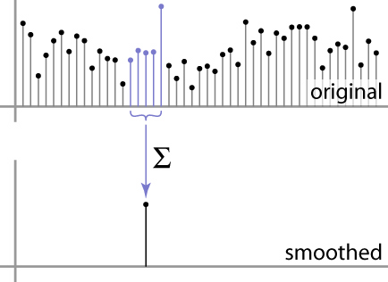



Moving Average
basic idea: define a new function by averaging over a sliding window
a simple example to start off: smoothing

Slide 46

Moving Average
Can add weights to our moving average
Weights […, 0, 1, 1, 1, 1, 1, 0, …] / 5

Slide 47

In 2D: box filter
1
1
1
1
1
1
1
1
1
Slide credit: David Lowe (UBC)

Slide 48
Image filtering
1
1
1
1
1
1
1
1
1
0 | 0 | 0 | 0 | 0 | 0 | 0 | 0 | 0 | 0
0 | 0 | 0 | 0 | 0 | 0 | 0 | 0 | 0 | 0
0 | 0 | 0 | 90 | 90 | 90 | 90 | 90 | 0 | 0
0 | 0 | 0 | 90 | 90 | 90 | 90 | 90 | 0 | 0
0 | 0 | 0 | 90 | 90 | 90 | 90 | 90 | 0 | 0
0 | 0 | 0 | 90 | 0 | 90 | 90 | 90 | 0 | 0
0 | 0 | 0 | 90 | 90 | 90 | 90 | 90 | 0 | 0
0 | 0 | 0 | 0 | 0 | 0 | 0 | 0 | 0 | 0
0 | 0 | 90 | 0 | 0 | 0 | 0 | 0 | 0 | 0
0 | 0 | 0 | 0 | 0 | 0 | 0 | 0 | 0 | 0
 | 0
0 | 0 | 0 | 0 | 0 | 0 | 0 | 0 | 0 | 0
0 | 0 | 0 | 0 | 0 | 0 | 0 | 0 | 0 | 0
0 | 0 | 0 | 90 | 90 | 90 | 90 | 90 | 0 | 0
0 | 0 | 0 | 90 | 90 | 90 | 90 | 90 | 0 | 0
0 | 0 | 0 | 90 | 90 | 90 | 90 | 90 | 0 | 0
0 | 0 | 0 | 90 | 0 | 90 | 90 | 90 | 0 | 0
0 | 0 | 0 | 90 | 90 | 90 | 90 | 90 | 0 | 0
0 | 0 | 0 | 0 | 0 | 0 | 0 | 0 | 0 | 0
0 | 0 | 90 | 0 | 0 | 0 | 0 | 0 | 0 | 0
0 | 0 | 0 | 0 | 0 | 0 | 0 | 0 | 0 | 0
Credit: S. Seitz
Notes:
ones, divide by 9

Slide 49
Image filtering
1
1
1
1
1
1
1
1
1
0 | 0 | 0 | 0 | 0 | 0 | 0 | 0 | 0 | 0
0 | 0 | 0 | 0 | 0 | 0 | 0 | 0 | 0 | 0
0 | 0 | 0 | 90 | 90 | 90 | 90 | 90 | 0 | 0
0 | 0 | 0 | 90 | 90 | 90 | 90 | 90 | 0 | 0
0 | 0 | 0 | 90 | 90 | 90 | 90 | 90 | 0 | 0
0 | 0 | 0 | 90 | 0 | 90 | 90 | 90 | 0 | 0
0 | 0 | 0 | 90 | 90 | 90 | 90 | 90 | 0 | 0
0 | 0 | 0 | 0 | 0 | 0 | 0 | 0 | 0 | 0
0 | 0 | 90 | 0 | 0 | 0 | 0 | 0 | 0 | 0
0 | 0 | 0 | 0 | 0 | 0 | 0 | 0 | 0 | 0
 | 0 | 10
0 | 0 | 0 | 0 | 0 | 0 | 0 | 0 | 0 | 0
0 | 0 | 0 | 0 | 0 | 0 | 0 | 0 | 0 | 0
0 | 0 | 0 | 90 | 90 | 90 | 90 | 90 | 0 | 0
0 | 0 | 0 | 90 | 90 | 90 | 90 | 90 | 0 | 0
0 | 0 | 0 | 90 | 90 | 90 | 90 | 90 | 0 | 0
0 | 0 | 0 | 90 | 0 | 90 | 90 | 90 | 0 | 0
0 | 0 | 0 | 90 | 90 | 90 | 90 | 90 | 0 | 0
0 | 0 | 0 | 0 | 0 | 0 | 0 | 0 | 0 | 0
0 | 0 | 90 | 0 | 0 | 0 | 0 | 0 | 0 | 0
0 | 0 | 0 | 0 | 0 | 0 | 0 | 0 | 0 | 0
Credit: S. Seitz
Notes:
ones, divide by 9

Slide 50
Image filtering
1
1
1
1
1
1
1
1
1
0 | 0 | 0 | 0 | 0 | 0 | 0 | 0 | 0 | 0
0 | 0 | 0 | 0 | 0 | 0 | 0 | 0 | 0 | 0
0 | 0 | 0 | 90 | 90 | 90 | 90 | 90 | 0 | 0
0 | 0 | 0 | 90 | 90 | 90 | 90 | 90 | 0 | 0
0 | 0 | 0 | 90 | 90 | 90 | 90 | 90 | 0 | 0
0 | 0 | 0 | 90 | 0 | 90 | 90 | 90 | 0 | 0
0 | 0 | 0 | 90 | 90 | 90 | 90 | 90 | 0 | 0
0 | 0 | 0 | 0 | 0 | 0 | 0 | 0 | 0 | 0
0 | 0 | 90 | 0 | 0 | 0 | 0 | 0 | 0 | 0
0 | 0 | 0 | 0 | 0 | 0 | 0 | 0 | 0 | 0
 | 0 | 10 | 20
0 | 0 | 0 | 0 | 0 | 0 | 0 | 0 | 0 | 0
0 | 0 | 0 | 0 | 0 | 0 | 0 | 0 | 0 | 0
0 | 0 | 0 | 90 | 90 | 90 | 90 | 90 | 0 | 0
0 | 0 | 0 | 90 | 90 | 90 | 90 | 90 | 0 | 0
0 | 0 | 0 | 90 | 90 | 90 | 90 | 90 | 0 | 0
0 | 0 | 0 | 90 | 0 | 90 | 90 | 90 | 0 | 0
0 | 0 | 0 | 90 | 90 | 90 | 90 | 90 | 0 | 0
0 | 0 | 0 | 0 | 0 | 0 | 0 | 0 | 0 | 0
0 | 0 | 90 | 0 | 0 | 0 | 0 | 0 | 0 | 0
0 | 0 | 0 | 0 | 0 | 0 | 0 | 0 | 0 | 0
Credit: S. Seitz
Notes:
ones, divide by 9

Slide 51
Image filtering
1
1
1
1
1
1
1
1
1
0 | 0 | 0 | 0 | 0 | 0 | 0 | 0 | 0 | 0
0 | 0 | 0 | 0 | 0 | 0 | 0 | 0 | 0 | 0
0 | 0 | 0 | 90 | 90 | 90 | 90 | 90 | 0 | 0
0 | 0 | 0 | 90 | 90 | 90 | 90 | 90 | 0 | 0
0 | 0 | 0 | 90 | 90 | 90 | 90 | 90 | 0 | 0
0 | 0 | 0 | 90 | 0 | 90 | 90 | 90 | 0 | 0
0 | 0 | 0 | 90 | 90 | 90 | 90 | 90 | 0 | 0
0 | 0 | 0 | 0 | 0 | 0 | 0 | 0 | 0 | 0
0 | 0 | 90 | 0 | 0 | 0 | 0 | 0 | 0 | 0
0 | 0 | 0 | 0 | 0 | 0 | 0 | 0 | 0 | 0
 | 0 | 10 | 20 | 30
0 | 0 | 0 | 0 | 0 | 0 | 0 | 0 | 0 | 0
0 | 0 | 0 | 0 | 0 | 0 | 0 | 0 | 0 | 0
0 | 0 | 0 | 90 | 90 | 90 | 90 | 90 | 0 | 0
0 | 0 | 0 | 90 | 90 | 90 | 90 | 90 | 0 | 0
0 | 0 | 0 | 90 | 90 | 90 | 90 | 90 | 0 | 0
0 | 0 | 0 | 90 | 0 | 90 | 90 | 90 | 0 | 0
0 | 0 | 0 | 90 | 90 | 90 | 90 | 90 | 0 | 0
0 | 0 | 0 | 0 | 0 | 0 | 0 | 0 | 0 | 0
0 | 0 | 90 | 0 | 0 | 0 | 0 | 0 | 0 | 0
0 | 0 | 0 | 0 | 0 | 0 | 0 | 0 | 0 | 0
Credit: S. Seitz
Notes:
ones, divide by 9

Slide 52
Image filtering
1
1
1
1
1
1
1
1
1
0 | 0 | 0 | 0 | 0 | 0 | 0 | 0 | 0 | 0
0 | 0 | 0 | 0 | 0 | 0 | 0 | 0 | 0 | 0
0 | 0 | 0 | 90 | 90 | 90 | 90 | 90 | 0 | 0
0 | 0 | 0 | 90 | 90 | 90 | 90 | 90 | 0 | 0
0 | 0 | 0 | 90 | 90 | 90 | 90 | 90 | 0 | 0
0 | 0 | 0 | 90 | 0 | 90 | 90 | 90 | 0 | 0
0 | 0 | 0 | 90 | 90 | 90 | 90 | 90 | 0 | 0
0 | 0 | 0 | 0 | 0 | 0 | 0 | 0 | 0 | 0
0 | 0 | 90 | 0 | 0 | 0 | 0 | 0 | 0 | 0
0 | 0 | 0 | 0 | 0 | 0 | 0 | 0 | 0 | 0
 | 0 | 10 | 20 | 30 | 30
Credit: S. Seitz
Notes:
ones, divide by 9

Slide 53
Image filtering
1
1
1
1
1
1
1
1
1
0 | 0 | 0 | 0 | 0 | 0 | 0 | 0 | 0 | 0
0 | 0 | 0 | 0 | 0 | 0 | 0 | 0 | 0 | 0
0 | 0 | 0 | 90 | 90 | 90 | 90 | 90 | 0 | 0
0 | 0 | 0 | 90 | 90 | 90 | 90 | 90 | 0 | 0
0 | 0 | 0 | 90 | 90 | 90 | 90 | 90 | 0 | 0
0 | 0 | 0 | 90 | 0 | 90 | 90 | 90 | 0 | 0
0 | 0 | 0 | 90 | 90 | 90 | 90 | 90 | 0 | 0
0 | 0 | 0 | 0 | 0 | 0 | 0 | 0 | 0 | 0
0 | 0 | 90 | 0 | 0 | 0 | 0 | 0 | 0 | 0
0 | 0 | 0 | 0 | 0 | 0 | 0 | 0 | 0 | 0
 | 0 | 10 | 20 | 30 | 30
?
Credit: S. Seitz
Notes:
ones, divide by 9

Slide 54
Image filtering
1
1
1
1
1
1
1
1
1
0 | 0 | 0 | 0 | 0 | 0 | 0 | 0 | 0 | 0
0 | 0 | 0 | 0 | 0 | 0 | 0 | 0 | 0 | 0
0 | 0 | 0 | 90 | 90 | 90 | 90 | 90 | 0 | 0
0 | 0 | 0 | 90 | 90 | 90 | 90 | 90 | 0 | 0
0 | 0 | 0 | 90 | 90 | 90 | 90 | 90 | 0 | 0
0 | 0 | 0 | 90 | 0 | 90 | 90 | 90 | 0 | 0
0 | 0 | 0 | 90 | 90 | 90 | 90 | 90 | 0 | 0
0 | 0 | 0 | 0 | 0 | 0 | 0 | 0 | 0 | 0
0 | 0 | 90 | 0 | 0 | 0 | 0 | 0 | 0 | 0
0 | 0 | 0 | 0 | 0 | 0 | 0 | 0 | 0 | 0
 | 0 | 10 | 20 | 30 | 30
 |  |  |  | 50
?
Credit: S. Seitz
Notes:
ones, divide by 9

Slide 55
Image filtering
1
1
1
1
1
1
1
1
1
0 | 0 | 0 | 0 | 0 | 0 | 0 | 0 | 0 | 0
0 | 0 | 0 | 0 | 0 | 0 | 0 | 0 | 0 | 0
0 | 0 | 0 | 90 | 90 | 90 | 90 | 90 | 0 | 0
0 | 0 | 0 | 90 | 90 | 90 | 90 | 90 | 0 | 0
0 | 0 | 0 | 90 | 90 | 90 | 90 | 90 | 0 | 0
0 | 0 | 0 | 90 | 0 | 90 | 90 | 90 | 0 | 0
0 | 0 | 0 | 90 | 90 | 90 | 90 | 90 | 0 | 0
0 | 0 | 0 | 0 | 0 | 0 | 0 | 0 | 0 | 0
0 | 0 | 90 | 0 | 0 | 0 | 0 | 0 | 0 | 0
0 | 0 | 0 | 0 | 0 | 0 | 0 | 0 | 0 | 0
 | 0 | 10 | 20 | 30 | 30 | 30 | 20 | 10
 | 0 | 20 | 40 | 60 | 60 | 60 | 40 | 20
 | 0 | 30 | 60 | 90 | 90 | 90 | 60 | 30
 | 0 | 30 | 50 | 80 | 80 | 90 | 60 | 30
 | 0 | 30 | 50 | 80 | 80 | 90 | 60 | 30
 | 0 | 20 | 30 | 50 | 50 | 60 | 40 | 20
 | 10 | 20 | 30 | 30 | 30 | 30 | 20 | 10
 | 10 | 10 | 10 | 0 | 0 | 0 | 0 | 0
Credit: S. Seitz

Slide 56





Cross-correlation
Let be the image, be the kernel (of size 2k+1 x 2k+1), and be the output image
Can think of as a “dot product” between local neighborhood and kernel for each pixel
This is called a cross-correlation operation:

Slide 57
Box Filter
What does it do?
Replaces each pixel with an average of its neighborhood
Achieve smoothing effect (remove sharp features)
1
1
1
1
1
1
1
1
1
Slide credit: David Lowe (UBC)

Slide 58


Linear filters: examples
1
1
1
=
1
1
1
1
1
1
Original
Blur (with a mean filter)
Source: D. Lowe

Slide 59
Practice with linear filters
0
0
0
?
0
1
0
0
0
0
Original
Source: D. Lowe

Slide 60
Practice with linear filters
0
0
0
0
1
0
0
0
0
Original
Filtered
(no change)
Source: D. Lowe

Slide 61
Practice with linear filters
0
0
0
?
0
0
1
0
0
0
Original
Source: D. Lowe

Slide 62
Practice with linear filters
0
0
0
0
0
1
0
0
0
Original
Shifted left
By 1 pixel
Source: D. Lowe

Slide 63


Other filters
1
0
-1
2
0
-2
1
0
-1
Sobel
Vertical Edge
(absolute value)

Slide 64

Other filters
Q?
1
2
1
0
0
0
-1
-2
-1
Sobel
Horizontal Edge
(absolute value)
Notes:
Questions at this point?
64

Slide 65


Back to the box filter

