Slide 1
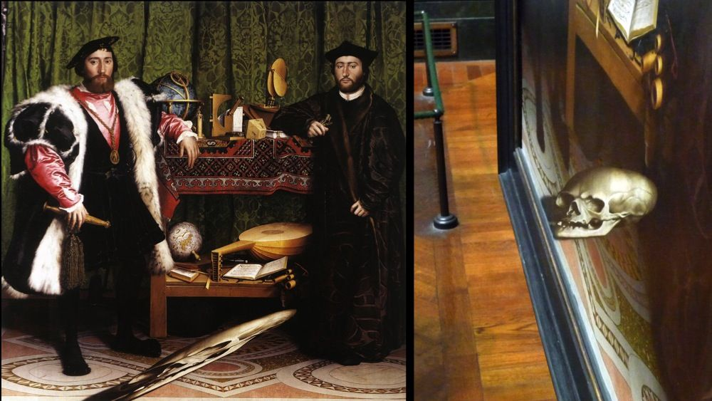
Image Transformations + Warping
The Ambassadors (Holbein), 1533
CS180: Intro to Computer Vision and Comp. Photo
Alexei Efros & Angjoo Kanazawa, UC Berkeley, Fall 2025
Some slides from Steve Seitz
Notes:
anamorphosis, another invention of the Early Renaissance, you need to look at it from extreme angle to see the skull

Slide 2
Logistics
If you are CE who made it into class, but originally wanted to get into CS280A let me know.

Slide 3

Today you will learn how to do this:

Slide 4
Or this:

Slide 5
Or this!

Slide 6

You will learn how to make panoramas
Notes:
3min

Slide 7
Image Transformations
image filtering: change range of image
g(x) = T(f(x))
f
f
T
x
x
image warping: change domain of image
g(x) = f(T(x))
f
f
T
x
x

Slide 8
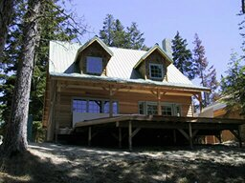
Image Transformations
image filtering: change range of image
g(x) = T(f(x))
f
g
T
image warping: change domain of image
g(x) = f(T(x))
f
g
T

Slide 9
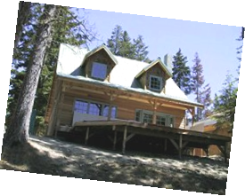
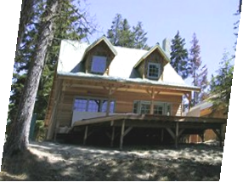
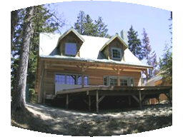
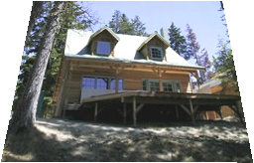
Parametric (global) warping
Examples of parametric warps:
translation
rotation
aspect
perspective
affine
cylindrical

Slide 10
Parametric (global) warping
T
p = (x,y)
p’ = (x’,y’)
Transformation T is a coordinate-changing machine:
p’ = T(p)
What does it mean that T is global?
Is the same for any point p
can be described by just a few numbers (parameters)
Let’s represent a linear T as a matrix:
p’ = Mp

Slide 11
Scaling
Scaling a coordinate means multiplying each of its components by a scalar
Uniform scaling means this scalar is the same for all components:
× 2

Slide 12
Scaling
Non-uniform scaling: different scalars per component:
X × 2, Y × 0.5

Slide 13
Scaling
Scaling operation:
Or, in matrix form:
scaling matrix S
What’s inverse of S?

Slide 14
2-D Rotation
(x’, y’)
(x, y)
x’ = x cos(θ) - y sin(θ)
y’ = x sin(θ) + y cos(θ)
θ

Slide 15
2-D Rotation
x = r cos (φ)
y = r sin (φ)
x’ = r cos (φ + θ)
y’ = r sin (φ + θ)
(x’, y’)
(x, y)
θ
φ

Slide 16
2-D Rotation
x = r cos (φ)
y = r sin (φ)
x’ = r cos (φ + θ)
y’ = r sin (φ + θ)
Trig Identity…
x’ = r cos(φ) cos(θ) – r sin(φ) sin(θ)
y’ = r sin(φ) cos(θ) + r cos(φ) sin(θ)
(x’, y’)
(x, y)
θ
φ
Notes:
cos(A+B) = cosAcosB - sinAsinB

Slide 17
2-D Rotation
x = r cos (φ)
y = r sin (φ)
x’ = r cos (φ + θ)
y’ = r sin (φ + θ)
Trig Identity…
x’ = r cos(φ) cos(θ) – r sin(φ) sin(θ)
y’ = r sin(φ) cos(θ) + r cos(φ) sin(θ)
Substitute…
x’ = x cos(θ) - y sin(θ)
y’ = x sin(θ) + y cos(θ)
(x’, y’)
(x, y)
θ
φ

Slide 18
2-D Rotation
This is easy to capture in matrix form:
Is this a linear transformation?
Even though sin(θ) and cos(θ) are nonlinear functions of θ,
x’ is a linear combination of x and y
y’ is a linear combination of x and y
What is the inverse transformation?
Rotation by –θ
For rotation matrices
R

Slide 19
2x2 Matrices
What types of transformations can be represented with a 2x2 matrix?
2D Identity?
2D Scale around (0,0)?

Slide 20
2x2 Matrices
What types of transformations can be represented with a 2x2 matrix?
2D Rotate around (0,0)?
2D Shear?

Slide 21
2x2 Matrices
What types of transformations can be represented with a 2x2 matrix?
2D Mirror about Y axis?
Reflection through (0,0)?
Notes:
4. Point reflection through origin (180° rotation):

Slide 22
All 2D Linear Transformations
Linear transformations are combinations of …
Scale,
Rotation,
Shear, and
Mirror/Reflection
Properties of linear transformations:
Origin maps to origin
Lines map to lines
Parallel lines remain parallel
Ratios are preserved
Closed under composition

Slide 23
2x2 Matrices
What types of transformations can be represented with a 2x2 matrix?
2D Translation?
NO!
Only linear 2D transformations
can be represented with a 2x2 matrix

Slide 24
Homogeneous Coordinates
Q: How can we represent translation as a 3x3 matrix?
A: Using the rightmost column:

Slide 25
Homogeneous Coordinates
Homogeneous coordinates
represent coordinates in 2 dimensions with a 3-vector

Slide 26
Homogeneous Coordinates
Add a 3rd coordinate to every 2D point
(x, y, w) represents a point at location (x/w, y/w)
(x, y, 0) represents a point at infinity
(0, 0, 0) is not allowed
y
2
(2,1,1)
or (4,2,2)
or (6,3,3)
1
1
2
x
Convenient tool to express translation as a linear transform

Slide 27
Translation
Example of translation
Homogeneous Coordinates
t_{x} = 2 t_{y} = 1

Slide 28
Basic 2D Transformations
Basic 2D transformations as 3x3 matrices
Translate
Scale
Rotate
Shear

Slide 29
Matrix Composition
Transformations can be combined by matrix multiplication
p’ = T(t_{x},t_{y}) R(Θ) S(s_{x},s_{y}) p
Does the order of multiplication matter?

Slide 30
Affine Transformations
Affine transformations are combinations of …
Linear transformations, and
Translations
Properties of affine transformations:
Origin does not necessarily map to origin (translation!)
Lines map to lines
Parallel lines remain parallel
Ratios are preserved
Closed under composition
Models change of basis
Will the last coordinate w always be 1?
Notes:
Yes in this case, why?

Slide 31
Projective Transformations/Homography
Projective transformations …
Affine transformations, and
Projective warps
Properties of projective transformations:
Origin does not necessarily map to origin
Lines map to lines
Parallel lines do not necessarily remain parallel
Ratios are not preserved
Closed under composition
Models change of basis
Notes:
Also called homographies

Slide 32
Another way to think about transformation
j =(0,1)
v =(v_{x},v_{y})
p
q
u=(u_{x},u_{y})
i =(1,0)
q=4i+3j = (4,3)
p=4u+3v
ij-basis
uv-basis
Same point represented using a Different Basis

Slide 33

Linear Transformations as Change of Basis
v =(v_{x},v_{y})
j =(0,1)
p_{i}=4u_{x}+3v_{x}
p_{j}=4u_{y}+3v_{y}
p^{uv}
p^{ij}
u=(u_{x},u_{y})
i =(1,0)
p^{uv} = (4,3)
p^{ij} = 4u+3v
⎡
u
v
⎡
4
⎡
u
v
p^{ij}
=
⎢
x
x
=
⎢
x
x
p^{uv}
⎢
⎣
u
v
⎣
3
⎣
u
v
y
y
y
y
Transformation from uv to ij basis
Any linear transformation is a basis!!!
Notes:
The column vectors are your new basis

Slide 34
What’s the inverse transform?
j =(0,1)
v =(v_{x},v_{y})
p^{ij}
p^{uv}
u=(u_{x},u_{y})
i =(1,0)
p^{ij} = (5,4)
= p_{x}u + p_{y}v
p^{uv} = (p_{x},p_{y}) = ?
-1
-1
⎡
u
v
⎤
⎡
5
⎤
⎡
u
v
⎤
p^{uv}
=
⎢
x
x
⎥
=
⎢
x
x
⎥
p^{ij}
⎢
⎥
⎣
u
v
⎦
⎣
4
⎦
⎣
u
v
⎦
y
y
y
y
How can we change from any basis to any basis?
What if the basis are orthogonal?

Slide 35
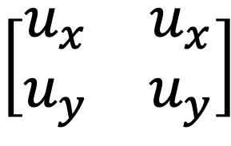
Projection onto orthogonal basis
j =(0,1)
v =(v_{x},v_{y})
p^{ij}
p^{uv}
u=(u_{x},u_{y})
i =(1,0)
p^{ij} = (5,4)
p^{uv} = (u·p^{ij}, v·p^{ij})
⎡
u
u
⎡
5
⎡
u
u
$$\left[\begin{matrix}u_{x} & u_{x} \\ u_{y} & u_{y}\end{matrix}\right]$$
=
x
x
=
x
y
p^{uv}
⎢
⎢
⎢
p^{ij}
⎣
v
v
⎣
4
⎣
v
v
y
y
x
y

Slide 36
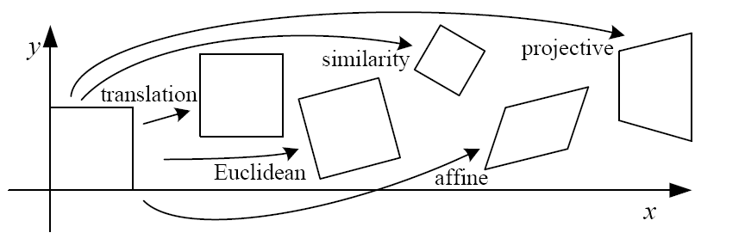
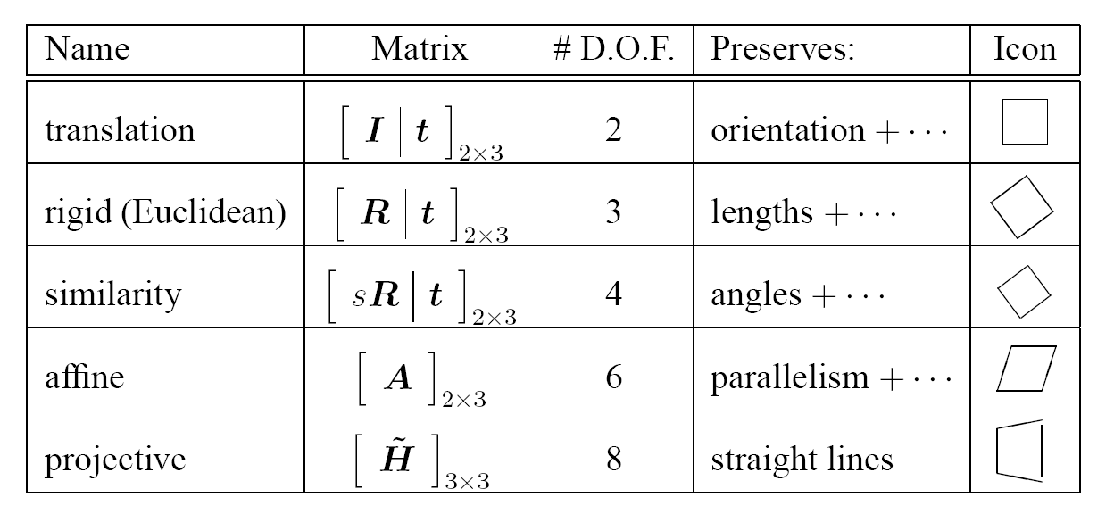

2D image transformations
These transformations are a nested set of groups
Closed under composition and inverse is a member

Slide 37
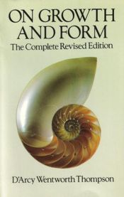
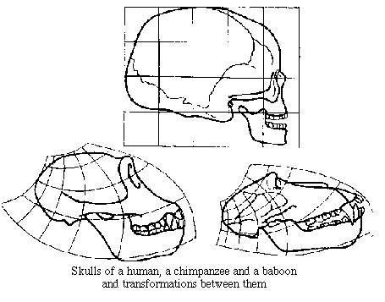
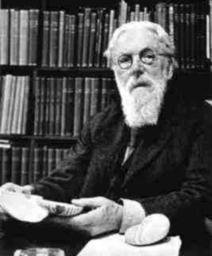
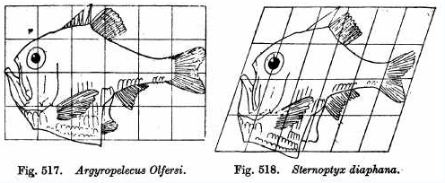
Image Transforms in Biology
D'Arcy Thompson
http://www-groups.dcs.st-and.ac.uk/~history/Miscellaneous/darcy.html
http://en.wikipedia.org/wiki/D'Arcy_Thompson
Importance of shape and structure in evolution
Slide by Durand and Freeman

Slide 38
Now the fun stuff
How do we go from this to this image??
Picture of Ayuna when she was a baby

Slide 39
Break
Notes:
45 min in

Slide 40
Now the fun stuff
How do we go from this to this image??

Slide 41
Now the fun stuff
How do we go from this to this image??
Picture of Ayuna when she was a baby

Slide 42
Now the fun stuff
How do we go from this to this image??
Crop + enlarge
Picture of Ayuna when she was a baby

Slide 43
Warping Pixels
T(x,y)
y
y’
x
x’
f(x,y)
g(x’,y’)
Given a coordinate transform (x’,y’) = T(x,y) and a source image f(x,y), how do we compute a transformed image g(x’,y’) = f(T(x,y))?

Slide 44
The Magic of imresize
So how to do it? Say the goal is to reduce the image size exactly by half
Take every other pixel!
This is like transforming every other pixel to a new location
Notes:
Skip every other pixel!

Slide 45
Forward warping
T(x,y)
y
y’
x
x’
f(x,y)
g(x’,y’)
Send each pixel f(x,y) to its corresponding location
(x’,y’) = T(x,y) in the second image
Q: what if pixel lands “between” two pixels?

Slide 46

Forward warping
f(x,y)
g(x’,y’)
T(x,y)
y
y’
x
x’
Send each pixel f(x,y) to its corresponding location
(x’,y’) = T(x,y) in the second image
Q: what if pixel lands “between” two pixels?
A: distribute color among neighboring pixels (x’,y’)
Known as “splatting” (Check out griddata in Matlab)
Generally, a very bad idea. Why?
Notes:
wha tdo we do? splatting, not interpolating bc we don’t exactly know how many other pictures will be tehre – have to wait until everything is there

Slide 47
Can we do better?
What if we want to make the image bigger?

Slide 48

Can we do better?
What if we want to make the image bigger?
$$T^{−1}$$
Go backwards!

Slide 49
Inverse warping
T⁻¹(x,y)
y
y’
x
x
x’
f(x,y)
g(x’,y’)
Get each pixel g(x’,y’) from its corresponding location
(x,y) = T⁻¹(x’,y’) in the first image
Q: what if pixel comes from “between” two pixels?
A: Interpolate color value from neighbors
nearest neighbor, bilinear, Gaussian, bicubic
Check out interp2 in Matlab / Python

Slide 50
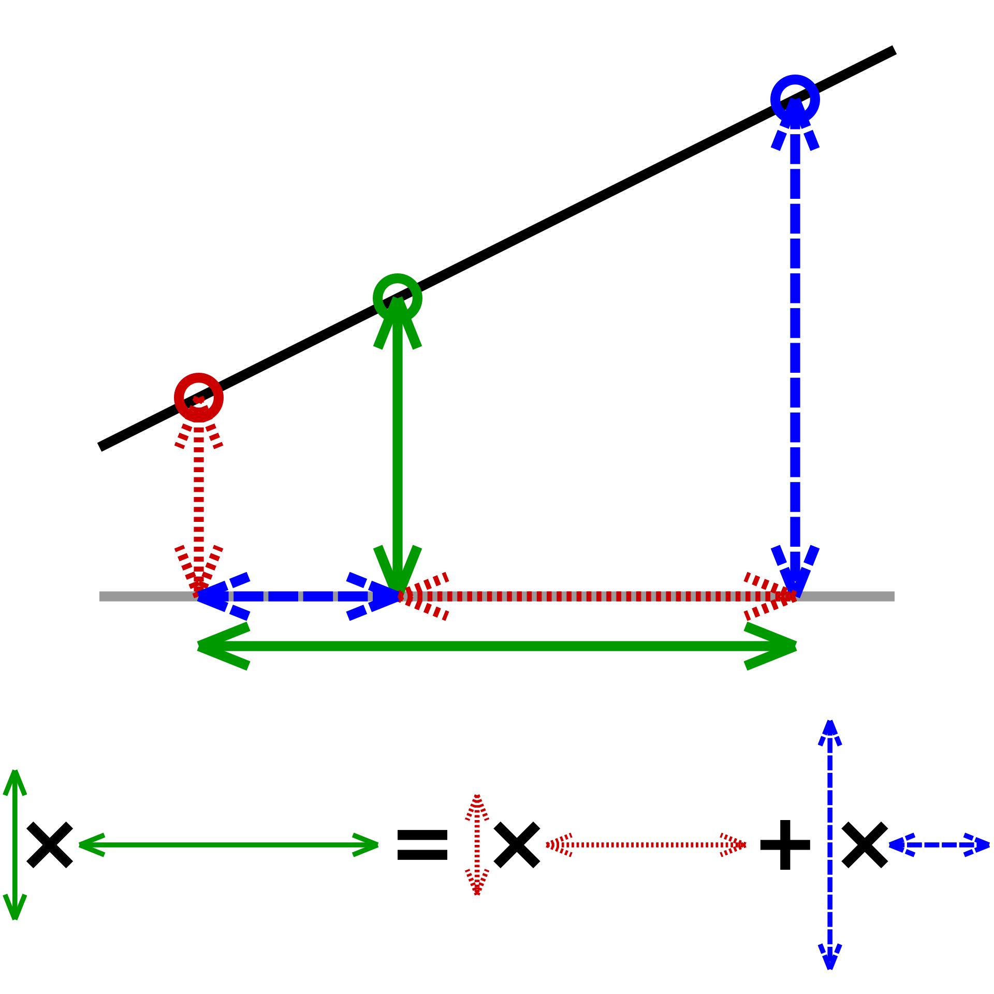
What do we need to watch out for??
Step 0 of any sampling:
Aliasing!!
Gaussian filter
Find the inverse warping
Interpolate
Recall 1D interpolation:

Slide 51
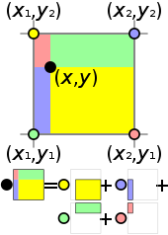
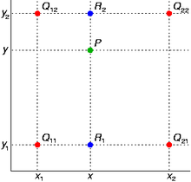
Bilinear Interpolation
http://en.wikipedia.org/wiki/Bilinear_interpolation
Help interp2

Slide 52
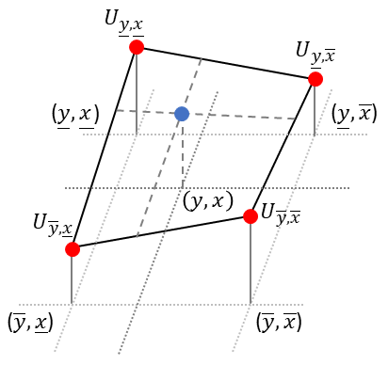
Bilinear Interpolation
Figure credit: https://medium.com/data-science/spatial-transformer-networks-tutorial-part-2-bilinear-interpolation-371e1d5f164f

Slide 53
Recovering Transformations
?
T(x,y)
y
y’
x
x’
f(x,y)
g(x’,y’)
What if we know f and g and want to recover the transform T?
e.g. better align images from Project 1
willing to let user provide correspondences
How many do we need?

Slide 54
Translation: # correspondences?
?
T(x,y)
y
y’
x
x’
How many correspondences needed for translation?
How many Degrees of Freedom?
What is the transformation matrix?

Slide 55
Euclidian: # correspondences?
?
T(x,y)
y
y’
x
x’
How many correspondences needed for translation+rotation?
How many DOF?

Slide 56
Affine: # correspondences?
?
T(x,y)
y
y’
x
x’
How many correspondences needed for affine?
How many DOF?

Slide 57
Projective: # correspondences?
?
T(x,y)
y
y’
x
x’
How many correspondences needed for projective/homography?
How many DOF?

Slide 58
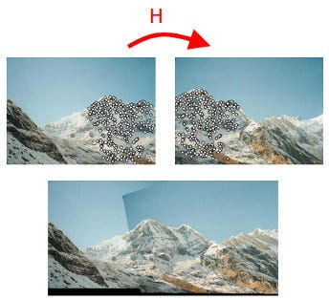
Next project: Panorama stitching
1. Compute the homography
2. Warp the image

