Slide 1

Amuse-bouche
https://vimeo.com/1456037

Slide 2
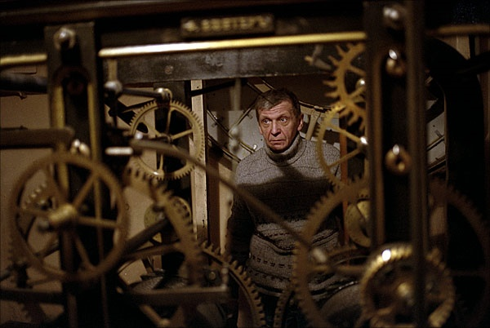
Image Warping and Morphing
© Alexey Tikhonov
CS180/280A: Intro to Computer Vision and Comp. Photo
Alexei Efros and Ren Ng, UC Berkeley, Fall 2026

Slide 3
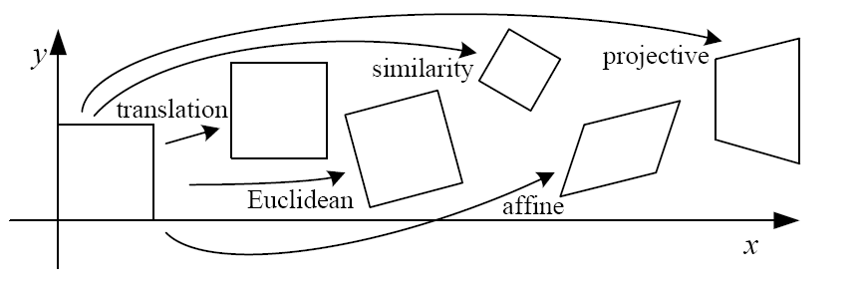
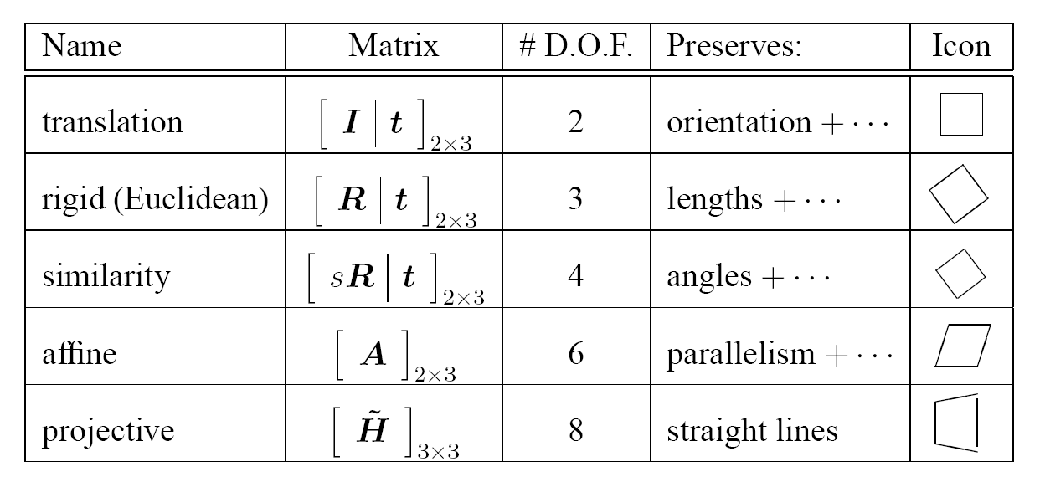
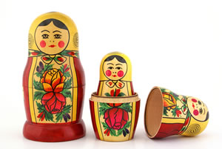
2D image transformations
These transformations are a nested set of groups
  Closed under composition and inverse is a member
Notes:
Recap
exercise:
The difference between rigid and similarity transformation?
Degree of freedom of translation in 2d?

Slide 4
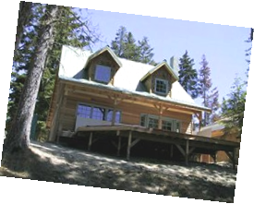
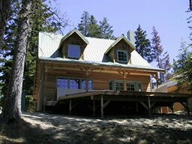
Recovering Transformations
?
T(x,y)
y
y’
x
x’
f(x,y)
g(x’,y’)
What if we know f and g and want to recover the transform T?
  e.g. better align images from Project 1
  willing to let user provide correspondences
    How many do we need?
Notes:
Last lecture given source f and T, compute the target image g
Inverse problem

Slide 5
Translation: # correspondences?
?
T(x,y)
y
y’
x
x’
How many correspondences needed for translation?
How many Degrees of Freedom?
What is the transformation matrix?

Slide 6
Euclidian: # correspondences?
?
T(x,y)
y
y’
x
x’
How many correspondences needed for translation+rotation?
How many DOF?

Slide 7
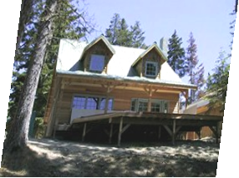
Affine: # correspondences?
?
T(x,y)
y
y’
x
x’
How many correspondences needed for affine?
How many DOF?

Slide 8
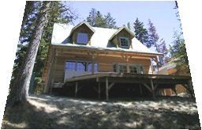
Projective: # correspondences?
?
T(x,y)
y
y’
x
x’
How many correspondences needed for projective?
How many DOF?

Slide 9

Example: warping triangles
B
B’
?
T(x,y)
C’
A
C
A’
Source
Destination
Given two triangles: ABC and A’B’C’ in 2D (12 numbers)
Need to find transform T to transfer all pixels from one to the other.
What kind of transformation is T?
How can we compute the transformation matrix:
Two ways:
Algebraic and
geometric
Notes:
why affine? well how many orresp do we have
ASK: how do you go about solving for the 6 numbers? there are multiple ways
for a basis in 2D how many vectors do we need? do we see the basis vectors here? AB, AC → A’B’, A’C’

Slide 10
warping triangles (Barycentric Coordinates)
(0,1)
(0,0)
(1,0)
B
B’
Inverse
change
of basis
change
of basis
C’
A
C
A’
Source
Destination
Don’t forget to move the origin too!
Notes:
do it both ways and make sure you get the right answer!
Don’t forget to move the origin also! (A and A’ are not in the same place), so don’t forget to include the translation component
Proj3 harder! than proj 1 & 2. only 2 weeks
any matrix can be thought of as a change of basis matrix (vert cols)

Slide 11
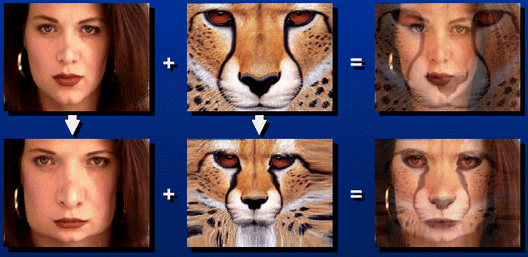

Morphing = Object Averaging
The aim is to find “an average” between two objects
  Not an average of two images of objects…
  …but an image of the average object!
  How can we make a smooth transition in time?
    Do a “weighted average” over time t
How do we know what the average object looks like?
  We haven’t a clue!
  But we can often fake something reasonable
    Usually required user/artist input

Slide 12
Averaging Points
Q
What’s the average
of P and Q?
v = Q - P
P
P + 1.5v
= P + 1.5(Q – P)
= -0.5P + 1.5 Q
(extrapolation)
P + 0.5v
= P + 0.5(Q – P)
= 0.5P + 0.5 Q
Linear Interpolation
(Affine Combination):
New point aP + bQ,
defined only when a+b = 1
So aP+bQ = aP+(1-a)Q
P and Q can be anything:
  points on a plane (2D) or in space (3D)
  Colors in RGB or HSV (3D)
  Whole images (m-by-n D)… etc.
Notes:
0.5P + 0.5Q -> What is this? A: Linear Interpolation

Slide 13
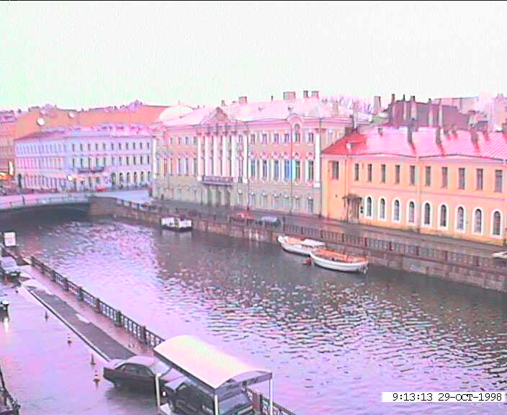
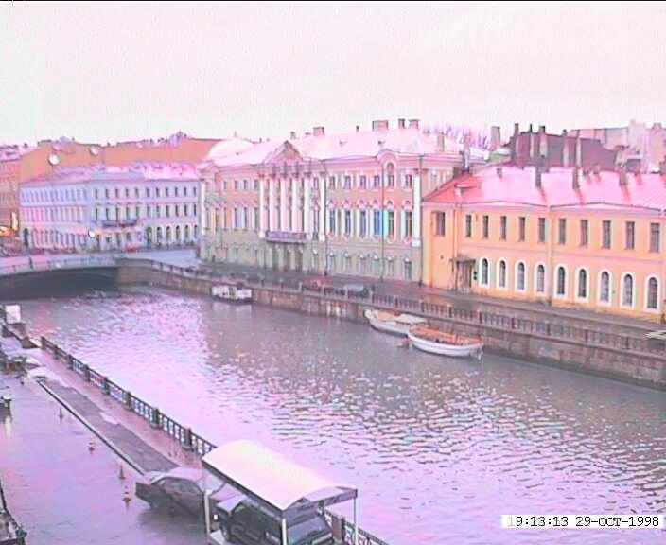
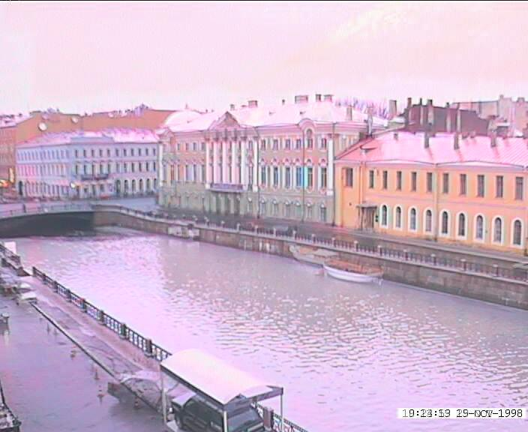
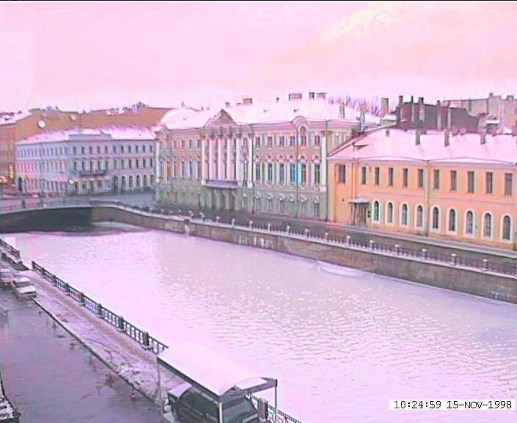
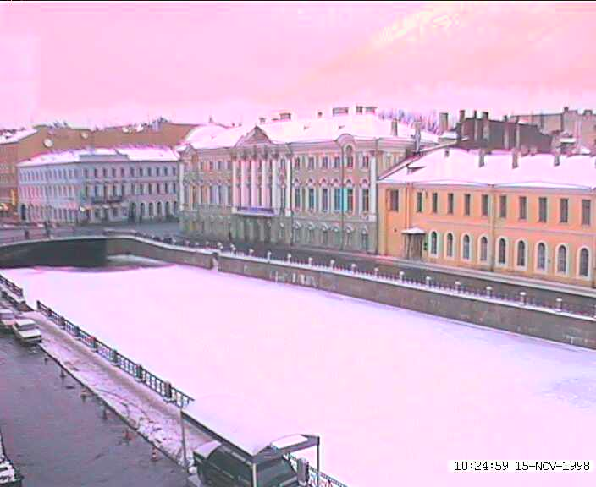
Idea #1: Cross-Dissolve
Interpolate whole images:
Image_{halfway} = (1-t)*Image₁ + t*image₂
This is called cross-dissolve in film industry
But what if the images are not aligned?
Notes:
Alyosha’s hometown.

Slide 14
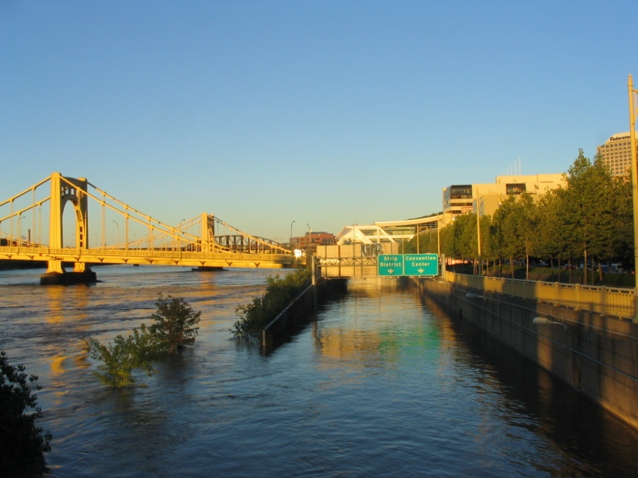
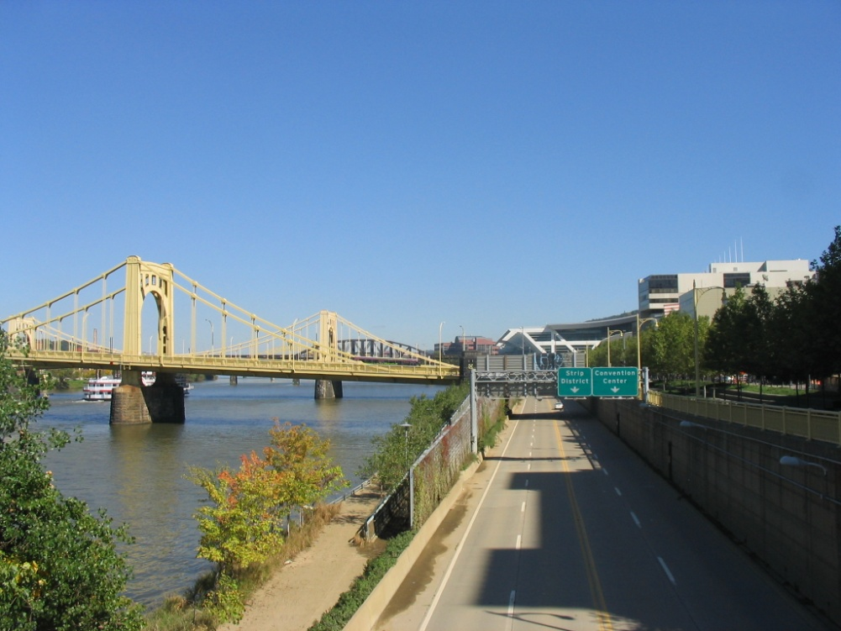
Idea #1: Cross-Dissolve
Cross-dissolve with images that are not aligned
Notes:
Pittsburgh, when Alyosha first got there. Didn’t realize till later, the first picture was a bad flood.

Slide 15
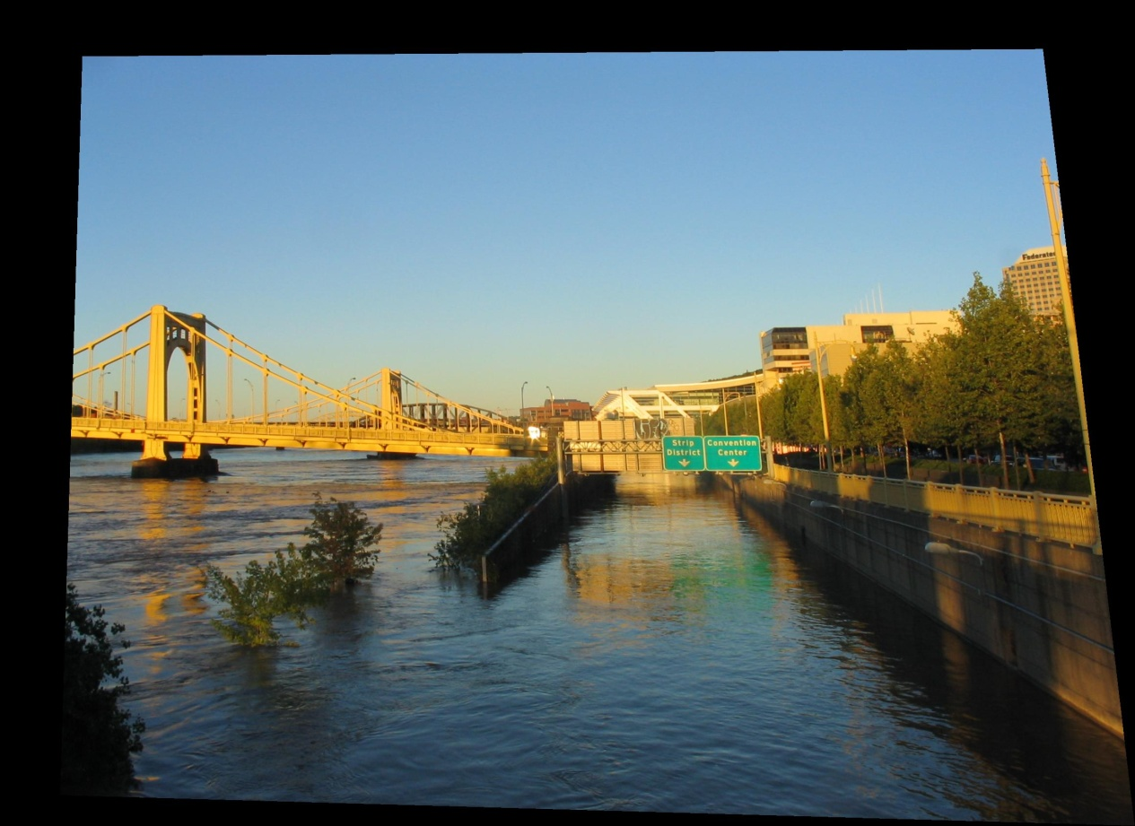
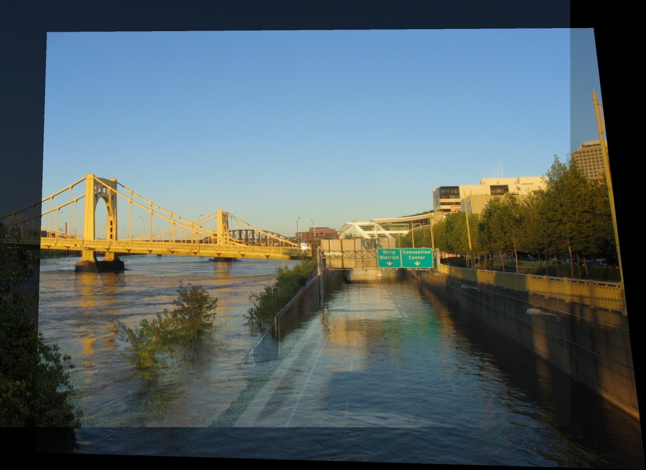
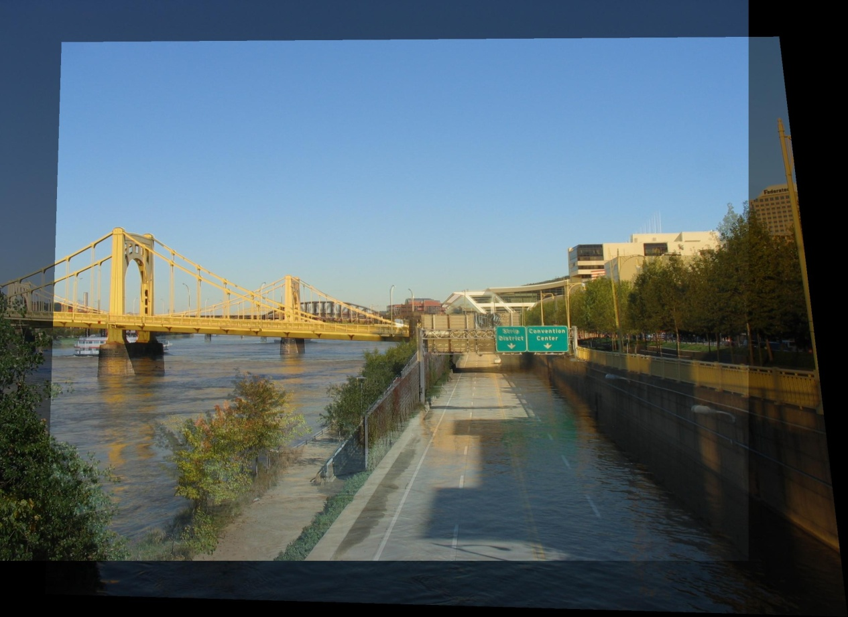
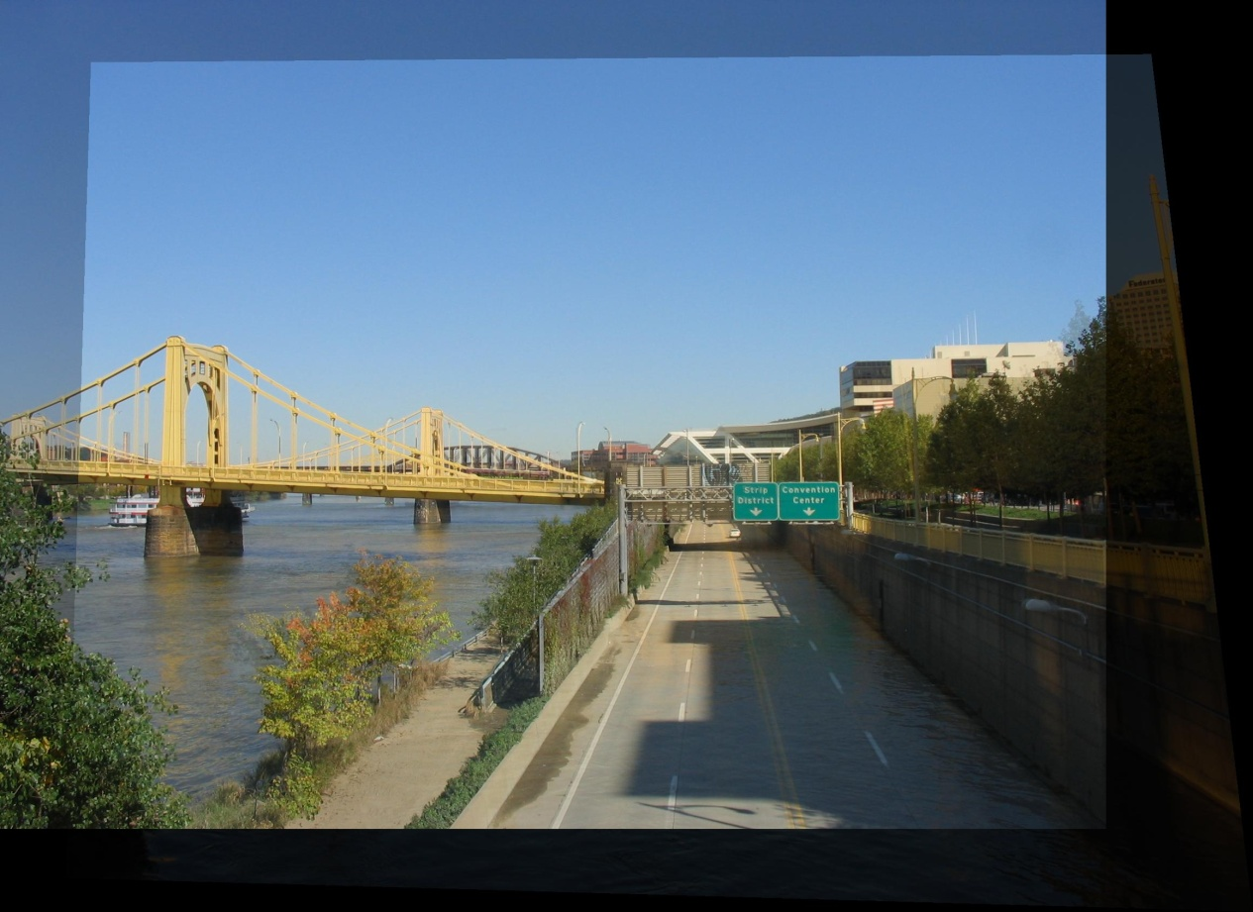
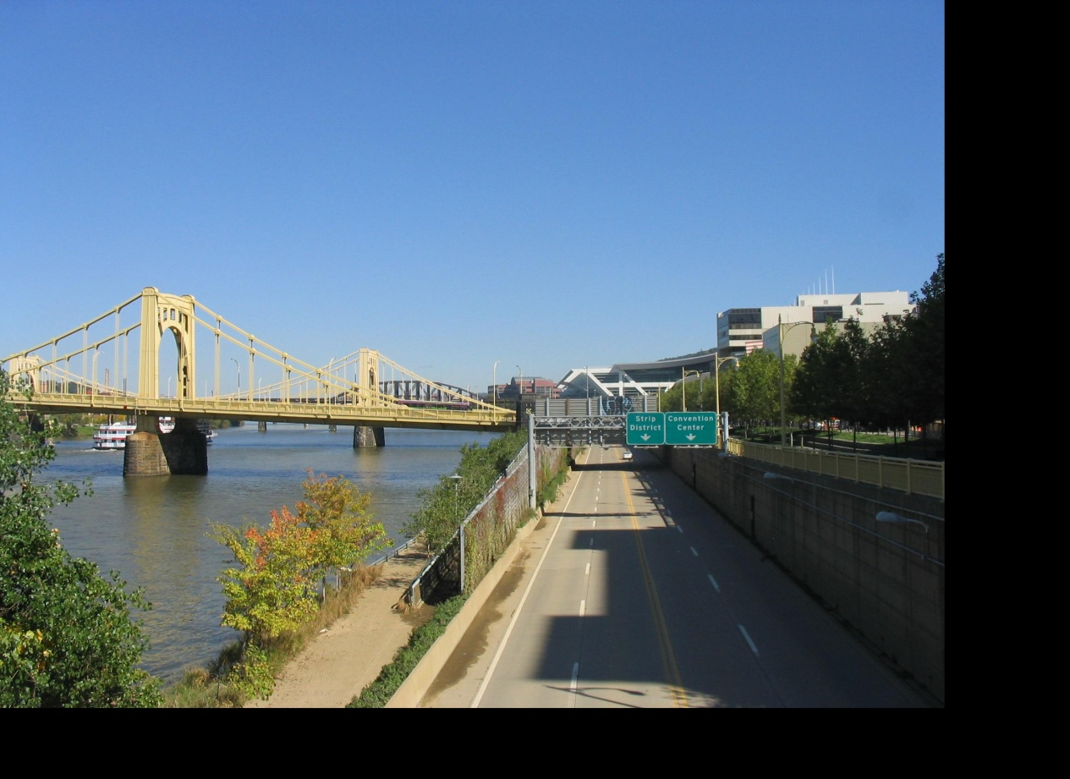
Idea #2: Align, then cross-disolve
Align first, then cross-dissolve
  Alignment using global warp – picture still valid
Notes:
What kind of warp is this?

Slide 16
Image Morphing
Morphing = warping + cross-dissolving
shape
(geometric)
color
(photometric)

Slide 17
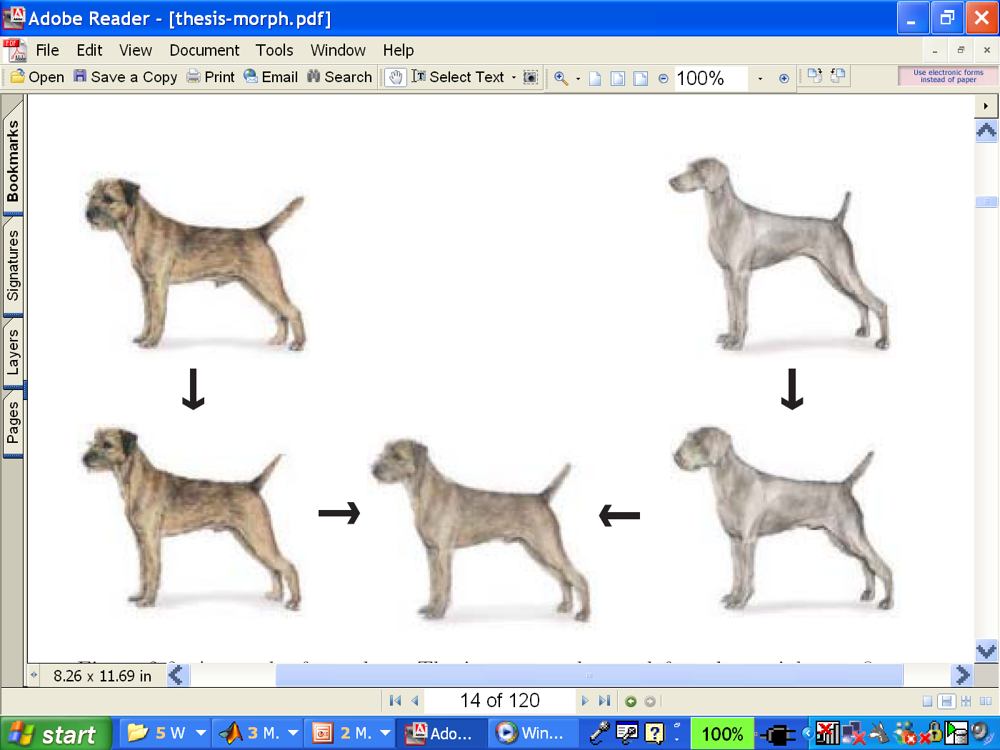
Two-stage Morphing Procedure
Morphing procedure:
for every t,
Find the average shape (the “mean dog”☺)
  warping
Find the average color
  Cross-dissolve the warped images

Slide 18
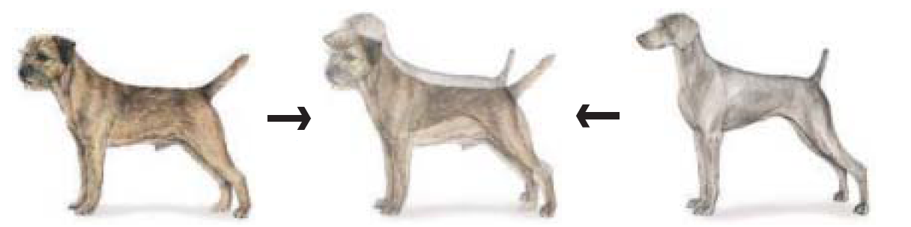
BUT: global warp not always enough!
What to do?
  Cross-dissolve doesn’t work
  Global alignment doesn’t work
    Cannot be done with a global transformation (e.g. affine)
  Any ideas?
Feature matching!
  Nose to nose, tail to tail, etc.
  But what to do with all the intermediate pixels?
Notes:
what kind of warp can we do?
What’s the extreme? A: click every singlepoint (Optical flow)

Slide 19
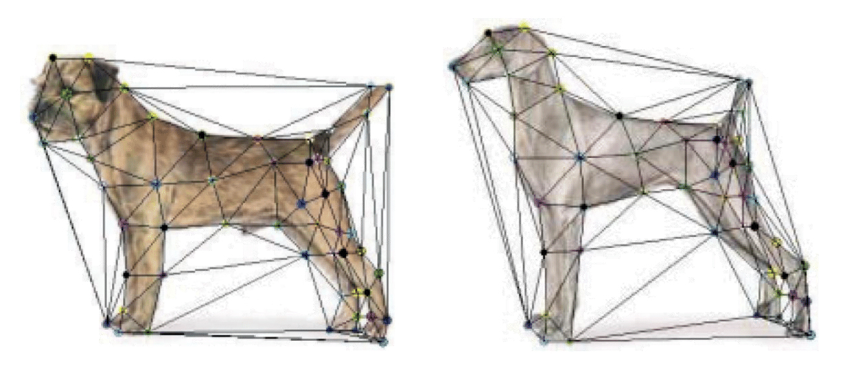
Triangular Mesh
Input correspondences at key feature points
Define a triangular mesh over the points
  Same mesh in both images!
  Now we have triangle-to-triangle correspondences
Warp each triangle separately from source to destination
  How do we warp a triangle?
Notes:
will two triangles separate? Why or why not. It will be the same because we’re already defining {from} and {to}
This is very key, divide things into tiny triangles and do affine in each.

Slide 20
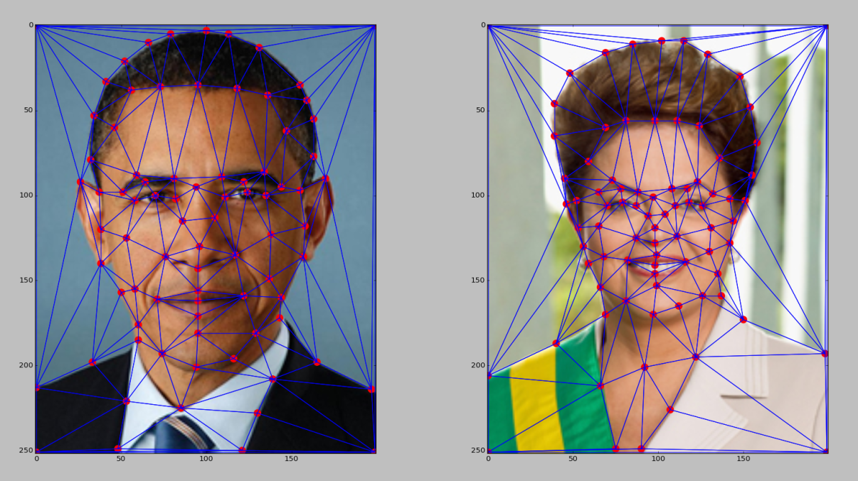
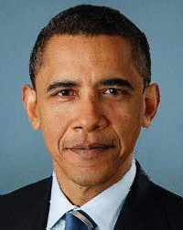
Full morphing result
(c) Ian Albuquerque Raymundo da Silva
Notes:
Obama’s triangles are bigger than the former brazillian president.. soo Obama’s triangles occupy many more pixels.. what happens? is this a problem? anyone thinking about this

Slide 21
Warping triangles
B
B’
?
T(x,y)
C’
A
C
A’
Source
Destination
Given two triangles: ABC and A’B’C’ in 2D (12 numbers)
Need to find transform T to transfer all pixels from one to the other.
What kind of transformation is T?
How can we compute the transformation matrix:

Slide 22
Warping Pixels
T(x,y)
y
y’
x
x’
f(x,y)
g(x’,y’)
Given a coordinate transform (x’,y’) = T(x,y) and a source image f(x,y), how do we compute a transformed image g(x’,y’) = f(T(x,y))?

Slide 23
Forward warping
T(x,y)
y
y’
x
x’
f(x,y)
g(x’,y’)
Send each pixel f(x,y) to its corresponding location
(x’,y’) = T(x,y) in the second image
Q: When does this work well, when not? If something goes wrong, what is it? Ideas to fix?

Slide 24
Forward warping
T(x,y)
y
y’
x
x’
f(x,y)
g(x’,y’)
Send each pixel f(x,y) to its corresponding location
(x’,y’) = T(x,y) in the second image
Q: what if pixel lands “between” two pixels?
A: distribute color among neighboring pixels (x’,y’)
  Known as “splatting”
Notes:
wha tdo we do? splatting, not interpolating bc we don’t exactly know how many other pictures will be tehre – have to wait until everything is there

Slide 25
Forward warping
What would happen here?

Slide 26
Inverse warping
T⁻¹(x,y)
y
y’
x
x
x’
f(x,y)
g(x’,y’)
Get each pixel g(x’,y’) from its corresponding location
(x,y) = T⁻¹(x’,y’) in the first image
Q: what if pixel comes from “between” two pixels?

Slide 27
Inverse warping
T⁻¹(x,y)
y
y’
x
x
x’
f(x,y)
g(x’,y’)
Get each pixel g(x’,y’) from its corresponding location
(x,y) = T⁻¹(x’,y’) in the first image
Q: what if pixel comes from “between” two pixels?
A: Interpolate color value from neighbors
  nearest neighbor, bilinear, Gaussian, bicubic
  Check out interp2 in Matlab / remap Python

Slide 28
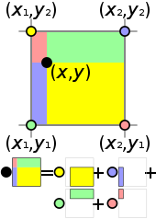
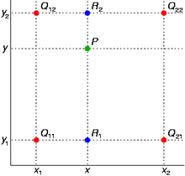
Bilinear Interpolation
http://en.wikipedia.org/wiki/Bilinear_interpolation
Help interp2

Slide 29
Forward vs. inverse warping
Q: which is better?
A: usually inverse—eliminates holes
  however, it requires an invertible warp function—not always possible...

Slide 30
Triangulations
A triangulation of set of points in the plane is a partition of the convex hull to triangles whose vertices are the points, and do not contain other points.
There are an exponential number of triangulations of a point set.

Slide 31
An O(n³) Triangulation Algorithm
Repeat until impossible:
  Select two sites.
  If the edge connecting them does not intersect previous edges, keep it.

Slide 32
“Quality” Triangulations
Let α(T) = (α₁, α₂ ,.., α_{3t}) be the vector of angles in the triangulation T in increasing order.
A triangulation T₁ will be “better” than T₂ if α(T₁) > α(T₂) lexicographically.
The Delaunay triangulation is the “best”
  Maximizes smallest angles
good
bad
Notes:
draw a circle with circumference between any two edges, no other vertex is in it

Slide 33
Improving a Triangulation
In any convex quadrangle, an edge flip is possible. If this flip improves the triangulation locally, it also improves the global triangulation.
If an edge flip improves the triangulation, the first edge is called illegal.

Slide 34
Illegal Edges
Lemma: An edge pq is illegal iff one of its opposite vertices is inside the circle defined by the other three vertices.
Proof: By Thales’ theorem.
p
q
Theorem: A Delaunay triangulation does not contain illegal edges.
Corollary: A triangle is Delaunay iff the circle through its vertices is empty of other sites.
Corollary: The Delaunay triangulation is not unique if more than three sites are co-circular.

Slide 35
Naïve Delaunay Algorithm
Start with an arbitrary triangulation. Flip any illegal edge until no more exist.
Could take a long time to terminate.

Slide 36
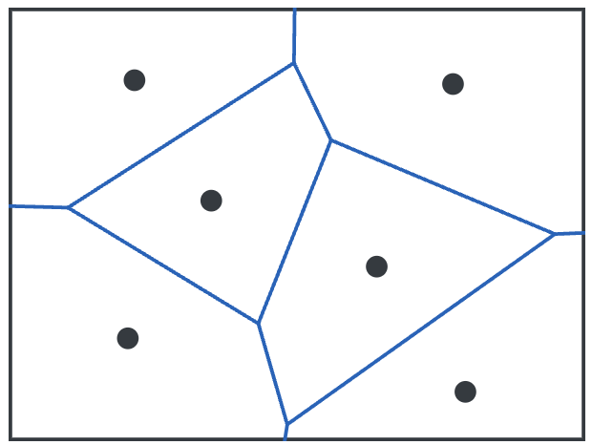
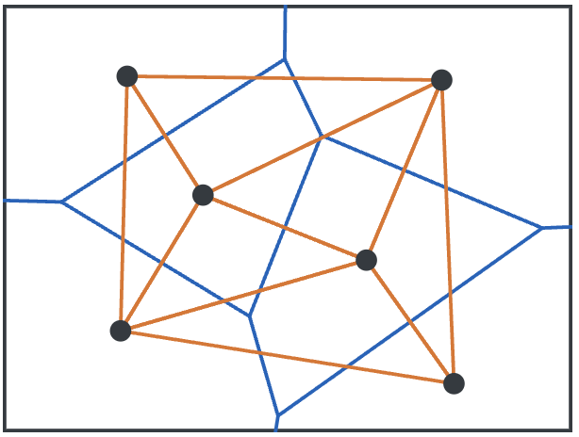
Delaunay Triangulation by Duality
General position assumption: There are no four co-circular points.
Draw the dual to the Voronoi diagram by connecting each two neighboring sites in the Voronoi diagram.
Corollary: The DT may be constructed in O(nlogn) time.
This is what Matlab’s delaunay function uses.
Notes:
Voronoi: Post-office!
It’s dual is Delaunay triangulation!
draw a circle with circumference between any two edges, no other vertex is in it → connect the circumcenter (circle around the triangle, take the center → connect them, that will be the Voronoi diagram
no three are collinear and no four are cocircular.(on the circle)

Slide 37
Image Morphing Review
Creating a half-way intermediate morph (t=0.5):
  Create an intermediate shape (by interpolation)
  Warp both images towards it
  Cross-dissolve the colors in the newly warped images

Slide 38
1. Create Average Shape
How do we create an intermediate warp at time t?
  Assume t is in [0,1]
  Simple linear interpolation of each feature pair
    p=(x,y) -> p’(x,y)
  (1-t)*p+t*p’ for corresponding features p and p’

Slide 39
2. Create Average Color
Interpolate whole images:
Image_{halfway} = (1-t)*Image + t*image’
cross-dissolve!

Slide 40
Morphing
Define corresponding points
Define triangulation on points
  Use same triangulation for both images
For each t = 0:step:1
  Compute the average shape at t (weighted average of points)
  For each triangle in the average shape
    Get the affine projection to the corresponding triangles in each image
    For each pixel in the triangle, find the corresponding points in each image and set value to weighted average (cross-dissolve each triangle)
  Save the image as the next frame of the sequence
Life-hack: can be done with just two nested loops (for t, and for each triangle). Hint: compute warps for all pixels first, then use interp2

Slide 41
Extras

Slide 42
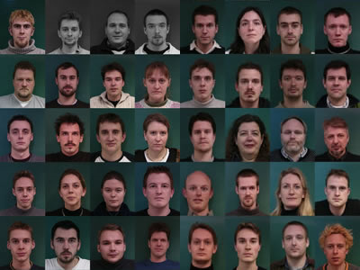
How to align faces?
http://www2.imm.dtu.dk/~aam/datasets/datasets.html

Slide 43
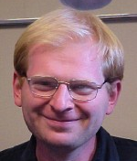
Shape Vector
=
Provides alignment!
43

Slide 44
Appearance Vectors vs. Shape Vectors
Appearance
Vector
Vector of
200*150*3
Dimensions
Requires Annotation
Provides alignment!
200*150 pixels (RGB)
Shape
Vector
Vector of
43*2
Dimensions
43 coordinates (x,y)
Slide by Kevin Karsch
Notes:
You can think about faces in different ways. You can represent this way or that way. These are complements.

Slide 45
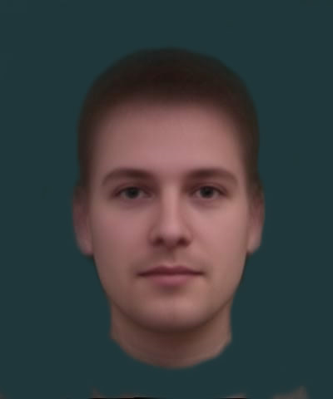
Average Face
1. Warp to mean shape
2. Average pixels
http://graphics.cs.cmu.edu/courses/15-463/2004_fall/www/handins/brh/final/

Slide 46
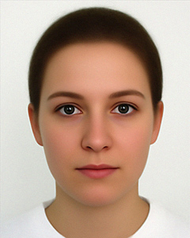
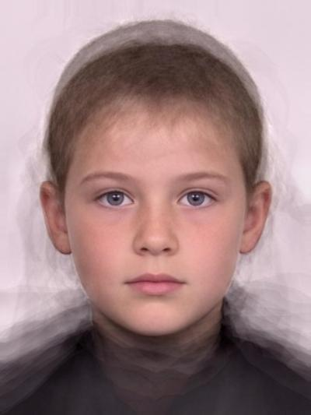
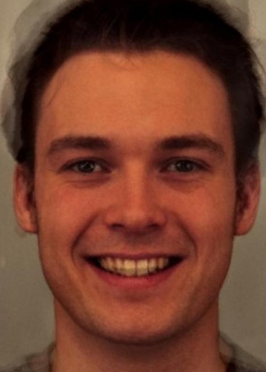
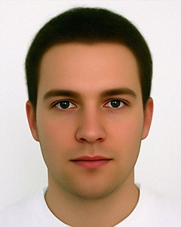
Subpopulation means
Examples:
  Male vs. female
  Happy vs. said
  Angry Kids
  People wearing glasses
  Etc.
  http://www.faceresearch.org
Average female
Average kid
Average happy male
Average male
Notes:
We might be curious what different populations of faces look like.

Slide 47
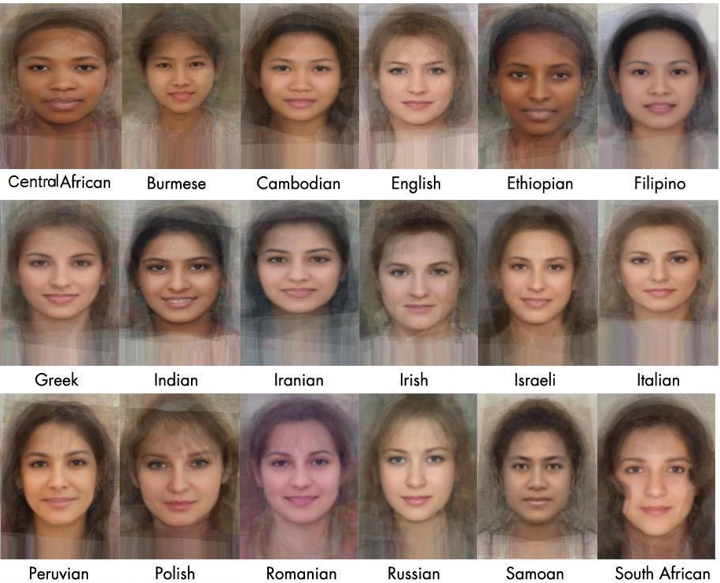
Average Women of the world
Notes:
You will notice that women from every place is very attractive because the …..

Slide 48
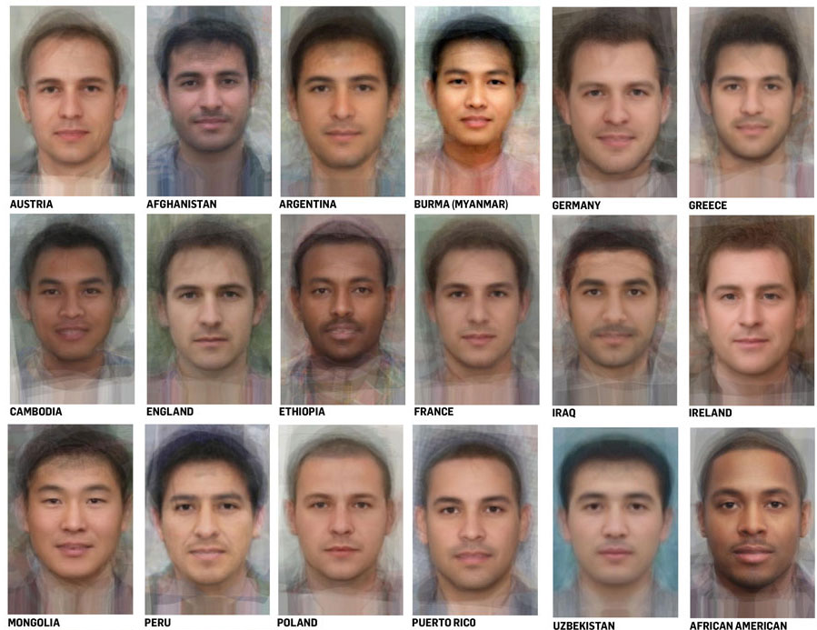
Average Men of the world

Slide 49
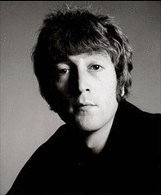
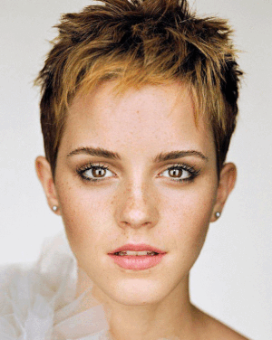
Examples
© Rachel Albert, CS194-26, Fall 2015

Slide 50
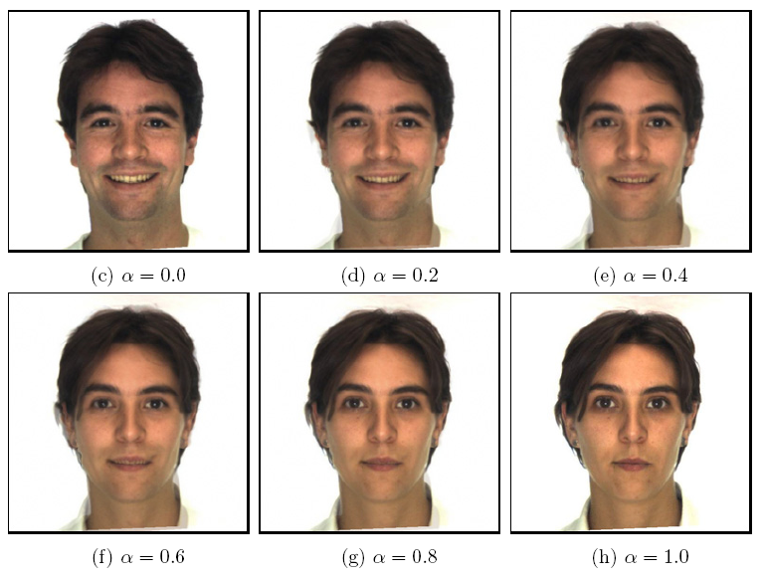
Morphing & matting
Extract foreground first to avoid artifacts in the background
Slide by Durand and Freeman

Slide 51
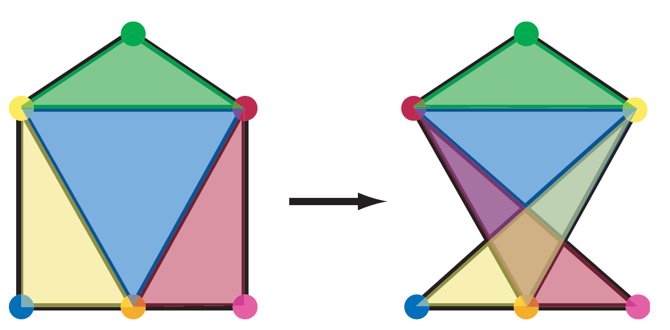
Other Issues
Beware of folding
  You are probably trying to do something 3D-ish
Morphing can be generalized into 3D
  If you have 3D data, that is!
Extrapolation can sometimes produce interesting effects
  Caricatures

Slide 52
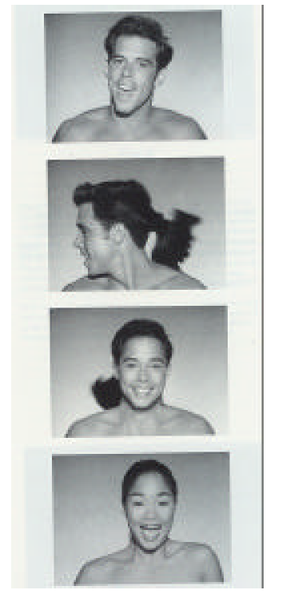
Dynamic Scene (“Black or White”, MJ)
https://vimeo.com/456846170

